Slide 1
TPC electronics for ILD
ECFA Panel review
Rehearsal Oct 24, 2013
P. Colas
Thanks to Leif Jönsson, U. Mjörnmark, A. Oskjarson et al.

Slide 2
Outline
Requirements for the electronics
Test electronics available so far (ALTRO, AFTER)
R&D in progress (GdSP)
2PCO2 cooling
Overview on the future

Slide 3
Basic Requirements
Read trains (2500 bunch crossings) at 5 to 10 Hz
5 mm² per channel density
Sample at 20-50 MHz
Low noise O(600 e-) to run at low gain
8-9 bit ADC should suffice
On-chip zero suppression
Shaping: about 100 ns peaking time
Less than 8 mW per channel, power pulsing

Slide 4
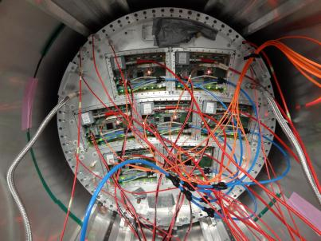
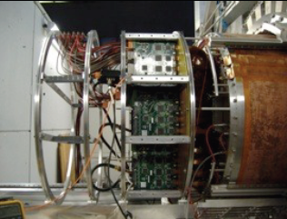
Electronics for LP: AFTER and SALTRO-16
The road to the electronics for ILD.
Readout |  | Pad Size | Electronics | Groups
MPGDs | Micromegas (Resistive anode) | (~ 3 × 7 mm² Pad) | AFTER | Saclay-Carleton
 | Double GEMs (Laser-etched) | (~ 1 × 6 mm² Pad) | ALTRO | Asia
 | Triple GEMs (wet-etched) |  |  | Desy
GEM
(test with 3 modules)
Micromegas
(test with 7 modules)

Slide 5
News and progress report from prototype electronics
AFTER-based (ASIC For TPC Electronic Readout). Designed at Saclay for T2K. Adapted in 2011-2012 to the Large Prototype. 72 channel Amplifier-shaper, full wave sampling by Switched Capacitor Aray, large versatility (1-100 MHz, 100-2000 ns peaking time, 120 to 600 pC full scale, 12 bit ADC).
ALTRO-based (ALice TPC Read Out). SALTRO: evolution from Alice readout, 16 channel Amplifier-shaper 60-200 ns peaking time, 25 MHz and 40 MHz sampling , Digital filtering, memory buffering.

Slide 6
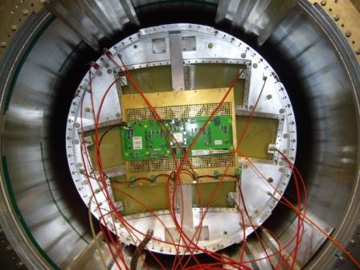
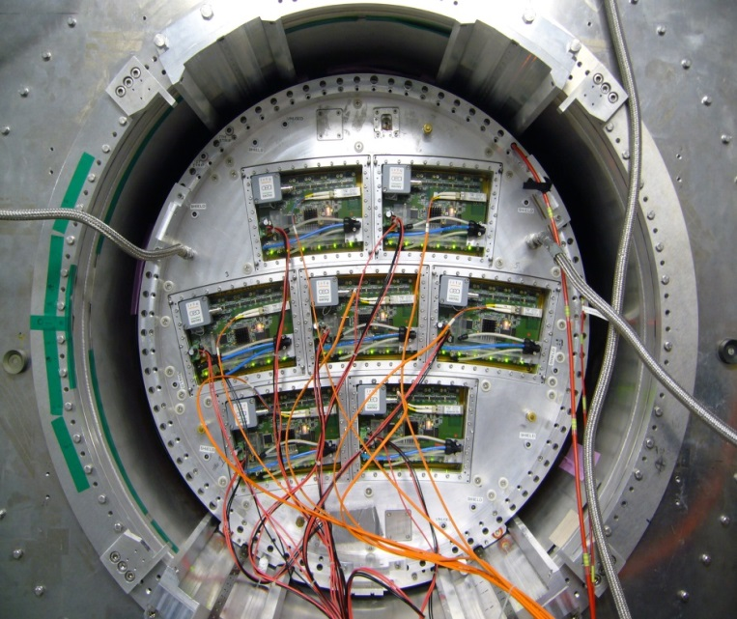
AFTER integration to fully cover
the endplate of LP-TPC (2012-2013)
D. Attié, D. Calvet, P. Colas, E. Delagnes, A. Le Coguie, M. Riallot et al.
The integration has been carried out so that the new electronics is flat behind the modules, and fits in 25 X° and 5 cm, with comfortable margins. It requires 3 connections only: 1 optical fibre, 1 LV and 1 HV.
Remaining refinements are going on (for March 2014):
More robust connections
2P CO2 cooling

Slide 7
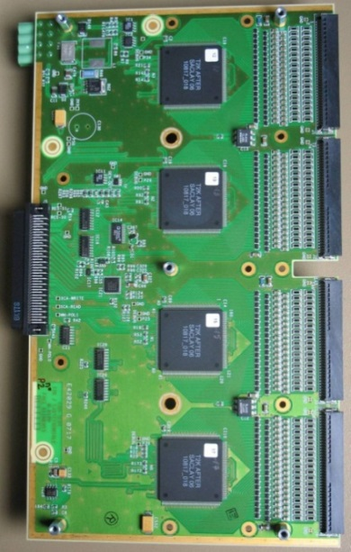
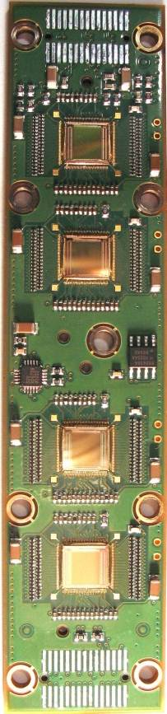
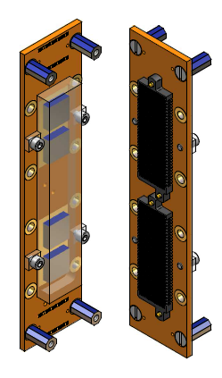
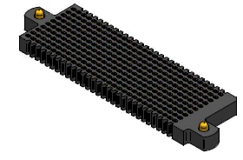
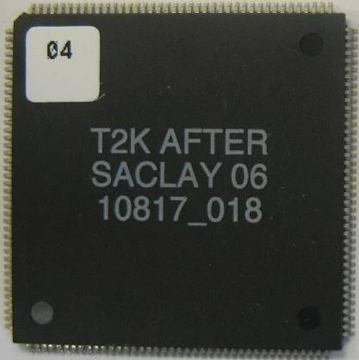
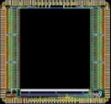
Integrated electronics
Remove packaging and protection diodes
Wire-bond AFTER chips
Use two 300-point connectors
Front-End Card
(FEC)
25 cm
4.5 cm
12.5 cm
14 cm
3.5 cm
2.8 cm
3.5 cm
0.78 cm
AFTER Chip
0.74 cm
  The resistive foil protects against sparks

Slide 8
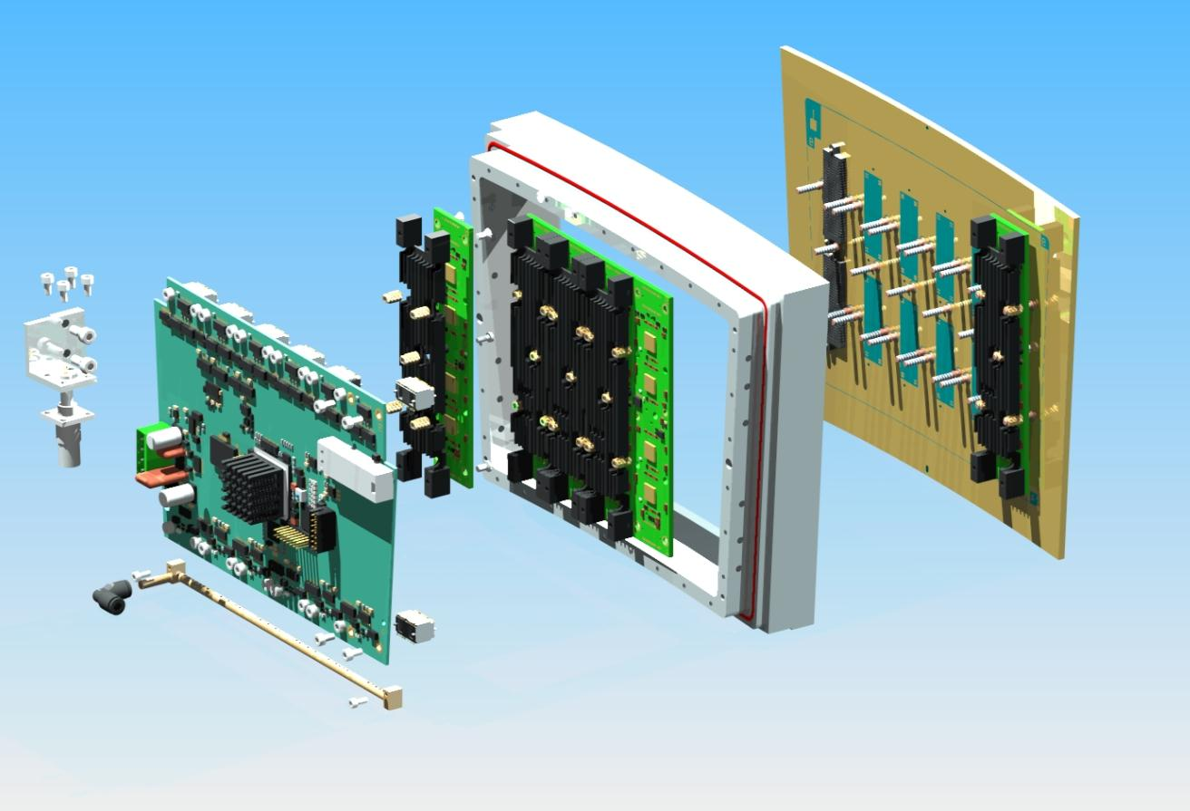
Material budget of a module
 |  | M (g) | Radiation Length (g/cm²)
Module frame + Back-frame + Radiator (×6) | Al | 714 | 24.01
Detector + FEC PCB (×6) + FEM | Si | 712 | 21.82
12 ‘300-point’ connectors | Carbon | 30 | 42.70
screws for FEC + Stud screws+ | Fe | 294 | 13.84
Air cooling | brass | 12 | 12.73
 | Plexiglas | 128 | 40.54
Average of a module |  | 1890 | 21.38
Front-End Card (FEC)
‘300-point’ connectors
Pads PCB +
Micromegas
Cooling system
Front-End Mezzanine (FEM)
Low material budget requirement for ILD-TPC:
Endplates: ~25% X₀
(X₀: radiation length in cm)

Slide 9
S-ALTRO 16 Developments
V. Hedberg, L. Jönsson, B. Lundberg, U. Mjörnmark, A. Oskarsson, L. Österman
Chip and carrier board
Test Socket and Test Socket Board
MCM board (multichip module) and its prototype
The CPLD chip
Ancillaries: LV board,…
DAQ with SRU (Scalable readout unit from RD51)

Slide 10
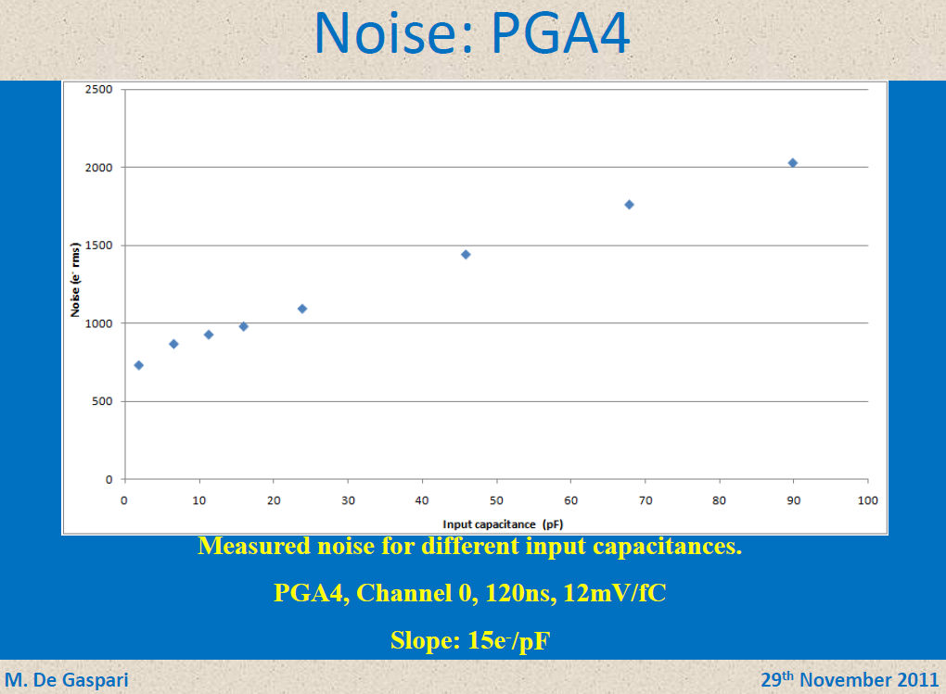
Noise from SALTRO
ENC < 1000e- @ Cd = 30pF

Slide 11
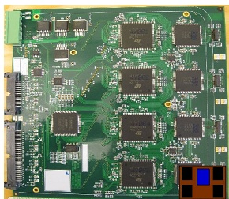
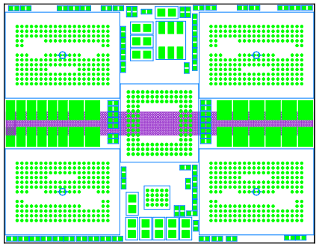
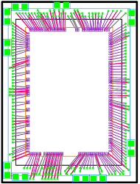
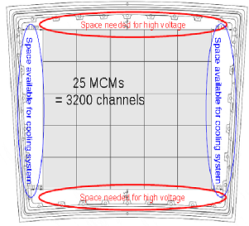
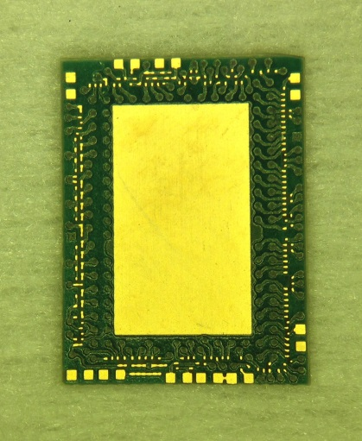
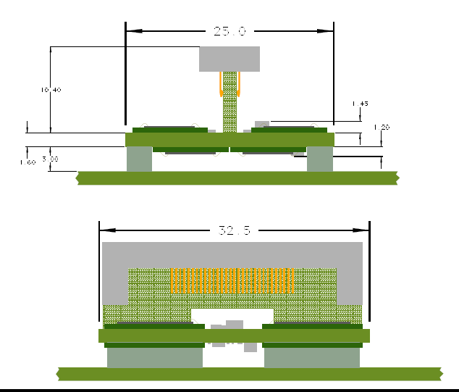
From ALTRO to SALTRO16
A decrease in size by a factor 40
FEC with 8 ALTRO
MCM with 8 SALTRO
on carrier boards
190 mm
32.5 mm
Carrier Board
8.9 mm
170 mm
12
mm
25
mm
17
cm
25 mm
8.9 mm
MCM
32.5 mm
CPLD
FEC
19 cm
Carrier Board PCB
Side
views
of an
MCM
PadPad
Module

Slide 12
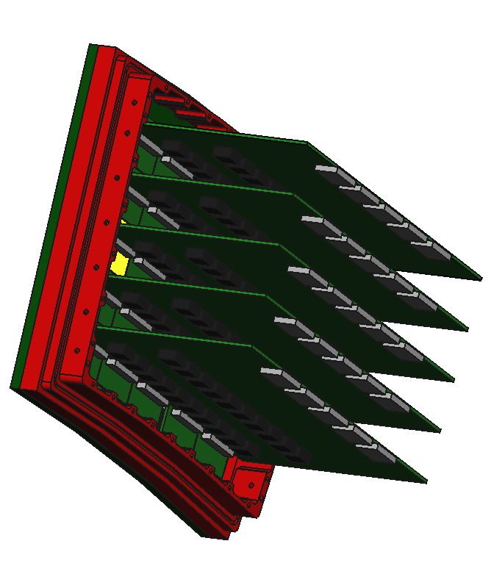
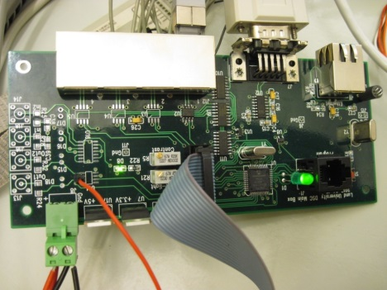
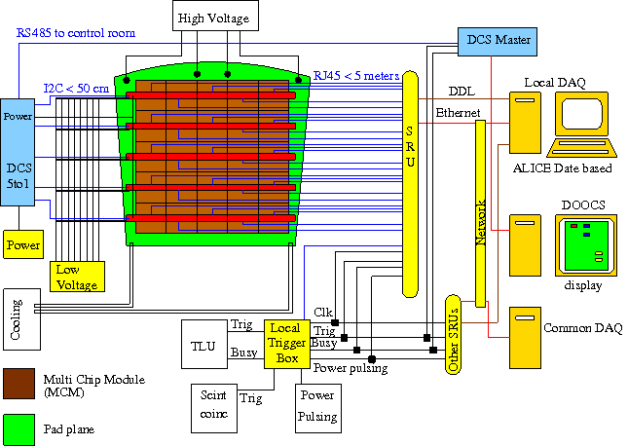
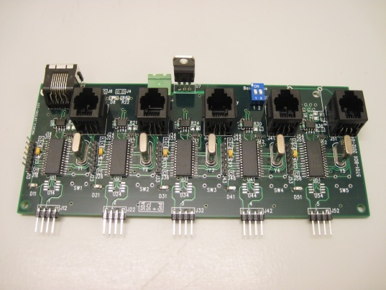
DAQ architecture of the SALTRO16 system
LV-boards attached
to one pad modue
MCM-modules on a pad module

Slide 13
Present status of the SALTRO-system and future plans
Item Status Plans/purpose
Carrier Board (CB) PCB:s delivered Mounting components
→ end Oct
Test Socket (TS) Ordered; exp. del. 10th Oct Setup → end Nov
Test Socket Board (TSB) Design ready; tests of 1st CBs → end Dez
exp. order end Oct. → possible modifications
→ new order → final tests?
MCM Prototype Board Ordered Functionality tests;
(pMCM) Communication CPLD-SRU
MCM Final Board (fMCM) Design essentially ready Finalize after tests with pMCM
LV Prototype Board (pLV) Ready Functionality tests; LV to TSB
test I2C communication
LV Final Board (fLV) Design essentially ready Finalize after tests with pLV
Detector Control System
Master Board Ready tests ongoing
5to1 Board Ready tests ongoing
Firmware for CPLD Developm. started in Brussels
Firmware for SRU Help from China
Possible pseudo-SRU 1st thoughts
Slow Control Use DOOCS; instal. Rostock
Mechanics First ideas; help from Saclay?

Slide 14
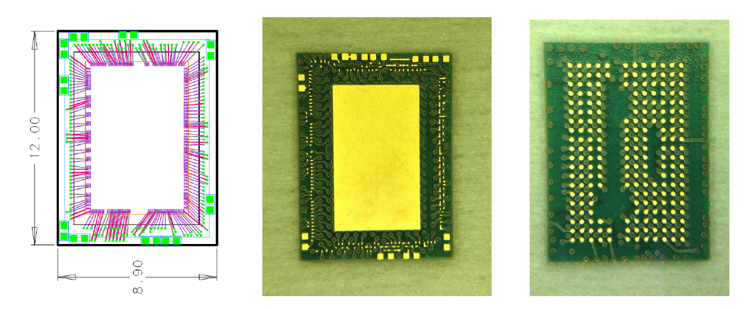
Carrier board
Arrived in Lund on 19/9/2013
Fully cabled and ready for testing end October
For the final electronics, dies could be either wire bonded to the MCM or mounted by chip-flip tech.

Slide 15
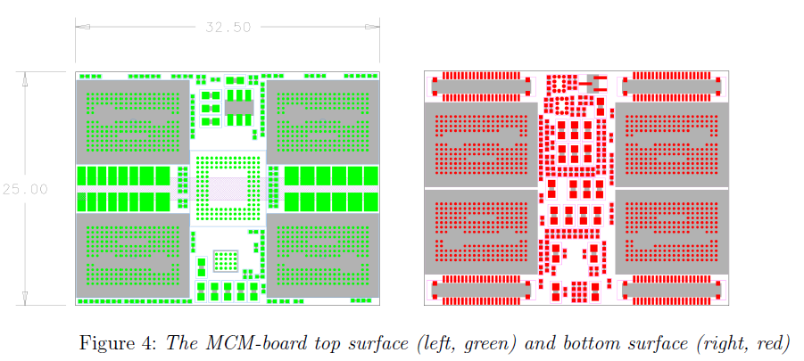

Slide 16
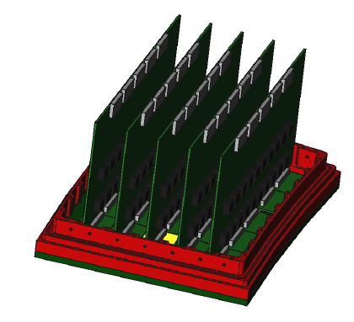
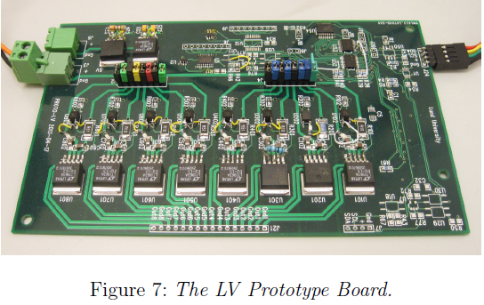
The Low Voltage board

Slide 17
Future electronics
GdSP (Paul Aspell et al.), joint R&D with other applications.
Common Front End : part of a multi-user wafer to test several options, within AIDA.

Slide 18
Developments in progress
VFAT3
S-ALTRO
IBM 130nm
128 ch
CMS
SAMPA
TSMC 130nm
GdSP
IBM 130nm
GdSP
32 ch
CMS
ALICE
SP1
SP2 2018
ALICE TPC
ALICE muons
Fondary Q4 2014
Use Q3 2015
LCTPC
Continuous readout
No power pulsing
Design 2016
Fondary 2024
Use 2026

Slide 19
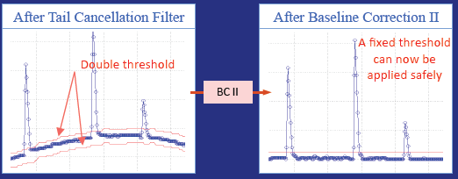
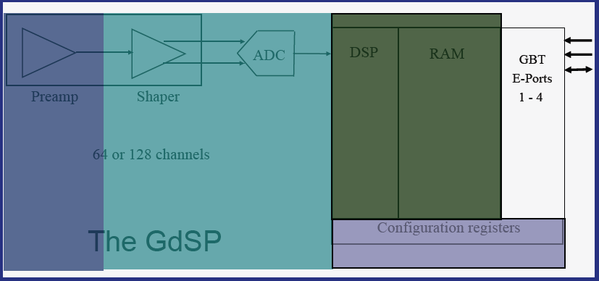
Preparation for future electronics
Design and optimization work in progress for a new chip GdSP, evolution from SALTRO16:
  64 or 128 channels
  130 nm technology
  Very low noise
  Integrated ADC
  Low power consumption (all-inclusive 7-8 mW/ch)
  6 different power regions for power cycling
  High level filtering (baseline subtraction, spike removal)
Gaseous detector Signal Processor, P. Aspell et al.

Slide 20
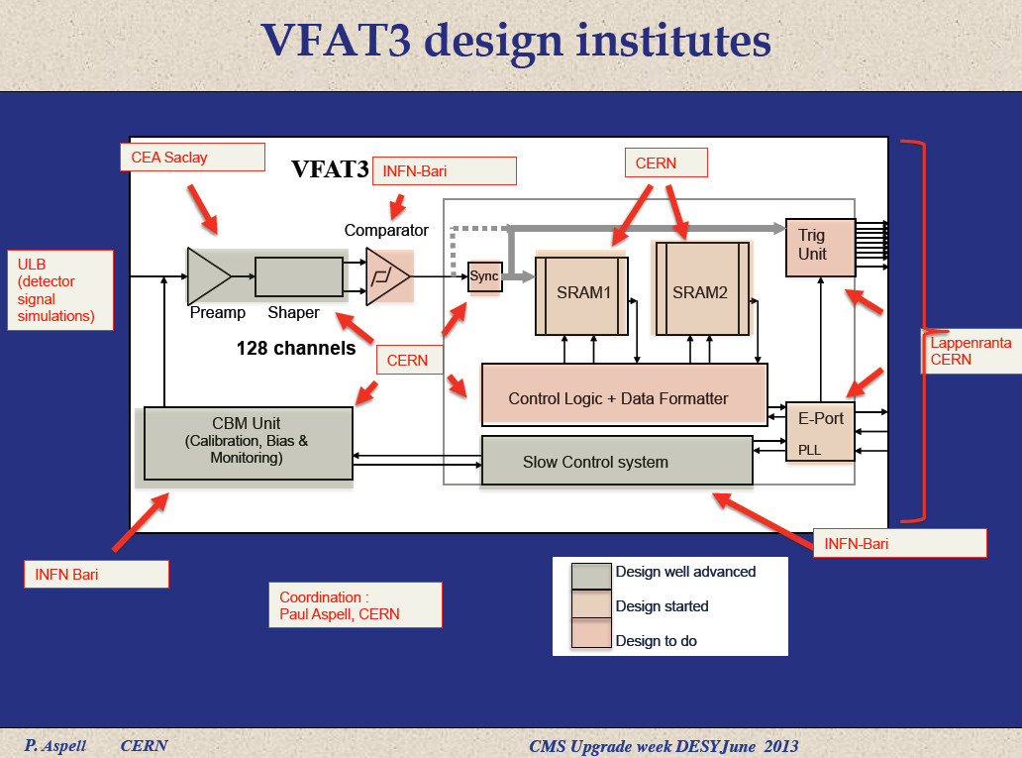

Slide 21
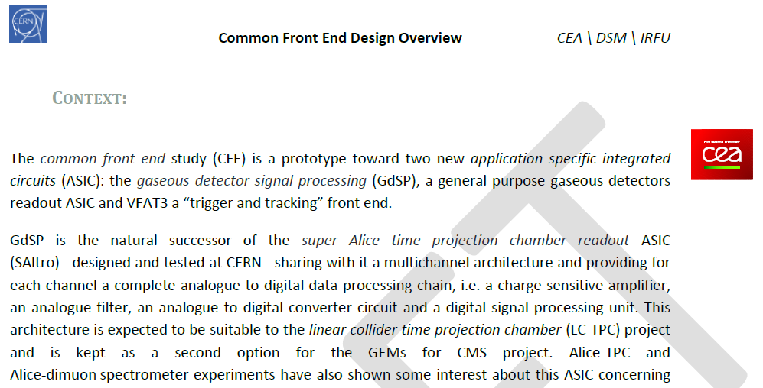
The CFE project (Paul Aspell et al.)
Fabrice Guilloux
…but ALICE electronics will be made in Brazil…

Slide 22
Future electronics
Need to refine the specifications: packing (number of channels per unit surface), number of bits for the ADC, frequency, noise, shaping time, etc…
Simulation required to justify the specifications
Need to have in LC-TPC a team including specialists to monitor the electronics R&D
Define the technology (130 nm? 95 nm?...) at the time of final design and vendor selection. Detailed design depends on the technology and is prone to become obsolete if choices are done too early.
The feasability of the project is demonstrated (though 1mm pads are still challenging).

