Slide 1
Higgs recoil mass analysis:
status and prospects
Taikan Suehara (Kyushu)
A. Miyamoto (KEK), T. Tomita (Kyushu)

Slide 2
Recoil in ILC
Direct measurement of g_{ZZH} with high precision
NOT the “ratio” of Higgs couplings
NOT suffered from QCD uncertainty
g_{EW}
g_{EW}
g_{ZZH}
not seen

Slide 3
Recoil mass
Using 4-momentum conservation (not possible in LHC)
Excellent mass resolution
(lepton only: no jet ambiguity)
~ 30 MeV in ILC
(1st phase only)
Usable as a cut to separate
the main background ZZ
(recoil mass peaked
at 91.2 GeV)
only looking 2f from Z

Slide 4
global fit of higgs couplings
Snowmass energy frontier report
Model independent
limited by σ_{ZH} @ 250 GeV

Slide 5
Further improvements
llh 250 → 3.0% (model independent)
/ 2.6% (model dependent)
Combining other modes
  Higher energies: ILC500
  Jet recoil qqh
    350/500 GeV
    250 GeV

Slide 6
llh at 500 GeV
Cross section (μμh) eL(0.8) pR(0.3)
  250 GeV: 10 fb
  500 GeV: 3.3 fb
  Combining two may improve the resolution
Recoil mass
  Smeared in 500 GeV
Background
  Large t-channel diagram in 500 GeV
Analysis
  Almost the same as 250 GeV

Slide 7
Cuts
Almost same as LoI
Lepton ID
Z mass (81.2 to 101.2 GeV)
di-lepton pT > 20 GeV
recoil mass (115-250 μμ, 100-250 ee)
acoplanarity (π +- 0.1 rad vetoed)
pT balance
|di-lepton pT – pT of the most energetic neutral particle| > 10 GeV

Slide 8
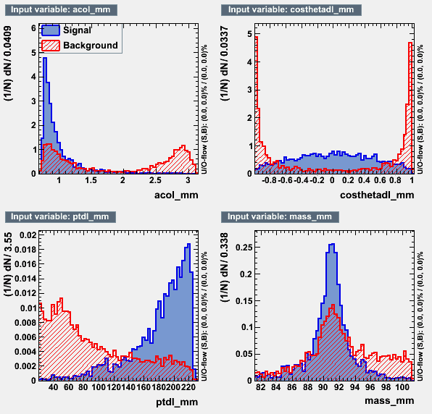
Likelihood
Same as LoI
di-lepton pT
cosθ of di-lepton
acolinearity
Z mass
TMVA used
BDT & likelihood gives similar results
Likelihood adopted

Slide 9
mumu channel: cut table
cut | eeh | mmh | ooh | 2f | 4f | 6f | o
m>=2 | 128 | 1691 | 3490 | 1.03e+6 | 966334 | 56719 | 361231
z mass | 7.2 | 1499 | 141 | 225706 | 111908 | 4203 | 2765
ptdl>20 | 6.2 | 1492 | 124 | 64342 | 95766 | 3861 | 1573
recoil | 1.6 | 1211 | 11 | 15198 | 30594 | 232 | 68
acop | 1.3 | 1208 | 11 | 14598 | 28447 | 227 | 56
ptbal | 1.2 | 1206 | 10 | 4544 | 27618 | 217 | 35
like>0.8 | 0 | 997 | 6.5 | 1632 | 3345 | 63 | 1.3

Slide 10
Recoil fit
BG fit (Gaus * 2nd pol for mm, linear for ee)
Fit will all paremeters free
  GPET with 5 parameters
  Gaus (left side)
  Gaus + expo (right side)
  background distribution from fit function
    to avoid large fluctuation due to the small stat
Toy-MC – 10000 times
  Poisson from data (sig), func (bg)
  Fit with fixing shape parameters
  (mean and amplitude free)

Slide 11
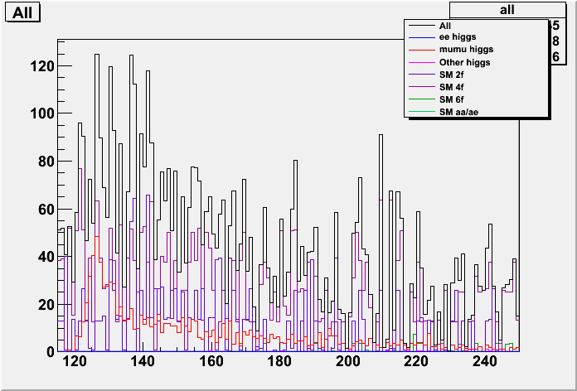
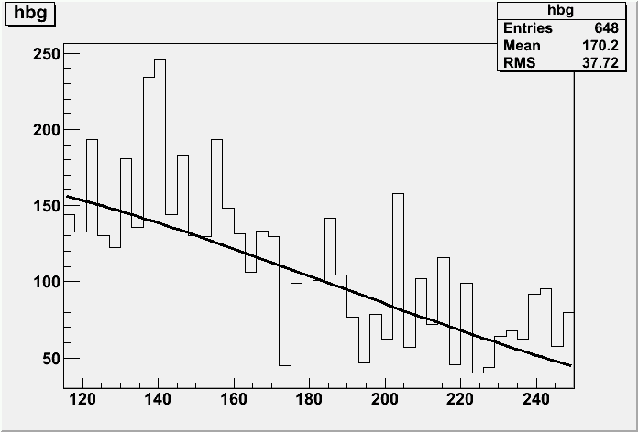
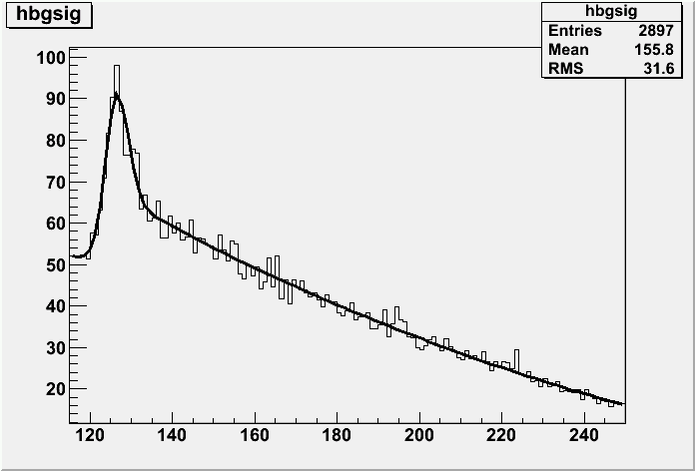
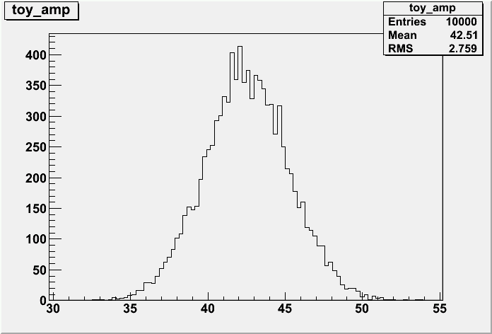
mumu: recoil fit
6.49%

Slide 12
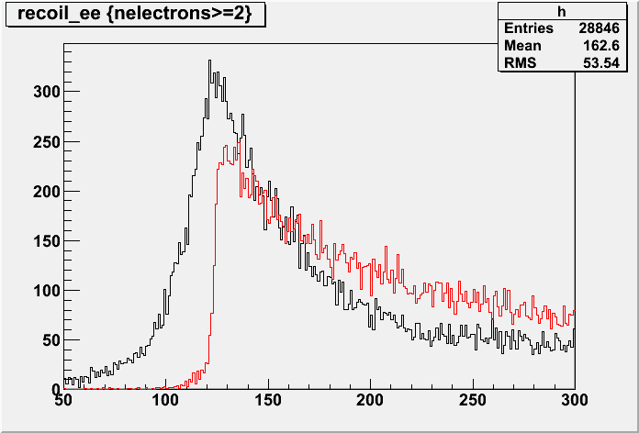
ee: brems recovery
all neutral particle at cosθ > 0.99 are added

Slide 13
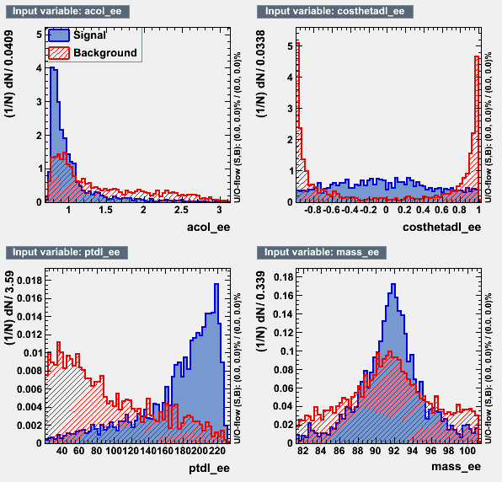
ee: cut table
cut | eeh | mmh | ooh | 2f | 4f | 6f | o
e>=2 | 4582 | 76 | 6241 | 500994 | 1.6e+4 | 94156 | 413309
z mass | 1654 | 2.3 | 559 | 18976 | 151032 | 14827 | 15562
ptdl>20 | 1627 | 2.0 | 459 | 12987 | 115384 | 12983 | 11496
recoil | 1126 | 0.6 | 14 | 478 | 31324 | 443 | 1278
acop | 1118 | 0.6 | 14 | 426 | 30123 | 429 | 1193
ptbal | 1113 | 0.6 | 14 | 388 | 28417 | 417 | 1154
l>0.9 | 757 | 0.6 | 1.4 | 26 | 2763 | 66 | 84

Slide 14
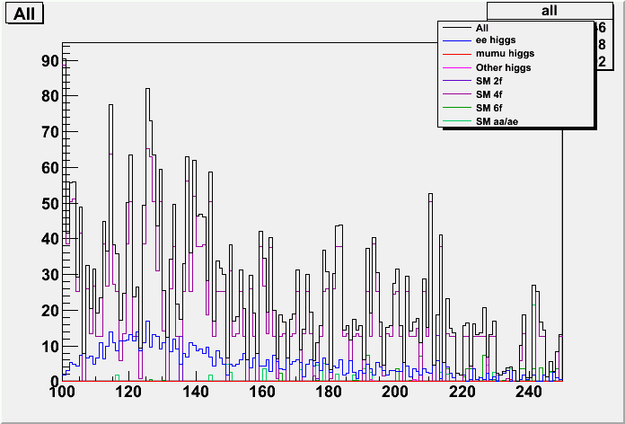
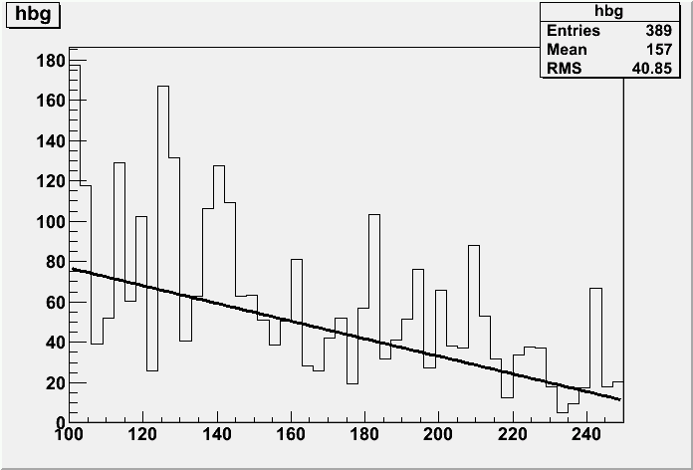
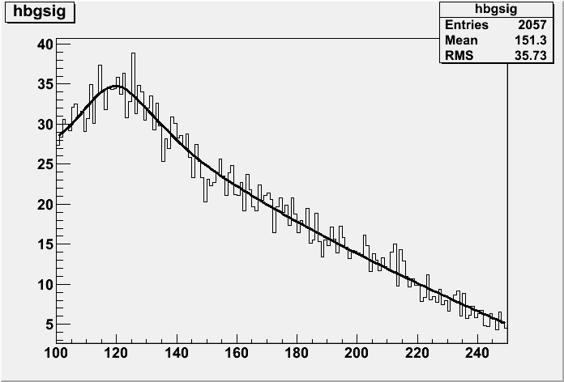
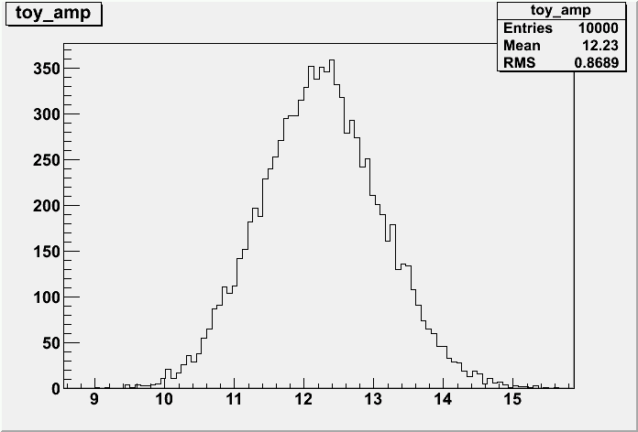
ee: recoil fit
7.10%

Slide 15
Summary of llh 500
mmh: 6.49%
eeh: 7.10%
combined: 4.8%

Slide 16
qqh recoil
llh: only 6% of Z (e+μ)
qqh: 70% → hopeful!
ννh, ττh: impossible to get recoil
Jet clustering
  efficiency can be different
  among higgs decay modes (6-jet, 4-jet, 2-jet)
Jet energy resolution
  Worse than leptons
  Wider peak of recoil mass

Slide 17
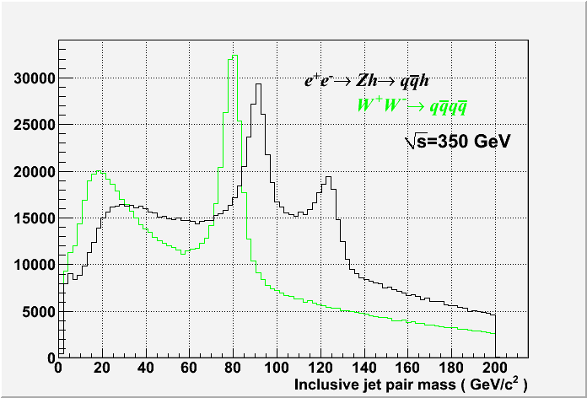
qqh 350: W/Z separation
A. Miyamoto
sales point of
PFA calorimeter

Slide 18
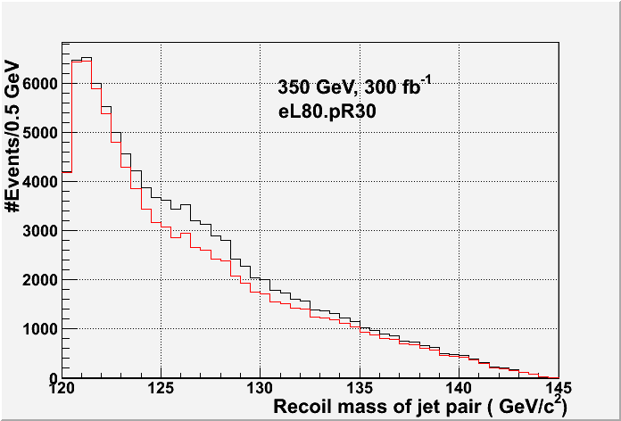
350 GeV result
A. Miyamoto
k_{t} clustering w/ R=1.2
  (may not be optimal)
Basic cuts of Z mass etc.
Selection statistics
 | eR80.pR30 (300fb-1) | eL80.pR30 (300fb-1)
qqh | 7581 | 11263
2f_h | 13049 | 33326
4f_h | 15726 | 109011
4f_sl | 10767 | 65971
4f_l | 597 | 1755
Higgs | 1313 | 1975
aa/ae/ea | 3971 | 7320
tt | 4124 | 8441
all-bkg | 49546 | 227800
S/sqrt(S+B) | 31.72 | 23.04
sqrt(S+B)/S | 0.03153 | 0.04341
S/N | 0.153 | 0.049
Recoil mass 123~133 GeV were counted.
150 fb-1 each to
-80/+30 & +80/-30%
Δσ/σ ∼ 3.6%

Slide 19
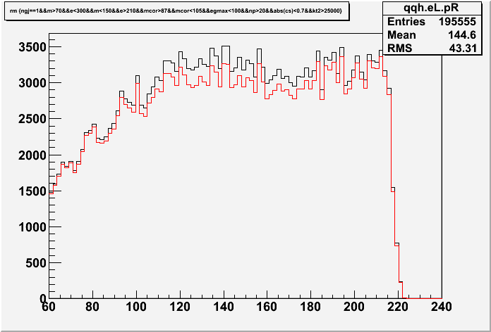
500 GeV
Event statistics for 500 fb-1,
eL80.pR30 at 500 GeV
Red: all background
Black: qqh + background
 | Process | Nevents | Fraction(%)
S | qqh | 11113
B | ffh | 338 | 0.19
 | 2f | 47377 | 27.01
 | 4f | 121086 | 69.02
 | 6f | 6357 | 3.62
 | aa_2f | 91 | 0.05
 | ae/ea | 186 | 0.11
Recoil mass
S/N=0.0633
sqrt(S+N)/S=0.0389
Δσ/σ ∼ 3.9%
Hard to see recoil mass peak,
but excess due to qqh could be seen

Slide 20
Summary
A possibility to measure σ_{ZH} using using Z→qq mode was investigated.
At 350 GeV, Higgs peak in jet recoil mass can be seen.
Combining eL80/eR30 150fb⁻¹ and eR80/eL30 150fb⁻¹,
Δσ/σ ∼ 3.6% is expected.
At 500 GeV, hard to see Higgs peak in jet recoil mass distribution.
But from event excess in qqh like events, Δσ/σ ∼ 3.9% is expected
for 500 fb⁻¹, eL80.pR30 beam polarization.
Further improvement may be possible by more sophisticated analysis.
A possibility to use Z→qq at 250 GeV should be investigated.

Slide 21
qqh 250
250 GeV analysis (σ_{ZH} ~ maximum)
  Durham y-fix clustering (should be optimized)
  or dedicated Z→qq finder from PFOs
Difference of efficiency in Higgs decay modes should be investigated
(as systematic error study)
Also used for detector optimization
  performance with various jet energy resolution will be investigated

Slide 22
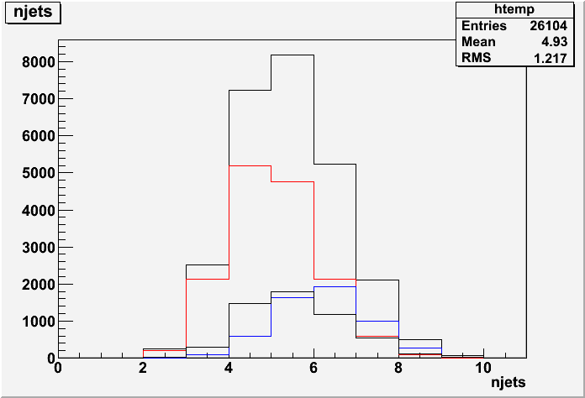
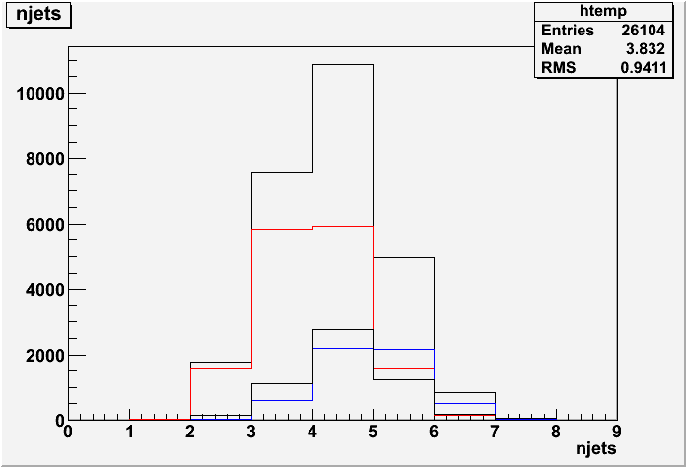
qqh 250: some plots
njets
ycut = 0.001
ycut = 0.005
black: all
red: H→bb
blue: H→WW*
black: H→others

Slide 23
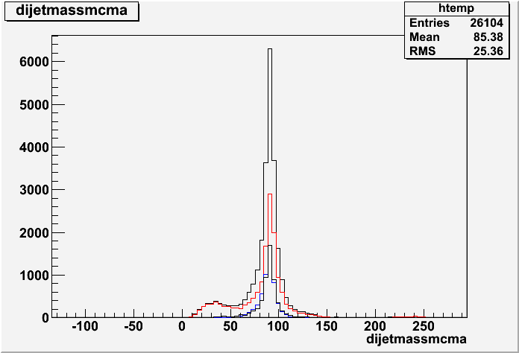
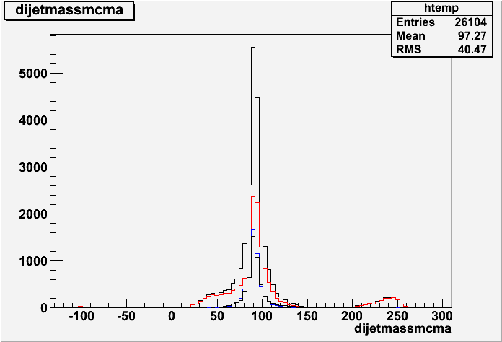
qqh 250: some plots
Z mass
ycut = 0.001
ycut = 0.005
The combination with
mass nearest to Z is selected
black: all
red: H→bb
blue: H→WW*
black: H→others

Slide 24
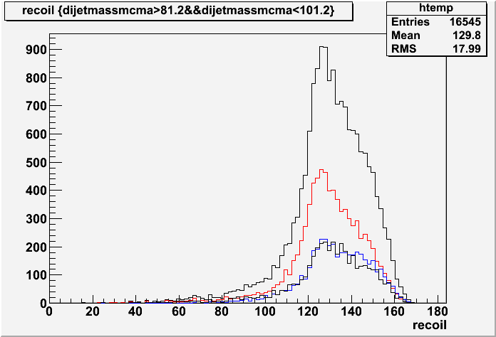
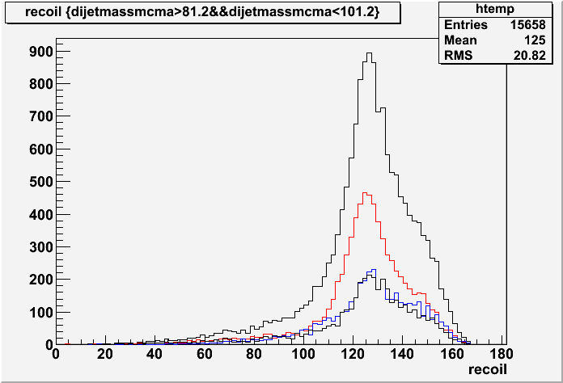
qqh 250: some plots
recoil mass
ycut = 0.001
ycut = 0.005
The combination with
mass nearest to Z is selected
cut on 81.2 < m_{Z} < 101.2
black: all
red: H→bb
blue: H→WW*
black: H→others

Slide 25
qqh 250 summary
Recoil mass peak observed
will see WW/ZZ events (before LCWS)
Optimization with ycut
Kinematic fit
Preliminary number? (not sure)
Dedicated Z→qq finder (after LCWS)

