Slide 1
European (& world) ILC Status
Brian Foster
(Uni Hamburg/DESY)

Slide 2
LCWS13 - Highlights
Talk of Chair of Diet ILC Federation, Mr Kawamura
While not a member of the government, he is a very senior figure in LDP and is known to have the ear of the Prime Minister Mr Abe:
“We are aware that people are usually worried that an increase of academic budget in one field may mean a decrease in other fields. … We shall arrange a dedicated budget to accommodate its much wider implications. It is the responsibility of the government to carry this out.”
2) “The Department of Education has requested the Department of Finance to provide an ILC investigation fund of 50 million yen in next year's budget. … once it has been approved, we members of the house will have achieved one of the most important milestones of recent years.”

Slide 3
Highlights
Talk of Chair of Diet ILC Federation, Mr Kawamura
3)“The Technical Design Report of ILC was issued in December 2012…I would again like to express my appreciation of this effort. I understand that it is now the turn of politicians to respond
to this effort, and to construct a worldwide partnership to realize this project.
4) “I think that most Diet members' knowledge of physics is at high school students’ level. If you allow me, let me take the liberty of pointing out that the understanding of political dynamics by most particle physicists is also at high school students’ level. If physicists and politicians collaborate by using each other's area of expertise, it is certain that we can accelerate the realization of the ILC project.”

Slide 4
A. Suzuki closing talk
Interaction with P5 in USA:
The world HEP scientists are strongly disappointed with media remarks about the JSC findings on the ILC project. This damage looks too serious.
Scientists are deeply concerned that the Japanese government would hesitate to advance the realization of the ILC project.
Given these, it is urgent that the government unfolds its view on the JSC findings.
The government should now pay much attention on how to define interests to host the ILC in Japan. It is the next step to start governmental discussions about the budget and man-power sharing.

Slide 5
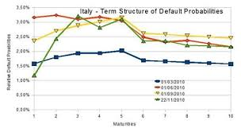
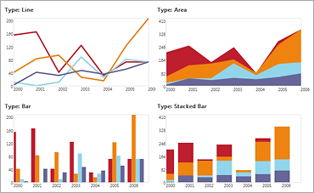
A. Suzuki closing talk
Interaction with P5 in USA:
The world HEP community understands that the next FALC is the best opportunity for the government message.
The Rolf Heuer (CERN), Nigel Lockyer (FNAL) and A.S (KEK) had the consensus that the timeprofiles of budget-breakdown (CFS, accelerator, detector ・・・) and man-power-breakdown are essential for the governmental negotiation.
budget
manpower
year
year

Slide 6
ILC timeline
2013 - 2016
  Negotiations among governments
  Accelerator detailed design, R&Ds for cost-effective production, site study, CFS designs etc.
  Prepare for the international lab.
2016 – 2018
  ‘Green-sign’ for the ILC construction to be given (in early 2016 )
  International agreement reached to go ahead with the ILC
  Formation of the ILC lab.
  Preparation for biddings etc.
2018
  Construction start (9 yrs)
2027
  Construction (500 GeV) complete, (and commissioning start)
  (250 GeV is slightly shorter)

Slide 7



IRFU Linear Collider Days
The 2013 Irfu Linear Collider Days organized jointly with CNRS will take place in CEA Saclay on-site in Building 526 Amphitheater Joliot Curie on November 27-29.
This will be the second “Journées Collisionneur Linéaire”of the French community, following the first event organized in Lyon on May 13-14, 2013*
The goal of the meeting is to discuss and to review linear collider activities in France in the areas of physics/phenomenology, detector and accelerators technologies:
http://irfu.cea.fr/Meetings/jcl02
Program Layout (Wednesday, Nov. 27 – Friday, Nov. 29, 2013):
Wed., Nov. 27 14:00-18:00 - Physics/Phenomenology Activities in France
Thu., Nov. 28 09:00-12:30 - Accelerator Activities in France
14:00-18:00 - Detector Activities in France
Visit XFELCEA cryomodule production facility
Fri., Nov. 29 09:00 – 12:00 - ILC Country presentations from Europe, Asia and
North America (areas of cooperation with France)
(* https://indico.in2p3.fr/conferenceDisplay.py?confId=8347)

Slide 8
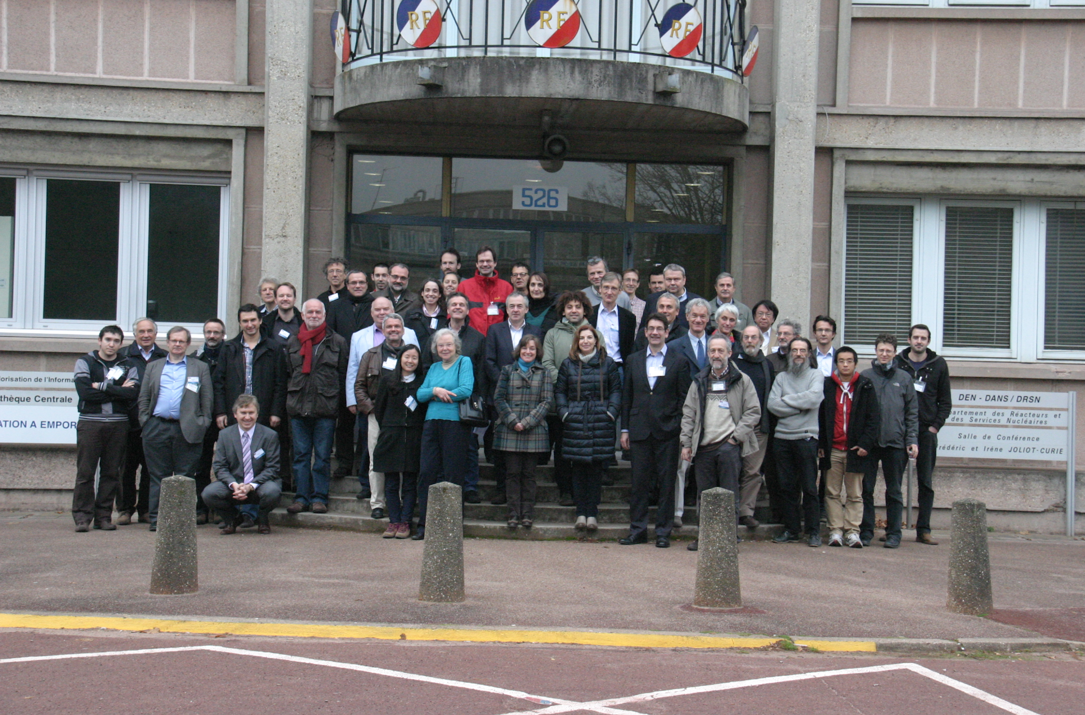
IRFU Linear Collider Days

Slide 9
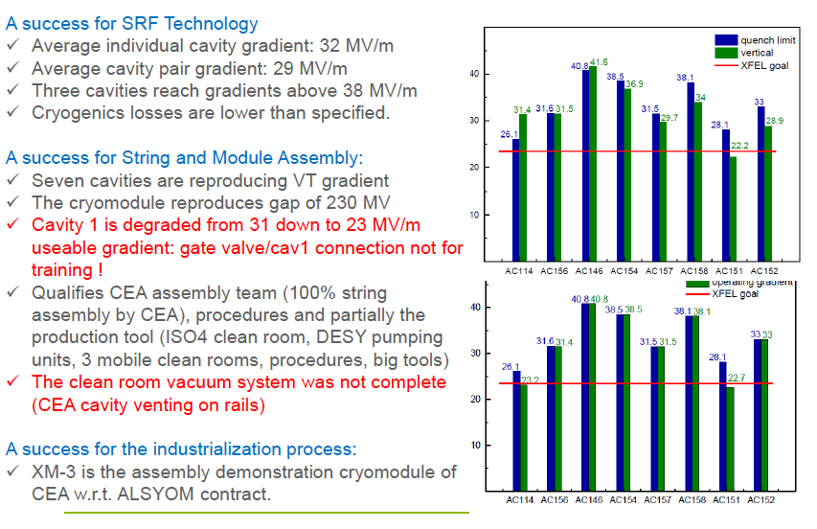
“ILC” Cryomodule @ Saclay

Slide 10
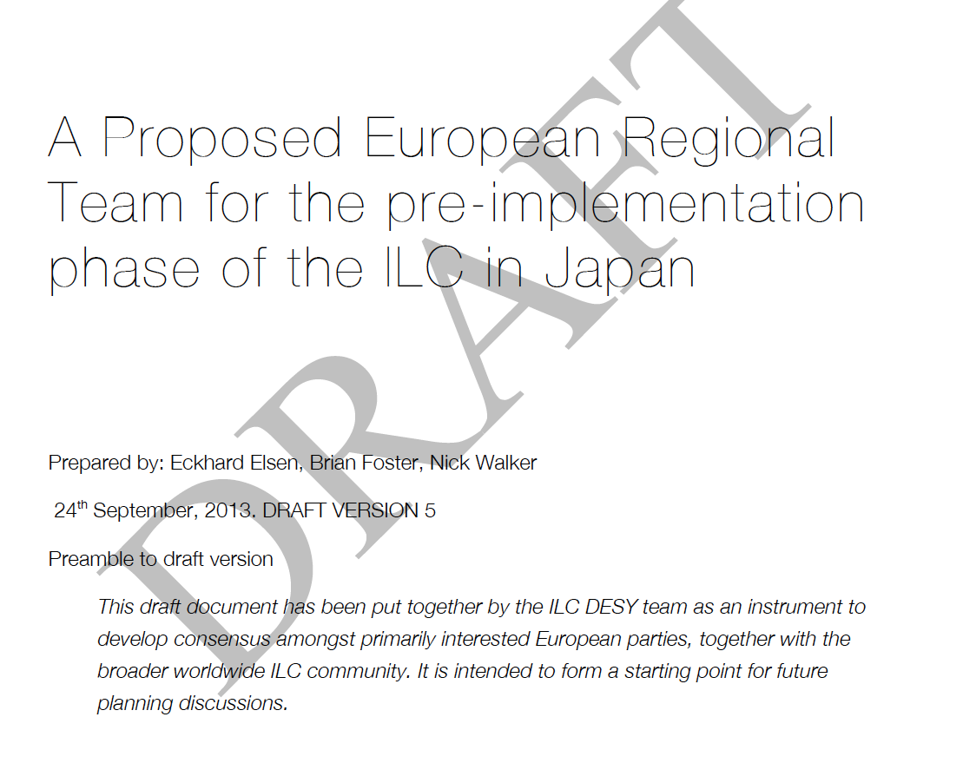
European activities
N. Walker et al. have drawn up draft indication of how Europe could get involved in site-specific work for next few years prior to project approval.

Slide 11
European activities
Notional breakdown of a request to EU
Under active discussion in LCC. Meeting for further development in January in DESY.

Slide 12
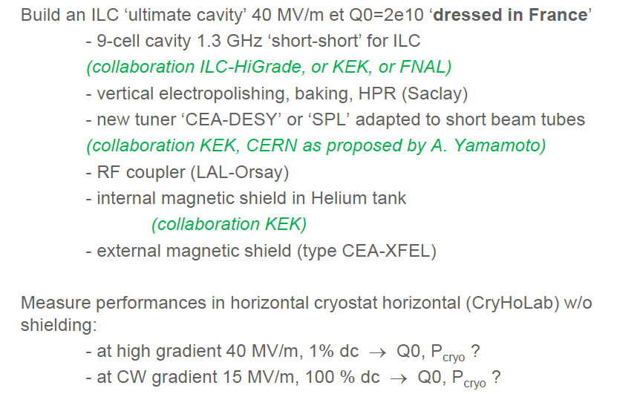
Saclay “couturier” proposal

Slide 13
European capabilities
Sources
Machine Detector Interfaces
Damping rings
Main linac
Beam delivery systems
Physics and detectors
Ring to main linac
Beam-dump systems
(Slides thanks to Steinar Stapnes)
Three main strong points:
  ILC participation (back to Tesla)
  XFEL and industrial base linked to it
  CLIC and combined CLIC/ILC activities
Make use of these ….
“Obvious model” to consider:
Keep capabilities to build and deliver cryomodules (natural lead DESY and CEA, but also INFN expertise)
Focus on a couple of other system where Europe have expertise, scientific/technical capabilities
(BDS system linked to participation in ATF, possibly damping rings, … )
BDS sticks out due to significant communities in UK, Spain, France, CERN, …
Next years – possibly related to EU supported activities:
Develop these two branches, with EU support if possible
Would naturally form two main technical development branches where most of the European ILC
community could participate, with European industry partners
Put together a modest team, distributed across mains labs with limited material budget, focusing on the key areas above (would also put in place a European structure, and support key existing activities linked to cryomodules and BDS/ATF in particular)

Slide 14
As a matrix …
Timeline | … | DR | ML | BDS | … | Phys/Detector | Comment
2014-2017(18): Design finalisation, technical designs & site specific design |  | European leadership but also clear interest from China and US | XFEL | European leadership |  | Other talks in this session | European project(s) to make coherent contribution to well defined and visible Japan lead but international design team – could invoke EU support
2017-2020: Pre-series |  | For potential deliverables | At end of XFEL | For potential deliverables |  | … | Outside scope of current discussion but capabilities in phase above (labs, industry)
2018-2028: Construction |  | Part could be delivered by Europe but likely other major possibilities | Fraction of cryomodules | Main parts could be delivered by Europe (room for others as well) |  | …. | Outside scope of current discussion

Slide 15
Summary of Orsay Meeting
Summary of the discussion: ------------------------ Detectors: continue within the AIDA framework and make an ILC proposal to the new AIDA II. Needs EoI before the 31st of December, proposal by mid February 2014. The EU call will close by September 2014. Concentrate on system tests for the detector concepts, including slice test of various detector parts (with common DAQs), integration, test-beams and high magnetic field tests. Marie Curie ITNs a proposal to apply for a network to develop software tools, simulation and data managing systems. Deadline for the 2014 call is expected by April 2014. Possible cooperation with the machine community to participate in the "Implementation Phase under Reasearch Infrastructures" call needs of more detailed discussion. (See later)

Slide 16
Summary of Orsay Meeting
Actions ------- - EoI to AIDA to be drafted by Juan Fuster by 15th of December.. - Start the detailed discussion of the ILC proposal for AIDA II following the general prescriptions of the Expression of Interest. This should happen by mid January by teleconference. Doodle will be sent out.
- Make a second European meeting during the Spanish Network meeting which will happen around mid February (dates not yet fixed, place Seville). In this meeting we should be ready to agree on a formal presentation of our proposal to AIDA II.

Slide 17
Discussions with French authorities
BF met with Jacques Martino, head of IN2P3, on 28/11. Very positive discussion – updates on political status, discussions of possible French national contribution to ILC - roles of Orsay/Saclay etc. Agreed to keep in touch.
BF met with Philippe Chomaz and Ursula Bassler from CEA on 29.11 (UB about to return to IN2P3). Again very positive with discussion of role of Saclay module production line etc.
French physicists showed real dedication and enthusiasm for ILC. Very positive meeting.

Slide 18
CoPoRI Meeting, Brussels, 4-5/12
As usual, contents of meeting very dull – interactions in coffee breaks etc very important.
Useful discussion with John Womersley, new Chair of ESFRI. Clarification of “Implementation Phase” – “one-off” measure intended to clear 60% of current ESFRI Road Map projects before 2016 – to be eligible, project must be implemented in 2015 – clearly ILC is not in that position => scaling down of accelerator aspirations for H2020.
Very helpful meeting with ILC “contact” in Brussels (as set up at CERN-EU meeting in September) – Bernhard Fabianek. Discussed possibility of a) second PP proposal – needs to be very different to ILC-HiGrade b) INFRASUPP-2-2015 Pre-Commercial Procurement (PCP) – timescales are to sort out what is best option in next couple of months and thwen go backwards and forward to Brussels.

Slide 19
Odoi-san in Europe
Director of MEXT “ILC” Division, Satoshi Odoi, is now in Geneva attending CERN Council as observer. He has no official role there but is discussing with people in coffee breaks.
Odoi was previously Scientific Attaché in Berlin and has many contacts there – he will arrive in Berlin tonight. Tomorrow I meet him and embassy officials for lunch.
On Tuesday he will spend day here in DESY:
Draft programme:
09:00 - 09:30 Welcome
09:30 - 11:00 Visit to XFEL
11:00 - 12:00 Discussion of programme of DESY & recent developments
12:00 - 13:30 Lunch
13:30 - 15:00 AMTF, Test beam, OBACHT
15:00 - 16:00 Virtual ILC reality
16:00 Adjourn

Slide 20
Summary
There is no doubt that lots of things happening in Japan under our radar – see Kawamura talk.
Encouraging re-engagement of activity in France and UK; continued strong engagement in Germany & France. Italy remains weak; CERN needs to be drawn in to specific areas.
Odoi is at quite a low level and can only hold discussions at or slightly above his level – where we know he will get little or no encouragement.
To move to the next stage, it is imperative that the Japanese government make some official statement. The (hopeful) approval of the MEXT ILC budget line expected in January is an opportunity. I have given them the English words – we have to encourage them - again and again – to use them!

Slide 21
Invitation
(At Gudi’s insistence) -
Symposium organised by
DESY on January 13th
to celebrate my continued
journey towards senility:
You are all cordially
invited!

