Slide 1


IP Feedback Roundup
Mikey Davis
8 November 2013
1/5

Slide 2
Introduction
As asked I’ve gone back over some of the IP feedback data
This is an overview of three of the scans we did
Have included a theoretical prediction where appropriate
Mikey Davis
8 November 2013
2/5

Slide 3
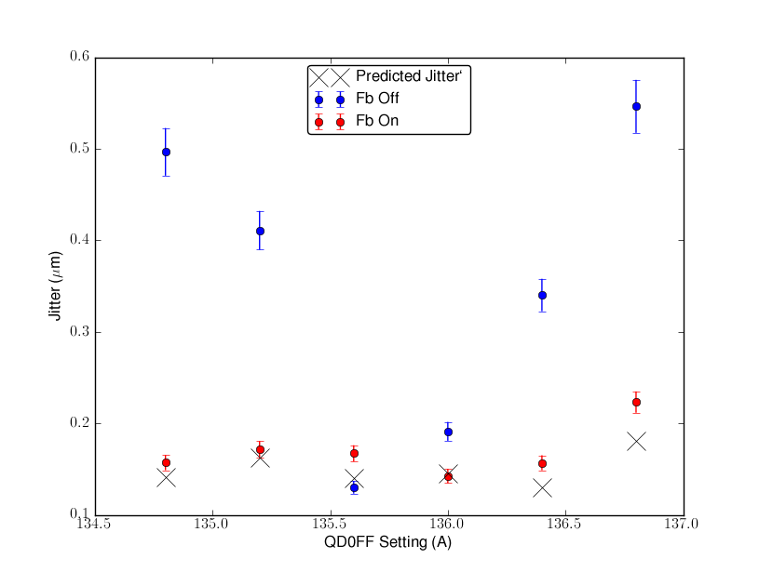
QD0FF Scan
Mikey Davis
8 November 2013
3/5

Slide 4
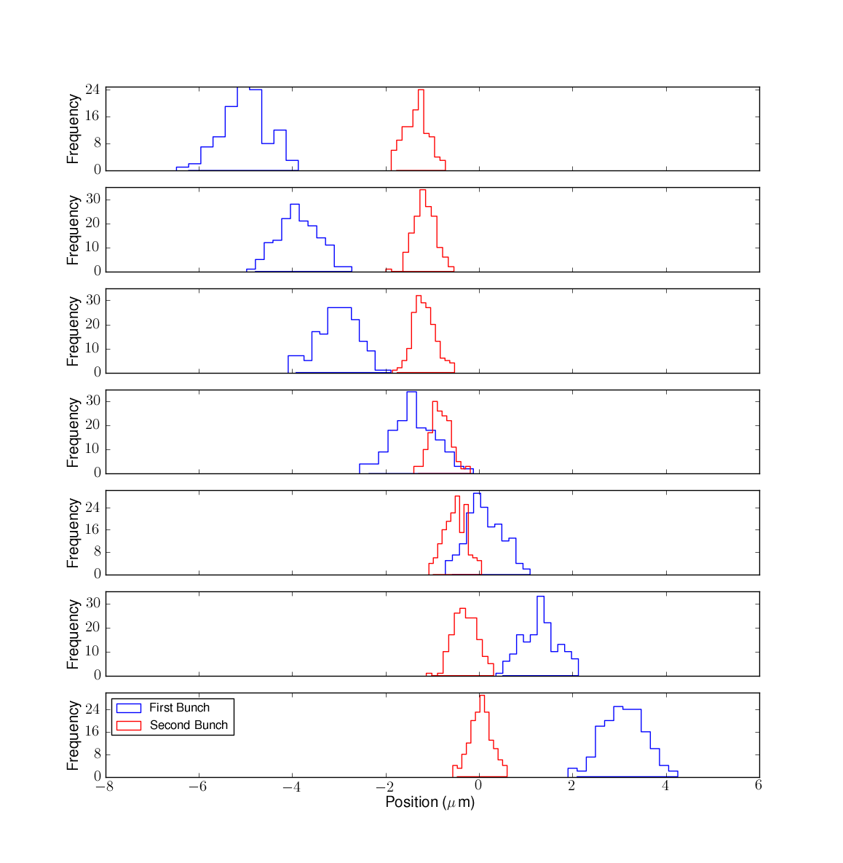
T Shirt Scan
Mikey Davis
8 November 2013
4/5

Slide 5
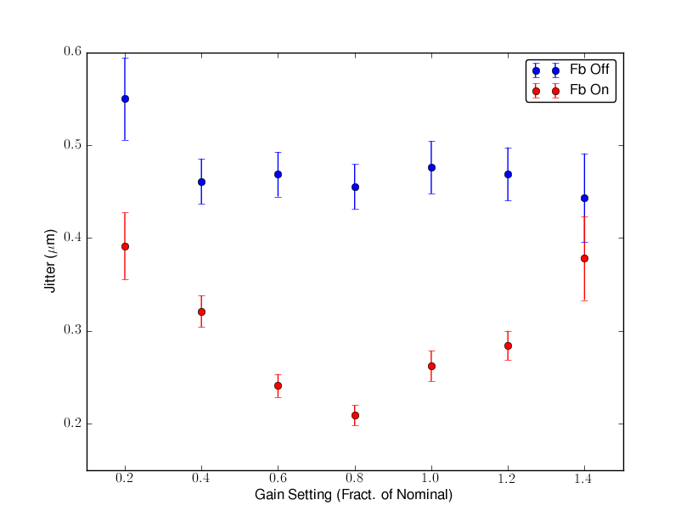
Gain Scan
Mikey Davis
8 November 2013
5/5

