Slide 1


IRL Status and Plans
Kurt Francis
NICADD/Northern Illinois University
AHCAL MEETING
DESY, Hamburg
December 9, 2013

Slide 2
Integrated Readout Layer (IRL)
Seeking ways to reduce the construction cost of large, granular calorimeters
Use surface mount devices
Mega-tiles consisting of many small tiles fabricated together
Direct coupling to eliminate wavelength shifting fibers
  But response over a flat cell would be non-uniform -> leads to a concave dimple to make response of the cell uniform

Slide 3
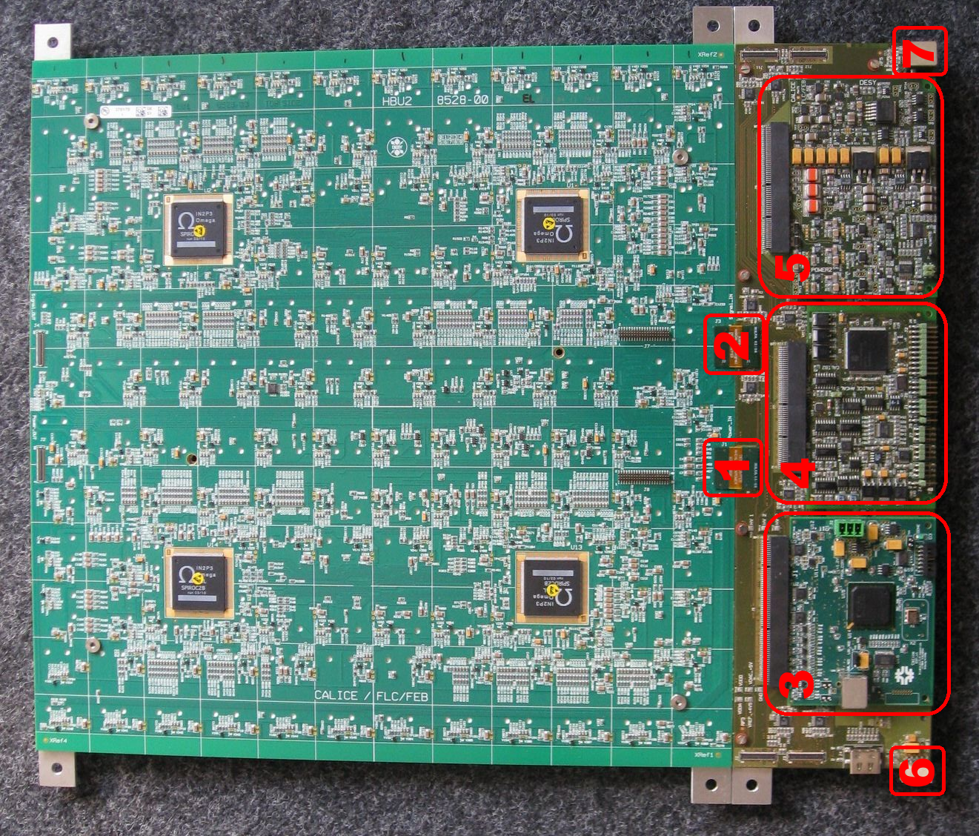
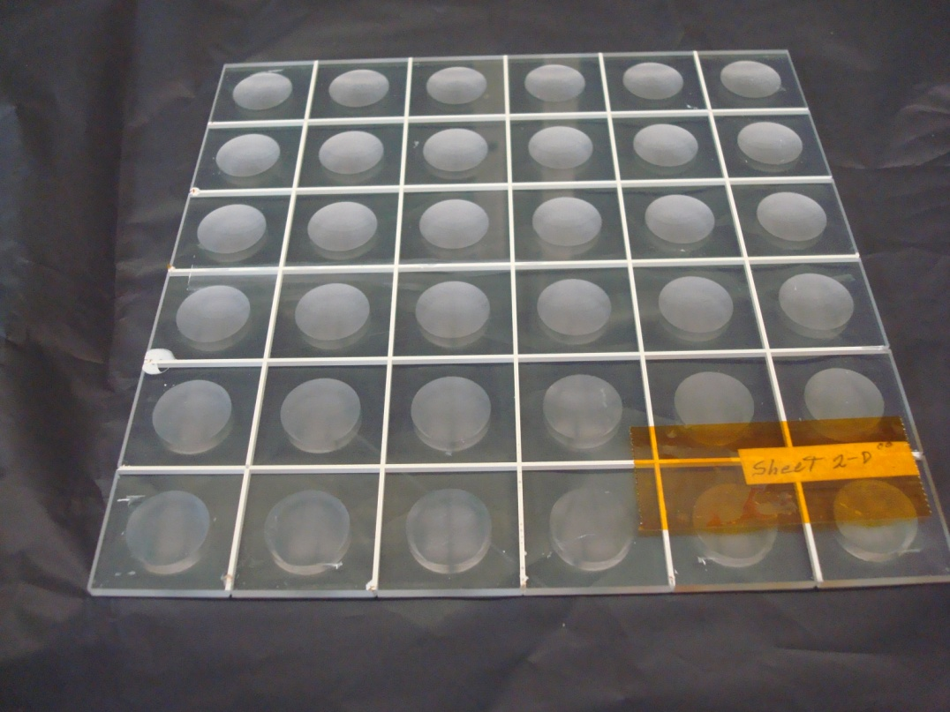
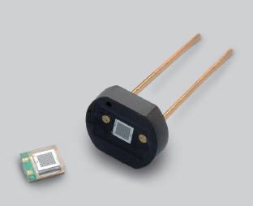
Integrated Readout Layer
- Uses HBU2 Front End with Silicon PM Readout ASIC (SPIROC) board so we had to make some compromises
- Hamamatsu MPPCs mounted on small flex circuits
- Scintillator “Megatile” with ~3 x 3 cm cells (30.15 mm to match AHCAL dimensions) optically isolated with white epoxy
- Cells have a concave dimple improve the uniformity of the response
- Easier to assemble, does not need WLS optical fiber

Slide 4
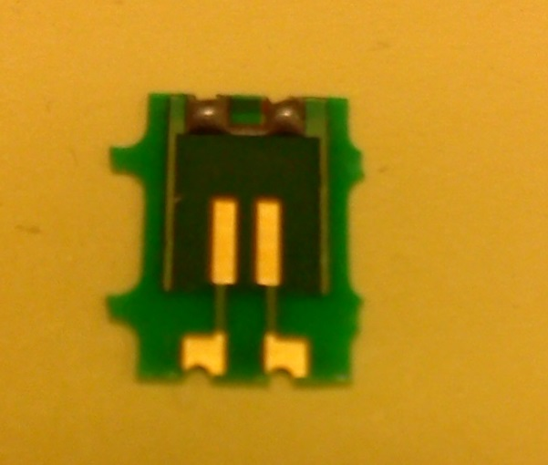
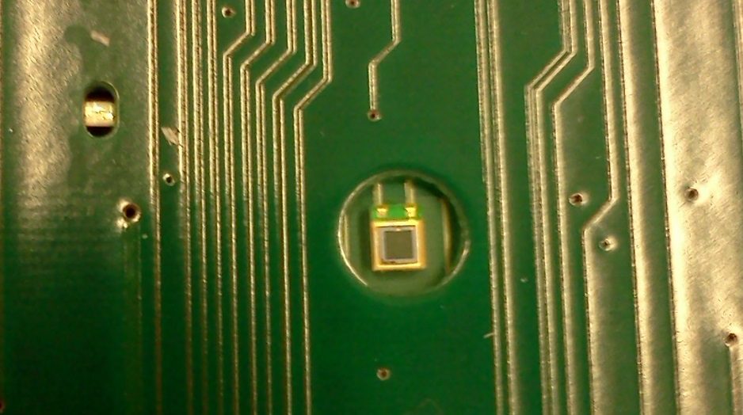
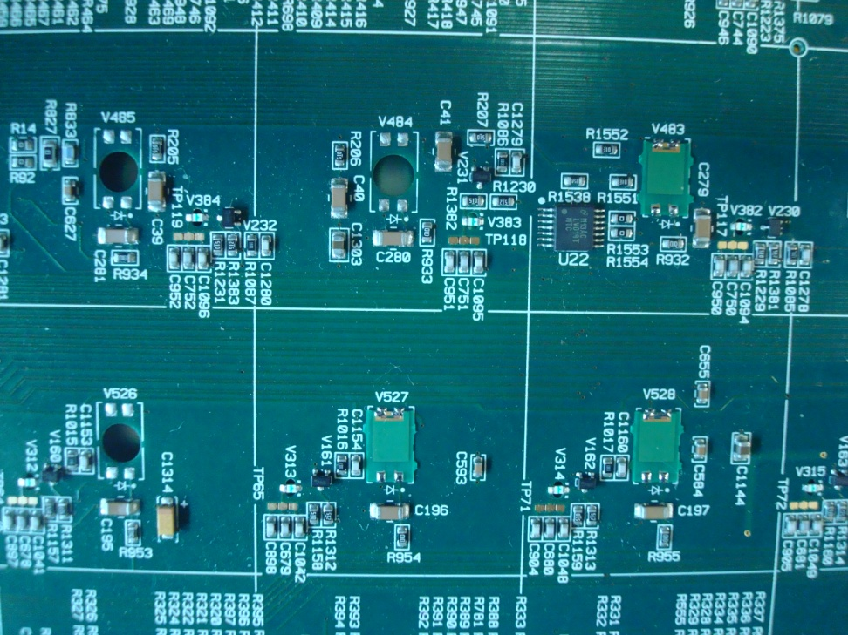
MPPC Mounting and Installation
- Hamamatsu S10362 SMD MPPCs mounted on small flex circuits
- Mounted in holes on HBU2 board so that sensitive surface of MPPC is on opposite side of circuit board as ICs
Each MPPC has its own LED (plan to test one LED for 4 MPPC which worked with our original design)
(Cannot populate area behind SPIROC chips because of HBU2 design)

Slide 5
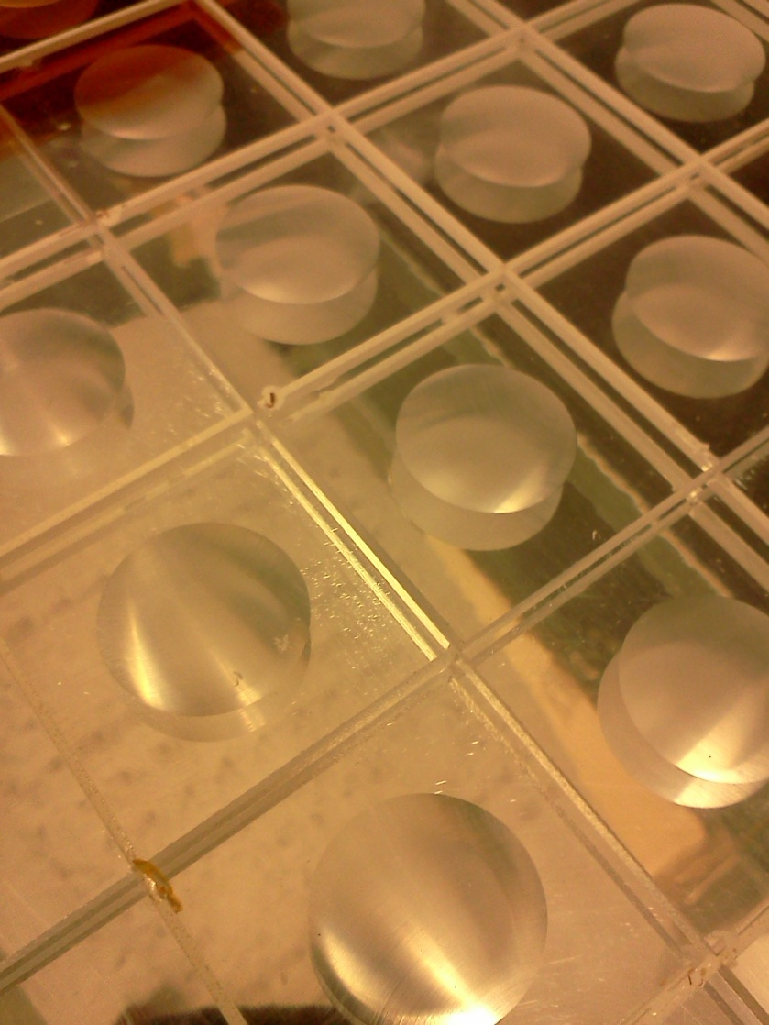
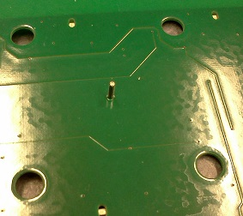
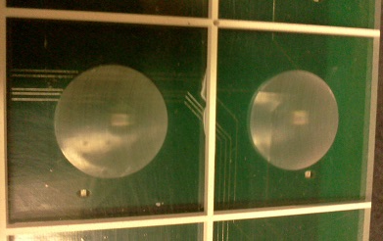
“Megatile” with Concave Dimple
Scintillator “Megatile”
  3.00 mm thick with 0.05 mm accuracy
  30.15 x 30.15 mm cells
  optically isolated with white epoxy
Cells have a concave dimple machined into cast scintillator to improve the uniformity of the response
Aligned with pins
The Megatile is milled from one solid piece of cast polyvinyltolulene scintillator for each HBU board
Each HBU board has four 6x6 cell Megatiles
Megatile is rigid and provides support for circuit board
Reflective VM2000 on flat surface

Slide 6
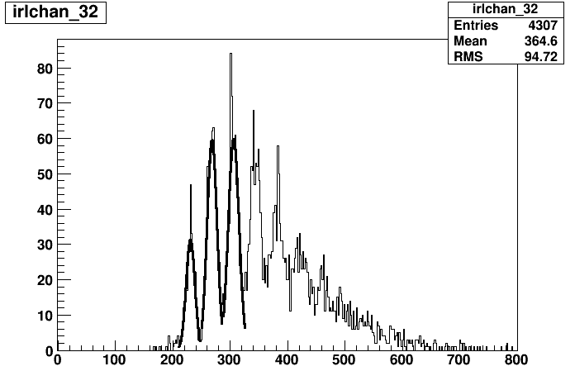
Initial Test Configuration
4,132
3,131
17 MPPC mounted with 25, 50 and 100 micron pixel size
50 micron Pixel have average gain of 40
25 micron Pixel MPPCs have lower gain and it is difficult to distinguish peaks
SPIROC 1 does not work, will be replaced
1,129
2,130

Slide 7
Evaluating Tiles with Dimple Formed by
Injection Molding
Injection molded cells would be less expensive to produce than machined cells
Two different manufacturers (Intrepid and AdvanTech) produced 2x2 arrays
Both the arrays and machined cell have their sides painted and VM2000 on the flat surface.
Selected dimple depth appears to overcompensate
Promising results

Slide 8
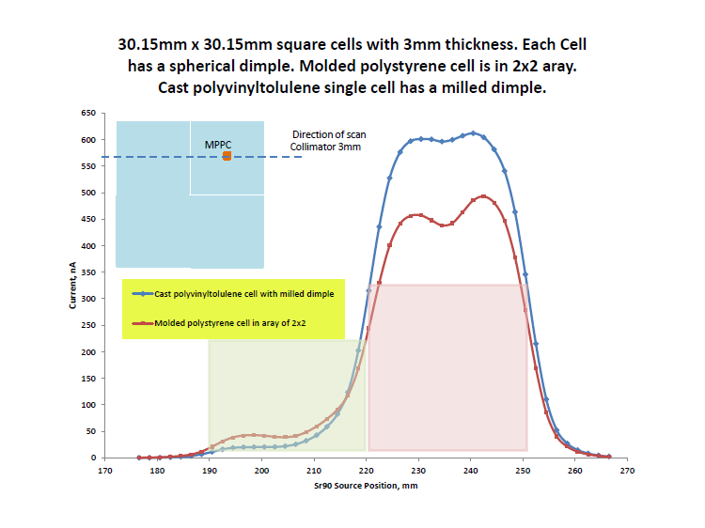

Slide 9
Next Steps
Test the SPIROC replacement on original board
Test second board
Mount new Hamamatsu MMPCs on boards and test (new S12571 series claims to have reduced crosstalk and after-pulsing)
Fabricate and test 9x12 machined Megatile
Test additional injection molded cells
Eventually place in test beam (Spring 2014)
Special thanks to Felix, Mathias and Oskar for support

