Slide 1
Course B: rf technology
Normal conducting rf
Overall Introduction
and
Part 1: Introduction to rf
Walter Wuensch, CERN
Eighth International Accelerator School for Linear Colliders
Antalya, Turkey
7 to 10 December 2013

Slide 2
Objectives of this course are to:
Give you an insight into the most important issues which drive the design and performance of the main linac in a normal conducting linear collider:
accelerating gradient, efficiency and wakefields.
The way in which we will go about this:
Review together a few key points of electromagnetic theory to establish a common language and as a basis for the rest of the lectures .
Introduce the concepts and formalism for dealing with the coupling between rf fields and beams.
Then we will look at linear collider hardware to see how it works and how the concepts from sections 1 and 2 are implemented.
Study wakefields – these are beam/structure interactions which can lead to instabilities in the beams.
Make a survey of methods used to suppress transverse wakefields. Wakefield suppression has a strong impact on structure design and performance.
Look at the complex world of high-gradients and high-powers.

Slide 3

Sixth International School for Linear Colliders
2011
Pacific Grove, USA

Slide 4
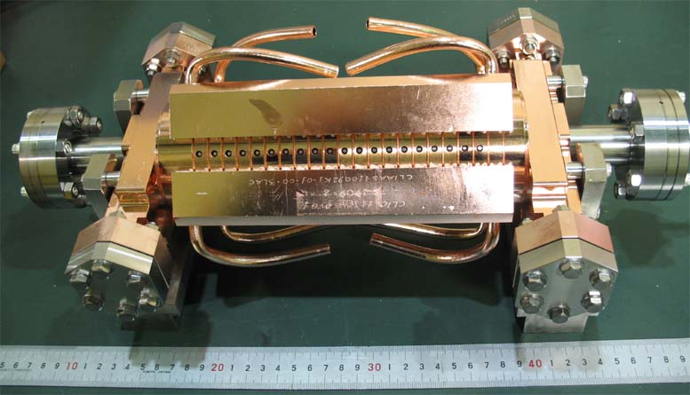
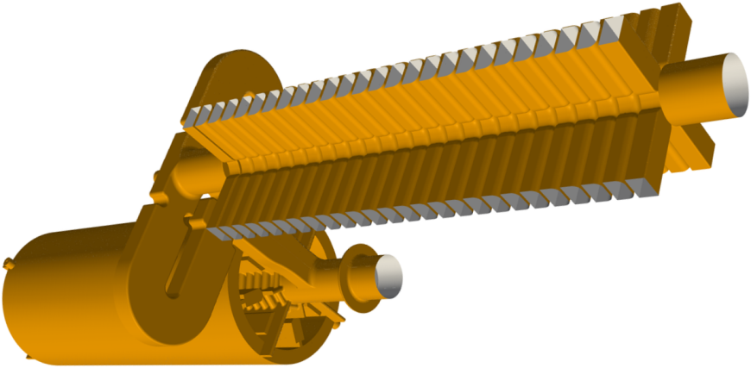
I hope over the next few days these objects become good friends!

Slide 5
In this section we will:
Review together a few illustrative examples from electromagnetic theory.
Study the main characteristics the fields in the types of rf structures used in accelerators.
Understand these fields interact with a relativistic beam.
The way we will go about this is to cover:
Remind our selves about plane waves, waveguides and resonant cavities.
Introduce the idea of beam-rf synchronism and periodic structures.

Slide 6
I will use the CLIC frequency, European X-band, for examples so
f = 11.994 GHz
unless noted otherwise.

Slide 7
Let’s start by looking at the solution to Maxwell’s equations in free space, no charges, no dielectrics, just simple plane waves.
We don’t have time to do a derivation of the solution,
we have learned, and are familiar, with all sorts of different techniques and time is short
I would like to emphasize understanding the essential characteristics of the solutions
all the real rf structure geometries are so complicated that we get the fields from computer simulation anyway. A key skill in the business is to understand the fields and how they behave.
We can re-write Maxwell’s equations to look like this for our special case:

Slide 8
The solution of these equations in one dimension are waves with electric and magnetic fields
in phase and
perpendicular to each other and to the direction of propagation.
For example:
Where E₀ and B₀ are related through:

Slide 9
Let’s look at just one of the components, the electric field:
In order to satisfy Maxwell’s equations we get the condition that:
It’s quite practical to think of this same formula but in terms of frequency and wavelength:
where
and

Slide 10
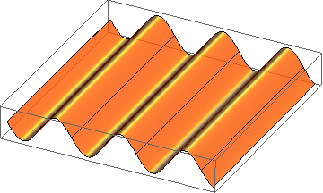
To help you visualize the wave each component, E say, at a single frequency looks like:
animation by Erk Jensen

Slide 11
A key feature of free-space electromagnetic waves is that they have no dispersion, that is:
The consequence is that one-dimensional free-space waves have the general form:
Another way of saying the same thing is that you decompose by Fourier transform any waveform. All the different frequency components propagate with the same speed so any old shape of E (and consequently B) doesn’t change as it races along at the speed of light.

Slide 12
Now waveguides
There are lots of kinds of waveguides but let’s just look at rectangular waveguide. There are lots of ways of analyzing them, circuit models for example, but we will stick with fields.
It turns out that the general properties of the hollow, uniform waveguides are independent of the cross section geometry.
y
x
z

Slide 13
We’re not going to solve the waveguide in all generality but we already know that there are solutions which look like this:
y
The lines are electric field
x
The fields we need to solve for this type of mode are determined by:

Slide 14
The solution is of the form (we can solve this because we already know the answer):
y
x
Which gives,

Slide 15
An important feature of the wavenumber in a waveguide is existence of a cutoff frequency:
when this is less than this (which gives the cutoff frequency)
this becomes an exponential decay rather than an oscillation.

Slide 16
We can now rewrite all this in terms of f and λ and put in a term for the cutoff frequency rather than the specific case we just solved.
NOTE! This term is ≥ 1, so the wavelength in a uniform waveguide is always bigger than in free space.

Slide 17
We now address the phase velocity
Let’s look at the exponent.
Points of constant phase are going to move with a speed:

Slide 18
Going back to wavelength the phase velocity is given by
Since the wavelength in a uniform waveguide is always bigger than in free space, the phase velocity is always faster than c.
This is very important to understand because it is one of the two main issues rf structures address. Electron beams mostly travel with c, plus in injectors even less not to mention heavier particles like protons. How do you get the phase velocity in a guided wave down to c?

Slide 19
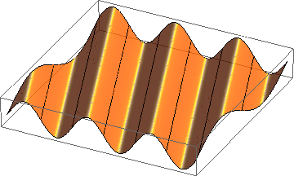
Homogeneous plane wave
Wave vector :
the direction of is the direction of propagation,
the length of is the phase shift per unit length.
behaves like a vector.
x
E_{y}
φ
z
Thanks to Erk Jensen for the next four slides.

Slide 20
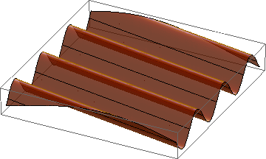
Wave length, phase velocity
The components of are related to the wavelength in the direction of that component as etc. , to the phase velocity as
E_{y}
x
z

Slide 21
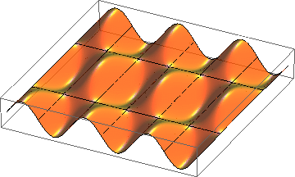
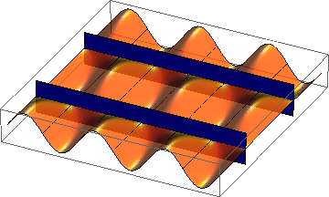
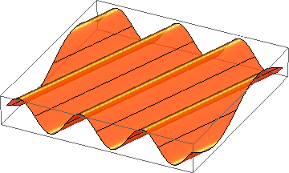
Superposition of 2 homogeneous plane waves
E_{y}
now frozen
x
z
=
+
Metallic walls may be inserted where
without perturbing the fields.
Note the standing wave in x-direction!
This way one gets a hollow rectangular waveguide

Slide 22
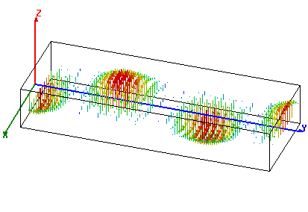
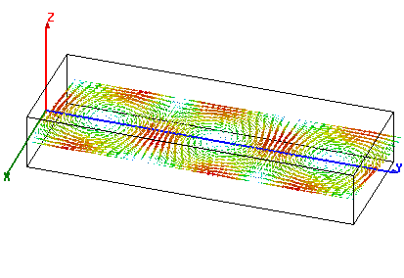
Rectangular waveguide
Fundamental (TE₁₀ or H₁₀) mode
in a standard rectangular waveguide.
Example: “S-band” : 2.6 GHz ... 3.95 GHz,
Waveguide type WR284 (2.84” wide), dimensions: 72.14 mm x 34.04 mm.
Operated at f = 3 GHz.
power flow
electric field
power flow:
magnetic field
power flow

Slide 23
Wavelength in another picture – the dispersion curve.
case 1
Horizontal green line: waveguide k is 0.75 of free space k at 11.994 GHz
case 2

Slide 24
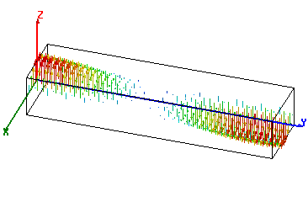
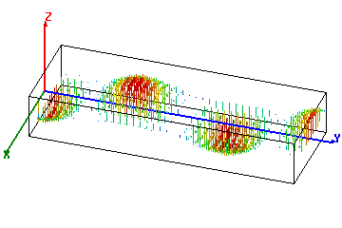
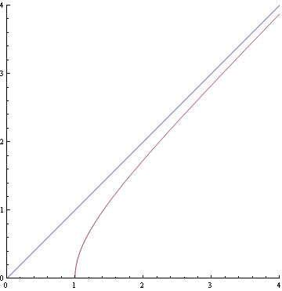
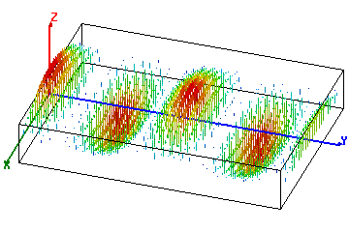
Waveguide dispersion
What happens with different waveguide dimensions (different width a)?
f = 3 GHz
1:
a = 52 mm,
f/f_{c} = 1.04
2:
a = 72.14 mm,
f/f_{c} = 1.44
3
2
3:
a = 144.3 mm,
f/f_{c} = 2.88
1
cutoff
Erk Jensen

Slide 25
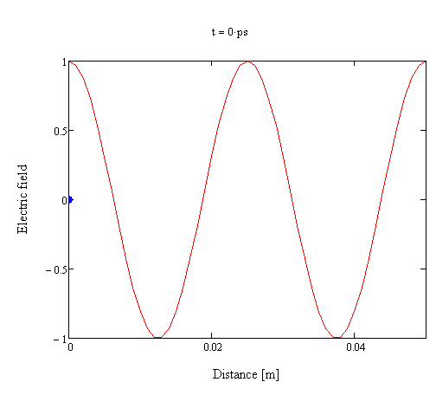
A first view of travelling wave acceleration
Beam (blue dot) travels with the speed of light.
z(t)=ct
Case 1: Wavelength is equal to free space wavelength, phase velocity equal to c.

Slide 26
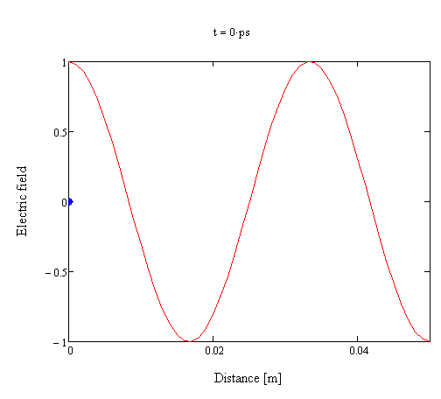
But in a uniform waveguide:
Beam (blue dot) travels with the speed of light.
x(t)=ct
Case 2: Wavelength is equal to free space wavelengthx4/3, phase velocity equal to 4/3xc.

Slide 27
Group velocity
We will get group velocity by first calculating the group delay, that is time it takes power to flow through a given section of waveguide. We’ll get velocity by dividing by the length.
Power flow
l

Slide 28
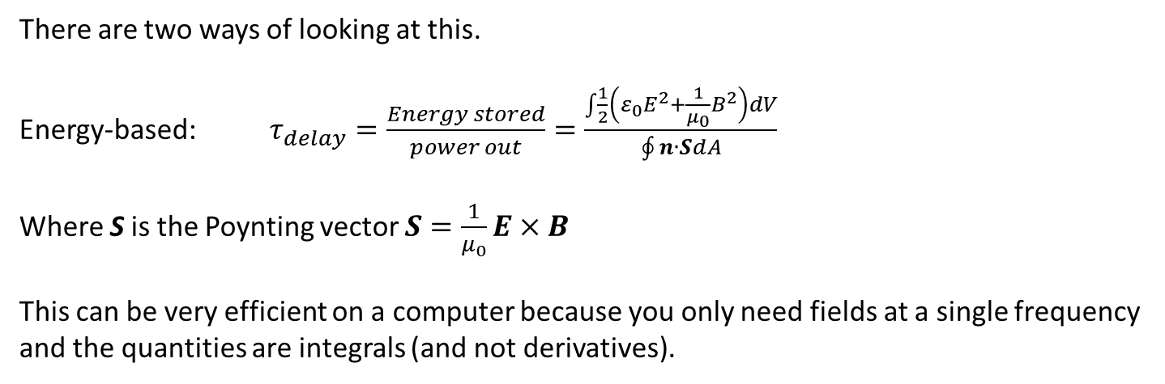
There are two ways of looking at this.
Energy-based: $τ_{delay}=\frac{Energy stored}{power out}=\frac{\int{\frac{1}{2}\left(ε_{0}E^{2}+\frac{1}{μ_{0}}B^{2}\right)dV}}{\oint{n∙SdA}}$
Where S is the Poynting vector $S=\frac{1}{μ_{0}}E×B$
This can be very efficient on a computer because you only need fields at a single frequency and the quantities are integrals (and not derivatives).
l
Power flow

Slide 29
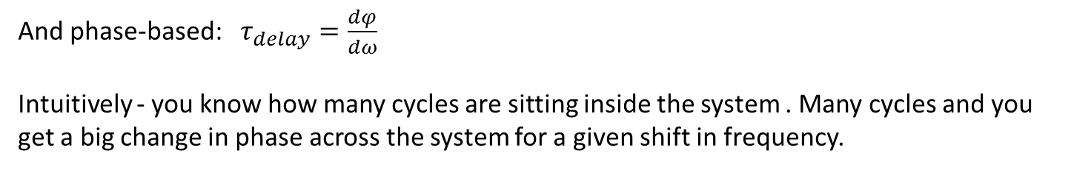
And phase-based: $τ_{delay}=\frac{dφ}{dω}$
Intuitively - you know how many cycles are sitting inside the system . Many cycles and you get a big change in phase across the system for a given shift in frequency.
This is particularly effective for reading dispersion curves. It also how you get group delay from a vector network analyser.
l

Slide 30
Now before we go to solving how to slow down a travelling wave’s phase velocity, we will take another perspective on acceleration:
Standing wave cavities.
Here again, I won’t describe how to solve of the fields. We will instead look at the general features of the specific solution.
The key thing if for you is to understand the general features.
Of course in the long run, understanding how to get the solutions helps you better understand what phase velocity and all that stuff really mean.

Slide 31
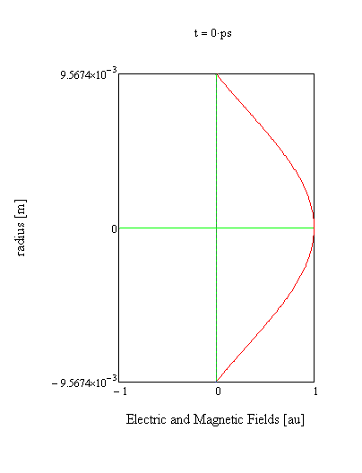
Fields inside a pillbox cavity TM_{0,1,0} mode
Electric field
Magnetic field

Slide 32
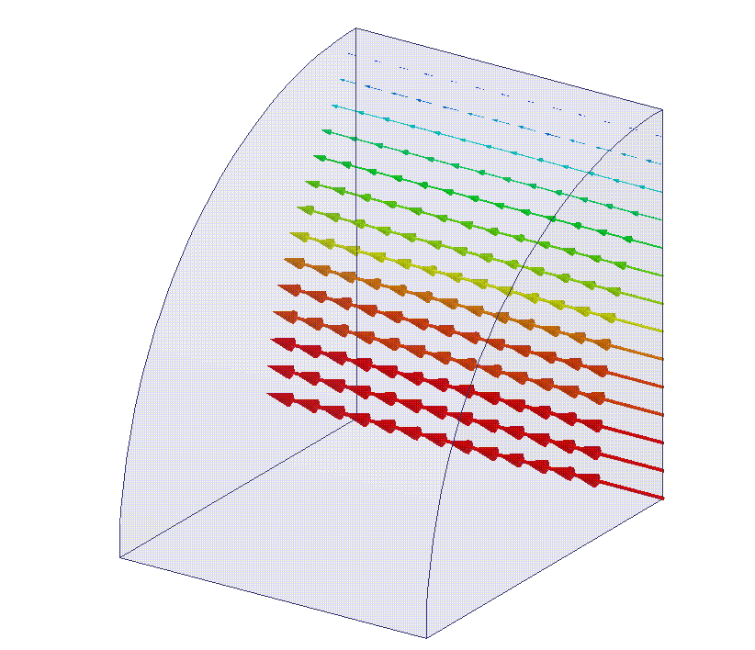
Electric field in the TM_{0,1,0} mode of a pillbox cavity

Slide 33
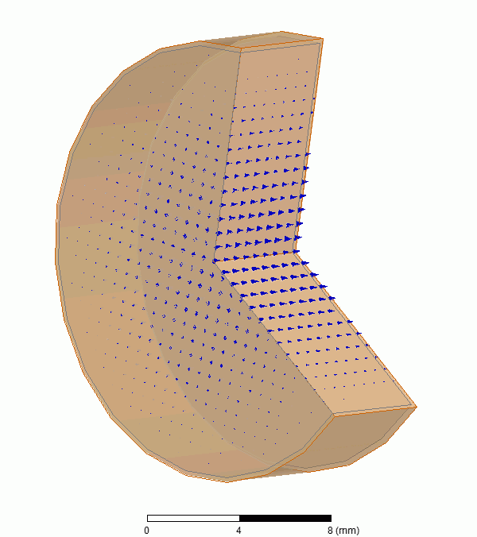
A better animation from Rolf Wegner.
Electric field
Magnetic field

Slide 34
We are now going to take a big step. We are going to consider to what happens to a beam crossing a cavity.
The equation for the force on a charge is:
For now we only consider that charges are being accelerated or decelerated, gaining or losing energy, by the rf field. That means we only need to consider electric fields in the direction of motion.
This we get in the TM_{1,1,0} mode we just saw with particles zipping along the axis of rotation.
In fact this hints at a profound point. Free space waves are transverse. You can’t give energy to a beam in the direction of power flow. That’s why laser aren’t used all over the place to accelerate particles. You need charges close by (in metals, dielectrics or plasmas) to turn the electric field in the direction of power flow. Those charges are going to cause all sorts of problems: losses, breakdown etc.

Slide 35
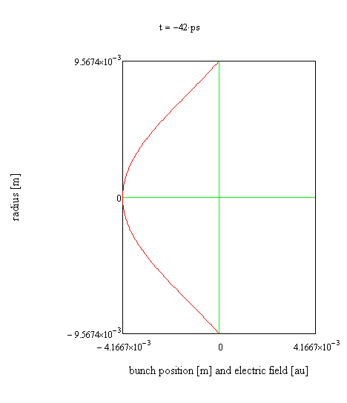
Beam crossing TM_{1,1,0} mode pillbox cavity
Beam (blue dot) travels with the speed of light.
x(t)=ct
Electric field (red line)

Slide 36
Fields change while the beam flies through the cavity. The beam not seeing the peak electric field all the way through gives the transit time factor.
Electric field
Bunch
beam
Electric field
time evolving field
Definition of transit time factor
Field full and frozen
Philosophy: we need the metal to turn our fields in the right direction but we can only use the part of the fields travelling with our, speed of light, particle. That’s the free-space part of the solution in our cavity…

Slide 37
Transit time factor 2
denominator
numerator

Slide 38
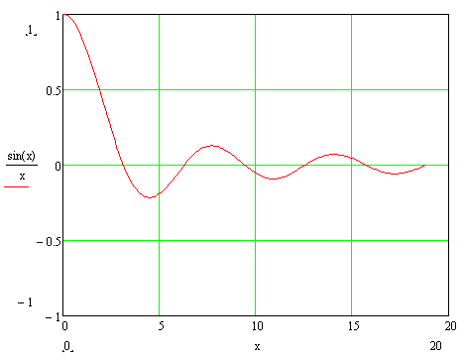
Transit time factor 3
phase rotates by full 360° during time beam takes to cross cavity

Slide 39
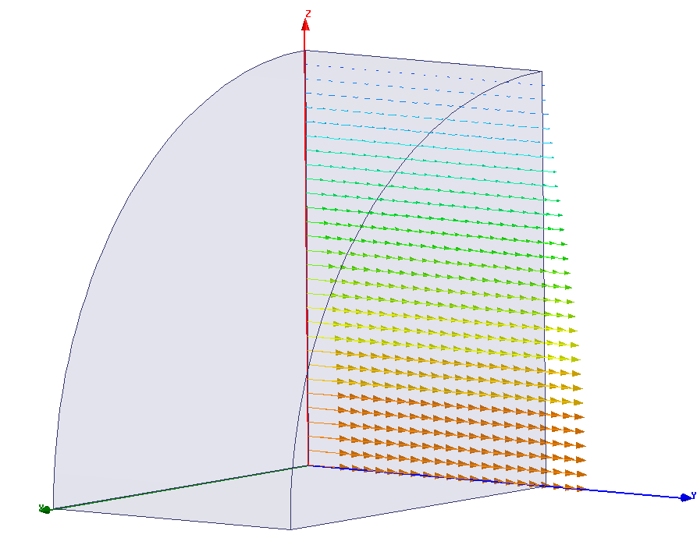
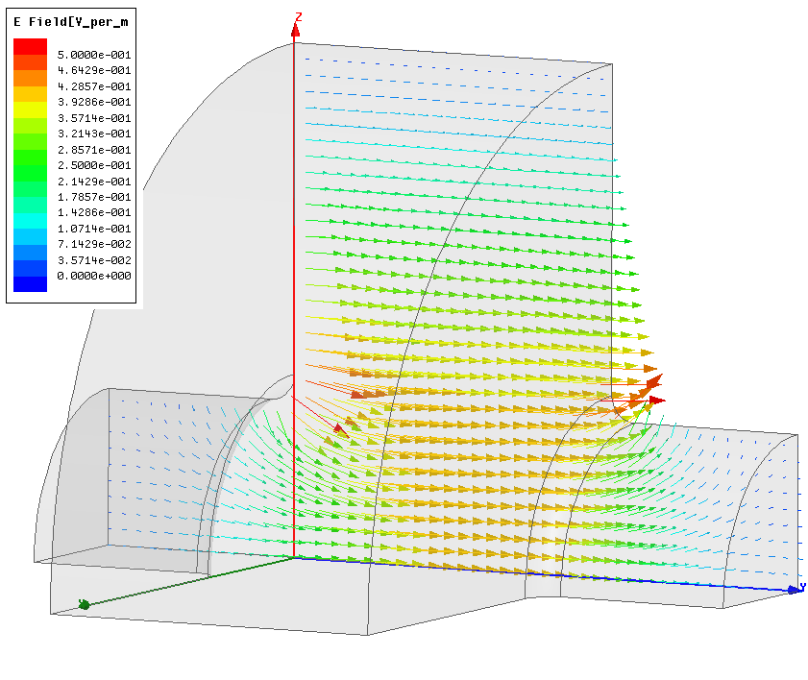
Now let’s get practical. A beam needs to enter and exit a cavity. Accelerating cavities have beam pipes.
normalized for stored energy

Slide 40
Acceleration by standing wave cavity is great but a single cell isn’t very long and you need to feed each one with power if you want to use more than one.
There are ways of coupling multiple cells together but things get really tricky with tuning when you get past a few cells.
A more common type of structure in linacs, and this is especially true with high energy electron linacs like linear colliders, is a travelling wave accelerating structure.
Power propagates along travelling wave structures in the same direction that the beam passes.
But from what we already learned - the key point is how to slow the phase velocity down to the speed of light.
This will be done with periodic structures.

Slide 41
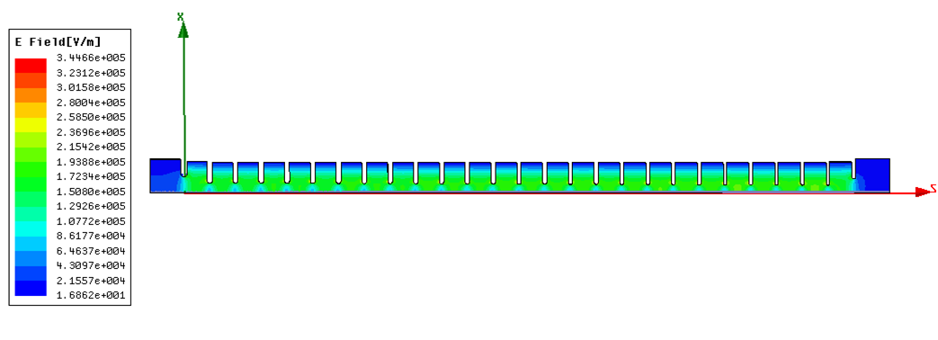
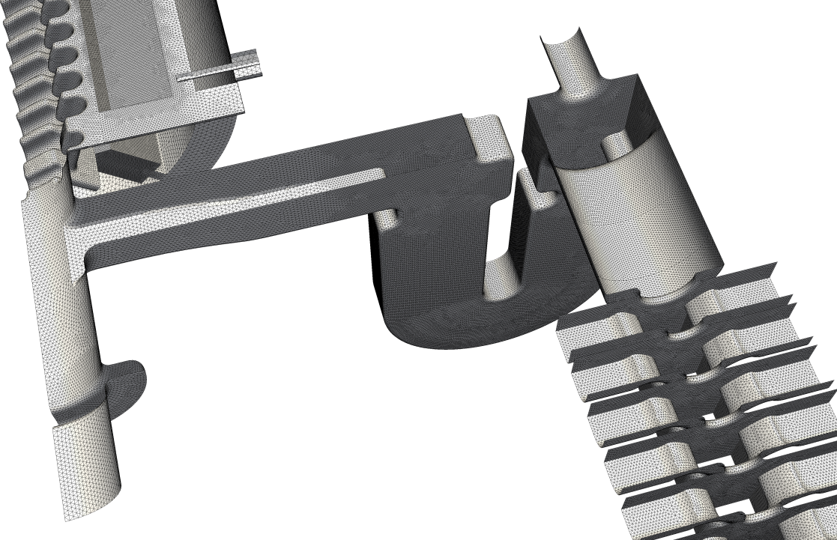
CLIC prototype accelerating structure
Inside this…
…is this.
Oleksiy Kononenko
Arno Candel

Slide 42
Remember our uniform waveguide fields:
In periodic loaded waveguide we don’t have such a simple z dependence anymore,
except that we know one geometrical period later has to have exactly the same solution (except for some phase advance) because the geometry is exactly the same.
This is in exact analogy to our uniform waveguide were every position z has exactly the same solution (except for some phase advance) because the geometry is exactly the same.
In its rigorous form, this is know as Floquet’s theorem.
The consequence of this is that some frequencies can propagate through the periodic structure and some can’t.
The uniform waveguide dispersion curve is bent up into pass and stop bands.
BUT this bending gives us crossings with the speed of light line, to give us the synchronism with speed of light beams!

Slide 43
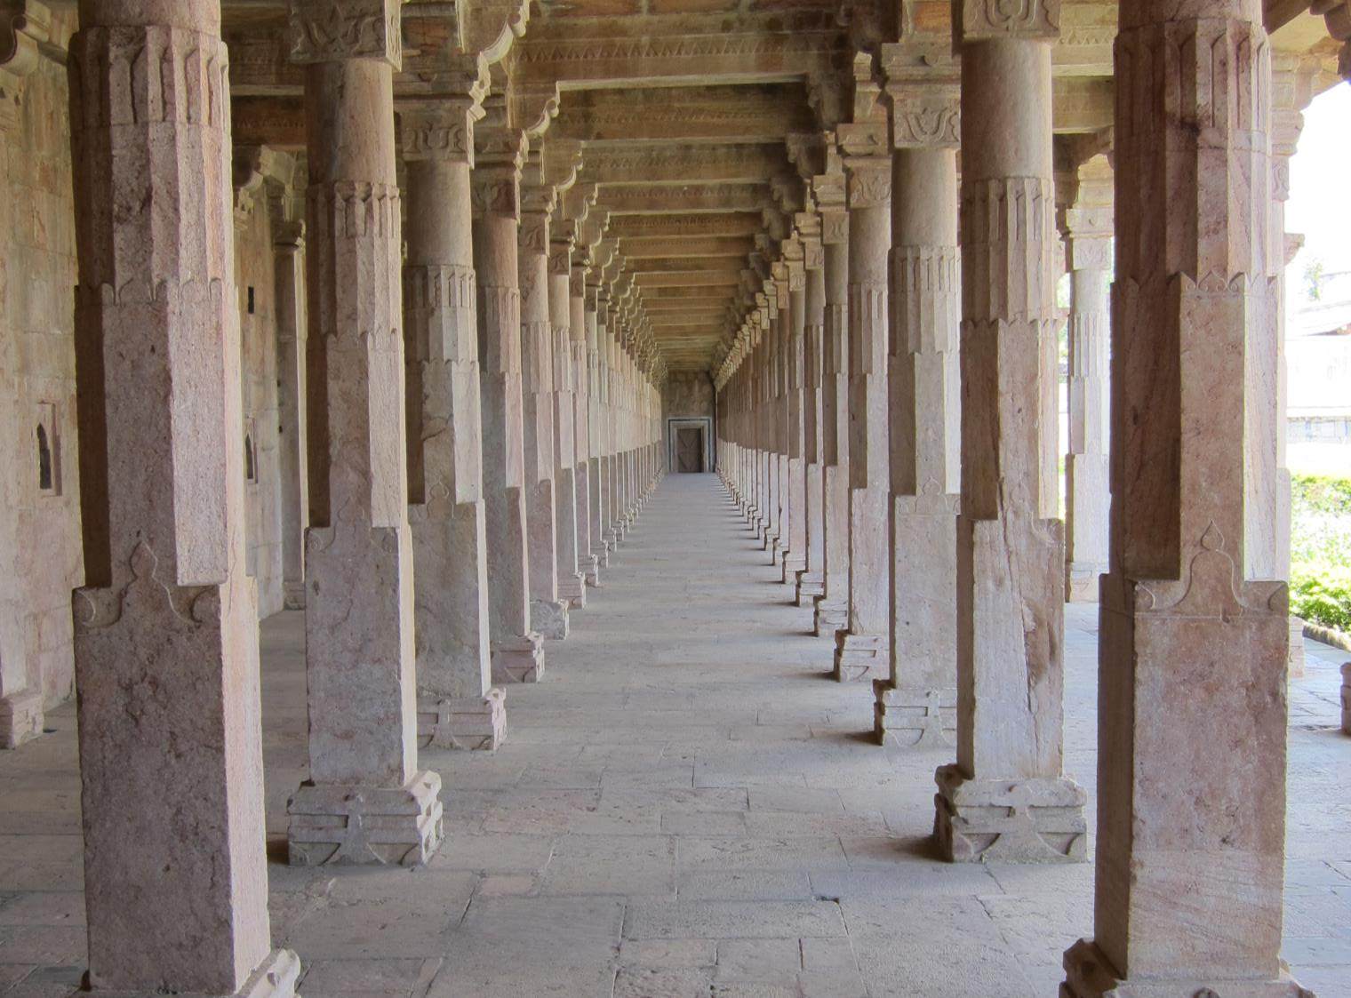
Seventh International School for Linear Colliders
2012
Indore, India

Slide 44
A very useful way to look a the structure of propagation characteristics of a periodic structure is the Brillouin diagram. We plot frequency against phase advance per period (or cell) which is kL.
2π
π
stop band
pass band
synchronism
0
0
kL
π

Slide 45
Brillouin diagram for a few pass bands
2π
π
0
-2π
-π
0
π
2π
ϕ

Slide 46
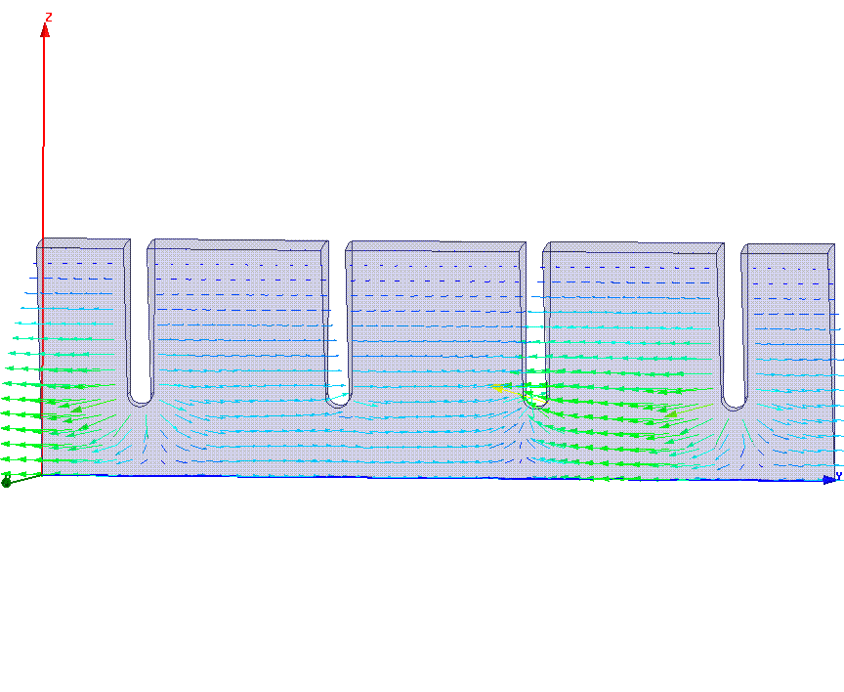
2π/3 travelling wave in disk loaded waveguide
Phase propagation direction

Slide 47
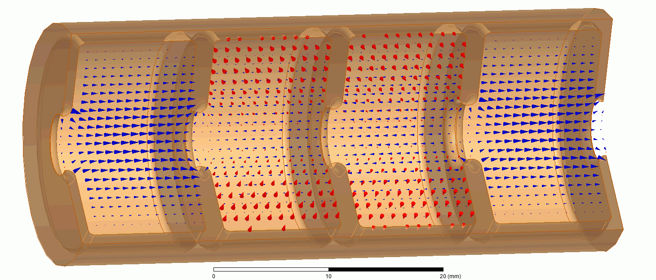
Another better animation from Rolf Wegner
beam propagation direction

Slide 48
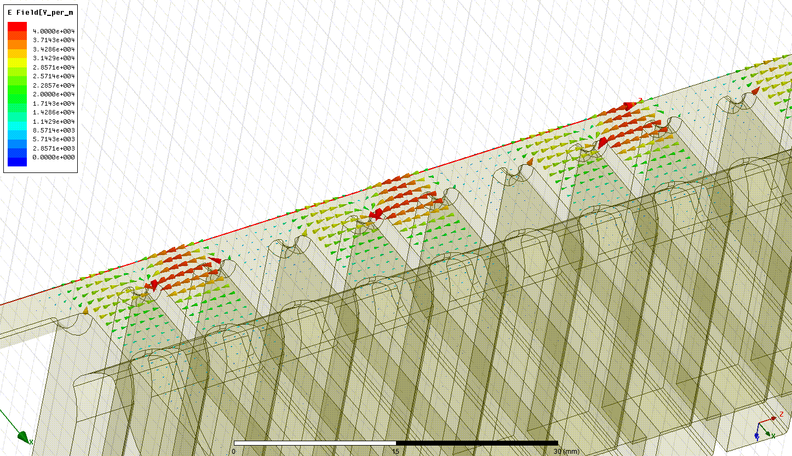
Acceleration!
Beam direction
By Alexej Grudiev

Slide 49
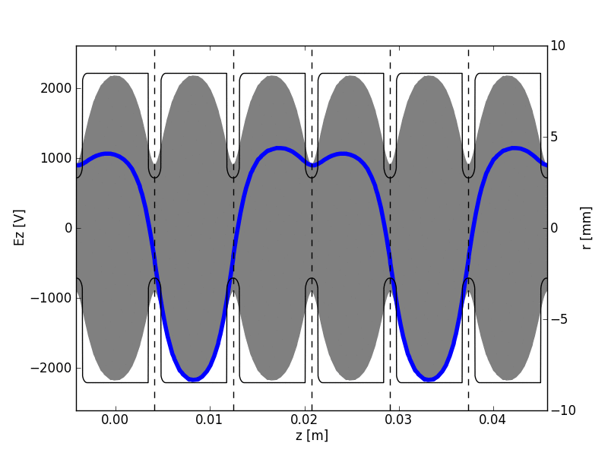
Acceleration as a function of distance and time along a periodically loaded structure.
An initial view of space harmonics…
From Kyrre Sjobaek

Slide 50
Brillouin diagram for a few pass bands
2π
π
0
-2π
-π
0
π
2π
ϕ

Slide 51
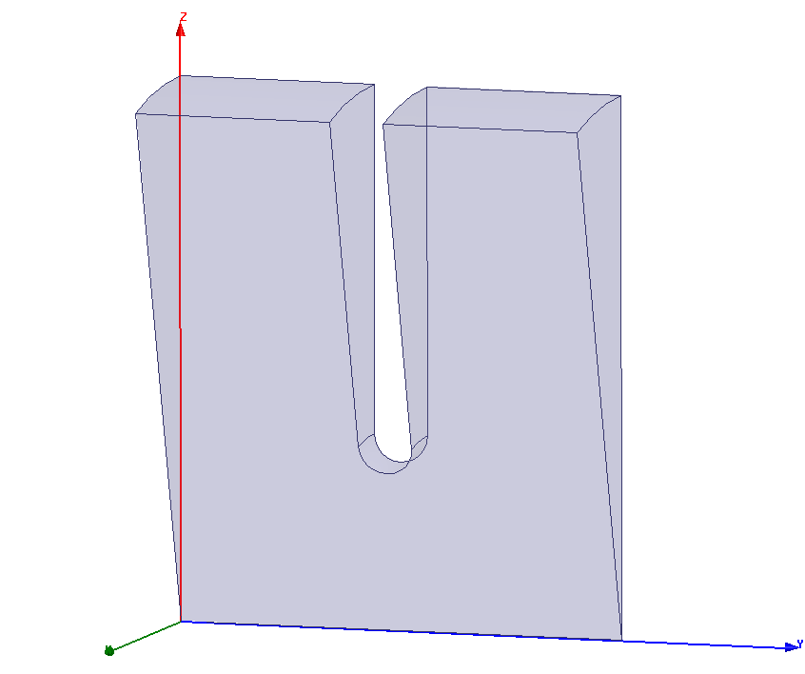
A specific case
speed of light
periodic loading

Slide 52
Close up

Slide 53
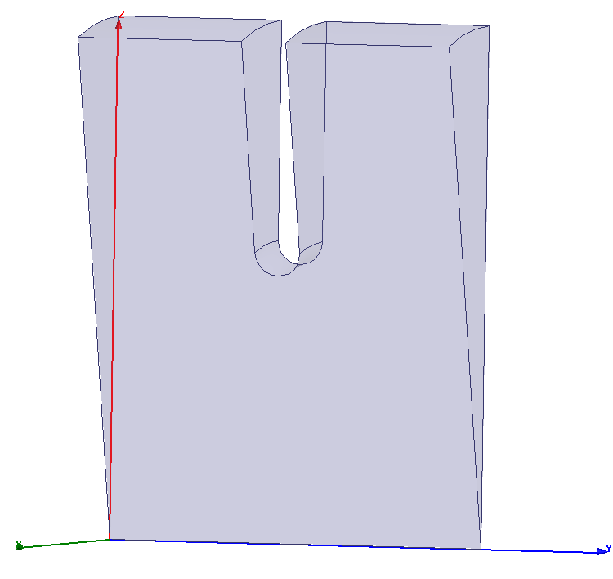
Two different aperture geometries. The same phase velocity for the 2π/3 mode but different group velocity. This is given by the slope of the dispersion curve.

Slide 54

How to calculate group velocity from a dispersion curve
Slope at 2π/3 mode
f [GHz]
dispersion curve
0
kL
$$π$$

Slide 55
How to calculate phase velocity from a dispersion curve
and you need the length of the cell L
f [GHz]
0
kL
2π/3
$$π$$

Slide 56
Now we have all the elements to understand the basic principles of a CLIC accelerating structure.
rf power is fed into structure
Beam goes through structure and is accelerated.
a little bit of power comes out

Slide 57
Resonant cavity impedance as a function of frequency
This is a diversion into a ‘standard’ rf problem and utilises a circuit model, which is often used in analysing rf problems.
We’re not going to become experts here in circuit models, but studying the resonant cavity in a bit more detail will help us understand some of the accelerator concepts better.
The answer provides you with a very practical tool in case you find yourself in the lab.

Slide 58
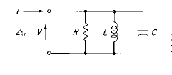
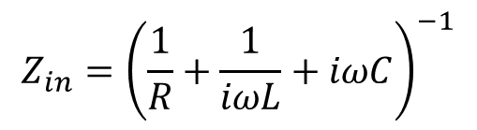
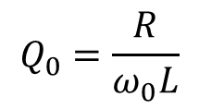
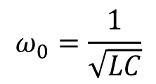
$$Z_{in}={\left(\frac{1}{R}+\frac{1}{iωL}+iωC\right)}^{−1}$$
At resonance energy stored in the inductor and capacitor is the same so:
$$ω_{0}=\frac{1}{\sqrt{LC}}$$
You get the Q from stored energy in the system divided by the energy lost per cycle and it works out to:
$$Q_{0}=\frac{R}{ω_{0}L}$$

Slide 59
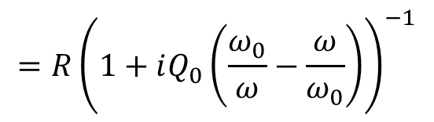
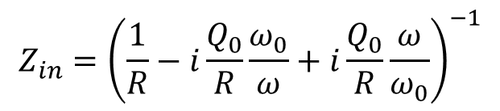
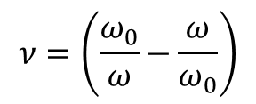

$$Z_{in}={\left(\frac{1}{R}−i\frac{Q_{0}}{R}\frac{ω_{0}}{ω}+i\frac{Q_{0}}{R}\frac{ω}{ω_{0}}\right)}^{−1}$$
$$=R{\left(1+iQ_{0}\left(\frac{ω_{0}}{ω}−\frac{ω}{ω_{0}}\right)\right)}^{−1}$$
$$=R{\left(1+iQ_{0}ν\right)}^{−1}$$
$$ν=\left(\frac{ω_{0}}{ω}−\frac{ω}{ω_{0}}\right)$$
Where:

Slide 60
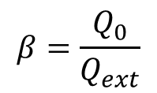

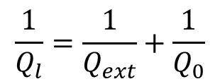
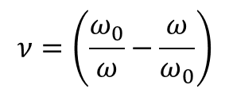
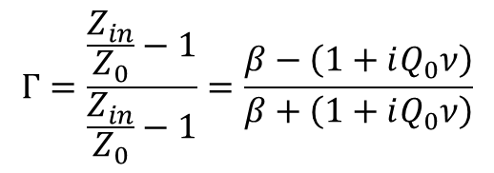

ideal transformer with coupling $β$
$$Z_{in}=β{\left(1+iQ_{0}ν\right)}^{−1}$$
$$ν=\left(\frac{ω_{0}}{ω}−\frac{ω}{ω_{0}}\right)$$
$$Γ=\frac{\frac{Z_{in}}{Z_{0}}−1}{\frac{Z_{in}}{Z_{0}}−1}=\frac{β−\left(1+iQ_{0}ν\right)}{β+\left(1+iQ_{0}ν\right)}$$
$$\frac{1}{Q_{l}}=\frac{1}{Q_{ext}}+\frac{1}{Q_{0}}$$
$$β=\frac{Q_{0}}{Q_{ext}}$$

Slide 61
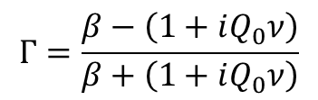
$$Γ=\frac{β−\left(1+iQ_{0}ν\right)}{β+\left(1+iQ_{0}ν\right)}$$

