Slide 1
Beam Instrumentation for Linear Colliders
3hours B-course at the 2013 LC school Antalya,
Hermann Schmickler, CERN-BE-BI
With a big “Thank You” to T. Lefevre for many splendid slides....
What is special about the beam instrumentation
of a Linear Collider ?
What are the main Instrumentation needs?
Details on:
- Measurement of nm beam positions
- Measurement of um transverse beam sizes
- Measurement of fs-scale long profiles
- Beam synchronization at the fs-scale
- Keeping the beams in collision
LC school 2013 H.Schmickler, CERN

Slide 2
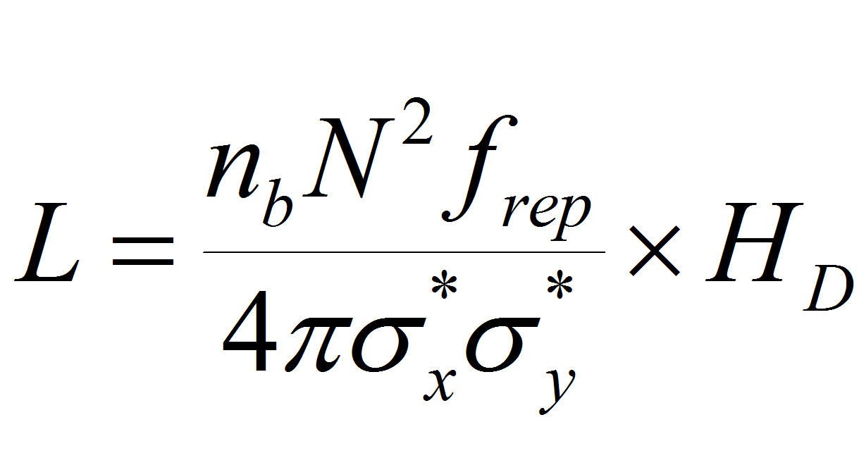
Luminosity of high energy Collider
Collider luminosity [cm⁻² s⁻¹] is approximately given by
  n_{b} = bunches / train
  N = particles per bunch
  f_{rep} = repetition frequency
  σ_{x,y} = beam size at IP
  H_{D} = beam-beam enhancement factor
A linear collider uses the beam pulses only once:
Need to accelerate lots of particles
Need very small beam sizes
N
1/f_{rep}
e+
e-
n_{b}

Slide 3
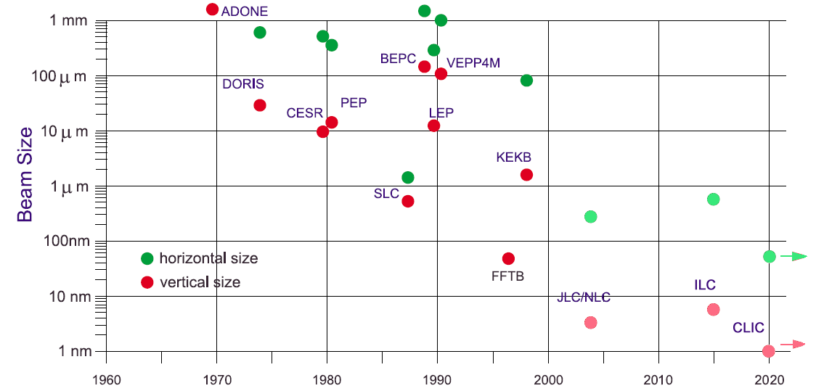
The small beam size challenge
Adapded from S. Chattopadhyay, K. Yokoya, Proc. Nanobeam `02
LEP: σ_{x}σ_{y} ≈ 130×6 μm²
ILC: σ_{x}σ_{y} ≈ 500×(3-5) nm²
T. Lefevre
“Beam Instrumentation for Linear Collider” - 2nd Ditanet School on Beam diagnostic - Stockholm– 2011

Slide 4
Luminosity issue with intense beams - Disruption
Field of the opposite particle will distort the other beam during collision:
- Pinch effect (can become instable if two strong)
– Beam-beam deflections – use to adjust beam overlap and luminosity
beam-beam characterised by Disruption Parameter:
σ_{z} = bunch length
Enhancement factor (typically H_{D} ~ 1.5 ÷ 2) is given by:

Slide 5
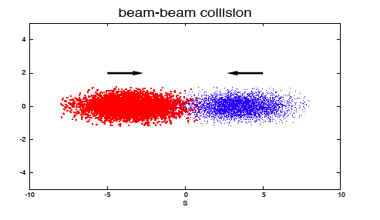
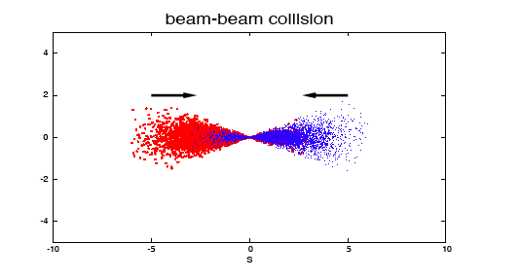
Luminosity issue with intense beams - Disruption
For LC, typical value of HD ~ 1-2

Slide 6
Luminosity issue with intense beams - Beamstrahlung
Generation of Synchrotron Radiation photons of particles in the strong EM field of the opposite bunch
e⁺ e⁻ pairs
e⁺
e⁻
Beamstrahlung photons
High energy Beamstralung photons can convert in strong field into e⁺/e⁻ pairs: background for the detector
  Coherent e⁺e⁻ pairs
    Direct photons conversion in strong fields
    Negligible for ILC but high for CLIC : Few 10⁸ particles per Bunch crossing
  Incoherent e⁺e⁻ pairs
    Photons interacting with other electron/photon
    Few 10⁵ particles/Bunch crossing

Slide 7
Beam size for minimizing beamstrahlung
rms relative energy loss
induced by Beamstrahlung
we would like to make (σ_{x} σ_{y}) small to maximise luminosity
and keep (σ_{x} + σ_{y}) large to reduce δ_{SB}
Trick: use “flat beams” with σ_{x} >> σ_{y}
Rule:
Make σ_{x} large to limit δ_{BS}
Make σ_{y} as small as possible to achieve high luminosity.
δ_{BS} ~ 2.4% @ ILC -- δ_{BS} ~ 29% @ CLIC

Slide 8
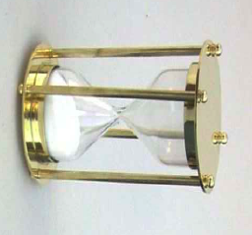
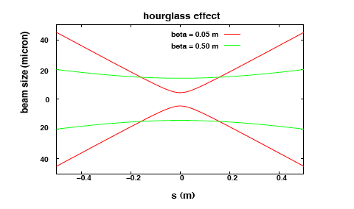
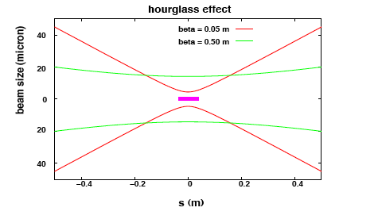
Hour glass effect – Bunch length
For achieving small Beta function ( small beam size) at IP, the beta function rapidly increases as the particle move away from the collision point
Variation of beam size along the bunch

Slide 9
Hour glass effect – Bunch length
From Nick Walker for TESLA
Rule: Keep β_{y} ~ σ_{z}

Slide 10
A final luminosity scaling for Linear collider ?
with
high RF-beam conversion efficiency η_{RF} and RF power P_{RF}
small normalised vertical emittance ε_{n,y}
strong focusing at IP (small β_{y} and hence small σ_{z})
Extremely small beam spot at Interaction Point beam delivery system, stability
  Generation of small emittance damping rings
  Conservation of small emittance wake-fields, alignment, stability
  Generation and acceleration of short bunches Bunch compressor

Slide 11
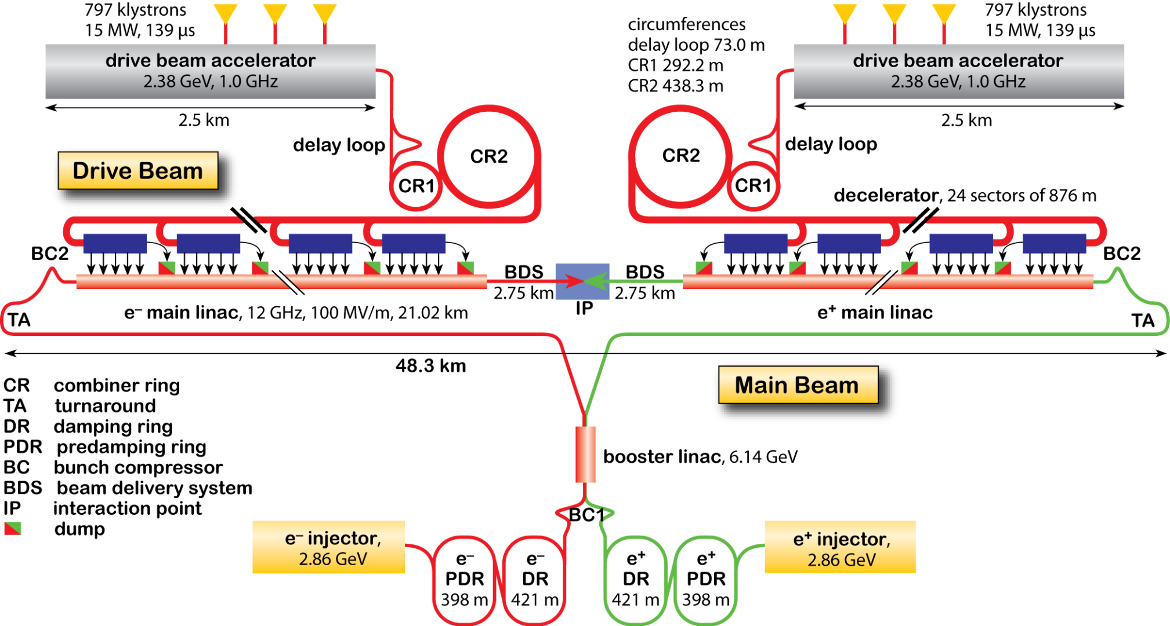
What‘s in the CLIC CDR for BI?
DB Instruments | Surface | Tunnel | Total
Intensity | 38 | 240 | 278
Position | 1834 | 44220 | 46054
Beam Size | 32 | 768 | 800
Energy | 18 | 192 | 210
Energy Spread | 18 | 192 | 210
Bunch Length | 24 | 288 | 312
Beam Loss | 1730 | 44220 | 45950
MB Instruments | Surface | Tunnel | Total
Intensity | 86 | 98 | 184
Position | 1539 | 5648 | 7187
Beam Size | 34 | 114 | 148
Energy | 19 | 54 | 73
Energy Spread | 19 | 4 | 23
Bunch Length | 17 | 58 | 75
Beam Loss | 1936 | 5854 | 7790
Beam Polarization | 11 | 6 | 17
Tune | 6 | 0 | 6
Luminosity |  | 2 | 2
Notes:
Big variarity of instruments more the ~ 111k instruments
Every measurable is described with the requirements in the different parts of the machine, as well as their number.

Slide 12
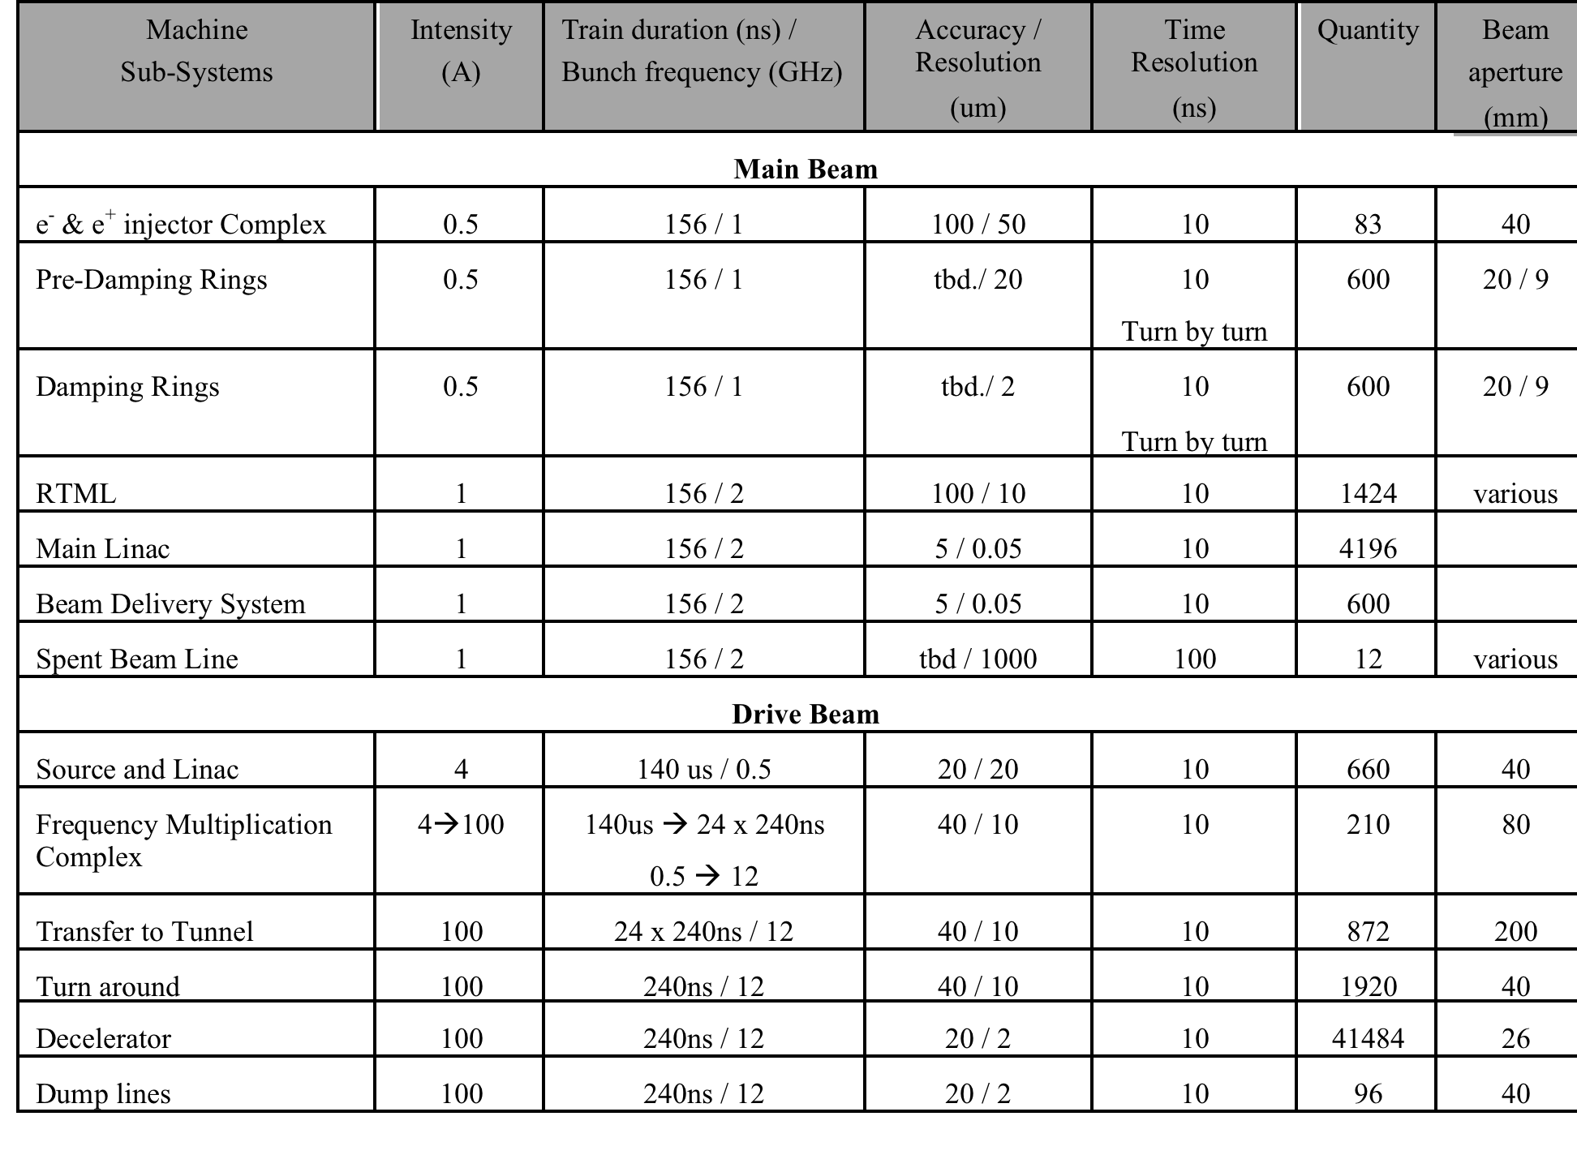
Beam Position Monitors - Baseline
High accuracy (5um) resolution (50nm) BPM in Main Linac and BDS
Various range of beam pipe diameters from 4mm to 200mm all over the complex (to minimize resistive wakefield effects)
Very high numbers of BPMs for the DB decelerator
Notes:
The much challenging requirements comes from the main Linacs.
Not only to the big numbers of instrument to beb build and maintained.
For the main linac we need 4000 high resolution/high accuracy BPMs. With 50 nm resolution. In the BDS down to 3nm. Resoultions in the order of 10nm has been demonstrated but with high Q cavity BPMs …we cannot due to the required time resolution. In ATF2 the highest number of cavity BPMs in history 30pc
For the DB more than 40000 which demands a close eye on costs and simplicity both for manufaturing and maintenance…1% down means 400 BPMs down
Outside the main linacs we have another 8000 BPMs almost 10 times more than LHC

Slide 13
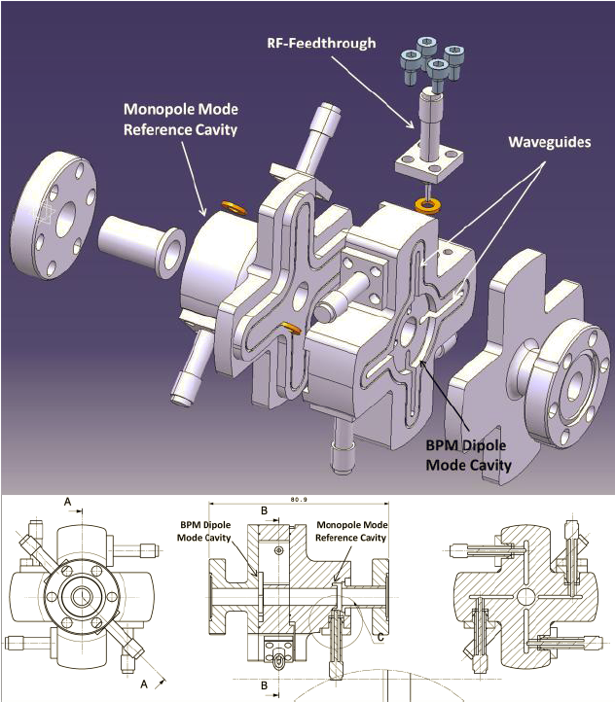
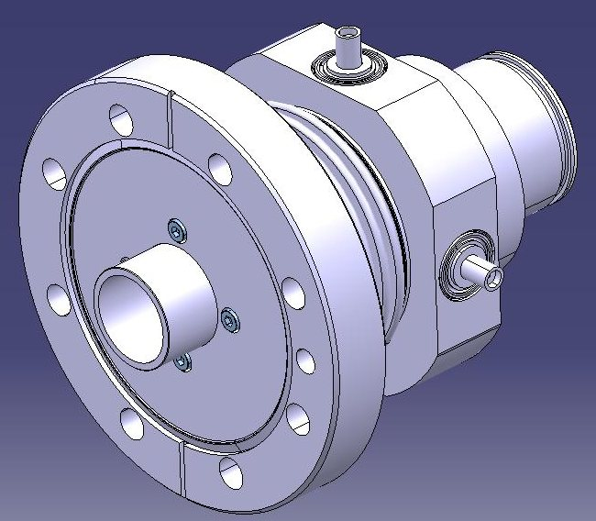
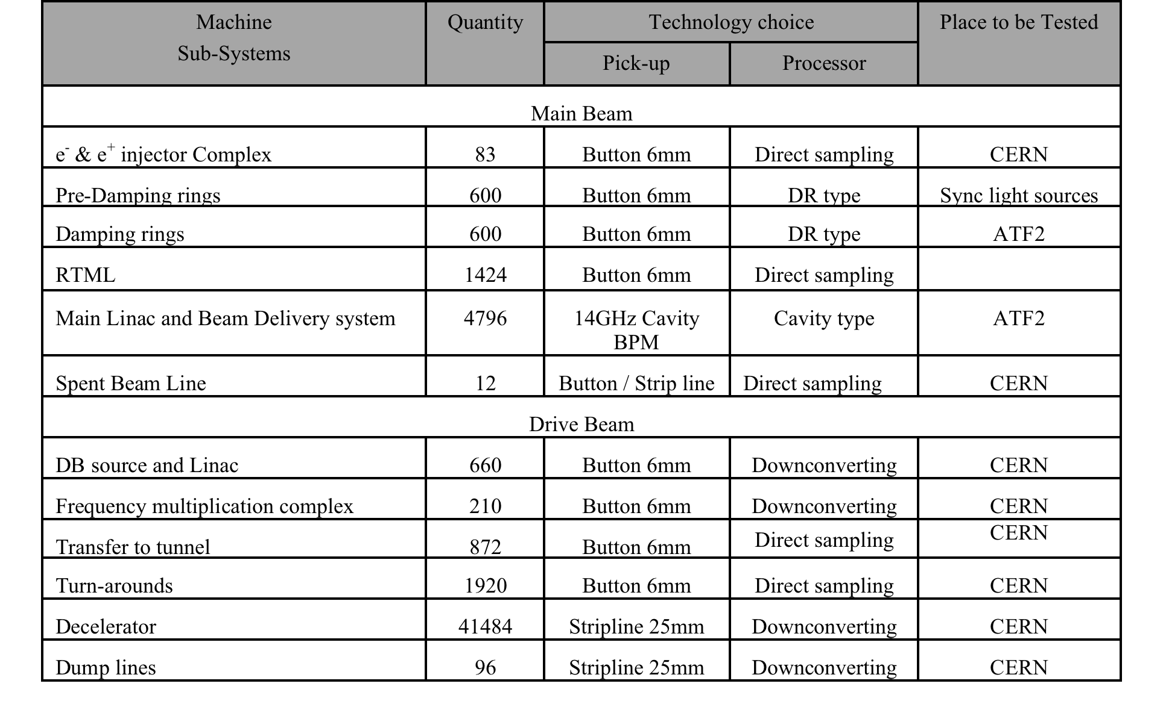
Beam Position Monitors - Baseline
Design by Manfred Wendt & co (FNAL)
Designed by Steve Smith
Notes:
Challenges CLIC Main Beam 50n with 10ns time resolution, low Q stainless steel
Three BPM types and three different acquisition system types
Cavity BPM 14GHz
Damping ring BPM 2 GHz
Direct sampling 2-500MHz
Calibration is mandatory to obtain the high demands on accuracy, which increas the complexity significantly.

Slide 14
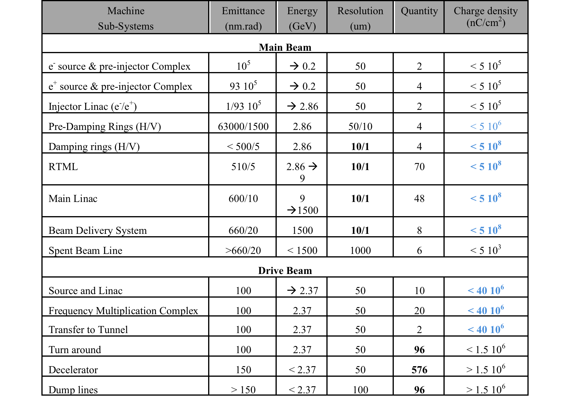
Transverse Profile Monitors - Baseline
Charge density limitation problems in many places / Strong need for non-interceptive devices : two systems required to cover the total dynamic range
Critical Issue on micron resolution beam profile measurements (> 100 monitors)
The thermal limit for ‘best’ material (C, Be, SiC) is 10⁶ nC/cm²
Imaging of high energy spread beams at the end of the decelerator
Relatively big number of Instruments ~ 1000
Notes:
Challenges CLIC Main Beam

Slide 15

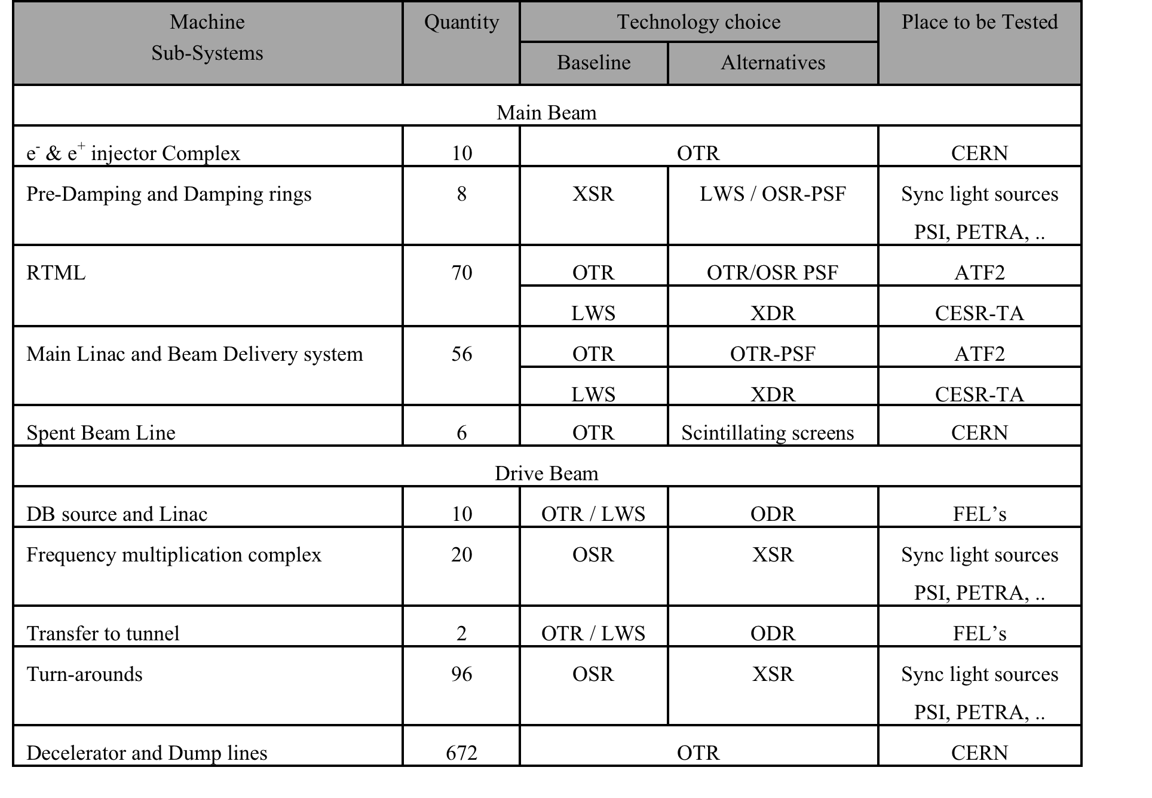
Transverse Profile Monitors - Baseline
Most of the systems based on the combined use of OTR screens and Laser Wire Scanners
- OTR used almost everywhere for commissioning (replaced by synchrotron radiation in rings)
- LWS 1um resolution required for the Main beam
- LWS used in the Drive Beam injector complex for high charge beams (full charge)
Non-interceptive monitor based on Diffraction radiation as a cheap alternative to LWS for both Drive and Main Beams
Notes:
Challenges CLIC Main Beam

Slide 16
Now we treat in detail:
- Measurement of nm beam positions
- Measurement of um transverse beam sizes
- Measurement of fs-scale long profiles
- Beam synchronization at the fs-scale
- Keeping the beams in collision (IP feedback)

Slide 17
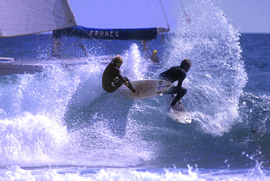
Conserving small Emittance along the Main Linac
  Wakefields in accelerating structures (damping of high order mode)
Δ
t
b
Bunches passing through an accelerating structure off-centre excite high order modes which perturbs later bunches
    Tolerances for acc. Structures alignment
    Cavity alignment at the 300 μm level @ ILC compared to 5 μm @ CLIC
    Need wakefield monitor to measure the relative position of a cavity with respect to the beam
T. Lefevre
“Beam Instrumentation for Linear Collider” - 2nd Ditanet School on Beam diagnostic - Stockholm– 2011

Slide 18



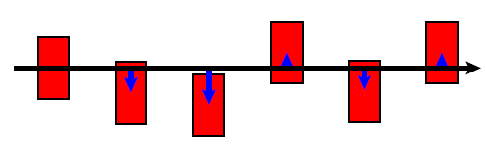
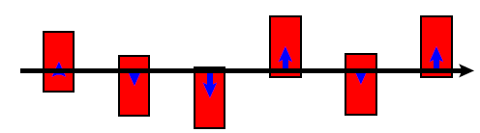
Proposed correction scheme
Electron bunch
AS with WFM
Girder
Girder
Movers
D. Schulte
Wakefield kicks from misaligned AS can be cancelled by another AS
One WFM per structure (142000 monitors) and mean offset of the 8 AS computed
WFM with 5um resolution
Need to get rid of the 100MW of RF power at 12GHz present in the structures
T. Lefevre
“Beam Instrumentation for Linear Collider” - 2nd Ditanet School on Beam diagnostic - Stockholm– 2011

Slide 19
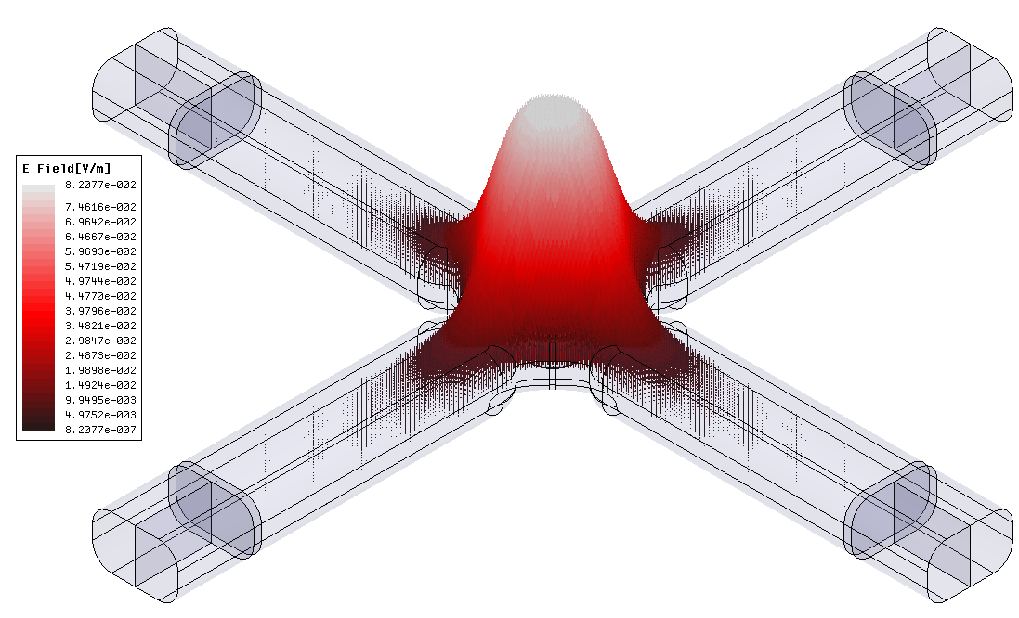
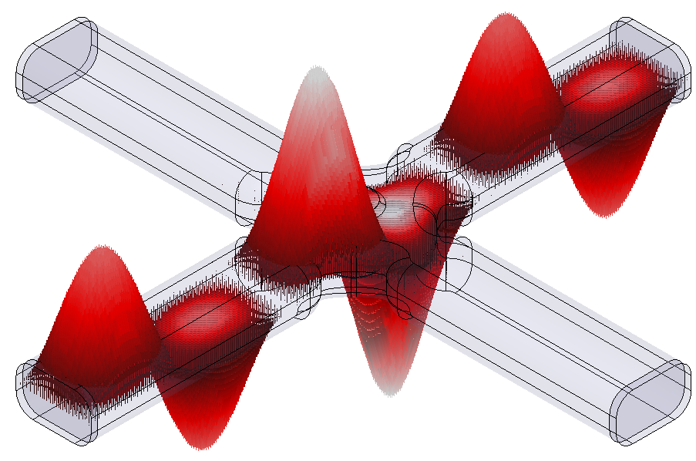
WakeField Monitor design
Monopole mode
Dipole mode
E Field
E Field
Opposite ports signals are in phase
Opposite ports signal have opposite phase
When we substract the opposite port signals, the monopole mode is cancelled and the dipole mode amplitude is increased
F. Peauger
T. Lefevre
“Beam Instrumentation for Linear Collider” - 2nd Ditanet School on Beam diagnostic - Stockholm– 2011

Slide 20
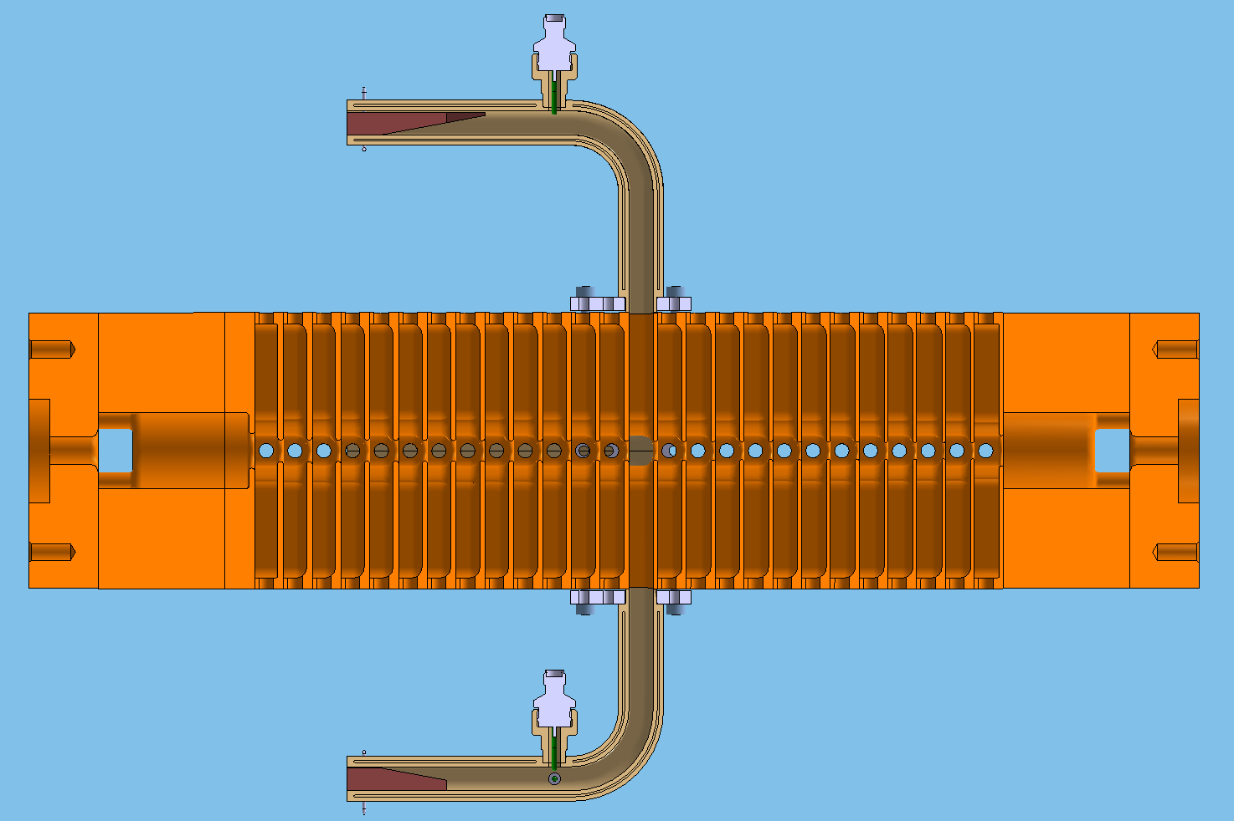
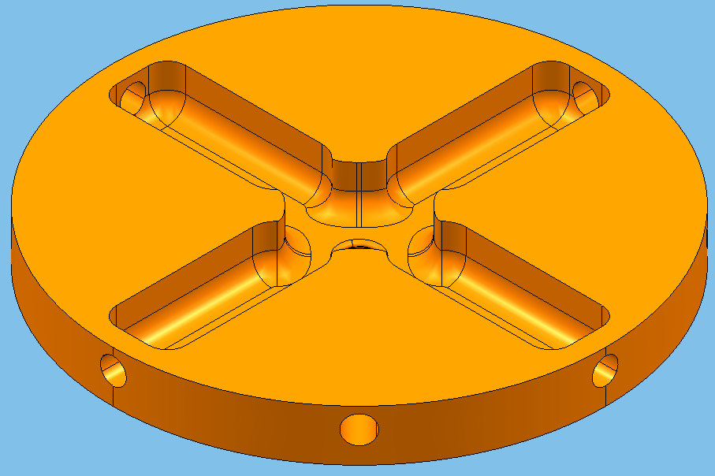
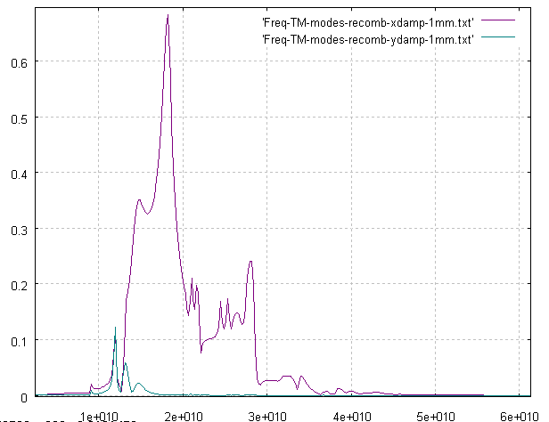
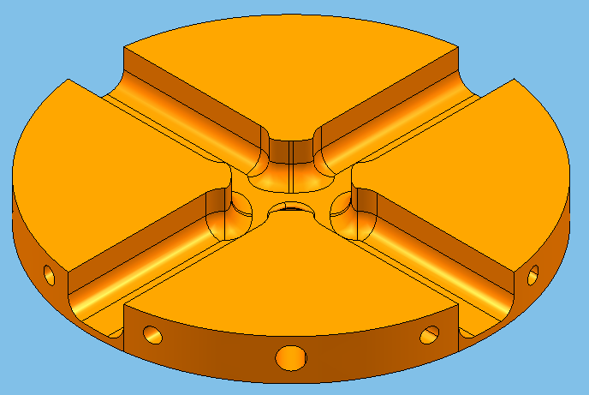
WakeField Monitor design
12GHz accelerating cavity
SIC Load
Long Waveguide
Cut-off at 12GHz
Regular cells with SIC load
Recombined port signal amplitude
Coaxial connector
18.19 GHz
Middle cell with WFM
14.81 GHz
11.95 GHz
F. Peauger
F (GHz)
T. Lefevre
“Beam Instrumentation for Linear Collider” - 2nd Ditanet School on Beam diagnostic - Stockholm– 2011

Slide 21
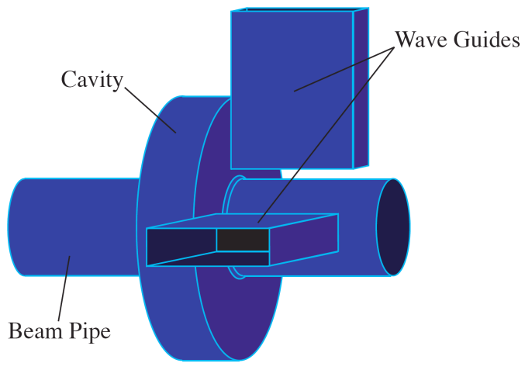
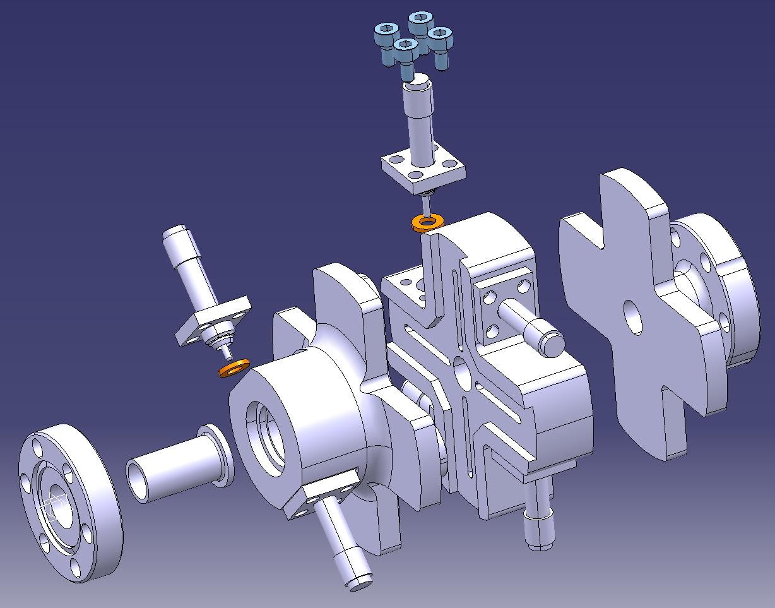
Conserving small Emittance along the Main Linac
  Dispersive emittance dilutions : offset of quadrupoles
    Beam based alignment to define a precise reference using high precision BPM (50nm resolution)
    Dispersion free-steering - Align quadrupoles precisely
    High resolution cavity BPM (50nm for CLIC)
    Long linac → large number of BPMs: 2000@ILC – 4000@CLIC
T. Lefevre
“Beam Instrumentation for Linear Collider” - 2nd Ditanet School on Beam diagnostic - Stockholm– 2011

Slide 22
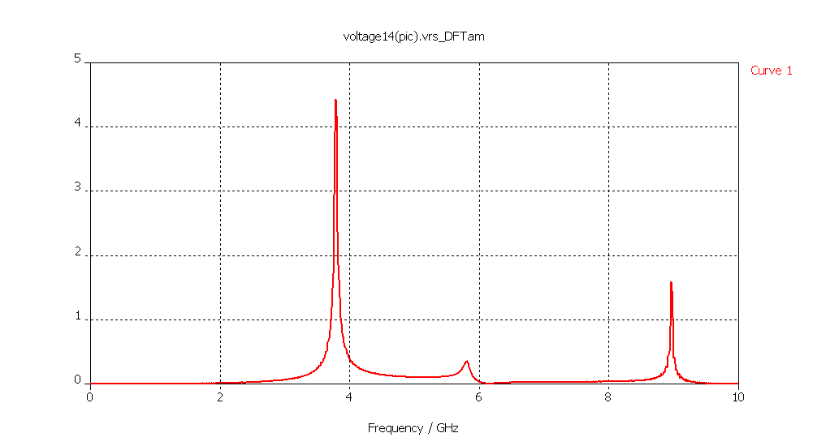
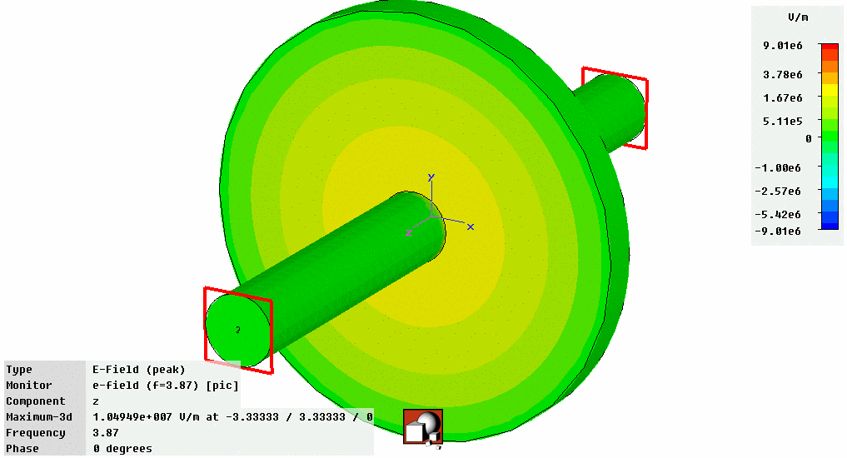
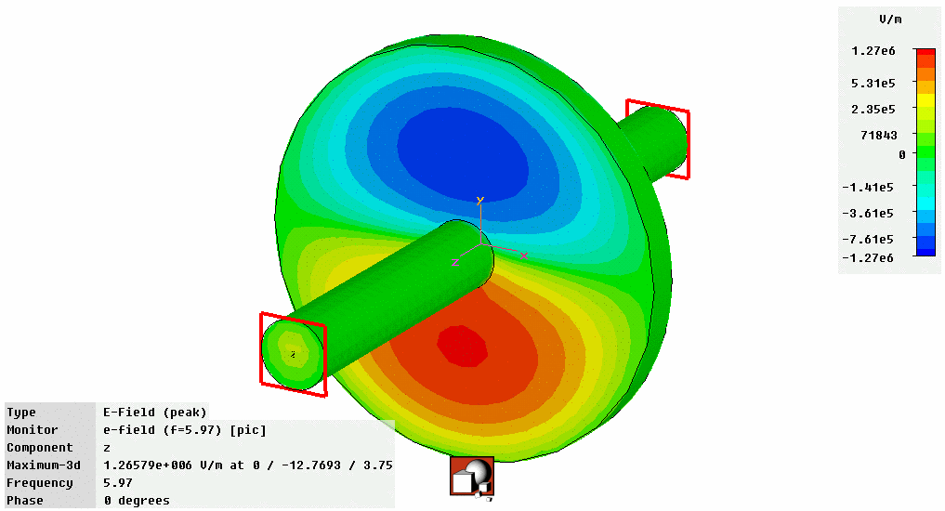
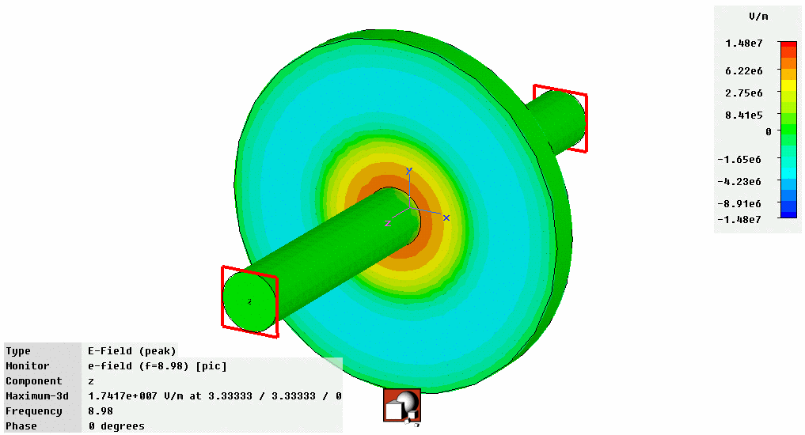
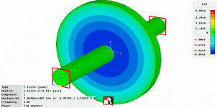
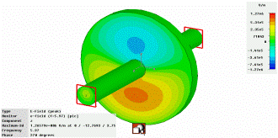
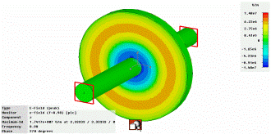
Improving the Precision for Next Generation Accelerators
Standard BPMs give intensity signals which need to be subtracted to obtain a difference which is then proportional to position
  Difficult to do electronically without some of the intensity information leaking through
    When looking for small differences this leakage can dominate the measurement
    Typically 40-80dB (100 to 10000 in V) rejection ⇒ tens micron resolution for typical apertures
Solution – cavity BPMs allowing sub micron resolution
  Design the detector to collect only the difference signal
    Dipole Mode TM₁₁ proportional to position & shifted in frequency with respect to monopole mode
Frequency Domain
TM₀₁
TM₀₁
U / V
TM₀₂
TM₀₂
TM₁₁
TM₁₁
f / GHz
Courtesy of D. Lipka,
DESY, Hamburg
U~Q
U~Qr
U~Q

Slide 23
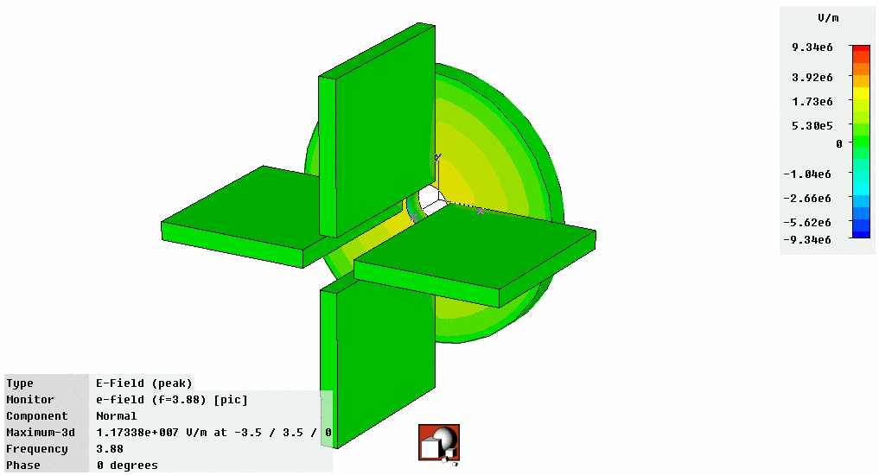
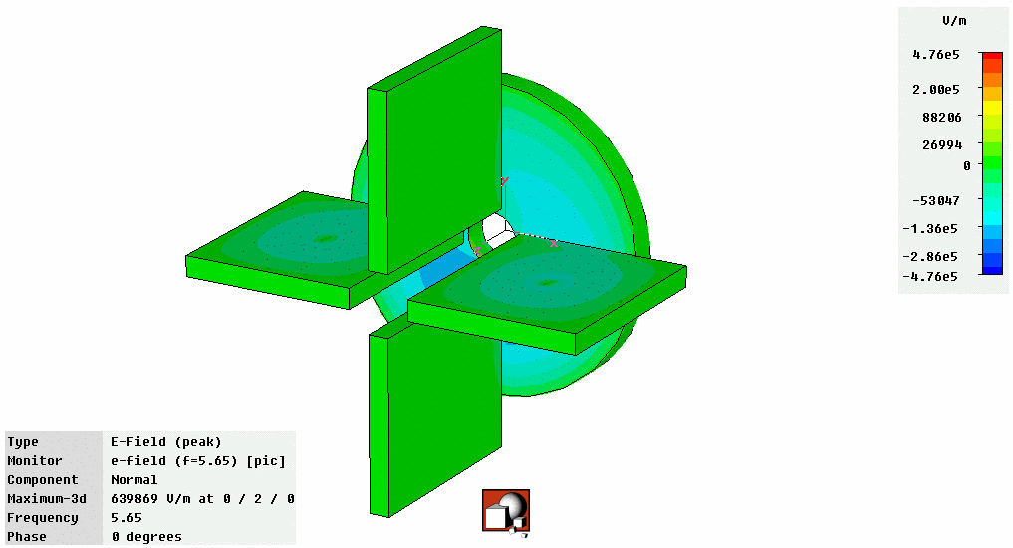
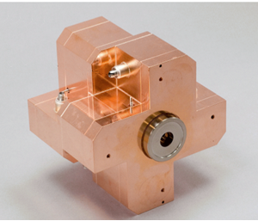
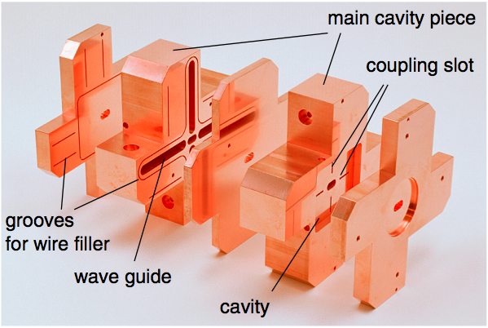
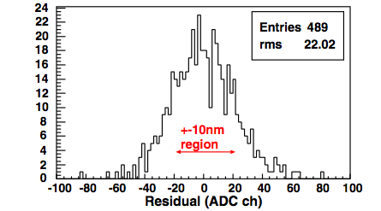
Today’s State of the Art BPMs
Obtain signal using waveguides that only couple to dipole mode
  Further suppression of monopole mode
Prototype BPM for ILC Final Focus
  Required resolution of 2nm (yes nano!) in a 6×12mm diameter beam pipe
  Achieved World Record (so far!) resolution of 8.7nm at ATF2 (KEK, Japan)
Monopole Mode
Dipole Mode
Courtesy of D. Lipka,
DESY, Hamburg
Courtesy of D. Lipka & Y. Honda

Slide 24
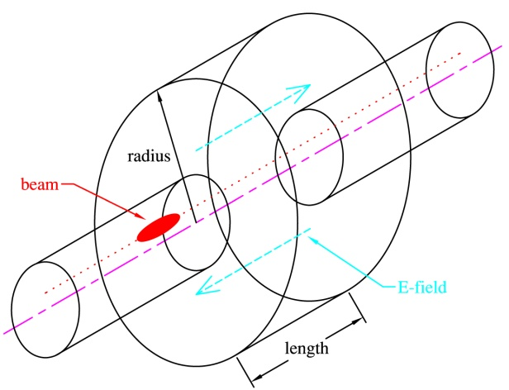
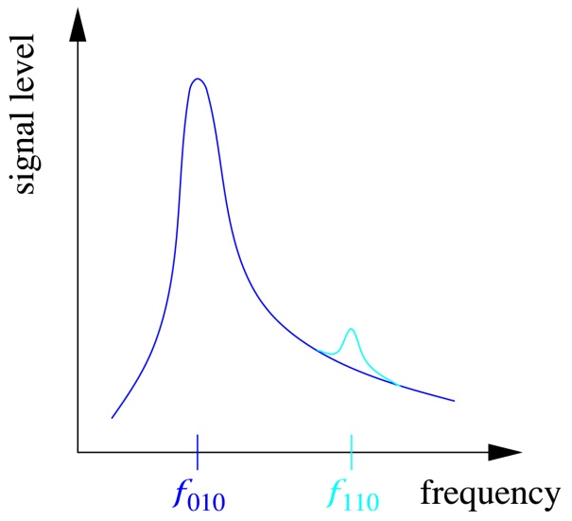

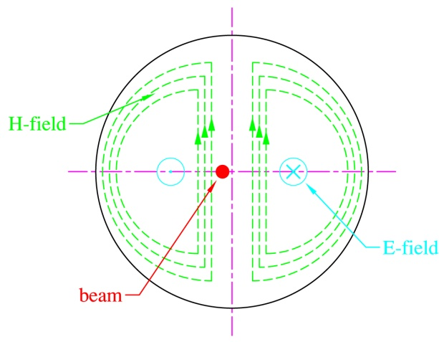
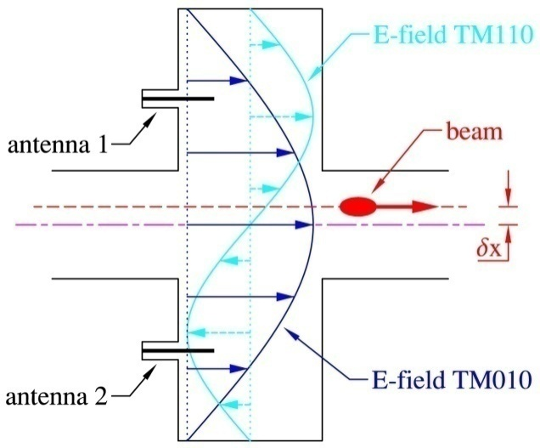
Cavity BPM
“Pillbox” cavity BPM
  Eigenmodes:
  Beam couples to
  dipole (TM₁₁₀) and monopole (TM₀₁₀) modes
  Common mode (TM₀₁₀) suppression by frequency discrimination
  Orthogonal dipole mode polarization (xy cross talk)
  Transient (single bunch) response (Q_{L})
  Normalization and phase reference
T. Lefevre
“Beam Instrumentation for Linear Collider” - 2nd Ditanet School on Beam diagnostic - Stockholm– 2011

Slide 25
Cavity BPM design steps
1
1
General idea:
- low Q-factors
- monopole modes decoupling
Cavity spectrum calculations:
- Frequency
- R/Q, Q
- TM11 output voltage
1
BPM parameters:
- Cavity length
- Waveguide dimensions
- Coupling slot
- Coaxial transition
1
3. Parasitic signals:
- monopole modes
- quadruple modes
4. Cross coupling:
- waveguide tuning
- 2 ports vs 4 ports
loop
loop
5. Tolerances calculation:
- coupling slots
  waveguide to cavity
- cavity to pipe
1

Slide 26
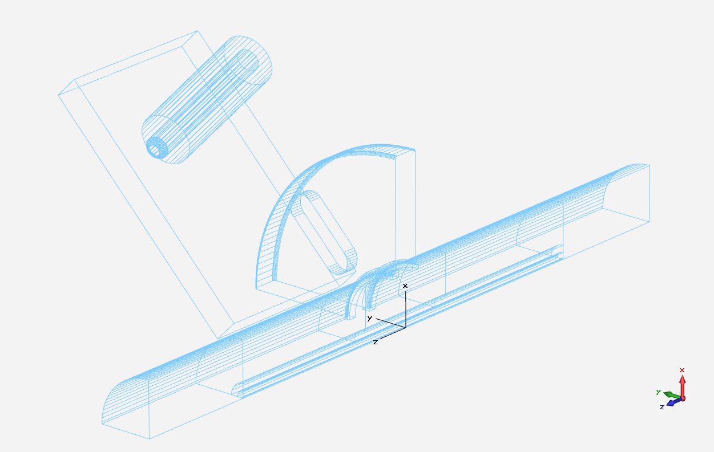
BPM Geometrical Dimensions
2
14
2
R12.05
R4
7
1
20
25

Slide 27
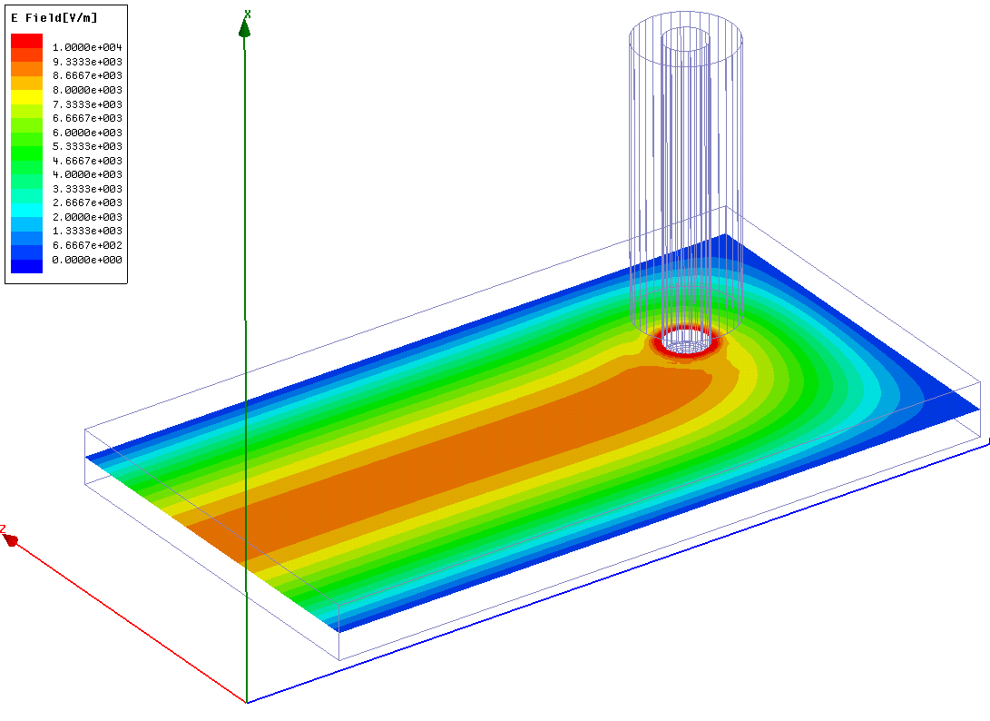
Waveguide to coaxial transition
5.05
5

Slide 28
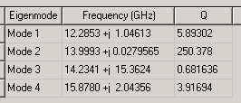
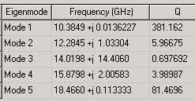
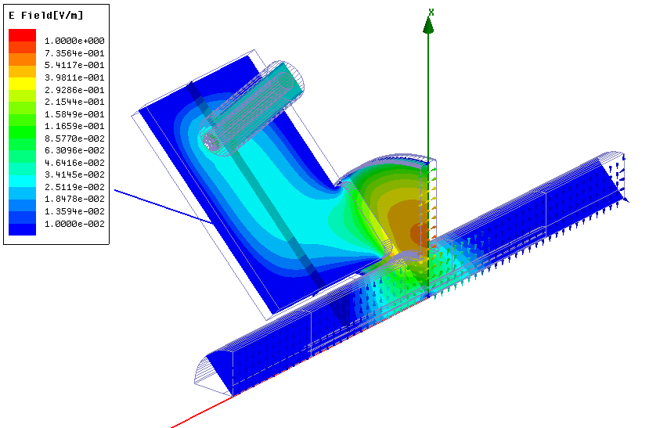
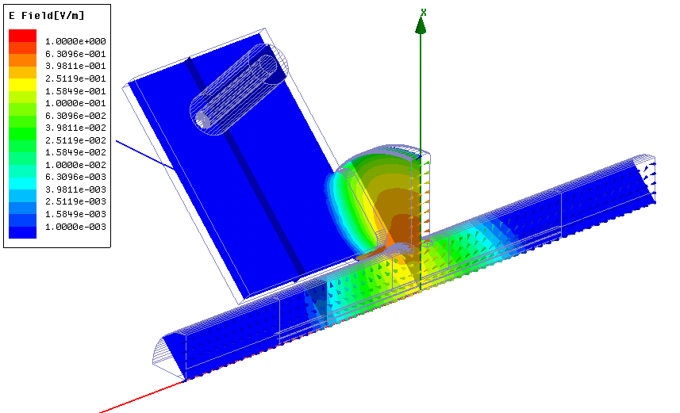

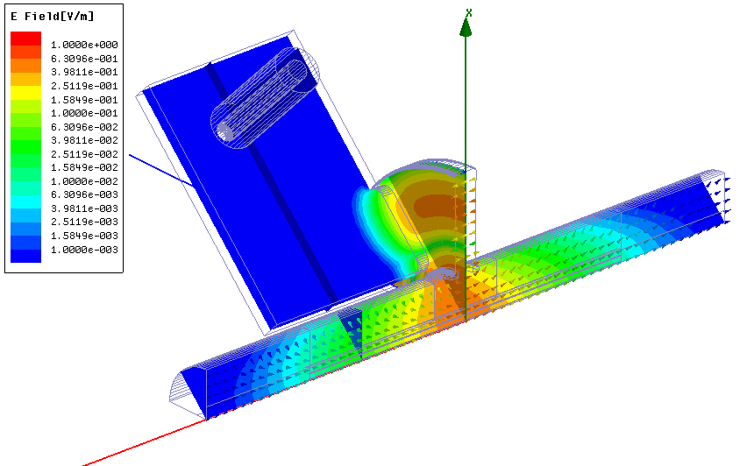
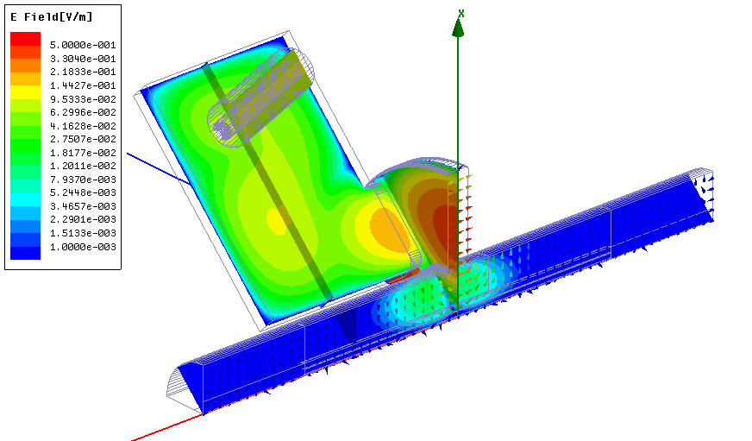
BPM Cavity Modes
Mode TM₁₁
Mode TM₀₁
Mode TM₀₂
Mode TM₂₁

Slide 29
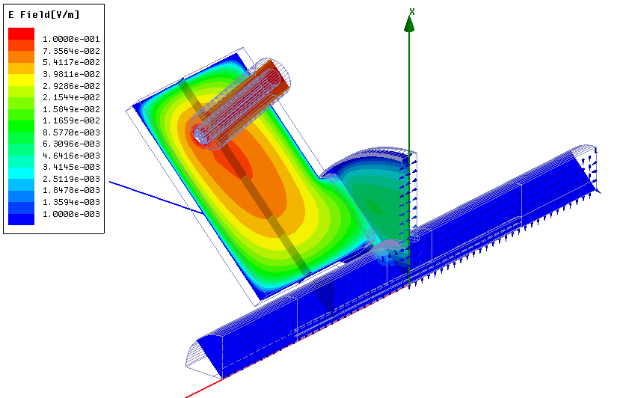



Waveguide Low-Q resonances
Mode WG_TM₁₁
Mode WG_TM₂₁

Slide 30
Multi-bunch Regime Rejection
Single Bunch Signals :
TM₀₁, TM₁₁, TM₂₁
Multi-bunch regime (2 GHz)
TM₁₁ signal
TM₀₁ signal
Rejection:
TM₂₁ signal
Rejection:
Time, [s]

Slide 31






Monopole Mode Coupling due to Mechanical Errors
Slot rotation causes the non zero projection of TM01 azimuth magnetic field component (Hφ) in the cavity to a longitudinal one (Hz) of TE10 mode in the waveguide. Small slot shift is equivalent to rotation with angle: α_{x} ~ arctan(Δx/Rslot). Therefore both slot rotation and shift cause strong magnetic coupling of monopole mode to waveguide.
Slot Rotation
Strong Magnetic Coupling
Slot Shift
∆α
H_{z}
~∆α_{x}
H_{z}
∆x
H_{φ}
H_{φ}
2. Slot tilt causes the non zero projection of TM₀₁ azimuth magnetic (H_{φ}) and longitudinal electric (E_{z}) filelds components in the cavity to a transverse (H_{x}) and vertical (E_{y}) components of TE₁₀ mode in the waveguide. Because both H_{x} and E_{y} are close to zero near the waveguide wall tilt error causes the weak electric and weak magnetic coupling of monopole mode to waveguide.
Slot Tilt
Weak Electric Coupling
Weak Magnetic Coupling
+
H_{x}
∆θ
E_{y}
E_{y}
H_{φ}

Slide 32

TM₀₁ Mode Leak (tolerances calculations)
c)
Slot Rotation
Slot Shift
∆x
∆α
a)
Waveguide Tilt
TM₀₁ normalized signals
∆θ

Slide 33
Now we treat in detail:
- Measurement of nm beam positions
- Measurement of um transverse beam sizes:
OTR, ODR, laser wire scanner (LWS)
- Measurement of fs-scale long profiles
- Beam synchronization at the fs-scale
- Keeping the beams in collision (IP feedback)

Slide 34

Measuring small beam size in a Linear Collider
Required high precision from the Damping ring to the Interaction Point (IP)
  Beam energy ranges from 2.4GeV → 1.5TeV
  Tens of km of beam lines – Big number of instruments
Flat Beams (ε_{x} >> ε_{y}) : Think of a flat noodle !
Small beam size
High beam charge
High Charge Densities
> 10¹⁰ nC/cm²
 | ILC | CLIC
Beam Charge (nC) | 7875 | 190
Hor. Emittance (nm) | 655 | 40
Ver. Emittance (nm) | 5.7 | 1
The thermal limit for ‘best’ material (C, Be, SiC) is 10⁶ nC/cm²
T. Lefevre
“Beam Instrumentation for Linear Collider” - 2nd Ditanet School on Beam diagnostic - Stockholm– 2011

Slide 35




‘Beam Profile Horror Picture Show’
Wire Scanner
Optical Transition Radiation
200μm thick mirror polished Si and CVD SiC wafer
Intercepting devices limited to single (or few) bunch mode
T. Lefevre
“Beam Instrumentation for Linear Collider” - 2nd Ditanet School on Beam diagnostic - Stockholm– 2011

Slide 36

High Resolution Imaging System using OTR
Diffraction effect would determine the resolution limit of the measurements
OTR screen
Charged
Particle
OTR angular distribution: Peak at 1/γ but large tails
  Problem for very high energy particles
Aperture of the focussing lens : θ >> 1/γ
Lens
Large tails
Camera
X. Artru et al, NIM AB 145 (1998) 160-168
C. Castellano and V.A. Verzilov, Physical Review STAB 1, (1998) 062801
T. Lefevre
“Beam Instrumentation for Linear Collider” - 2nd Ditanet School on Beam diagnostic - Stockholm– 2011

Slide 37
High Resolution Imaging System using OTR
  Depth of field limits the resolution because the image source is not normal to the optical axis
Charged
Particle
OTR screen
σ_{y}
Df
Classical OTR configuration :
90º observation angle
Camera
Make Df > σ_{y}
T. Lefevre
“Beam Instrumentation for Linear Collider” - 2nd Ditanet School on Beam diagnostic - Stockholm– 2011

Slide 38

High Resolution Imaging System using OTR
Imaging small beam size → large magnification → short Depth of field (Df)
OTR screen
σ_{y}
Df
Camera
Smaller Df → Tilt the screen
T. Lefevre
“Beam Instrumentation for Linear Collider” - 2nd Ditanet School on Beam diagnostic - Stockholm– 2011

Slide 39

Beam size monitoring with Diffraction Radiation
Non destructive alternative for beam size measurement (not imaging anymore)
Two slits DR target
Charged
Particle
Measuring the angular distribution of the interference pattern between the DR emitted by the two slits
h impact parameter
Radiation wavelength
Beam energy
Camera
After the Damping ring the beam has few GeV and ODR is generated for reasonable values of h
T. Lefevre
“Beam Instrumentation for Linear Collider” - 2nd Ditanet School on Beam diagnostic - Stockholm– 2011

Slide 40
Approach for the beam size measurements
Assume a Gaussian beam profile
σ_{y} is the electron beam size and
is its offset with respect to the slit center

Slide 41
Beam size effect
Projected vertical polarization component
Δθ_{x}
Δθ_{x} – x detector angular acceptance
Projection
γ = 2500
σ_{y}=0
σ_{y}=30μm
Intensity (arb. units)

Slide 42
δ = 1/γ = 0.4mrad
Δl = 0
Δl = λ/10
Δl = λ/4
a_{x} = 0
a_{x}=0.05mm
a_{x} = 0.1mm

Slide 43
Target configuration
A silicon wafer covered with a thin gold foil

Slide 44

Target configuration
E. Chiadroni, et al., NIM B 266 (2008) 3789
E. Chiadroni, et al., DIPAC’09

Slide 45
Method for the beam size determination
max
min

Slide 46
Beam size monitoring with Diffraction Radiation
Investigation on the low emittance beam at ATF, KEK, Japan
E=1.28GeV ; λ=445nm ; h=70μm
Beam size measured by ODR (μm)
Beam size measured with Wire Scanner (μm)
P. Karataev et al., Physical Review Letters 93 (2004) 244802
P. Karataev et al, Physical Letters A345 (2005) 428
T. Lefevre
“Beam Instrumentation for Linear Collider” - 2nd Ditanet School on Beam diagnostic - Stockholm– 2011

Slide 47

Project aim : Exp. Validation of ODR transverse profile measurements in a circular machine (CESR-Ta, Cornell)
To design and test an instrument to measure on the micron-scale the transverse (vertical) beam size for the Compact Linear Collider (CLIC) using incoherent Diffraction Radiation (DR) at UV/soft X-ray wavelengths.
DR
vBSM
Cornell Electron Storage Ring Test Accelerator (CesrTA) beam parameters:
 | E (GeV) | σ_{H} (µm) | σ_{V} (µm)
CesrTA | 2.1 | 320 | ∼9.2
 | 5.3 | 2500 | ∼65
D. Rubin et al., “CesrTA Layout and Optics”, Proc. of PAC2009, Vancouver, Canada, WE6PFP103, p. 2751.
xBSM
http://www.cs.cornell.edu

Slide 48
Project phases
Phase 1: (2013)
UV - Optical wavelengths
Measurement of beam size σ_{y} ≤ 50 µm
Observation of beam lifetime
Phase 2: (2014-2016)
Relocate experiment to beam waist in L3 straight section of CesrTA
Soft x-rays
Measurement of beam size σ_{y} ≤ 10 µm

Slide 49

Vacuum chamber assembly
LHS : CHESS operation
RHS: DR experiment
Optical system connected to DR viewport
Gate valve to disconnect CESR vacuum for target changeover
Target mechanism: rotation + translation IN/OUT
LHS = Left Hand Side
RHS = Right Hand Side

Slide 50



f
Optical System
1. Mirror
Gated ICCD camera
6. UV Camera
$\frac{γ^{2}λ}{2π}$ given γ and λ:
2. Bi-convex lens to reduce prewave zone effect
OR
achromatic lens to image target
3. Bandpass filter
4. Polarizer
 | 2.1 GeV | 5 GeV
200 nm | 0.54 m | 3.18 m
400 nm | 1.08 m | 6.37 m
Far-field Condition: $L≫\frac{γ^{2}λ}{2π}$
DR from viewport
L = distance from source of DR to detector
Compact optical system is in the prewave zone therefore a biconvex lens is used with detector in back focal plane to obtain the angular distribution.
(Pre-wave zone effect in transition and diffraction radiation: Problems and Solutions -P. V. Karataev).

Slide 51



Molecular adhesion target
Molecular adhesion target (2mm version shown here). 1mm aperture version was used at CesrTA.
“Bonding by molecular adhesion (either ‘direct wafer bonding’ or ‘fusion bonding’) is a technique that enables two substrates having perfectly flat surfaces (e.g., polished mirror surfaces) to adhere to one another, without the application of adhesive (gum type, glue, etc.).”
Patent US 8158013 B2
Coplanarity measurement:
Metrology by Winlight Optics

Slide 52




Identification of DR in target imaging
DR intensity decays exponentially from slit edge
SR intensity uniform over small regions
From simulations, max SR intensity (vert. pol.) does not occur at slit edge
DR intensity [ph/e⁻]= k * SR intensity [ph/e⁻]
$$k\sim 50 \text{using} \text{real} \text{data} \text{from} \text{TR}$$
$$k\sim 25 \text{using} \text{DR} \text{images}$$
DR vert. pol. $\sim 4.0×{10}^{−5}$ ph/e⁻
SR. vert. pol. $\sim 6.3×{10}^{−7}$ ph/e⁻
Left peak
T. Aumeyr et al., IBIC2013, WEPF18.

Slide 53


DR target imaging
2.1 GeV
1 mA single- bunch beam
400 nm DR observation wavelength
Theory-
D. Xiang et al., Phys. Rev. ST Accel. Beams, 10 (2007) 062801.
Zemax-
T. Aumeyr et al., IBIC2013, WEPF18.
Data broadening possibly due to:
data taken for $σ_{y}\sim 20 \text{μ}\text{m}$
theoretical model and Zemax : single e⁻ ${ σ}_{y}→0$
Polariser misalignment → some horiz. pol. DR and synchrotron radiation (SR)
10 ± 2 nm bandwidth → data smearing (small)
15 ms exposure time (CesrTA rev. period $T=2.56 \text{μ}\text{s}$) → smearing from beam jitter

Slide 54



Mask
Silicon Carbide
Laser machining
Not etched (orientated perpendicular to beam)
Mask aperture = 4 * target aperture
→ avoid destructive interference (ODRI)
Technical drawings by N. Chritin,
Metrology by L. Remandet
Specification | Location 1 (in µm or in µrad) | Location 2 (in µm or in µrad)
Maximum to minimum | ≈ 10 µm | ≈ 80 µm
Tilt in X direction | 0 µrad | -1897 µrad
Tilt in Y direction | 0 µrad | -13913 µrad
2 mm
4 mm
LOCATION 2
mask
Y
target
LOCATION 1
X

Slide 55




SRW simulations
Total intensity at 400nm, 10%bw
= 2.30315e+10 ph/s
Horiz. pol.
Total intensity at 400nm, 10%bw
= 4.31643e+09 ph/s
Vert. pol.
A. Jeff

Slide 56
Beam size monitoring with Laser Wire Scanner
Baseline solution for linear collider: high spatial resolution would rely on Laser Wire Scanner
High power laser
Thomson/Compton scattering
hν₀
hν_{sc}=2 γ₀² hν₀
Scanning
system
Ψ=π/2
θ ≈ 1/γ₀
(β₀ ,γ₀)
e⁻
(β_{sc}, γ_{sc})
e⁻ beam
T. Lefevre
“Beam Instrumentation for Linear Collider” - 2nd Ditanet School on Beam diagnostic - Stockholm– 2011

Slide 57
Beam size monitoring with Laser Wire Scanner
Laser Beam
λ₀ : Laser wavelength
ω₀ : Laser waist size
Z_{R} : Rayleigh range
Electrons Beam
σ_{y} : ver. beam size
σ_{x} : hor. beam size
ω₀
ω₀
y
2ω₀
x
Z_{R}
The number of X-rays produced is given by
with A the interaction area, N_{e} and N_{laser} are the number of electrons and photons in A
T. Lefevre
“Beam Instrumentation for Linear Collider” - 2nd Ditanet School on Beam diagnostic - Stockholm– 2011

Slide 58
Beam size monitoring with Laser Wire Scanner
High spatial resolution need very focused laser beam: Need a optimum Focusing system
Lens defined by a focal length f, and diameter D :
Performance of Laser : M²=1 for pure Gaussian distribution
Diffraction
Smaller F# is better
Spherical aberration
For the single lens,
small F# makes spherical aberration large.
Minimize spherical aberration using several lenses
T. Lefevre
“Beam Instrumentation for Linear Collider” - 2nd Ditanet School on Beam diagnostic - Stockholm– 2011

Slide 59

Beam size monitoring with Laser Wire Scanner
Design for ATF2 LWS by G. Blair et al
T. Lefevre
“Beam Instrumentation for Linear Collider” - 2nd Ditanet School on Beam diagnostic - Stockholm– 2011

Slide 60

Beam size monitoring with Laser Wire Scanner
Design for ATF2 LWS by G. Blair et al
GO to smaller wavelength to do better (green → UV)
T. Lefevre
“Beam Instrumentation for Linear Collider” - 2nd Ditanet School on Beam diagnostic - Stockholm– 2011

Slide 61

Beam size monitoring with Laser Wire Scanner
At high energy, the Compton cross section gets smaller
σ₀ = 6.65 10⁻²⁴ cm²
The number of interaction produced is given by
Increase the Laser Power (10MW and more)
T. Lefevre
“Beam Instrumentation for Linear Collider” - 2nd Ditanet School on Beam diagnostic - Stockholm– 2011

Slide 62

Beam size monitoring with Laser Wire Scanner
At high energy (>10GeV) the detection system can be easily done either using the scattered photons or the scattered electrons
T. Lefevre
“Beam Instrumentation for Linear Collider” - 2nd Ditanet School on Beam diagnostic - Stockholm– 2011

Slide 63
Now we treat in detail:
- Measurement of nm beam positions
- Measurement of um transverse beam sizes
- Measurement of fs-scale long profiles
- Beam synchronization at the fs-scale
- Keeping the beams in collision (IP feedback)
 | ILC | CLIC linac | XFEL | LCLS
Beam Energy (GeV) | 250 | 1500 | 20 | 15
Linac RF Frequency (GHz) | 1.3 | 12 | 1.3 | 2.856
Bunch charge (nC) | 3 | 0.6 | 1 | 1
Bunch Length (fs) | 700 | 150 | 80 | 73

Slide 64
Short bunch length measurements
Radiative techniques
Optical Method
Bunch Frequency Spectrum
Produce visible light
Analyse the light pulse using dedicated instruments
The shorter the bunches, the broader the bunch frequency spectrum
RF manipulation
Laser-based beam diagnostic
Use RF techniques to convert time information into spatial information
Using short laser pulses and sampling techniques
T. Lefevre
CAS intermediate level - Trondheim– 2013

Slide 65
Beam instrumentation
1- Longitudinal Profile ← → RMS or FWHM values
    More precise information on the beam characteristic
2- Single shot measurements ← → Sampling measurements
    Do not care about the beam reproducibility
    No additional problem due to timing jitter
3- Non interceptive ← → Destructive Devices
    Can be used for beam study and beam control for on-line monitoring
    Beam Power : No risk of damage by the beam itself
σ
1
n!
T. Lefevre
CAS intermediate level - Trondheim– 2013
Notes:
Beam power

Slide 66

Beam instrumentation
Can we do non intercepting, single shot, beam profile measurement in an easy way ?
1
+
+
=
All in red → ‘perfect system’
T. Lefevre
CAS intermediate level - Trondheim– 2013
Notes:
Easy and cost effective

Slide 67
Radiative techniques
‘Convert particles into photons’
T. Lefevre
CAS intermediate level - Chios– 2011

Slide 68
Coherent / Incoherent Radiation
At wavelength much shorter than the bunch length, the radiation is emitted incoherently because each electron emits its radiation independently from the others without a defined phase relation
A coherent enhancement occurs at wavelengths which are equal to or longer than the bunch length, where fixed phase relations are existing, resulting in the temporal coherence of the radiation
T. Lefevre
CAS intermediate level - Trondheim– 2013

Slide 69
Radiation Spectrum
Incoherent term
Coherent term
S(ω) – radiation spectrum
S_{p}(ω) – single particle spectrum
N – number of electrons in a bunch
F(ω) – longitudinal bunch form factor
ρ (s)– Longitudinal particle distribution in a bunch
T. Lefevre
CAS intermediate level - Trondheim– 2013

Slide 70

Optical Synchrotron Radiation
SR appears when a charged particle is bent in a magnetic field
γ charged particle Lorentz-factor
ρ is the bending radius
Critical frequency :
Beam energy
Beam curvature
Limitations :
Use a lot on electrons (for visible light: E > 100 MeV)
Limited to very high energy proton or heavy ion beams
T. Lefevre
CAS intermediate level - Trondheim– 2013

Slide 71
Cherenkov radiation
‘Equivalent to the supersonic boom but for photons’
Threshold process: Particles go faster than light β > 1/n
Cherenkov photon
n is the index of refraction (n>1)
β is the relative particle velocity
θ_{c} is the Cherenkov light emission angle
d the length of the cherenkov radiator
Charged
Particle
n
d
The total number of photons proportional to the thickness of the Cherenkov radiator
Limitations :
Using transparent material (Glass n=1.46) : thermal and radiation hardenss issues
Time resolution limited by the length of the radiator
T. Lefevre
CAS intermediate level - Chios– 2011

Slide 72
Optical Transition Radiation
‘TR is generated when a charged particle passes through the interface between two materials with different permittivity (screen in vacuum)’
Number of OTR photons per charge particle
~ 5 10⁻³ in [400-600]nm
Radiation wavelength
Beam energy
Using good reflecting material
The thermal limit for ‘best’ screens (C, Be, SiC) is ~ 1 10⁶ nC/cm²
M. Castellano and V. Verzilov, Phys. Rev. ST-AB 1, 062801 (1998
T. Lefevre
CAS intermediate level - Trondheim– 2013

Slide 73
Optical Diffraction Radiation
‘DR is generated when a charged particle passes through an aperture or near an edge of dielectric materials, if the distance to the target h (impact parameter) satisfies the condition :
Beam energy
Radiation wavelength
Limitations :
Not enough photons in the visible for low energy particles : E < 1 GeV for a decent impact parameter (100μm)
T. Muto et al, Physical Review Letters 90 (2003) 104801
T. Lefevre
CAS intermediate level - Trondheim– 2013

Slide 74
Optical method with Incoherent radiation
‘Convert particles into visible photons’
T. Lefevre
CAS intermediate level - Trondheim– 2013

Slide 75


Time Correlated Single Photon Counting
n!
Geiger-mode Avalanche photodiode converts photon to electrical pulse
Visible photon
Time to Digital converter records pulse arrival time
Precise trigger synchronized with the beam
Sampling Method allowing very high dynamic range if you measure long enough
Avalanche photodiode have deadtime and are subject to afterpulsing
State of the art TDC typically limited to 10ps sampling
D.V. O’Connor, D. Phillips, Time-correlated Single Photon Counting, Academic Press, London, 1984
C.A. Thomas et al., Nucl. Instr. and Meth. A566 (2006) p.762
T. Lefevre
CAS intermediate level - Trondheim– 2013

Slide 76


Time Correlated Single Photon Counting
Longitudinal profile of the entire LHC ring (89us) with 50ps resolution using SR light
A. Jeff
A very large dynamic range should make it possible to see ghost bunches as small as 5e5 protons / 50ps with long integration
T. Lefevre
CAS intermediate level - Trondheim– 2013

Slide 77


Streak Camera
1
‘Streak cameras uses a time dependent deflecting electric field to convert time information in spatial information on a CCD’
Mitsuru Uesaka et al, NIMA 406 (1998) 371
200fs time resolution obtained using reflective optics and 12.5nm bandwidth optical filter (800nm) and the Hamamatsu FESCA 200
  Limitations : Time resolution of the streak camera :
  (i) Initial velocity distribution of photoelectrons : narrow bandwidth optical filter
  (ii) Spatial spread of the slit image: small slit width
  (iii) Dispersion in the optics
T. Lefevre
CAS intermediate level - Trondheim– 2013

Slide 78






Streak camera examples
Observation of 5MeV electron bunch train using cherenkov
Sweep speed of 250ps/mm
Measure of bunch length using OTR and OSR
Sweep speed of 10ps/mm
σ = 4.5ps (1.4 mm)
σ = 8.9ps (2.7 mm)
T. Lefevre
CAS intermediate level - Trondheim– 2013

Slide 79
Bunch Length measurement with Coherent Radiation
‘The shorter in time, The broader in frequency’
T. Lefevre
CAS intermediate level - Trondheim– 2013

Slide 80
Bunch Form Factor for Gaussian distribution
Assume N = 10¹⁰ e/bunch
Coherent radiation appears when the bunch length is comparable to or shorter than the emitted radiation wavelength
T. Lefevre
CAS intermediate level - Trondheim– 2013

Slide 81
Measuring Radiation Spectrum
S(ω) – radiation spectrum ((known in the experiment)
N – number of electrons on the bunch (known from the experiment)
F(ω) – bunch form factor (what you want to find out)
S_{p}(ω) – single particle spectrum (should be known)
Coherent Transition Radiation (CTR)
P. Kung et al, Physical review Letters 73 (1994) 96
Coherent Diffraction (CDR) or Coherent Synchrotron (CSR)
B. Feng et al, NIM A 475 (2001) 492–497 ; A.H. Lumpkin et al, NIM A 475 (2001) 470–475 ; C. Castellano et al, Physical Review E 63 (2001) 056501
T. Watanabe et al, NIM A 437 (1999) 1-11 & NIM A 480 (2002) 315–327
T. Lefevre
CAS intermediate level - Trondheim– 2013

Slide 82


Bunch Frequency Spectrum by Coherent Radiation
1
‘The polychromator enables to get the spectrum directly by a single shot. The radiation is deflected by a grating and resolved by a multi-channels detector array’
T. Wanatabe et al., NIM-A 480 (2002) 315-327
H. Delsim-Hashemiet al., Proc. FLS, Hamburg 2006, WG512
B. Schmidt, DESY
T. Lefevre
CAS intermediate level - Trondheim– 2013

Slide 83
Bunch Frequency Spectrum by Coherent Radiation
Frequency Domain
Extrapolation
(high and low frequencies)
Correction
(transfer function of detection system)
Spectral Intensity
A(ω)
Long Form Factor
|F(ω)|
Inverse Fourier Transform for symmetric bunch distribution
Long. Bunch profile S(z)
Kramers-Kronig relation
for non symmetric bunches
Time Domain
R. Lai and A.J. Sievers, NIM-A 397 (1997) 221 -231
T. Lefevre
CAS intermediate level - Trondheim– 2013

Slide 84
RF techniques
‘How to transform time information into spatial information’
T. Lefevre
CAS intermediate level - Trondheim– 2013

Slide 85

Bunch Shape Monitor - Feschenko monitor
ΔT
ΔX
1 - Target (wire, screen, laser for H⁻ ) : Source of secondary electrons
2 - Input collimator
3 - RF deflector (100MHz, 10kV) combined with electrostatic lens
4 - Electron Beam detector (electron multiplier, ..)
1
T. Lefevre
CAS intermediate level - Trondheim– 2013

Slide 86

Bunch Shape monitor - Feschenko monitor
Longitudinal Bunch profile @ SNS
A. Feschenko et al, Proceedings of LINAC 2004, Lübeck, p408
T. Lefevre
CAS intermediate level - Trondheim– 2013

Slide 87

RF Deflecting Cavity
1
eV
Old idea from the 60’s
RF Deflector ~ relativistic streak tube
eV₀
z
⟨
Δ
⟩
⟨
Δ
y
⟩
y
σ
ϕ < 0
σ
y
y
−
e
−
e
σ
σ
z
β_{c}
β_{p}
z
Δ
ψ
≈
Δ
ψ
≈
6
0
°
6
0
°
Beam profile RF off
Deflecting Voltage
Beam profile RF on
Betatron phase advance
(cavity-profile monitor)
sinΔψ = 1, β_{p} small
Make β_{c} large
Bunch length
RF deflector
wavelength
Beta function at cavity
and profile monitor
Beam energy
P. Emma et al, LCLS note LCLS-TN-00-12, (2000)
T. Lefevre
CAS intermediate level - Trondheim– 2013

Slide 88


RF Deflecting Cavity
CTF3
LOLA @ Flash
Courtesy: M. Nagl
T. Lefevre
CAS intermediate level - Trondheim– 2013

Slide 89

RF Deflecting Cavity
Calibration of RF Deflector
ΔX(mm)
Δϕ(°)
ΔT(ps)
Beam Position (mm)
Monitor the Beam Position on (or close to) the Profile monitor to calibrate the deflection angle
RF Phase (º)
RF deflector phase
Beam offset on the screen
T. Lefevre
CAS intermediate level - Trondheim– 2013

Slide 90

RF by Deflecting Cavity
σ_{z}=2ps
T. Lefevre
CAS intermediate level - Trondheim– 2013

Slide 91

RF by Deflecting Cavity
Bunch length measurement @ Flash
LOLA off:
LOLA on:
→ Resolution of 4fs/pixels
M. Hüning et al, Proceeding of the27th FEL conference, Stanford, 2005, pp538
T. Lefevre
CAS intermediate level - Trondheim– 2013

Slide 92

RF accelerating structures
‘The electron energy is modulated by the zero-phasing RF accelerating field and the bunch distribution is deduced from the energy dispersion measured downstream using a spectrometer line’
1
ΔT
ΔE
ΔX
T. Lefevre
CAS intermediate level - Trondheim– 2013
Notes:
Moved to last position

Slide 93

RF accelerating structures
CEBAF injector, Newport News
1st SRF module
45MeV spectrometer dipole
Beam profile monitor
D. X. Wang et al, Physical Review E57 (1998) 2283
2nd SRF module
used for zero-phasing
84fs, 45MeV beam but low charge beam
RF off
RF on
Limitations
RF non linearities
Beam loading and wakefield for high charge beam
T. Lefevre
CAS intermediate level - Chios– 2011
Notes:
fautes

Slide 94
Laser based techniques
T. Lefevre
CAS intermediate level - Trondheim– 2013

Slide 95

Sampling Techniques
Using a short laser pulse to scan through the beam profile
Longitudinal
Beam profile
Sampling
Principle
Limitation
Laser-beam synchronization jitter (50fs)
T. Lefevre
CAS intermediate level - Trondheim– 2013

Slide 96
Laser Wire Scanner : Photo-neutralization
High power laser
Photo-neutralization
Scanning
system
hν₀
e⁻
(β, γ)
Ψ=π/2
H⁻
H
H⁻ beam
First ionization potential for H⁻ ions is 0.75eV
Photo-neutralization cross section : σ ~ 4.10⁻¹⁷ cm²
Detection system based on
The measurement of released electrons using a magnet and a collector (faraday cup, MCP,..)
Measured the conversion of H⁻ into H with a current monitor
n!
T. Lefevre
CAS intermediate level - Trondheim– 2013

Slide 97

Laser Wire Scanner : Photo-neutralization
Mode Locked Laser Longitudinal Measurements @ SNS
2.5 MeV H⁻, 402.5 MHz bunching freq, Ti-Sapphire laser phase-locked @ 1/5th bunching frequency
Collected electron signal plotted vs. phase
Measured and predicted bunch length
vs. cavity phase setting
S. Assadi et al, Proceedings of EPAC 2006, Edinburgh, pp 3161
T. Lefevre
CAS intermediate level - Trondheim– 2013

Slide 98
Laser Wire Scanner – Compton scattering
High power laser
Thomson/Compton scattering
hν₀
hν_{sc}=2 γ₀² hν₀
Scanning
system
Ψ=π/2
θ ≈ 1/γ₀
(β₀ ,γ₀)
e⁻
(β_{sc}, γ_{sc})
e⁻ beam
Detection system based on
The measurement of the scattered photons
The measurement of degraded electrons
σ₀ = 6.65 10⁻²⁴ cm²
n!
T. Lefevre
CAS intermediate level - Trondheim– 2013

Slide 99


Laser Wire Scanner – Compton scattering
ALS @ LBNL
Using a 10TW Ti:Al₂O₃ laser system. Detecting 5.10⁴ 10-40 keV X-rays using either an X-ray CCD and Ge detector.
W.P. Leemans et al, PRL 77 (1996) 4182
T. Lefevre
CAS intermediate level - Chios– 2011
Notes:
W.P.

Slide 100


Non linear mixing
‘Non linear mixing uses beam induced radiation, which is mixed with a short laser pulse in a doubling non linear crystal (BBO,..). The resulting up frequency converted photons are then isolated and measured’
M. Zolotorev et al, Proceeding of the PAC 2003, pp.2530
n!
15-30ps electron bunches (ALS, LBNL) scanned by a 50fs Ti:Al₂O₃ laser
T. Lefevre
CAS intermediate level - Trondheim– 2013

Slide 101

Electro Optic Sampling
‘This method is based on the polarization change of a laser beam which passes through a crystal itself polarized by the electrons electric field’
E-field induced birefringence in EO-crystal : Pockels effect
probing laser pulse
EO crystal
Coulomb field
e beam
Relative phase shift between polarizations
increases with the beam electric field
n!
T. Lefevre
CAS intermediate level - Trondheim– 2013
Notes:
Index of refraction

Slide 102


Electro Optic Sampling
EOS @ FELIX
Delay line
Using 12fs Ti:Al2O3 laser at 800nm and ZnTe crystal 0.5mm thick and a beam of 46MeV, 200pC, 2ps.
X. Yan et al, PRL 85, 3404 (2000)
T. Lefevre
CAS intermediate level - Trondheim– 2013
Notes:
Suppress the wollaston prism

Slide 103

Electro Optic based bunch length monitors
1. Sampling:
multi-shot method
arbitrary time window possible
2. Chirp laser method, spectral encoding
laser bandwidth limited~ 250fs
Wilke et.al., PRL 88 (2002) 124801
3. Spatial encoding:
imaging limitation ~ 30-50 fs
Cavalieri et. al, PRL 94 (2005) 114801
Jamison et. al, Opt. Lett. 28 (2003) 1710
Van Tilborg et. al, Opt. Lett. 32 (2007) 313
1
4. Temporal decoding:
laser pulse length limited ~ 30fs
Berden et.al, PRL 93 (2004) 114802
T. Lefevre
CAS intermediate level - Trondheim– 2013

Slide 104








Electro Optic Temporal decoding
Courtesy: S. Jamison et al.
T. Lefevre
CAS intermediate level - Trondheim– 2013

Slide 105


Encoding Time resolution
Bandwidth limitation
ringing artefacts
  Thin crystal (>10μm)
  Consider new materials GaSe, DAST, MBANP ..... or poled organic polymers?
W.A. Gillespie & S. Jamison
T. Lefevre
“Beam Instrumentation for Linear Collider” - 2nd Ditanet School on Beam diagnostic - Stockholm– 2011

Slide 106


Encoding Time resolution
Spectral limitations of the Crystal
GaP
ZnTe
Phonon resonances
W.A. Gillespie & S. Jamison
T. Lefevre
“Beam Instrumentation for Linear Collider” - 2nd Ditanet School on Beam diagnostic - Stockholm– 2011

Slide 107
Summary
Optical radiation
  Cherenkov / OTR radiation X
  ODR / OSR Radiation X
  Streak camera X 200fs
Coherent radiation : Bunch spectrum
  Interferometry X X
  Polychromator X X
RF techniques
  ‘Feschenko’ monitor X X X Hadron, 20ps
  RF Deflector X X X 10fs
  Zero phasing techniques X X X 10fs
Laser based Method
  Sampling X Jitter (50fs)
    Non linear mixing X
    Thomson/Compton scattering X X Electron
    Photo-neutralization X X H⁻
    Electro-Optic Sampling X X
  E-O Spectral decoding X X X ~ 200fs
  E-O Spatial decoding X X X ~ 50fs
  E-O Temporal decoding X X X ~ 50fs
σ
1
n!
Limitations
T. Lefevre
CAS intermediate level - Trondheim– 2013

Slide 108
Now we treat in detail:
- Measurement of nm beam positions
- Measurement of um transverse beam sizes
- Measurement of fs-scale long profiles
- Beam synchronization at the fs-scale
- Keeping the beams in collision (IP feedback)

Slide 109

Synchronization of (distant) accelerator components down to the femtosecond
Speed of light:
= 3*10^8 m/s
= 0.3 um/ fs
Clock stability
Distribution over length

Slide 110

Nobel Lecture
Passion for Precision
Theodor W. Hänsch December 8, 2005, at Aula Magna, Stockholm University.
http://nobelprize.org/nobel_prizes/physics/laureates/2005/hansch-lecture.html

Slide 111


Master Oscillator: Passively Mode-Locked Er-fiber lasers
Ippen et al. Design: Opt. Lett. 18, 1080-1082 (1993)
diode pumped
sub-100 fs to ps pulse duration
1550 nm (telecom) wavelength for fiber-optic component availability
repetition rate 30-100 MHz

Slide 112


Master Oscillator Timing Jitter
Agilent Signal Analyzer 5052a
f₀=1 GHz
Scaled to 1 GHz
Limited by photo
detection
Theoretical limit ~1 fs
Very stable operation
over weeks !

Slide 113

Why fiber transmission?
Fiber offers THz bandwidth, immunity from electromagnetic interference, immunity from ground loops and very low attenuation
However, the phase and group delay of single-mode glass fiber depend on its environment
  temperature dependence
  acoustical dependence
  dependence on mechanical motion
  dependence on polarization effects
These are corrected by reflecting a signal from the far end of the fiber, compare to a reference, and correct fiber phase length.
Two approaches: CW and pulsed

Slide 114

Stabilized fiber link
Frequency-offset Optical Interferometry
Technique used at ALMA
64 dishes over 25 km footprint, 37 fsec requirement
Principle: Heterodyning preserves phase relationships
1 degree at optical = 1 degree RF
1 degree at 110 MHz = 0.014 fsec at optical
Gain 10⁵ leverage over RF-based systems in phase sensitivity

Slide 115






Thermal control of critical components
Peltier Coolers
Baseplate
Aluminum Chamber
Some components
Complete
Insulating Jacket

Slide 116



Measurement: Bunch arrival monitor (Σ)
A Sub-50 Femtosecond bunch arrival time monitor system for FLASH; F. Loehl, Kirsten E. Hacker, H. Schlarb (DESY, Hamburg) DIPAC07

Slide 117
Now we treat in detail:
- Measurement of nm beam positions
- Measurement of um transverse beam sizes
- Measurement of fs-scale long profiles
- Beam synchronization at the fs-scale
- Keeping the beams in collision (IP feedback)

Slide 118
Beam Control Stability Issues
Degradation of the luminosity due to IP beam jitter
Sources of IP beam jitter: ground motion, additional local noise (e.g. cooling water)
IP jitter control:
“Warm-RF” based LC (e.g. CLIC)
IP beam stability mainly provided from:
- Selection of a site with sufficiently small
ground motion
- Pulse-to-pulse FB systems for orbit
correction in linac and BDS
- Active stabilisation of the FD quadrupoles
In this case a fast intra-train FB system is
thought as an additional line of defence to
recover at least ~ 80% of nominal luminosity
in case of failure of the above stabilisation
subsystems.
A fast FB system can also help to relax the
FD subnanometer position jitter tolerance
“Cold-RF” based LC (e.g. ILC)
A fast intra-train FB systems at
the IP can in principle recover
> 90% of the nominal luminosity
The linac+BDS elements jitter
tolerance and tolerable ground
motion are not determined from
IP jitter, but from diagnostic
performance and emittance
preservation

Slide 119
IP-FB Systems
ILC (500 GeV)
Beam time structure:
  Train repetition rate: 5 Hz
  Bunch separation: 369.2 ns
  Train length: 969.15 µs
Intra-train (allows bunch-to-bunch correction)
Digital FB processor (allows FPGA programming)
Large capture range (10s of σ)
IP position intra-train FB system + Angle intra-train FB system (in the FFS)
CLIC (3 TeV)
Beam time structure:
  Train repetition rate: 50 Hz
  Bunch separation: 0.5 ns
  Train length: 0.156 µs
Intra-train (but not bunch-to-bunch)
Analogue FB processor
No angle intra-train FB system due to latency constraints

Slide 120

Beam-beam deflection curve
The analysis of the beam deflection angle caused by one beam on the other
is a method to infer the relative beam-beam position offset at the IP
Linear approximation in the range [-10, 10] σ*_{y}:
The convergence range is limited by the non-linear response of beam-beam deflection

Slide 121
Bunch train structure comparison
Cold LC
Warm LC
For CLIC 738 times smaller bunch separation and 6212 times smaller bunch
train length than for ILC !
IP intra-pulse FB is more challenging.

Slide 122
Analogue FB system
Basic scheme
Stripline 1
Σ
Delay
loop
BPM
Splitter
PROCESSOR
+
G
ΔG
Δy
beam
Δ α Q Δy
Amplifier
Attenuator
Stripline 2
Kick:
KICKER
Equipment:
  BPM: to register the orbit of the out-coming beam
  BPM processor: to translate the raw BPM signals into a normalised
  position output
  Kicker driver amplifier: to provide the required output drive signals
  Fast kicker: to give the required correction to the opposite beam

Slide 123
CLIC IP-FB system latency issues
Irreducible latency:
  Time-of-flight from IP to BPM: t_{pf}
  Time-of-flight from kicker to IP: t_{kf}
Reducible latency:
  BPM signal processing: t_{p}
  Response time of the kicker: t_{k}
  Transport time of the signal BPM-kicker: t_{s}
Study and test of an analogue FB system for ‘warm’ linear colliders: FONT3:
P. Burrows et al. “PERFORMANCE OF THE FONT3 FAST ANALOGUE INTRA-TRAIN BEAM-BASED FEEDBACK SYSTEM AT ATF”, Proc. of PAC05.
Comparison of tentative latency times for a possible CLIC IP-FB system with the latency times of FONT3

Slide 124

CLIC IR
IP-FB BPM and kicker positions
The choice of the position of the IP-FB elements is a compromise between:
  Reduction of latency
  Avoiding possible degradation of the BPM response due to particle
  background/backsplash and possible damage of electronics components
If FONT elements 3 m apart from IP, then beam time-of-flight = 10 ns

Slide 125
Luminosity performance
Simulation time structure:
Simulation applying a single random seed of GM C
For the simulations we have considered a correction iteration every 30 ns. The systems performs approximately a correction every 60 bunches (5 iterations per train)

