Slide 1
FONT shift report
Glenn Christian
Young-Im Kim
Mikey Davis
Neven Blaskovic

Slide 2
Introduction
Used new IP BPMs with KNU electronics
Variable attenuator worked well
IP BPM movers used successfully
Signals digitised using FONT5 board
N. Blaskovic

Slide 3
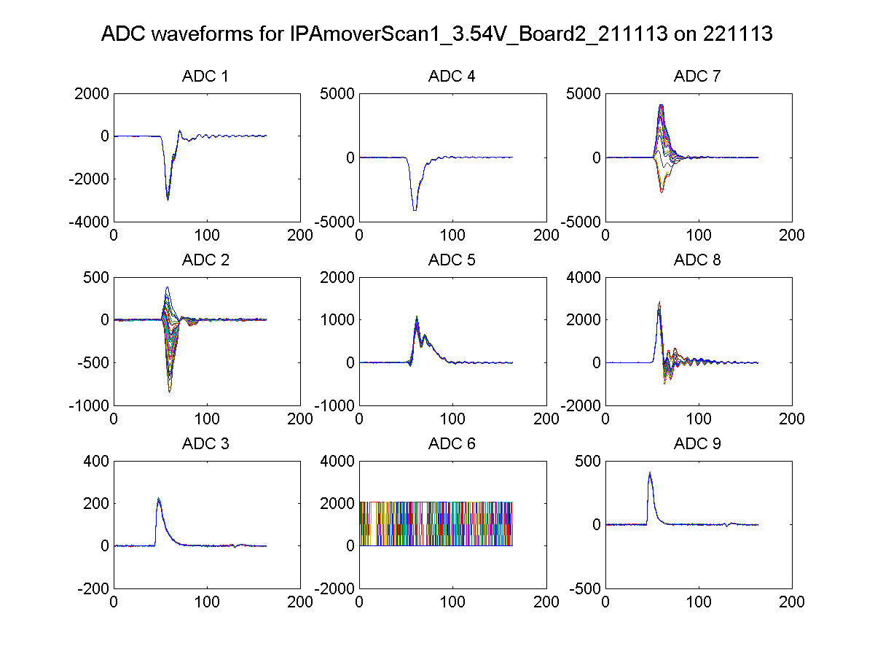
IPA(Y) I
IPB(Y) I
IPB(Y) I
IPA(Y) Q
IPB(Y) Q
IPB(Y) Q
Ref(X)
unused
Ref(Y)
N. Blaskovic

Slide 4
IP BPM calibration
IP BPM calibration done using 2 methods:
  IP BPM mover scan
    IPA & IPB motion: 31.25 um/V
    IPC motion: -30 um/V
  AQD0FF mover scan
    Beam at IPA moves 1.45 x AQD0FF position
    Beam at IPB moves 1.46 x AQD0FF position
    Sensitivity at IPC not yet simulated
N. Blaskovic

Slide 5
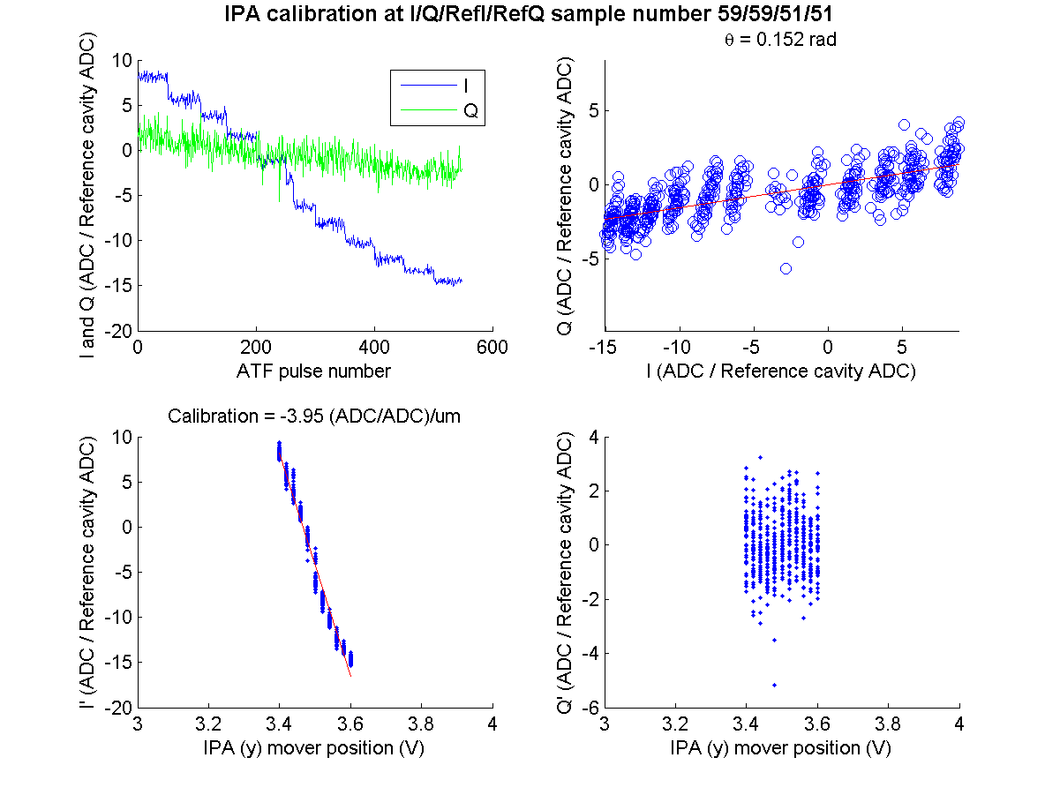
IPA mover scan
waist at IPA
attenuator 0 dB
*
* um in calibration refers to beam position (um) at BPM
N. Blaskovic

Slide 6
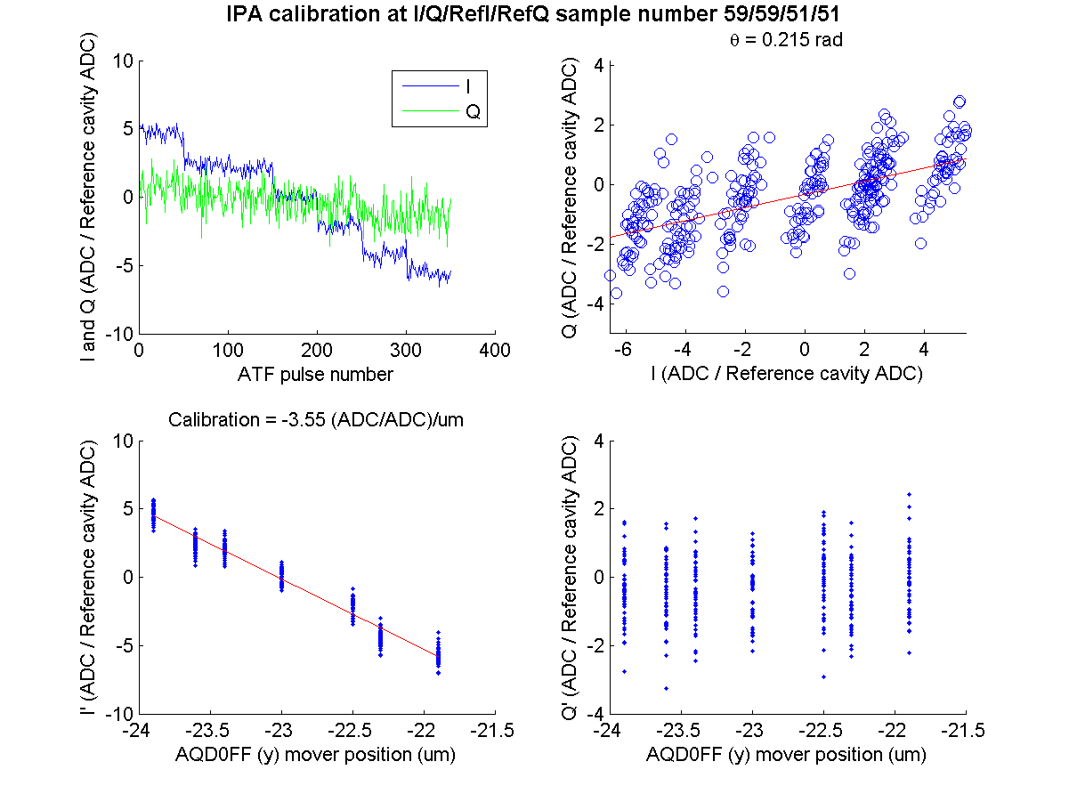
AQD0FF scan
waist at IPA
attenuator 0 dB
*
* um in calibration refers to beam position (um) at BPM
N. Blaskovic

Slide 7
IPA calibration
Variable attenuation (dB) | Calibration using BPM mover ((ADC/ADC)/um) | Calibration using AQD0FF mover ((ADC/ADC)/um)
0 | -3.95, -3.35 | -3.55
10 | -1.45 | -1.50
20 | -0.42 | -0.40
Attenuation effect as expected
Agreement between 2 calibration methods
N. Blaskovic

Slide 8
IPA, IPB and IPC calibration
IP BPM | Calibration using BPM mover at 20 dB attenuation ((ADC/ADC)/um)
IPA | -0.42
IPB | -0.58
IPC | -0.50
N. Blaskovic

Slide 9
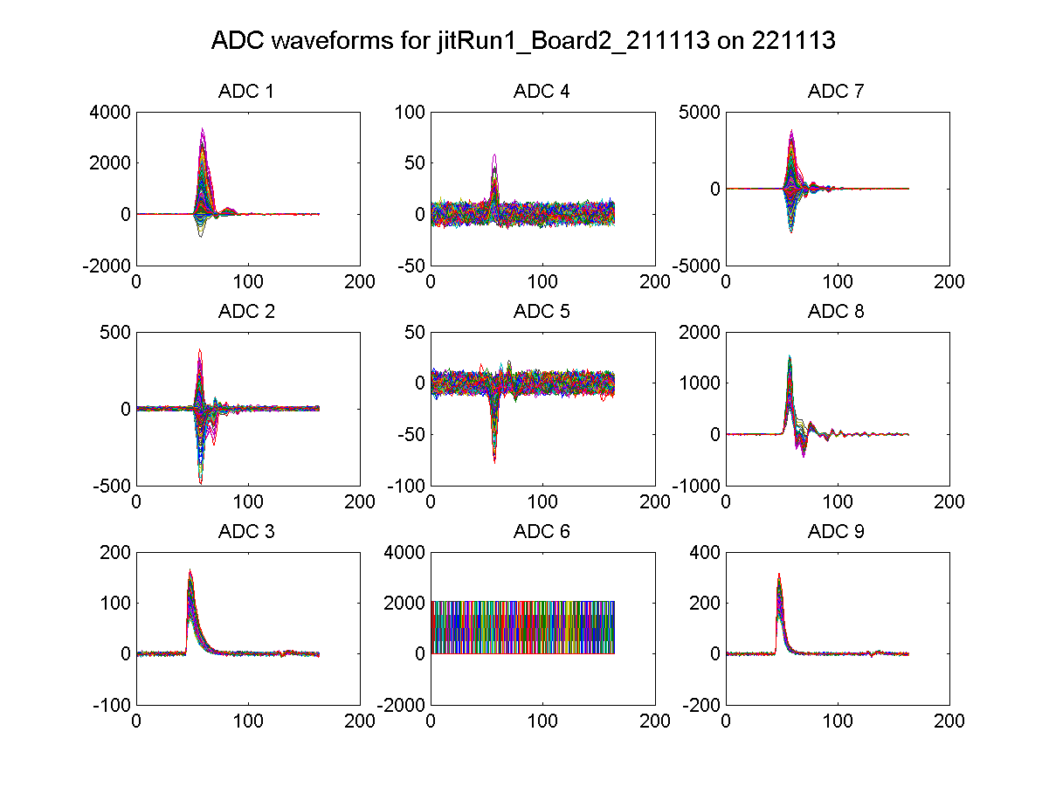
attenuator
20 dB
waist at IPB
IPA(Y) I
IPB(Y) I
IPB(Y) I
IPA(Y) Q
IPB(Y) Q
IPB(Y) Q
Ref(X)
unused
Ref(Y)
N. Blaskovic

Slide 10
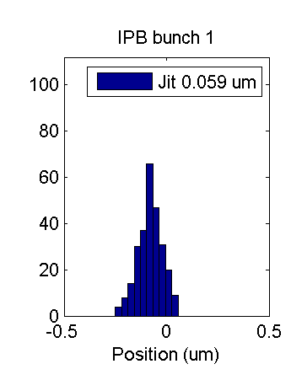
attenuator
20 dB
waist at IPB
IPB(Y) I
IPB(Y) Q
Beam waist at IPB
Beam centred in y at IPB
N. Blaskovic

Slide 11
Outlook
IP BPMs
  Beam centred through 3 IP BPMs
  3-BPM resolution calculation at different attenuator settings
FONT P1-P2-P3 stripline BPM system
  Operate using 3 stripline phase shifters
MFB1FF stripline BPM
  P2-P3-MFB1FF resolution
  Position over FONT kicker scans & feedback
N. Blaskovic

Slide 12
Appendix
IP BPM calibration plots
(22nd November 2013)

Slide 13
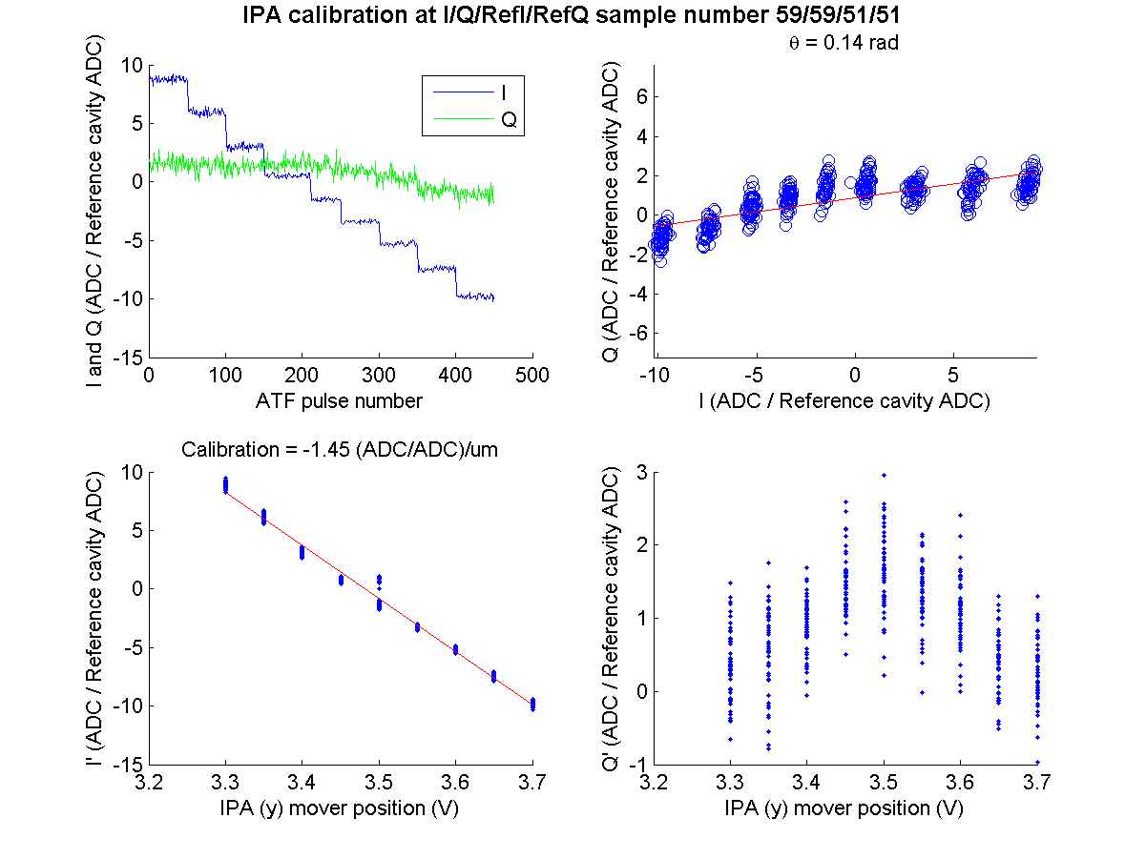
IPA mover scan
waist at IPA
attenuator 10 dB
N. Blaskovic

Slide 14
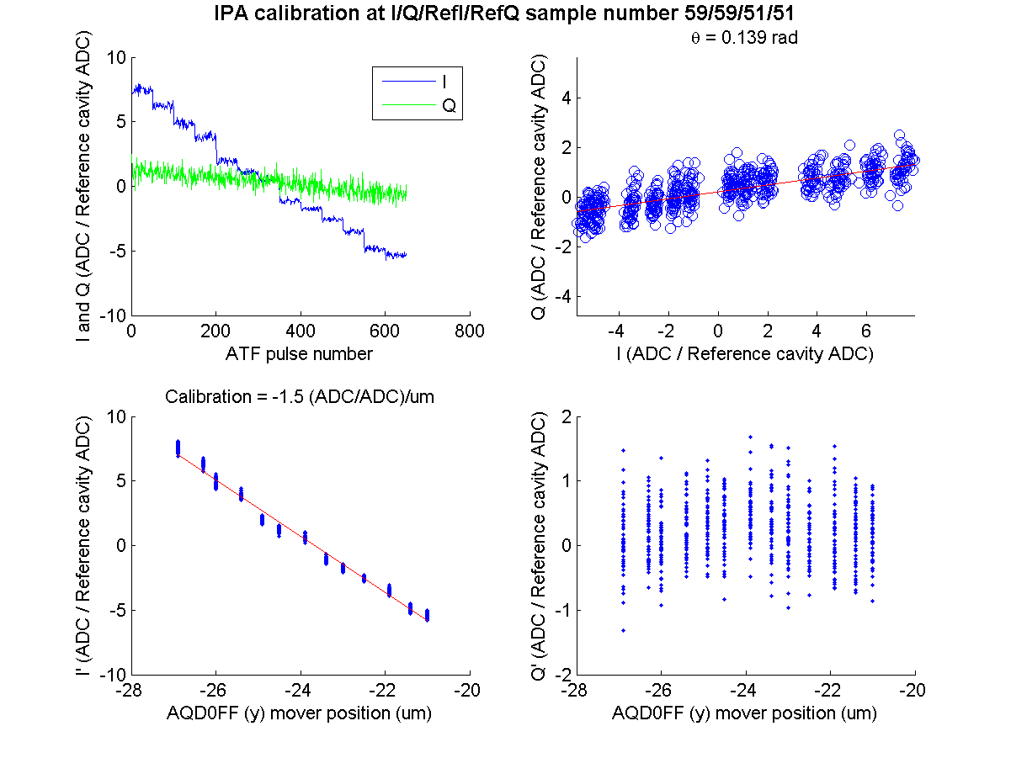
AQD0FF scan
waist at IPA
attenuator 10 dB
N. Blaskovic

Slide 15
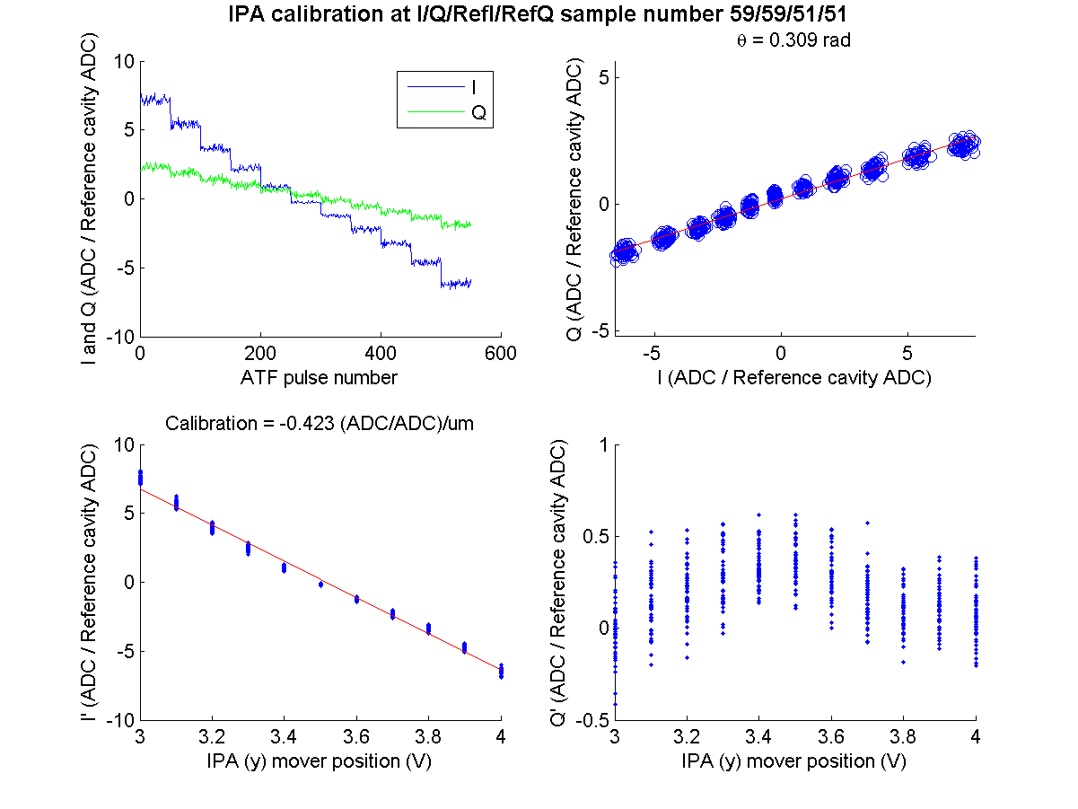
IPA mover scan
waist at IPA
attenuator 20 dB
N. Blaskovic

Slide 16
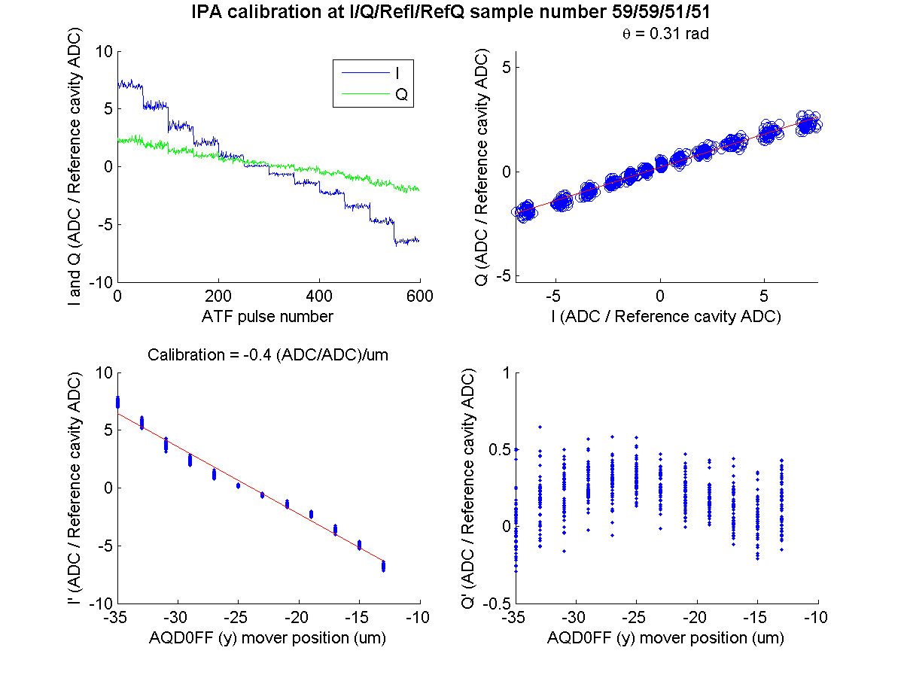
AQD0FF scan
waist at IPA
attenuator 20 dB
N. Blaskovic

Slide 17
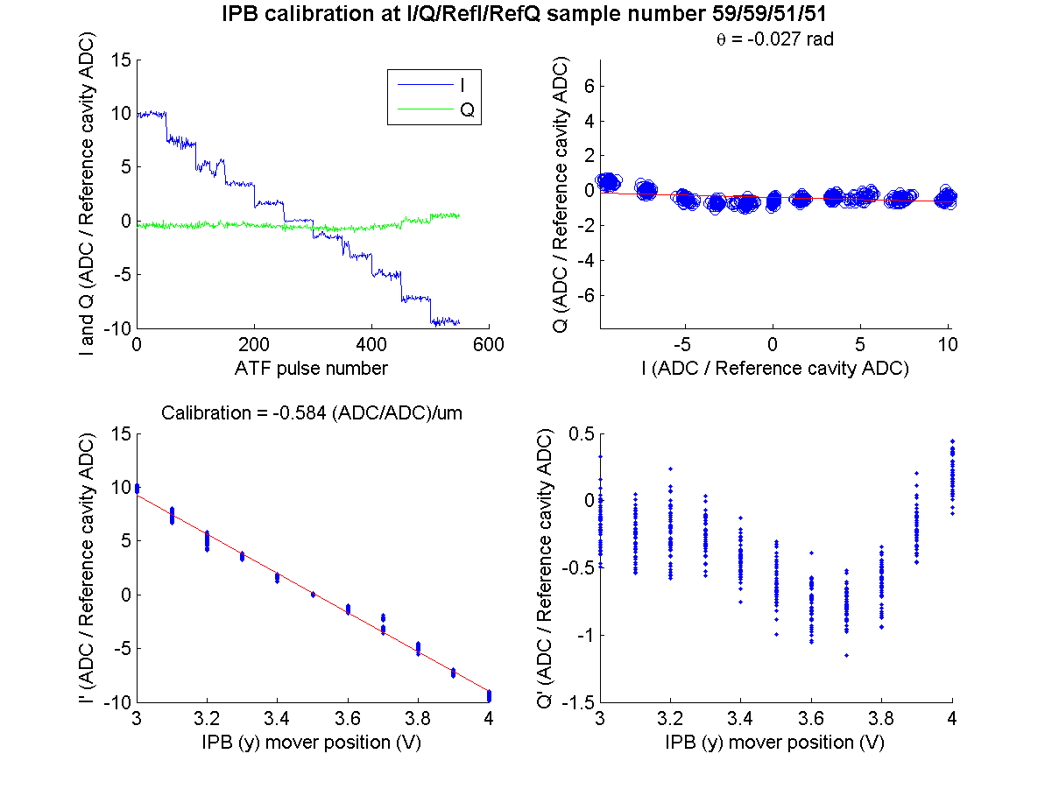
IPB mover scan
waist at IPB
attenuator 20 dB
N. Blaskovic

Slide 18
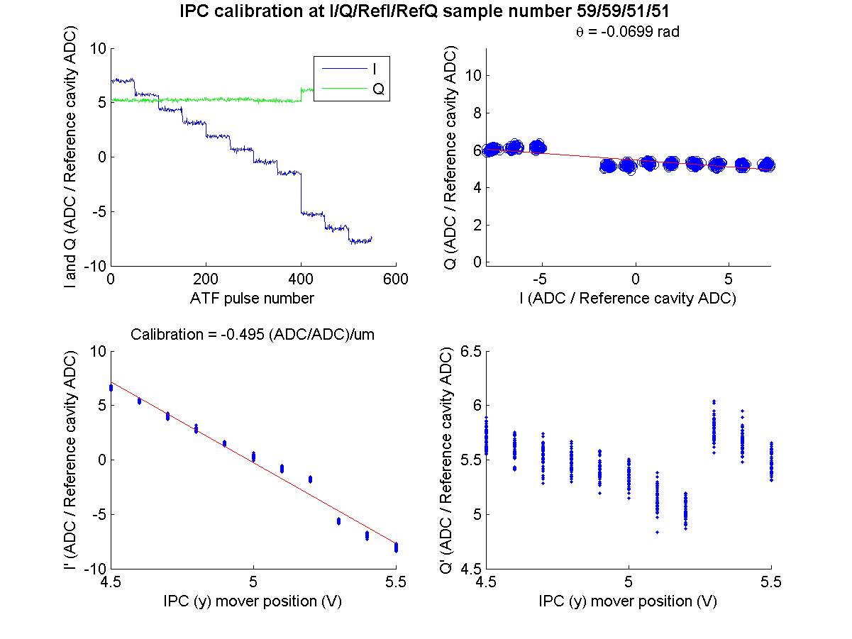
IPC mover scan
waist at IPC
attenuator 20 dB
N. Blaskovic

