Slide 1
Pair background distribution at 500 GeV
-- study on GunieaPig samples --
Akiya Miyamoto
KEK
Analysis/Software meeting
13 December 2013

Slide 2
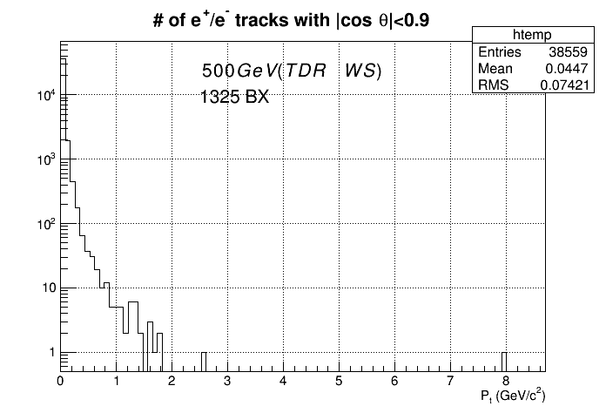
Pt distribution with cut on |cosθ|
(1 pulse)
VXD/SIT covers
|cosθ|<0.90

Slide 3
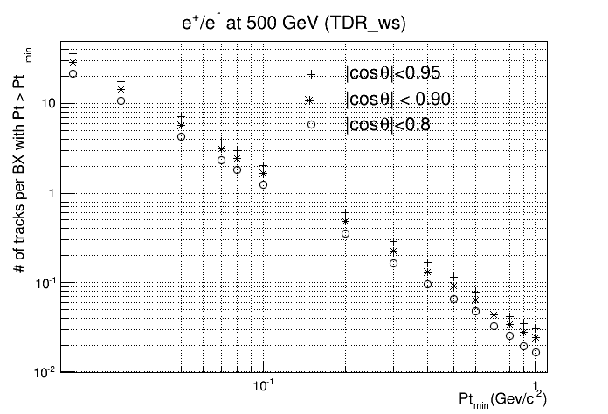
# of e+/e- tracks per bunch crossing
VXD Coverage(Rout/2)
Pt>0.03 GeV
|Cosq|<0.90
SiT coverage (Rout/2)
Pt>0.15 GeV
|Cosq|<0.90
~0.8/BX

Slide 4
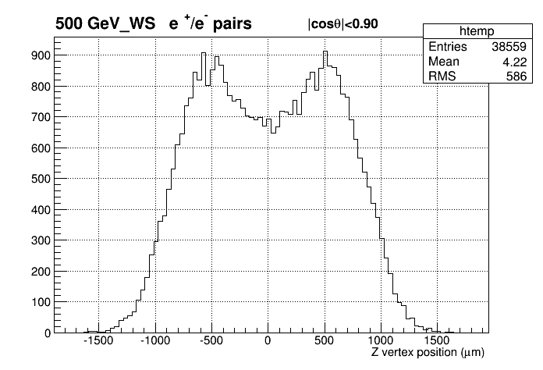
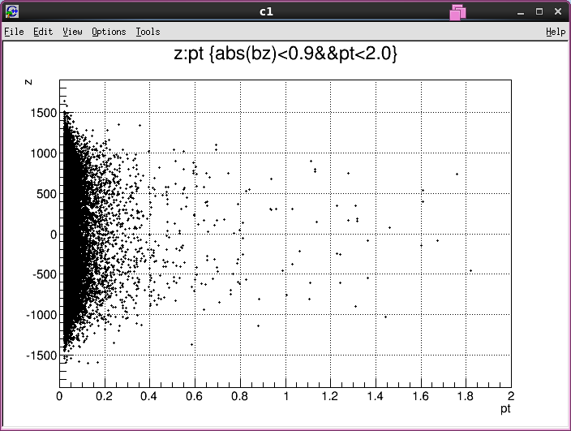
Z vertex distribution
Zpos(um)
Pt(GeV)

