Slide 1





Steering algorithm experience at CTF3
Davide Gamba
davide.gamba@cern.ch
13 December 2013
(Slides from previous presentation at The International Workshop on Future Linear Colliders LCWS13)

Slide 2
Outlook
CTF3: the CLIC Test Facility at CERN.
Steering necessities.
A general feedback algorithm and its implementation.
Preliminary results and issues.
Work in progress: new tools.
Dispersion measurement from Jitter.
“Jitter free steering.”
Summary.

Slide 3
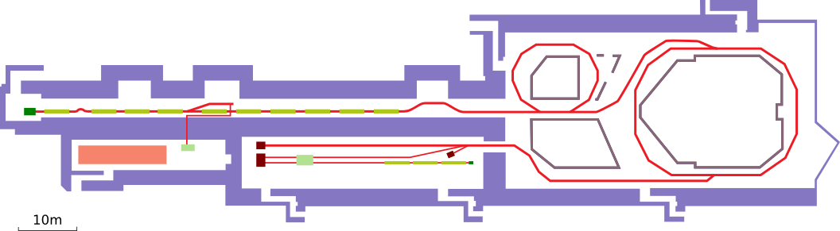
CTF3: the CLIC Test Facility at CERN.
Drive Beam
Gun
Dogleg Experiment
Factor 2
Recombination
Factor 4
Recombination
Building 2003
DL
42 [m]
Building 2001
CR
84 [m]
Building 2013
Building 2010
CLEX area
Photo Injector Tests
Two Beam Test Stand (TBTS)
Probe Beam
Photo-Injector
XBOX
experiment
Deceleration Test Beam Line (TBL)

Slide 4
Steering necessities

Slide 5
Steering necessities.
For machine operation and optimization we need a general tool to control the orbit of the beam.
It has to deal with some intrinsic limitations
Data acquisition is affected by noise
White noise
Not null dispersion and energy jitter
Non responsive control system
Delicate Front-Ends
Instable beam (mainly coming from RF instabilities)
Beam position may not be a well defined measurement in case of losses
Challenging machine
MADX model not always accurate
Aperture limitations
Algorithm to measure the response matrix needed
Has to be “fast” compared to machine faults and drifts
Has to be able to follow slow drifts of the machine

Slide 6
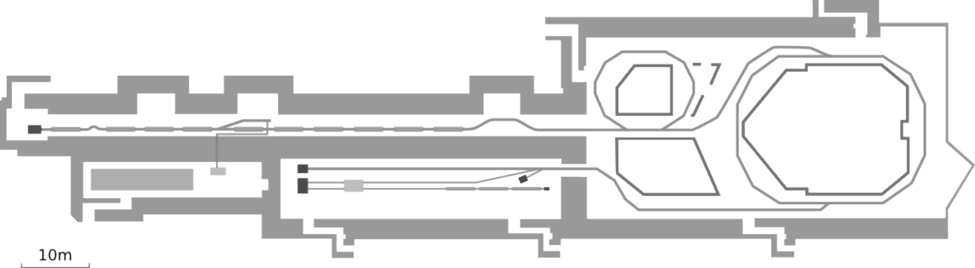
Steering necessities.
Special case: during recombination, different section of the initial train take different paths.
They don’t necessarily come back on the same trajectory.
Only one section over two is delayed into the Delay Loop
Initially we only have a long train “divided” into 8 sections, each 140 ns long
Projected emittance blow-up.
Increased losses.
In the Combiner Ring all the 8 sections can end up in having different orbits

Slide 7
Steering necessities.
First stage: match orbits of delayed and not-delayed trains.
Use correctors in Delay Loop
Force the same orbit in the next Transfer Line (TL1)
In principle only two correctors with the right phase advance are needed.
Aperture limitations may impose to use more correctors.

Slide 8
The feedback algorithm

Slide 9
The algorithm
Solving a linear system of equations

Slide 10


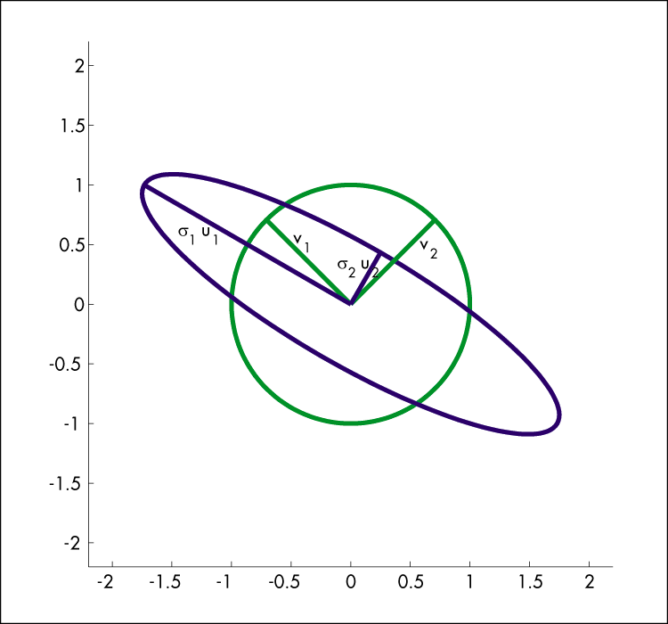



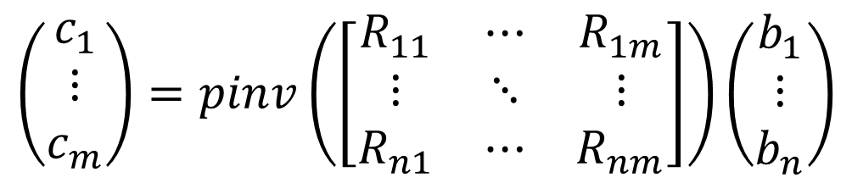
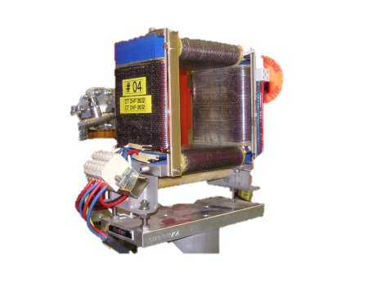
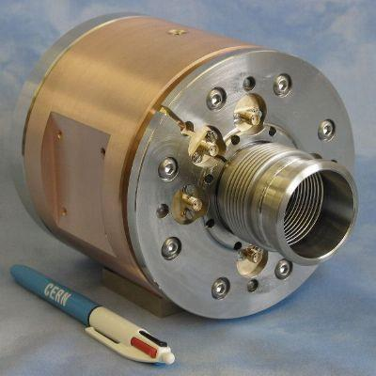
The algorithm
SVD
Synchronization

Slide 11
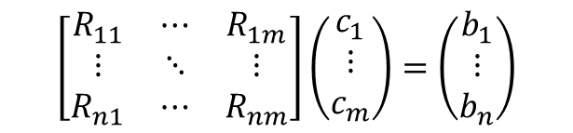
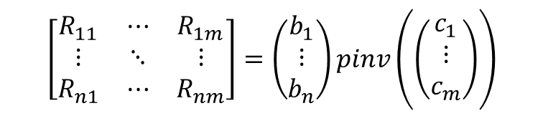

The algorithm
Measure the response matrix based on a simple concept:
Randomly excite all the correctors
Read the Beam Position at all the interested points
Invert the same linear system of equations, but the Response Matrix is now the unknown:
Keep a history of last setting/observations pairs of variable length
Also during beam corrections outcome data can be used to improve Response Matrix.

Slide 12
Testing the response matrix measurement algorithm
Real response matrix
Computed response matrix
Computed – Real
N correctors = 8
N BPMs = 12
correctors excitation σ = 1[A]
correctors noise σ = 0.01[A]
BPMs noise σ = 0.1[mm]
dispersion induced jitter σ = 1 [mm]
number of iterations: 100
history size: n = 30.

Slide 13
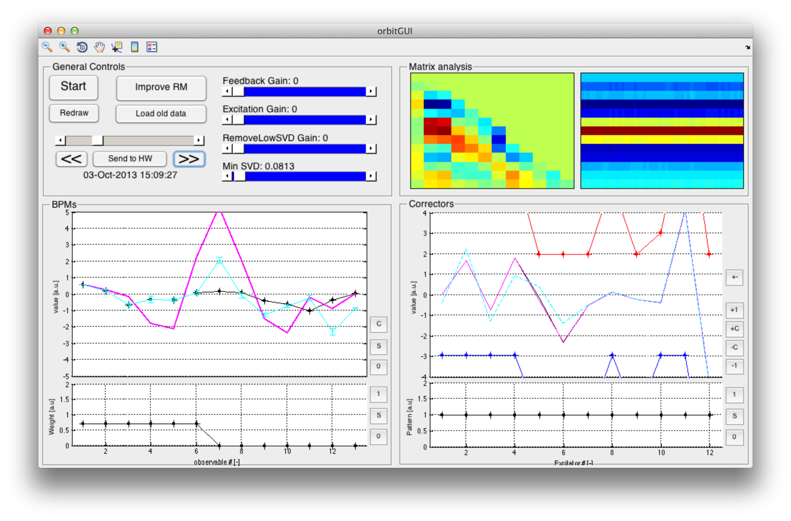
The algorithm: implementation and test
Developed a Matlab application for generic linear feedbacks.

Slide 14
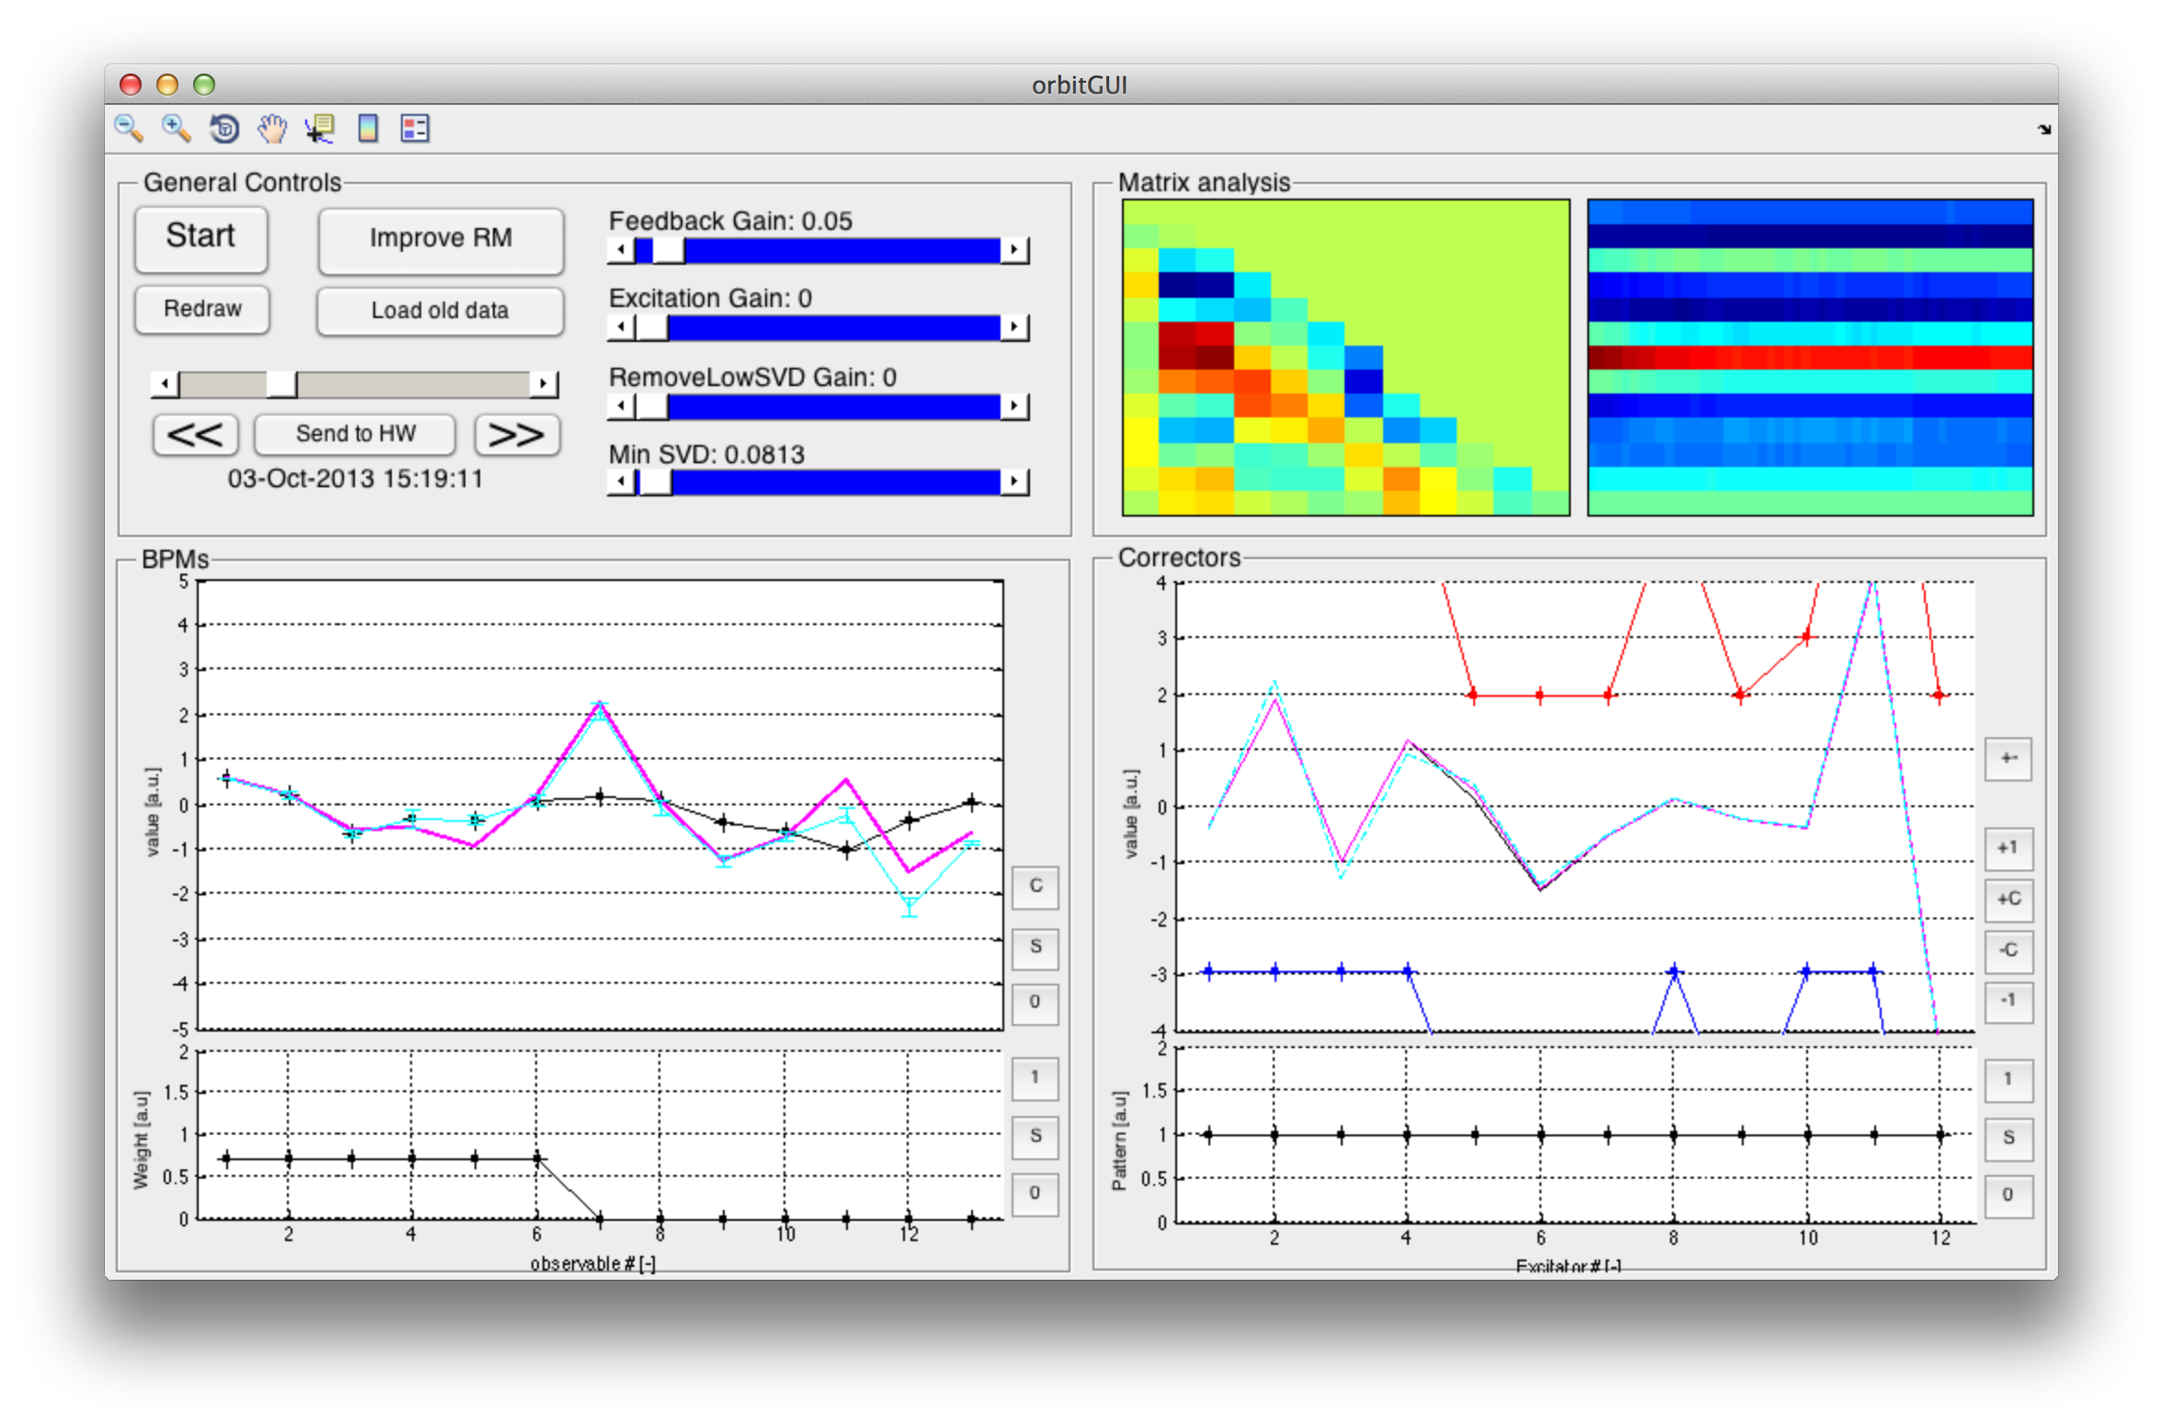
The algorithm: implementation and test
Example of correction of beginning orbit of the linac.

Slide 15
The algorithm: implementation and test
Example of use to control end of linac orbit:

Slide 16
The algorithm: implementation and test
Example of use to control end of linac orbit:

Slide 17
The algorithm: implementation and test
Example of use to control end of linac orbit:

Slide 18
The algorithm: implementation and test
Example of use to control end of linac orbit:

Slide 19
Preliminary results
Back to the main goal:
use the tool to match “delayed” and “straight” orbits in TL1.
Use correctors in Delay Loop
Force the same orbit in the next Transfer Line (TL1)

Slide 20
Preliminary results
“Orbit matching” in TL1

Slide 21
Preliminary results
A first issue: straight and delayed beam have different energy
From a rough estimation, this offset is related to a
Δp/p = -0.03 of the delayed beam.
Note: the injector was not properly optimized. These results were not obtained in normal condition of operation.

Slide 22
Work in progress

Slide 23
Interlude: beam jitter induced by energy jitter
After summer shutdown: looking at energy jitter markup in beam position in dispersive region.
We are affected by a natural jitter of the energy.
Beam energy along the pulse is also not always flat.
Thanks to generality of our feedback tool we can use it to shape the RF power of last linac structure to try to compensate the second effect.
Note: 3Ghz beam for factor 4 recombination,
i.e. different setup respect to previous slide!

Slide 24
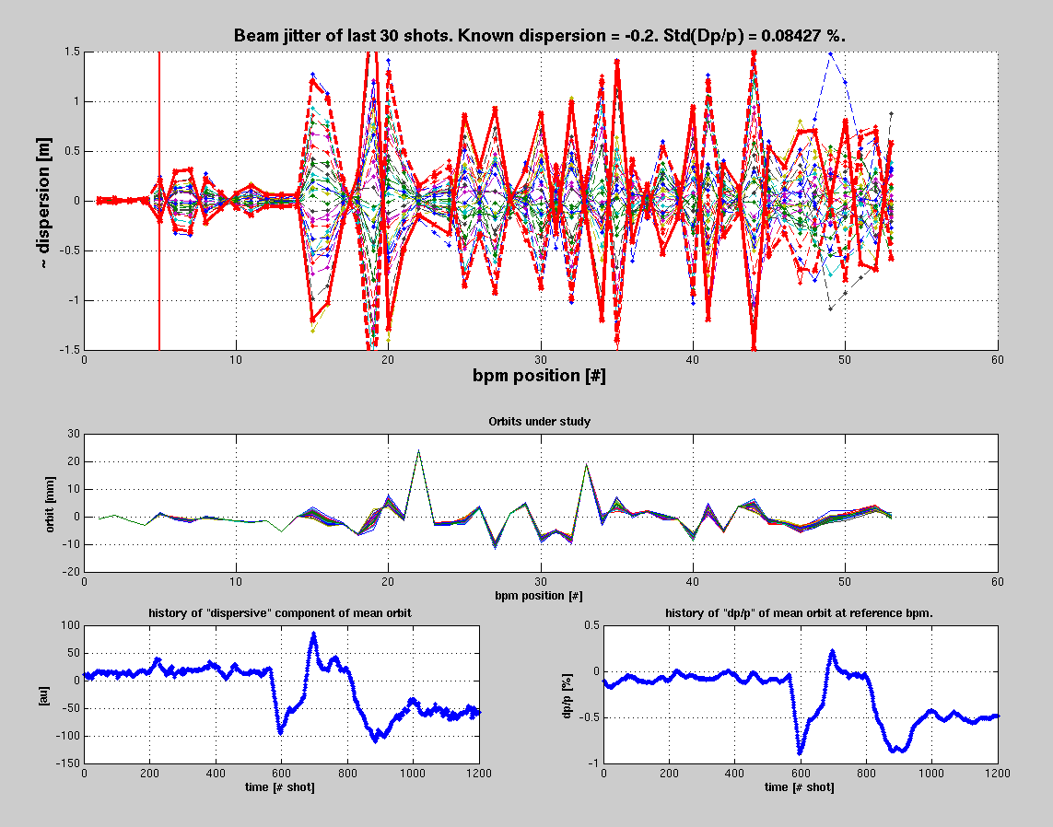
Dispersion measurement from Jitter
Developed an application to passively measure dispersion by beam jitter.

Slide 25
Jitter free steering
The first area where we have dispersion is at the end of Drive Beam linac, where a chicane is installed.
Nominally
non zero dispersion
Nominally dispersion free

Slide 26
Jitter free steering
Using the same feedback application and measuring dispersion as jitter.
Change correctors inside chicane to reduce jitter (i.e. dispersion) downstream.
Acquiring 30 beam pulses for each iteration.
Main disadvantage: RM measurement and correction takes longer time.
Preliminary results!

Slide 27
New ideas
Other ideas to get read of energy jitter to measure Response Matrices?
Even better: use it in a different way to get Dispersion Response Matrix.
Can we guess the beam main characteristics ( x₀ ; x₀’ ; Δp/p ) only looking at the orbit of the beam in few BPMs upstream, and predict the orbit downstream?
What if in the mean time a corrector is changed (and so the dispersion)?
Use as indipendent variables the BPMs readings in TL1
In the mean time randomly excite downstream correctors
(also indipendent variables)
In a system like this, at first order, beam position in a downstream BPM seems to linearly depend on:
x₀ ; x’₀ ; Δp/p ;
(Δp/p x₀) ; (Δp/p x’₀) ;
I_{C1} ; (Δp/p I_{C1}) ; … ; I_{CN} ; (Δp/p I_{CN})
We don’t have any of this information, but they may be expressed in terms of upstream beam positions.
Measure response matrix downstream

Slide 28
New ideas

Slide 29
New ideas
If we suppose that within two shots we only change correctors and energy.
Δ(Δp/p) can be measured from the jitter on a BPM.
… Work in progress to verify this is correct …

Slide 30
Summary
What has been done:
Developed and tested a generic linear feedback.
Smart way to measure the response matrix: it can work in quasi-parasitic mode and/or during orbit correction.
First results and characterization of possible limitations.
What is ongoing:
Dispersion measurements from jitter.
“Jitter free” steering.
Comparison of the response matrix with machine model (MADX).
e.g.: found a corrector with inverted polarity.
Model optimization using LOCO procedures.
What is next:
Demonstrate the possibility to match the two orbits in TL1 within noise level.
Apply the feedback for the full closure of CR.
Measure the improvement in beam emittance and power production stability.

Slide 31
Thank you.

Slide 32
Appendix slides

Slide 33
Measured Linac RM with errors (Appendix)

Slide 34
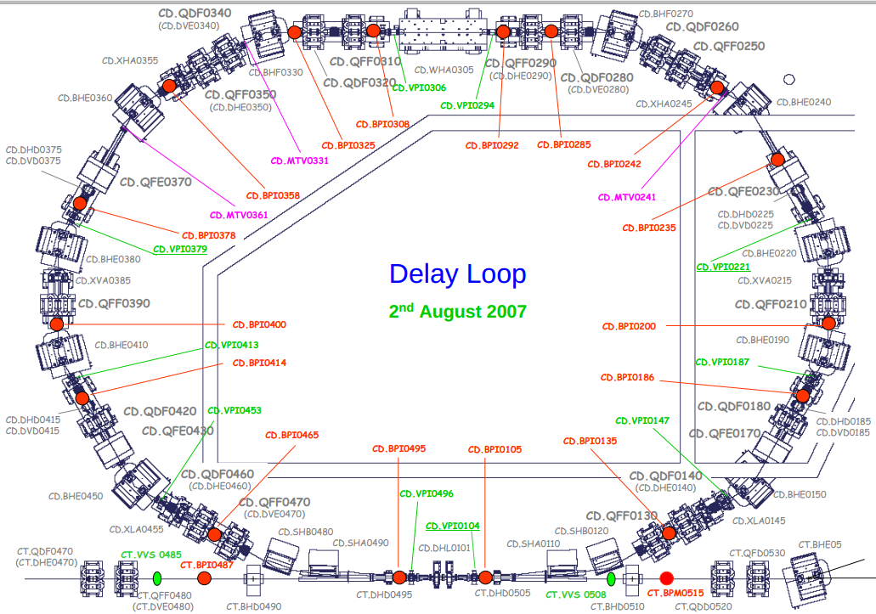
DL layout (Appendix)

Slide 35
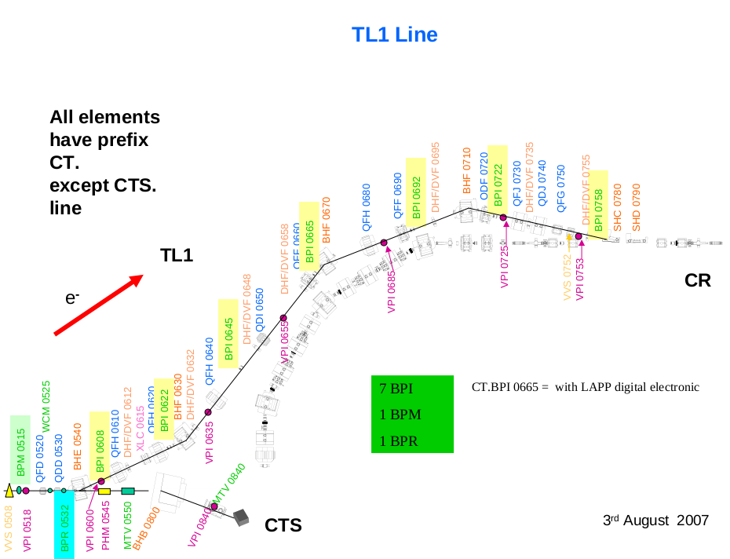
TL1 layout (Appendix)

Slide 36
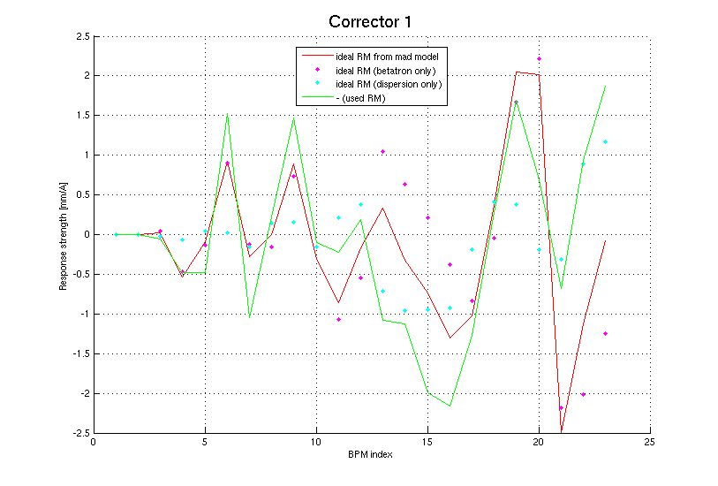
DL -> Tl1 Response Matrix (Appendix)
MADX and Measured RM

Slide 37
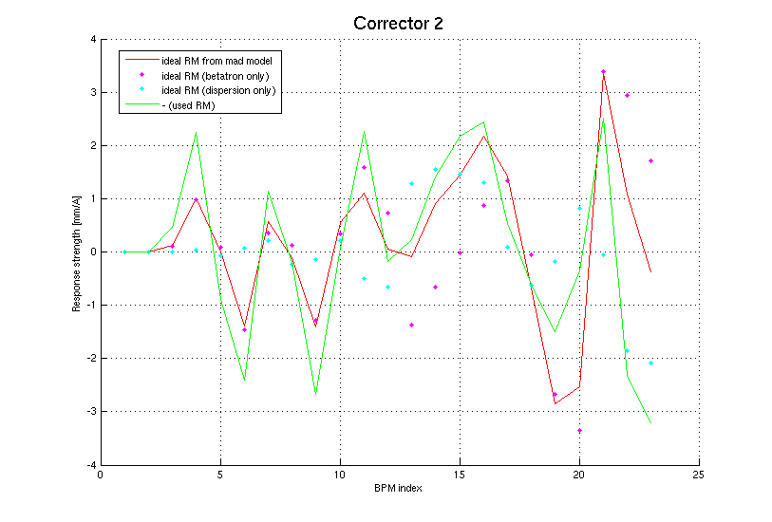
DL -> Tl1 Response Matrix (Appendix)
MADX and Measured RM

Slide 38
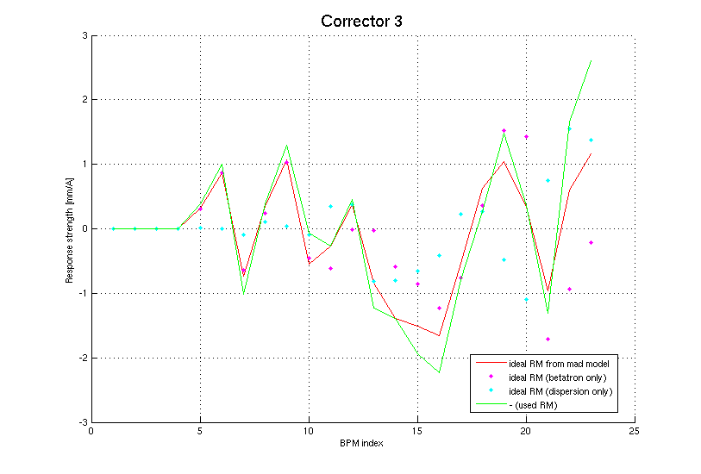
DL -> Tl1 Response Matrix (Appendix)
MADX and Measured RM

Slide 39
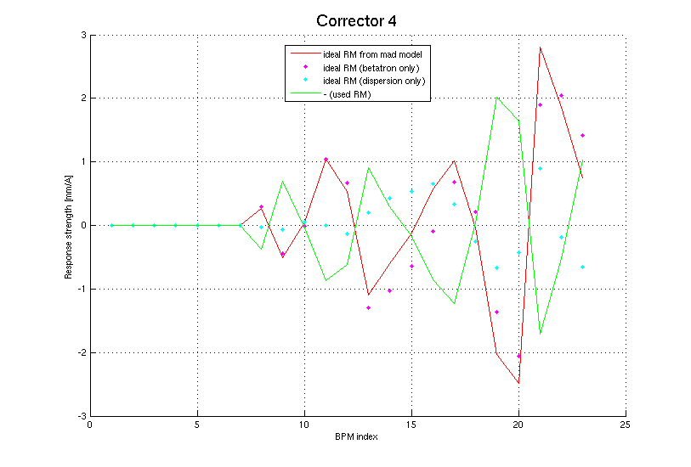
DL -> Tl1 Response Matrix (Appendix)
MADX and Measured RM

Slide 40
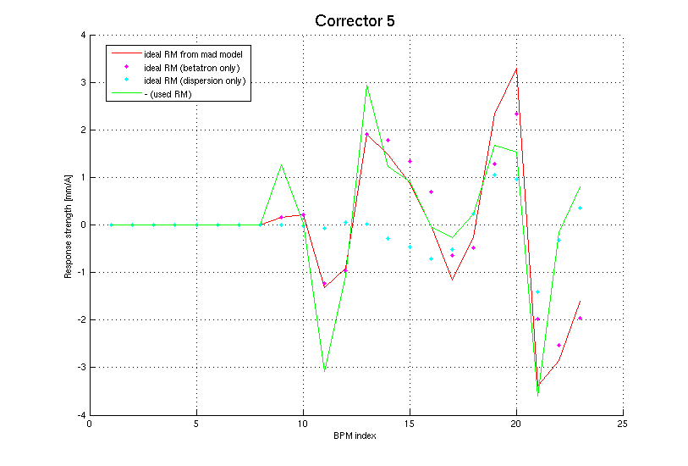
DL -> Tl1 Response Matrix (Appendix)
MADX and Measured RM

Slide 41
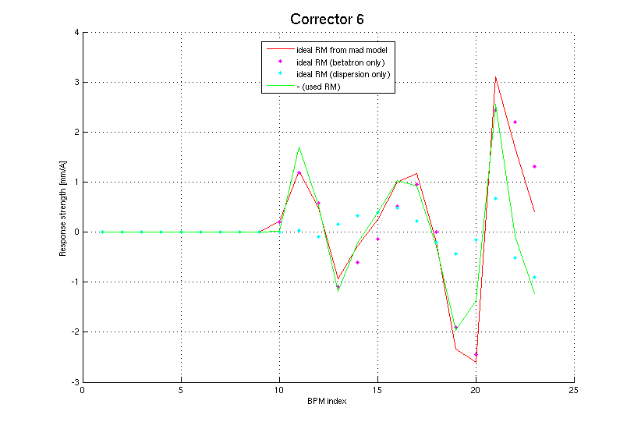
DL -> Tl1 Response Matrix (Appendix)
MADX and Measured RM

Slide 42
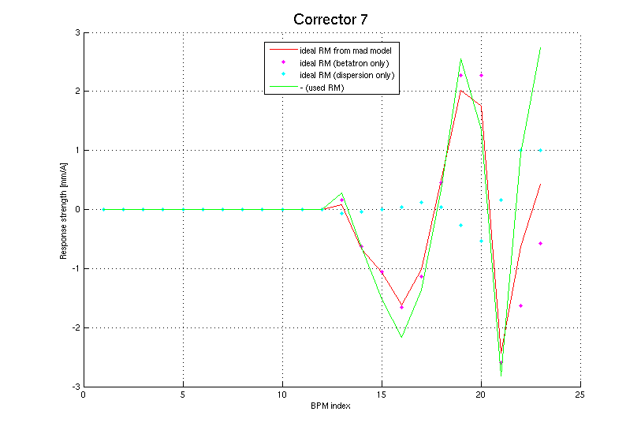
DL -> Tl1 Response Matrix (Appendix)
MADX and Measured RM

Slide 43
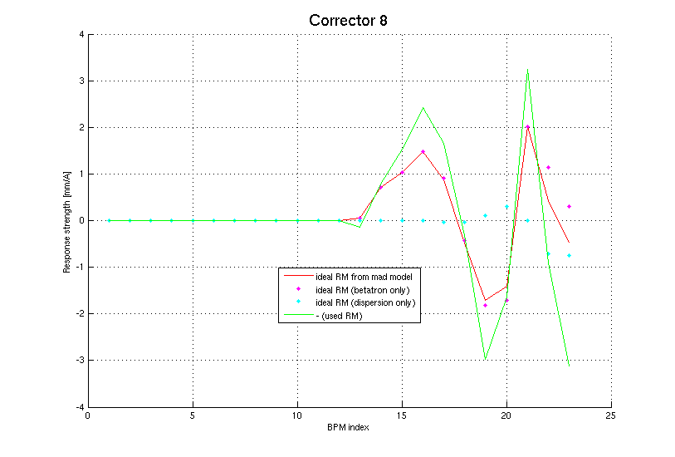
DL -> Tl1 Response Matrix (Appendix)
MADX and Measured RM

