Slide 1


Stripline Resolution Studies
Mikey Davis
13 December 2013
1/8

Slide 2
Introduction
We setup the three phase shifters upstream
Took the data at the end of the last shift
Took 9 single bunch jitter runs and 5 two bunch jitter runs
LO phase scans over a range of RCPS settings
We tried to do a scan of jitter vs RCPS setting, however we didn’t use a big enough range
Mikey Davis
13 December 2013
2/8

Slide 3
P1 vs P2 and P3 phase sensitivity
P1 has always had a particularly bad phase sensitivity
To reduce this requires a very large RCPS setting
It’s sensitivity to a change in RCPS setting is the same as P2 and P3
It seems that the problems just come from a large mismatch between the two channels
Mikey Davis
13 December 2013
3/8

Slide 4
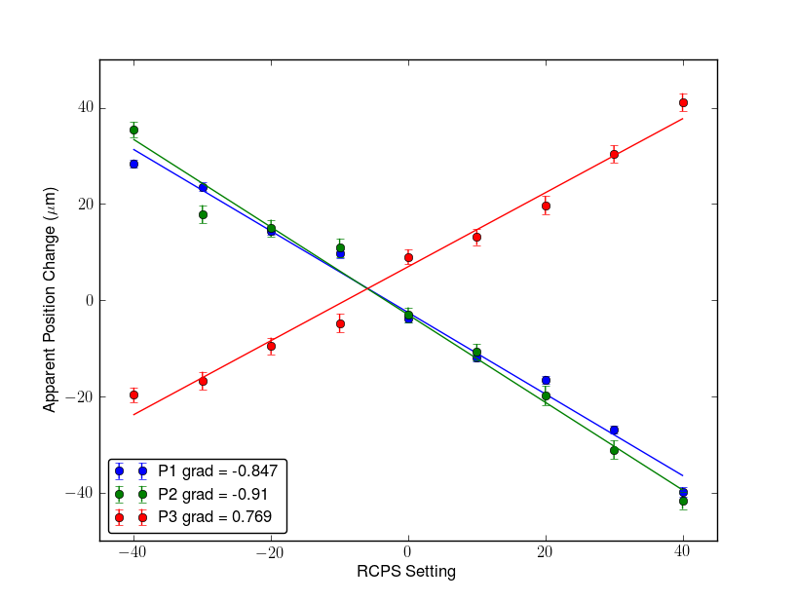
P1 vs P2 and P3 phase sensitivity
Mikey Davis
13 December 2013
4/8

Slide 5
Results
I’ll show resolution numbers for all the jitter runs
Currently only have ‘fitted method’ results
Haven’t calculated an up to date transfer matrix yet
Not all runs can be offline LO phase corrected
I will go through and check which ones are ok
Mikey Davis
13 December 2013
5/8

Slide 6
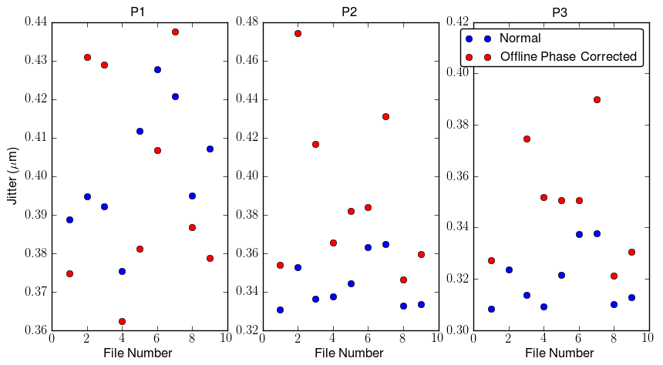
Signal Bunch Resolution (fit)
Mikey Davis
13 December 2013
6/8

Slide 7
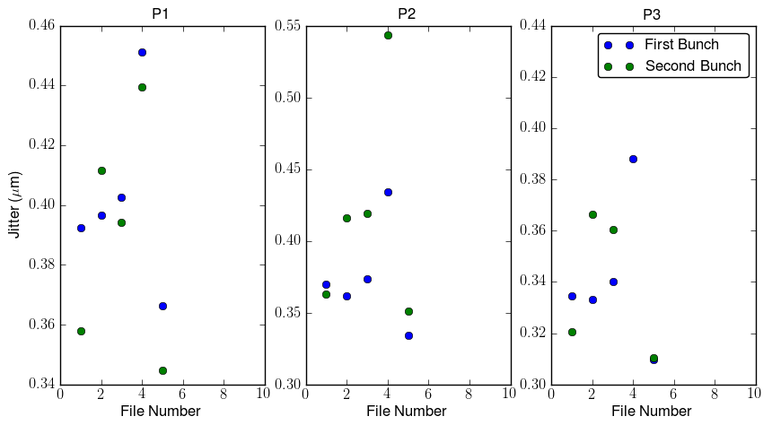
Two Bunch Resolution (fit)
Mikey Davis
13 December 2013
7/8

Slide 8
Conclusions
Some pretty good initial numbers
A lot more to get from these data sets which I will look at next week and report back
There was some considerable interest at the ATF
Juergen has been in touch with me, he would like to do some work in the extraction line in collaboration with us
Rogelio(?) is apparently very excited
Mikey Davis
13 December 2013
8/8

