Slide 1
P5
Potential US Accelerator Collaboration with the ILC-in-Japan
Mike Harrison

Slide 2
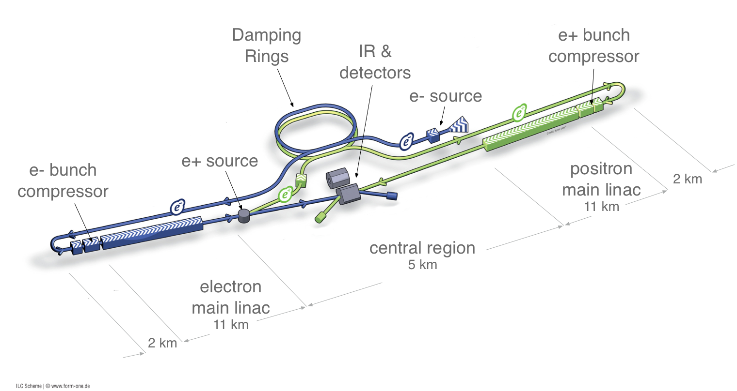
ILC Design – unchanged since the TDR
500 GeV

Slide 3
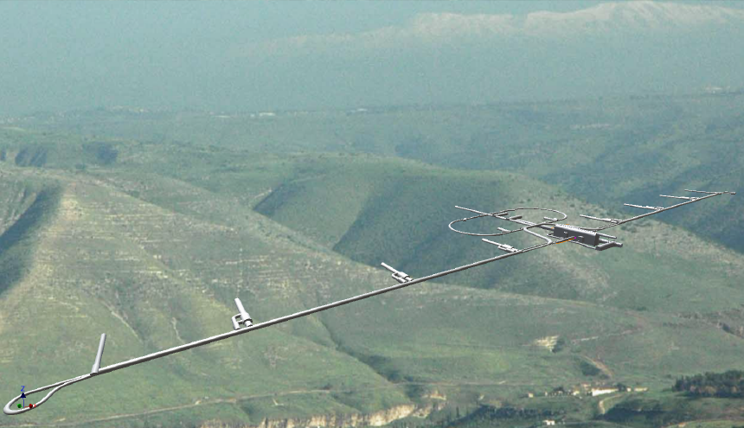
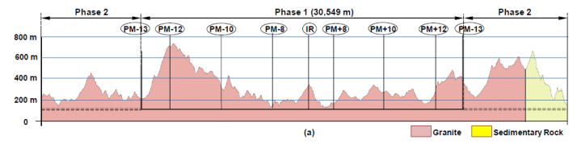
Site Specific Design
Kitakami-site cross section
Damping Ring
Ring To Main Linac (RTML)
Detector Hall
PM+10
PM+12
PM+13
PM-ab
PM+8
Surface Structures
e+ ML
PM-8
e- Source
Existing surface road
PM-10
PM-12
(Slope <7%)
PM-13
e+ Source
Access Tunnel
Access Hall
PX
(Slope <10%)
(Center Campus)
e- Main Linac (ML)
Existing road
RTML turn-around
(The background photo shows a similar site image, but not the real site.)
Need to establish the IP and linac orientation
Then the access points and IR infrastructure
Then linac length and timing

Slide 4
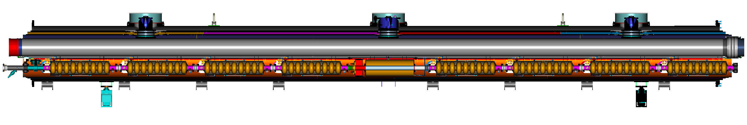
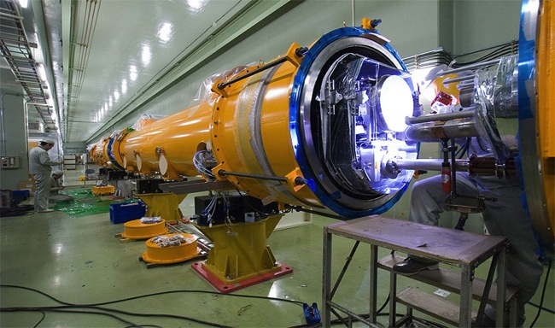
The Cryomodule
Type-B module
Type-A has 9 cavities and no quadrupole
cavities (8)
SC quad package
12.652 m (slot length)

Slide 5
TDR Value Estimate 500 GeV
7.8 BILCU
By accelerator system
ILCU = $FY12
Value estimate – no contingency, inflation, pre-ops, R&D, spares, etc….
Host
Host
Host
By technical
system
Notes:
Note: ML only 55% of the CFS cost.
This breakdown based on DKS (mountainous).

Slide 6
TDR Explicit Labour
Explicit labour estimates include the scientific, engineering and technical staff needed to plan execute and manage the technical systems including specification, design, procurement, vendor liaison, acceptance testing, QA, integration, installation and checkout.
Averaged over the different TDR sites this amounts to 22,448 K person-hrs.
Implicit labour such as cryomodule fabrication is included in the component costs.

Slide 7
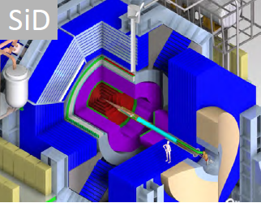
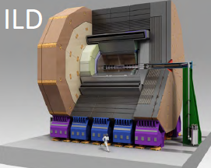
Detector TDR Estimates
The validated detector concepts in the TDR showed value estimates done on the same basis as the ILC, and using common commodity costs (Si, Fe, W).
SiD ILD
Value cost (MILCU) 315 392 (336 – 421 depending on options)
Engineering (Man-yrs) 186
Technical 532
Administration 30

Slide 8
US Involvement in the GDE R&D Program
There was significant ($35M/yr peak, $134M over 5 years) US involvement in the GDE program in both the technical design and technology development. SRF systems were ~ 66% of the total.
Electron source – SLAC & JLAB
Positron Source – ANL & LLNL
Damping Rings – SLAC & Cornell
Transfer Line & Bunch Compressor – Fermilab
Main Linac – SLAC & Fermilab
Beam Delivery System & Machine Detector Interface – SLAC & BNL
SRF High Gradient – JLAB, Fermilab & ANL, Cornell
SRF Cryomodules – Fermilab
SRF HLRF - SLAC

Slide 9
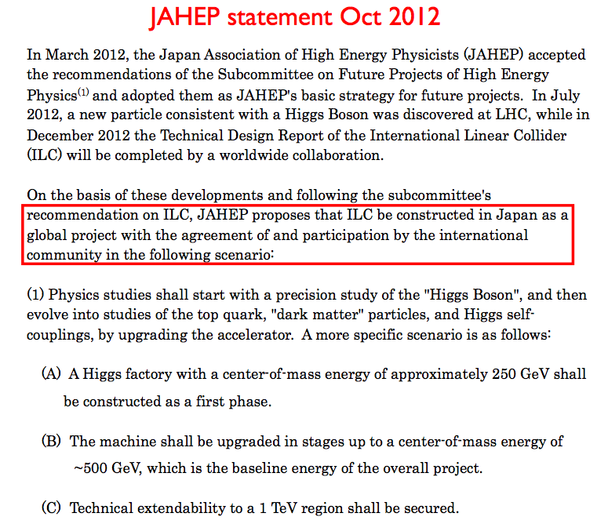
Which ILC ?
In what follows we shall only consider Phase 1 (~250 GeV). The model is a 250 GeV machine in a tunnel sized for 500 GeV. This is estimated at 5,846 MILCU and 19,050K person-hrs, i.e. about 75% of the TDR machine. It requires ~ 850 cryomodules.

Slide 10
Potential US Machine Involvement (1)
There is of course, no absolute criterion for inclusion in an in-kind contribution. The US industry/laboratory complex covers many technologies and skills necessary to complete a high-energy linear collider wherever it is located. There are however certain attributes that should be considered when assessing any particular contributions: unique (or world class) capabilities, strategic value to the domestic program, value to the project, and US industrial involvement.
Any US contribution will perforce involve a significant number of SRF cryomodules since the scope of the ILC will require the full capacity of the global community to meet the necessary production rate. The US cryomodule fabrication and test capacity resides at Fermilab and JLAB.
Expertise in RF systems has been a feature of the SLAC program for many years and SLAC has been the global ILC lead in the development of the HLRF power systems including the waveguide distribution system, a next generation state-of-the art solid-state modulator, and industrial klystron procurement.

Slide 11
Potential US Machine Involvement (2)
The R&D associated with the positron system has been performed by Argonne (undulators, beam dynamics) and Lawrence Livermore (target dynamics, positron capture pulsed systems). Both laboratory contributions are derived from specialized in-house expertise.
The ultra-compact magnet systems used in the ILC baseline final-focus elements adjacent to the interaction point, are based on direct wind technology which is only presently available at Brookhaven National Laboratory in the US.
A project of the scale and complexity of the ILC would be a major challenge for any single country. The US will need to play a role in the accelerator design as well as the final engineering design phase and hence part of the US contribution will be intellectual property. This would cover the positron source, damping rings, beam dynamics, transfer line, beam delivery system, and machine detector interface.

Slide 12
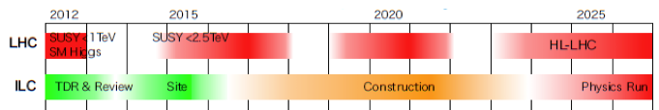
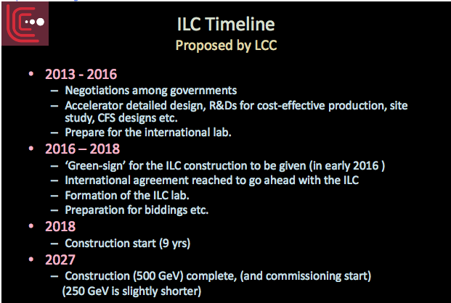
Timeline
Atsuto Suzuki @ the P5 meeting in Chicago
LCC working timeline

Slide 13
Pre-project support
After the GDE phase the US has adopted a wait-and-see approach. “The GDE program was very successful but no signs of a LC project”.
Since FY13 there has been no OHEP funding for the ILC beyond the LCC common fund (LCC Directorate support with Asia & Europe) and 2 FTE’s & travel.
With movement in Japan we now need a support level to re-establish the US presence and prepare for possible subsequent events. We estimate this initially at $5M/yr ramping up to $10M in FY17 for the accelerators:
Re-establish positron target R&D
Small SRF R&D program (cavities & value engineering)
15 FTE’s (positrons, damping rings, RTML, main linac, beam delivery, LCC & system leaders) for system and site specific design.

