Slide 1

Space frame endplate
19.Dez..2013 Volker Prahl

Slide 2
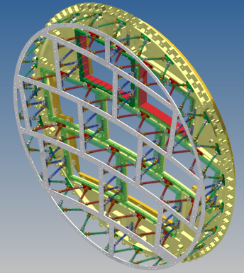
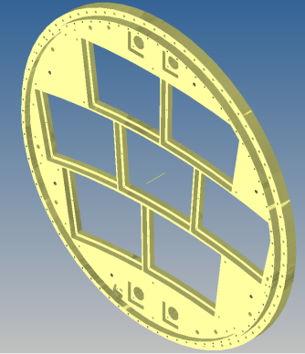
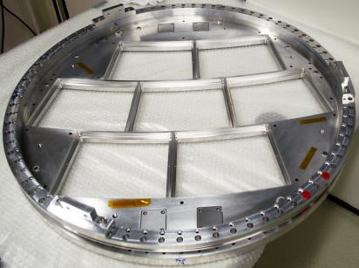
Space frame endplate
Guide ring necessary
HV-Connector

Slide 3
Space frame endplate
Additional works at the endplate
Fabrication of new guide ring required
Redesign of the 1st and 7th field strip HV-connection
Redesign of the head of the mounting tool required (slide 4)
Mounting bracket divide into four parts (slide 6)
Mounting tool necessary,
very less space for manual mounting of the modules

Slide 4
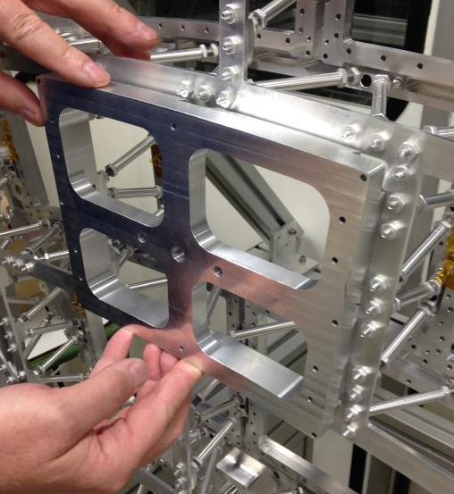
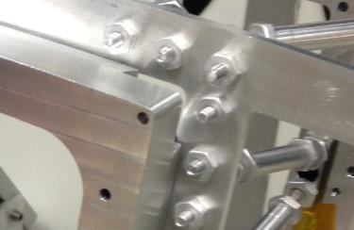
Space frame endplate
Uncertain issue at the pin hole?
Adjustment plate of the mounting tool has to redesigned

Slide 5
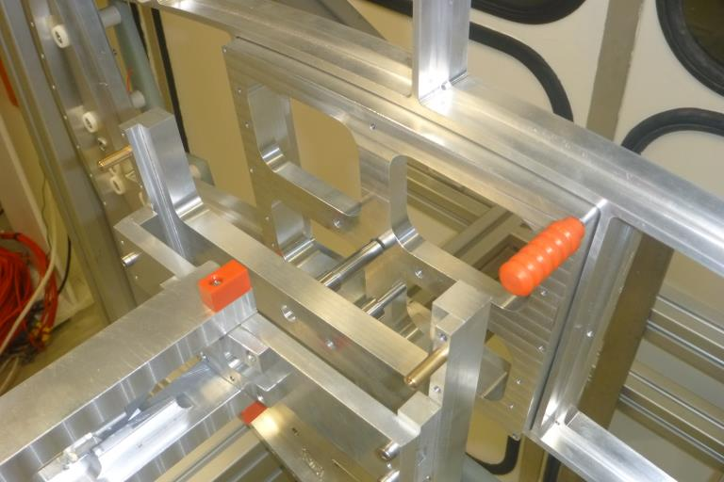
Space frame endplate
Adjustment plate
Module holding bracket

Slide 6
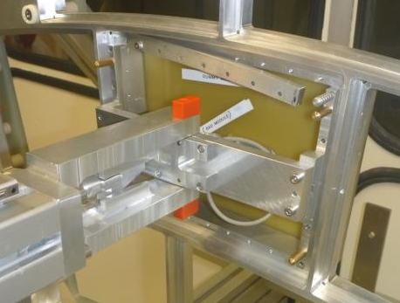
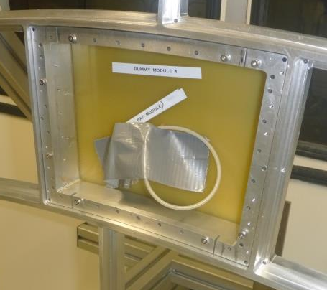
Space frame endplate
Back frame
Module holding bracket

