Slide 1
Octopuce-3 test @ CEA Saclay
Jan Timmermans

Slide 2
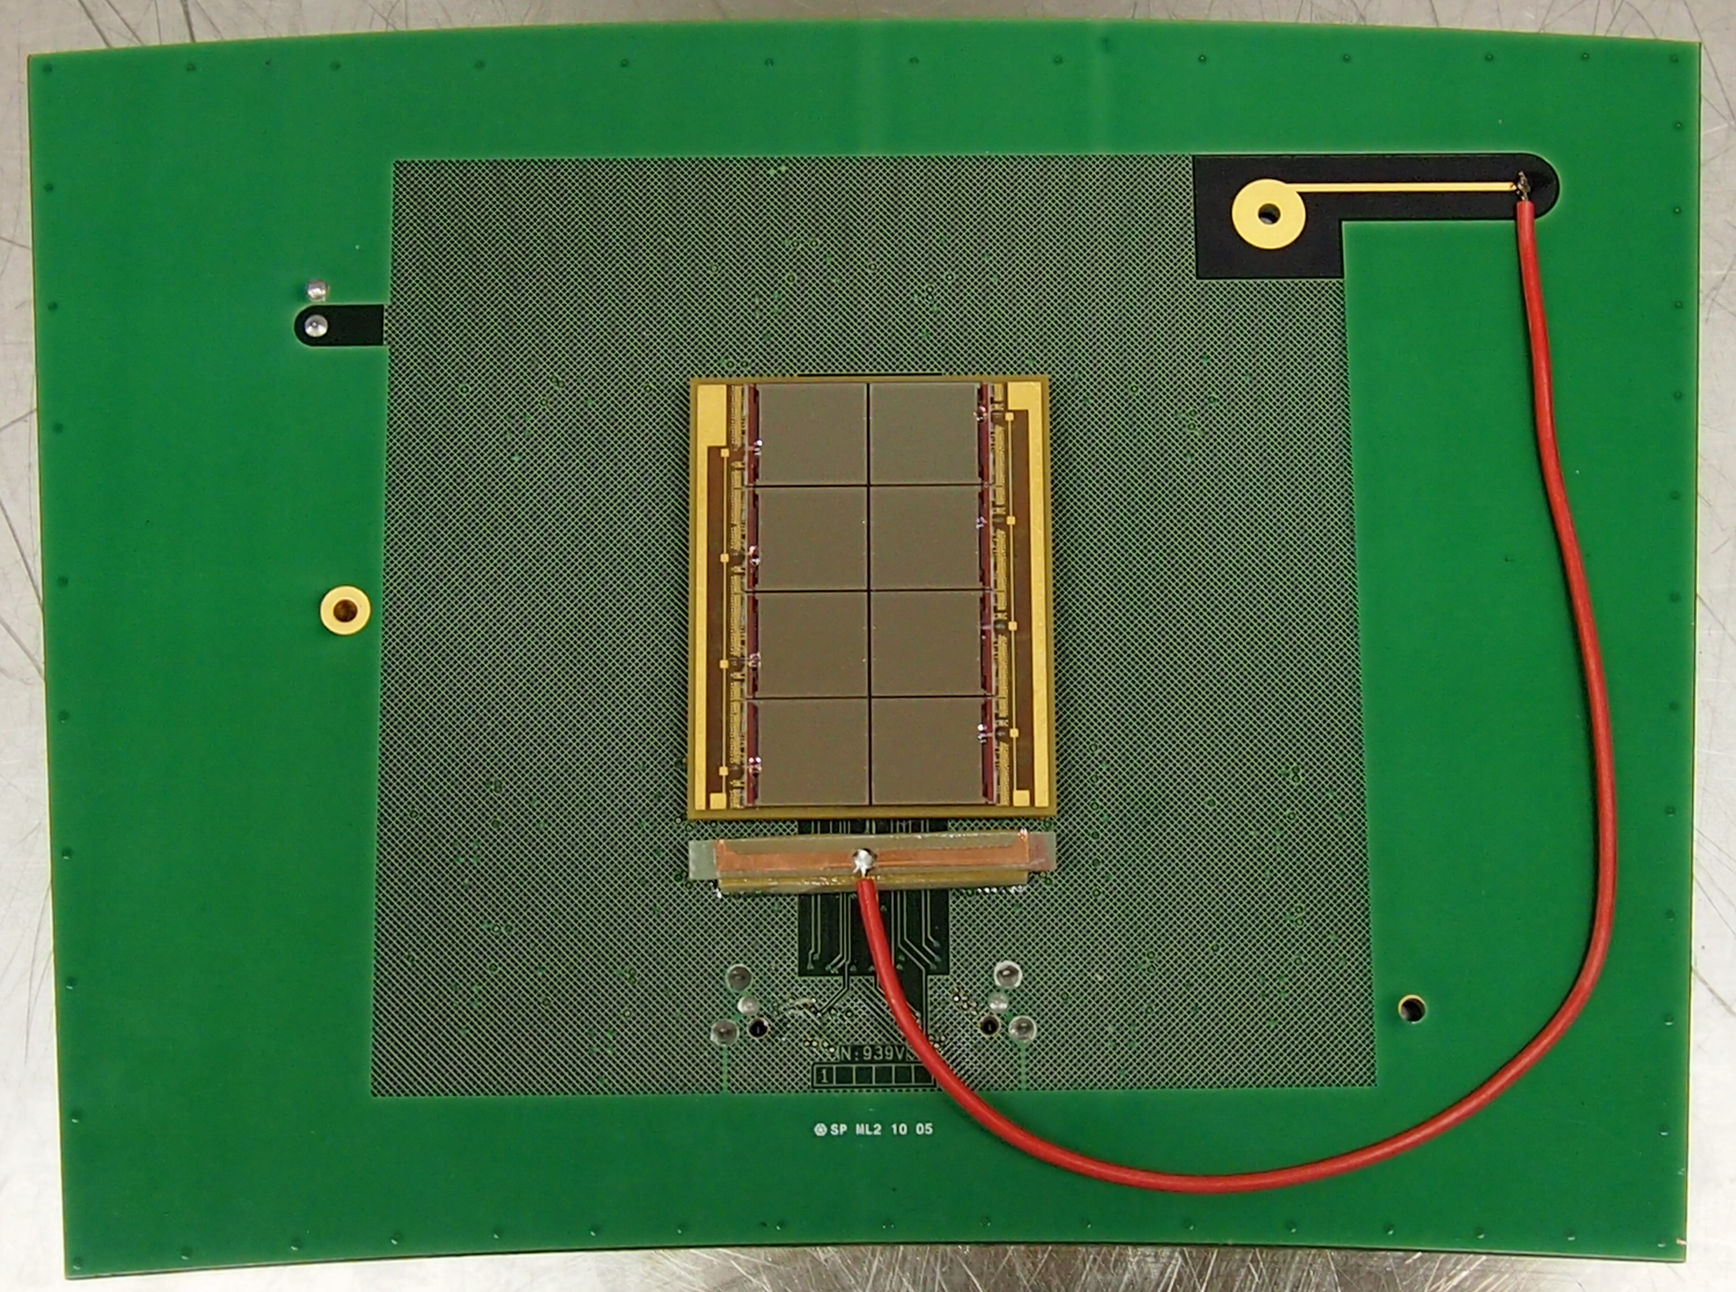
Octopuce-3 (on the way to a LC-TPC module)
Construction and test of 8-Ingrid (Octopuce) module by Jan Timmermans (+ CEA Saclay)
Cosmics, laser tests, DESY testbeam 3/2014
Cosmic interacting in wall of gas testbox
524k pixels of 55x55 (μm)²

Slide 3
To show the ‘invisible’?
Cosmic interacting in wall of gas testbox

Slide 4
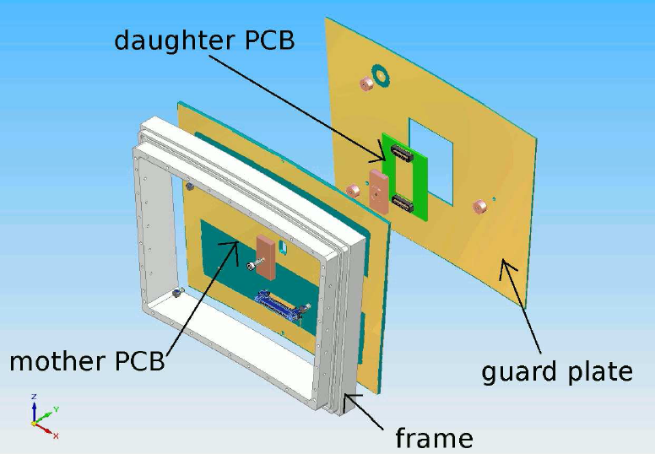
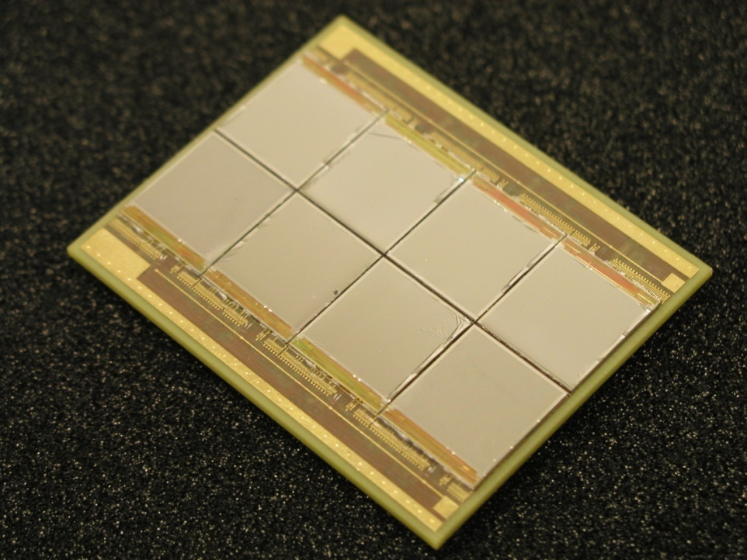
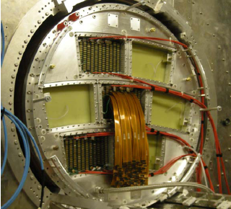
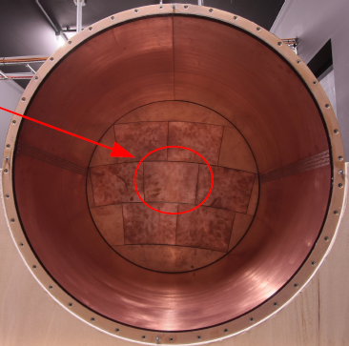
8 Ingrids on daughter board
LPTPC with 7 detector slots
inside1 T solenoid

Slide 5
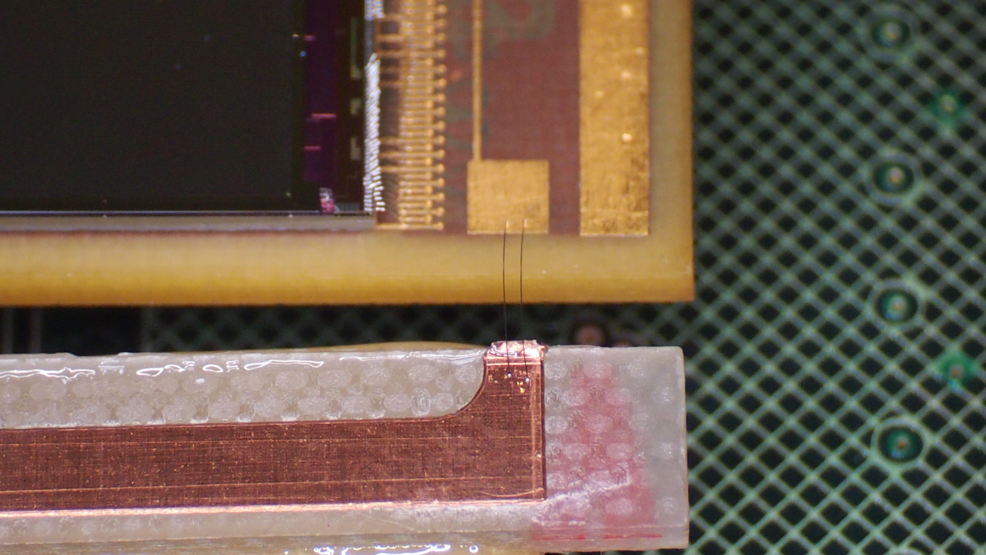
HV wire-bond connection

Slide 6
90Sr Integral 1000 frames
(Internal) boundaries seem narrower than for
Octopuce-1 run in 2010

Slide 7
Event 862

Slide 8
Event 1865

Slide 9
Event 1895

Slide 10
Event 2194

Slide 11
Event 2468

Slide 12
Event 2580

Slide 13
Event 3722

Slide 14
Event 3889

Slide 15
Event 3987

Slide 16
Event 4298

Slide 17
Event 4554

Slide 18
Plans Jan-Feb 2014 (preparations beam test)
Modification testbox (quartz entry window for N₂ laser)
Modification LP module frame (adapt to Octopuce + guard height)
Construct and electronics test Octopuce-4
As spare mezzanine module
Eventually prepare as LP module
Possibly simultaneous readout of two Octopuce modules
Hope for testbeam at LP (end-of-Feb or 1st week March)

