Slide 1
TL2 Optics Measurements FONT Meeting 20th Dec 2012
Jack Roberts

Slide 2
Overview
Changes to the TL2 lattice.
Nominal optics from MADX matching.
Nominal optics in the machine.
Kick measurements

Slide 3
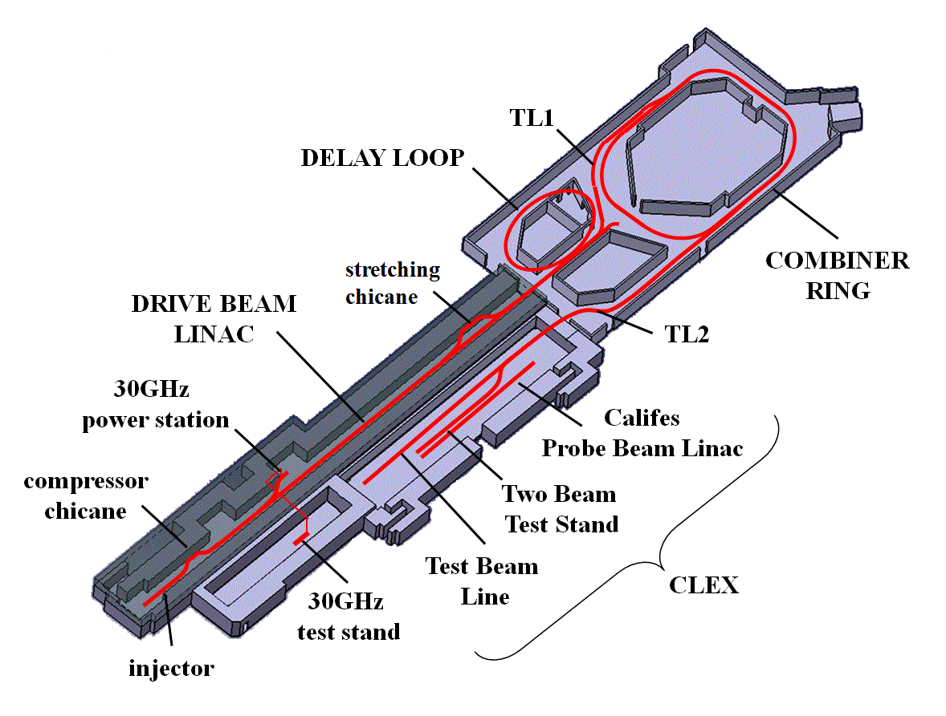
Where/What is TL2?
TL2

Slide 4
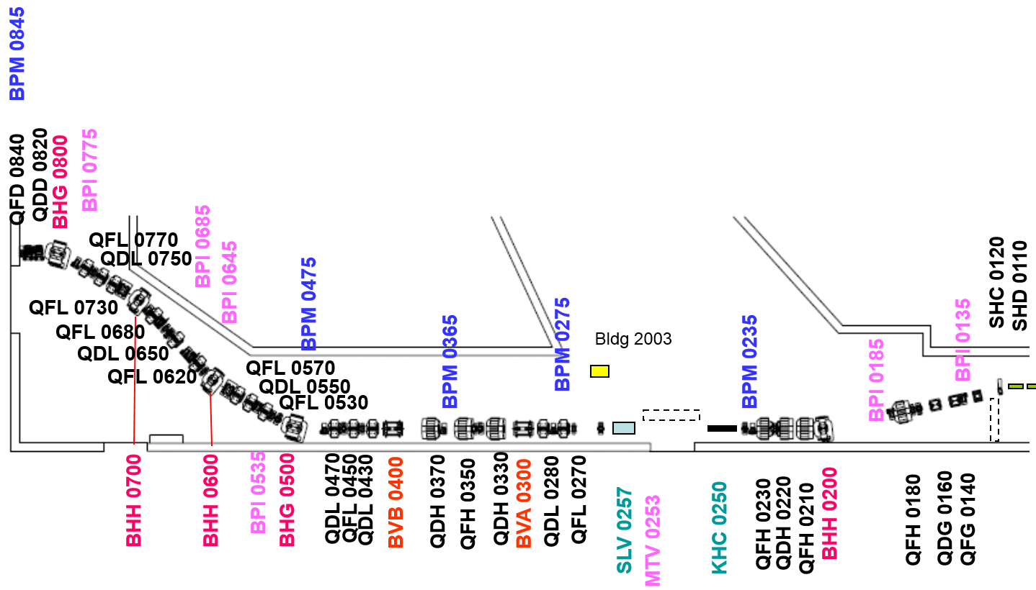
Old TL2 Lattice
DHF/DVF 0655
DHF/DVF 0345
DHD/DVD 0125
DHF/DVF 0765
DHF/DVF 0435
DHF/DVF 0175
CORRECTORS
DHF/DVF 0855
DHF/DVF 0525
DHF/DVF 0225
DHF/DVF 0615
DHF/DVF 0253

Slide 5
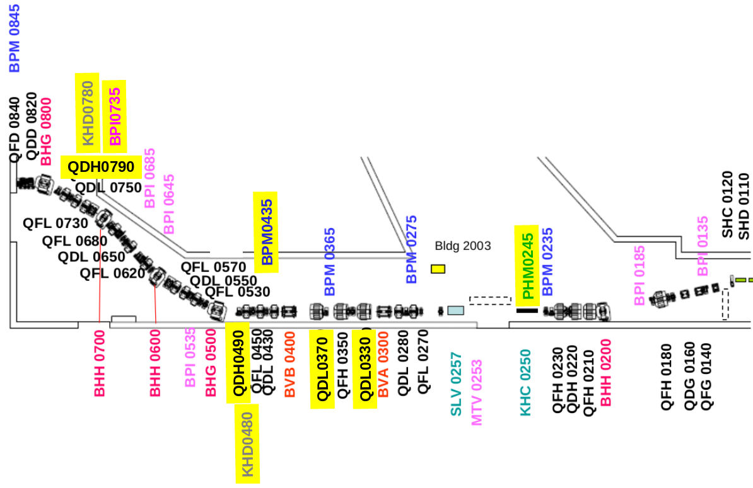
New TL2 Lattice
DHF/DVF 0655
DHF/DVF 0345
DHD/DVD 0125
DHF/DVF 0465
DHF/DVF 0175
CORRECTORS
DHF/DVF 0765
DHF/DVF 0525
DHF/DVF 0225
DHF/DVF 0855
DHF/DVF 0615
DHF/DVF 0265

Slide 6
TL2 Ideal Nominal Optics
Dispersion closed
Dxy < 1.2m
Betas < 80m but >0.5m
Alphas < 20m
Low betas (<15m) in long (7m) drift in girder 2.
R56 = 0.0, +0.2, -0.2 through horizontal dog leg.
These constraints are relaxed for the phase feedforward optics to obtain larger R52 etc.
MADX matching…

Slide 7
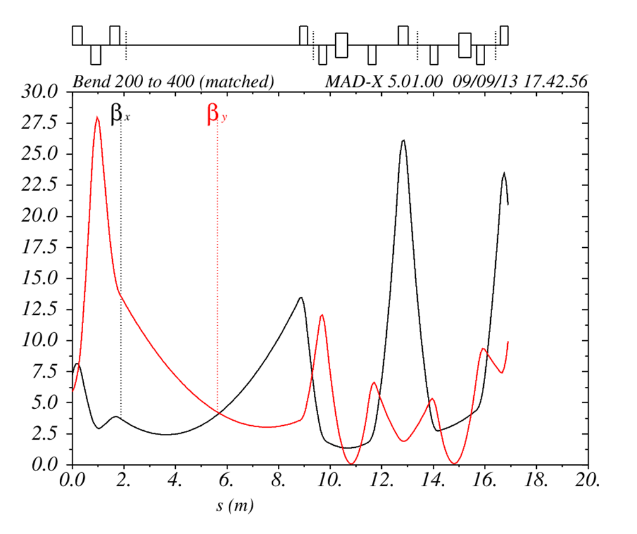
Matched Nominal Optics: Start to Vertical Chicane Exit

Slide 8
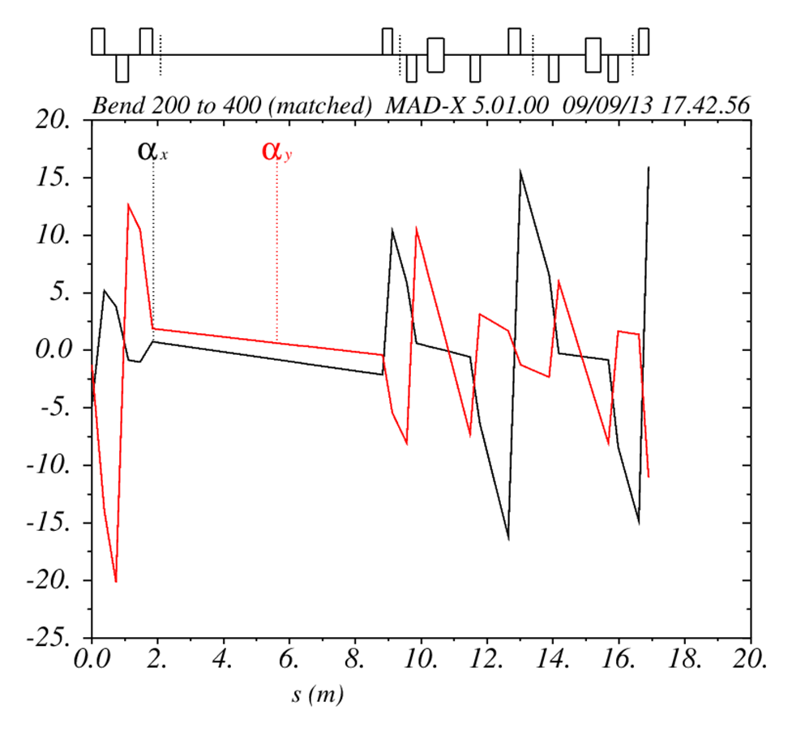
Matched Nominal Optics: Start to Vertical Chicane Exit

Slide 9
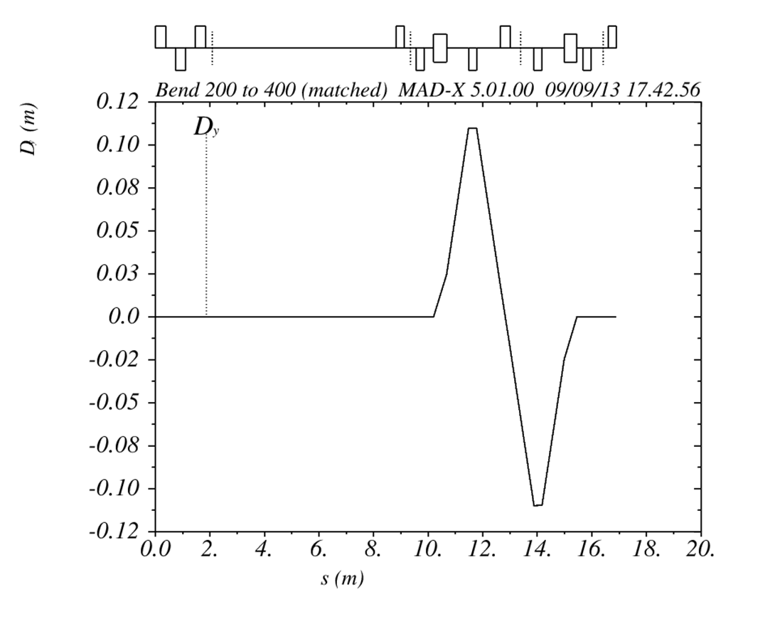
Matched Nominal Optics: Start to Vertical Chicane Exit

Slide 10
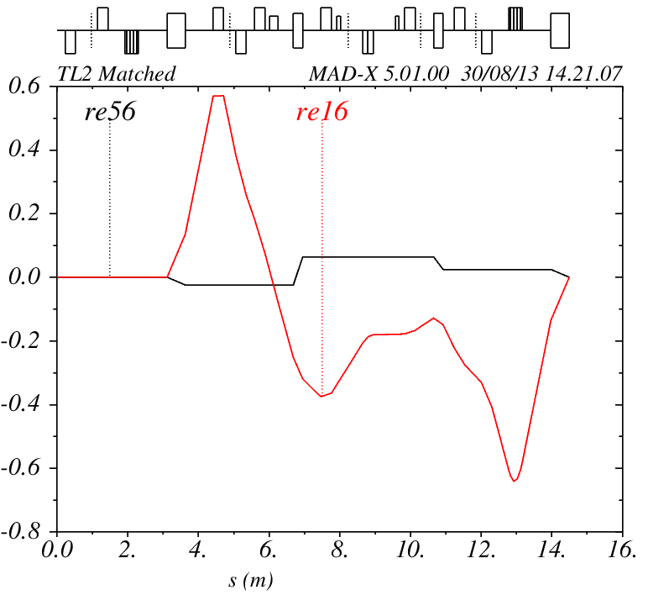
Matched Nominal Optics: Horizontal Dog Leg

Slide 11
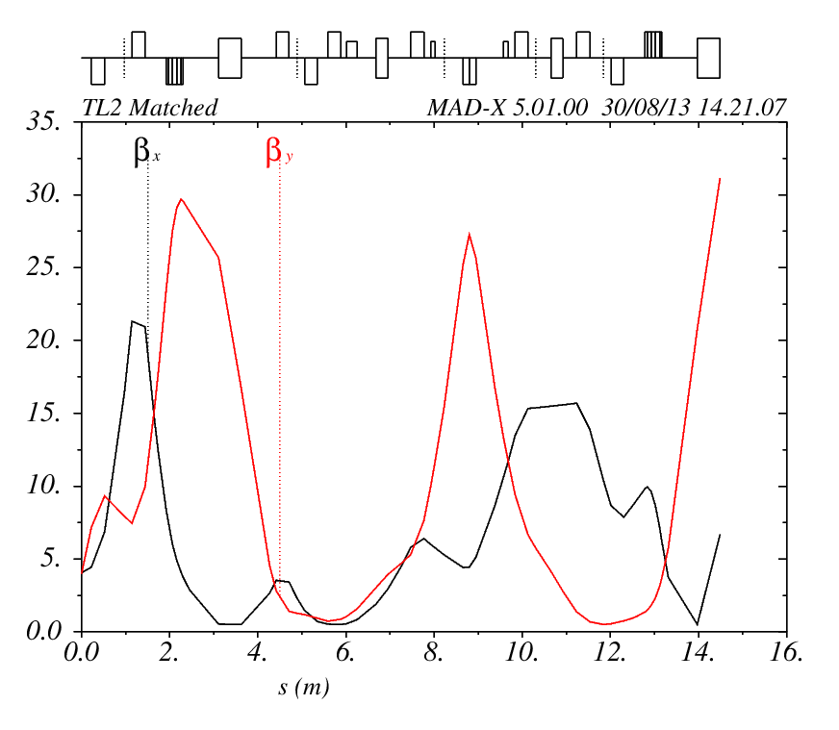
Matched Nominal Optics: Horizontal Dog Leg

Slide 12
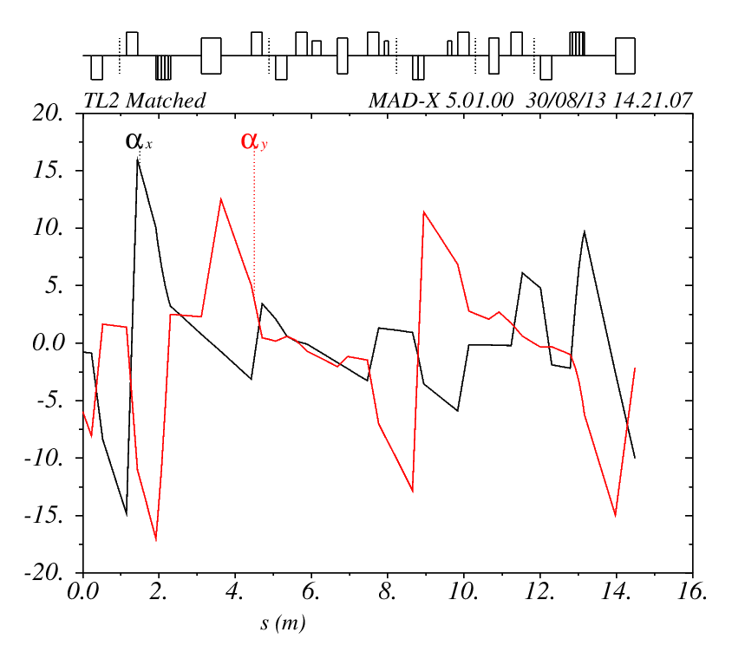
Matched Nominal Optics: Horizontal Dog Leg

Slide 13
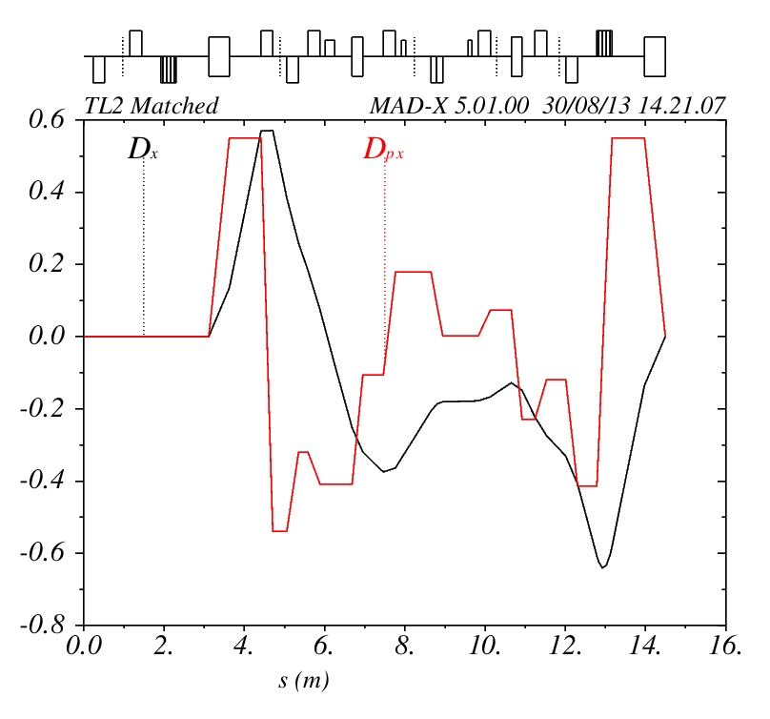
Matched Nominal Optics: Horizontal Dog Leg

Slide 14
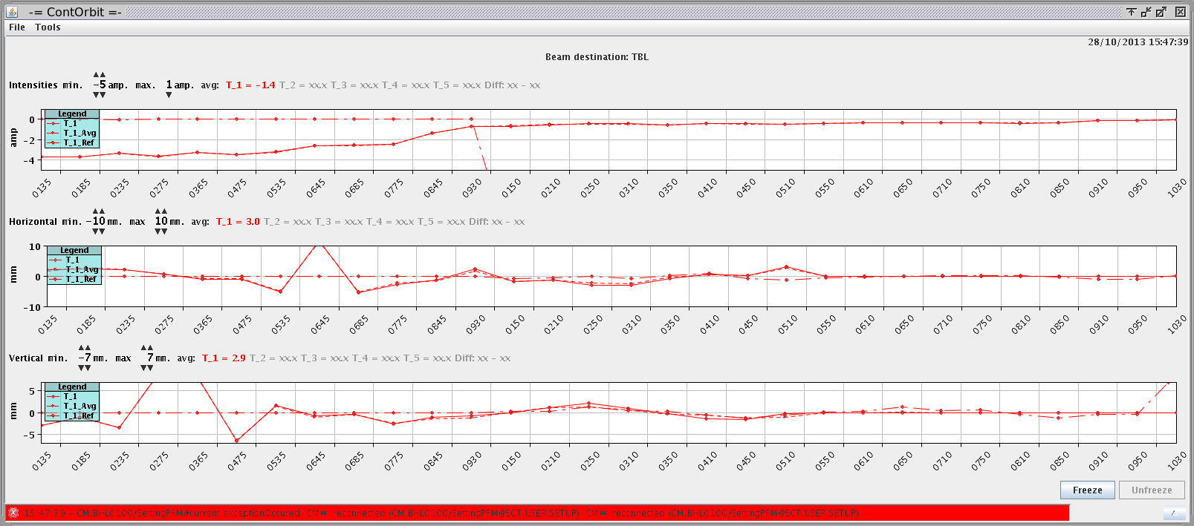
Matched Optics in the Machine
Lose all the beam by the end of TL2…

Slide 15
Full Transmission Through TL2
Magnet | Model | Machine | Difference
cc.qfh0210 | 41.02 | 40.99 | 0%
cc.qdh0220 | 39.71 | 39.68 | 0%
cc.qfh0230 | 15.20 | 15.18 | 0%
cc.qfl0270 | 14.12 | 13.61 | -4%
cc.qdl0280 | 22.38 | 21.36 | -5%
cc.qdl0330 | 24.48 | 23.45 | -4%
cc.qfh0350 | 40.14 | 40.10 | 0%
cc.qdl0370 | 24.47 | 23.45 | -4%
cc.qdl0430 | 16.13 | 18.11 | 12%
cc.qfl0450 | 18.83 | 19.82 | 5%
cc.qdh0490 | 23.11 | 27.09 | 17%
cc.qfl0530 | 24.42 | 24.09 | -1%
cc.qdl0550 | 9.28 | 9.27 | 0%
cc.qfl0570 | 9.12 | 9.11 | 0%
cc.qfl0620 | 10.10 | 10.09 | 0%
cc.qdl0650 | 12.47 | 11.46 | -8%
cc.qfl0680 | 5.51 | 5.51 | 0%
cc.qfl0730 | 5.85 | 5.85 | 0%
cc.qdl0750 | 10.89 | 10.88 | 0%
cc.qdh0790 | -47.35 | -47.32 | 0%
cc.qdd0820 | 36.15 | 46.10 | 28%
cc.qfd0840 | 35.29 | 49.98 | 42%
cc.qfl0910 | -11.13 | -11.70 | 5%
cc.qdl0920 | -12.24 | -14.23 | 16%
One of the girder 4 quads (430/450/490) was found to have incorrect polarity. Cables were swapped back to correct it.
Tweaks made to quad currents to get full transmission (left).
Quad scan measurements still showed large emittance blow up in TL2.
Kick measurements to identify location and magnitude of errors in the machine/model.

Slide 16
Kick Measurements
Use the correctors to kick the beam (horizontal and vertical with different amplitudes).
Record the beam position in the BPMs as a result of the kick.
Compare the measured kicked orbit to the MADX model.
Identify where the discrepancies are and try to fix them.

Slide 17
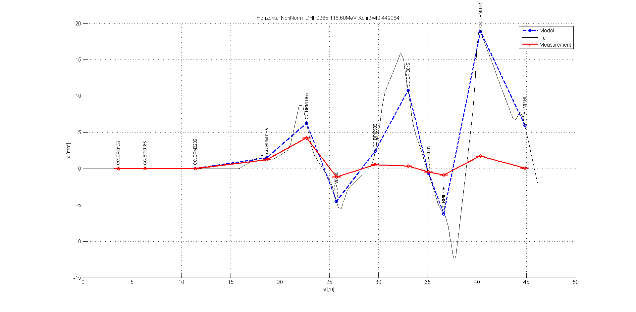
Example: Corrector 265, Horizontal

Slide 18
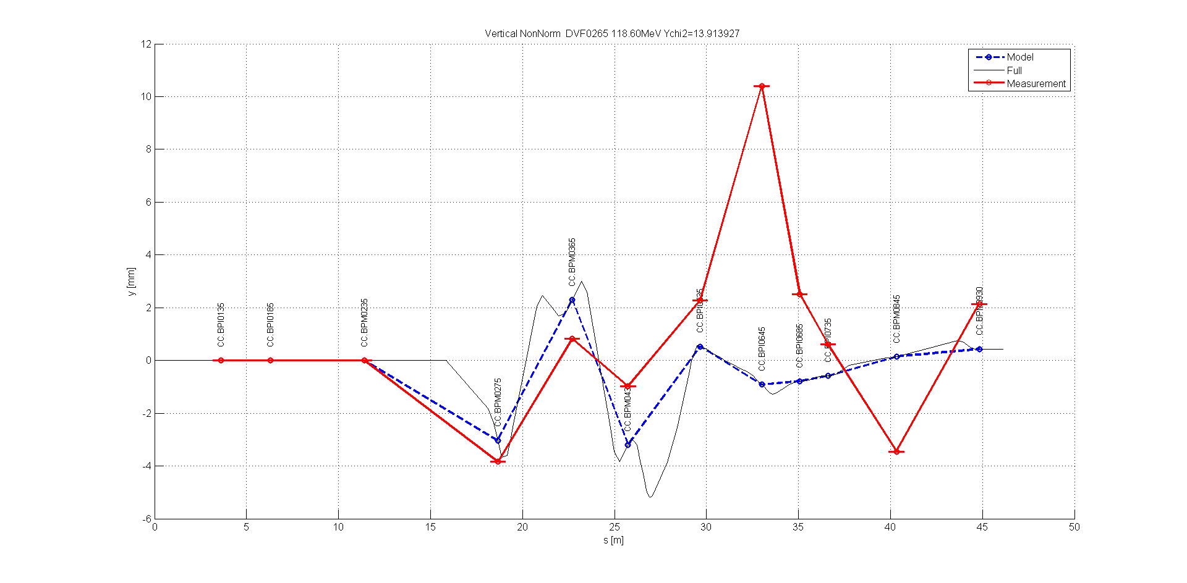
Example: Corrector 265, Vertical

Slide 19
Possible Errors
Dipole focusing: vertical edge focusing and horizontal focusing.
L type quadrupole strength.
Quadrupole polarity.
Corrector scaling.
BPM scaling.
Try to correct by hand or with MADX matching using measurements as constraints.

Slide 20
Data Sets
All quads on.
Girder 5,6,7,8 quads off (bend 600/700 focusing).
Girder 4,5,6,7,8 quads off (bend 500/800 focusing).
Girder 2,3,4 quads off (bend 300/400 focusing).
Only 1 quad on in horizontal dog leg (quad strength/polarity).

Slide 21
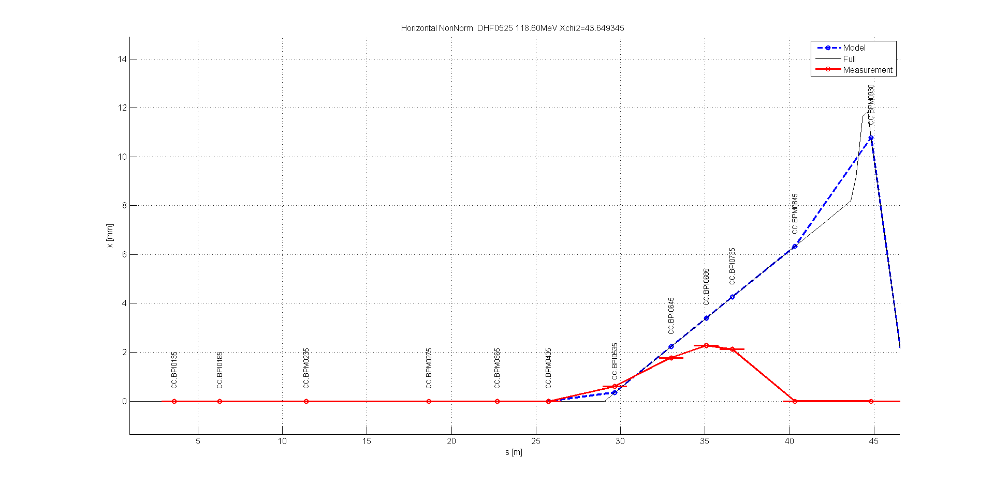
Girder 5,6,7,8 Quads Off – Corrector 525 Horizontal
LOSSES

Slide 22
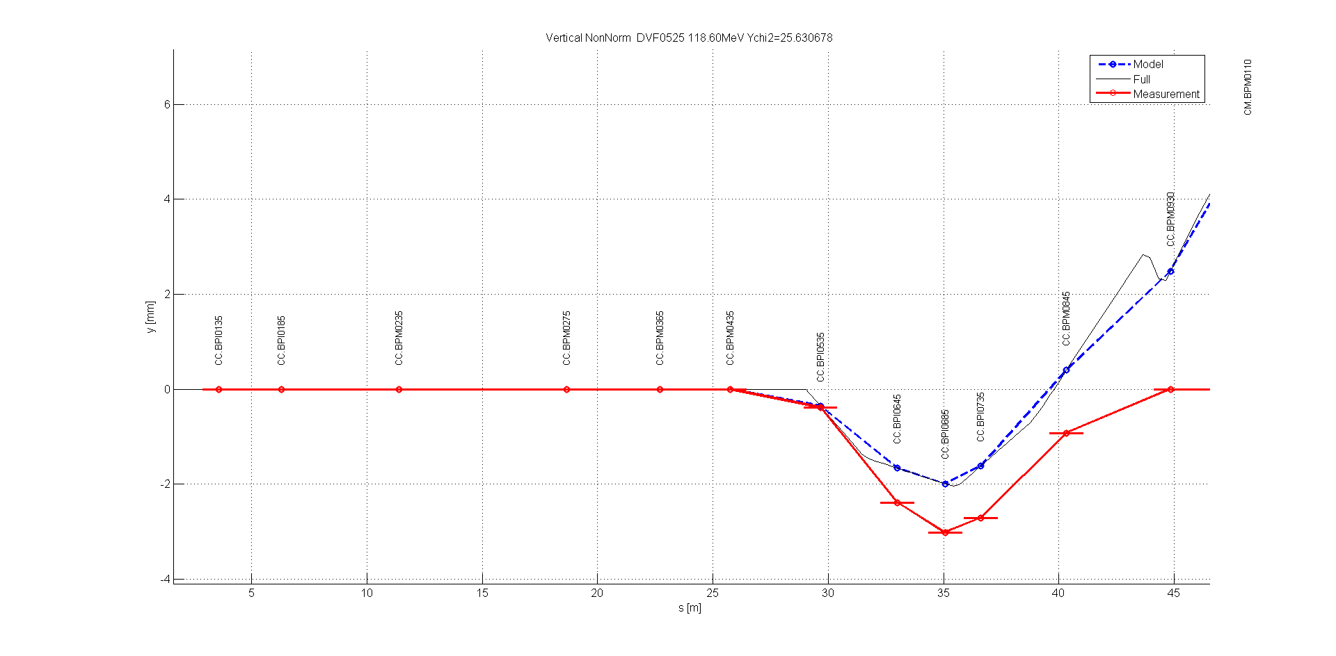
Girder 5,6,7,8 Quads Off – Corrector 525 Vertical
LOSSES

Slide 23
600 and 700 Bend Focusing Matching
With the girder 5,6,7,8 quads off data with multiple correctors the following parameters were matched in MADX:
Global corrector scaling (kick strength): 0.68
Bend 600/700 pole face rotation angle (rbend/sbend): 0.62*(bendAngle/2).
Bend 600/700 FINT (vertical edge focusing) = 1.28
Bend 600/700 HGAP (vertical edge focusing) = 0.005 m.

Slide 24
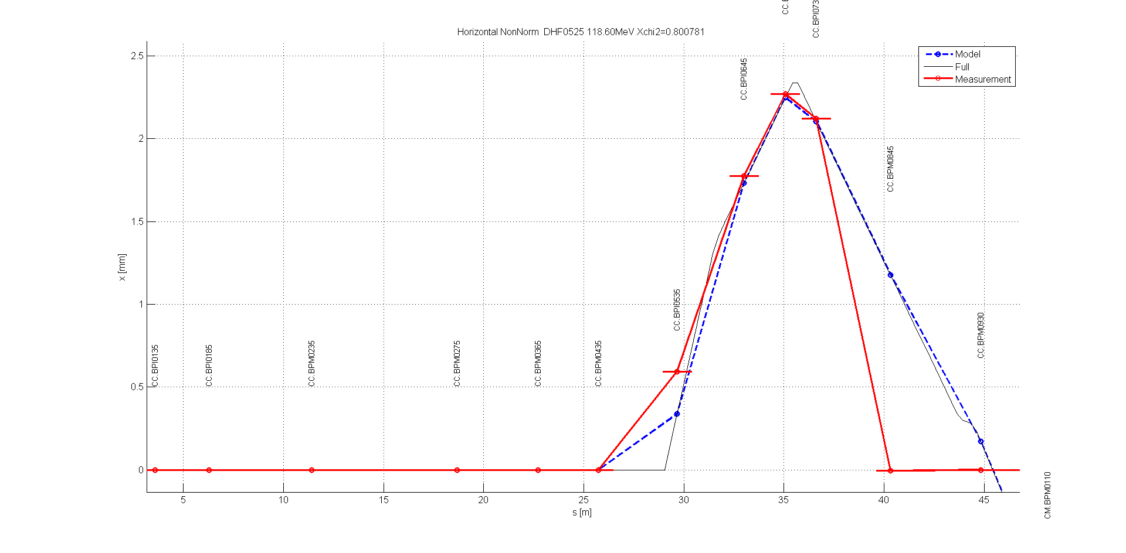
Girder 5,6,7,8 Quads Off – Corrector 525 Horizontal AFTER MATCHING
LOSSES

Slide 25
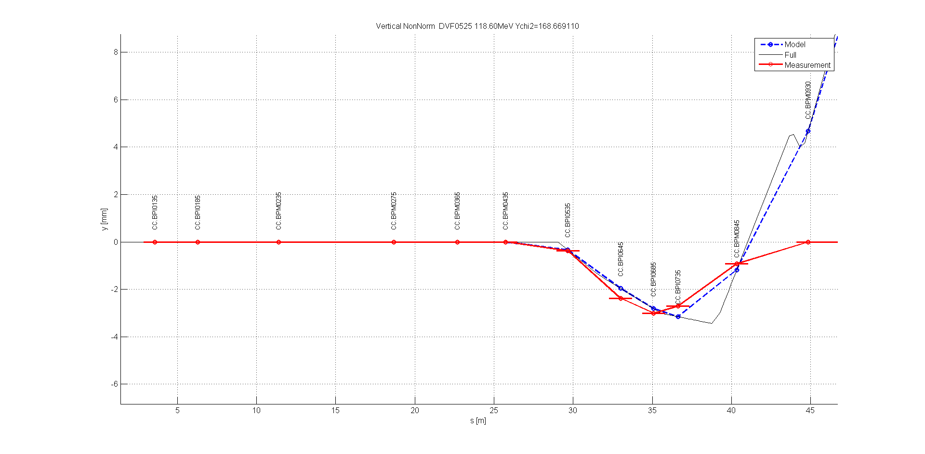
Girder 5,6,7,8 Quads Off – Corrector 525 Vertical AFTER MATCHING
LOSSES

Slide 26
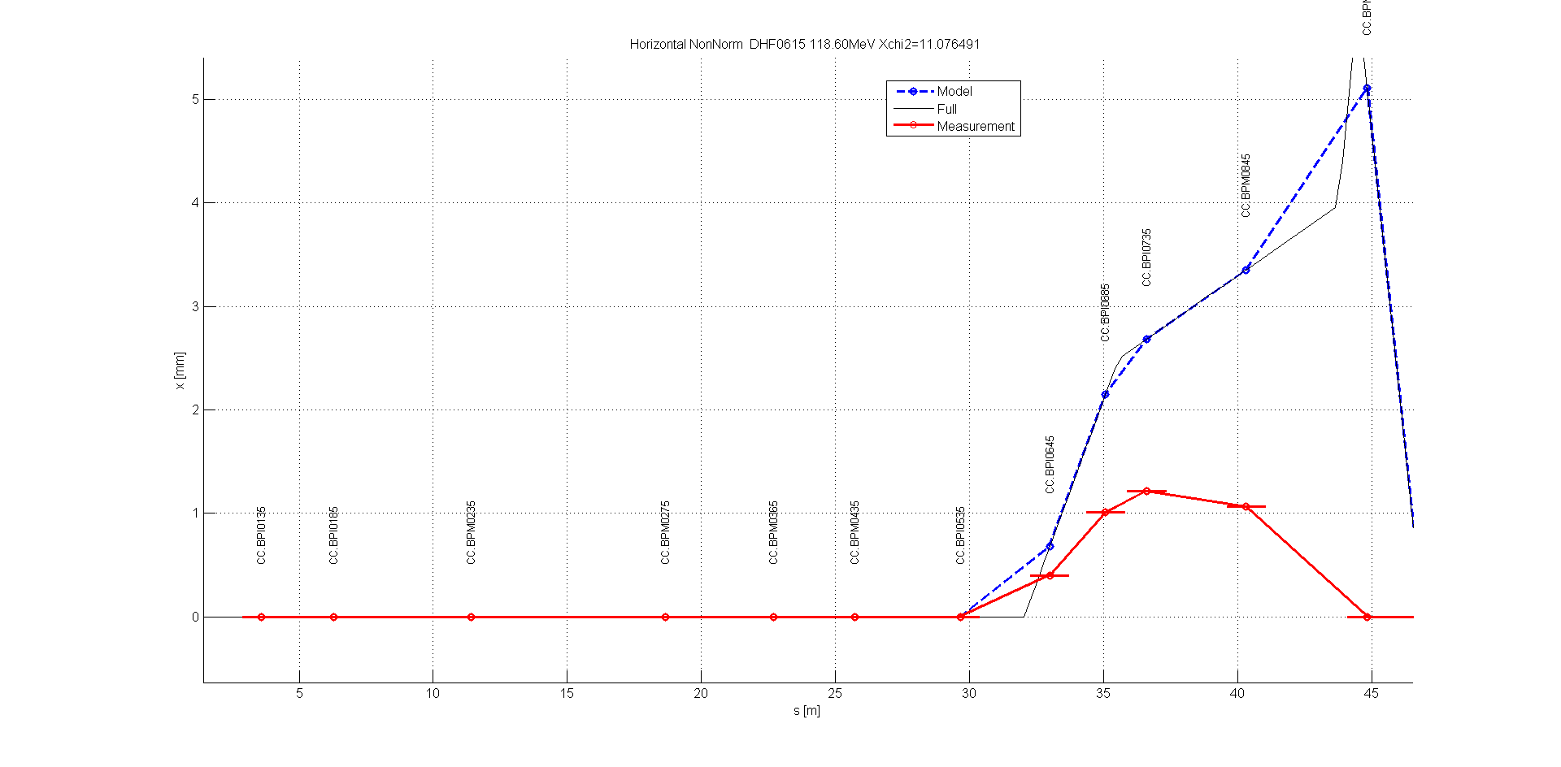
Girder 5,6,7,8 Quads Off – Corrector 615 Horizontal AFTER MATCHING
LOSSES

Slide 27
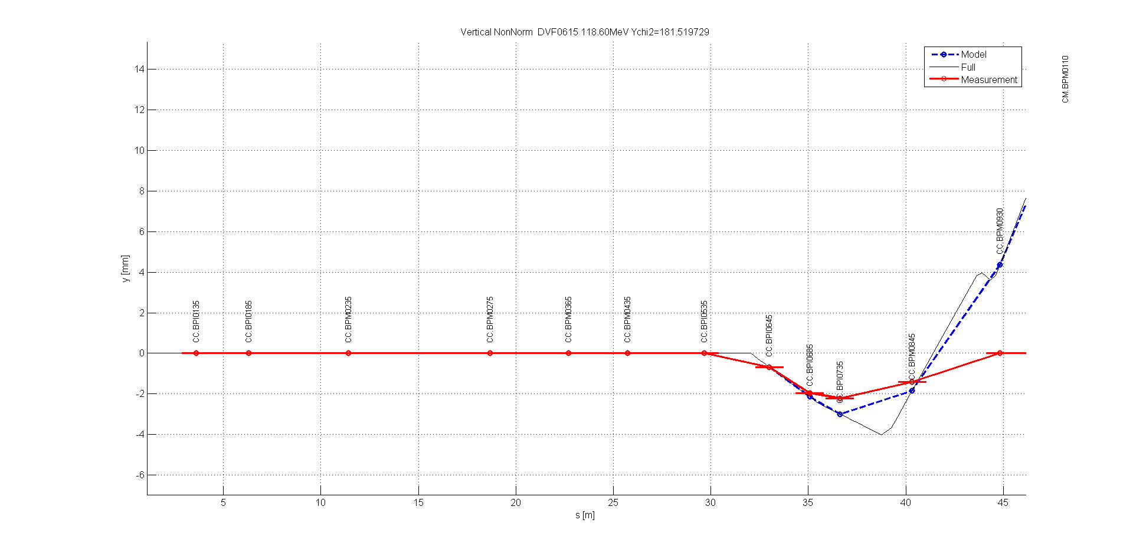
Girder 5,6,7,8 Quads Off – Corrector 615 Vertical AFTER MATCHING
LOSSES

Slide 28
BPM/Kicker Scaling
With the quads off the section from corrector 615, through BPM 645 and BPM 685 is a drift (no bends, no quads).
Assuming model positions are correct, can use this to find the correct BPM and kicker scaling.
BPI0685
DHF0615
BPI0645

Slide 29
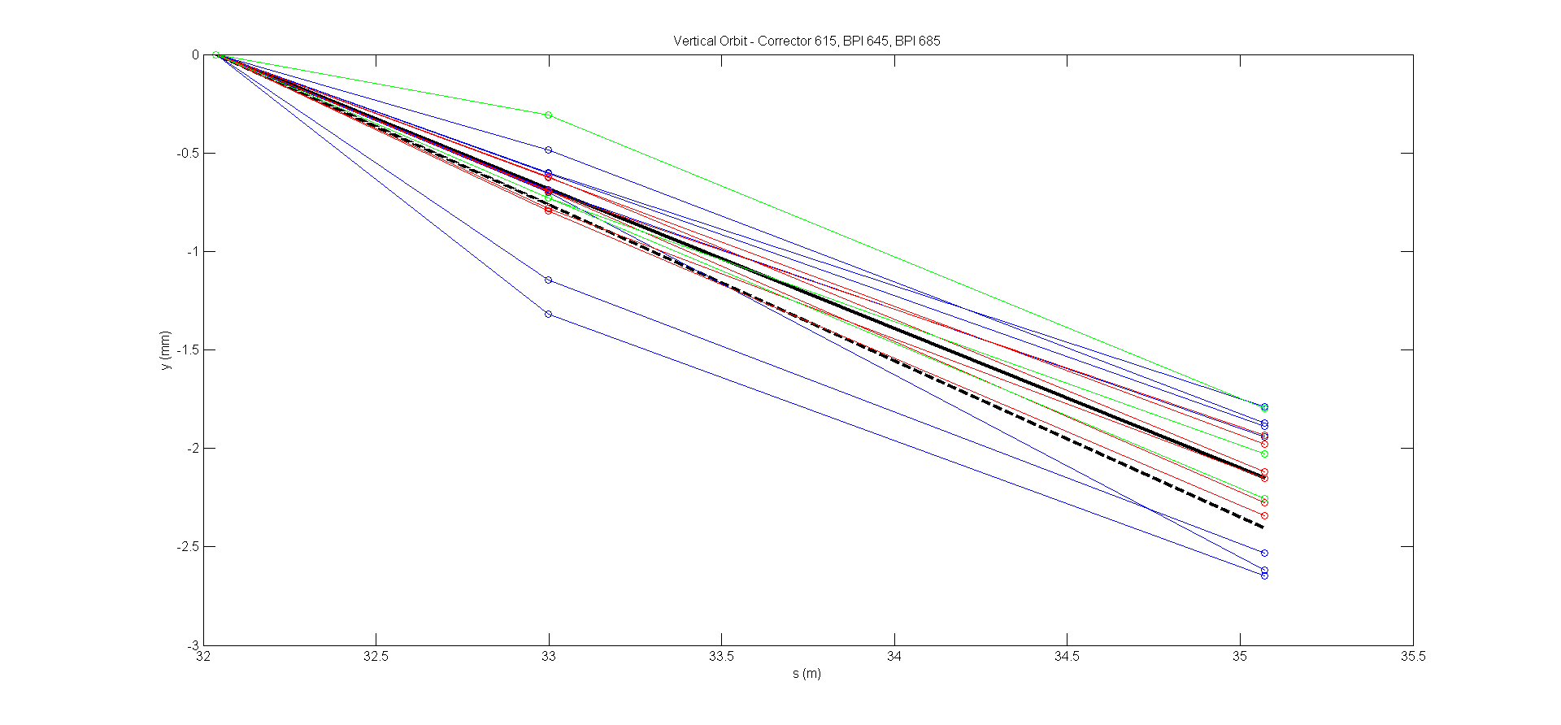
Vertical Corrector/BPM Scaling
SCALED
ORIGINAL
Corrector 615 scaling: 0.89 +/- 0.08
BPM 645 scaling: 1.05 +/- 0.09
BPM 685 scaling: 1.02 +/- 0.03

Slide 30
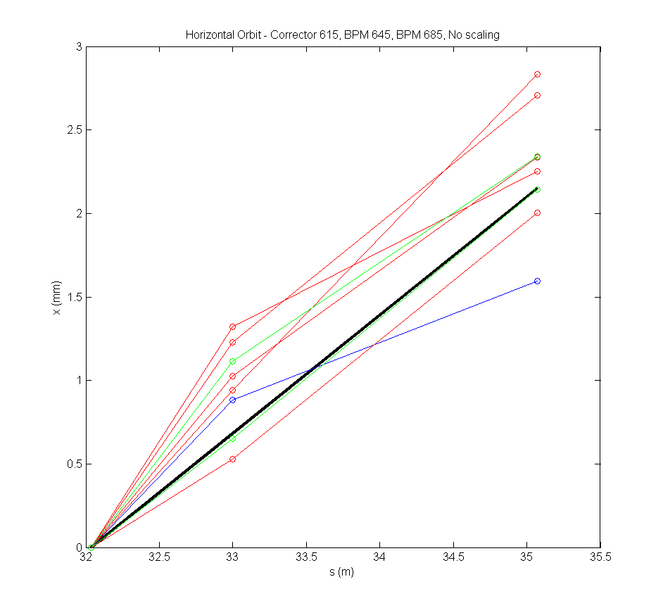
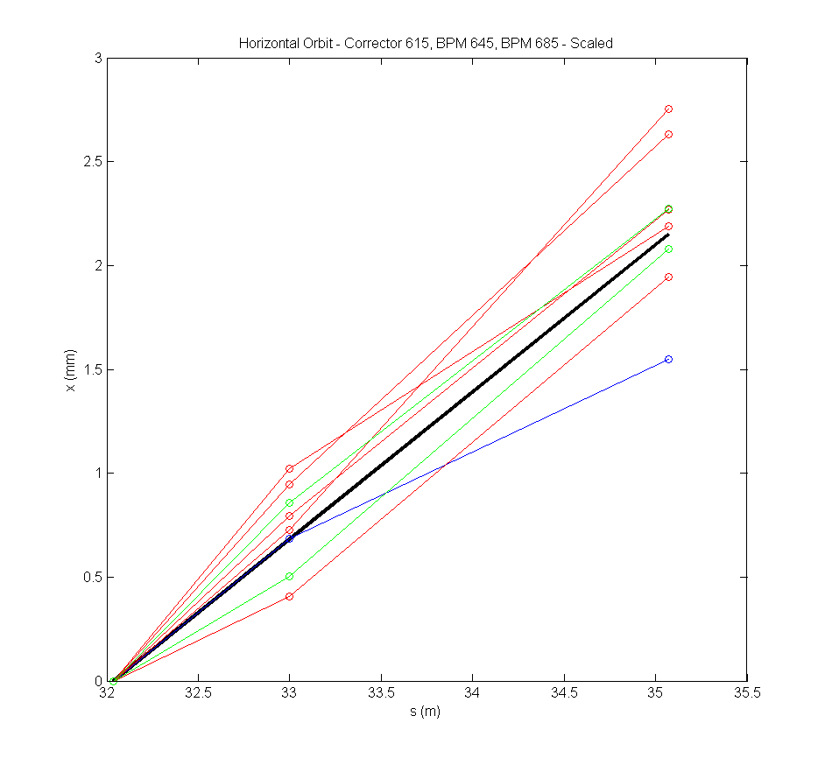
Horizontal Corrector/BPM Scaling
ORIGINAL
BPMs SCALED
BPM 645 scaling: 0.77 +/- 0.09
BPM 685 scaling: 0.97 +/- 0.07

Slide 31
Summary
Quadrupoles, correctors and BPMs moved in TL2 to accommodate phase feedforward kickers.
New nominal optics derived from MADX matching.
Matched MADX values need a lot of tweaking to get full transmission in the machine.
Kick measurements to identify errors in the machine/model are ongoing and far from conclusive so far.

