Slide 1


Further BPM Processor Studies
Mikey Davis
20 November 2013
1/5

Slide 2
Introduction
I followed up what I did last week with further work
Improved my analysis to fit the phase sensitivity
Looked at converting units of the RCPS to degrees @ 714
Analysed a scan I took of resolution vs RCPS setting
Mikey Davis
20 November 2013
2/5

Slide 3
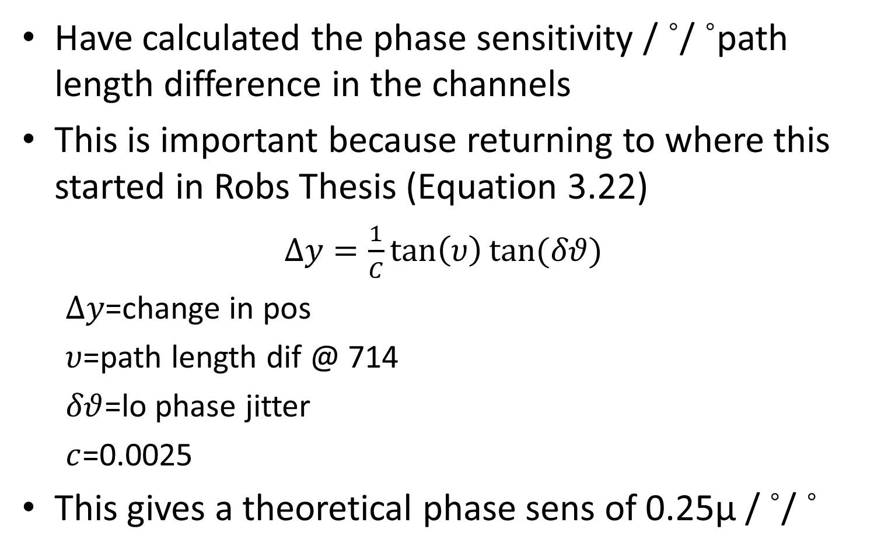
Phase Sensitivity vs Path Dif
Have calculated the phase sensitivity / ˚/ ˚path length difference in the channels
This is important because returning to where this started in Robs Thesis (Equation 3.22)
$∆y=\frac{1}{C}\tan\left(υ\right)tan⁡(δθ)$
$∆y$=change in pos
$υ$=path length dif @ 714
$δθ$=lo phase jitter
$c$=0.0025
This gives a theoretical phase sens of 0.25μ / ˚/ ˚
Mikey Davis
20 November 2013
3/5

Slide 4
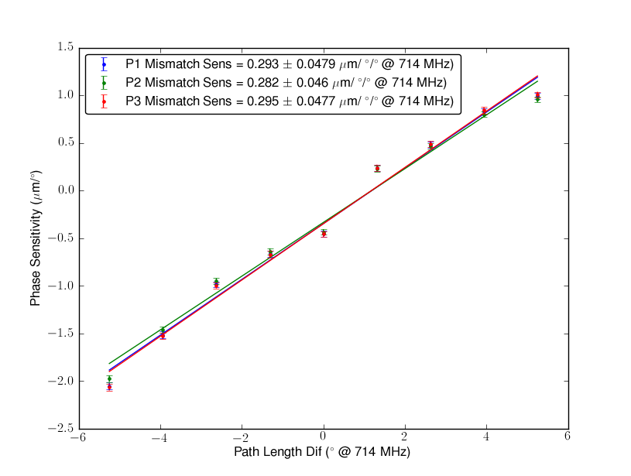
Results
Mikey Davis
20 November 2013
4/5

Slide 5
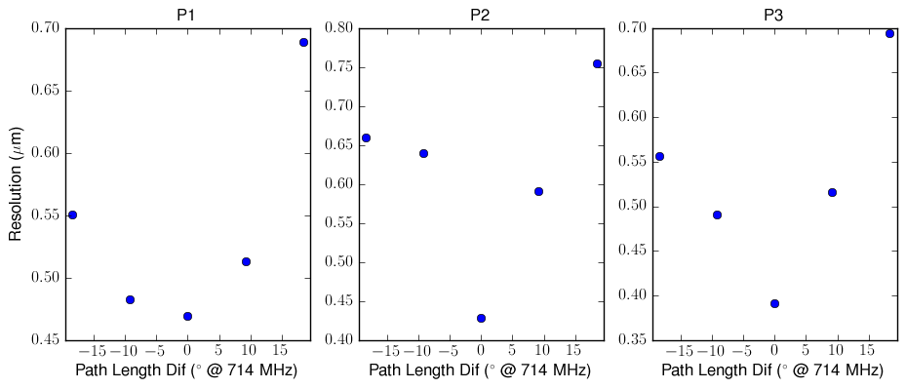
Reso vs RCPS Setting
Mikey Davis
20 November 2013
5/5

