Slide 1
Status and Plan of Compton γ-ray
Generation at KEK-ATF
Tsunehiko OMORI (KEK)
for
Japanese Labs. : KEK, ATF group,
Hiroshima University
13 February 2014
ATF Project Meeting at KEK

Slide 2
Laser-Compton Scheme
and
Laser Pulse Stacking

Slide 3
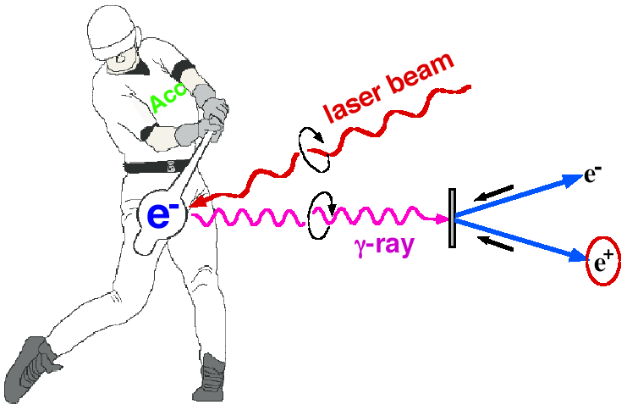

Introduction
Polarized e+ by laser Compton Scheme
Ee~1GeV for 10MeV gammas
easy to control polarization
Toward the positron sources
-> increase intensity of gamma rays

Slide 4

Miyoshi PosiPol2010
L_{cav}
λ
dL∝λ/enhancement << 0.01nm
for enhancement ~1000

Slide 5
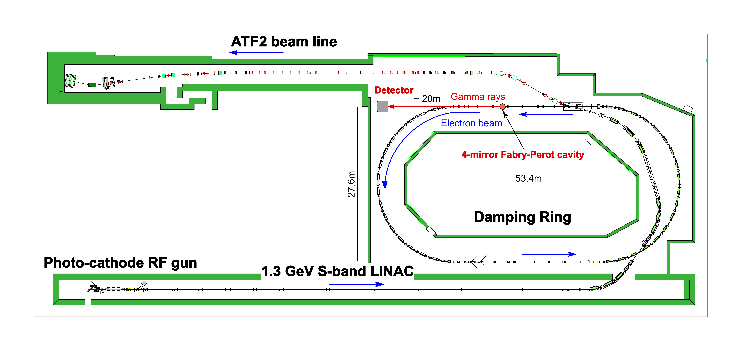
Experiments at the KEK ATF
γs
Cavity
1.3GeV
up to 10 bunches/train

Slide 6
KEK-Hiroshima
4-mirror Cavity

Slide 7
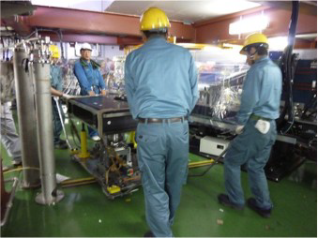
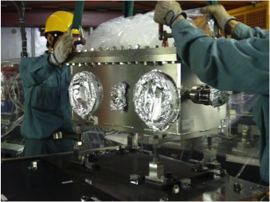
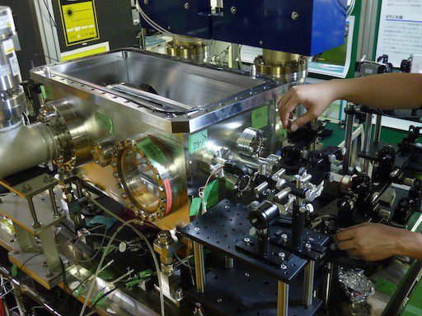
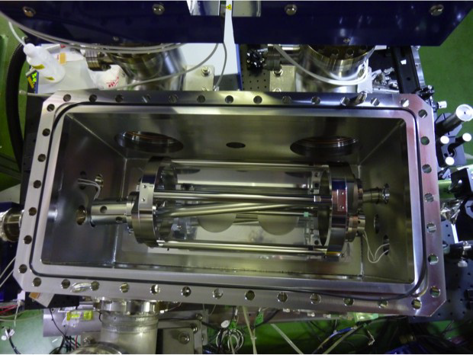
2011 Autumn: New KEK-Hiroshima Cavity was Installed

Slide 8
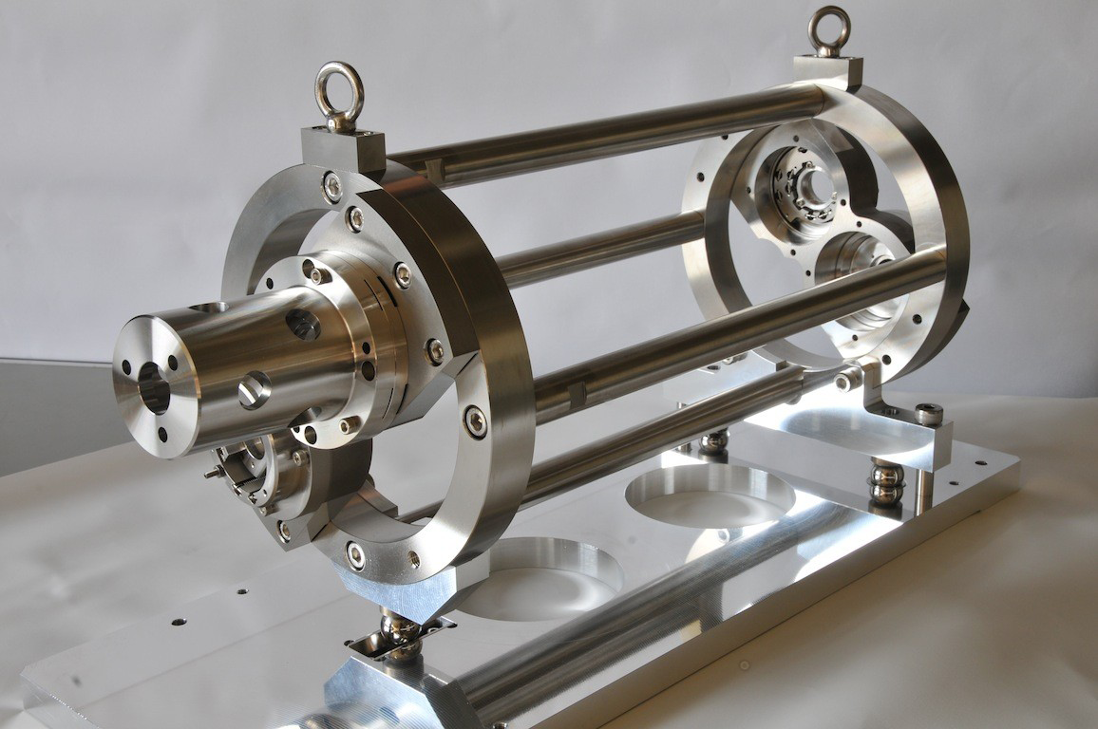
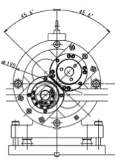
New KEK-Hiroshima Cavity (4-Mirror Cavity)
45.6°
45.6°
70mm
3D configuration (twisted) for round profile

Slide 9
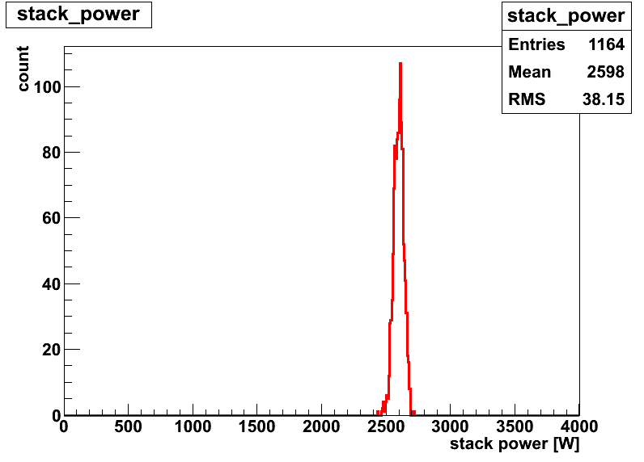
Stable resonance with small spot size
Stable resonance by new feedback sys. (analog)
2.6kW average power w/ 1.4% fluctuation
laser waist size at IP(σ)=13um (vertical scan)
Finesse 4040+-110 (Enhance = 1200)
2.6kW stacking
38W
4pm
(1.4%)
13um (V)
stack power [W]

Slide 10
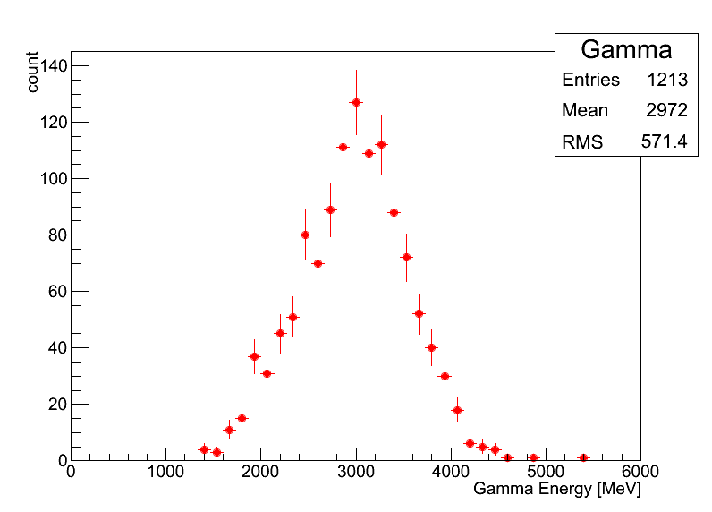
γ-ray Generation / electron
5bunches/train
laser
e-
γ
5.6ns
2970±20 MeV
⇒ ~128γs/trainのガンマ線に相当
ATF 2.16MHz
~2.6×10⁸/sec
Eγ[MeV]

Slide 11
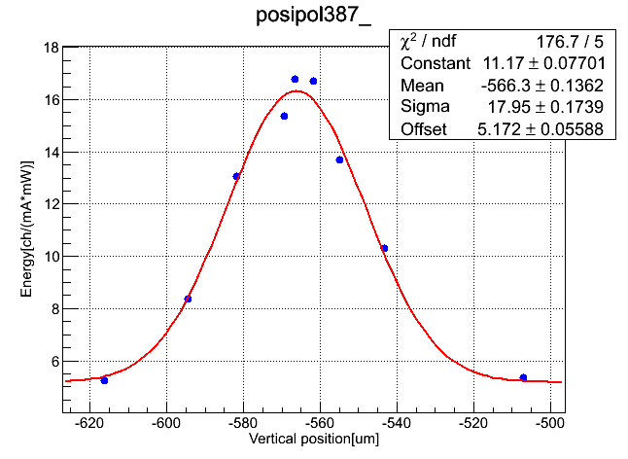
Laser vertical spot size 13μm achieved
vertical direction
σe=10μm
electrons
σL(V) =13μm
γ ray yield [A.U]
σ=16.8μm
it was 30μm w/ 2 M cavity
vertical position[μm]

Slide 12
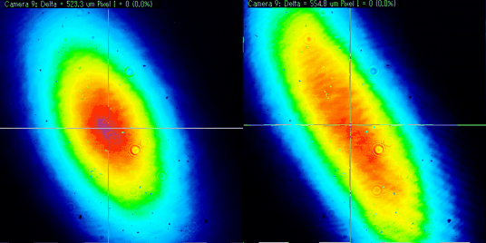
Laser profile at IP
Proflie measurement
of transmission light
Proflie Estimation
at IP vis T_matrix
V
σV ＝
1６μm
10um
30^{O}
H
27um
Vertical Position Scan
vertical direction
σe=10μm
γ ray yield [A.U]
σL(V) =13μm
σ=16.8μm
electrons
vertical position[μm]

Slide 13
Issues

Slide 14
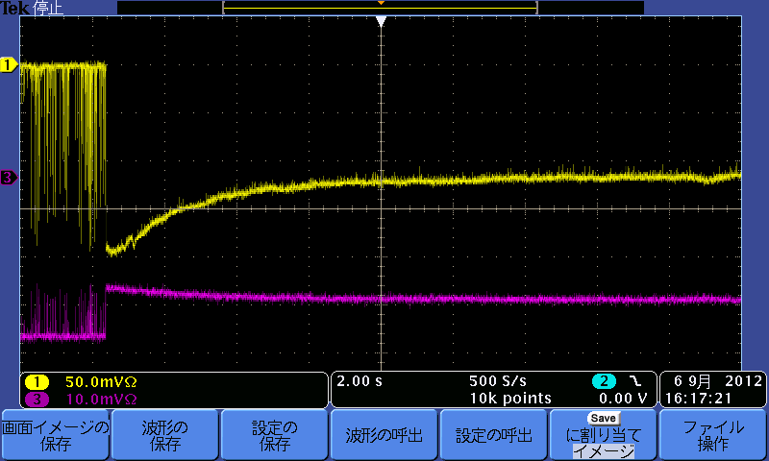
Issues
Issue (1)
Issue (2)
y
10um
Transmitted power
Reflected power
x
20s
27um
・Possibly a thermal effect
・Profile at the IP
Stored power decrease as time goes
Not round
must revisit optical property in the cavity
due to (unexpected) power loss on mirrors

Slide 15
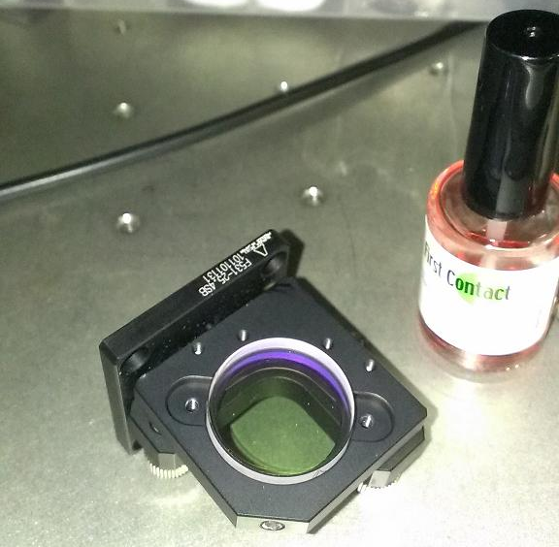
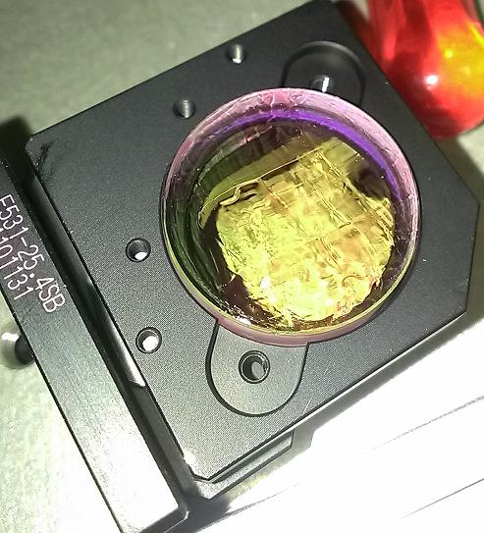
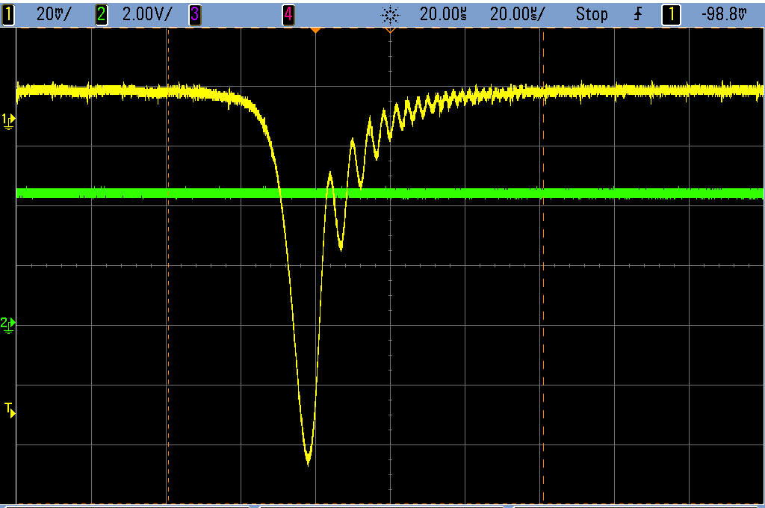
22nd Sep 2013
Issue (1) Cure:
Cleaning the mirrors w/ First Contact
洗浄薬品
洗浄の様子
透過光強度
共振器長
20um
Before
R = 0.999846 + - 0.000003
(Loss：50ppm）
After
R = 0.99986４ + - 0.000003
（Loss：30ppm）

Slide 16
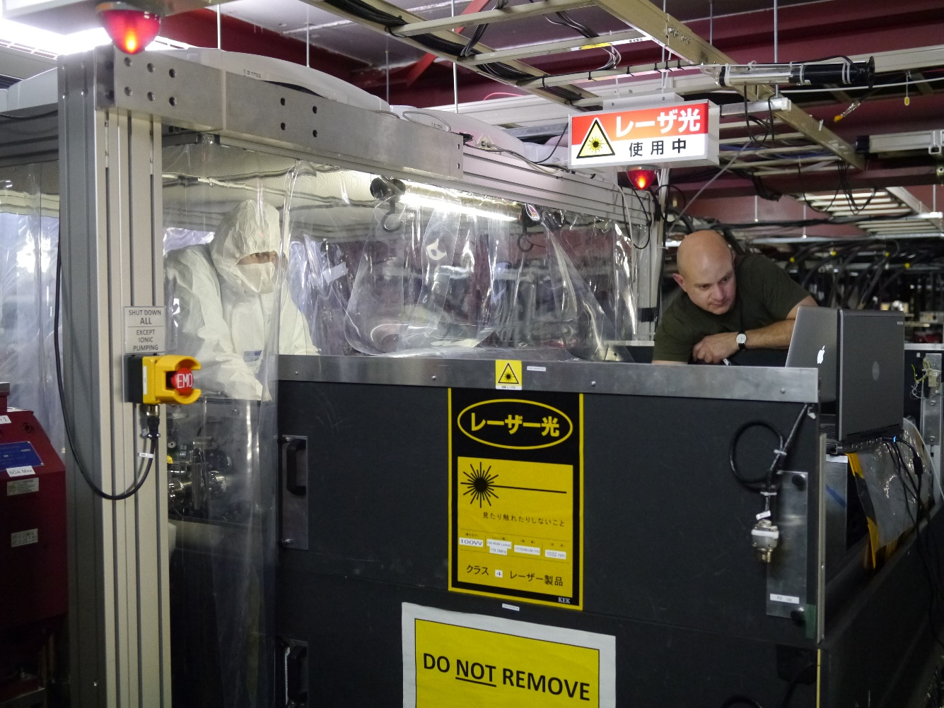
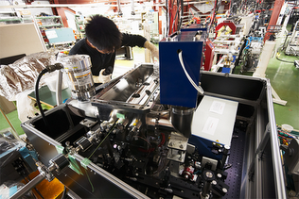
Issue (1) Cure:
We must be

Slide 17
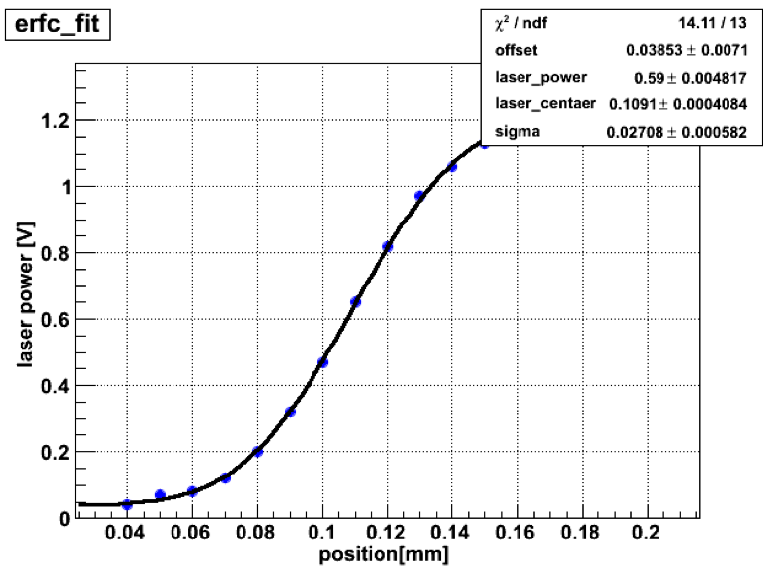
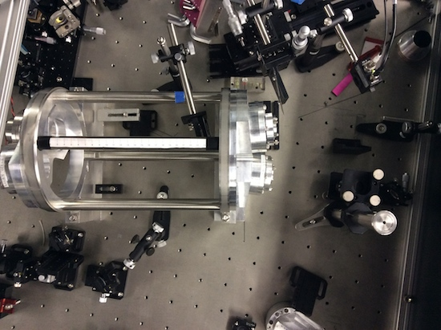
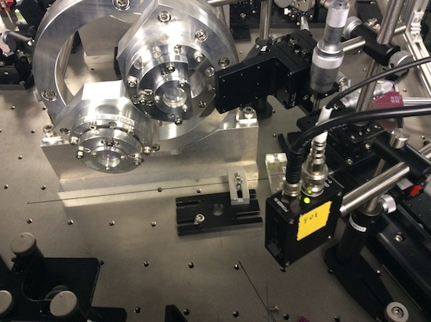
Issue (2) Study:
Quasi-direct Profile measurement at / near IP
knife-edge method
pellicle mirror
(thickness 2 µm)
detector
detector

Slide 18
Issue (2) Study:
Quasi-direct Profile measurement at / near IP

Slide 19
Summary

Slide 20
Summary
Current 3D4M cavity works well.
  we have basic technologies in our hand.
but,
  optical properties yet to be understood (profile is NOT round).
  mirrors should be studied for high power storage.
How to deal with Issues? It is clear.
  step back once to basic study(PHYSICS) to go forward.

Slide 21
Backups

Slide 22
next ?
Gloal: More than 100 times more power in the cavity
  power enhancement
  injection laser power
Mirrors with
  higher reflectivity
  low loss (LMA, REO, ATFilms)
Understand EM wave behavior in the cavities

Slide 23
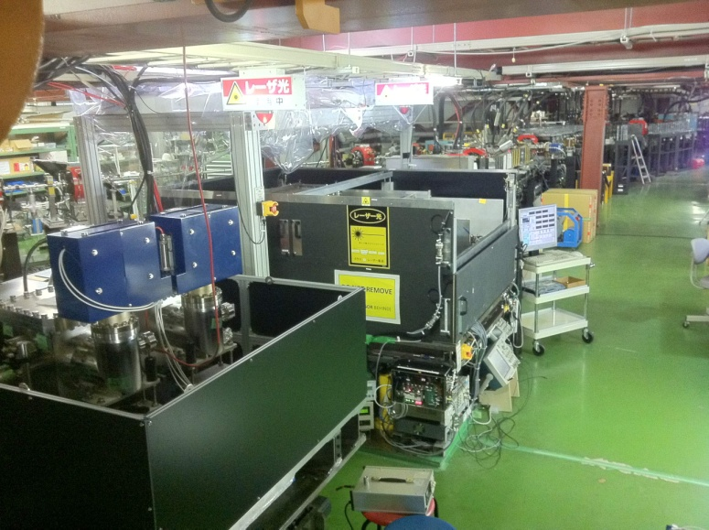
Two 4-mirror cavities are at the ATF
KEK-Hiroshima
installed autumn 2011
LAL-Orsay
installed summer 2010
relatively simple control system
employs new feed back scheme
sophisticated control
digital PDH feedback

Slide 24
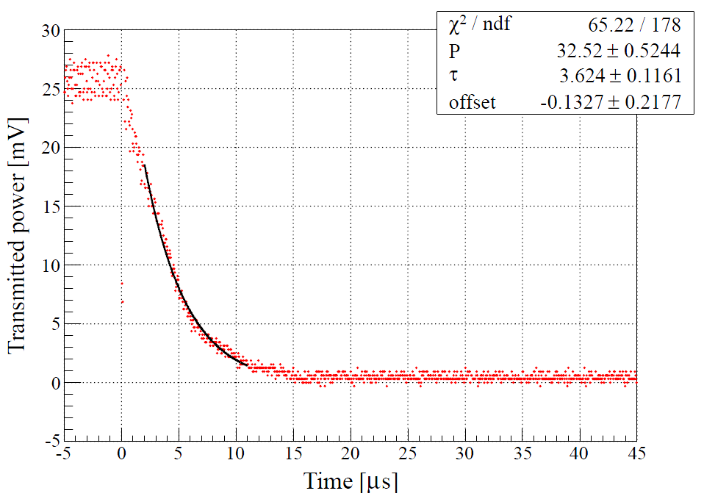
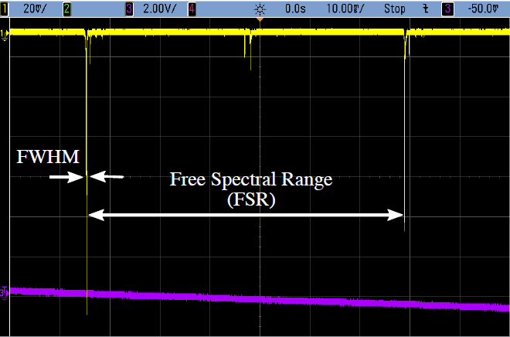
Finesse measurement
Airy Function
Decay time measurement
Pockels cell
PD
PBS
Finesse: 4040±420 4040±110
Both Consistent but smaller than expected, 4830,
from mirror reflectivity

Slide 25
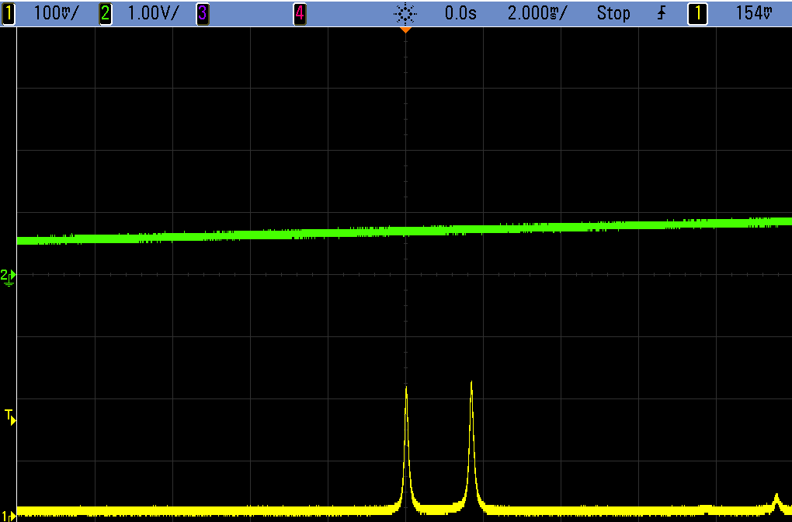
3-Dimensional 4 Mirror Cavity
Resonates only for circular polarization
  geometric phase due to twisted pass
  cavity only resonates with circular polarization
  usable for pol. switching
left handed
right handed
transmitted light
circumference of the cavity

Slide 26
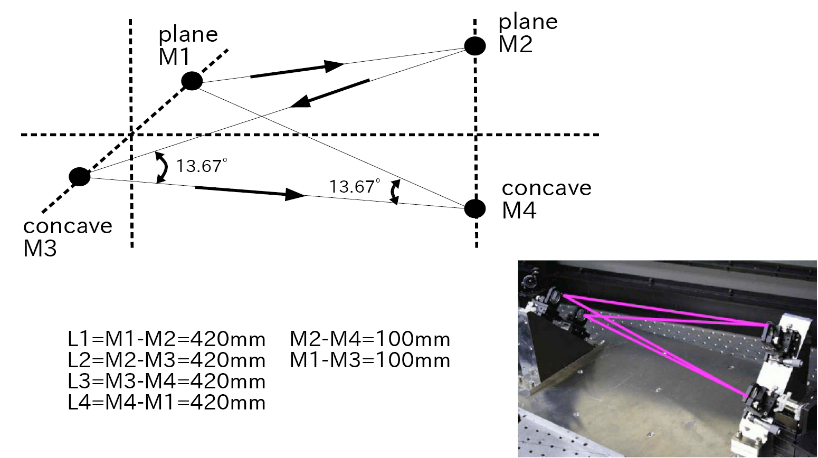
Configuration of Test Bench

Slide 27
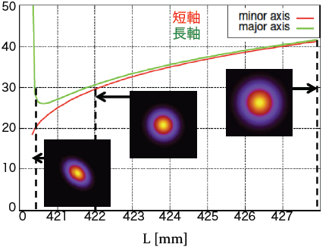
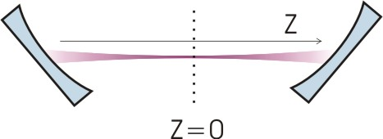
Calculation of Spot Size w/ Test Bench Geometry
major axis
minor axis
spot size σ (μm)
L(mm)
spot size is not sufficiently small
with test bench geometry
L

Slide 28
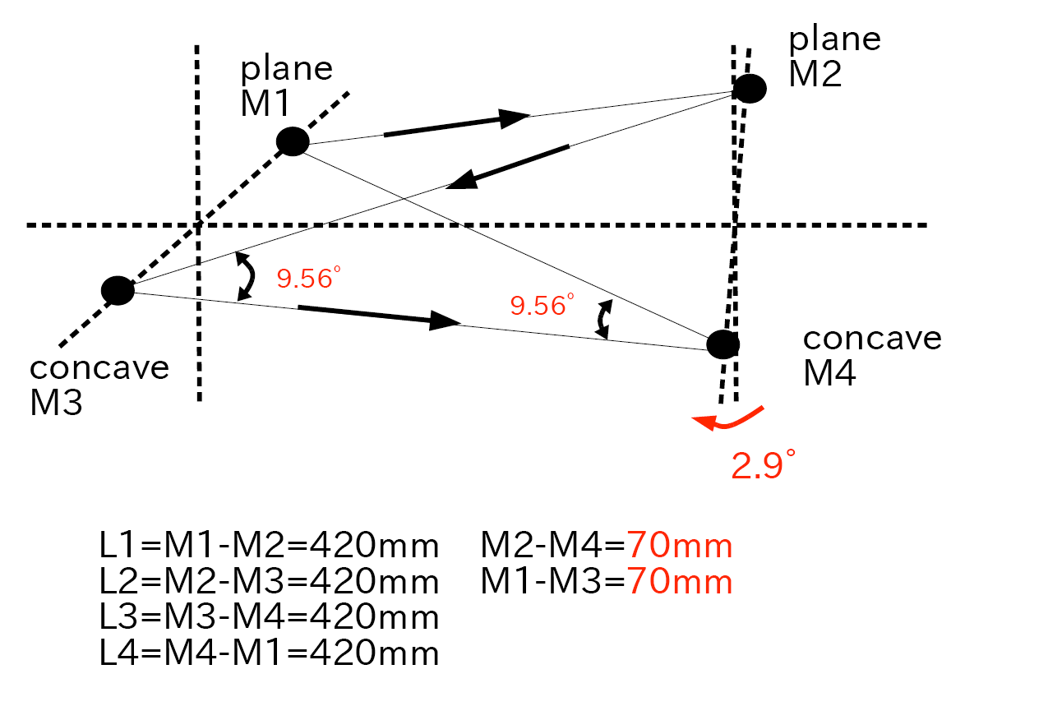
New Geometry

Slide 29
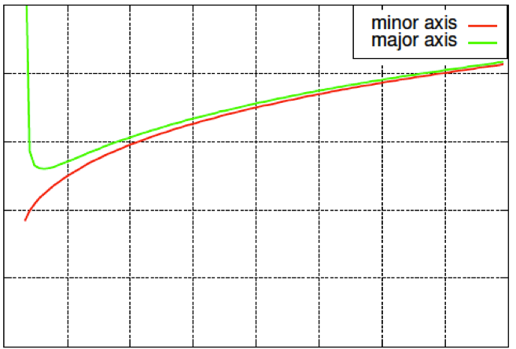
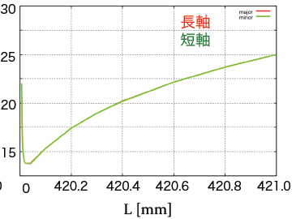
Expected Spot Size w/ New Geometry
Before optimization
After optimization
40
spot size σ (μm)
20
0
421
424
426
428
L(mm)
laser spot size of 15 μm is expected with new geometry

Slide 30
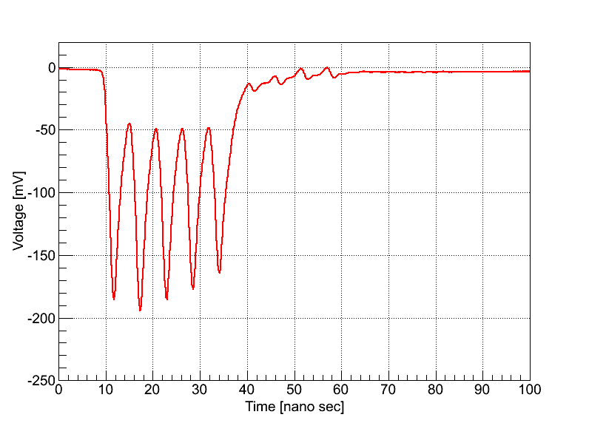
5bunches/train
laser
e-
γ
5.6ns
・# of γs =123.8/train
confirmed stable photons from each bunch
Notes:
この図はガンマ線のエネルギーのヒストグラムであり，ここから１トレインあたり，123.8個のガンマ線を検出したことになる．
また，この図は高い時間分解能を持った検出器でバンチ毎のガンマ線生成量を測定した結果です．
各バンチごとに安定してガンマ線生成が行われていることがわかる．
This figure is a histogram of gamma-ray energy, we are able to detect 123.8 gamma per train.
This figure is result of measurment of number of gamma-ray for each bunch with a high time resolution detector.
We found gamma-ray generation is performed stably for each bunch.

Slide 31
Status as the last meeting
What achieved
  2.6 kW stored w/ 1.4 % stability
  128 photons/train
  laser waist size 13 μm in vertical direction
What to be confirmed
  finesse
  power balance
  laser profile at IP
Notes:
6月に多くのガンマ線を得たが，共振器に対する定量的理解は出来ていなかった．
デザインでは4800とした共振器のフィネスは実測で4000～5500と大きな誤差をもっており決めきれていなかった．
そのため，増大率が不明なので，蓄積パワーの定量的理解は出来ておらず，共振器への入射強度など不確定な要素が多聞にあった．
また，円形になるように設計されたが，ガンマ線収量のバーティカルスキャンではデザイン値ではありえない値になっており，電子との衝突点におけるレーザープロファイルはブラックボックスだった．
つまり，共振器に対して我々は全くの無知であった．
In june we got better gamma-ray than path, we could not understand quantitatively for cavity.
Finesse of cavity was designed

Slide 32
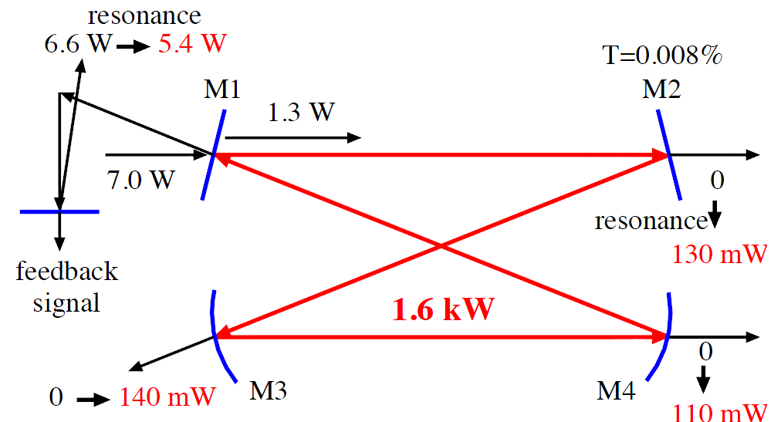
Power Balance
Stacked power
Injected Power x Enhancement =1.6kW
Tansmitted Power / Transmission =1.6kW
⇒Two Estimations are Consistent
Notes:
共振器の様々な点で強度を測定すると，共振器は約1Wの吸収があることが分かった．
この熱は鏡で反射される際に，鏡の吸収で起きると考えられる．
その熱が鏡にたまり，鏡が熱膨張を起こし，曲率の変化が起きてしまう．
この曲率の変化により，透過光プロファイルの変化起きる．
そのため，共振器に入射すべきレーザープロファイルが変化するので，入射効率が低下して，蓄積強度が低下する．
現在，重力波のグループと低吸収ミラーの開発を進めている．
Intensity is measured at various points of cavity, we found that cavity have an absorption of about 1W.
We considere that mirror absorp heart, when light reflection on mirror.
Heat is accumulated in mirror, mirror coause thermal expansion, change in mirror curvature occur.
Change in transmitted light profile occur by this change of carvature.
Therefore, since change in laser profile to be incident to cavity, indent efficiency is reduced, intensity in cavity is reduced.
We are developing a low absorption mirror with gravitaonal waves group.

Slide 33
Decrease in stack power
Feedback on
Transmitted power
Reflected power
20s
Thermal deformation of the mirror
->Change of transmitted pofile
=Incident efficency is reduced.

Slide 34
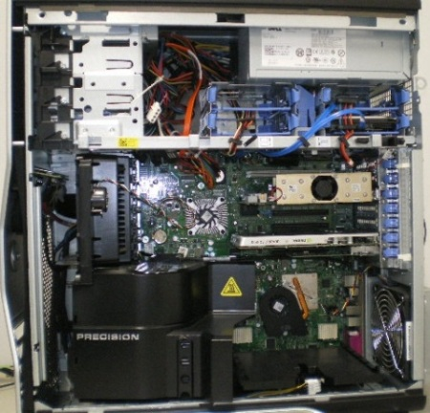
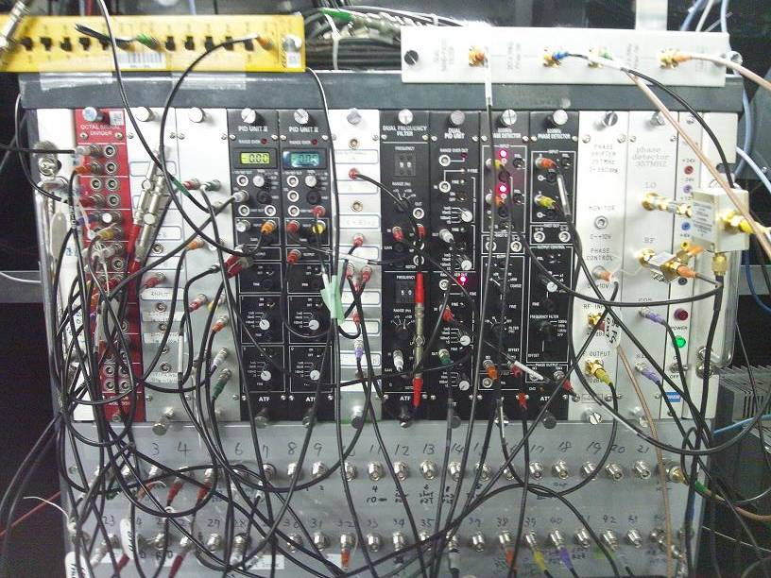
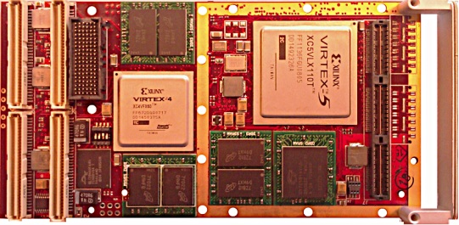
Ongoing: Installation Digital Feedback
Feedback circuit : analog -> digital
Expected Advantages
・large fexibility
・Auto control

Slide 35
Cavity Length Feedback with 3D Feature
cavity length must be L = nλ/2 with very high precision
(for enhancement of 1900 dL<< 87pm while L = 1.64m)
3D4M cavity resonate only with
circularly polarized lasers
differential signal
for feedback
+
=

Slide 36
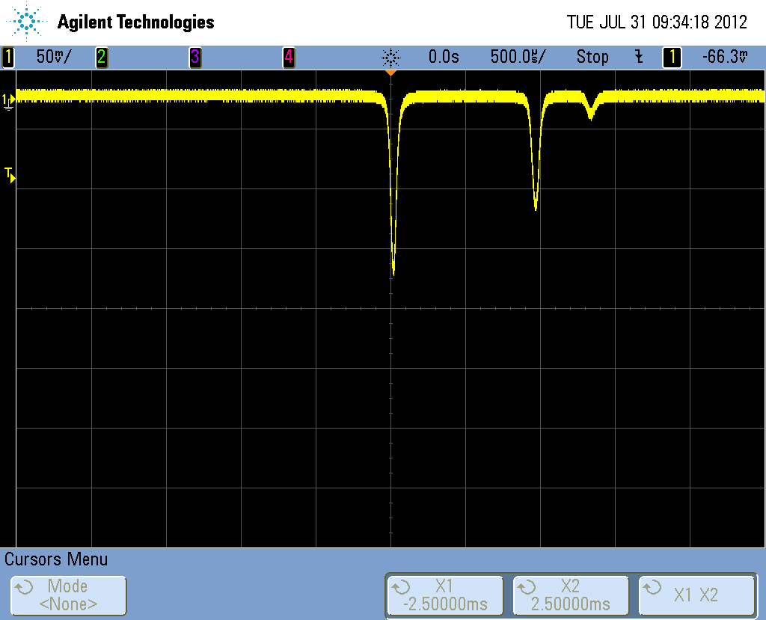
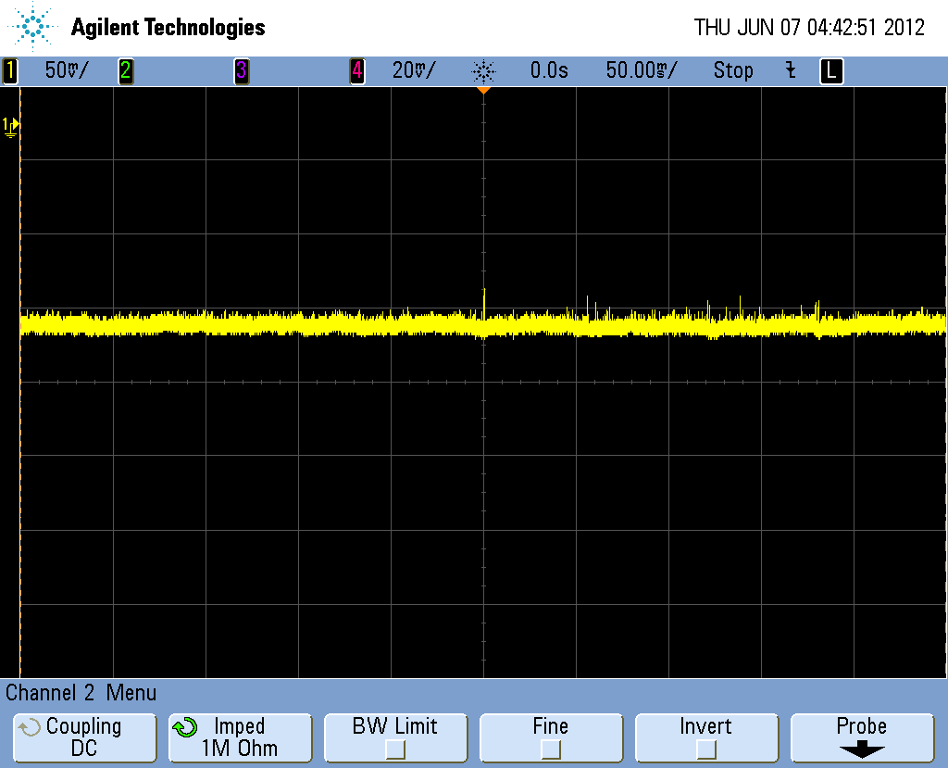
Stored Laser Power in the Cavity
14th Sep 2012
蓄積強度
右円偏光
左円偏光
Laser Power 2.6kW
Time Jitter＝8.0ps

Slide 37
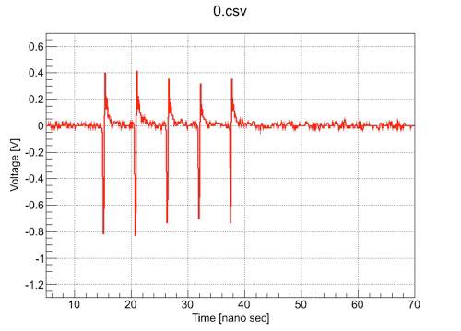
Bunch-by-Bunch Measurement
14th Sep 2012
wave form from detector
e- bunch monitor
◆～117/train ⇒ consistent w/ calorimeter measurement
◆no bunch dependence ( yield is proportional to e- current)

