Slide 1
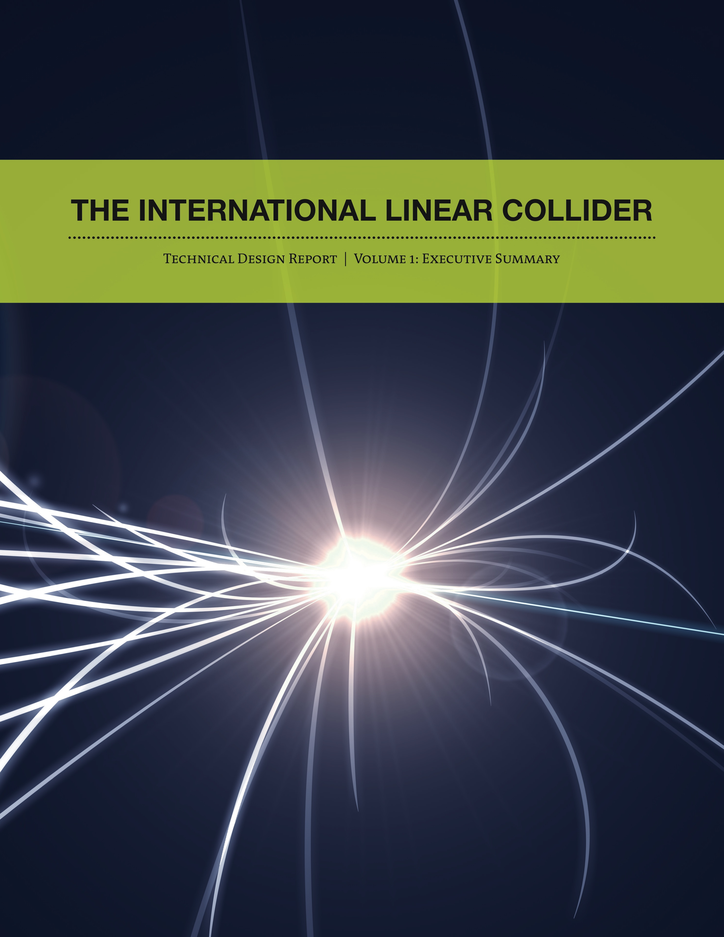
ILC Physics and Detectors:
P5 Report
Jonathan Bagger
December 15, 2013
Johns Hopkins University
American Linear Collider Committee

Slide 2
July 4, 2012
The discovery of a Higgs-like boson marks a turning point for our field
With the Higgs boson, the Standard Model is complete
  It provides a consistent explanation of the quarks, leptons and gauge bosons – so far as it goes
However, there are important phenomena that the Standard Model does not explain, including
  Dark matter, dark energy, matter/antimatter asymmetry, and even the properties of neutrinos
The Standard Model provides a platform. We need to build on it to explore what lies ahead

Slide 3

The Higgs Boson
The Higgs is different …
  It is the first of its kind
  It is not a quark, a lepton or a gauge boson
  It is a brand new form of matter – a fundamental spin-zero boson
As such, it can condense and fill the vacuum, and alter the properties of particles
The Higgs changes our conception of fundamental physics
  Is it matter? Is it a force?
  Or is it both?

Slide 4
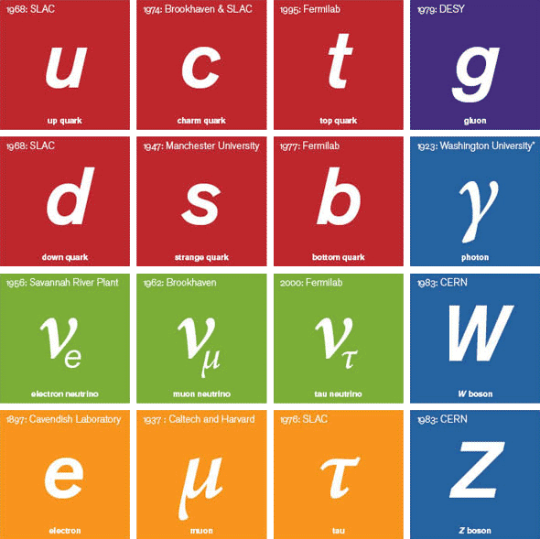
The Standard Model
The Higgs changes To this
the picture from this
H
The Higgs is the linchpin that holds it all together
Murch

Slide 5
Precision Higgs Physics
  The case for the ILC starts with the Higgs
  The Higgs boson has many properties that must be checked
    Have we found the Higgs or an impostor?
    Is it a portal to a new world?
  For example: Models of strong dynamics and extra dimensions contain new electroweak singlet scalars – dilatons and radions. Supersymmetry can contain such particles as well
    Are they mixing with the Higgs and changing its properties?
The Snowmass Energy Frontier group studied these questions
  They examined precision measurements of the Higgs couplings. Because of decoupling, deviations are expected to be small
  Their conclusion: We need to measure ZZ, WW, gg, γγ, HH, tt, bb, cc, ττ, μμ, ee – even invisible – couplings to the percent level. We need to detect the pattern of deviations!

Slide 6
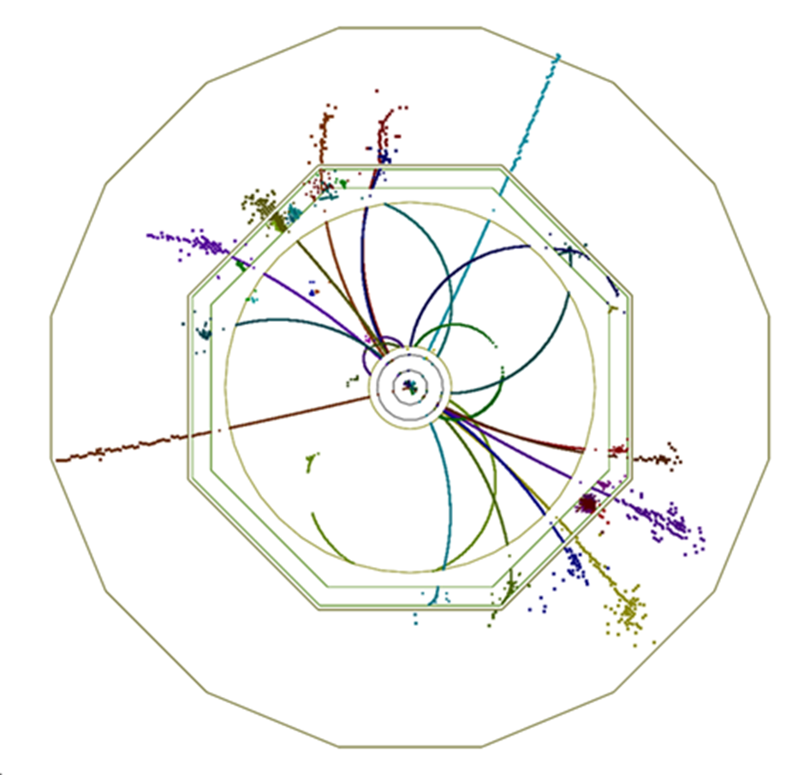
Precision Higgs Physics
At LHC, experiments measure σ(H) * BR(H → AA) and the absolute couplings are extracted by global fits
At ILC, experiments directly measure the couplings
  The initial state is known
    The energy is adjustable
    Electrons and positrons are polarized
    Events are clean and free from pileup
  No trigger is required
    All events are recorded, independent of decay mode
ILC detectors contain relatively little material associated with supports, cooling, cabling, which results in improved precision
ILD

Slide 7
ILC Campaign
At ILC, we study the Higgs through a staged campaign with a rich precision physics program at each stage
Because the accelerator is linear, its energy can be increased over time
  Stage 1: Start at 250 GeV in a tunnel sized for 500 GeV
  Stage 2: Increase energy adiabatically to 500 GeV
  Stage 3: Extend tunnel and energy to 1 TeV
Stages 2 and 3 could use higher gradient cavities to be developed through additional R&D

Slide 8
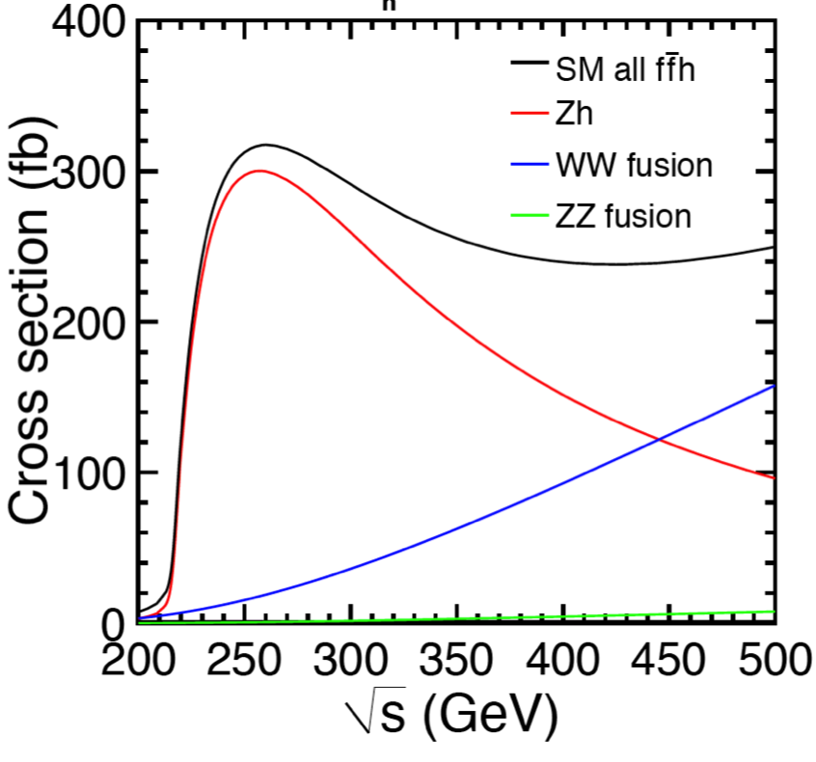
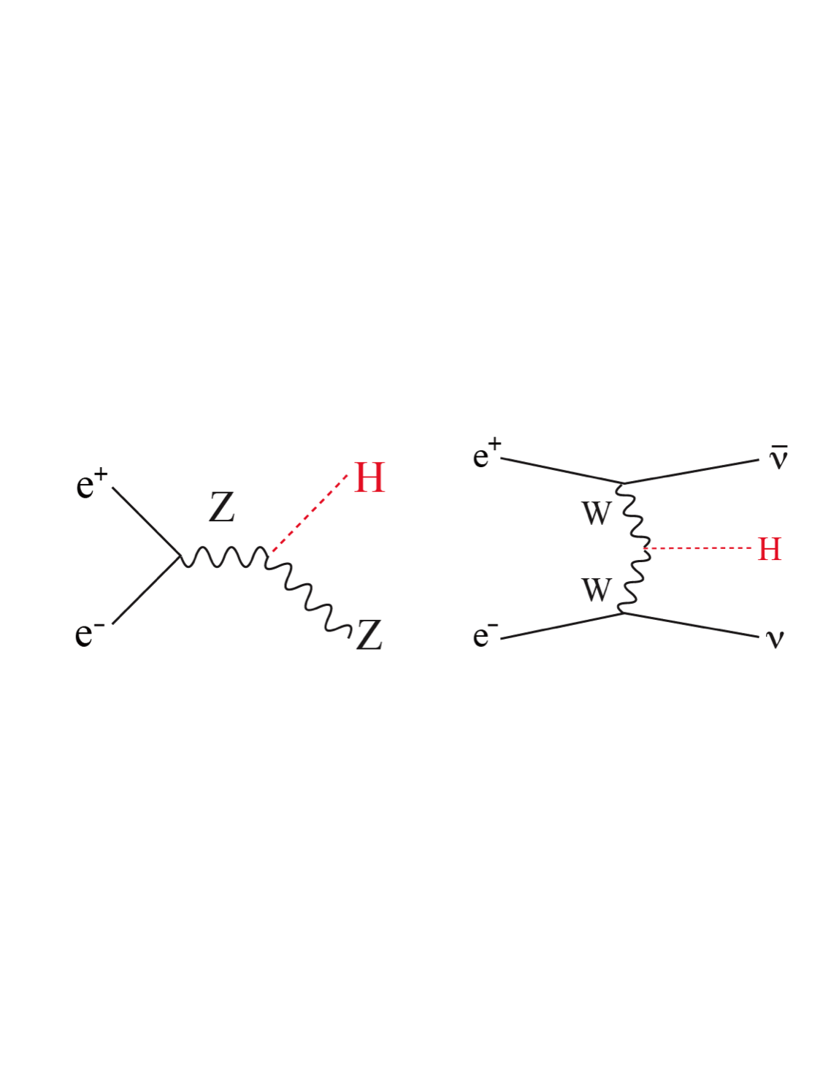
Higgs at ILC
At ILC, the Higgs is produced by two main processes
Tag!
ILC TDR

Slide 9
Higgs Physics
At 250 GeV, ZH production provides tagged Higgs source
  Measure
    Higgs mass and total width
    Relative BFs, including invisible modes
    Absolute ZZ partial width (but statistics limited)
      Allows normalization of all partial widths
Above 250 GeV, WW fusion becomes increasingly important
  Measure
    Absolute WW partial width
      Allows a reduction in errors for all the absolute widths
    Top quark Yukawa
    Triple Higgs coupling
ILC is a precision Higgs factory!

Slide 10
Higgs Physics
At 250 GeV, measure Higgs mass from Z recoil to ± 32 MeV
Also absolute measurement of ZH cross section to percent level
ILC TDR

Slide 11
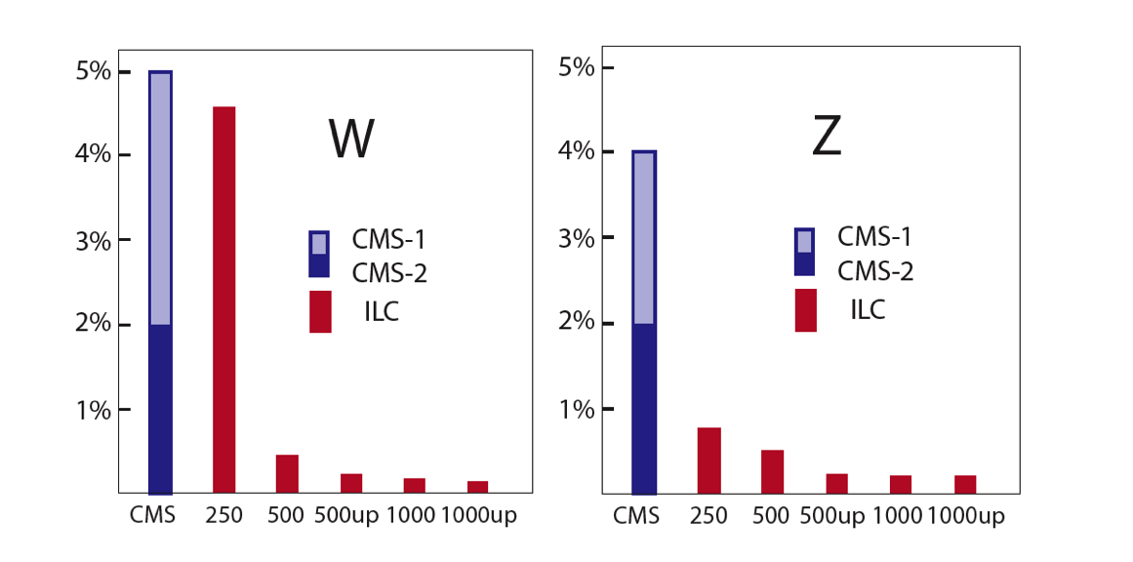
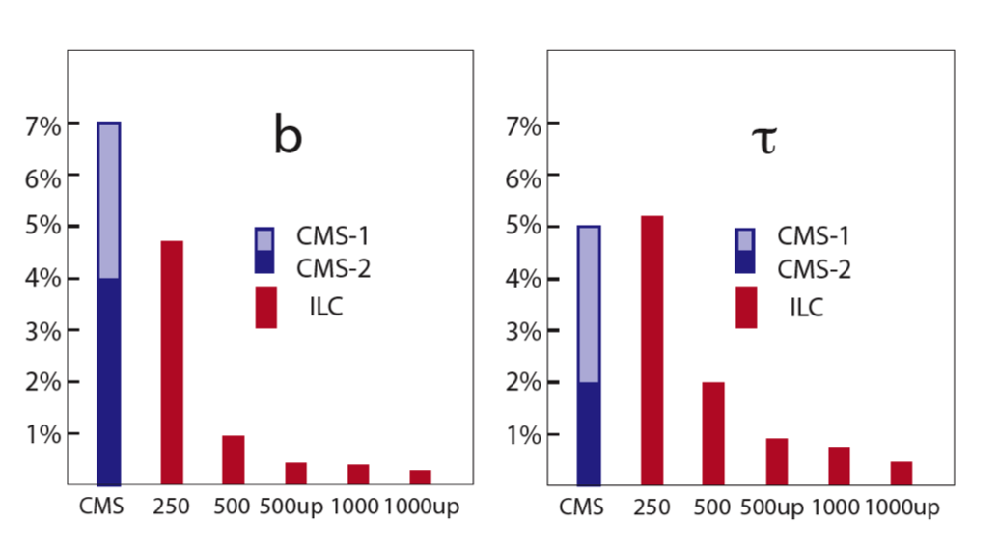
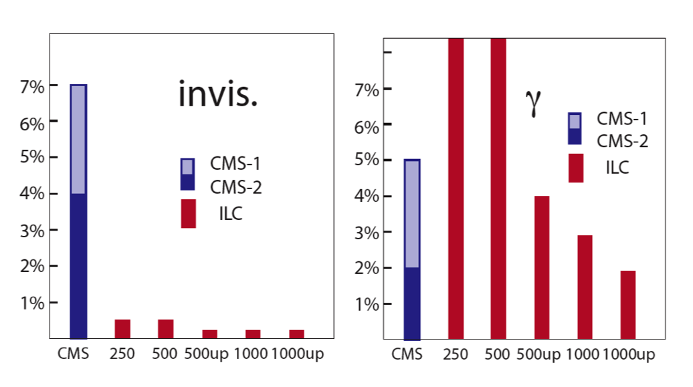
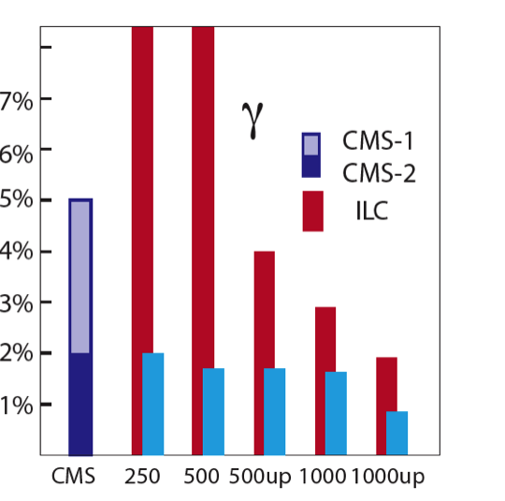
Higgs Physics
Using BR(γγ)/BR(ZZ*) from LHC
250: 250 /fb
250 up: 1150 /fb
500: 500 fb
500up: 1600 /fb
Peskin (Snowmass)
Measurement of absolute Higgs couplings from LHC and ILC, from Snowmass

Slide 12
Beyond the Higgs
Of course, the ILC is much more than a Higgs factory. With its adjustable energy and polarization, and its clean and controlled initial state, the ILC is capable of a variety of precision measurements
  For example, studies at top-quark pair production threshold will measure the top quark mass to 100 MeV, and the helicity structure of the top-quark Z boson couplings to the percent level. The top quark is the heaviest quark, so it must couple most strongly to the EWSB sector
  Precision studies of e⁺e⁻ → f fbar provide another example. They have great reach (~ 40-100 TeV at 500 GeV) for new physics that couples through the s or t channels, and with precision and polarization, experiments can begin to determine its nature

Slide 13
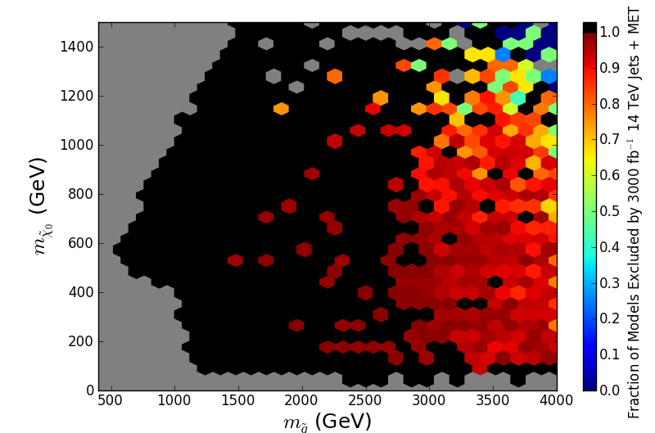
Supersymmetry
A Snowmass supersymmetry study finds models with heavy colored sparticles, and light uncolored ones, that remain undetected at the high luminosity LHC
These sparticles are are targets for the ILC!
(Jets + MET analysis only)
Cahill-Rowley, Hewett, Ismail, Rizzo (Snowmass)

Slide 14
ILC TDR
The ILC physics case is sufficiently compelling that 2400 physicists from 392 institutes in 48 countries have signed its Technical Design Report
  Including 387 physicists from 78 institutions in the United States
Over the past ten years, US universities and laboratories have participated in a global detector R&D program, validated by test beam results, that realized the detector capabilities needed for the exceptional precision of the ILC detectors

Slide 15
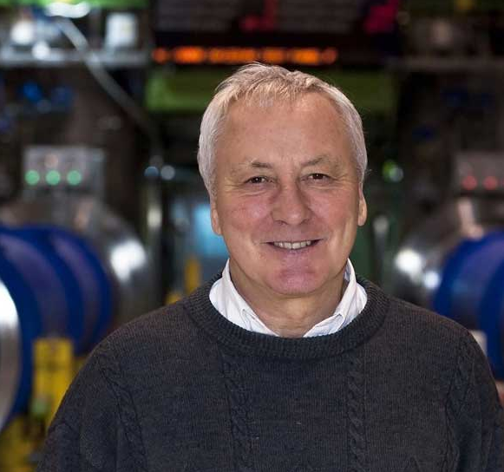
ILC TDR
The TDR was completed in mid 2013
  The TDR was prepared by the Global Design Effort, led by Barry Barish
  Costs were validated by an international review committee, chaired by Norbert Holtkamp
With the completion of the TDR, a new group, the LCC – Linear Collider Collaboration – was formed to realize the machine
  Also a global effort, the LCC is led by Lyn Evans, former CERN LHC project leader. His team includes Mike Harrison from BNL as associate director for ILC
The bottom line is that the ILC design is complete and the project is good to go

Slide 16
ILD and SiD: Precision Detectors
ILC physicists have collected themselves into two nascent detector collaborations: ILD and SiD. Each of the two detectors enjoys
  superb momentum resolution to measure the Higgs recoil
  excellent jet energy resolution to separate W, Z and Higgs bosons
  high efficiency flavor tagging to measure branching ratios with precision
SiD is based on 100% silicon tracking, while ILD employs a state-of-the-art TPC
The detector groups anticipate 2-3 more years of engineering and prototyping to finalize their designs before construction

Slide 17
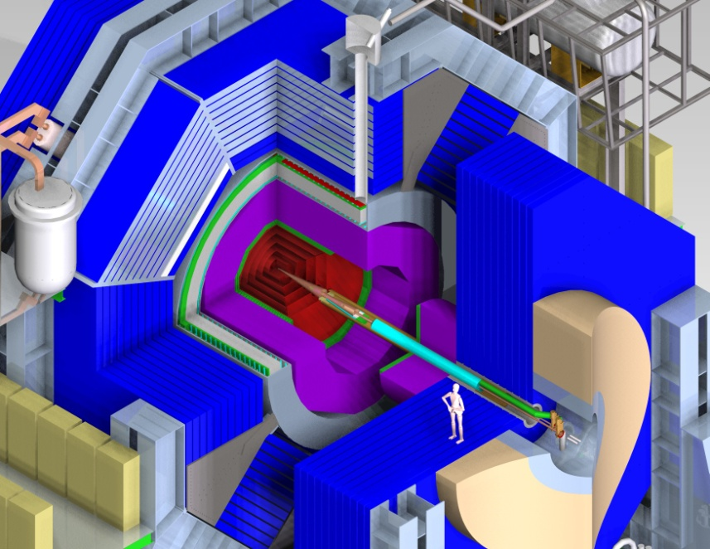
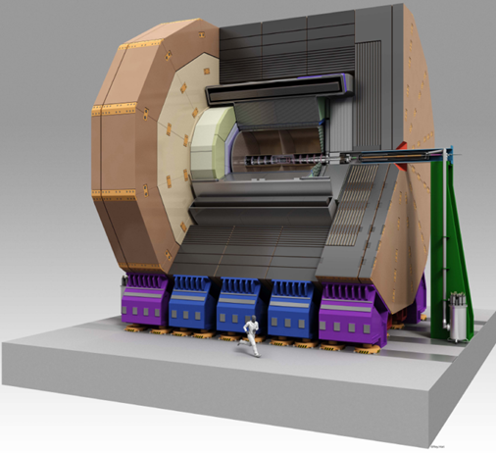
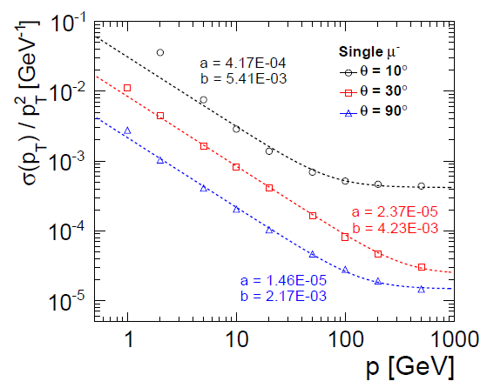
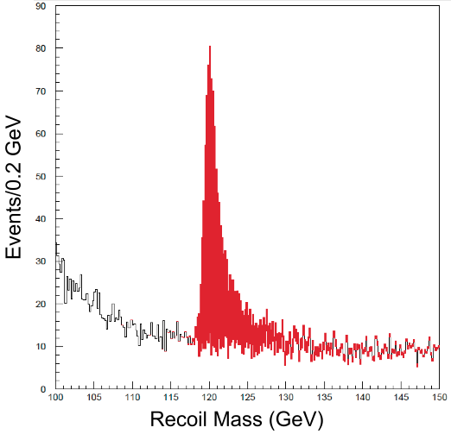
ILD and SiD: Precision Detectors
SiD
ILD
Both detectors have unprecedented tracking, vertexing and jet performance
Superb momentum resolution aides in measuring Higgs recoil
σ(p_{T})/p_{T}² ~
2-5 x 10⁻⁵ GeV⁻¹
ZH →μ⁺μ⁻ + X
SiD
Recoil Mass (GeV)

Slide 18
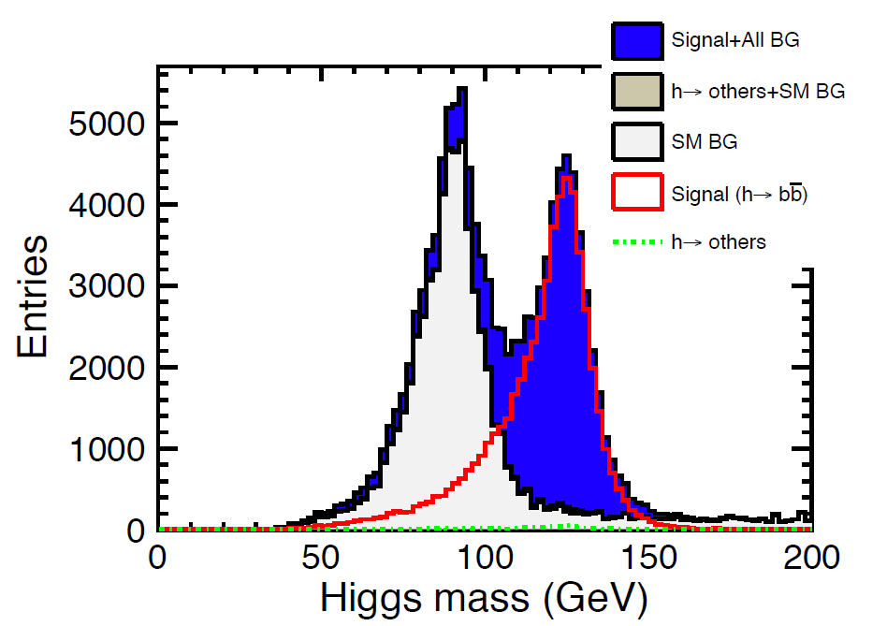
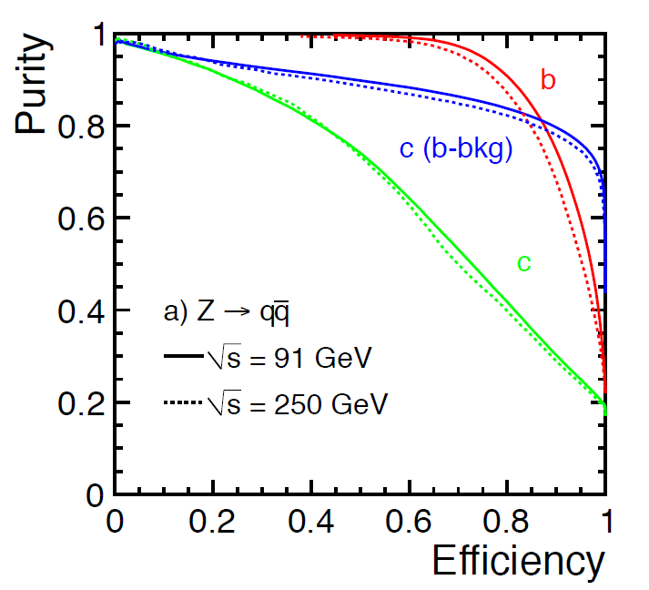
ILD and SiD: Precision Detectors
Efficient flavor tagging allows robust H → bb
reconstruction
ILD
Excellent jet energy resolution separates ZZ (red) from WW (blue) final states in Higgs decay
ILD

Slide 19
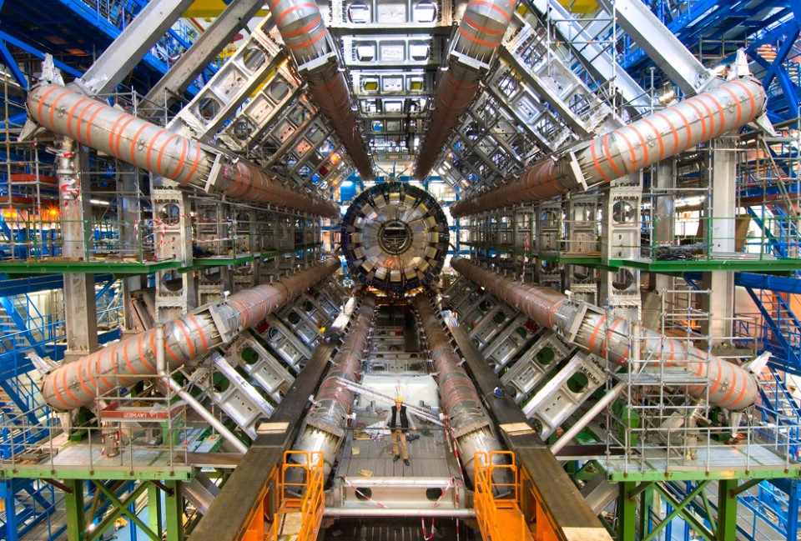
Proof of Principle
The LHC experience demonstrates that our field knows how to build and operate complex facilities

Slide 20
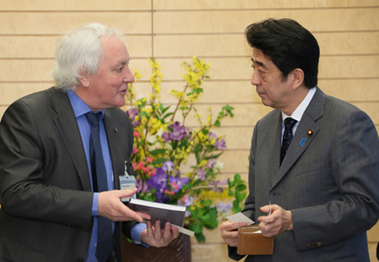
So where do we stand?
As P5 heard from Atsuto Suzuki at Fermilab, Japan is considering hosting the ILC as a global project
Japan is serious. Very serious.

Slide 21
Japan
From the Science Council of Japan:
  “We endorse the scientific significance of the ILC project within particle physics”
  “There are uncertainties and risk factors concerning the project organization within Japan and the availability of researchers from other countries”
  “We recommend intensive investigation and discussions on various issues for two to three years to make the decision on execution of the ILC project”
  “In parallel with the above investigations, negotiations should be conducted with research laboratories and responsible funding authorities of primary countries and regions to clarify the prospects for the international cost sharing”
  “SCJ is willing to help the government for the final decision by making recommendations from the academic viewpoint”

Slide 22
Japan
From Takeo Kawamura, chair of the bipartisan federation of Diet members in support of ILC:
  “It is certain that the ILC will bring about a dramatic advance in science”
  “From now on, we should move towards forming the framework for an international partnership which goes beyond simple cooperation between researchers, towards one to which governments commit”
  “We would like to proceed in an orderly manner and with a large-scale view, by building an international network base for researchers and engineers with our partner nations, reinforcing cooperation in the fields of science, technology, and economics”
  “It is our duty to realize this ILC project”
This sounds serious to me!
www.icepp.s.u-tokyo.ac.jp/lcws13/Mr_Kawamura_LCWS13_Speech_English_Translation.pdf

Slide 23



Japanese Media
Electron and Positron

Slide 24
Europe and Asia
The 2013 European Strategy for Particle Physics states:
  “The initiative of the Japanese particle physics community to host the ILC in Japan is most welcome, and European groups are eager to participate. Europe looks forward to a proposal from Japan to discuss a possible participation”
A 2013 report from the Asian High Energy Physics Community states:
  “AsiaHEP/ACFA welcomes the proposal by the Japanese HEP community for the ILC to be hosted in Japan. [It] looks forward to a proposal from the Japanese Government to initiate the ILC project”

Slide 25
United States: HEPAP and Snowmass
From HEPAP Facilities Panel:
  “The ILC accelerator and detectors enable a research program that will address questions of very great scientific importance, and both the accelerator and the detectors are absolutely central”
From Snowmass Energy Frontier group, reporting to P5
  “There is a compelling case for a lepton collider beyond LHC”
    “Theory sets the goal in Higgs, top quark couplings as discovery of deviations from the SM at the few-percent level. ILC, on the table now, can meet this goal”
  “We will realize these goals through global collaboration”
    “We are fortunate that other regions of the world agree with our goals and are providing high-energy colliders with impressive capabilities”
    “It is important the US physicists can participate in these programs”

Slide 26
United States: P5
The question before P5 is: What will the US say?
At Snowmass, the community found that the physics case is compelling, and that it is important for the US to participate
  Participating in the ILC will develop core competencies that will strengthen US industry and the DOE laboratory complex
  US laboratories bring essential skills to bear, especially in SCRF and high level RF
  US university groups are carrying out critical detector R&D in preparation for TDRs

Slide 27
Leadership
We ask that P5 recall Harold Shapiro’s words in the National Academies’ EPP2010 report…
  “In the flat world that is taking shape, leadership … no longer consists of single-handed efforts to maintain dominance in a particular field. Rather, leadership emerges from the creativity and initiative needed to organize international teams of collaborators to pursue projects that are beyond the capability of any one country”
And Rolf Heuer’s more pointed
  “Global collaboration = Global partnership with long term support”

Slide 28
Leadership
We need to be very aware of the signals we send
And we need to place the project in a very broad context. We are the most international field of science
Kawamura again:
  “The scientific innovation of this large international collaborative project is an important opportunity for the improvement of culture, education, economy and social life throughout the world”
  “Above all, the international process for the realization of ILC is a new challenge. ILC is a project that can serve as a model for worldwide collaboration, not only in science and technology, but also in many other fields”
www.icepp.s.u-tokyo.ac.jp/lcws13/Mr_Kawamura_LCWS13_Speech_English_Translation.pdf

Slide 29
Bottom Line
My bottom line: Our facilities are of such a scale that we need to leverage non-traditional sources of funding
Japan is in the process of deciding that it is in its national interest to host the ILC
  That would inject new money into the field, towards an exciting project, as part of a global effort
I believe that it is in all of our interests to make sure that this global effort succeeds
  And for that we need P5’s support

Slide 30

From CERN to ILC
Remember CERN …
  At the close of the second world war, CERN was founded by a set of visionary physicists
    We are beneficiaries of their foresight
Today, the SESAME light source is attempting something similar
  Current members include Bahrain, Cyprus, Egypt, Iran, Israel, Jordan, Pakistan, Palestinian Authority, and Turkey
    Where else but science could these nations meet on common ground?
Going forward, perhaps the world needs Japan, China, Korea, India, Vietnam all collaborating towards a common goal
  Could ILC play that role?

Slide 31

Summary
With the ILC, we have
  A strong physics case
  A machine we can build
  An experienced design team
  A nation moving to host
The world is watching!

Slide 32
ALCC Membership
Jonathan Bagger Johns Hopkins
Jim Brau Oregon
Dmitri Denisov Fermilab
Paul Grannis Stony Brook
Mike Harrison BNL
Nigel Lockyer Fermilab
Joe Lykken Fermilab
David MacFarlane SLAC
Lia Merminga TRIUMF
Hugh Montgomery JLab
Marc Ross SLAC
David Rubin Cornell
Director of TRIUMF TRIUMF
Harry Weerts ANL (Chair)
Andy White UT Arlington
Graham Wilson Kansas

