Slide 1
Recent status of ATF
October to December, 2013 –
Nobuhiro Terunuma, KEK
22 slides

Slide 2
Upgrades during summer 2013
Renewals on LINAC (aging)
  Four klystron modulators were renewed.
  Refrigerator of the cooling water for klystrons and accelerating structures was renewed.
    Beam injection to DR was significantly stabilized.
    It brings the stable beam intensity at ATF2 because of DR storage; example) 10%→2% or less.
Installation of the IP-BPMs
  Three low-Q cavity BPMs for the multi-bunch beam
    Possibly a few nm position resolution
    … help to understand the present beam jitter toward 37 nm (Goal-1)
    … reference for FONT IP-feedback; i.e., nanometer beam position stabilization (Goal-2)

Slide 3
In vacuum IP-BPMs and piezo movers
BPMs
  Low Q for multi-bunch beam. Short decay time
  Bolted aluminum plates, no brazing because of In-vacuum.
  BPM A&B bolted together.
  BPM C is independent.
Piezo mover
  BPM units are mounted on the base with three piezo movers.
  Dynamic range of each mover is +/- 150 um.
BPM A&B
BPM C
IP
Piezo Movers
(Cedrat)
Piezo Movers
(PI)

Slide 4
by Siwon Jang (KNU)

Slide 5
by Siwon Jang (KNU)

Slide 6
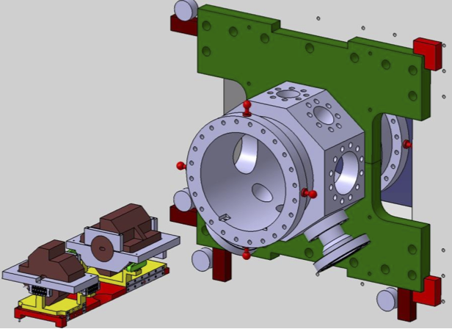
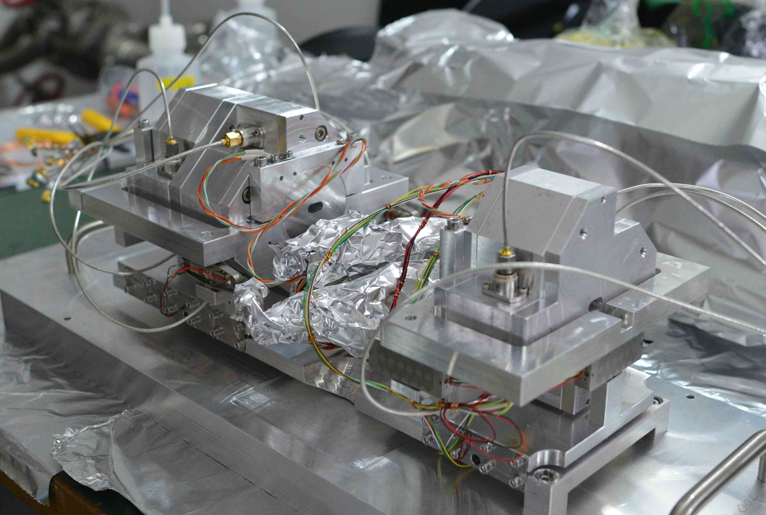
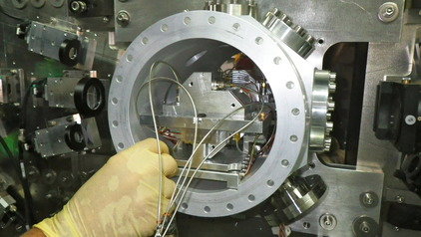
ATF2 IP-BPM installation
BPM cavities (AB & C)

Slide 7
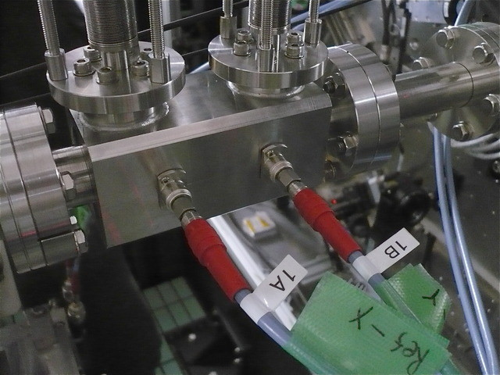
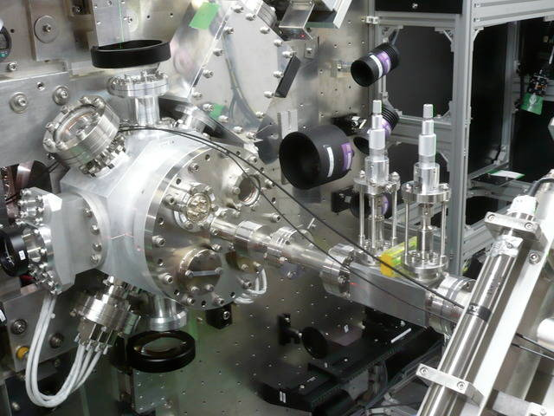
ATF2 IP-BPM installation
Reference cavity

Slide 8
Beam runs in 2013 fall
Commissioning of LINAC
Startup after summer shutdown (4 months)
x10 intense beam for the radiation inspection
Commissioning of renewed IP
  IP-BPMs
  Shintake monitor
  IP-FONT

Slide 9
Beam status and R&Ds in 2013 fall runs
Multi-bunch beam recovery for the radiation inspection
  Inspection for the renewal of the ATF radiation since 2011
    operate at least 15% of the maximum beam power (30 mA in DR)
    satisfy the lower radiation level even if it is scaled to 100% of beam power
  It is 10 times higher intensity than the recent ATF2 studies and we have no such beam since 2011.
  We passed the inspection successfully but spent 1/3 of beam runs in Oct-Dec.4 to retune LINAC and DR… beam loading.
Commissioning of the renewed IP system was the first priority.
  Beam time for Goal-1 was the checkout for the Shintake monitor. No small beam trials.

Slide 10
Commissioning of the renewed IP system
IP-BPMs
  Three IP-BPMs with piezo movers (+/- 150 um)
  New KNU front-end electronics for x,y-pickups (12ch)
  IP chamber with BPMs should be re-positioned to the beam to get an effective piezo range for BPM calibration/centering.
  Beam studies
  Oscilloscope based waveform recording (tentative)
    4ch x 4scopes with trigger synchronization
    present FONT digitizer has only 9 channels.
  Use 1000xβy optics to minimize the beam jitter contribution
  Alignment
  Performance studies
    electronics, resolution etc.

Slide 11
Special optics for the IP-BPM studies

Slide 12
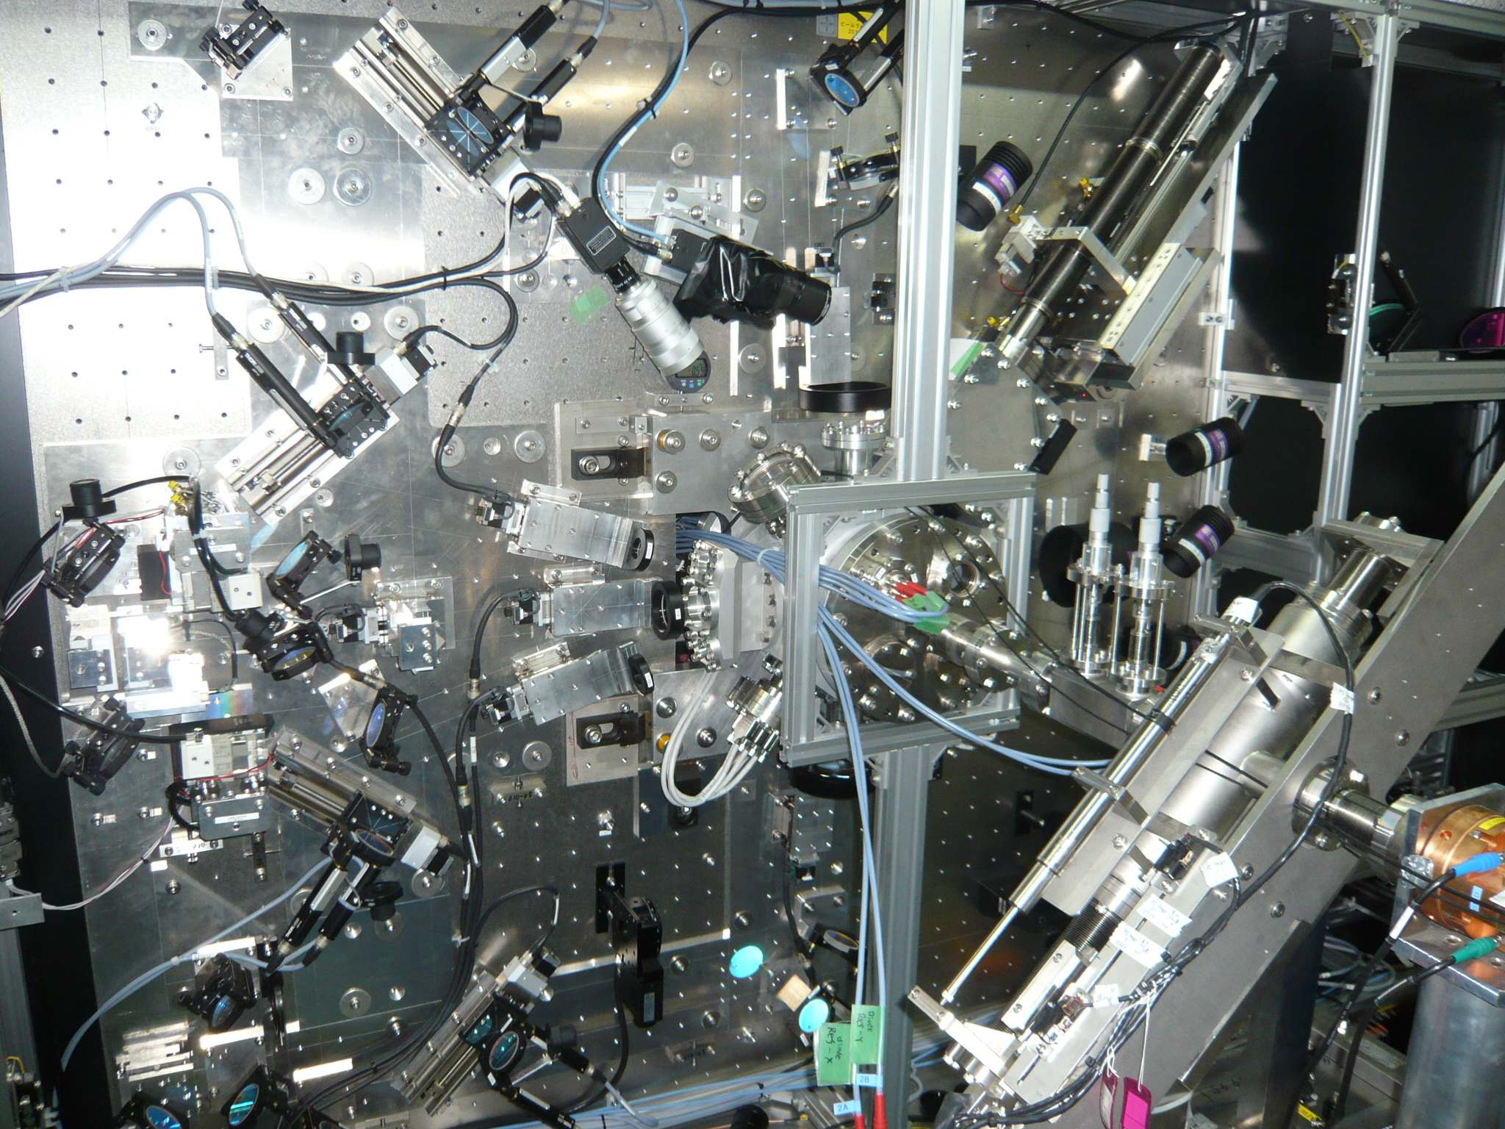
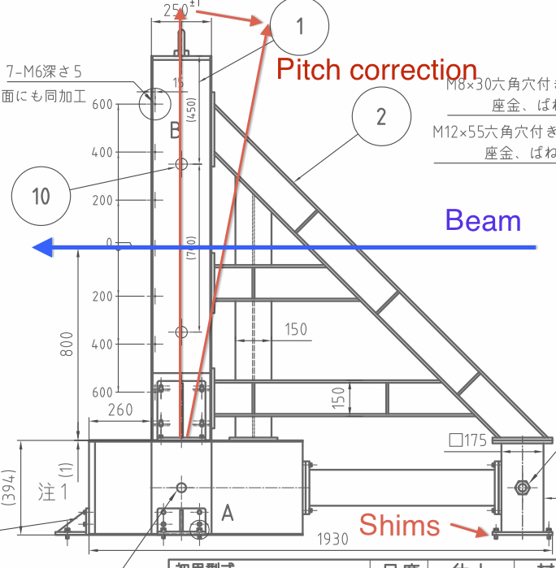
Alignment of the IP-BPMs
  to the beam → find the condition to minimize I and Q
  on the vertical table: tilting, vertical and horizontal offset
  in the IP chamber: relative alignment between BPMs
  Repeated a few times then beam passed the center of BPMs within a range of piezo movers.

Slide 13
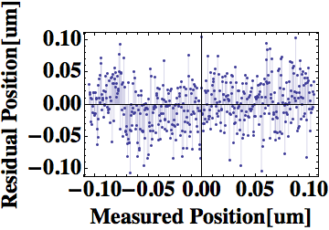
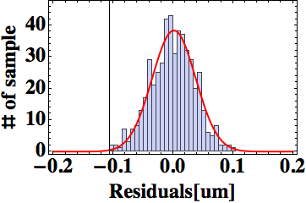
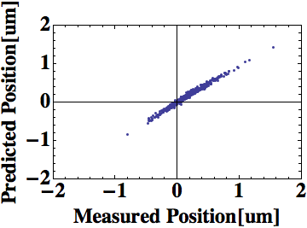
Simple resolution test by using Low-Q IP-BPM
by Siwon Jang (KNU)
X
X
X
Convert to
residual
Beam position prediction
Residual value
= measured position – predicted position
X
X
X
Residual Gaussian fitting
Beam position measurement
1σ=36.35nm

Slide 14
IP-BPM Current status
by Siwon Jang (KNU)
Still need more analysis...
 | IP-BPM A | IP-BPM B | IP-BPM C
SVD 1 sigma | 36.3 nm (0.63x10^10 particles) | 36.4 nm (0.63x10^10 particles) | 36.2 nm (0.63x10^10 particles)
with Geometrical factor | 19.8 nm (0.545711) | 29.1 nm (0.79883) | 9.2 nm (0.25312)
Normalized beam current (10^10 particles) | 12.5 nm | 18.3 nm | 5.8 nm

Slide 15
Commissioning of the renewed IP system
IP-FONT
  First attempt to read the signal from KNU front-end electronics by the FONT5 digitizer board was successfully done.
    under the limited 9 ch on a digitizer. (need 12; 2x,2y, 3BPMs)
  Two brand-new boards are under preparation and hopefully available for this spring runs.

Slide 16
New IPBPM waveforms with FONT5 board
FONT by YoungIm Kim (Oxford)
BPM-A
Ref. y
I
Q
BPM-B
I
Q
Ref. x
BPM-C
I
Q

Slide 17
BPM calibration using piezo mover and FONT board
to be scaled into position
FONT by YoungIm Kim (Oxford)

Slide 18
Commissioning of the renewed IP system
Shintake monitor
  Laser optics (mirror, lens) was re-assembled on the vertical table.
    dismounted during the IP chamber installation.
    re-position with base plates every time when the IP chamber is re-positioned.
  New IP target system was installed.
    Carbon wire scanner: beam size measurement down to 2 um
    Screen monitor: beam and laser alignment for collision
Note
  IP screen is “essential” to realize the collision of a beam and lasers. 10 um initial alignment on a crossing plane.

Slide 19
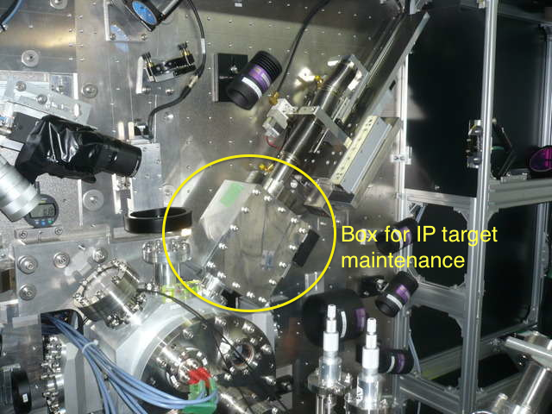
IP Target
Previous IP target
We could adjust the target head by hand when opened the end flange.
find the crossing point with low-power laser.
New IP target
Can not access to IP because of IPBPM-C.
Target should be pulled in the external box for maintenance.
(repeat) adjust head → insert

Slide 20
Alignment of the BSM laser optics
BPMs are aligned on the beam axis.
IP is defined, 10cm from a table (lasers).
Chamber is well machined and can be used as a reference to IP.
Laser optics are mounted on the base plates.
Plate alignment by connecting machined edges.
IP target system

Slide 21
for spring beam runs
  IPBPM
  more studies are necessary but may not need 1000xβy optics; i.e., can work with ATF2 beam studies.
  Online tools should be establish for the real-time position monitoring.
  FONT
  basically function as the digitizer for IPBPMs.
  waiting new boards for all BPMs readout (x,y), hope to get in this spring.
  Shintake monitor
  re-alignment of target and optics was done.
  Compton line defined by the center of IPBPMs should be checked.
  laser stabilization study is underway.
  ATF2 beam study
  resume the 60 nm operation, first.
  continue Goal-1 study with IPBPMs

Slide 22
Beam schedule before summer shutdown 2014
Recovery of Shintake monitor and reproduce 60 nm
Prepare online IP-BPM DAQ
IP-FONT commissioning
ATF2 project meeting, ATF-TB meeting (KEK)
Goal-1 (37 nm)
IP-FONT commissioning
Topical meeting in Annecy for Goal-2
Details will be discussed in the project meetings and updated every weeks.
Summer shutdown until mid. of October

