Slide 1
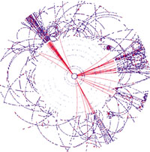
Quark Flavour Violating Bosonic
Squark Decays
K. Hidaka
Tokyo Gakugei University
Collaboration with
A. Bartl, H. Eberl, E. Ginina, B. Herrmann,
W. Majerotto and W. Porod
PoS (EPS-HEP 2013) 013 [arXiv:1310.5974]
PoS (ICHEP2012) 110 [arXiv:1212.0203]
arXiv:1212.4688
ILCWS, 18 Jan 2014, KEK

Slide 2
Contents
1. Introduction
2. MSSM with Quark Flavour Violation (QFV)
3. Constraints on the MSSM
4. QFV bosonic squark decays
5. Impact on squark signals at LHC
6. QFV squark signals at LC
7. Conclusion

Slide 3
1. Introduction
Quark flavour conserving (QFC) fermionic squark decays, such as
are usually assumed in the squark search analyss.
Here we study quark flavour violating (QFV) bosonic squark decays, such as
, where the mass eigenstates are mixtures of scharm and stop quarks.
We point out that the branching ratios of such QFV bosonic squark decays can be very large due to the and mixing effects despite
the very strong constraints on the QFV parameters from B meson data.
We show that such QFV bosonic squark decays can play
a very important role in the squark and gluino searches at LHC(14 TeV) and the squark searches at Lepton Colliders with = 1.5 TeV - 2 TeV.

Slide 4
2. MSSM with QFV
The basic parameters of the MSSM with QFV:
{tanβ, m_{A} , M₁ , M₂ , M₃ , μ , M²_{Q,αβ} , M²_{U,αβ} , M²_{D,αβ} , T_{Uαβ} , T_{Dαβ} }
(at Q = 1TeV scale (SPA convention)) (α,β = 1,2,3 = u, c, t or d, s, b)
tanβ : ratio of VEV of the two Higgs doublets <H⁰ ₂>/<H⁰₁>
mA : CP odd Higgs boson mass (pole mass)
M_{1,} M₂ ,M₃ : U(1), SU(2),SU(3) gaugino masses
μ : higgsino mass parameter
M²_{Q,αβ} : left squark soft mass matrix
M²_{Uαβ} : right up-type squark soft mass matrix
M²_{Dαβ} : right down-type squark soft mass matrix
T_{Uαβ} : trilinear coupling matrix of up-type squark and Higgs boson
T_{Dαβ} : trilinear coupling matrix of down-type squark and Higgs boson

Slide 5
QFV parameters in our study are:
M²_{Q,23} : mixing term
M²_{U23} : mixing term
T_{U23} : mixing term
T_{U32} : mixing term
(Note) We work in the super-CKM basis of squarks.
.

Slide 6
3. Constraints on the MSSM
We respect the following constraints:
(1) the recent LHC limits on the masses of squarks, gluino, charginos and neutralinos.
(2) the constraint on (m_{A ,} tanβ ) from the recent MSSM Higgs boson search at LHC [arXiv:1202.4083].
the constraints on the QFV parameters from the B physics experiments.
(4) the constraints from the observed Higgs boson signal at LHC
(allowing for theoretical uncertainty): 123 GeV < m_h⁰ < 129 GeV.
(5) theoretical constraints from the vacuum stability conditions for the
trilinear coupling matrices.
Notes:
Experimental constraint from B(b -> s l+ l-) ;
The low-s region (1 GeV^2 < s < 6 GeV^2) is dominated by the Wilson
coefficients C_9 and C_10, has sizable integrated branching ratio and is very
sensitive to the C_7 - C_9 interference. In the following, we utilize the latter
to put constraints on the Wilson coefficients C_7,8,9,10.
We calculate the integrated branching ratio in the low-s region following Ref. [52]:

Slide 7
4.1 QFV Benchmark Scenario
4. QFV bosonic squark decays
We take the following scenario as our QFV benchmark scenario:
These weak scale parameters are defined at Q = 1 TeV scale (SPA convention).
(M_{1,} M₂ ,M₃) = (400, 800, 1000) GeV
μ = 2640 GeV, tanβ = 20, m_{A}(pole) = 1500 GeV
(M²_{Q11}, M²_{Q22}, M²_{Q33}) = (2400^2, 2360^2, 1450^2) GeV^2
(M²_{U11}, M²_{U22}, M²_{U33}) = (2380^2, 780^2, 750^2) GeV^2
(M²_{D11}, M²_{D22}, M²_{D33}) = (2380^2, 2340^2, 2300^2) GeV^2
All of T_{Uαα} and T_{Dαα} are zero, except T_{U33} = -2160 GeV.
QFV parameters: M²_{U23} = 419^2 GeV^2
T_{U32} = -458 GeV.
decoupling Higgs scenario
large mixing scenario
(large top-trilinear-coupling scenario)
large mixing
large mixing

Slide 8
Main features of the benchmark scenario
large QFC/QFV trilinear couplings of
/
sizable scharm-stop mixing ( mixing)
large mass of either or
large mass of the CP-odd neutral Higgs boson
(= 1500 GeV) and large (= 20).
Decoupling-Higgs scenarios with
The lightest Higgs boson is SM-like!

Slide 9
Physical masses in the benchmark QFV scenario
= 124GeV
- CP-even lighter Higgs boson h⁰ is SM-like!
- its mass mh⁰ = 124 GeV is in the LHC “Higgs signal” range ! : 123 < mh⁰ < 129GeV.

Slide 10
Benchmark QFV scenario
< up-squark sector >
< down-squark sector >
mass-splitting due to large
mixing
large mass splitting between and !
could be sizable!

Slide 11
In this large & & mixing scenario;
In our scenario "top trilinear coupling“ ( coupling) = T_{U33} is large!
coupling is large!
QFV branching ratio can be large!

Slide 12

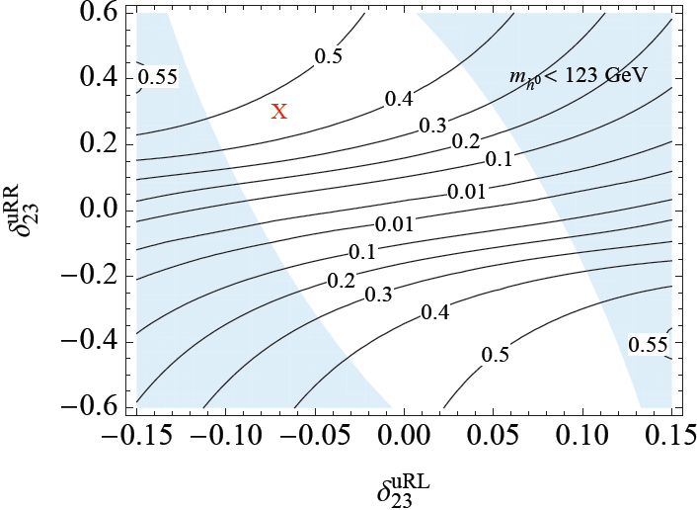
mixing parameter
mixing parameter

Slide 13
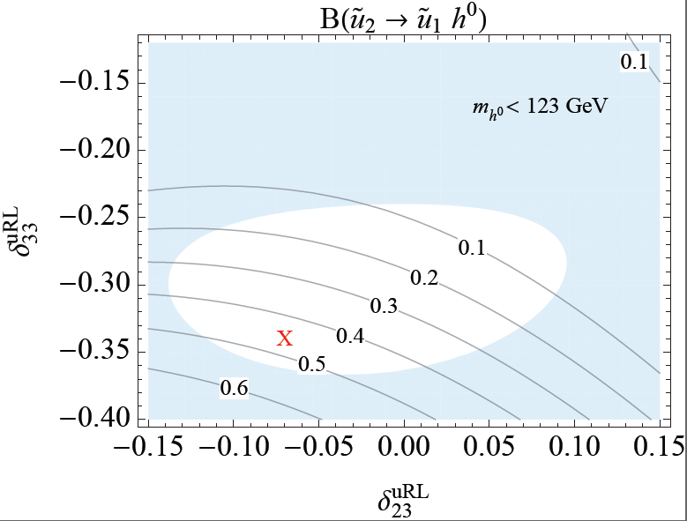
mixing parameter
mixing parameter

Slide 14
In this large & & mixing scenario;
QFV BR can be large!
QFV BR can be large!

Slide 15
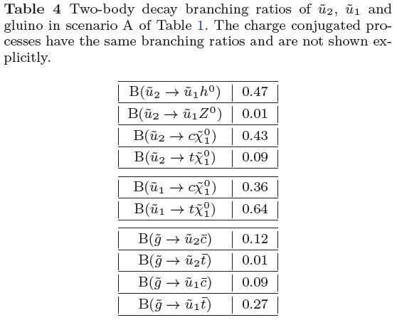
4.2 Impact of squark generation mixing
Squark & gluino decay branching ratio in our QFV benchmark scenario
QFV squark decay BR can be very large (~50%) !
QFV squark decay BR can be very large simultaneously!

Slide 16
5. Impact on squark signals at LHC
Example of QFV squark signal at LHC
Gluino pair production and the QFV squark bosonic decay can lead to
QFV squark signature at LHC :
‘ top-quark + 3 jets + h⁰ + missing-E_{T} + beam-jets‘

Slide 17
Example of QFV squark signal at LHC
‘ top-quark + 3 jets + h⁰ + missing-E_{T} + beam-jets‘

Slide 18
QFV bosonic squark decay signal rates at LHC
In our scenario;
- gluino prod. cross section is significant:
~ 150 fb at LHC(14 TeV)!
- can be large (~ 25 %)!
We can expect copious production of
from gluino prod. and decays at LHC(14 TeV)!
QFV bosonic squark decay signal rates can be significant at LHC(14 TeV)!

Slide 19
QFV bosonic squark decay signal rates can be significant
at LHC(14 TeV) in our QFV benchmark scenario !:
For LT=300 fb⁻¹ we expect 1200, 1200, 600, 600 events for these
QFV signal rates.

Slide 20
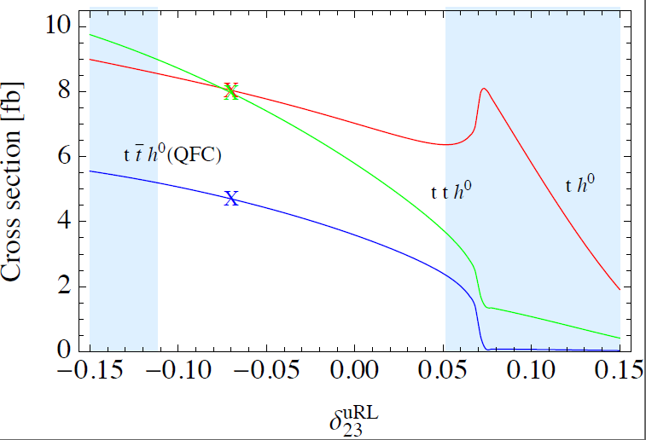
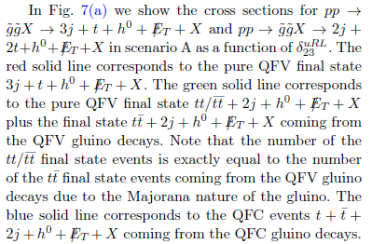
Signal cross sections (fb)
mixing parameter

Slide 21
The strongly interacting sparticles produced at LHC (14 TeV)
are practically only and in this scenario.
In case the QFV squark ( ) decay signals could not be
observed due to significant BG at LHC(14 TeV), then we need
LC(1.5-2.0 TeV) for the discovery of such squarks !!!

Slide 22
6. QFV squark signals at LC
Example of QFV fermionic squark decay signal at LC
‘ top-quark + charm-jet + missing-E_{T}‘

Slide 23
Example of QFV fermionic squark decay signal at LC
‘ top-quark + charm-jet + missing-E_{T} ‘

Slide 24
Example of QFV bosonic squark decay signal at LC
‘ top-quark + charm-jet + 2h⁰ + missing-E_{T}‘

Slide 25
Example of QFV bosonic squark decay signal at LC
‘ top-quark + charm-jet + 2h⁰ + missing-E_{T} ‘

Slide 26
7. Conclusion
We have shown that QFV bosonic squark decay branching ratios such as
can be very large (up to ~50%) due to the and mixings despite the very strong constraints from B meson data.
This can result in remarkable QFV squark signal events, such as
+ beam-jets
with a significant rate at LHC(14 TeV).
Our analysis suggests that one should take into account the possibility of
important contributions from QFV bosonic squark decays in
the search for squarks and gluinos and in the determination of the MSSM
parameters at LHC(14 TeV).

Slide 27
In case the QFV squark ( ) decay signals could not be
observed due to significant BG at LHC(14 TeV), then we need
LC(1.5-2.0 TeV) for the discovery of such squarks !!!
END

Slide 28

Backup Slides

Slide 29
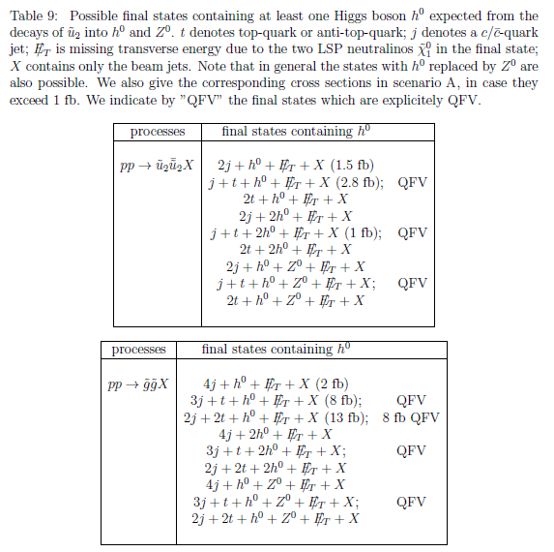
Possible signatures from the decays of into and at LHC

