Slide 1
Timepix-3 test
All-ceramic InGrid
The focusing TPC
Timepix-3 test as gaseous (GridPix) detector
Naked TimePix-3 chip
Framed Micromegas on top
Sealed with framed cathode foil at 8 mm distance from chip

Slide 2
Today, Dec 11, 2013, a gaseous detector formed by a TimePix-3 chip and
a Micromegas became operational. Below, you find pictures of the ‘open’
chamber, showing the framed Micromegas, pressed on the TPX-3 chip by two strings.
The chamber is sealed by a framed gas foil, also acting as (drift) cathode. Drift gap: 8 mm
The chamber unit is read out by a Spidre prototype.
Two events are shown, clearly indicating the drift time, coded by the color
of the hit pixel.
Micromegas: 50 μm pillars, square pitch of holes: 60 μm
Pixel Chip: Timepix-3, first batch, read out by Spidre prototype
No protection layer: Micromegas-on-naked-chip.
Gas: He/ibutane 95/5
Source: ⁹⁰Sr
HV_{grid}: 340 V
HV_{cathode}: 700 V
Nikhef Detector R&D group: Niels, Jan, Martin, Fred, Harry
+ Joop, Bas, Vladimir, Francesco, Ruud, Wim, Henk

Slide 3
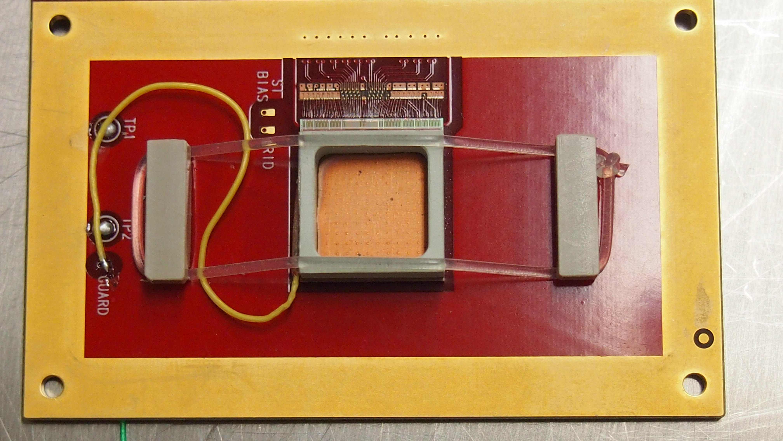

Slide 4
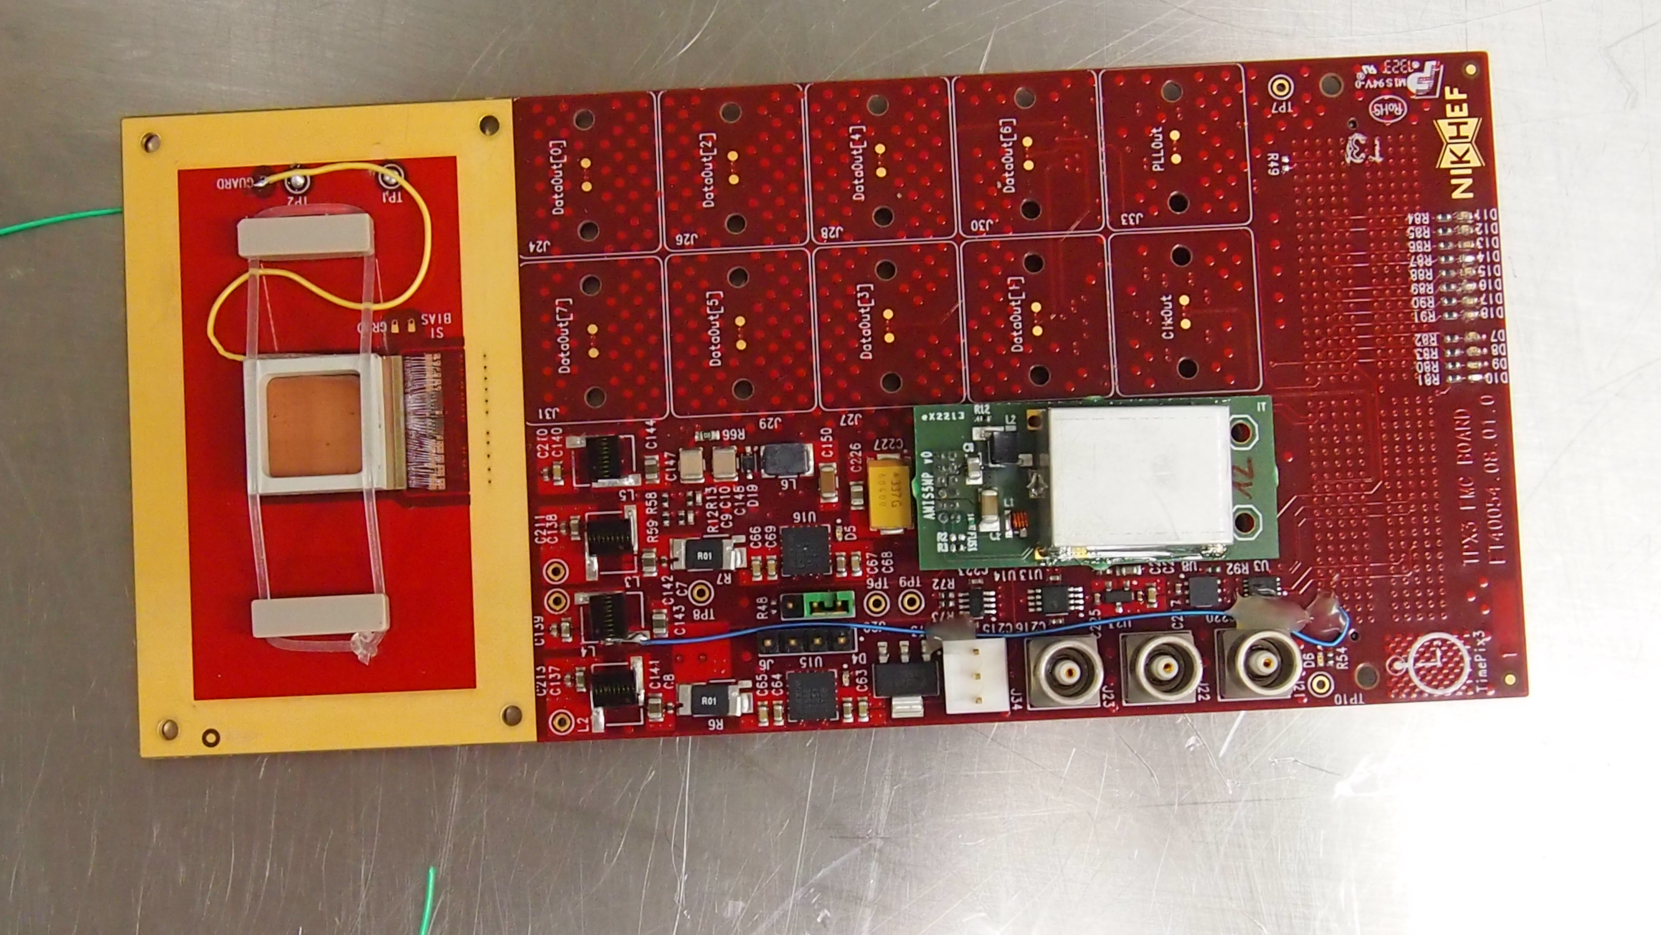
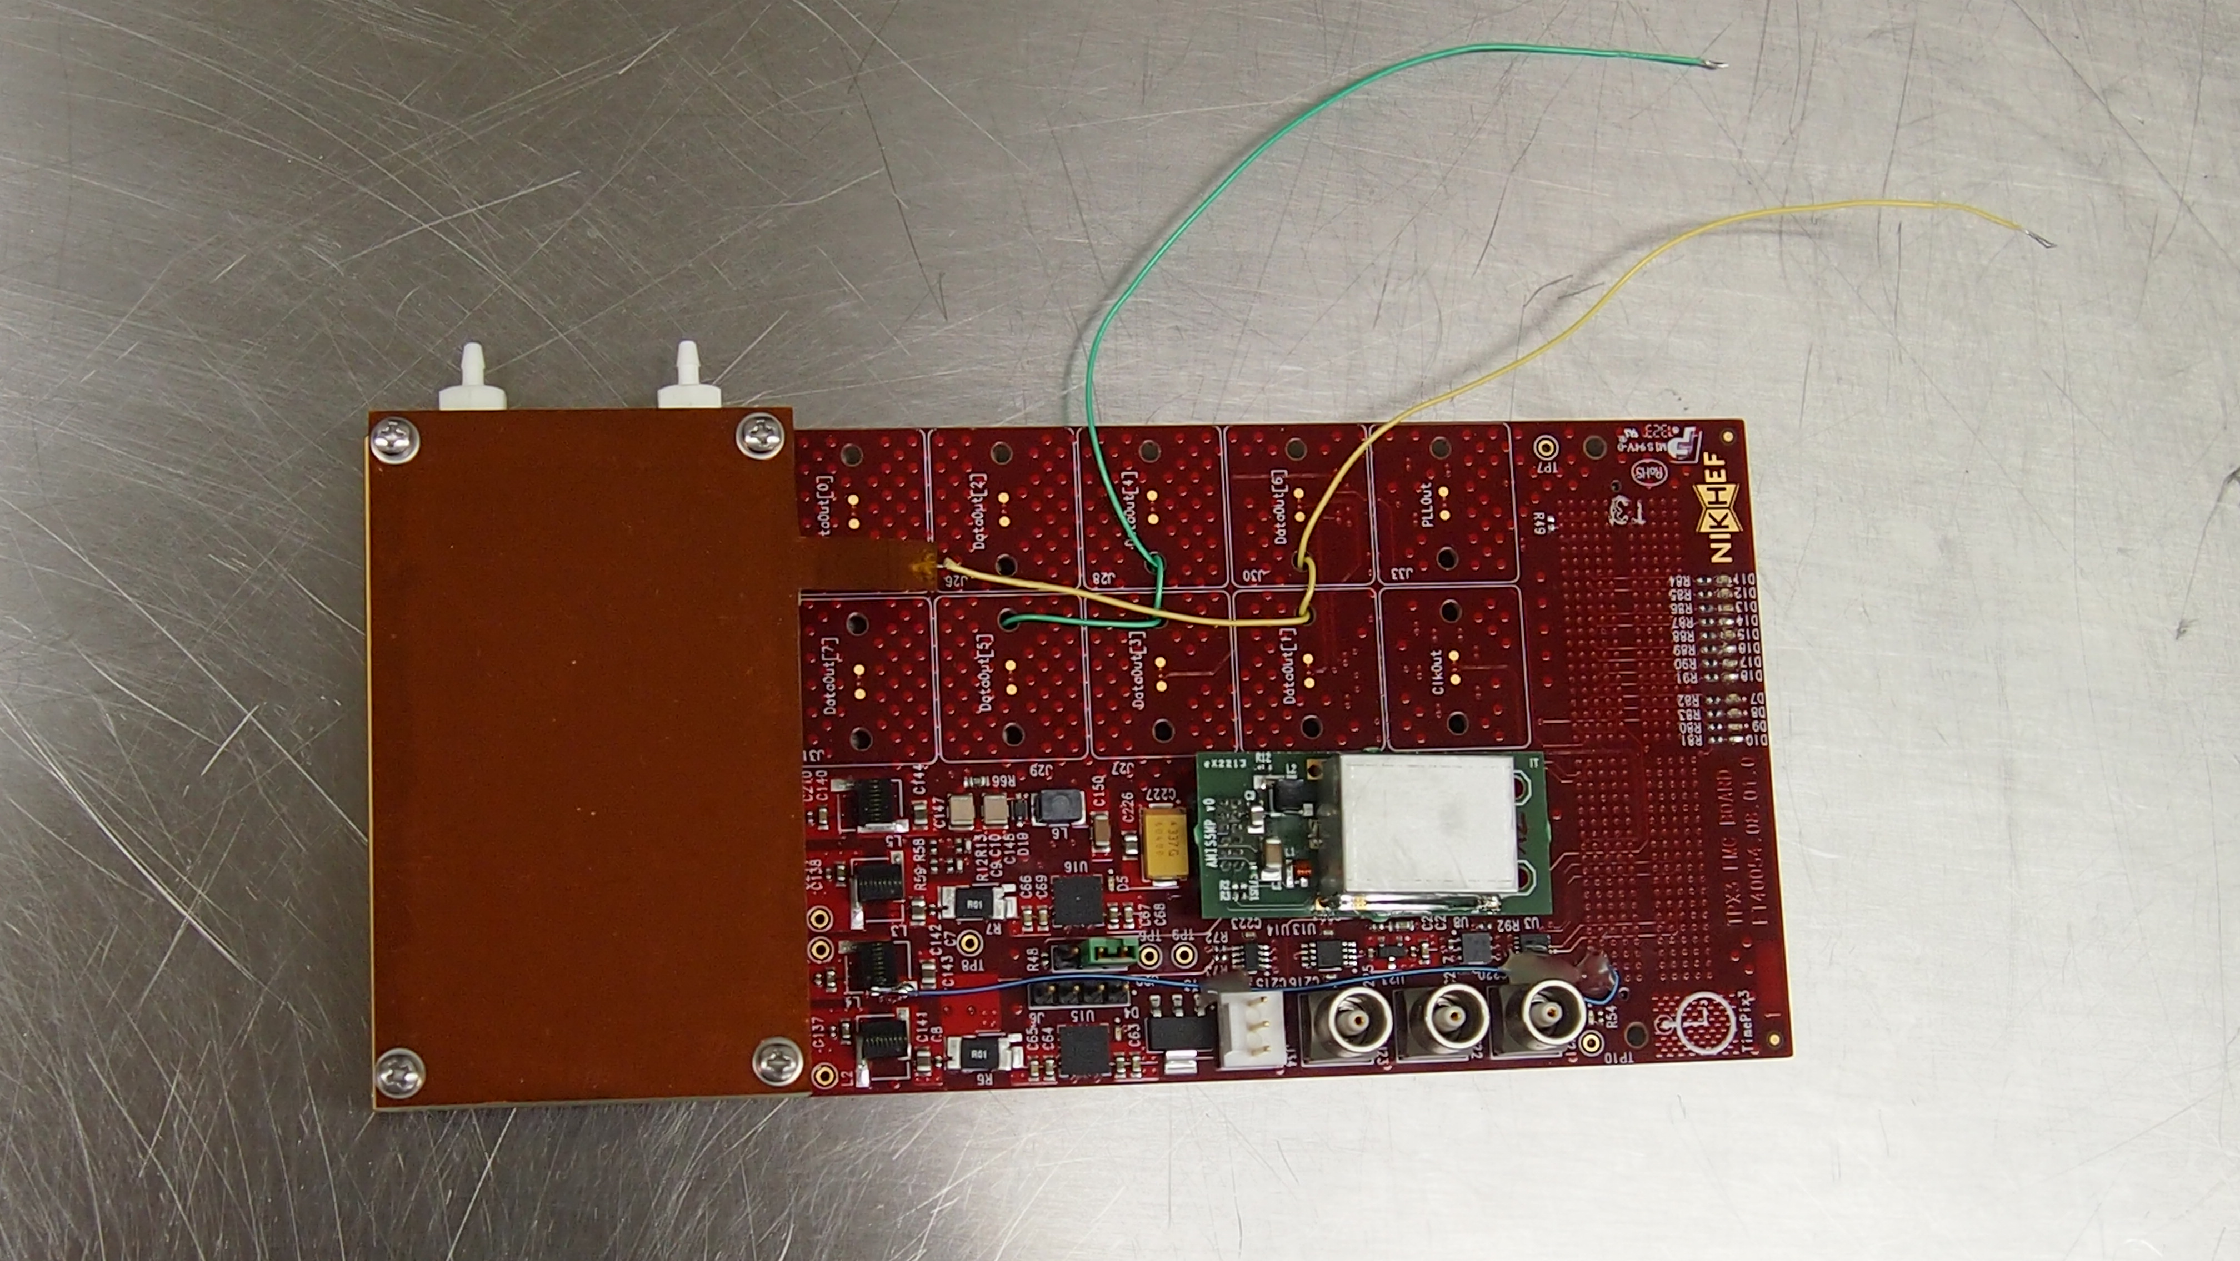

Slide 5
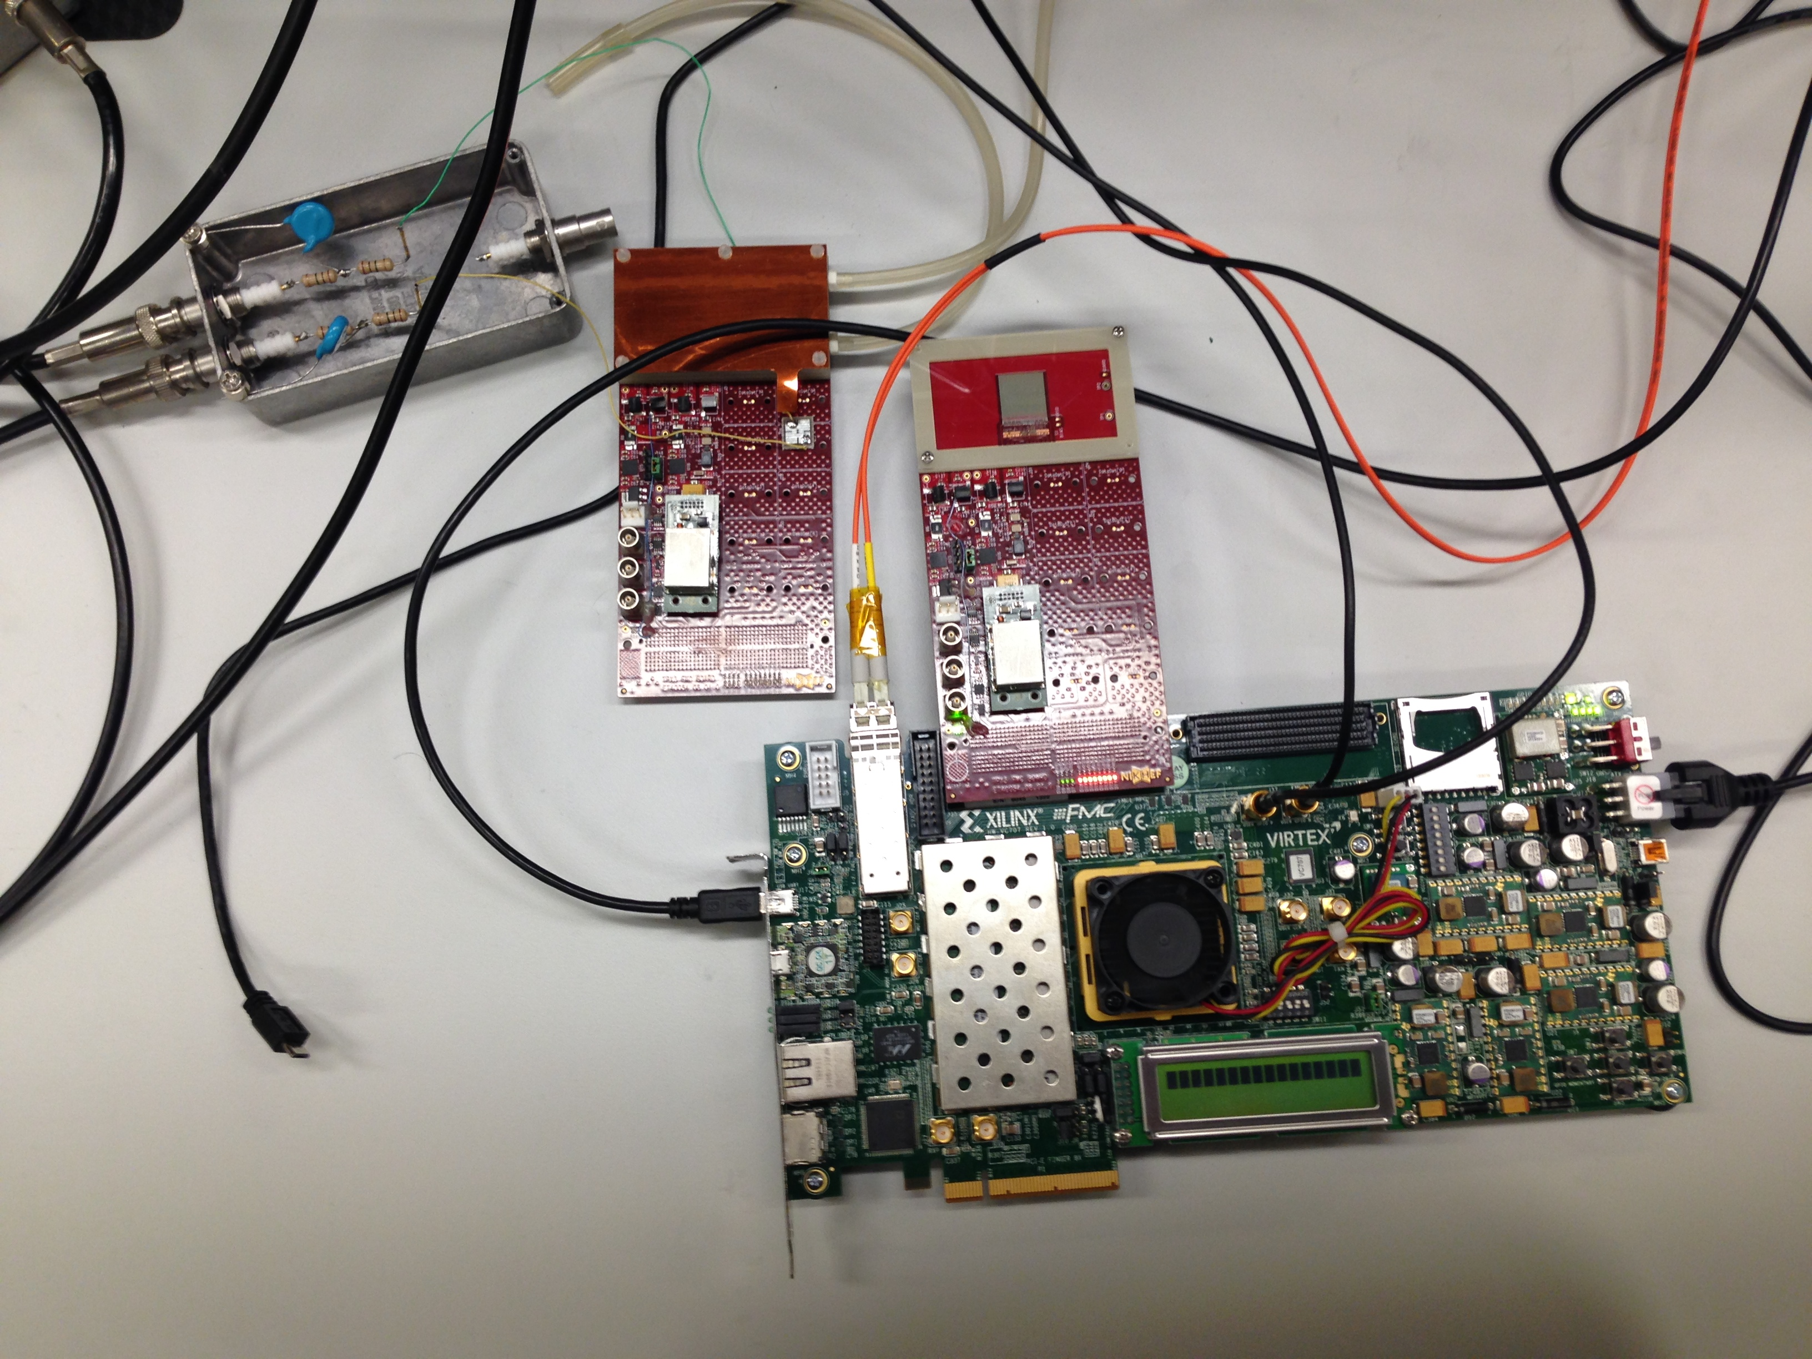

Slide 6
Analysis: Els Koffeman and Stergios Tsi.
Strong non-homogeneous drift field: 2nd order fit
Time coding not yet fully settled
[Time (arrival) measurement OK confirmed by Xavii (Seoul IEEE Oct 2013)

Slide 7
So far: Timepix-3 works as expected (not aware of any problem)
Prototype Spidre works (firmware!)
DAQ works
Data represents something good
Yet much work to do on software

Slide 8
The all-ceramic InGrid
Why?
Double Discharge protection (like Resistive Plate Chambers)
Equal coefficient of thermal expansion throughout InGrid: needed
for operating in cryogenic environments
Plastics (like SU8) outgas. These materials can never be used
in ultra clean (cryogenic) environments

Slide 9
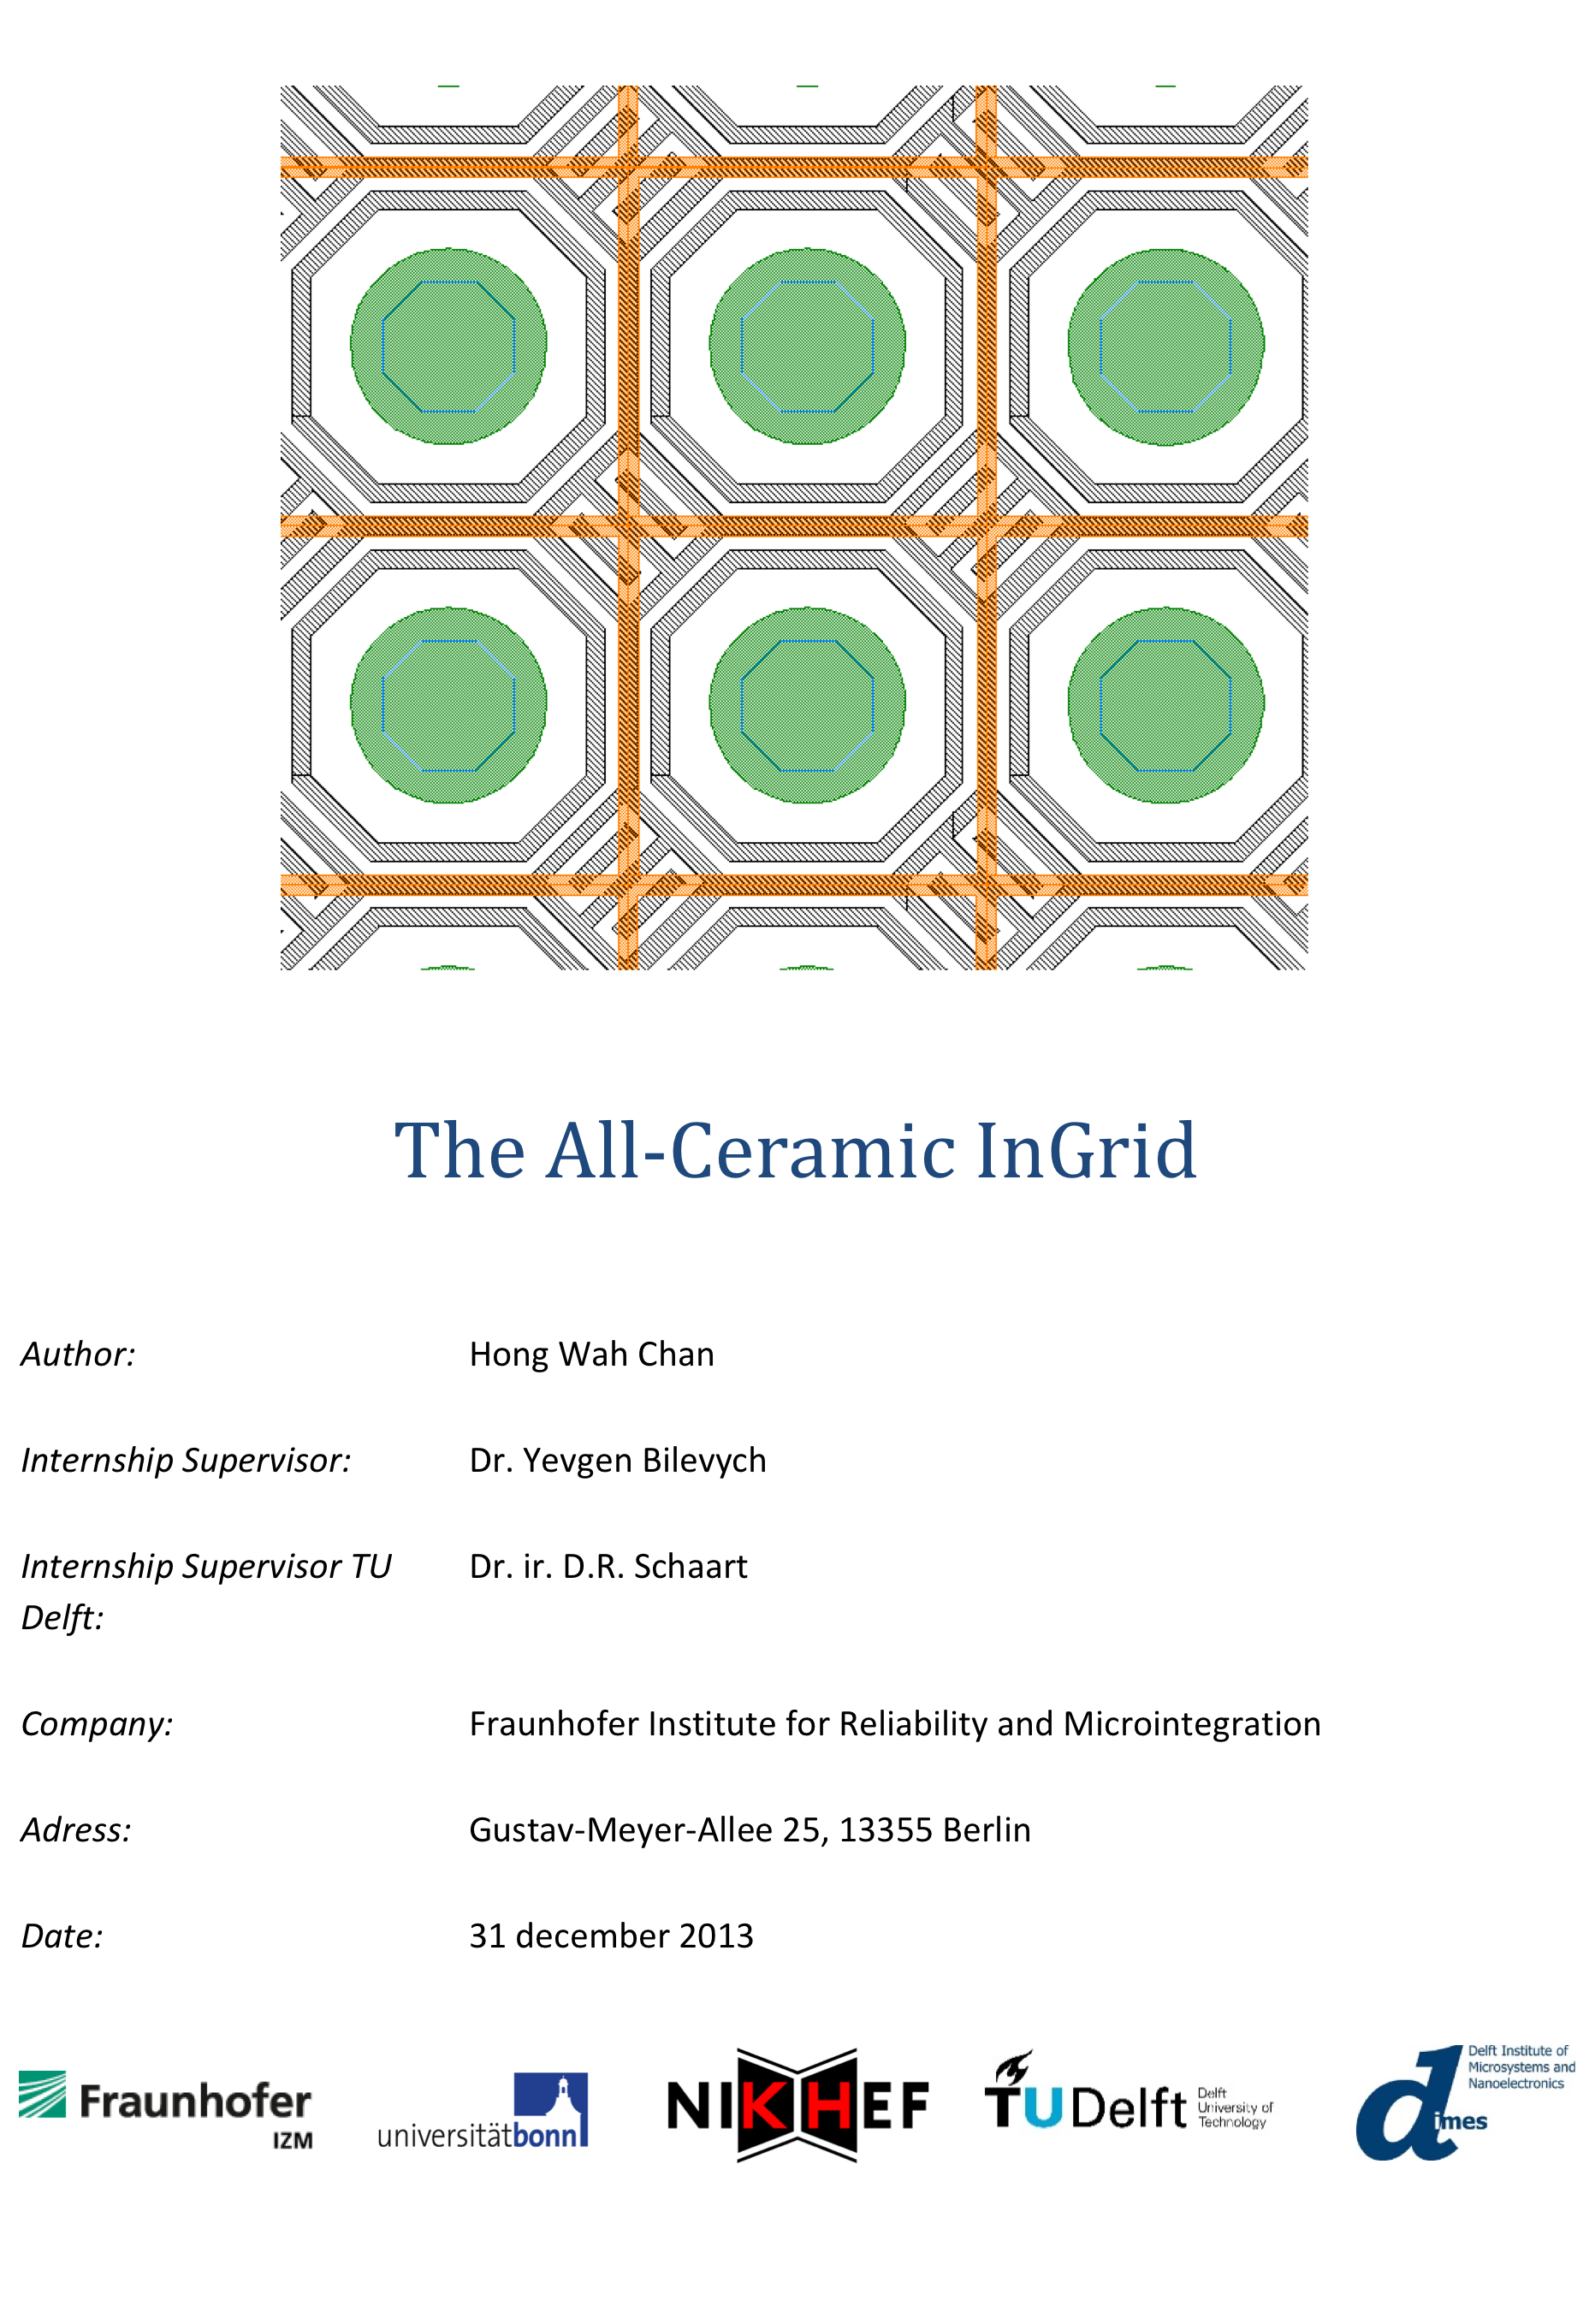

Slide 10
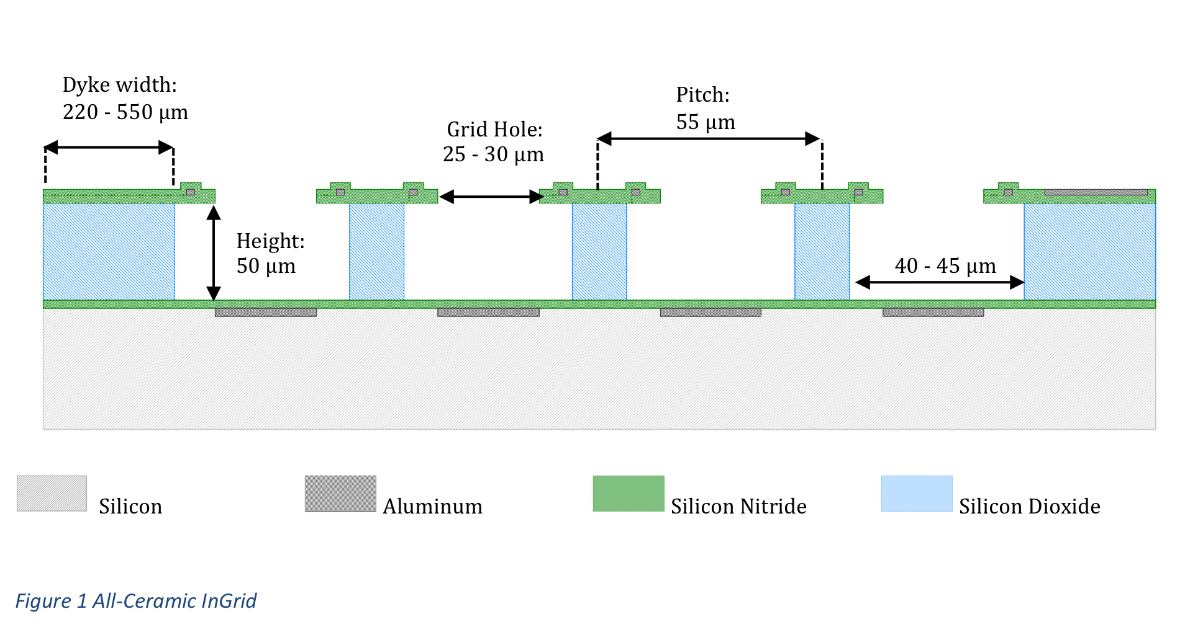

Slide 11
Thick layers of SiO₂ (50 μm) made by Victor Blanco Carballo @ MESA+
New way to make thick layers: changedirection of growth by 90 deg.

Slide 12
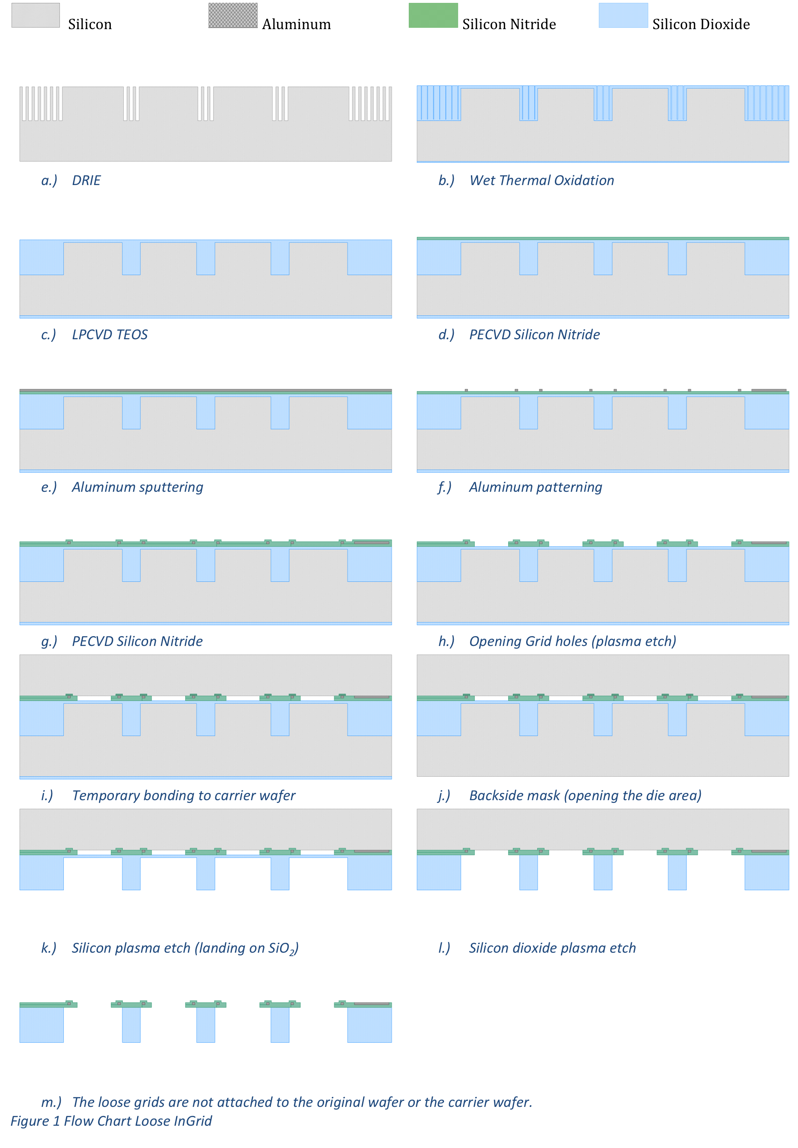

Slide 13
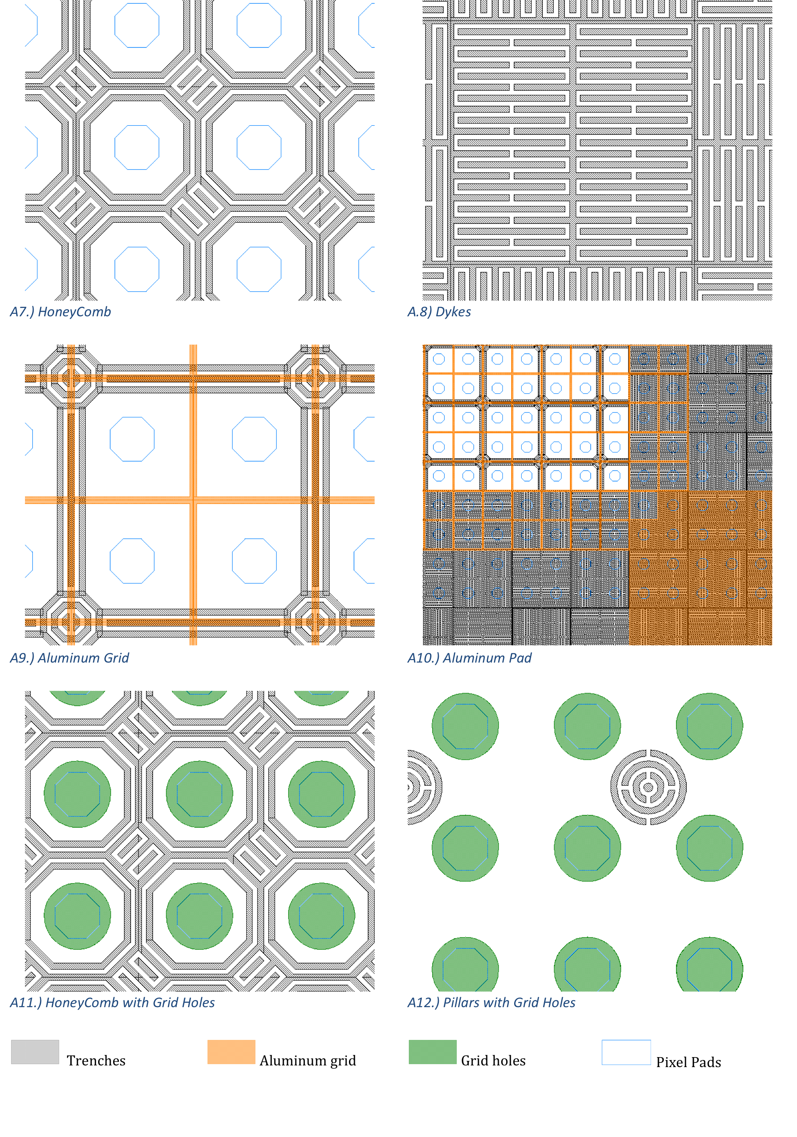

Slide 14
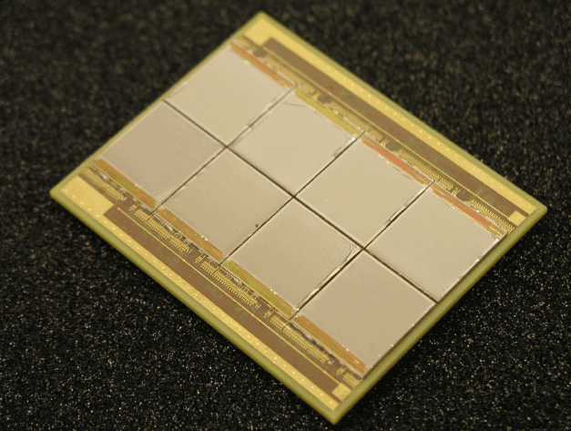
The Focusing TPC
Octopuce: multi-chip array. Attempt to minimize dead regions
- very hard to exchange broken chips (and we will have broken chips)
- uncontrolled distortion of drift field

Slide 15
Focus drift field by means of guard electrode to:
have control over the non-homogeneous) drift field
avoid dead regions

Slide 16
Strong focusing
cover only 25 of fiducial surface with active pixel chip
  saves $$
  saves power, thus cooling, thus radiation length
But:
larger effective pixel pitch (256 x 256 pixels @ 55 μm x 55 μm)
110 μm x 110 μm Moore’sLaw: smaller pixels in future
region of amplified diffusion
in B-field: E x B effect: amplified (coupled) diffusion

Slide 17
work:
pcb
focusing electrode
cooling (ReLaXd)

Slide 18
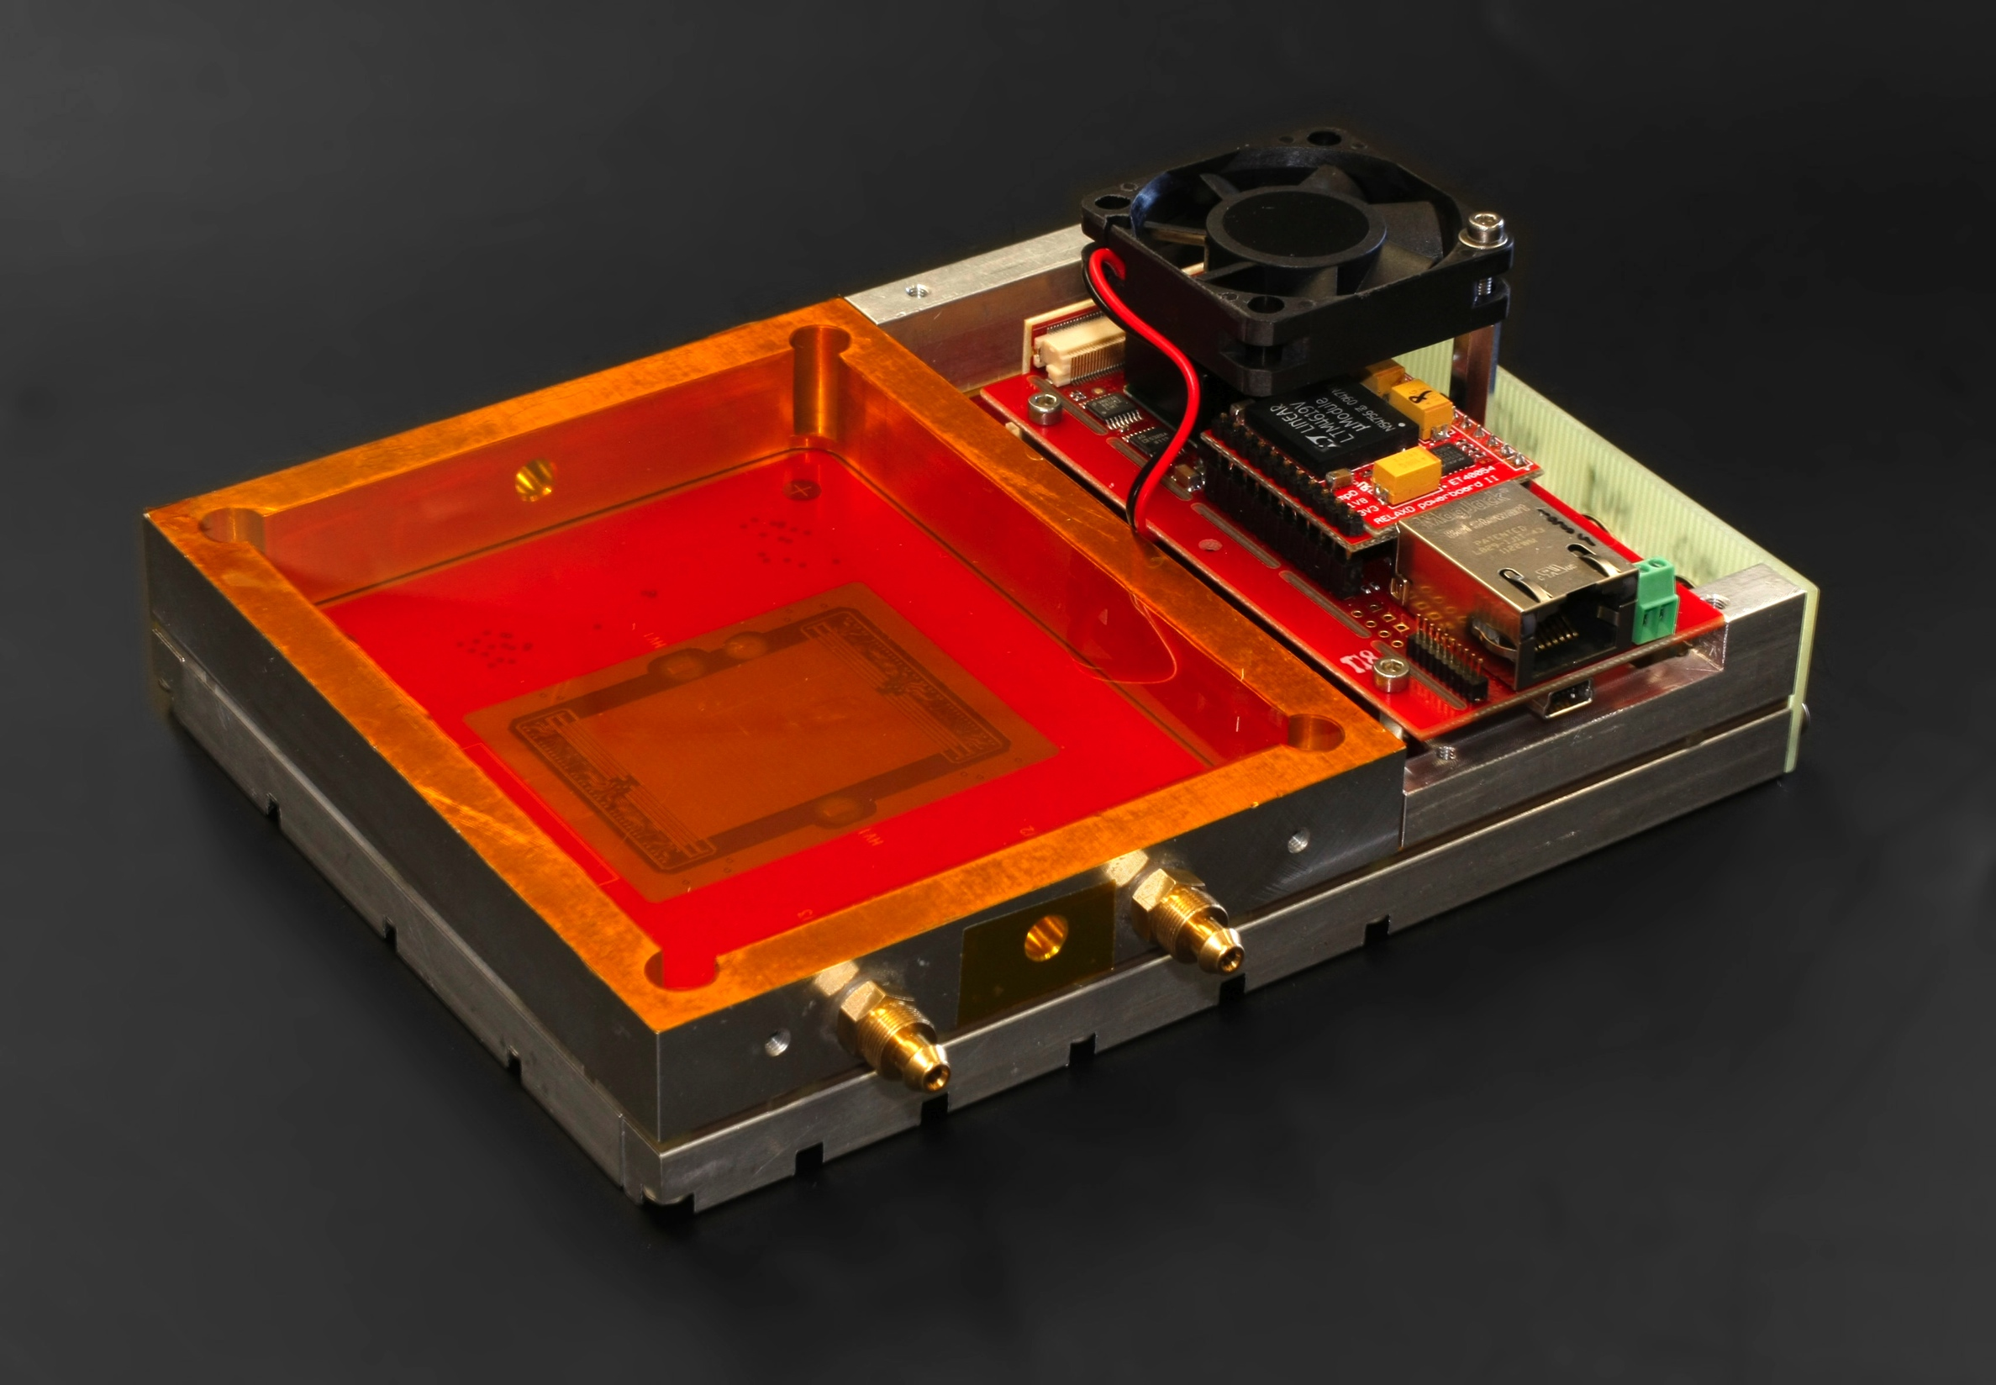
ReNext: ReLaXd for gaseous detectors
Quad timepix carrier board for gaseous detectors
Provides gas enclosure
Relaxd readout board as mezzanine

Slide 19
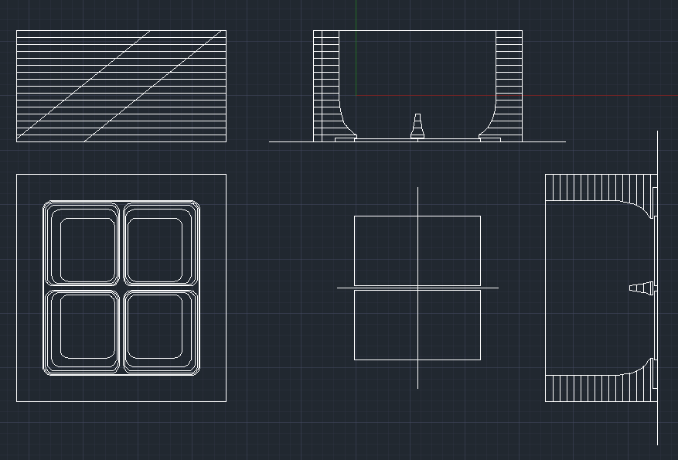
Focusing drifter for Quad TimePix on ReNexd

Slide 20
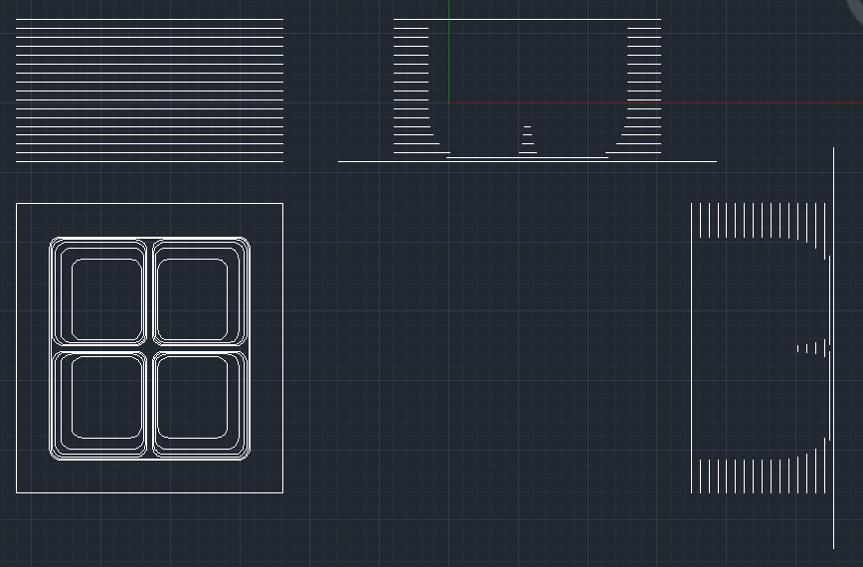
Extract copper pattern for 3D field calculations

Slide 21
Flat Cable with 16 leads: external potential settings

Slide 22
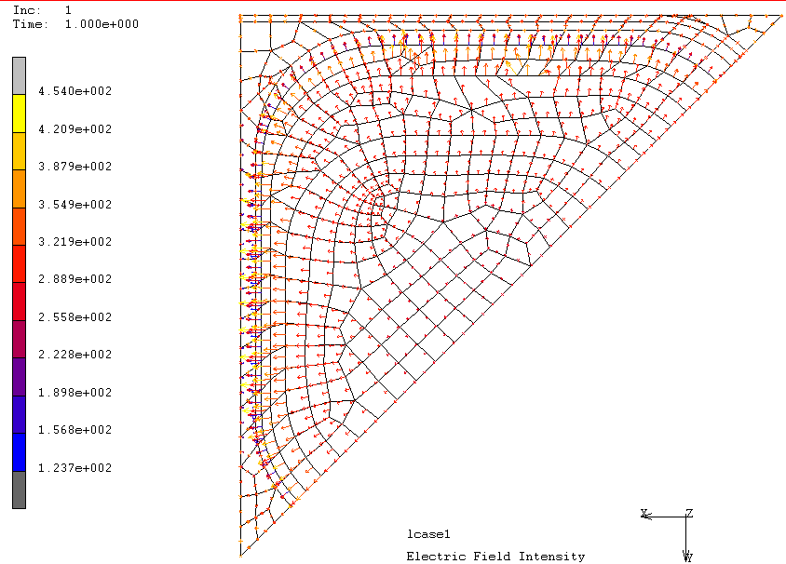

Slide 23
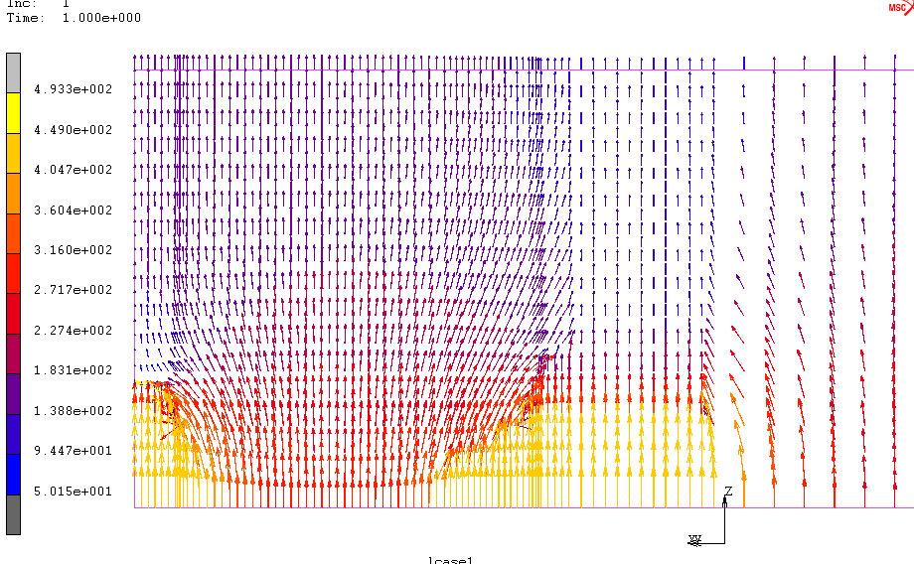

Slide 24
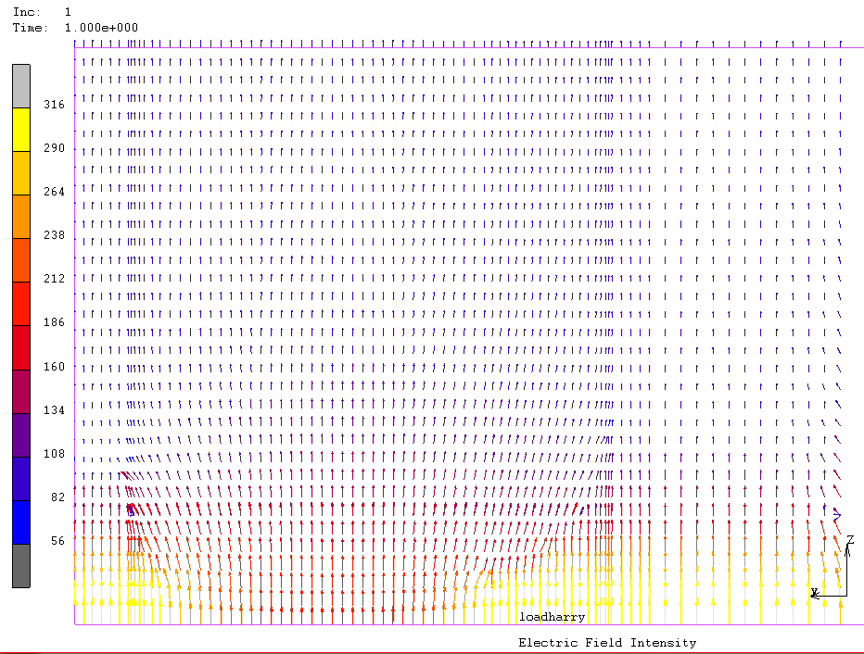

Slide 25
Autocalibration
get initial f(X,Y)➔ (X’,Y’) from 3D e-field
make scatter plots of residials
modify f(X,Y) until residuals are minimized
Basic correction: X’ = C X, Y’ = C Y
+ E x B effect

Slide 26
Performance
requires knowledge of local vectors E, B
effective pixel size related to electron diffusion
E x B effect, although correctable, may worsen resolution
Plans
Quad Focus Drifter under construction (finished)
2x Sci 30 mm x 40 mm to be constructed
Chamber support + rotator (around Z axis) ready
HV distribution box (16 channels!) ready
Testbeam @ DESY in Oct 2013
  Data analysis, Monte Carlo simulation, correction procedure
Collaboration with Bonn

Slide 27
Q64: an assembly of 16 Quads
Number of chips is not a variable

