Slide 1
Status of SU-8 based InGrid production
Yevgen Bilevych
27.01.2014 Bonn

Slide 2
Outline:
TimePix wafers
Production runs
InGrids and single TimePix chips
SU-8 production status

Slide 3
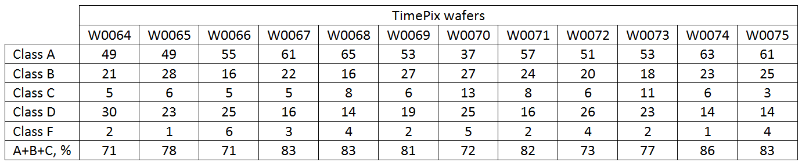
Overview of TimePix wafers
W00127 (K3NQX8T) and W00129 (KXNQSZT) - J. Timmermans, probed in CERN
W0064 – W0075 (i.e. 12 TimePix wafers) - Bonn, probed in NIKHEF

Slide 4
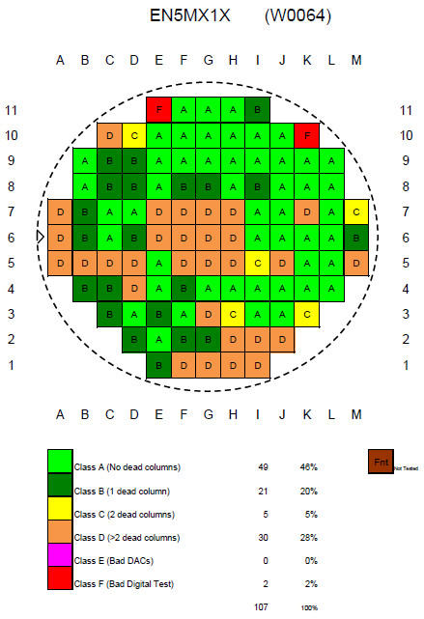
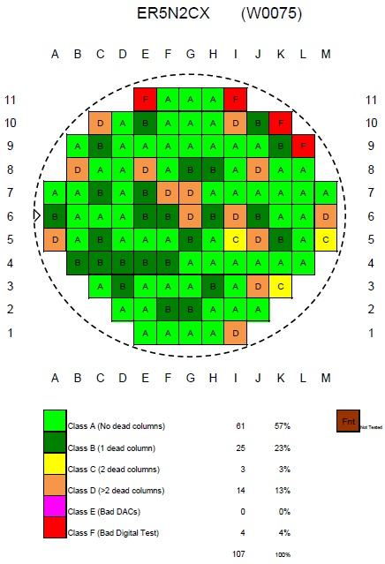

Slide 5
Production runs decoding
IZM-1 - W0011_ATFWTLX_02.11.2011 – (8 um Si_{x}N_{y}) – bad grid and dirty bonding pads
Available chips: 18 chips type A, 10 B, 4 C, 5 D
IZM-2 - W0057_EL5MX3X_17.06.2011 – (??? um Si_{x}N_{y}) – SixNy problem
Available chips: 20 A, 11 B, 7 C, 5 D
IZM-3 - W0056_ E85MXGX_06.07.2012 – (8 um Si_{x}N_{y}) – OK, but grid not so flat
Available chips: 6 A, 4 B, 19 D
IZM-4 - W0058_EW5MWBX – (4 um Si_{x}N_{y}) – SU-8 overbaked during Al deposition
Available chips: 67 A, 14 B, 1 C, 13 D
W0059_EU5MWDX – (4 um Si_{x}N_{y}) – broken wafer
W0060_E85MWZX – (8 um Si_{x}N_{y}) – SU-8 overbaked during Al deposition
Available chips: 56 A, 18 B, 2 C, 24 D
W0061_E15MVPX – (8 um Si_{x}N_{y}) – broken wafer

Slide 6
IZM-5 - W0062_E95MWYX – (8 um Si_{x}N_{y}) – OK
Available InGrids: 13 A, 15 B, 11 D
Available chips: 8 A, 6 B, 3 C, 3 D
W0063_EY5MW9X – (4 um Si_{x}N_{y}) – OK
Available InGrids: 32 A, 22 B, 8 C, 2 D
Available chips: 9 A, 3 B, 3 C

Slide 7
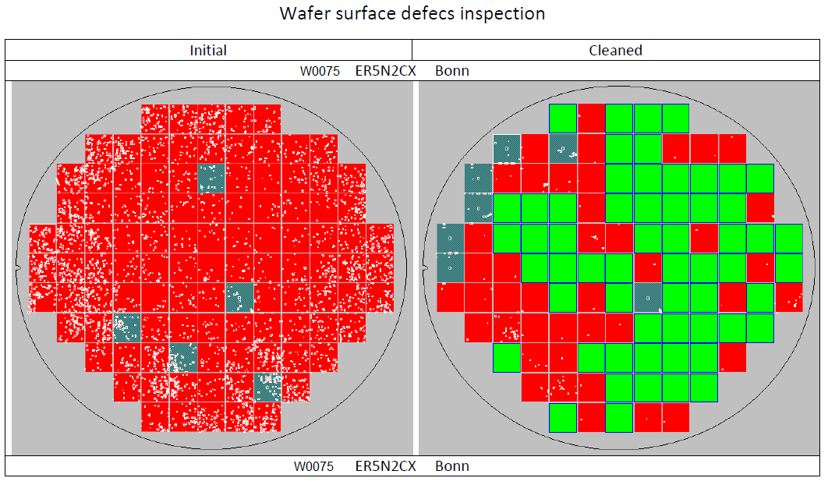
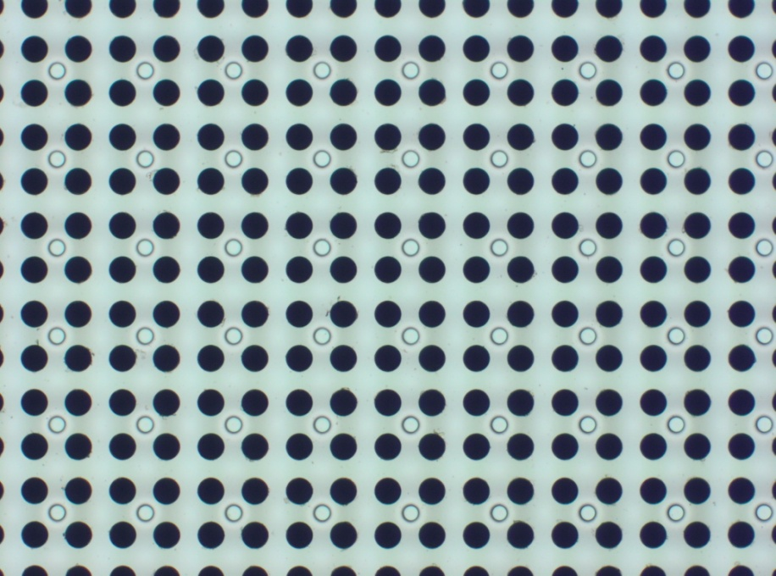
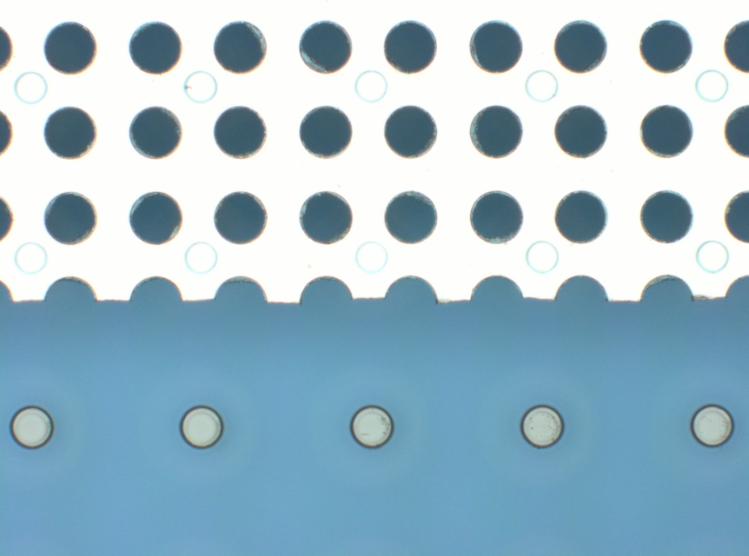
IZM 6 ?
- wafers
- chemicals
- equipment
- processes

