Slide 1
Full-ceramic InGrids
Yevgen Bilevych
27.01.2014 Bonn

Slide 2
Detached Ceramic Grid (top view)

Slide 3
Detached Ceramic Grid (backside view)

Slide 5
Ceramic grid
Metal grid top view
Grid cross-section

Slide 6
Ceramic grid short process-flow
Dry etching of silicon
Silicon oxide deposition
Wafer bonding
Wafer grinding
Bottom Grid protection layer
Metal electrode formation
Top protection layer deposition
Ceramic layers patterning
Ceramic Grid releasing

Slide 7
1 μm Si oxidized to 2,17 μm
85-140 μm
200-360 μm
15-20 μm
110 μm

Slide 8
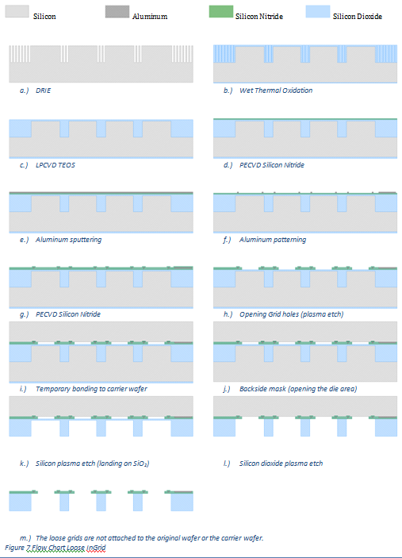

Slide 9
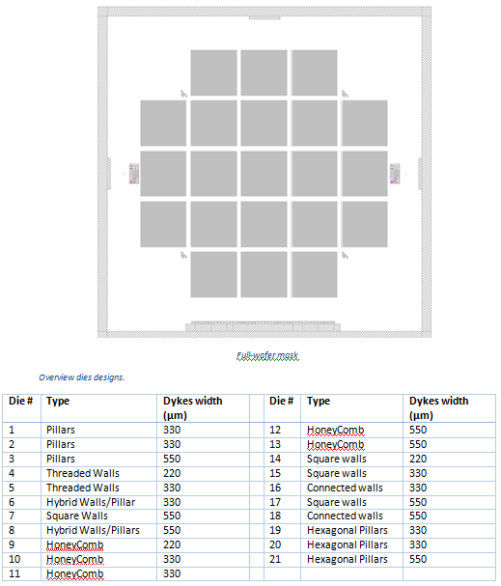

Slide 10
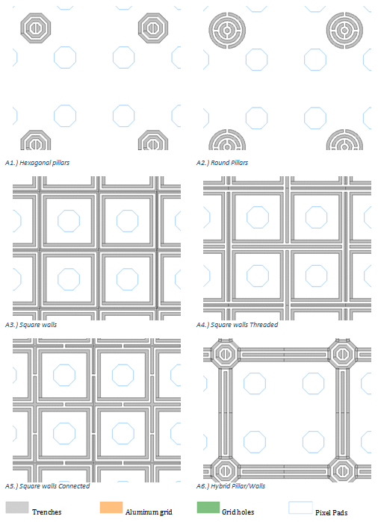

Slide 11
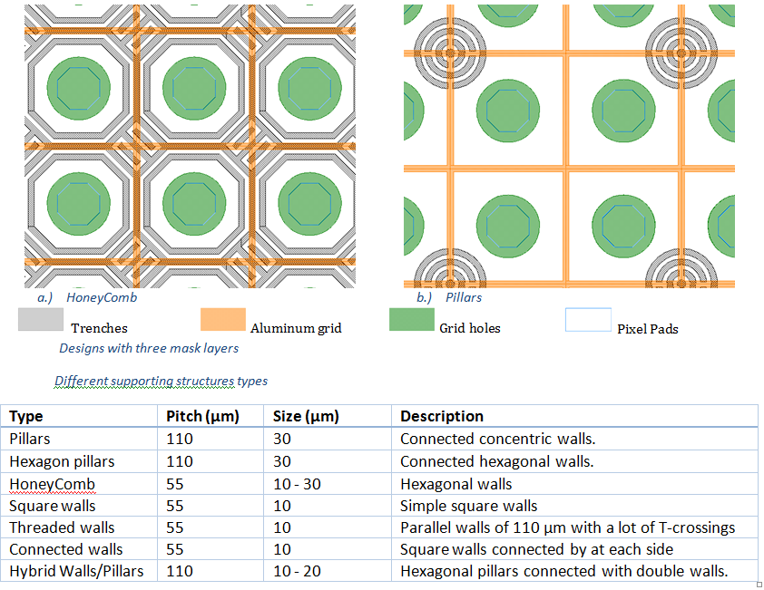

Slide 12
?????
Alignment marks – 2 times
Dicing or cracking
2 layers of SixNy or only top-layer
Thickness of SiO2
Thickness of metal layer
Thermal stability of bonding material
Possibility of bonding to chip or to wafer afterwards

