Slide 1
Progress in CMOS post-processing
Jurriaan Schmitz
Pixel Meeting Bonn, 27 January 2014

Slide 2
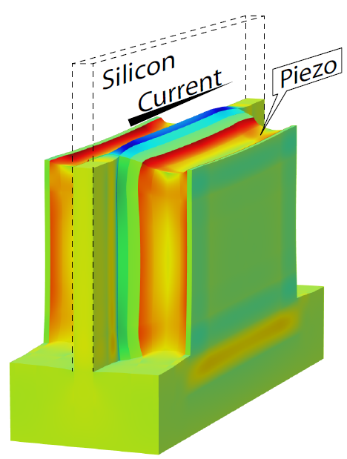


Twente in the news:
Squeezing transistors really hard generates energy savings
News item early December
Transistor modeling work
Ray Hueting & Tom van Hemert

Slide 3
CONTENTS
Wafer post-processing: results from my group
Recent achievements
  SiON waveguide material
  Sub-nanometer TiN by atomic layer deposition
Ideas for InGrid / GridPix

Slide 4
CMOS wafer post-processing
a. Chip manufacturing
b. Dicing and packaging

Slide 5
Adding new process steps “Above-IC”
“pizza” technology
a. Chip manufacturing
b. post-processing
c. Dicing and packaging

Slide 6

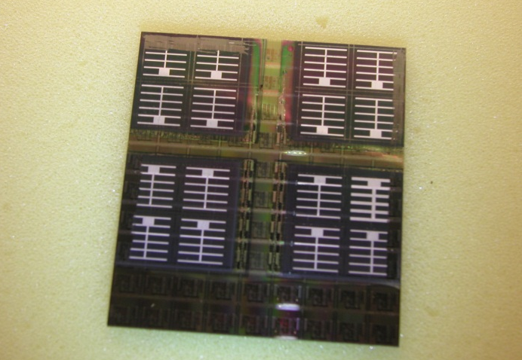
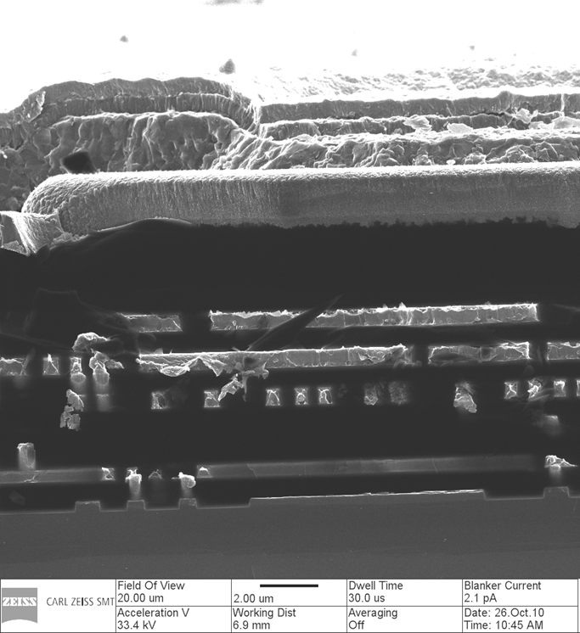
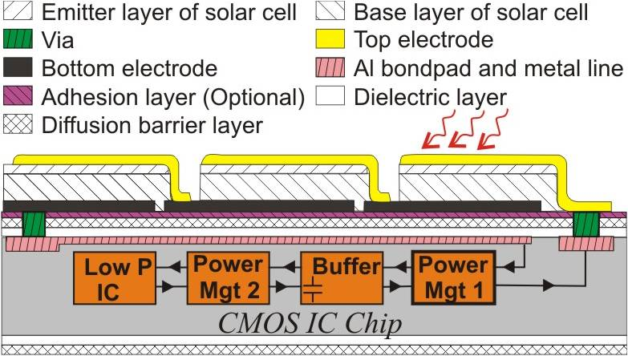
Solar cells on a CMOS chip
CIGS solar cell
CMOS
J. Lu et al., IEDM, December 2010

Slide 7
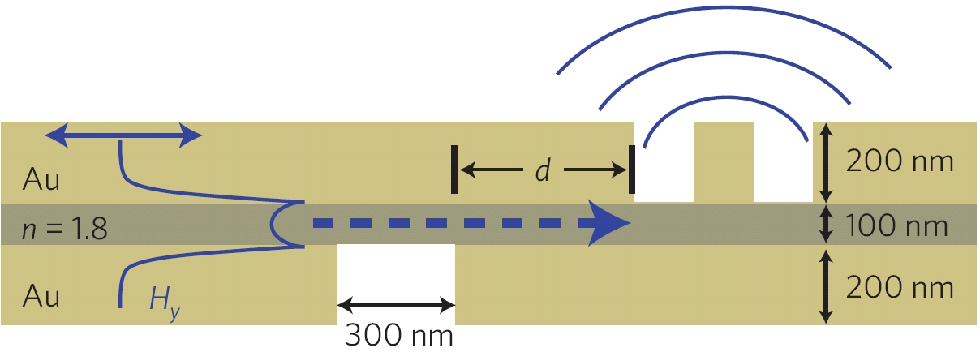
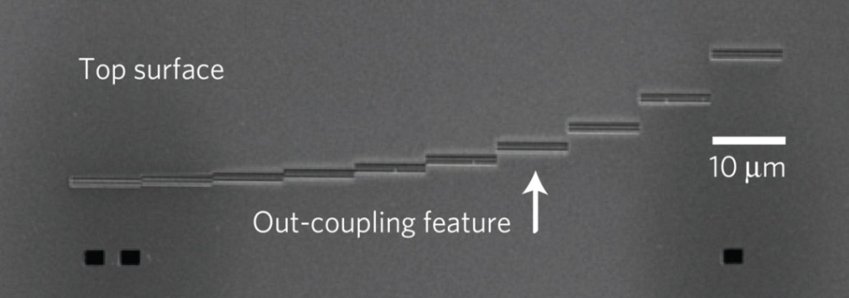
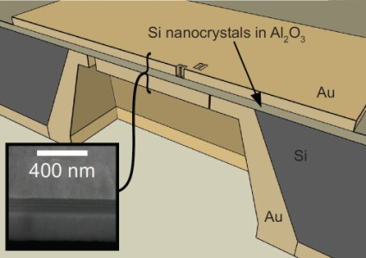
An electrical surface plasmon polariton source on CMOS
Cross section:
SEM top view:
R. J. Walters et al., Nature Materials vol. 9 (Jan. 2010) pp. 21-25.
Notes:
7
Nucleation of islands depends on: deposition materiel, used precursors, temperature and type of substrate (termination).

Slide 8
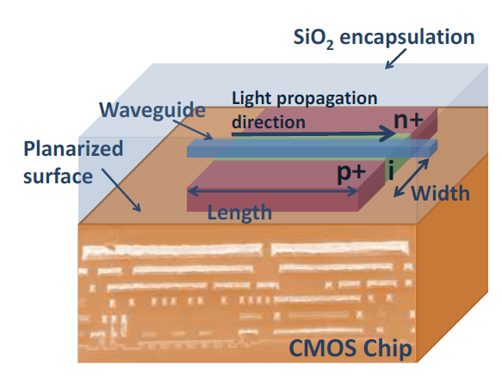
Optics on top of CMOS
B. Rangarajan et al., Optics Letters 38 (6) 941 (2013).
B. Rangarajan et al., J. Solid State Sci. Technol. 1, P263 (2012).

Slide 9
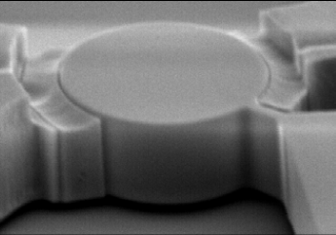
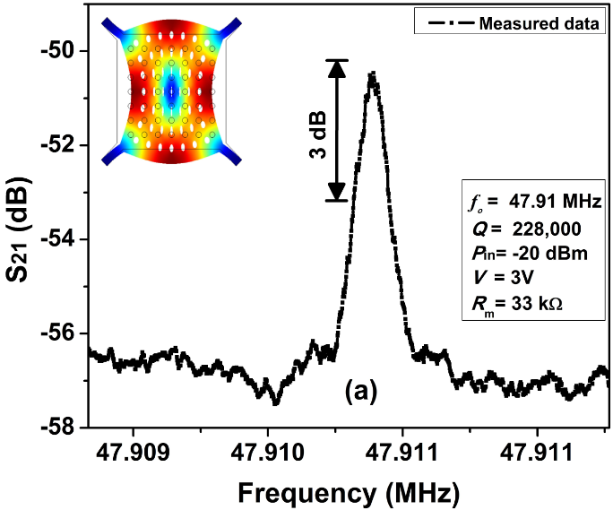
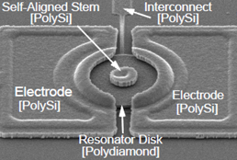
RF MEMS components on top of CMOS
Ayazi et al.
Nguyen et al.
Nguyen et al.
S.N.R. Kazmi et al., IFCS 2012; JSST 2012; Micr. Eng. 2013

Slide 10
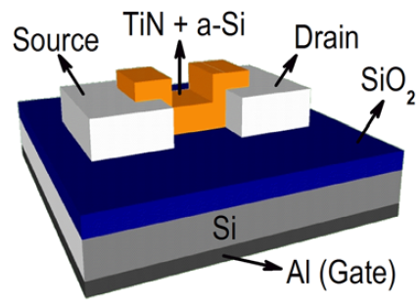
TiN – thinner and thinner

Slide 11
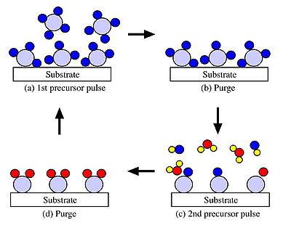
Atomic layer deposition explained

Slide 12
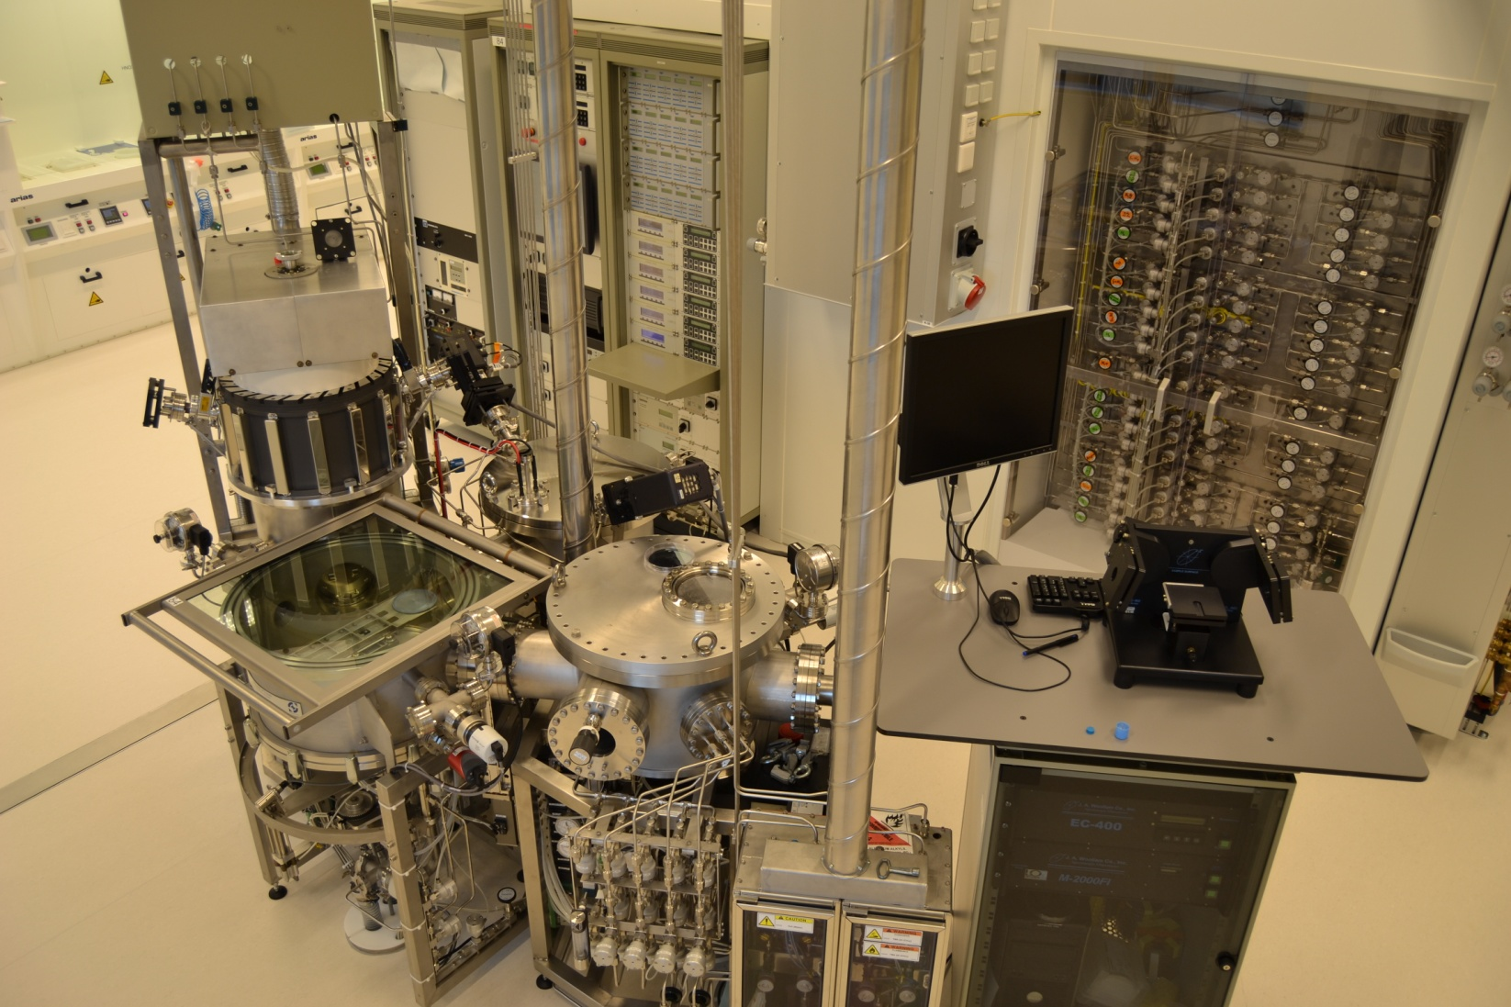
Home-built Atomic Layer Deposition system

Slide 13
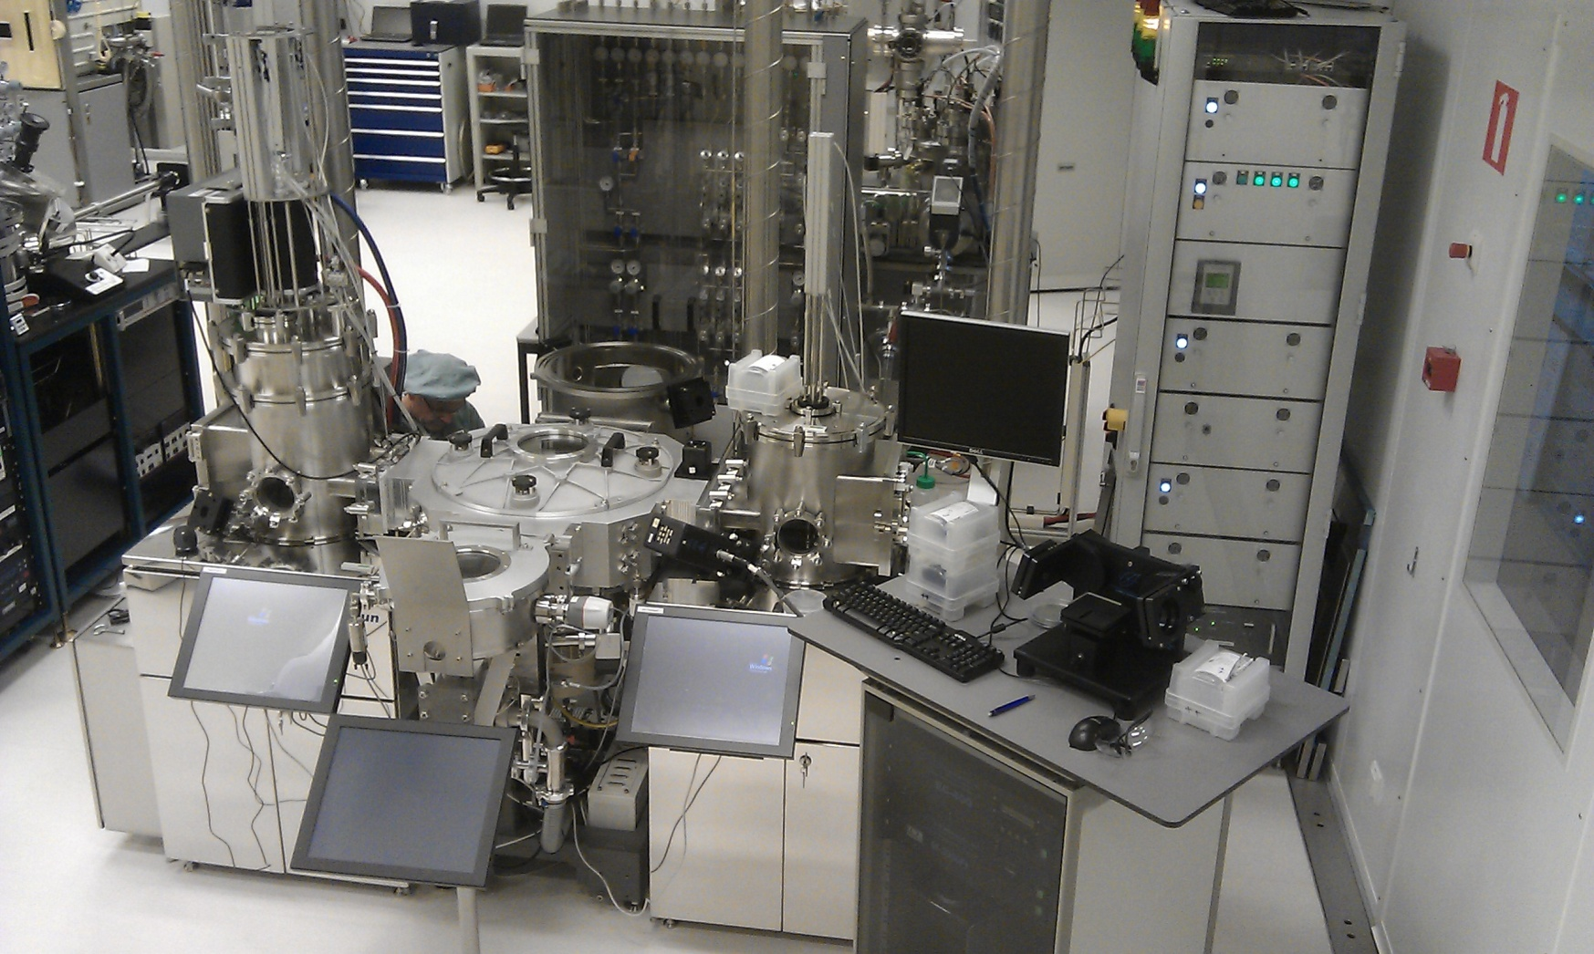
New: commercial ALD system

Slide 14
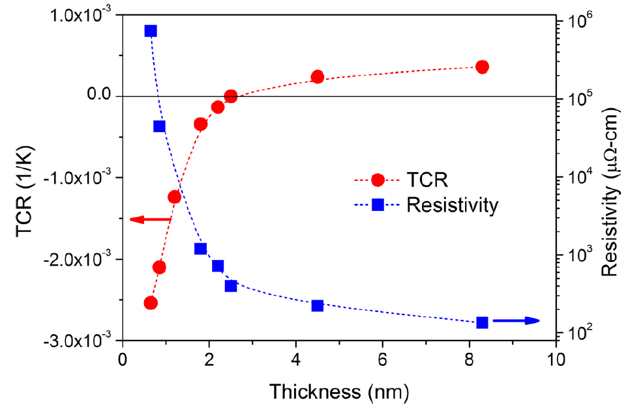
Resistivity skyrockets – quantum effects

Slide 15
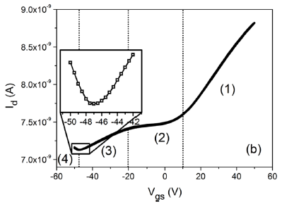
Going subnanometer: field effect in a metal!
Hao Van Bui et al., Applied Physics Letters 2013

Slide 16
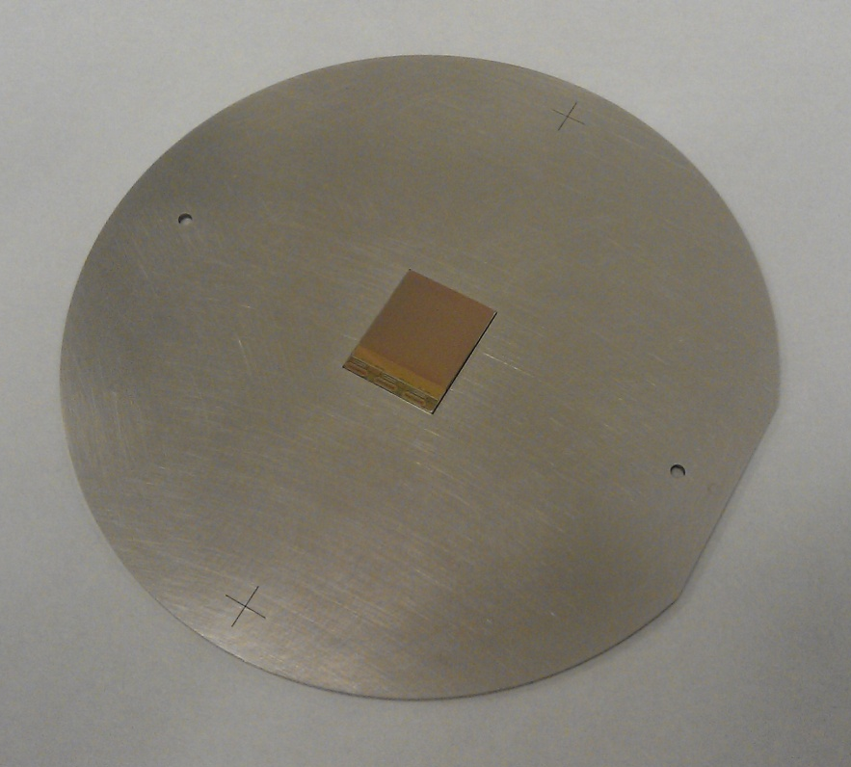
Prospects at the University of Twente
Atomic Layer Deposition:
“perfect” bi-atomary compounds (Al₂O₃, TiN, HfO₂, ...)
Any use for InGrid/GridPix?
Insulator coating
Outgassing prevention
Reduce photon feedback?
Working on improvement of single-chip processing for TimePix3

