Slide 1

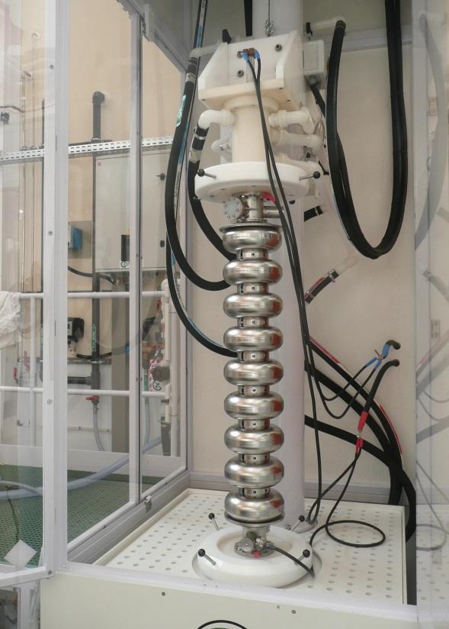
Vertical Electro-Polishing at CEA Saclay: update
January 22th 2014
S. Berry, P. Carbonnier, J-P. Charrier, F. Eozénou, L. Maurice, F. Peauger, D. Roudier, C. Servouin

Slide 2
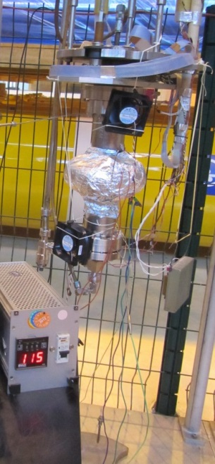
Last Results on 1Cell
Nice Q0 after VEP on 1AC1 cavity
1AC1 1C cavity 1.3 – 1.7K
1AC1 baking at 115°C
1AC1 baked at 115°C Test Week#4
1AC2 baked at 115°C after VEP Test Week#5
1AC3 (Quench at 35MV/m): Replica of the inner surface of the cavity
  Morphology depends on location in the cell
  Outlook: Quench area morphology & Ra at different locations

Slide 3
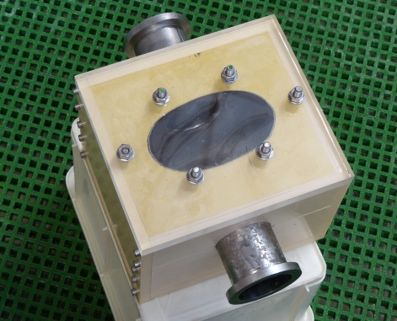
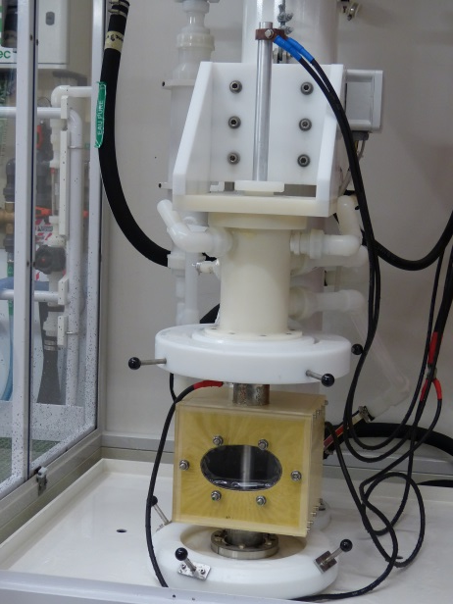
STUDY OF VEP MECHANISM (Flows in cavity)
Set-up to investigate inner surface of the cavity during VEP:
1.3 GHz 1C cavity cut and embedded in resin
Goal: investigate the effect of the acid flow, viscous layer during VEP
Explanation for asymmetry?
First test with acid (Ø30mm rod cathode):
Hydrogen bubbles flow alongside the cathode
Air bubbles might be trapped at the cavity surface if the acid flow is too high during filling

Slide 4
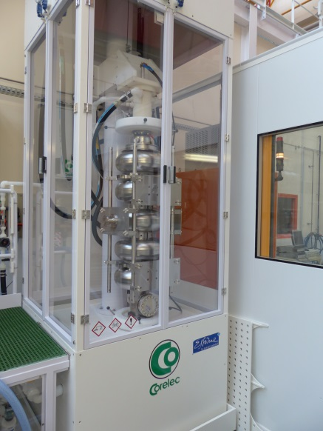
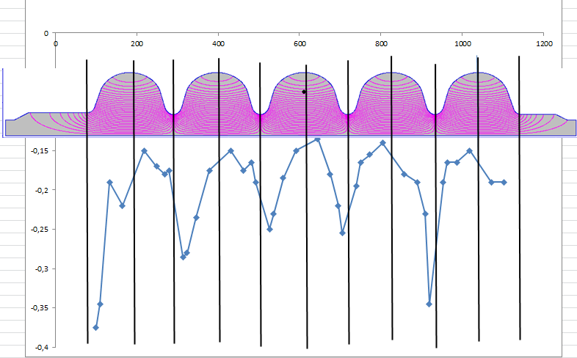
VEP with 5Cell 704MHz Cavity with parameters derived from 1300MHz optimization:
Low voltage, high acid flow, large rod cathode
Removal (mm) along the cavity after 200µm VEP
No thickness
measurement in
this area
Pb during 1st seq: low hydrogen removal because of obstructed exhaust pipe : uncrontrolled EP and high removal at upper cell,
4 sequences with turning of the cavity in between
Exhaust problem discovered (acid condensation) and solved
200 µm average removal
Resulting removal ratio equator/iris ~ 1/2

Slide 5
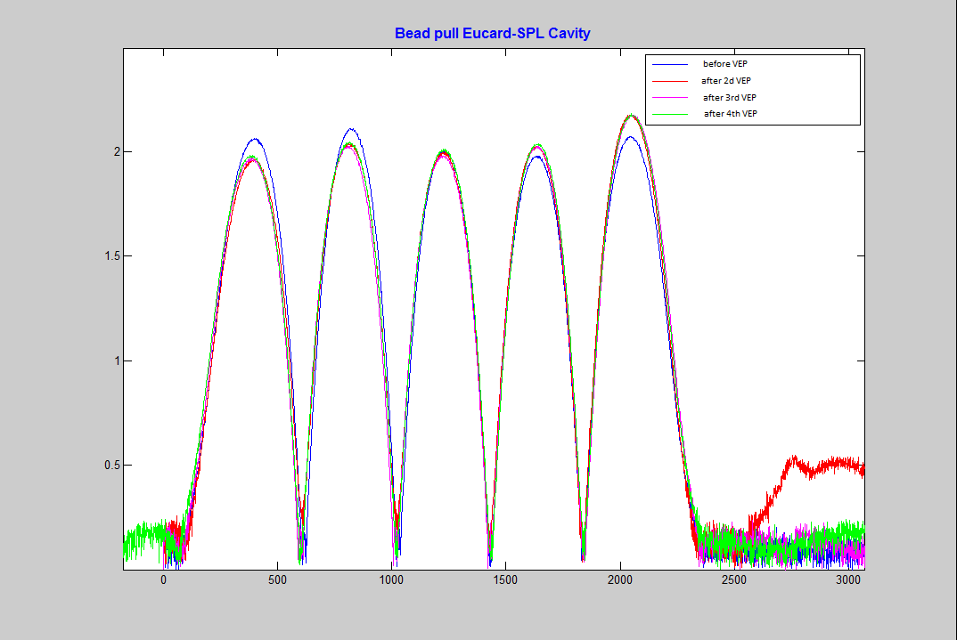
Field flatness of SPL after each VEP sequence
Field flatness modified after uncrontrolled VEP
Once the problem solved, no field flatness modification

