Slide 1

Powering of Detector Systems
Satish Dhawan, Yale University
Richard Sumner , CMCAMAC LLC
AWLC 2014, Fermilab
May 12 - 16, 2014

Slide 2
Agenda
Prior / Current Status
  LDO Powering Efficiency
  Buck Converter
  Frequency limited by FeCo
  Commercial Devices limited by 200 KHz – 4 MHz - Core losses
Higher Frequency > smaller components
Wireless Charging, Intel 4th Generation Core
Air Core Toroid vs Planar (spirals). PC Traces @ > 100 MHz
Shielding Electrostatic & RF
ATLAS Tracker
Future

Slide 3
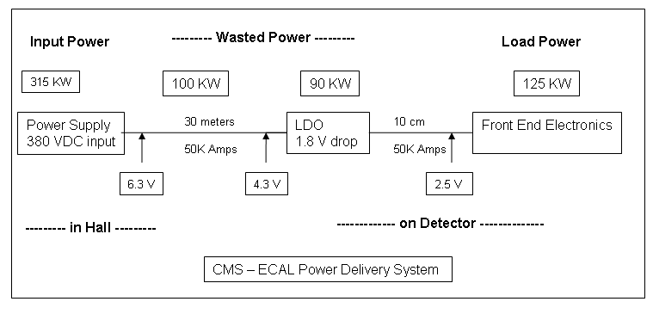
Power Efficiency _ Inefficiency _ Wasted Power
Power delivery Efficiency = 30 %
with Power for Heat Removal = 20 %
Notes:
Pout = 125 kW 30 m cabels 100 kW LDO’s

Slide 4
Crucial element - Inductor
Low DCR for output current
Shielding to sensor
Cooling

Slide 5
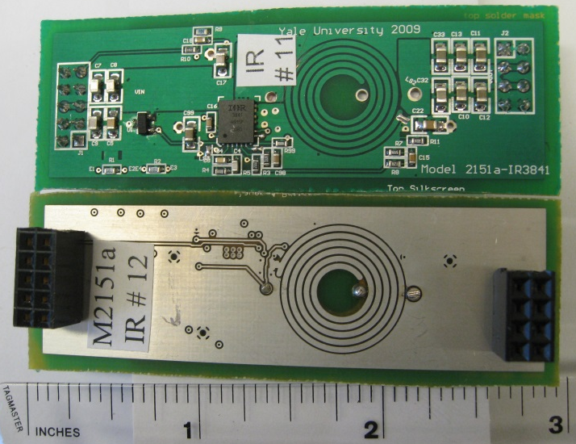
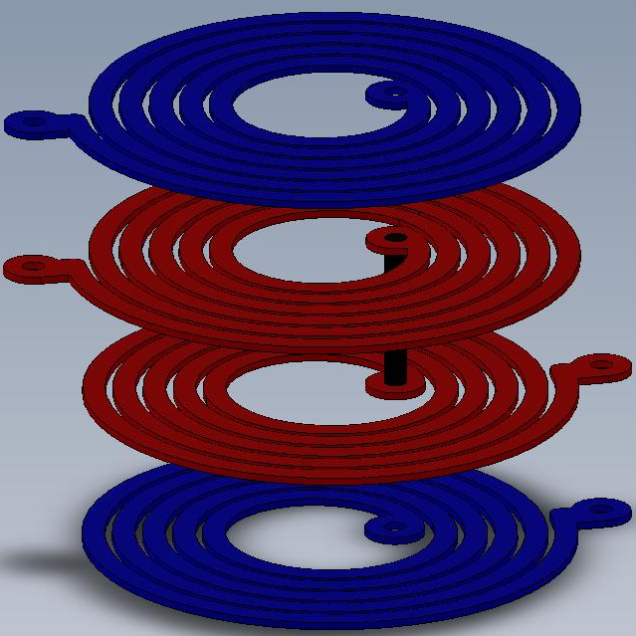
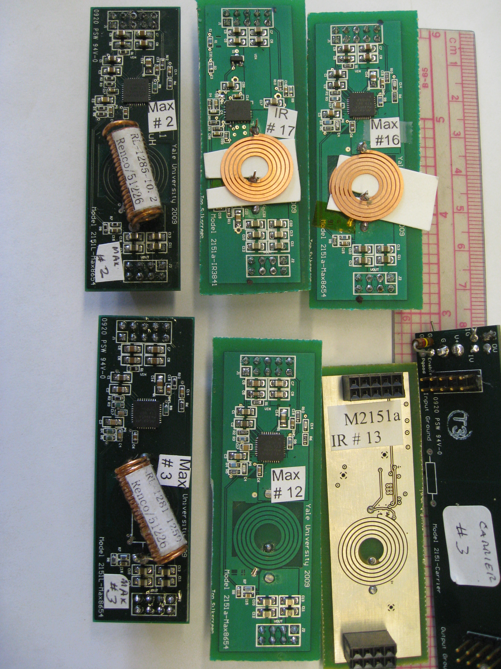
Plug In Card with Shielded Buck Inductor
Coupled Air Core Inductor
Connected in Series
0.35 mm
1.5 mm
12 V
2.5 V
@ 6 amps
Different Versions
Converter Chips
Max8654 monolithic
IR8341 3 die MCM
Coils
Embedded 3oz cu
Solenoid 15 mΩ
Spiral Etched 0.25mm
Spiral Coils Resistance in mΩ
 | Top | Bottom
3 Oz PCB | 57 | 46
0.25 mm Cu Foil | 19.4 | 17
Noise Tests Done: sLHC SiT prototype, 20 µm AL Shield

Slide 6
Solenoid
Copper Coils
PCB embedded Coil
From Fermilab Talk 041310

Slide 7
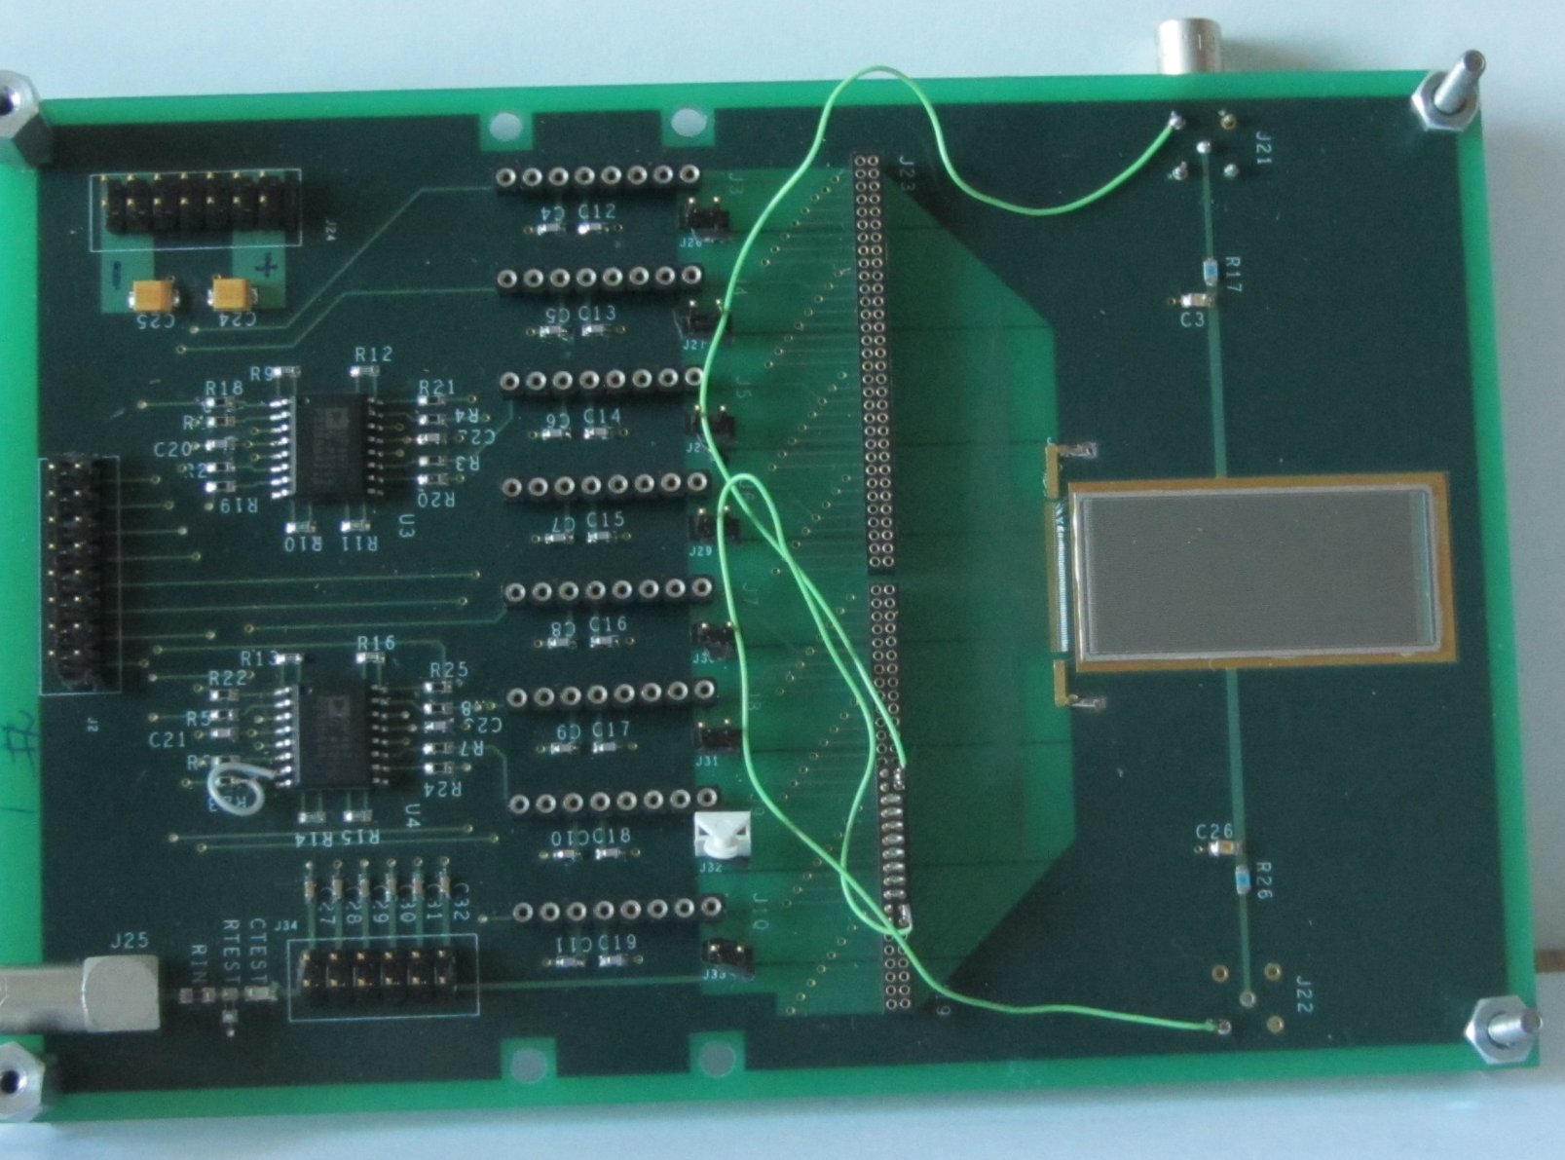
Test Silicon Strip Detector
GLAST Sensor [Nucl & Instr Meth A 541 (2005) 29-39]
64 strips- 228 µm pitch
Size 15mm x 35mm
Substrate Thickness = 410µm
Charge Sensitive
Pre-amp
Cremat CR-110
Switch Matrix
Select 8 strips of 64
For analog output
Output Op amp
64 Parallel Al Strips
Length = 35 mm
Width = 56µm
Pitch = 228 µm
August 4, 2012

Slide 8
Signal Chain
CR110
Q Amp
10 KΩ
2 pF
0.1 µF
Pulser
1 KΩ
1 KΩ
50 Ω
Scope
50 Ω
50 Ω
1.4 mV / fC
x10
X 0.5
50 Ω
X 0.05
Signals
100 mV
5 mV
10 fC
14 mV
140 mV
70 mV
Measure 45 mV
1 mip = 7 fC
1 mip = 32 mV
August 4, 2012

Slide 9
Top View
Side View
12 V Square
Waves on Spiral Coil
Inductive coupling to strip
Capacitive Coupling to Strip
1 cm
-
Signal Induced
From spiral to a single strip
Net effect is zero
Electrostatic Shield
For eliminating Charge injection from spiral to strip
20 µm Al foil is OK
+
-
Gnd
Q Amp
Gain G = - 3K
1.4 mV / fC
G
1.4 pF

Slide 10
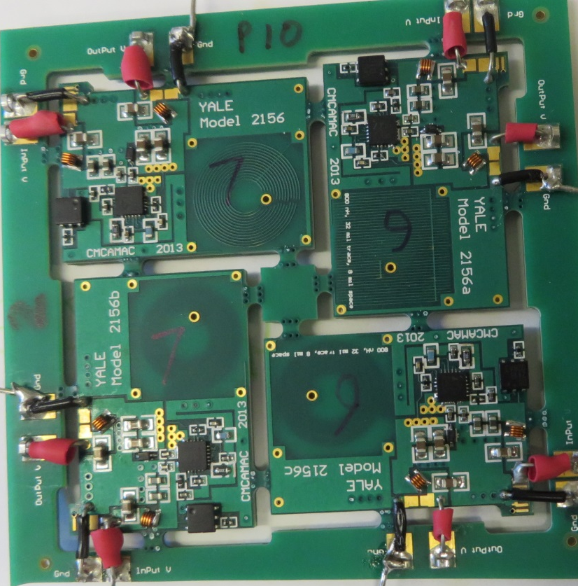
RF shielding
Measurement of RF field (by eddy current loss) vs distance
34 mil thick 4 layer PCB
Spacers 2, 8 & 32 mil thick
36 mm
15 mm
4 mil Copper Tape
4 mil thick Mylar
25 cms x 25 cms
Spiral Inductor
Measure IC current vs distance between spiral & copper tape
Put finger pressure between copper tape and PCB
Yale University
January 2, 2014

Slide 12
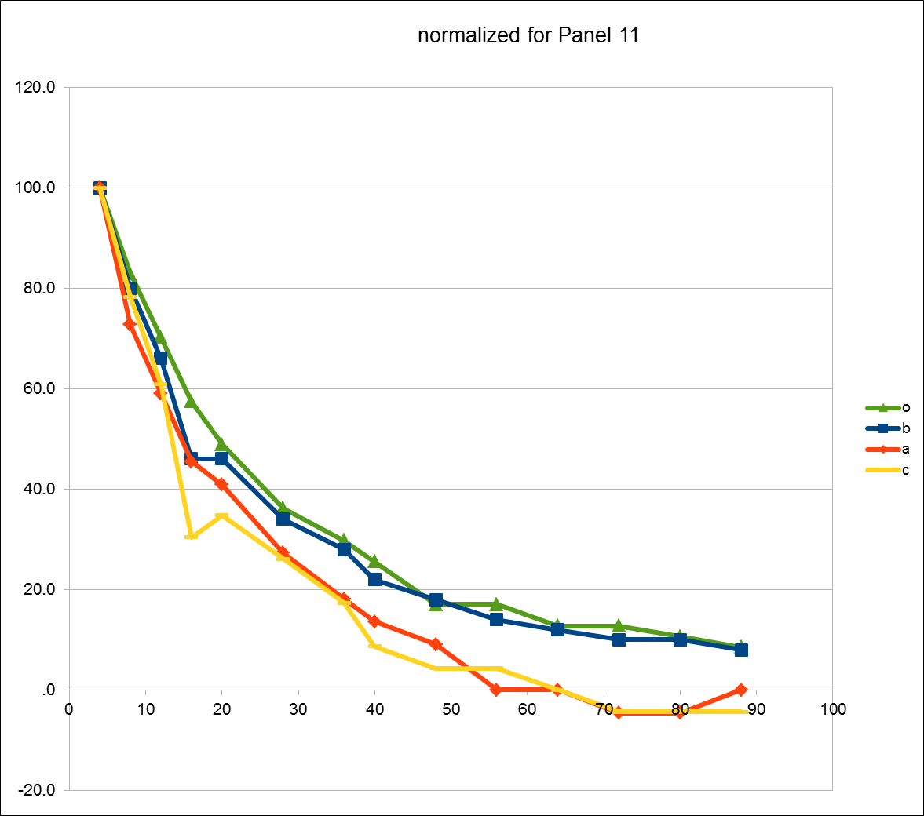
Eddy Current Loss vs Distance between Spiral to Copper Tape
Current in mA Distance in mils

Slide 13
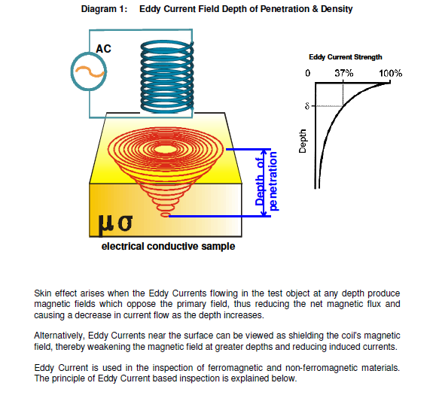

Slide 14
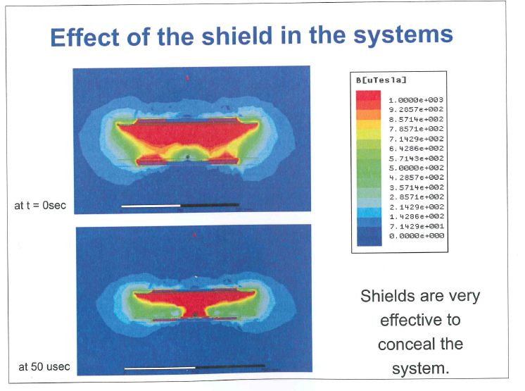
Seminar 9: Wireless charging of EV
Chris Mi . U of Michigan
http://www-personal.engin.umd.umich.edu/~chrismi/
Car Metal
Al Plate 600 mm x 800mm 1 mm thick for mechanical strength
Coil - Top
Coil - Bottom
Frequency = 85 KHz
Power transmitted = 10KW
Inefficiency without Al shield = 20 %
Inefficiency with Al shield = 1 %
Power loss in Car metal without Al shield = 2 KW > 15C rise in temperature
Power loss in Al shield = 0.1 KW
Yale University
March 21, 2014

Slide 15
Wireless Power Groups
Automobile Charging
Cell phone Mats - 3 Groups. Each has > 50 companies involved
Wireless Kitchen - ISM Band 6.78 MHz & multiples. GaN

Slide 16
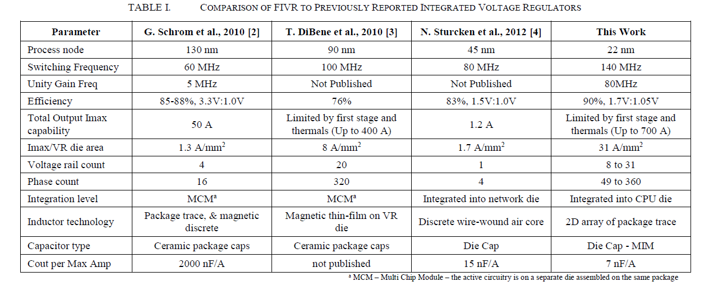
Intel 4th Generation Core Processor: June 2013
Input = 1.8V
Maximum Current = 700 Amps
Output ~ 1 V Multiple Domains – up to 16 Phases
Turn output On when needed
Inductors on Die / on Package
Efficiency = 90%
Mac Pro Air !!!

Slide 17
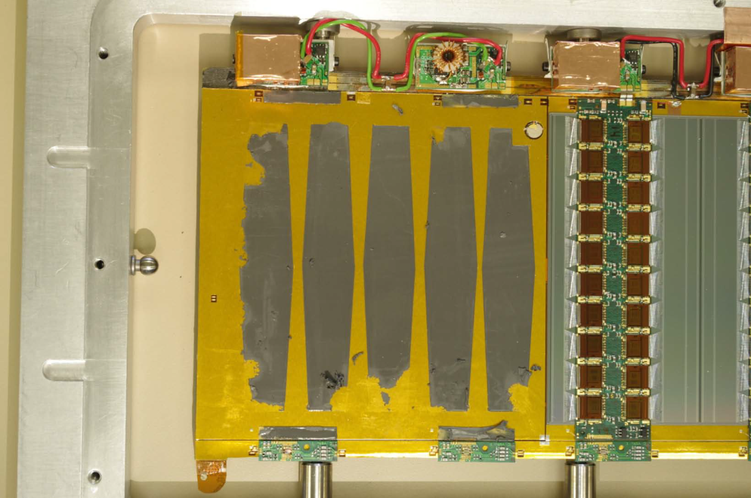
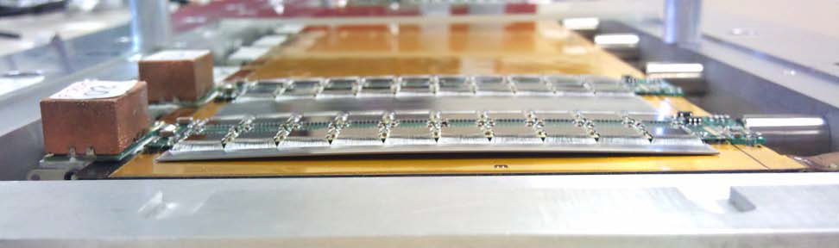
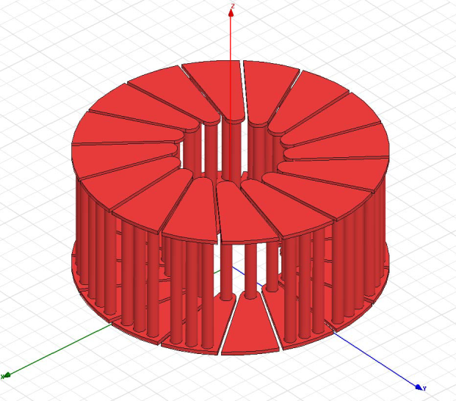
ATLAS DC-DC Powered Stave
STV10 DC-DC Convertor From CERN group
  Based on commercial LT chip
  10V in, 2.6V out, up to 5A
PCB Toroid
Peter W Phillips
STFC RAL
14/11/11

Slide 18
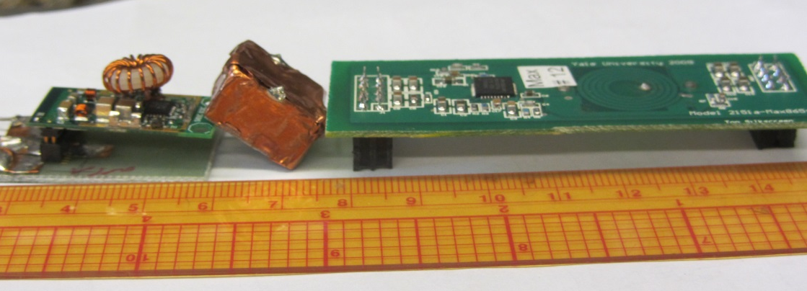
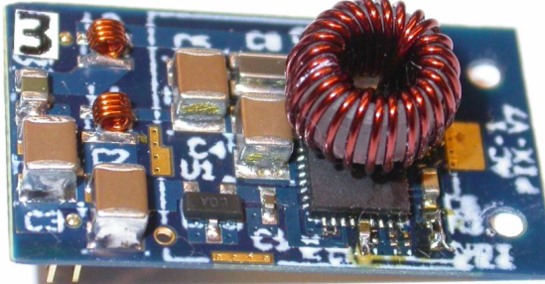
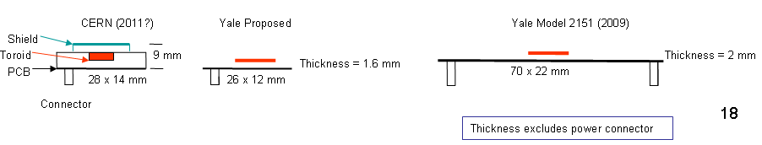
Last Proposal to DoE to develop Inductors
Another air core Toroid solution
An air core Toroid solution with shield
2009 Yale Solution with Embedded air core Spiral inductors in a
4 layer Standard PCB. Not shown an electrostatic 10 µm Al foil Shield
Yale version can be made same size as the Toroid solution by changing power connectors
Generic / Project funding???

Slide 19
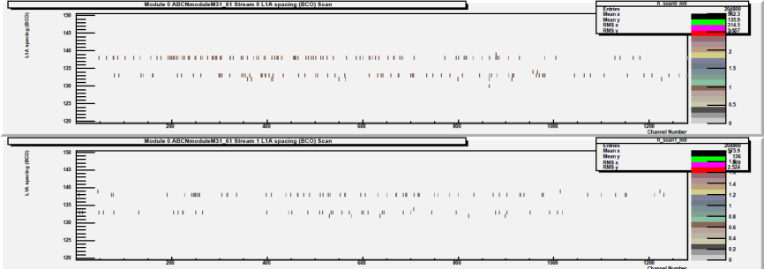
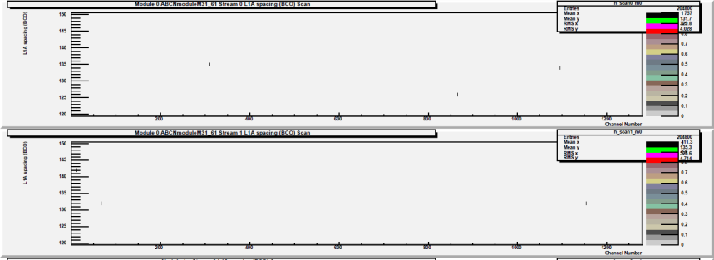
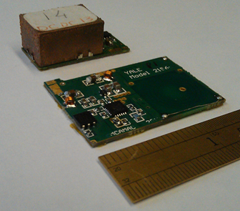
Planar Coil – “Up Close and Personal”
Double Trigger Noise (DTN)
With Toroid Converter
With Planar Converter
Reference measurement (CERN STV10 converter) @ 0.5fC
Approx <3mm from wire bonds with improved reference @ 0.5fC
Ashley Greenall , UK Group
CERN converter registers zero occupancy until 0.5fC,
then registers 528/244 hits
For conducted noise configuration, Planar
coil registers zero occupancy(even at 0.5fC)
Only when close to asics are hits registered,
3/2 counts at 0.5fC, see above
Above picture is Double trigger noise
i.e. after a hit ; spurious counts are registered
Comments inserted by Yale University
Noise in Electrons Measured @ Liverpool
cern stv10 noise 589, 604 average = 601
yale planar noise 587, 589 average = 588
noise with dc supplies (no dcdc) = 580
assuming the noise adds in quadrature, extract noise due to dcdc converter:
cern stv10 Additional noise = 157
yale planar Additional noise = 96
Planar Converter uses the same components except Inductor coil
CERN stv
Yale Planar
Thickness of stv = 8 mm vs 3mm for Planar
Shield to Silicon strips are Electrostatics & Eddy current
Bottom side shield 2 mm from Planar coil traces
Can be mounted on the sensor with 50 µm Kapton
Cooling via sensor
Notes:
19

Slide 20
3-Feb-14 | Comparison of Coils for DC-DC Converters
3:30 PM
Yale University
 |  | CERN | Yale | Yale | Yale | Yale | Yale
Model |  | AMIS5MP | 9 mm ID | 9 mm ID | 9 mm ID | 6 mm ID | 6 mm ID
 |  | Data Sheet | proto coil | proto coil | estimated | Model 2156 | Model 2156a
coil shape |  | oval toroid | 2 layer spiral | 2 layer spiral | 2 layer spiral | 2 layer spiral | 2 layer spiral
Total number of turns |  | 29 | 8 | 6 | 6 | 7 | 9
conductor |  | Cu wire | Cu wire | Cu wire | Cu wire | pcb trace | pcb trace
equivalent wire gauge |  | 25 | 22 | 22 | 25 | 28 | 29
Coil dimensions | mm | 10 x 15 | 14.5 OD | 13 OD | 12 OD | 14.5 OD | 15.5 OD
thickness | mm | 4.00 | 1.80 | 1.80 | 1.20 | 0.50 | 0.50
Inductance | nH | 430 | 836 | 469 | 469 | 487 | 811
DC Resistance | mOhms | 39 | 18 | 13 | 26 | 47 | 83
Weight grams | Grams | 0.537 | 0.978 | 0.702 | 0.360 | 0.203 | 0.220
Length of Wire | mm | 370 | 336 | 240 | 240 | 221.000 | 307.000
Power Loss in Coil @ 4 Amps | Watts | 0.608 | 0.288 | 0.208 | 0.416 | 0.752 | 1.328
normalized weight |  | 1.00 | 1.82 | 1.31 | 0.67 | 0.38 | 0.41
normalized power loss |  | 1.00 | 0.47 | 0.34 | 0.68 | 1.24 | 2.18
DC DC ripple current in inductor | RMS Amps | 0.657 | 0.340 | 0.602 | 0.602 | 0.580 | 0.348
Note: the Inductor ripple current produces the AC magnetic field, which must be shielded from the sensors

Slide 21
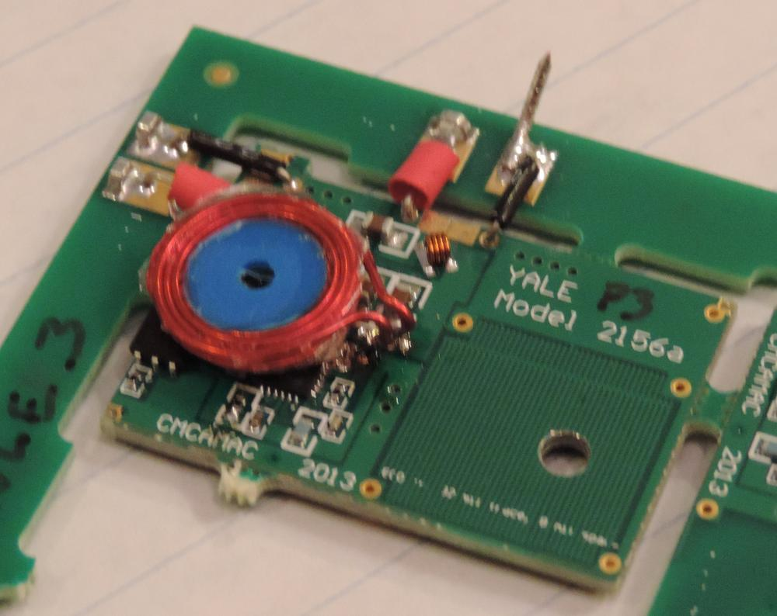
No magnetic materials
Proposed Thinner Converter: Coil
PCB size = 8 mm x 26 mm
Question on Air Core Coil (change to oval shape as width is limited)
Take this coil and squeeze/ stretch it to 8 mm x 26 mm.
wire size 24 - 28 AWG Frequency 2 MHz; Later 10 MHz
L = 800 nH
Losses are limited by DCR and not ACR.
# of turns =?
ACR & DCR with wire Gauge
Shield Box
Coil
4mm
Embedded Spirals
Disabled for the hand wound coil
Height = 2 mm plus shield
Toroid Inductor with Shield on toroid
height = 8 mm
Yale Model 2156a
PCB size 24mm x 36 mm
Coil size 16 mm dia. Embedded in 4 layer PCB. Inner 2 layer spirals are in series is the inductor.
2 versions: Total 6 or 9 turns
Hand wound coil (Short solenoid) is 24 AWG. Lower DCR for same inductance
Yale University
April 07, 2014

Slide 22
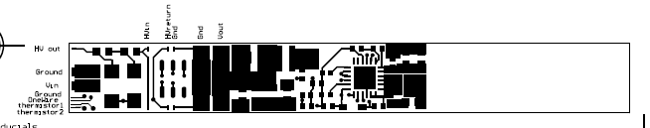
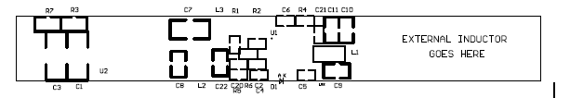
Work in Progress
48 mm
8 mm
22 mm
8 mm
Coil to fit in 8 mm x 22mm
Embed in PCB?

Slide 23
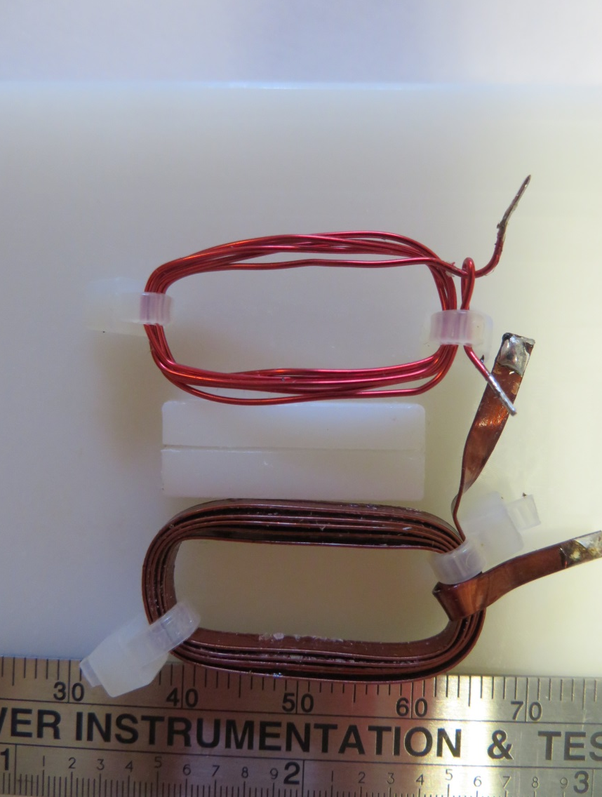
AWG 24
Winding Frame
8 mm x 22 mm
Slot in middle to hold wire
g-2 Ribbon 9 mils x 90 mils
5 turns. Inductance = 715 nH
DCR = <100 mΩ
Lower Inductance
2 turns vs 5 turns
Higher Ripple current
Shield distance is higher
More lost power in shield
Yale University
May 10, 2014

Slide 24
Simulations
s. Kalani UCL; UK Atlas Group
We want to understand the efficiency costs of the external shield for the planar coils.
For a given planar coil we would like a plot of the energy loss in the shields as a function of distance from the coil. There should be a shield on each side of the coil placed symmetrically. The inductance of the coil changes as the distance to the shields changes. Since the ripple current is inversely proportional to the inductance this must be included in the calculation.
I expect that the energy loss in the shield will be linearly proportional to the ripple current but we should check this by simulating two different ripple currents for the same configuration.
For each coil configuration we would like to plots, inductance and energy loss over a range of shield distances from 0.5 mm to 10 mm with appropriate step sizes. The energy loss plot should be for 1 amp at the 10 mm spacing, with the current increasing as the inductance decreases. The frequency should be 2 MHz. Use five mill thick copper for the shields.
Start with the standard nine turn two layer coil and see how it goes. After that we will want to try other coil configurations and possibly other shield thickness and material.

Slide 25
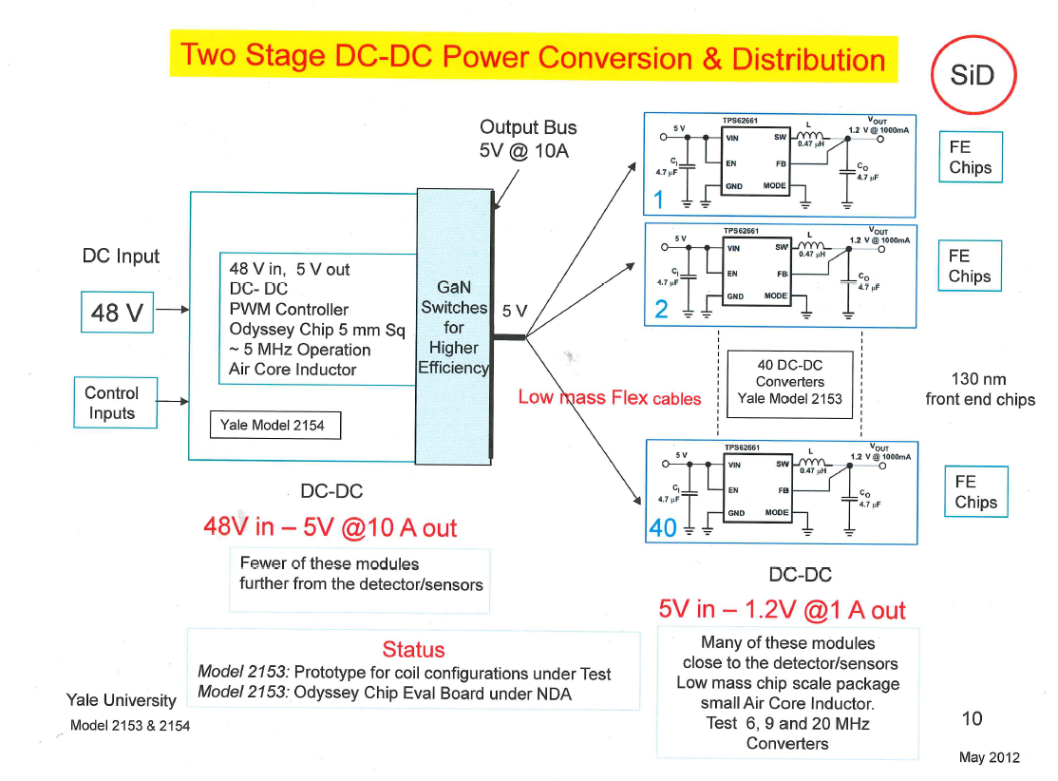
For SiD

Slide 26
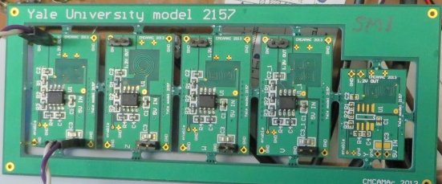
High Frequency
Input = 5 V
Semtech SC220: 20 MHz 0.6 Amps:
North / South Coils for far Field cancellation
DCR becomes a problem
Enpirion EL711: 18 MHz 0.6 Amps

Slide 27
GaN Update
600 Volt is the holy grail
EPC is the only one delivering Devices thru distribution
LM5113: driver for eGaN
1Q2015: Half bridge. ( 2LM5113 + FETS) in 6 mmx 5mm x 1.5mm. 5 -10 MHz External PWM
GaN driver on FET Die Several companies. Panasonic Roadmap 2016

Slide 28
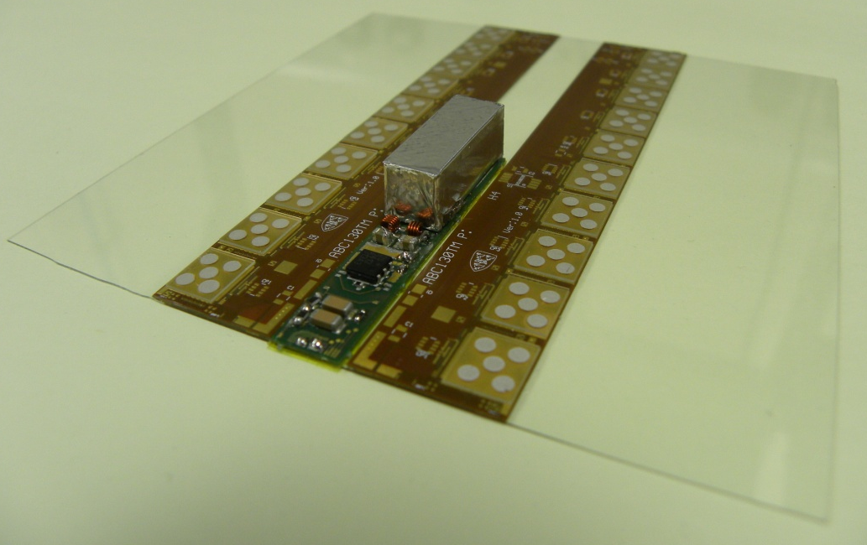
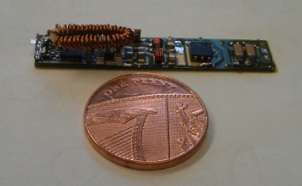
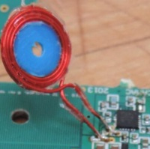
Why Yale design needs GaN
For GaN NDA
No magnetic materials – All instruments in 4 Tesla magnetic field
Design Goal = Size of converter 8 mm x 26 mm x 4 mm thickness including eddy current shield
Vin = 12 V: Vout = 2.5 V / 1.5 V: I_out = 3 Amps Frequency = 2 MHz
Toroid leak H fields: Spiral /Planar 2 layer 9 turn > Inductance = 800 nH
Need Low DCR & Lower mass to reduce noise created by protons passing thru inactive material
Lower ripple current limits H field range > thinner package
Why GaN ? High frequency > smaller inductor & passives. Smaller foot print
Current Design / Status
CERN design size is ok but thickness = 9 mm
Yale design thickness is ok. Foot print Ok for circuit only but no room for inductor
Size of PCB = 23 mm x 35 mm x 1.5 mm plus shield
Spiral inductor embedded in 4 layer PCB.
Spirals are 15 mm dia.
New Design
What GaN Buys us
Higher operating frequency
> smaller air core inductor & lower DCR
Higher efficiency > Lower heat loss
Smaller package PowerSoC technology
Shield Box
Coil
4mm
Fold Coil > Squeeze 2 layer spiral to oval shape
Oval Aircore Toroid
Short Solenoid > Low DCR
Yale University
April 15, 2014

Slide 29
Closing Remarks
48 V into Detector: 2 Stages
IC 2 step: 12 V > 1.2V High efficiency
GaN: Driver on Die may be Rad Tolerant
Need lower power loss in detector

