Slide 1

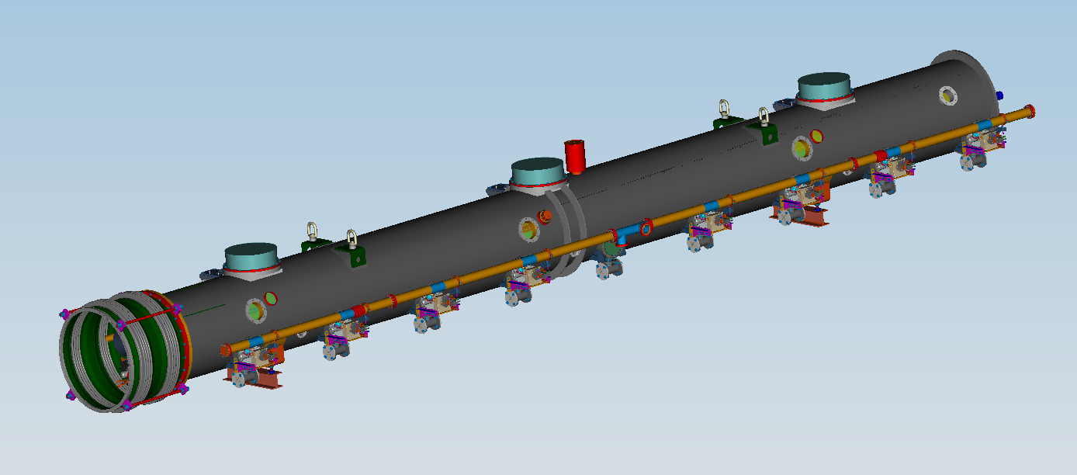
Overview of LCLS-II Cryomodule Plans
E. Daly for LCLS-II Cryomodule Collaboration
AWLC Meeting
14 May 2014

Slide 2
Acknowledgements
Special Thanks – T. Peterson, T. Arkan, A. McEwen, G. Neil
JLab, FNAL and SLAC colleagues
XFEL Project Team at DESY & CEA/Saclay

Slide 3
Outline
Overview of LCLS-II Collaboration
Design Highlights
Prototypes
Production Strategy
CM Production Preparations
Summary

Slide 4





LCLS-II Project Collaboration
50% of cryomodules: 1.3 GHz
Cryomodules: 3.9 GHz
Cryomodule engineering/design
Helium distribution
50% of cryomodules: 1.3 GHz
Cryoplant selection/design
Processing for high-Q
LLRF design
Undulators
e⁻ gun & associated injector systems
Undulator Vacuum Chamber
Also supports FNAL w/ SCRF cleaning facility
Undulator R&D: vertical polarization
R&D planning, prototype support
processing for high-Q
e⁻ gun option

Slide 5
Cryomodules for LCLS-II (CDR)
Cryomodule (CM) Parameters | value
Cavity operating temperature (K) | 2
Number of 9-cell cavities per cryomodule (1.3 GHz) | 8
Total installed cryomodules (1.3 GHz) | 35
Number of 3.9-GHz cavities per 3.9 GHz CM | 4 (→ 8, TBC)
Total installed 3.9 GHz cryomodules | 3 (→ 2, TBC)
Number of installed 1.3 GHz cryomodules in L0 | 1
Number installed 1.3 GHz cryomodules in L1 | 2
Number of installed 3.9-GHz cryomodules as linearizer | 3 (→ 2, TBC)
Number of installed cryomodules in L2 | 12
Number of installed cryomodules in L3 | 20
Courtesy of T. Peterson, SRF Weekly Mtg, DEC 2013

Slide 6
Cryomodule Collaboration
Fermilab is leading the cryomodule design effort
  Extensive experience with TESLA-style CM design and assembly
  Basis is 3-D model & drawings of similar Type-IV CM
Jefferson Lab and Cornell are partners in design review, costing, and production
  Cornell and JLab both have valuable CW CM design experience
  Jefferson Lab sharing half the 1.3 GHz production
    Recent 12 GeV Upgrade production experience
Argonne Lab is also participating in cryostat design
  Beginning with system flow analyses and pipe size verification
  Experienced SRF and cryogenic personnel at ANL may be available for other collaborative tasks
Courtesy of T. Peterson, SRF Weekly Mtg, DEC 2013

Slide 7
1.3 GHz CM Modifications for LCLS-II
Design Specification – Qo > 2.7 x 10 ¹⁰ @ 16 MV/m, < 100 W per CM at 2K
  High Qo Team has intense focus (see A. Grasselino’s AWLC May 2014 talk)
Design Points - TESLA Type 3+, XFEL, and Type 4 CM designs
Modifications for CW heat loads
  Larger chimney pipe from helium vessel to 2-phase pipe
  Larger 2-phase pipe (4 inch OD)
Closed-ended 2-phase pipe
  Separate 2 K liquid levels in each cryomodule
  2 K JT valve on each cryomodule
End lever tuner and helium vessel design for minimal df/dP
  Details in Y. Pischalnikov’s AWLC May 2014 talk
Double-layer inner magnetic shield
SC Magnet – splits in half for installation outside cleanroom
Two cool-down ports in each helium vessel for uniform cool-down of bimetal joints
No 5 K thermal shield
  But retain 5 K intercepts on input coupler
Input coupler for ~10 kW CW
  Details in N. Solyak’s AWLC May 2014 talk
Courtesy of T. Peterson, SRF Weekly Mtg, DEC 2013

Slide 8
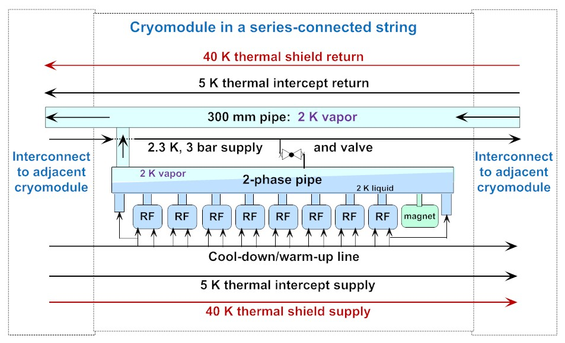
LCLS-II CM Schematic
Note : Slope of 2-phase helium in pipe due to tunnel slope (6 cm over 13 m), need single connection to 300 mm pipe
Courtesy of T. Peterson

Slide 9
Prototype 1.3 GHz CM Description
Each lab produces a prototype CM
Main Objectives for Prototypes
  Establish working collaboration for production with Jlab – each lab produces a prototype cryomodule, then provides production cryomodules
  Demonstrate CW operation of 8 high-Q cavities in a cryomodule
  Prototype cryomodule planned for use in LCLS-II
New cryostat design and procurement with Type 3+ spacing
Use existing cavities in prototype CMs
  Incorporate High-Q0 surface process development in a logical way
Peripherals
  New He vessel
  Slight modifications to HOM coupler
  End-lever tuner
  RF power couplers, modify TTF couplers or procure new ones (more later)
Do these developments once – the primary cryomodule design effort
Courtesy of T. Peterson, SRF Weekly Mtg, DEC 2013

Slide 10
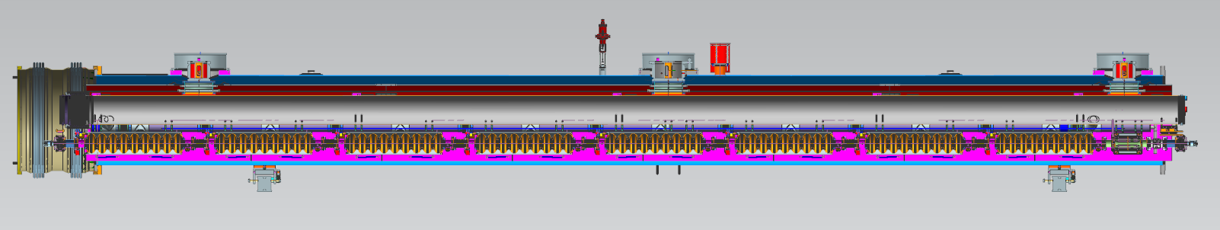
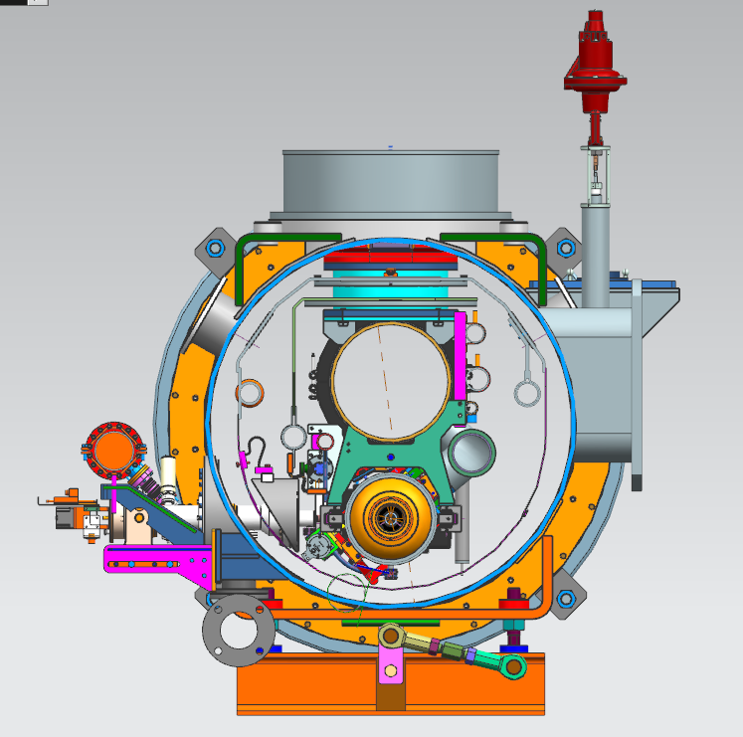
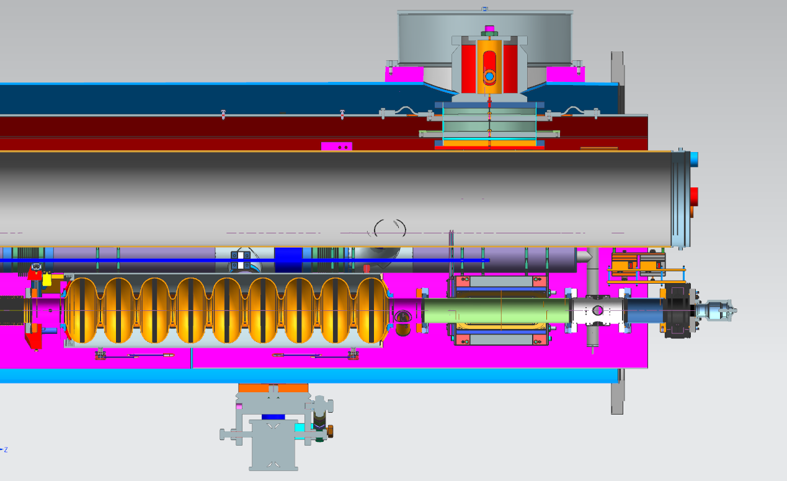
LCLS-II Prototype Cryomodule
Courtesy of T. Peterson, SRF Weekly Mtg, DEC 2013
8 cavities (End Tuner) + 1 “Splittable” SC Quad, 6 Current Leads ~50A
-JT Valve
-Splittable Quad
-BPM
-Gate Valve

Slide 11
Strategy – One Design, Two Production Lines
Designs for Prototype and Production CMs (aim to satisfy PR and CM FRS)
Identical Prototypes - utilize as much existing hardware as possible to reduce schedule risk and reduce overall cost while achieving the same performance as the production CMs
Identical Production Designs - utilize as much of the DESY/XFEL design as practically possible to reduce schedule risk and reduce overall cost
  FNAL produces 16 CMs; JLab produces 17 CMs
Identical Parts Received at Partner Labs
Well-developed drawing packages, clear requirements and specifications
Concurrent reviews within LCLS-II project
Procurement activities – lead technical contacts at Jlab/FNAL/SLAC work together during all phases
Identical Tooling Interfaces
Interfaces between CM hardware and tooling are identical
  Avoid adding custom features to CM
Adapt non-CM hardware interfaces to Lab-specific tooling
Equivalent Processes yielding Equivalent Performance
Recognize that some tools are different at each lab (e.g. HPR, vertical testing systems, vacuum leak checking equipment, etc.)
Monitor key process variables in consistent fashion (e.g. samples to verify etch rates)

Slide 12
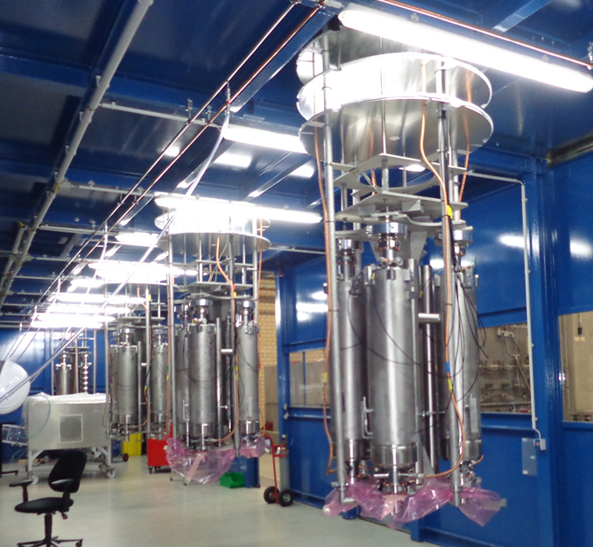
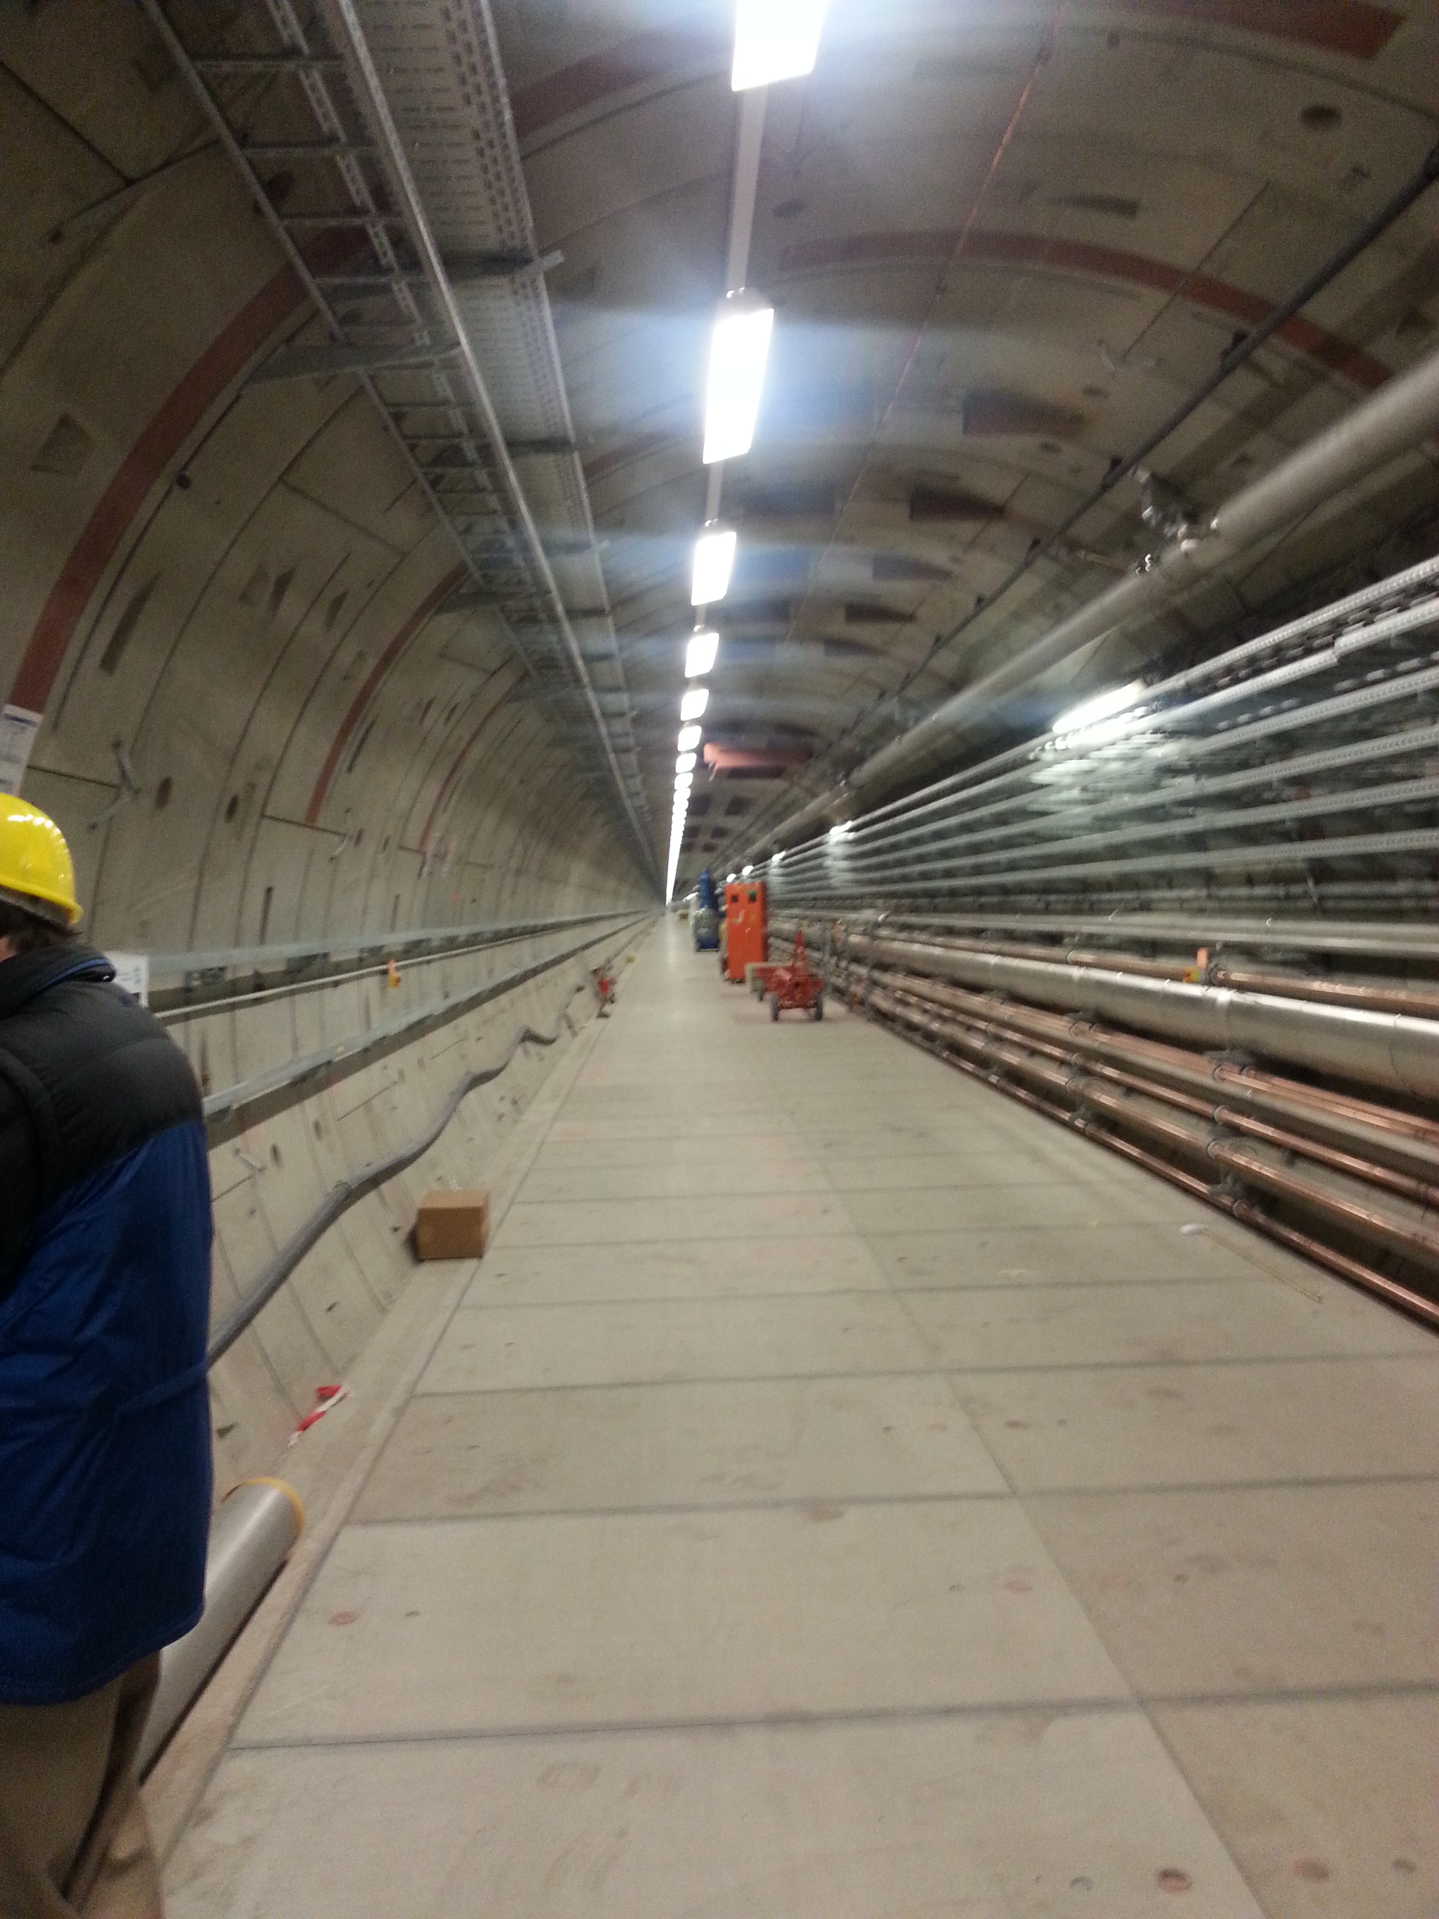
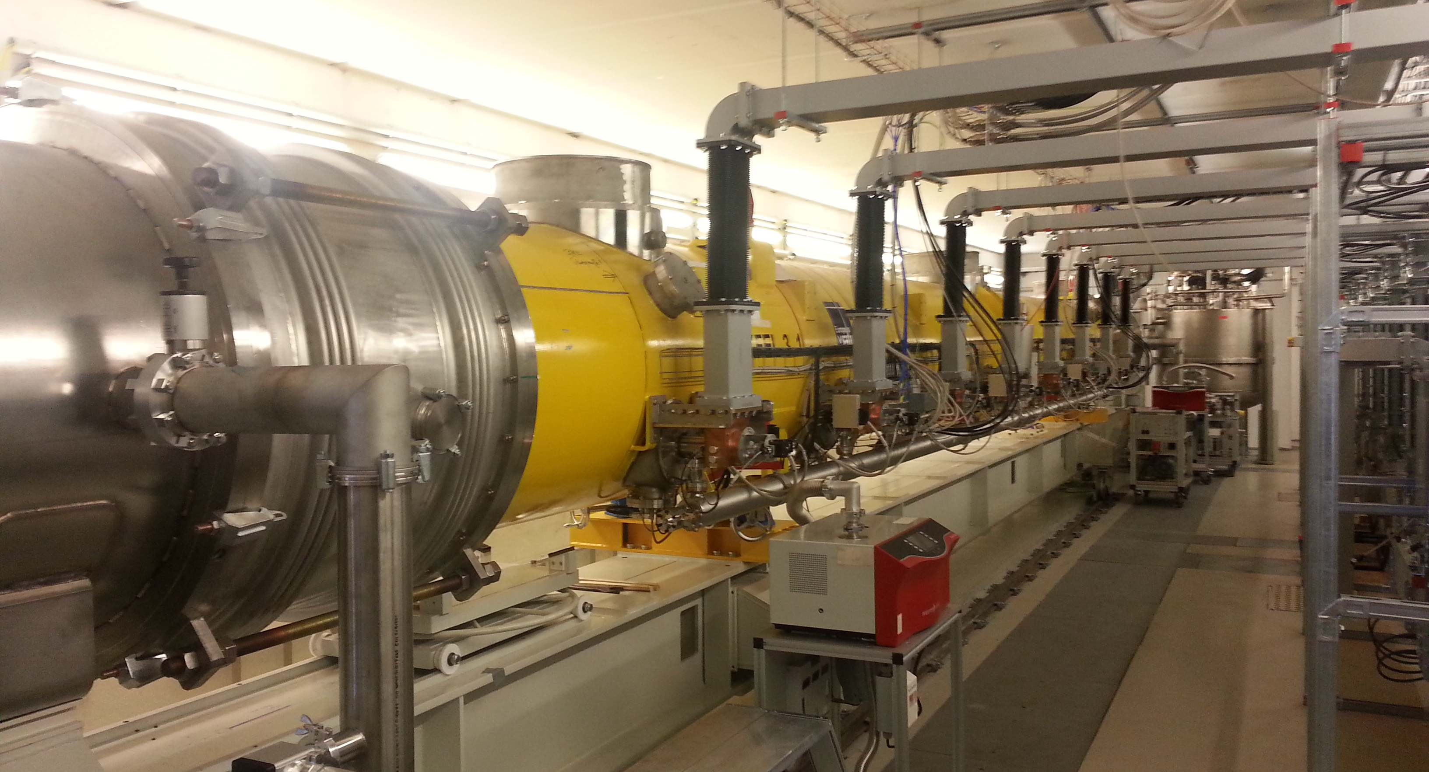
Leveraging XFEL’s Existing CM Experience
XFEL Production - Four cavities per test stand
Tunnel construction is underway
Production of CMs is currently ramping up!
Start operations in April 2017, see http://www.xfel.eu/project/construction_milestones/
CM ready for testing (can test 3 CMs at once)

Slide 13
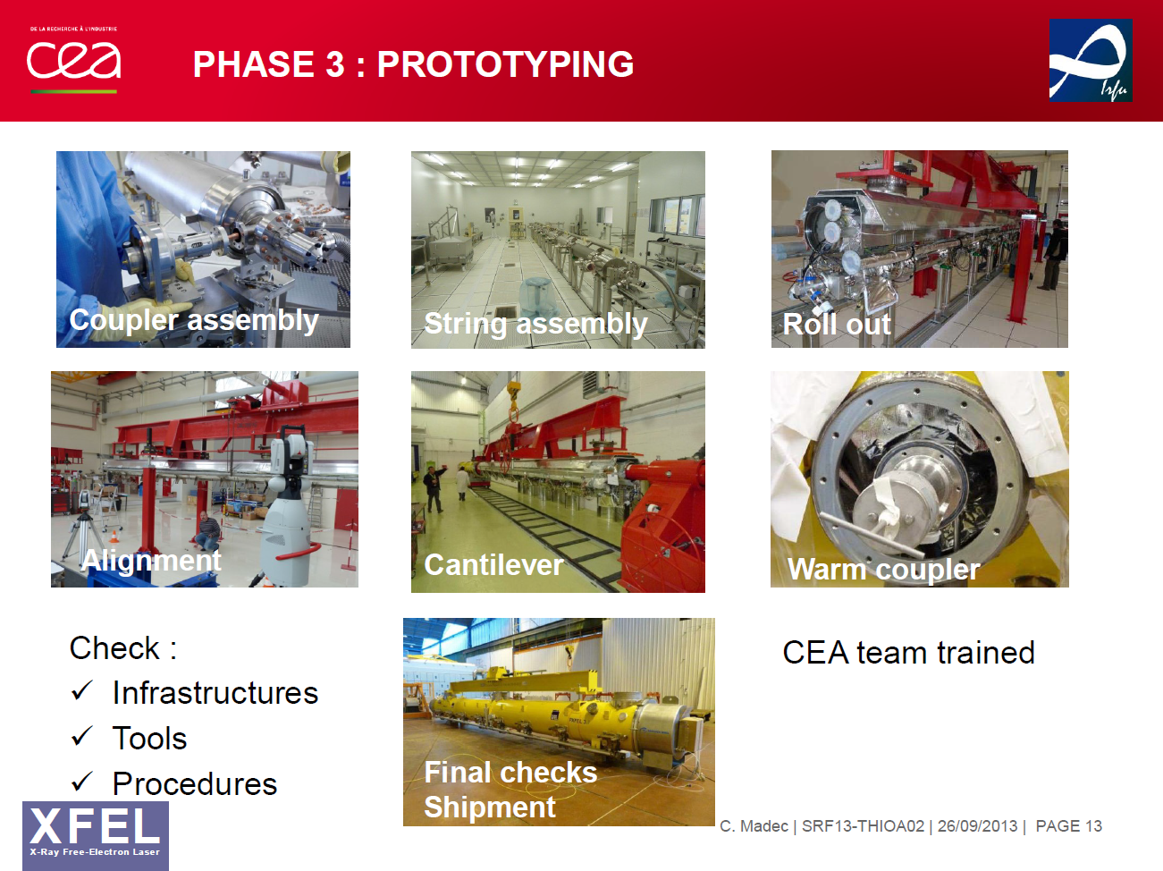
Opportunity to Learn from CEA Colleagues
Production of CMs is currently ramping up!

Slide 14
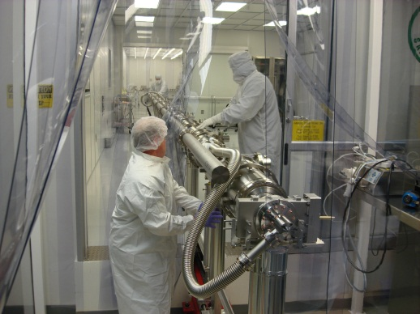
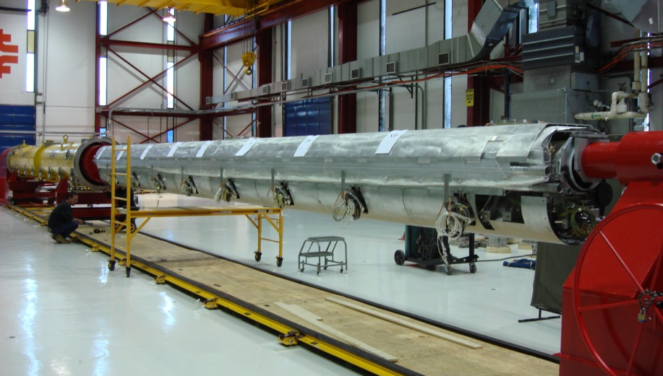
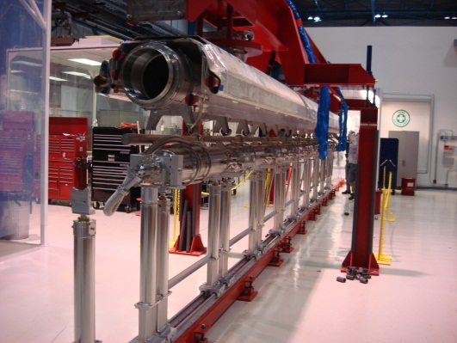
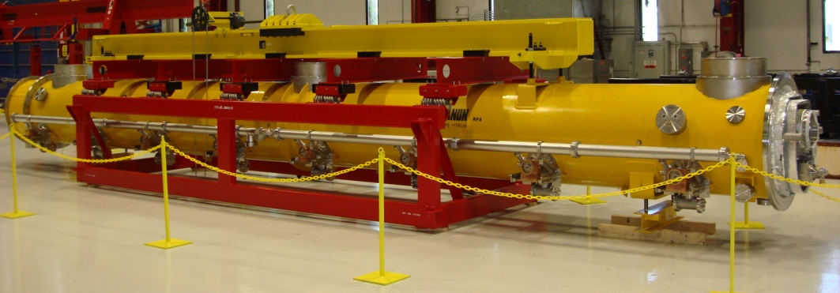
Leveraging FNAL’s ILC-style CM Production Development
Cavity String Assembly
Insertion of Cold Mass into Cryostat Assembly
Cryomodule Ready for Transport On-site
Cold Mass Assembly
Courtesy of T. Arkan, FNAL

Slide 15

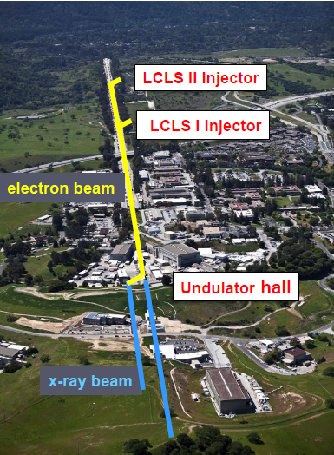

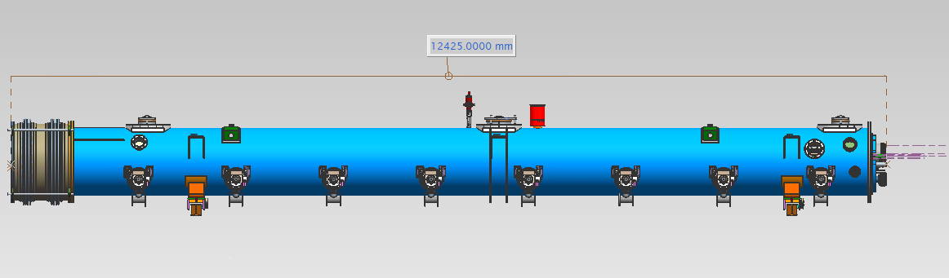
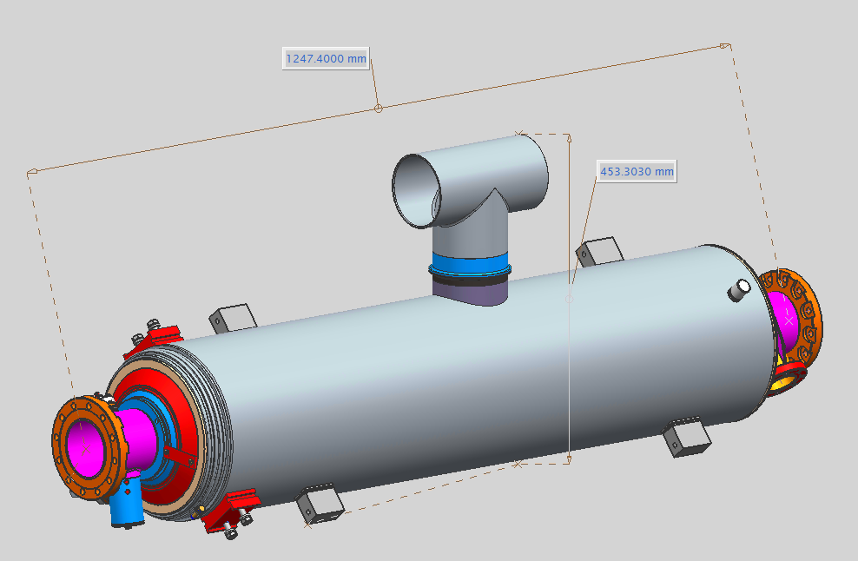
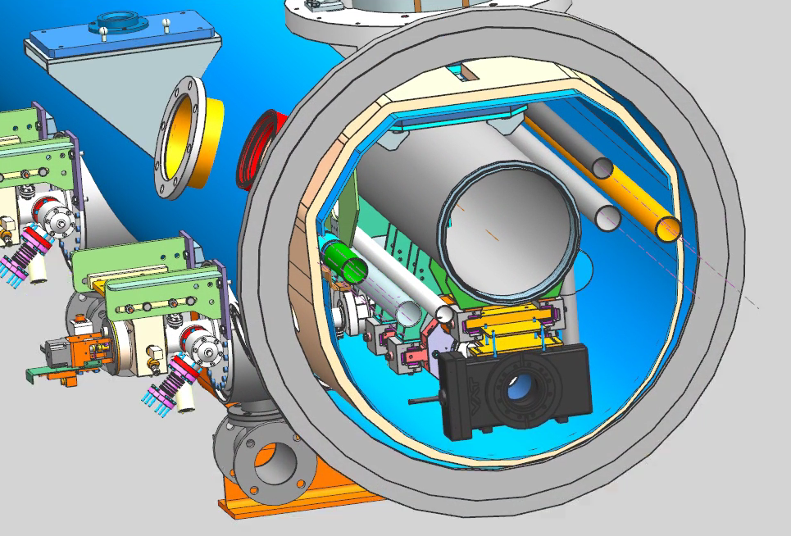
LCLS-II Cavity/Cryomodule Process at JLab
Supplier
Partners
JLAB SRF Facility
Receiving in SRF Inventory
Mechanical Inspection CMM
Component | FNAL | JLAB | SLAC
Niobium | X
Cavities |  | X
HOM/FP Feed through |  | X
Cavity Flanges - VTA Testing |  | X
Cavity Flanges - HTB Testing | X | X
Helium Vessels |  | X
FPC- Fundamental Power Couplers |  |  | x
Cavity String Bellows |  | X
Cavity String Hardware |  | X
Magnet | X
BPM- Beam Position Monitors, | X
HOM Absorber | X
Gate Valve |  | X
2-Phase Pipe Bellows | X
End Lever Tuner |  | X
Magnetic Shielding | X
GRHP Sub-assembly Gas Return Header Pipe, Cryostat, Intercept, Thermal Shield, Multi-layer Insulation etc. | X
Vacuum Vessel | X
Instrumentation |  | X
Interconnect Parts |  | X
Shipping Frames / End Caps |  | X
X = Lead Laboratory (as of 20Mar2014)
Courtesy of A. McEwen, JLab
Cavity /Helium Vessel Prep. & Test
VTA RF Test in liquid Helium @ 2 K
Cavity String Assembly & Leak Test
Assemble Cavity String -Class 100 Clean Room
Courtesy Chi-Chang Kao, SLAC
Cryomodule Assembly
Instrumentation & Wiring
Tuners, MLI– Multi Layer Insulation,
Cryogenic Circuits , magnetic shielding, alignment
Super Insulation Cabling & Shield
Vacuum Vessel & Final Alignment
Install Cryogenic Supply Interfaces
  Horizontal Test Preparation
  Pressure Test & Leak Check (vacuum)
Commissioning at SLAC
Install Cryomodules in Accelerator, cool to 2 K
Weld & certify leak tight , pressure test
check Controls,
Gradient & Dynamic Heat Load - Q_{o}
Cryomodule Test in “Test Cave”
Cryomodule integrity @ 2 K
Tuners - Range, Hysteresis, & Resolution/ Sensitivity
Cavities for Gradient & Dynamic Heat Load Q_{o}
LCLS-II 1.3 GHz
Dressed Cavity, Doped and Ready for VTA Testing
LCLS-II 1.3 GHz Cryomodule
Cryomodule shipping to SLAC
JLAB support for installation of first 3 Cryomodule

Slide 16
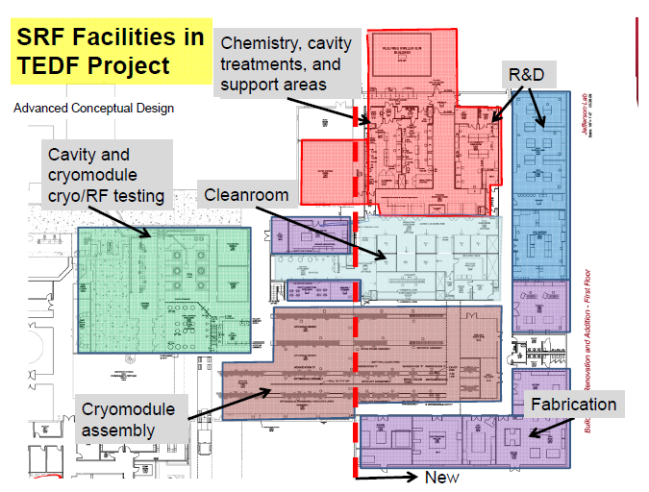
SRF Facilities at JLab
Start
Ship

Slide 17
CM Production Preparations
Adapt existing infrastructure and facilities to accommodate LCLS-II components, sub-assemblies, final assembly and testing
Define processes required for component handling, assembly and testing
Develop test plans – key activities are cavity qualification from vendors and cryomodule acceptance testing
Employ SRF QA Tools used for 12 GeV 100 MV CW cryomodules (aka C100) production and SNS production

Slide 18
Infrastructure, Tooling & Facilities (JLab)
Vertical Testing of Bare/Dressed Cavities
  Planned rate - 4 cavities per week
Cavity String, Cold Mass and CM Assembly Tools
  Planned rate – 1 CM per month
Horizontal Testing Bench – supports Qo R&D and production efforts
  Planned rate ~ 1 cavity per CM
Cryomodule Testing Facility (CMTF)
  Planned rate – 1 CM per ~ 6 weeks

Slide 19
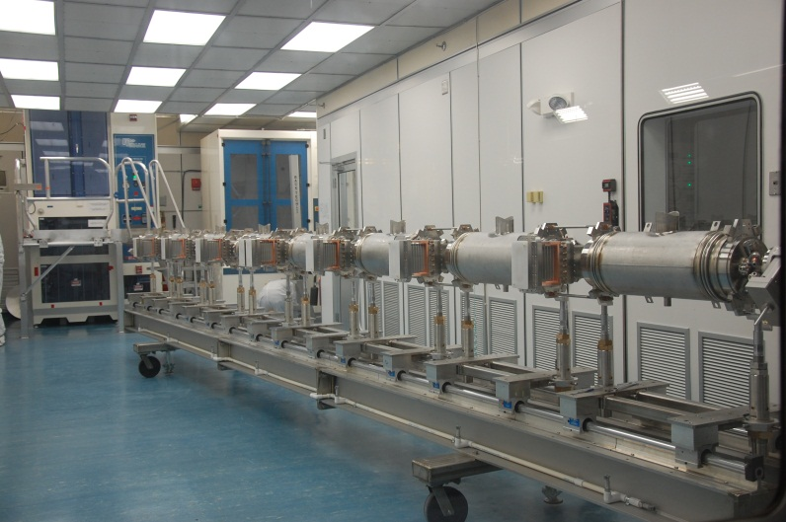
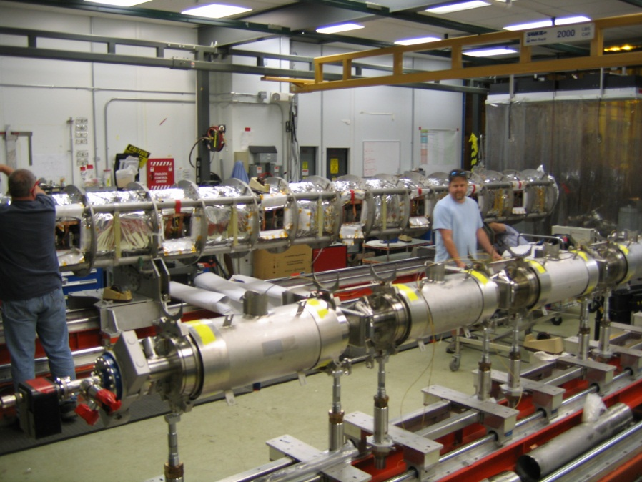
Cavity String Assembly in Clean Room (JLab)
“Lollipop” supports for each cavity
TBD for SC magnet and bpm
Use mobile rail system rather than rail-in-floor used at DESY, CEA/Saclay and FNAL
Transfer to CM assembly rails for cold mass assembly

Slide 20
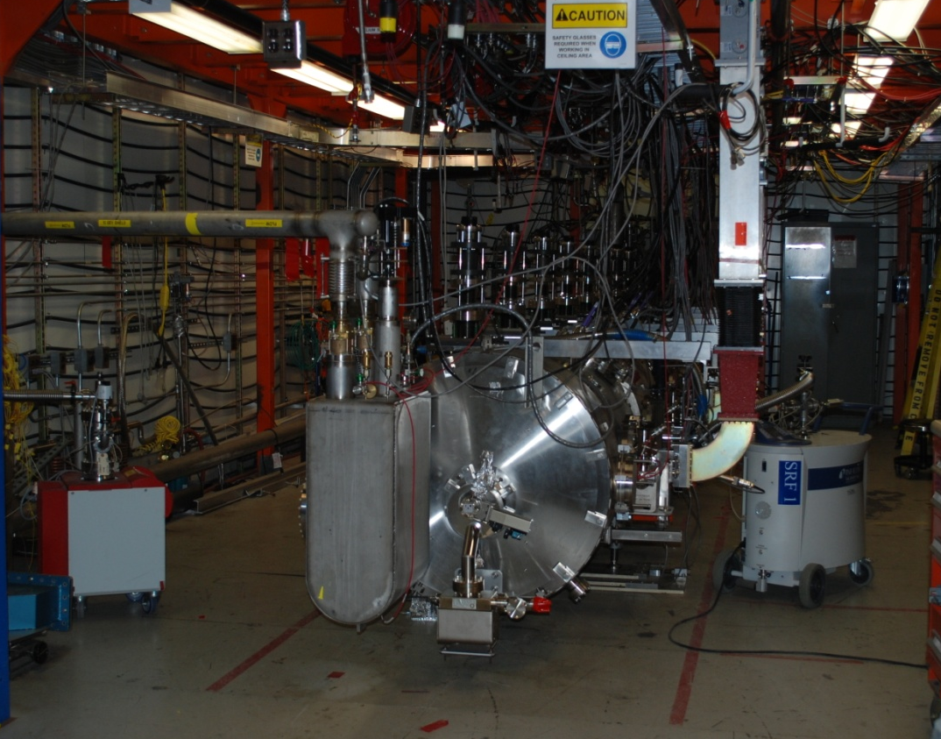
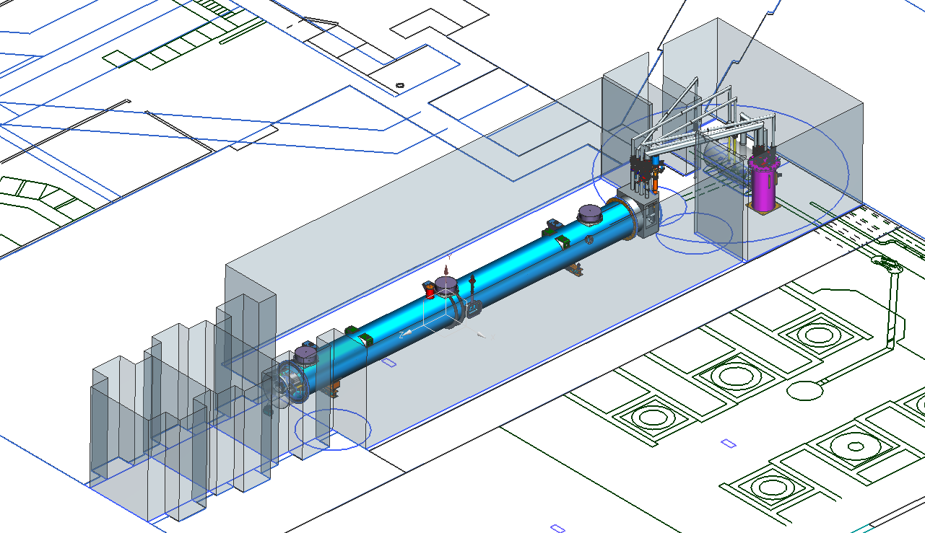
JLab CMTF : Production “Bottleneck”
HPRF system suitable for individual cavity testing or 8 cavities in short duration steady state
TBD system for testing SC magnet
Magnetic shielding encloses testing volume reducing external fields to ~50 mG
Cryogenic capacity for testing individual cavities in CW mode
End Caps – specific for LCLS-II CM testing
  Interface to CM piping and existing junction box using u-tubes

Slide 21
Facilities Improvements : Testing in CMTF
End Cans
  Connects CM to CTF valve box via u-tubes
  Interfaces for valves, LL and diodes to monitor and control helium flow/inventory
  Provides reliefs for primary circuit, shield circuit and insulating vacuum space
HPRF
  Procure 1.3 GHz 10 kW Solid-State Amplifiers (SSAs) & Circulators
  Modify Waveguide and Interlocks
  Run line power to SSA/Circulators
  Provide controls in CMTF Control Room
LLRF
  RF Instrumentation (arc detectors, IR sensors, etc.)
  Provide controls in CMTF Control Room
  Software development
Cryogenic Test Facility (CTF)
  Increase return side piping to reduce overall pressure drop from CMTF
  Improve recovery system (pumping, compression) to provide base pressure of 0.031 atm (23 torr) in the CM helium bath

Slide 22
Summary
Goal for production of CMs at Jlab/FNAL is “identical design, identical parts, equivalent processes to yield equivalent performance”
  Infrastructure development supports this goal
Overall Plan for Cryomodule Design & Production
  R&D / Design Modifications Complete FY14
  Infrastructure / Tooling FY14/15
  Prototype CMs (2 units) FY15
  Start of Production 1.3 GHz CMs (33 units) FY16
    Rates of 1 CM per 6 – 8 weeks in current plans
  Start of Installation at SLAC FY17

Slide 23
Back Up Slides

Slide 24
Facilities Improvements: Assembly Tools (JLab)
Main Cavity Tools
  Clean room tooling - small fixtures for coupler installation, flange alignment, VTA testing hardware*
  Cavity Handling Cages*
  Cavity Processing Tool Improvements (e.g. HPR, Heat Treatment Furnace, Horizontal EP)
  Two sets of carriages for cavity string
Main Cold Mass and Cryomodule Assembly Tools
  Cold Mass Spreader Bar - Supports / Positions Cold Mass for cavity string attachment*
  Cold Mass Installation into Vacuum Tank
  Vacuum Tank Supports
  Spreader Bar - Lifts Cryomodule*
  Shipping Frame & End Caps*
*Design exists, purchase copies

Slide 25
Vertical Test Area / Horizontal Test Bench (JLab)
VTA
Up to four test stands available for production acceptance testing capable of testing one cavity at a time
Utilize same cavity hardware (test flanges, feedthroughs, etc.) provided by project to cavity suppliers
Small modifications required to existing supports
Ensure low magnetic field environment (“magnetic hygiene”)
HTB
Support High Qo R&D
Plan to conduct five tests during production effort to provide feedback on cavity assembly process or for production development activities
Modifications to top hat for XFEL-style FPC and small modifications to existing supports

Slide 26
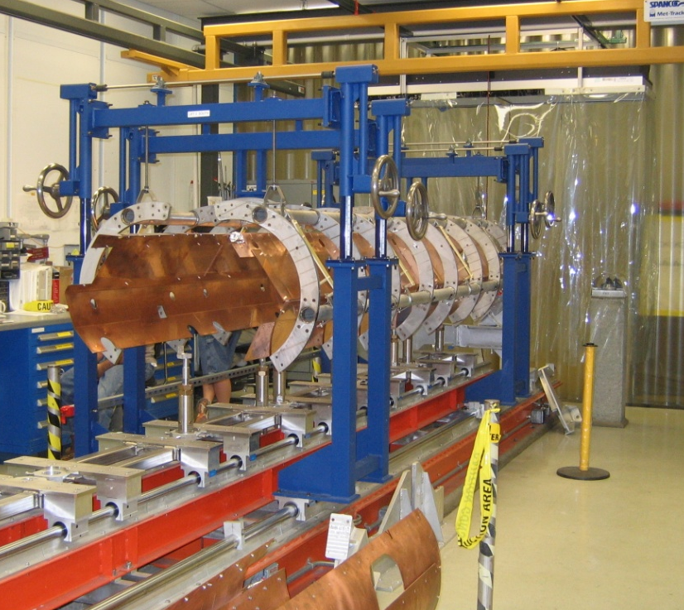
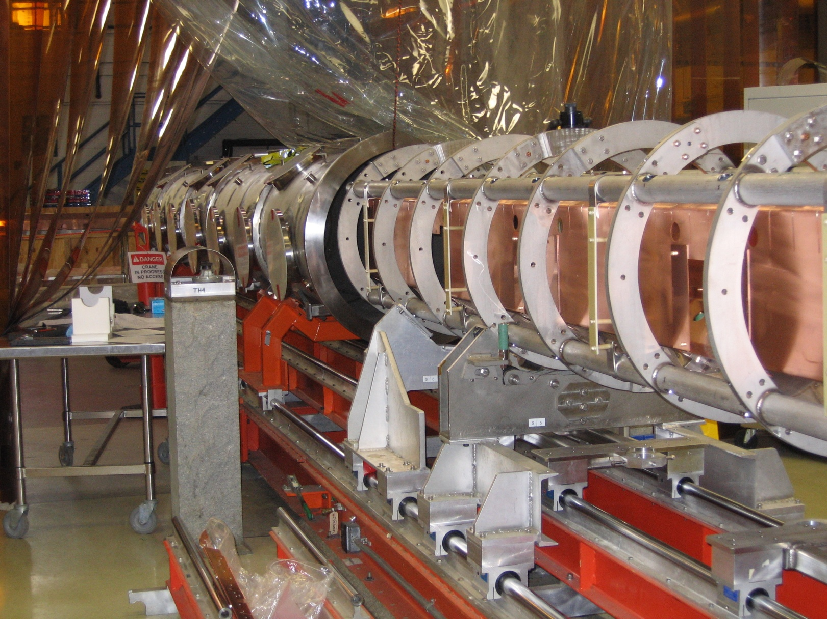
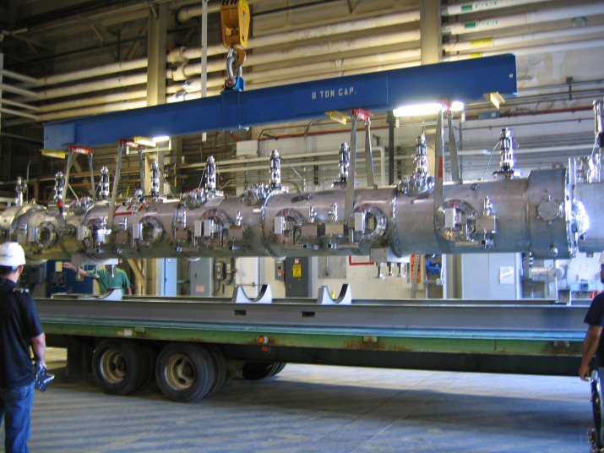
Cold Mass / VV Assembly
“Lollipop” supports for each cavity
TBD for SC magnet and bpm
Use two-rail system to transfer cavity string onto Return Pipe
Use two-rail system to transfer cold mass into vacuum vessel
Crane access in high-bay for shipping

Slide 27
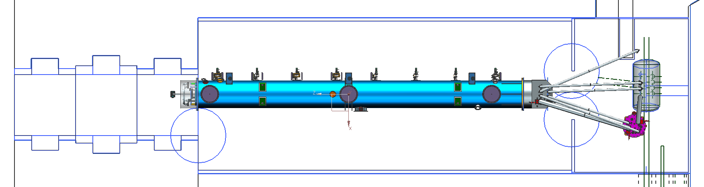
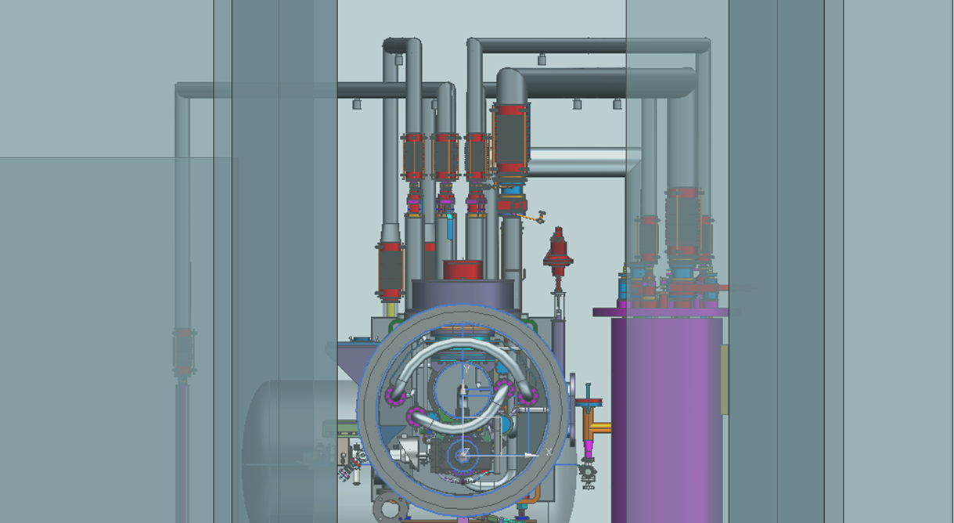
CMTF Conceptual Layout
JUNCTION BOX
END CAP
BAYONET BOX
BAYONET U-TUBE
CAVE DOOR
(CLOSED)
HEAT EXCHANGER
End view of CM with bayonets connecting JB, HX and BB

