Slide 1
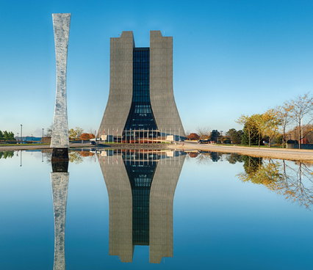
Summary of the Calorimeter/Muon Session
José Repond
Argonne National Laboratory
Americas Workshop on Linear Colliders
Fermilab, Batavia, IL, U.S.A.
May 12 – 16, 2014

Slide 2
Activities in the Calorimeter/Muon Session
 | Calorimeter | Talks
Imaging calorimeters | ECAL | 3
 | HCAL | 5
 | FCAL | 1
Dual readout | Fibers | 1
 | Fibers+ glass | 1
Muon system |  | 0
Total |  | 11
Development
of systems specifically
for the LC
Generic
calorimeter R&D

Slide 3
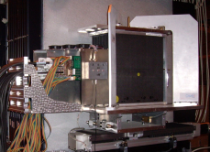
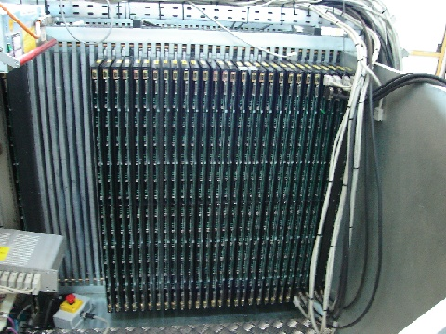
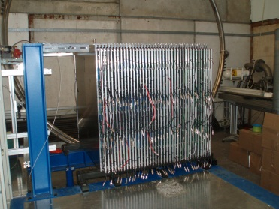
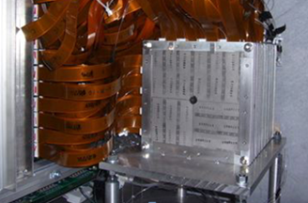
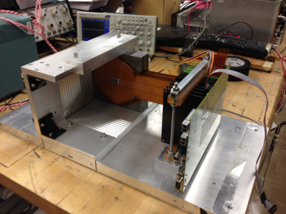
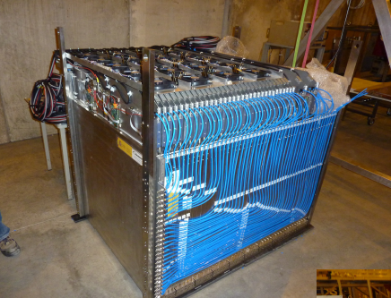
Status of Imaging Calorimetry
 | Project | Prototypes | At this conference
ECAL | CALICE Si-W | Built and tested | Towards scalable prototypes
 | CALICE Scin-W | Built and tested
 | SiD Si-W | 9 layers built and first tests
HCAL | Scintillator | Built and tested | GEANT4 comparisons + scalable prototype
 | RPCs (DHCAL) | Built and tested | Calibration
 | RPCs (SDHCAL) | Built and tested
 | Micromegas | 4 layers built and tested
 | GEMs | Smaller prototypes
FCAL |  | R&D on components | Physics with the FCAL
Proof of principle

Slide 4
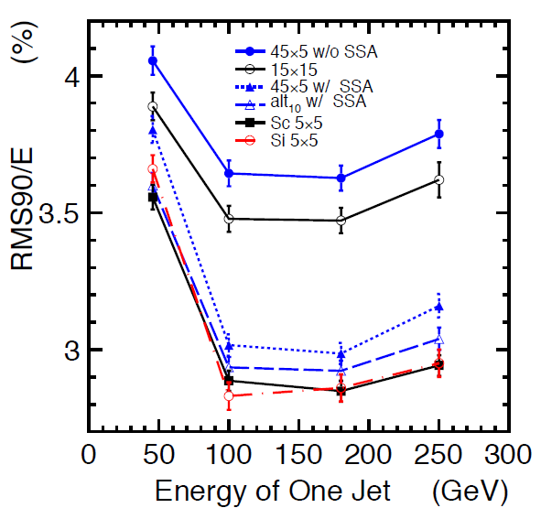
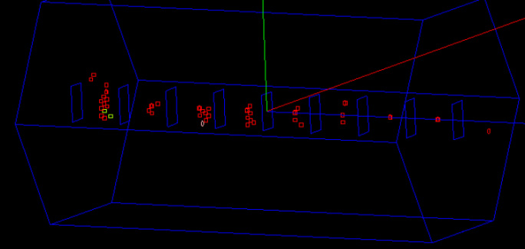
Comments to the ECALs
Performance of the CALICE Scintillator – W ECAL
Scintillator strips 45 x 5 x 1 mm³
Strip Splitting Algorithm SSA to achieve smaller effective segmentation
Similar performance to Si-W with 5 x 5 mm² pads
B) Progress with the CALICE Si – W scalable prototype
Embedded front-end electronics
Front-end ASIC embedded into readout board
Beam tests of several layers
Progress with the SiD Si – W ECAL
First beam tests successful
Identification of a number of issues
(crosstalk , monster events…)
Katsu Coterra
Taikan Suehara
Marty Breidenbach

Slide 5
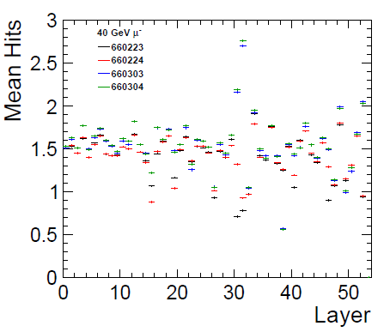

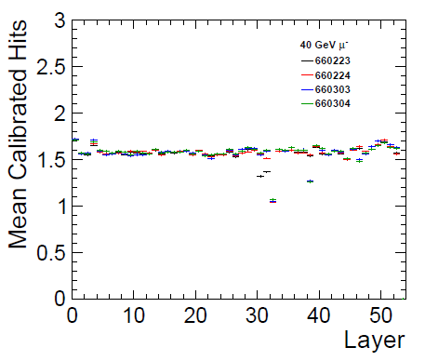
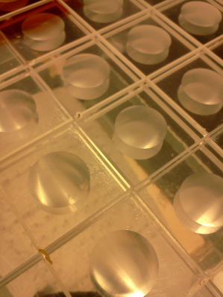
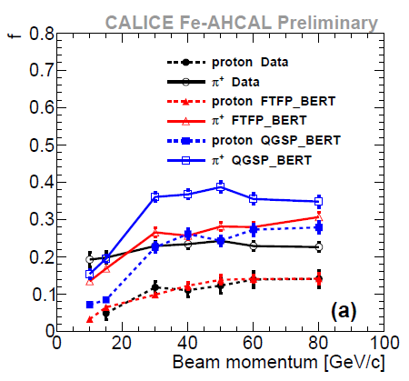
Comments to the HCALs
40 GeV μ
Burak Bilki and
Christian Grefe
Calibration of the Fe-DHCAL and the W-DHCAL
Equalization of the response of individual RPCs
Turned out to be very challenging (depends on particle type, density of hits!)
Procedure now complete with 3 different schemes (differences at high energies)
        Progress with the Scintillator HCAL
WLS-fiber less tiles
Embedded electronics
Several layers tested in test beams
Scalable to large detector
Comparison with GEANT4 (Scintillator HCAL)
Measurements of shower shapes
Parameterization of shapes
Important information for simulation of hadronic showers
e.g. Indication of overestimation of π⁰ production in first
inelastic interaction (important feedback to GEANT4!)
Huong Lan Tran and
Katja Krüger
Marina Chadeeva and Felix Sefkow
f… Fraction
of ‘short’
longitudinal
component

Slide 6
Dual Readout Calorimetry
Goal
Optimization of the hadronic energy resolution through the measurement
of both Scintillator and Čerenkov light
Underlining assumption
Scintillator light produced by all charged particles depositing energy in the calorimeter
Čerenkov light only produced by relativistic particles (i.e. mostly electrons and positrons)
Use of Scintillator/Čerenkov information
Either: determine the ‘electromagnetic fraction f_{em}’ of hadronic showers and apply
appropriate weights
Or: exploit correlation in signals to improve resolution

Slide 7
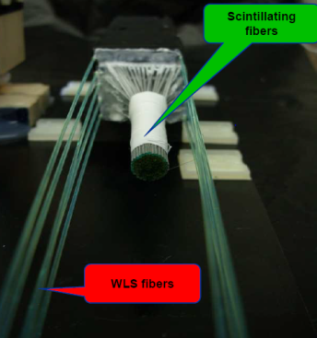
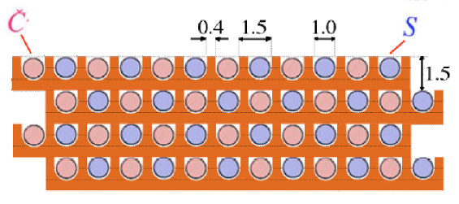
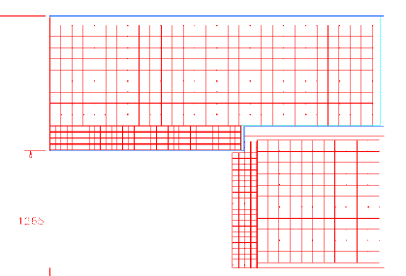
Corrado Gatto
3 DR Projects
ADRIANO
Glass as absorber → Čerenkov light
Scintillating fibers → Scintillation light
→ Simulation studies
→ Small scale R&D on glasses etc.
(SUPER)DREAM
Clear fibers → Čerenkov light
Scintillating fibers → Scintillation light
All embedded in a metal absorber (Pb, Cu, W)
→Results from an (almost complete) prototype
John Hauptman
Alexander Conway
TOTAL ABSORPTION
2 → 20 cm³ sized Crystals with 2 sensors
→ Simulation studies

Slide 8
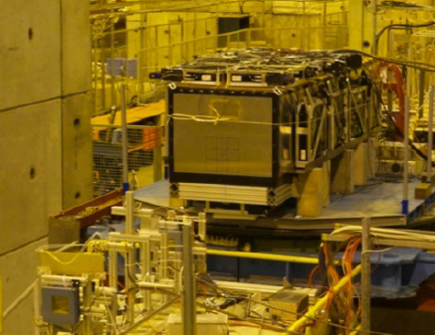
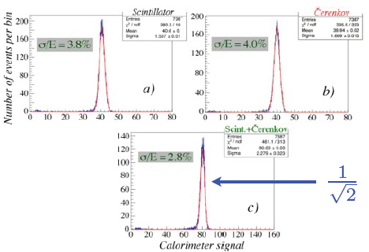
SUPERDREAM
Constructed large prototype
11 modules (Cu and Pb-absorber)
Several metric tons
Tested
CERN SPS test beam in 2012
John Hauptman
Electron response at 80 GeV
Simple sum of S and Č signals
(not dual readout algorithm)
Corresponds to 17.7%/√E
(comparable to ZEUS)

Slide 9
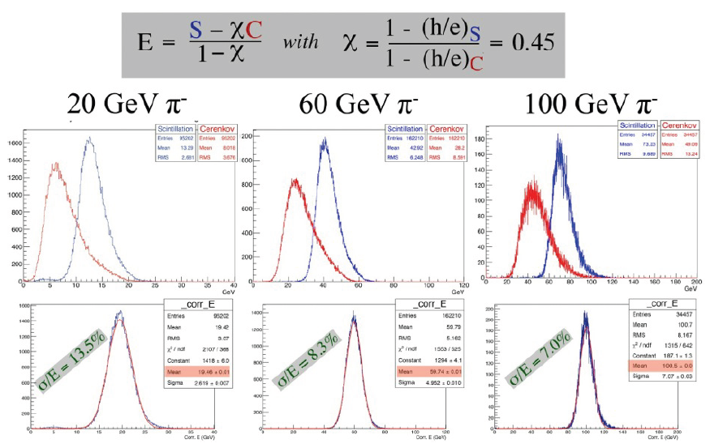
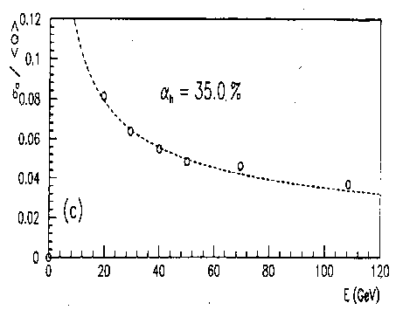

SUPERDREAM’s Hadronic Response
Dual readout reconstruction
John Hauptman
Corresponds to 60 - 70%/√E
(factor of 2 worse than ZEUS)
→ and it is not due to leakage!

Slide 10
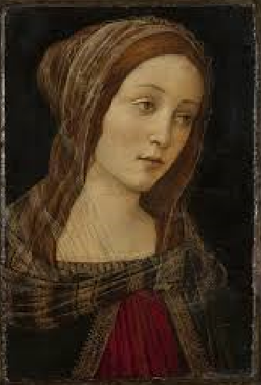


Slide 11
Thank you for your attention

