Slide 1
ML / RTML WG Summary
N.Solyak, K.Kubo, A.Latina
AWLC 2014 – Fermilab – May 16, 2014

Slide 2
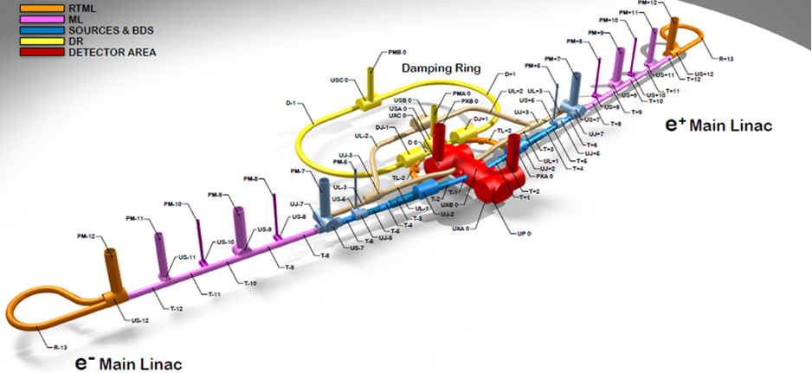
ILC TDR Layout
30 km

Slide 3
ML Working group sessions
WG –JOINT BDS/Main Linac
  Wakefield-free steering at ATF2 - J. Snuverink
  CLIC 2-beam tuning progress - J.Snuverink
  BDSIM development and BDS/MDI applications - L. Nevay
  CLIC FFS tuning - - H.Morales
  CFS: Joint Session with SRF/Main Linac for Cyrogenics
  Main Linac: Joint Session with CFS/SCRF - cavities
  WG - Beam Delivery System: Joint Session with Main Linac
    S2E ML+BDS simulations (RDR) and future plans - G.White
    CLIC recent S2E simulations - A.Latina
  WG - Main Linac: Joint with RTML Physics
  Staging and Energy upgrade scenarios discussion – K.Kubo
  ML Lattice in TDR – N.Solyak
  Flexibility of ILC Bunch Compressor – S.Seletskiy
  Baseline RTML in TDR – S.Kuroda
  WG - Beam Delivery System: Joint Session with Main Linac
  Beam steering experience at CTF3 - D.Gamba
  Beam tests of DFS & WFS @ FACET – A.Latina
  Prospects for FACET-II – V.Yakimenko

Slide 4
ML Lattice design status (incl. BC)
Two ML lattices (KCS & DKS) were designed in TDR phase. DKS is the baseline for Japanese site:
  Earth curvature and cryo-segmentation included
  Collimation system migrated from BDS to ML
Two stage BC migrated from RTML to ML. Lattice was re-optimized (w.r.t. RDR) for a new set of beam parameters, provided by DR
  Extra 3CM’s in BC2 RF system to improve flexibility and support smaller bunch length option
  Matching and optimization of wiggler
  Better design of the extraction lines
  Sensitivity studies are complete

Slide 5
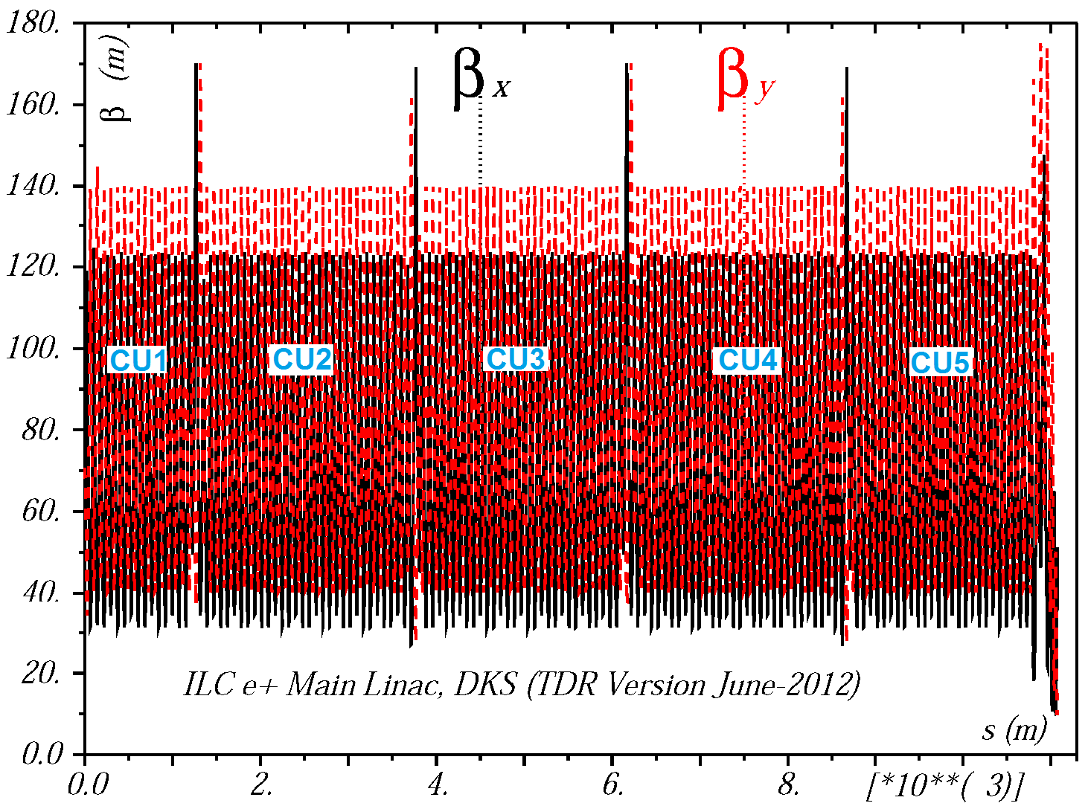
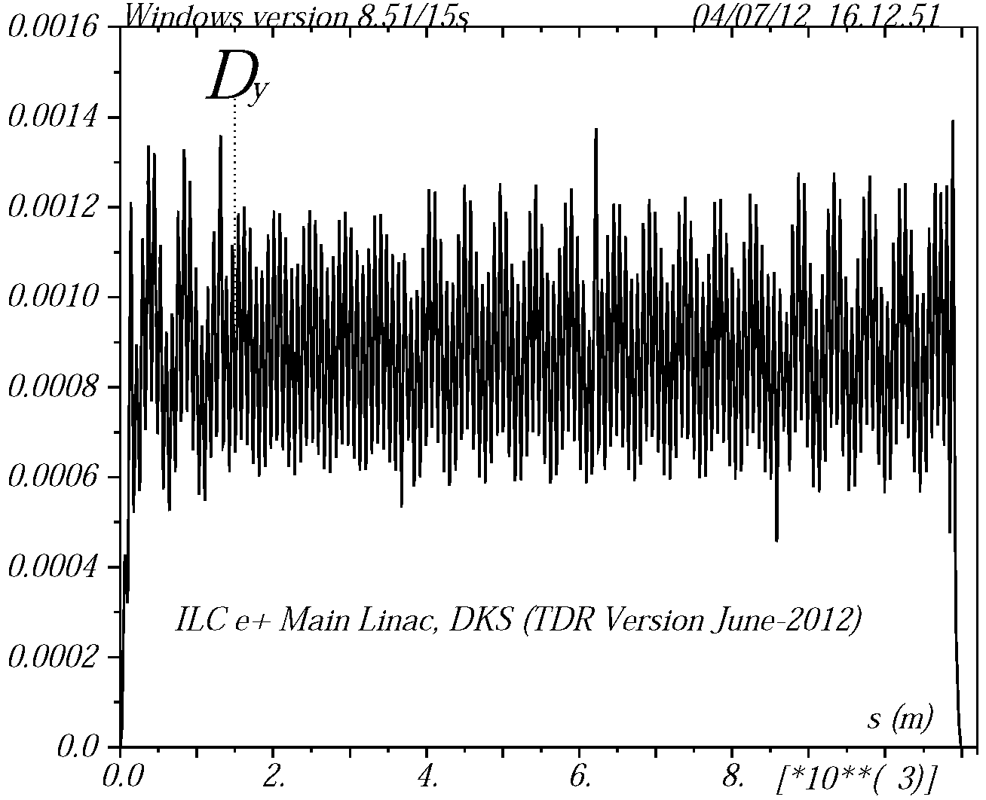
Matched β-functions and Dispersion in PLIN (DKS)
PLIN

Slide 6
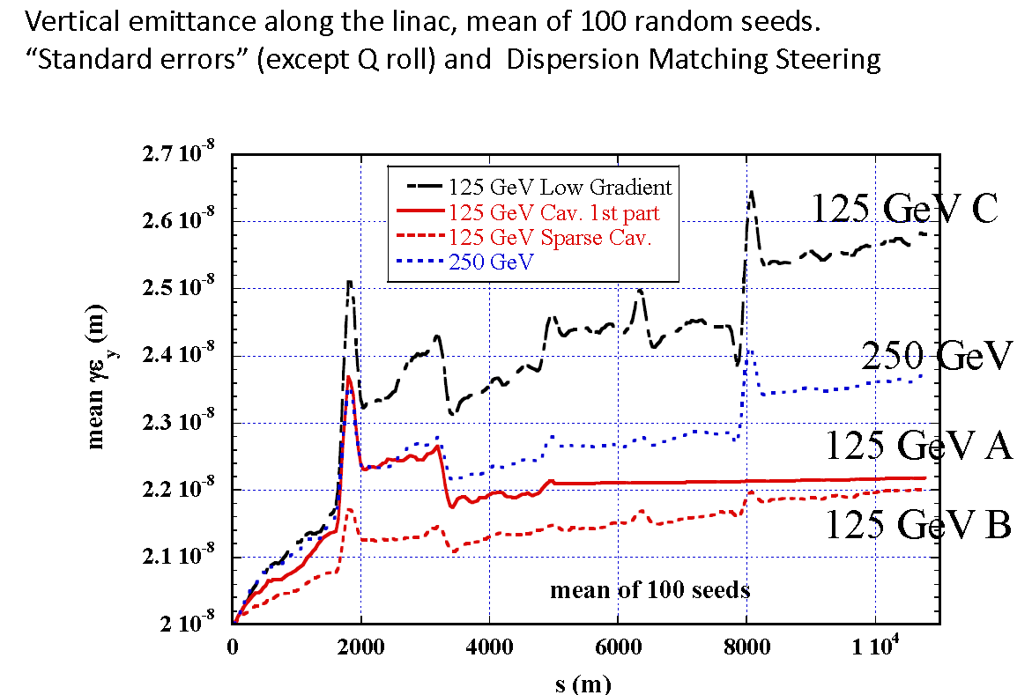
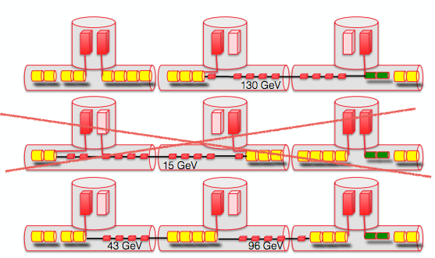
Staging 125 GeV: Emittance after DMS correction
A
B
C: all cavities with half gradient
(for comparison only)
Emittance growth mostly from Wakefield
After DMS, mostly from Wakefield. No significant difference
between A (fill cavities in 1st part) and B (sparsely distributed cavities)

Slide 7
Upgrade, ECM from 500 GeV to 1 TeV
ML (15-25 GeV)
Special magnets
ML (25-250 GeV)
BC (5-15 GeV)
Move to upstream
Keep for
275 – 500 GeV
New part (25-275GeV)
FODO
FOFODODO
Magnets designed for 250 GeV FODO will be used up to 500 GeV beam.
FOFODODO can make dispersion in downstream part small.
Loose tolerance of BPM scale error in DMS correction.

Slide 8
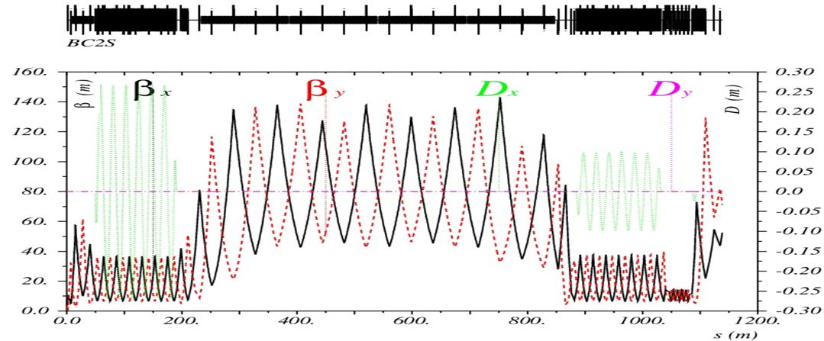
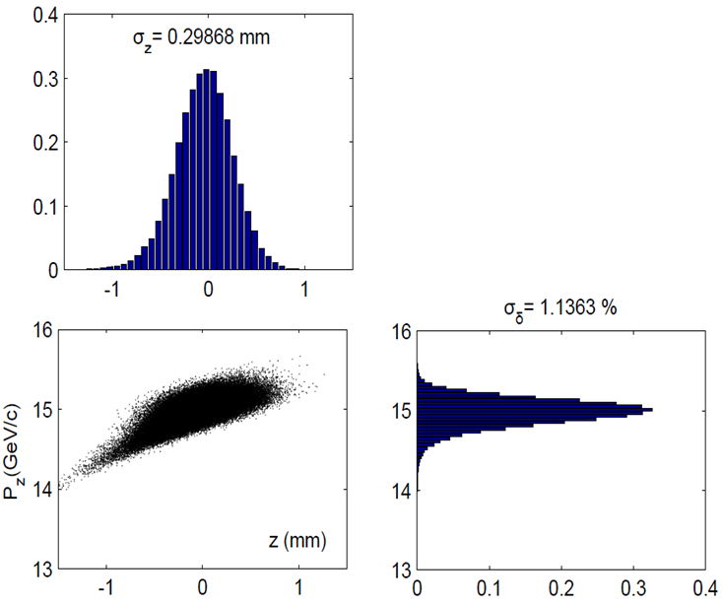
2-stage Bunch Compressor (current TDR design)
After deviation to single stage BC design a RDR 2 stage BC design was finally selected for TDR design (more tunability, provides shorter bunches ~ 150μm).
BC modifications (vs. RDR):
  3 CM’s with quads for BC1 (ILC design instead of XFEL).
  16 RF units in BC2 RF (48 CM’s; 416 cavities) to reduce gradient.
  New parameter optimization of BC wigglers (S. Seletskiy)
  New output parameters from DR is used.
  New treaty point from RTML to ML
Final longitudinal phase space for bunch compression at nominal operation mode (5 Hz, Ecm = 500 GeV).
S. Seletskiy, A.Vivoli

Slide 9
BC parameters for 150 um long final beam
Initial beam |  |  | BC1 parameters |  | Beam after BC1 |  |  | BC2 parameters |  | Final beam
dp/p, % | σ_{z}, mm | E, GeV | Grd/-φ, MeV/ deg | R₅₆, mm | dp/p, % | σ_{z}, mm | E, GeV | Grd/-φ, MeV/ deg | R₅₆, mm | dp/p, % | σ_{z}, mm | E, GeV
0.11 | 6 | 5 | 18.67 / 120 | 348 | 1.37 | 1.36 | 4.77 | 27.2 / 29.2 | 69 | 1.85 | 0.15 | 15
0.12 | 6 | 5 | 18.67 / 120 | 348 | 1.37 | 1.37 | 4.77 | 27.5/ 30.4 | 69 | 1.93 | 0.15 | 15
0.137 | 6 | 5 | 18.67 / 120 | 348 | 1.37 | 1.4 | 4.77 | 30.5 / 39 | 52.4 | 2.52 | 0.15 | 15
The 150um final length is achievable for all three cases of initial energy spread. (0.11, 0.12, 0.137%)
It requires higher RF2 gradient.
The maximum final energy spread is 2.5%.

Slide 10

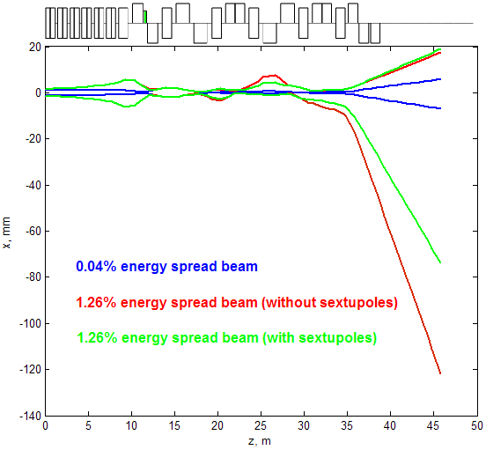
Extraction Lines nonlinear lattice
For a beam with a high energy spread there is a substantial blow-up of beam size at the end of the Els because of chromatic aberrations and nonlinear dispersion.
We found that relatively weak sextupoles can contain the nonlinear halo and such solution doesn’t require any additional beam collimation.
sextupoles
sextupole
EL2
EL1

Slide 11
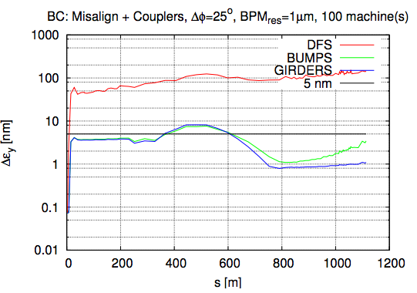
BC beam dynamics Simulations
Emittance budget is barely satisfied in TDR.
  Need more studies.
Coupler kicks should be carefully looked at.
  Cryo-module pitch control should be considered.
Proposed parameters:
Range ~ 0.3 mm
Step ~ 10 micron
All 3 modules in BC1, 4 modules in BC2 (out of 48)
Vertical emittance growth 1.09 nm
(vs. 4.3 nm without pitch optimization)
Or Crab Cavities?

Slide 12
Beam Dynamics studies and issues
From results of large amount of past studies in ML beam dynamics, our conclusion was (and is): No serious problem is expected.
However
  More simulations for emittance preservation in BC is necessary
  BC + ML combined simulation is necessary for completeness
  Experimental test of steering correction is desirable
  How to proceed commissioning has not been studied
  Our requirements may not be really understood or agreed by groups/people who should be responsible for the hardware e.g., alignment, magnet control, cavity control, …
    Need to modify some of the requirements, for making them more realistic.
    Coupler kicks in BC

Slide 13
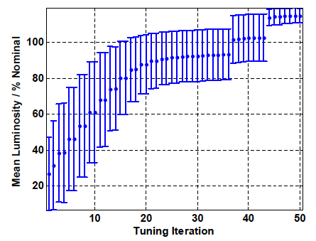
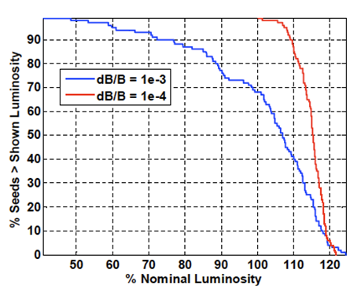
Simulation work (incl. S2E) performed in the past (RDR-era)
RTML, Linac, BDS studied separately
  Independently defined luminosity growth “budgets”
  Most effort on Linac emittance preservation techniques
S2E Linac+BDS global simulation for RDR performance studies (Lucretia, SLEPT, Placet)
  Linac
    Independently “static” tune 100 seeds
    Pick those that fulfill “emttance growth budget” expectations.
    Apply dynamic errors, tracking through to get wakefields and realistic beam response functions
    Include GM & 5Hz feedbacks
  BDS
    Full tuning (BBA, orbit steering etc & FFS tuning with sextupoles).
    Use GUINEA-PIG for beam-beam simulations, track pairs through solenoid to detector.
    BDS 5Hz feedbacks
Tuning time <1,000 pulses
Magnet strength errors
Glen White talk

Slide 14
S2E simulations: TDR Work
Study of integrated luminosity performance
  Static and dynamic errors: ground motion, jitter, feedbacks, …
A lot work was done in past (RDR)
Simulations tools exist and are mature
Parameter sets and lattices have been changed, need to refresh work
Need to fully document
Need to prioritize the tasks to make efficient use of the (limited) available resources
  Can image 0.5 – 2+ FTE / year in this effort.

Slide 15
Experimental studies of the BBA techniques at FACET and other facilities. Results and plans
FACET: promising results demonstrated; need more work to understand the limitations.
New proposals for experimental studies:
  Fermi @ Electra
    (S-band linac, 150m-long , two BC; 0.15-3GeV; ~20 correctors/BPMs)
  ATF2/KEK:
    ~11 X/Y correctors; 55 BPM’s
    WFS might address charge-dependent effects (WF?)

Slide 16
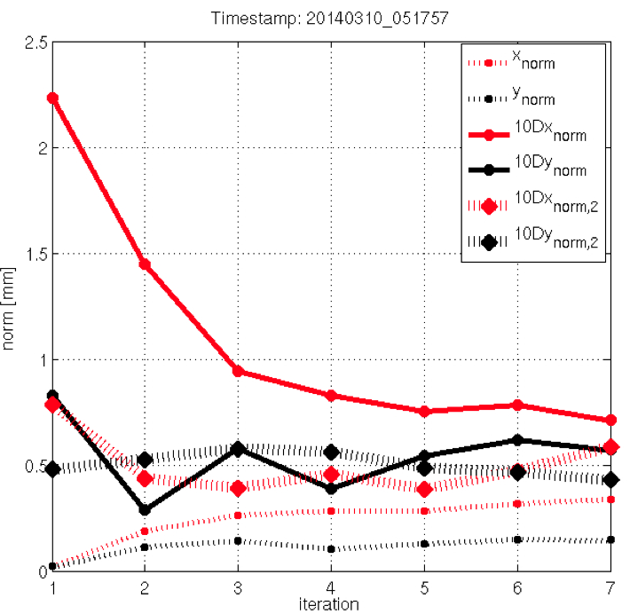
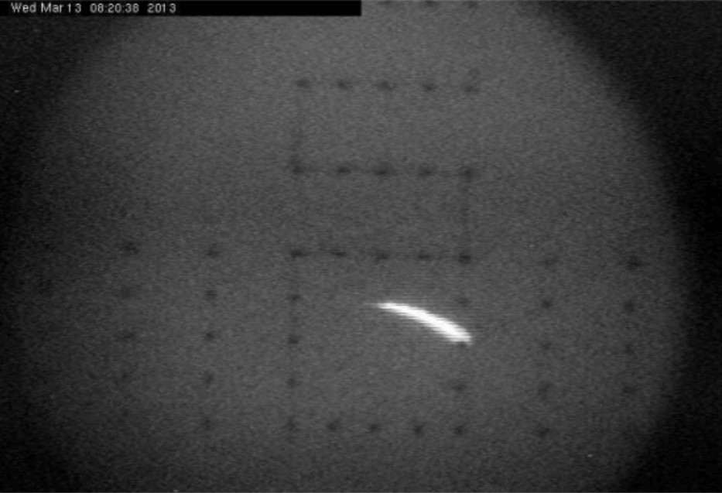
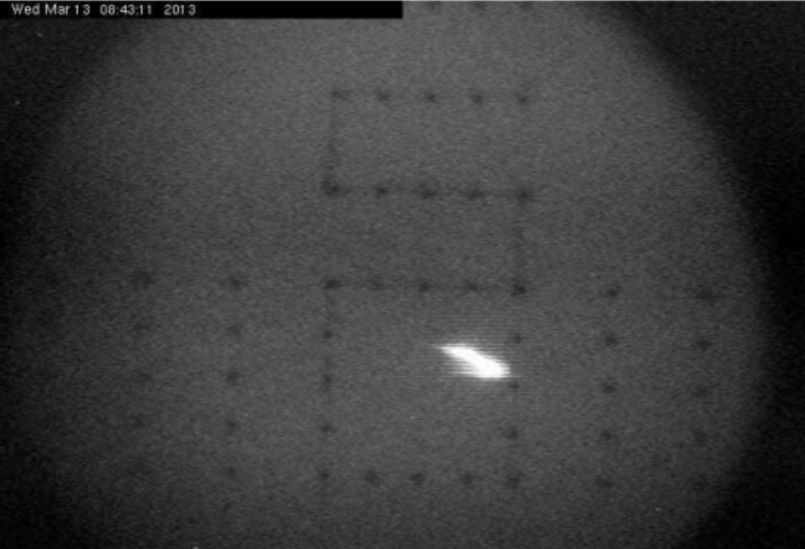
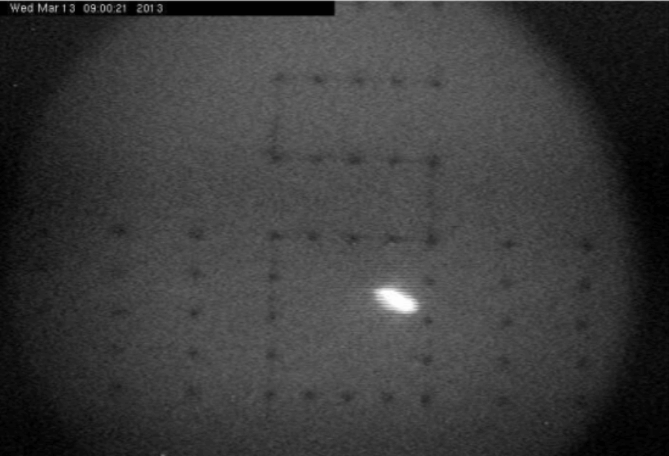
Beam-based Steering Tests at FACET
(1) Sectors 02-04, first 300 meters of SLAC linac
(3) First tests of simultaneous
Orbit + Dispersion + Wakefield correction
in sectors S05-11, 700 meters of SLAC linac
Emittance before BBA:
X = 2.79 x 10⁻⁵ m
Y = 0.54 x 10⁻⁵ m
Vertical emittance got reduced by a factor ~3.8.
Issues: considerable incoming jitter on the H-axis jeopardized the X-axis; Response matrix measurement is time consuming (~2hrs).
After BBA:
X = 3.38 x 10⁻⁵ m
Y = 0.14 x 10⁻⁵ m
Convergence plot
(2) Vertical emittance vs. weight scan:
It matches the expected behavior
measured data
Very bad at very large weights
To be redone to find optimum
Vertical emittance reduced by a factor 4:
from 1.58 x 10⁻⁵ m to 0.40 x 10⁻⁵ m
PLAN for FACET studies:
Understand divergence in X
Speed-up response matrix measurement, with the help SLAC experts
Beam transverse profile per iteration step (DFS correction)

Slide 17
RTML status and plans (S.Kuroda)
BC is moved to ML system
TDR lattice is completed (earth curvature, diagnostics, collimation, dump lines are included). Many changes since RDR.
  Some work need to tune and accommodate further changes
Beam dynamics studies (static tuning and effect of dynamic errors) are done mostly for RDR lattice
  Need more studies for new lattice
  S2E global simulation (with DR?+ML+BDS) are needed
Accelerator Components (BPM resolution, laserwire, beam polarization monitor?, etc. )
Accelerator Physics issues:
  Residual magnetic field < 2nT
    SLAC, FNAL measurement shows that this level achievable, if frequencies are repeatable from pulse2pulse. Need systematic studies.

Slide 18
Low emittance transport in the RTML

Slide 19
Other Beam Physics Issues in TDR
ISR
  Vertical emittance growth is negligible
Beam-Ion instability (L.Wang, et al.)
  < 2μPa
Halo Formation from Scattering (S.Seletskiy)
  2μPa → 2e-6 of beam intensity < tolerance of 1e-5
Space-Charge Effect
  Incoherent space charge tune shift is O(0.15) in Vertical
  To be studied
Horizontal emittance growth
Arc( RTL ) | 90nm (1.1 % )
Turn-around | 430nm ( 5.4 % )

Slide 20
ML estimated resources
Tasks (guesstimated FTE x Year)
Beam Dynamics
  Lattice design, including flexible BC (0.5)
  BC emittance simulations including coupler kicks (1)
  BC + ML combined simulations, part of S2E whole machine simulations (1-2)
Beam dynamics + Engineering
  BC cryo-module pitch control engineering (0.5)
  Alignment studies and modeling, probably for whole machine (?)
Experiment
  Beam-Based Steering Correction, at FACET, Fermi, ATF2
Present manpower is not enough (for Beam Dynamics)
Currently: level of ~0.1 FTE in 2014 from America ? ~0.1 FTE from Europe ? ~0.2 from Asia ?

