Slide 1



Polarized Positron Source
AWLC, Fermilab, 13 May 2014
Sabine Riemann, Friedrich Staufenbiel, (DESY)
Gudrid Moortgat-Pick, Andriy Ushakov (Hamburg U)

Slide 2
Outline
Optimization: see Andriy’s talk
Positron polarization for best physics analyses
  Baseline polarization
  Polarization upgrade
  Photon target
e+ polarization as upgrade option?
Summary
2
Notes:
2

Slide 3
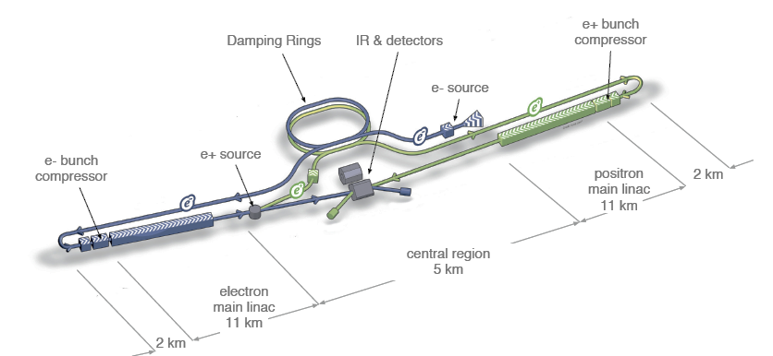
ILC e+ source
Requirements
Long bunch trains: ~1ms
  1312 (2625) bunches per train
  rep rate 5Hz
Yield 1.5e+/e-
  3×10¹⁰ particles/bunch
Beam polarization:
  Undulator-based source: ≥30%
  conv. Source: unpolarized
3

Slide 4
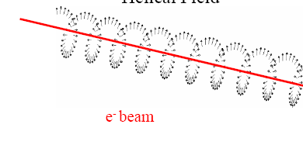
ILC baseline: helical undulator
    Higher γ yield
  → polarized e+
    Optimize undulator parameters to get ~30% w/o collimator
  E deposition in target ~3-5kW, PEDD = 50-67 J/g (mechanical fatigue limit <180J/g )
  To be done:
    Target prototyping (rotating wheel [≤100m/s] or alternatives)
    Target cooling
    (FC protection: shielding against radiation from target)
Alternative: conventional source
  unpolarized e+
  E deposition in target ~35kW, PEDD ~ 30J/g (limit ~35J/g from SLC)
  To be done:
    Target prototyping (moving target, ≥5m/s)
    Target cooling
    FC protection: shielding against radiation from target (~35kW energy deposition in AMD)

Slide 5
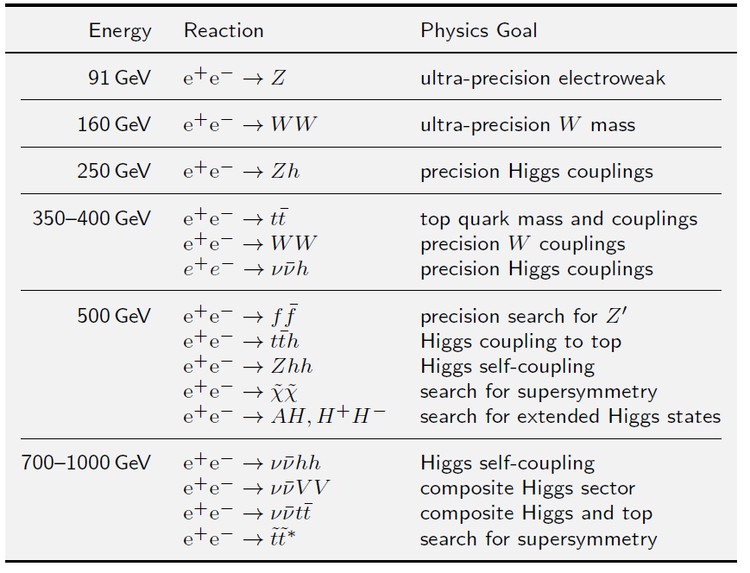
Physics requirements
TDR executive summary
  Important:
    Higgs,
    Top,
    New physics
Details: ILC TDR Physics chapter

Slide 6
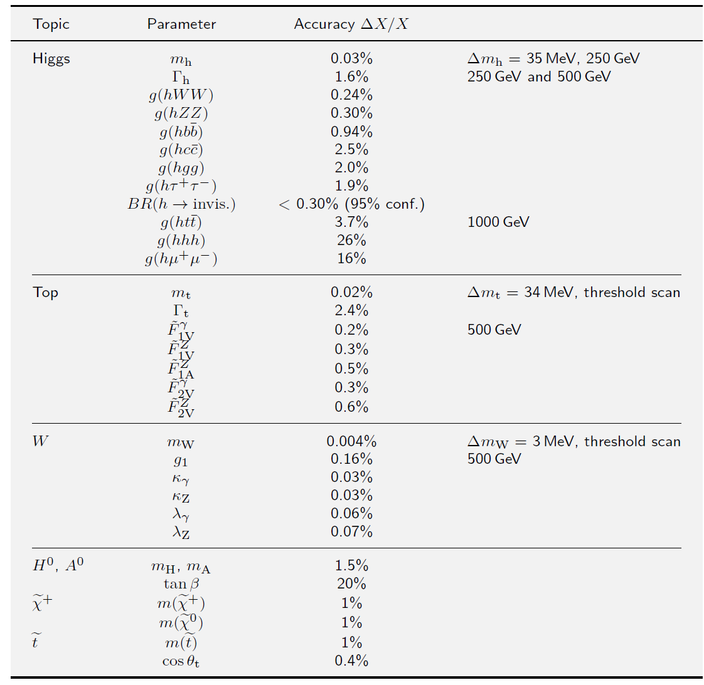
Physics requirements
TDR executive summary
  Important:
    Higgs,Top,New physics
Details: ILC TDR Physics chapter

Slide 7
Most likely, the ILC will start with E_{cm} = 240 GeV.
250GeV operation are possible with undulator source (no 10Hz scheme) – see Andriy’s talk
Benefit of e+ polarization at this energy?
  Main physics @250GeV: precision Higgs boson couplings

Slide 8
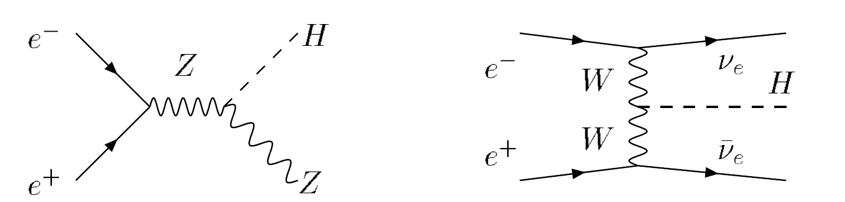
Higgs boson at ILC@250GeV
m_{H} = 126 GeV
Higgs Strahlung (ee→ HZ)
(dominating)
  WW Fusion (ee→Hνν)
E_{cm}=250GeV

Slide 9
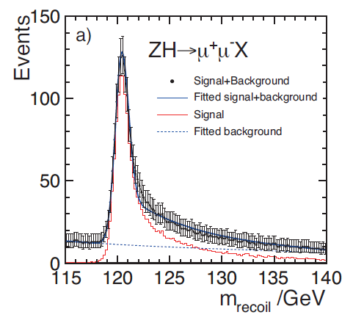
Higgs Mass and Higgs Coupling to the Z
Select events: e+e- → ZH
Z → μμ,ee
Fit to the spectrum of recoil mass of both leptons ➔ Higgs mass and coupling
ILC TDR
Peak position ⬄ Higgs mass
Peak hight ⬄
Model independent g(HZZ) measurement!!
Higher lumi improves precision
Δm < 100 MeV

Slide 10
Higgs Strahlung dominates at 250GeV
e⁺_{R} e⁻_{L} → ZH
e⁺_{L} e⁻_{R} → ZH
e⁺_{L} e⁻_{L} → ZH
e⁺_{R} e⁻_{R} → ZH
With e+ and e- polarization ‘ineffective’ processes are suppressed
→ Enhancement of effective luminosity
P(e-,e+) = (±80%; ∓30%) ⬄ 24% lumi gain
➔ Δσ_{ZH} reduced by 11%
L (R)
σ(e_{L}e_{L} → ZH)= 0
σ(e_{R}e_{R} → ZH)= 0
R (L)

Slide 11
At ILC energies ≥ 350GeV
WW Fusion: ee → ννH
e⁺_{R} e⁻_{L} → ννH
e⁺_{L} e⁻_{R} → ννH
e⁺_{L} e⁻_{L} → ννH
e⁺_{R} e⁻_{R} → ννH
Electron beam is polarized
→ for P(e+)=+1 the contribution σ(e⁺_{R} e⁻_{L} → ννH)
is substantially enhanced
L
R

Slide 12
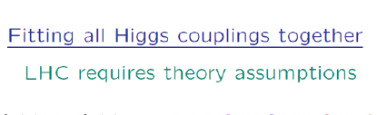
Sensitivity to Higgs couplings in model-independent analyses
ILC1: E=250GeV
ILC: up to E=500GeV (full program)
ILCTeV: E=1TeV
ILC TDR
19.9.13

Slide 13
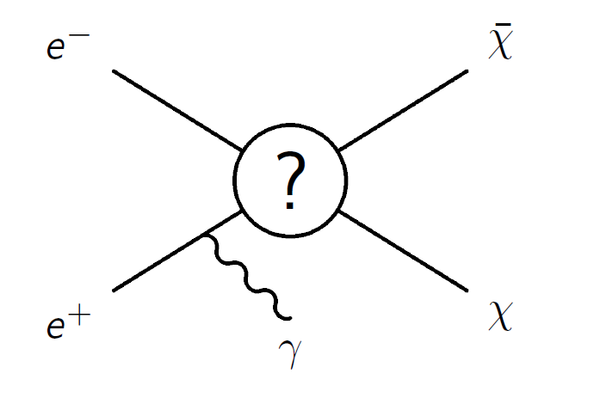

E+ polarization and New Physics
Important at ILC: search for physics beyond SM; dark matter, WIMP
Model-independent searches (WIMP, …) at the ILC are complementary to LHC, direct and indirect detection
  Studies exist and are ongoing, see TDR, Berggren et al.:arXiv1206.6639,
  J. List et al., D. Schmeier, Chaus, F. Richard, …
E+ polarization is essential to suppress background
  Irreducible background: ee → νν(γ) polarization
  Reducible bgd:
    ee→ ee(γ) (radiative Bhabha)
    ee → γ(N)γ
Irreducible νν(γ) background
e-
W
e+

Slide 14
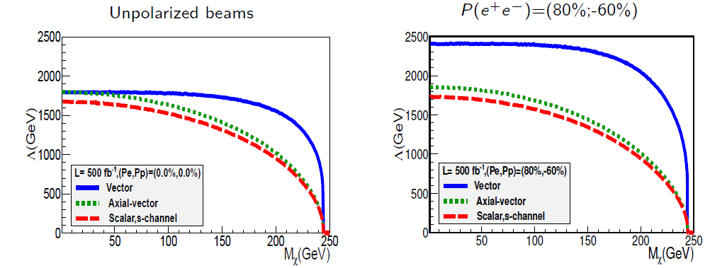
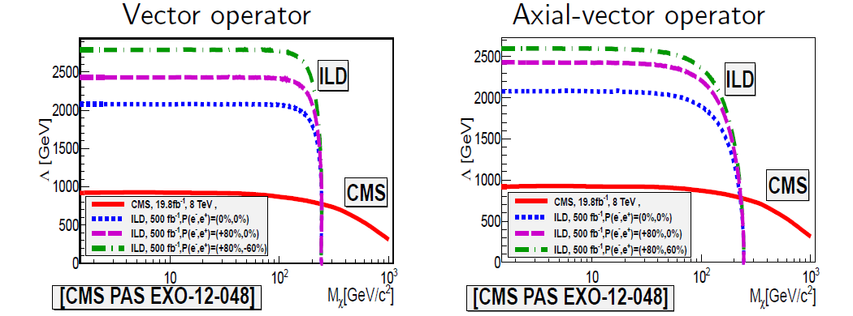
Dark Matter search at ILC
Chaus, LC Forum, Bonn, April 2014
polarized beams increase sensitivity to DM models (here optimum configuration for Vector operator)
→ Improved limits for DM search with polarized beams
polarization (e+ and e-) is important to suppress ee→νν(γ) background
and to distinguish models

Slide 15
E_{cm} ≥ 350 GeV
  Top quark physics
  Higgs physics
  New phenomena beyond Standard Model
  e+ polarization
    Helical undulator ⬄ polarized e+ from ILC start on
    Enhance effective luminosity
    Substantial background suppression ⬄ much better sensitivity to unknown physics
    Important for measurement of LR asymmetries:
    Reduced error on effective polarization, P_{eff}=(-P_{e-}+P_{e+})/(1+P_{e-}P _{e+}) ⬄ precision
    See also Moortgat-Pick et al., Phys.Rept. 460 (2008)

Slide 16
Top quark physics @ LC
heaviest quark (as heavy as gold atom), pointlike
Extremely unstable (τ ~ 4×10⁻²⁵s)
  Decay of top-quark before hadronization
  Top-polarization gets preserved to decay (similar to τ-lepton)
  ➔ The ‘pure’ top quark can be studied (Threshold scan at ~350GeV)
  Top quark coupling as test of SM and physics beyond
→ top quark coupling, spin, spin correlations are observable by measuring polarization and LR asymmetries with high precision
  Need high degree of polarization
  e+ polarization highly desired (see i.e., Grote, Koerner, arXiv:1112.0908)
  Need precise measurement of polarization
→ e+ polarization > 30% desired

Slide 17
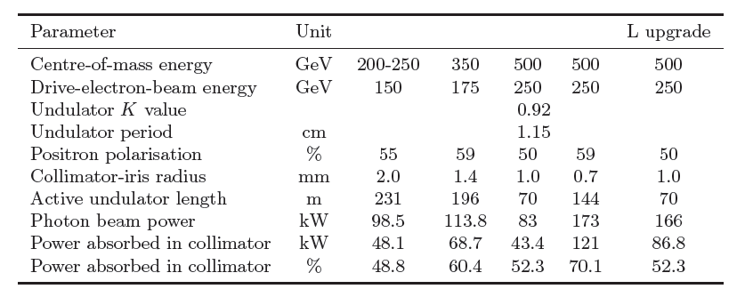
Photon beam collimation
ILC TDR
350GeV: 60% e+ polarization ⬄ ~60% of photon beam power absorbed in collimator
500GeV: 60% e+ polarization ⬄ collimator absorbs ~70% of photon beam power → 50% e+ polarization ‘sufficient’
Notes:
Go to ”Insert (View) | Header and Footer" to add your organization, sponsor, meeting name here; then, click "Apply to All"
17

Slide 18
Photon beam collimation
Photon collimator to increase polarization
P ≥ 50% ⬄ optimize K value and increase active undulator length
to achieve 1.5e+/e-
Heat load and PEDD on target increases: 30% ⬄ ~65J/g
(2000rpm) ≥50% ⬄ ~90J/g
ILC TDR
Notes:
Go to ”Insert (View) | Header and Footer" to add your organization, sponsor, meeting name here; then, click "Apply to All"
18

Slide 19
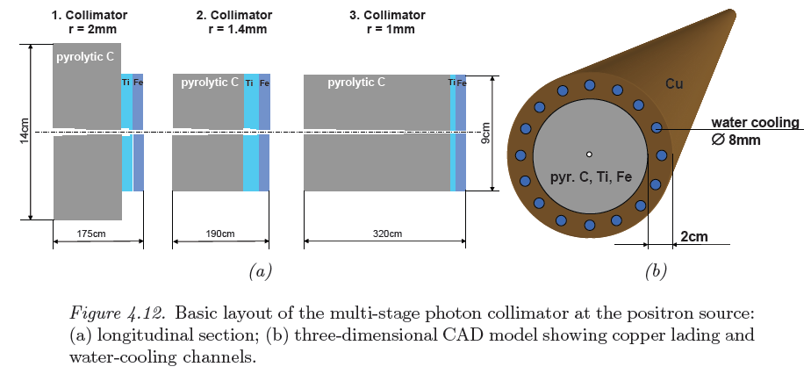
Photon collimator
Collimator parameters depend on energy
  Multistage collimator (3 stages with each pyr. graphite, Ti, Fe)
Potential problem: damage due to long-term irradiation
  Fatigue limit with irradition?
  Max values for displacement per atom (dpa) ~ 0.5 at inner collimator surface
  volume change (swelling); consequences are under consideration
E_{e-} =150 GeV, P_{e+} = 50%
E_{e-} = 175 GeV, P_{e+} ≈ 60%
E_{e-} = 250 GeV, P_{e+} ≈ 50%

Slide 20
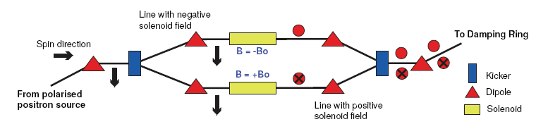
Spin flipper
Undulator windings determine polarization sign
→ spin flipper required
without spin flipper:
  No enhancement of effective luminosity
  Long-term operation with unchanged e+ helicity ➔ systematic errors increase
  No flexibility to chose e+ helicity as required for precision physics
Design exists (see ILC TDR, L. Malysheva, ….)
  2 parallel instead of 1 rotation line

Slide 21
Photon target
Spinning target, prototyping @ LLNL
  2000rpm
  In vacuum
  FC with low B field at target
  Cooling of target rim not yet included in protoyping
J. Gronberg, POSIPOL13:
  We are pushing them (ff seals) to speeds at which there is significant heat dissipation
    Off-the-shelf models do not seem to be well designed for this.
    Improved cooling design is a must for any future system
  Ideas for improvement:
    Window concept
    Magnetic levitation bearings
    Radiative cooling

Slide 22
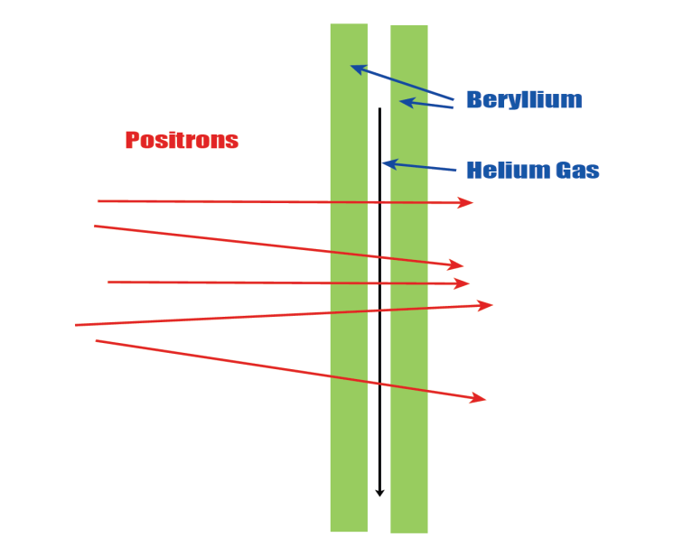
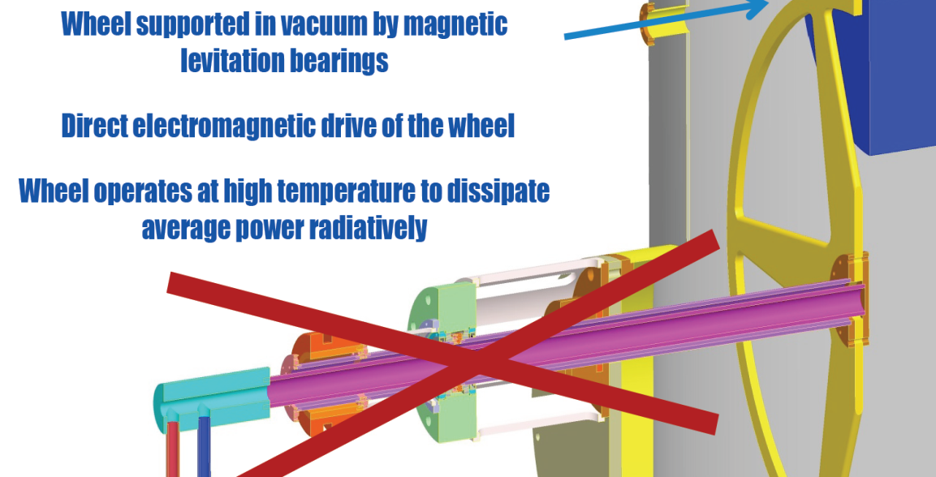
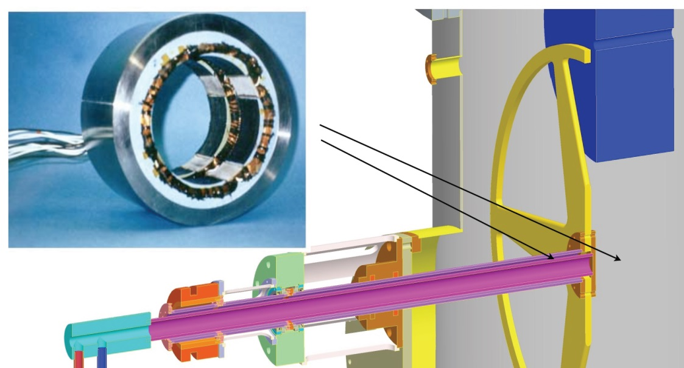
Photon target
J. Gronberg, POSIPOL13
Ideas for improved cooling design:
    Window concept
    Radiative cooling
    Magnetic levitation bearings

Slide 23
Photon target
Spinning target, prototyping @ LLNL
  2000rpm, water-cooled
  In vacuum
  FC with low B field at target
  Cooling of target rim not yet included in protoyping
J. Gronberg, POSIPOL13:
  We are pushing them (ff seals) to speeds at which there is significant heat dissipation
    Off-the-shelf models do not seem to be well designed for this.
    Improved cooling design is a must for any future system
  Ideas for improvements:
    Window concept
    Magnetic levitation bearings
    Radiative cooling
F. Staufenbiel: POSIPOL13, LCWS13
  Rotation speed could be reduced
No showstopper, but more engineering work is necessary

Slide 24
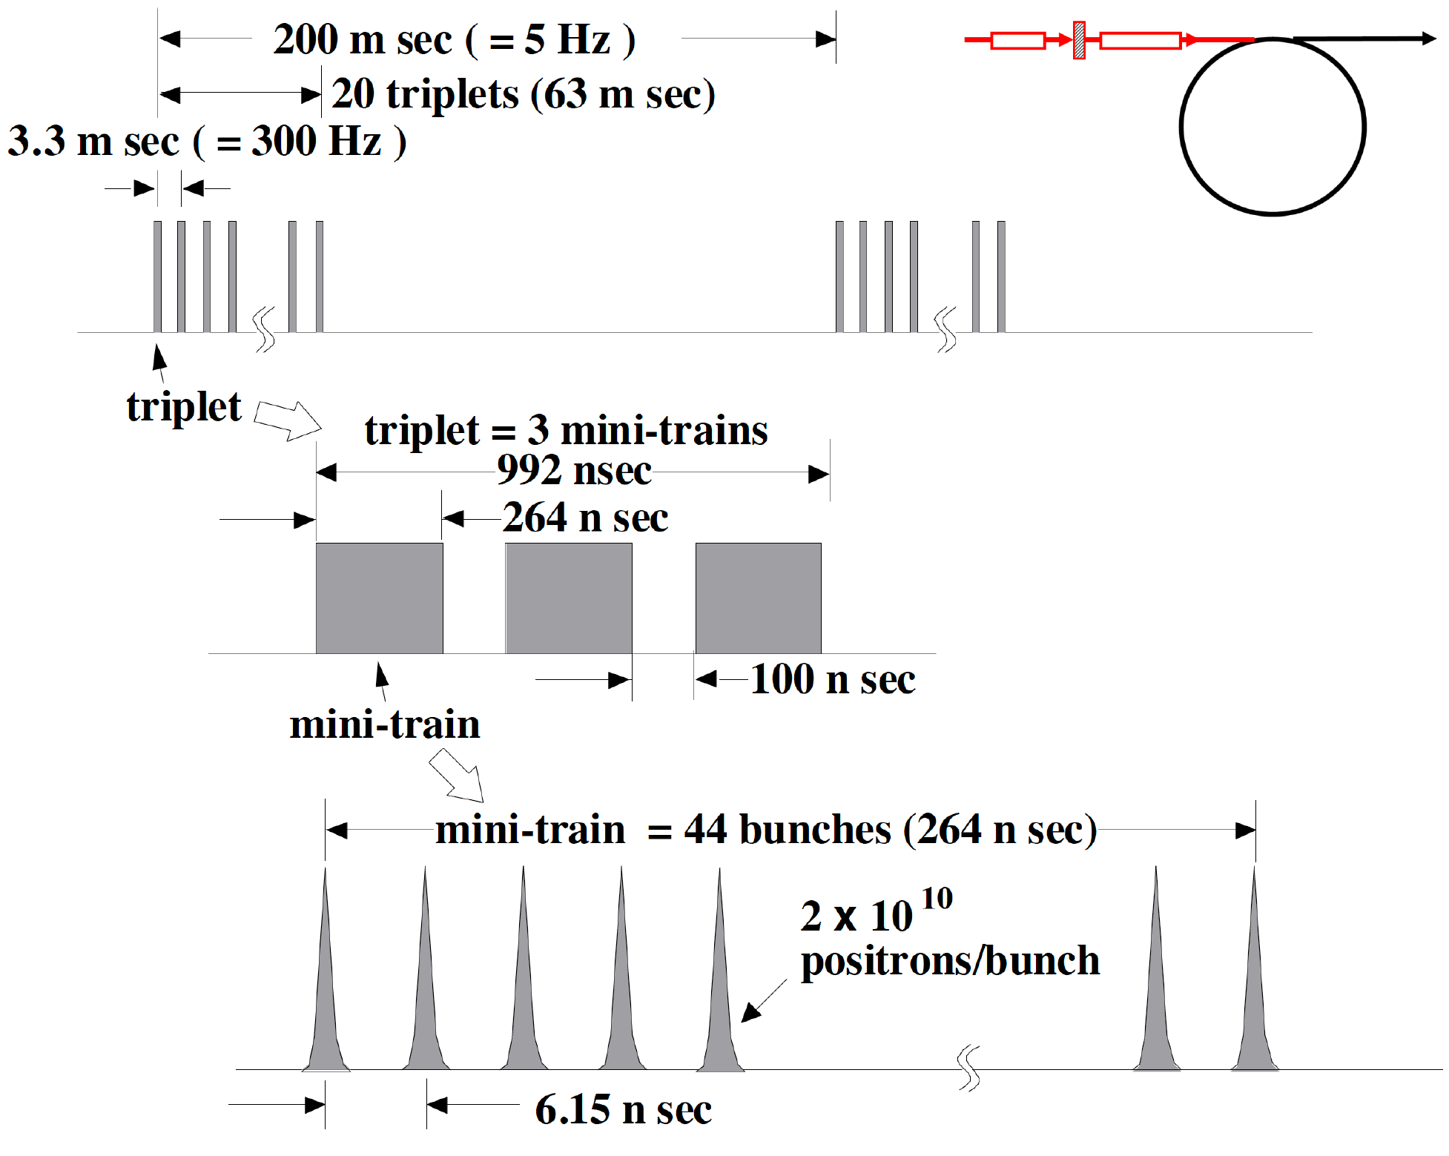
Alternative source: “300 Hz scheme”
T. Omori
6GeV e- beam, 4 X0 tungsten target
Time stretched generation of e+ bunch train:
  63ms instead of 1ms
  → lower peak load on target
  2640 bunches per train; 2640 = 20 × 132
  Bunch train ⬄ 20 triplets = 20 × 3 Mini-Trains
  triplet
  Triplets are generated with 300Hz
With beam size σ = 4mm, the peak energy deposition density is below 30J/g (limit from SLC target)
Dynamic stress under study (see talk by Felix)
=132 bunches
S. Riemann

Slide 25
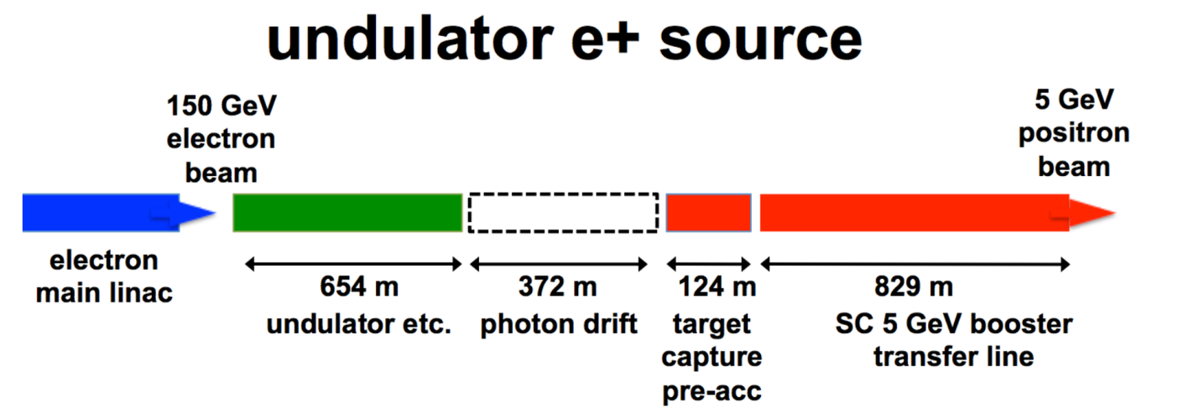
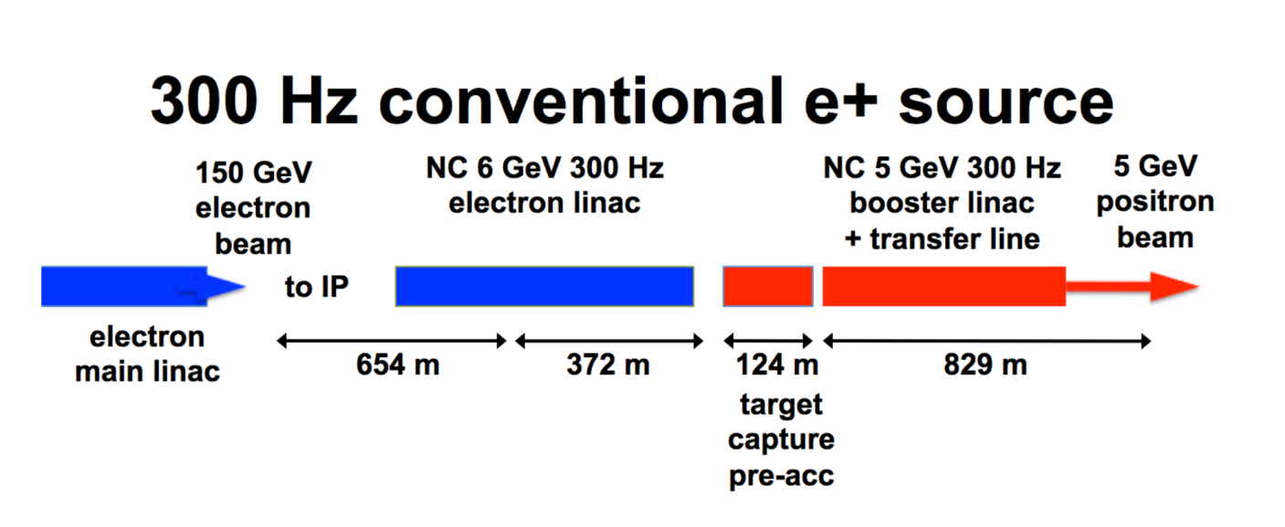
LCWS 2013, talk by T. Omori: start with conventional scheme does not prevent upgrade with undulator scheme
But: When will the e+ polarization upgrade happen?
Physics potential of ILC? (TDR studies with e+ pol)

Slide 26
Summary
Undulator Scheme
  Is the baseline concept
  Provides polarized e+ → benefit for physics results
  Requires still engineering work (target, collimator)
    In particular, cooling of target wheel
    DESY Zeuthen, Uni HH will contribute to studies for alternative target cooling options
Conventional (300Hz) Scheme
  Unpolarized source
  alternative & backup for undulator based source
  Moving target (≥~ 5m/s) needed
  Overall simulation ongoing
    Including target stress, capture, bunch compression, beamloading & energy compression
Assumption: Start with conventional source ??
  → e+ polarization is upgrade option
  When will that upgrade happen?
  Consequences for physics analyses (TDR studies with e+ pol)
  → Polarized undulator source is the preferred option

Slide 27
Backup
5/13/2014S. Riemann

Slide 28
LC as Higgs factory
Higgs Strahlung WW Fusion
Enhancement of Higgs Strahlung by factor (1-Pe-Pe+)
Enhancement of Higgs Production by WW Fusion

Slide 29
e- Beam Parameters for e+ generation | Ecm (GeV)
 | 200 | 230 | 250 | 350 | 500 | 500 L upgrade | 1000
e+ per bunch at IP ( ×10¹⁰) | 2 |  |  | 2 | 2 | 2 | 1.74
Number of bunches per pulse | 1312 |  |  |  |  | 2625 | 2450
Undulator period (cm) | 1.15 |  |  |  |  | 1.15 | 4.3
Nominal 5Hz mode | 4Hz
Undulator strength (K value) |  |  |  | 0.92 | 0.75 | 0.45 | 1
Beam energy (GeV) |  |  |  | 178 | 253 | 253 | 503
Undulator length (m) |  |  |  | 147 |  | 147 | 132
10Hz alternate pulse mode
Undulator strength (K value) | 0.92
Beam energy for e+ prod.(GeV) | 150
Undulator length (m) |  | 147
Beam energy for lumi (GeV) | 101 | 117 | 127
e- beam bunch separation (ns) | 554 |  |  |  |  | 366 | 366
Power absorbed in e+ target (%) | 7 |  |  | 7 | 5.2 | 5 | 4.4
Spot size on target (mm rms) | 1.4 |  |  | 1.2 | 0.8 | 0.8
Peak power density in target (J/g) | 51.7 |  |  | 65.6 | 67.5 | 101.3 | 105.4
Polarization (no collimator) (%) | 31 |  |  | 30 | 29 | 29 | 19
5/13/2014S. Riemann

Slide 30
e- Beam Parameters for e+ generation | Ecm (GeV)
 | 240 |  |  | 350 | 500 | 500 L upgrade | 1000
e+ per bunch at IP ( ×10¹⁰) | 2 |  |  | 2 | 2 | 2 | 1.74
Number of bunches per pulse | 1312 |  |  |  |  | 2625 | 2450
Undulator period (cm) | 1.15 |  |  |  |  | 1.15 | 4.3
Nominal 5Hz mode | 4Hz
Undulator strength (K value) | 0.84 |  |  | 0.92 | 0.75 | 0.45 | 1
Beam energy (GeV) | 120 |  |  | 178 | 253 | 253 | 503
Undulator length (m) | 192 |  |  | 147 |  | 147 | 132
10Hz alternate pulse mode
Undulator strength (K value) | 0.92
Beam energy for e+ prod.(GeV) | 150
Undulator length (m) |  | 147
Beam energy for lumi (GeV) | 101 | 117 | 127
e- beam bunch separation (ns) | 554 |  |  |  |  | 366 | 366
Power absorbed in e+ target (%) | 9.2 |  |  | 7 | 5.2 | 5 | 4.4
Spot size on target (mm rms) |  |  |  | 1.2 | 0.8 | 0.8
Peak power density in target (J/g) | 44 |  |  | 65.6 | 67.5 | 101.3 | 105.4
Polarization (no collimator) (%) | 31 |  |  | 30 | 29 | 29 | 19
5/13/2014S. Riemann

Slide 31
Sensitivity to new physics (E_{cm} ≥240 GeV)
sensitivity to new physics expressed by 4 fermion contact interaction
Scaling of sensitivity:
  Λ ~ (L_{int})^{1/4} √E_{cm}
  LEP (130GeV < E_{cm} ≤ 208 GeV)
    L_{int} = 3 fb-1
  ILC @ 240 GeV:
    L_{int} ≈ 200 fb-1
  sensitivity reach of Λ improves by factor 3 up to ~10-70TeV
  Further improvement by at least ~7% for 30% e+ pol
e+ polarization improves substantially identification of models in case of deviations from SM
e⁺_{i}
f_{i}
?
i,j = L,R
e⁻_{j}
f_{j}

