Slide 1
Cost comparison of tuners
AWLC14 SRF-WG@FNAL
H. Hayano, KEK
05132014

Slide 2
Performance comparison at S1-Global experiment

Slide 3
Saclay
Slide-jack
Blade
Mechanical stroke
Piezo stroke
Slide-jack(center)
Blade(1+2)
Blade(only 1)
Saclay(only 2)
Saclay(only 1)
Slide-jack(end)

Slide 4
Saclay
Blade
Slide-jack(end)
Slide-jack(center)

Slide 5
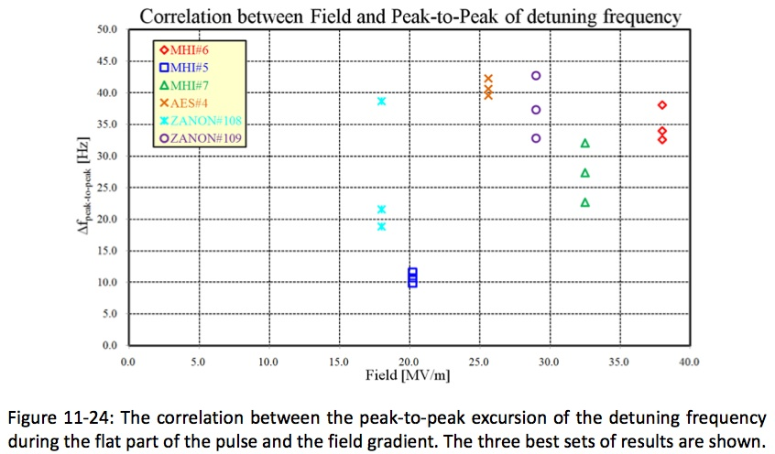
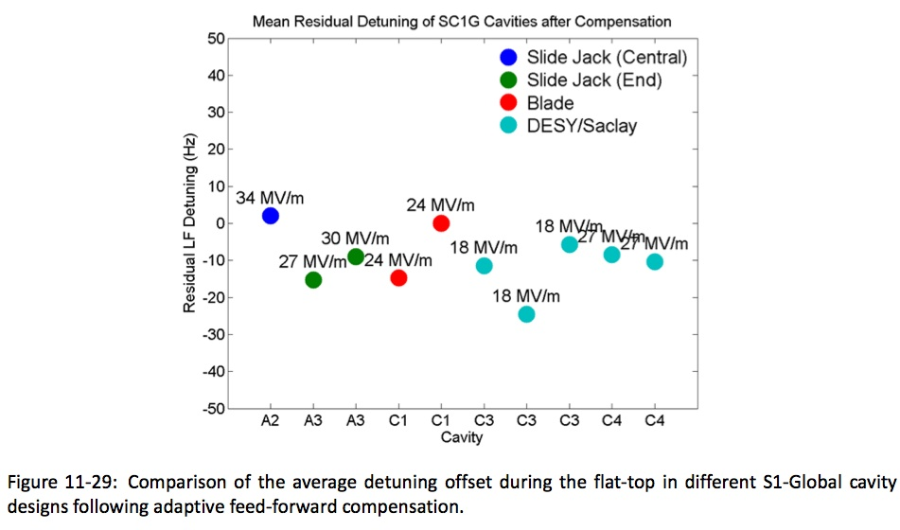
Half-sine wave
compensation
Detuning offset < 50Hz
for every tuner
Adaptive F.F.
compensation
Every tuner worked well.

Slide 6
TDR design choice
Tuner design should keep cavity plug-compatible interface.
flange-to-flange length, support tab interval length,
coupler-to-coupler interval length, etc.
Tuner should work at 31.5MV/m gradient within 50Hz residual detuning.
Tuner should have low-cost.
Blade tuner was selected for TDR design and cost estimation basement
If we can make new design keeping above condition,
it is worth considering and doing R&D.
Adaptation of Saclay Tuner to ILC cavity design was considered.

Slide 7
Length difference between TESLA cavity and ILC cavity
XFEL TESLA-Cavity
FNAL ILC-Cavity
36mm

Slide 8
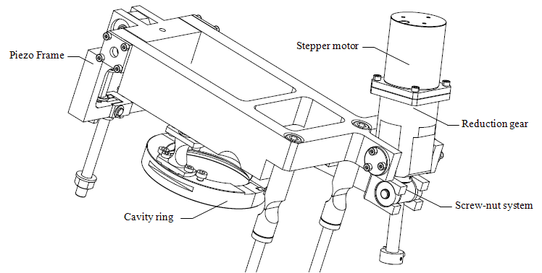
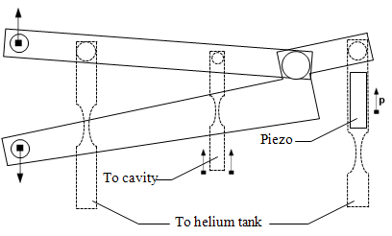
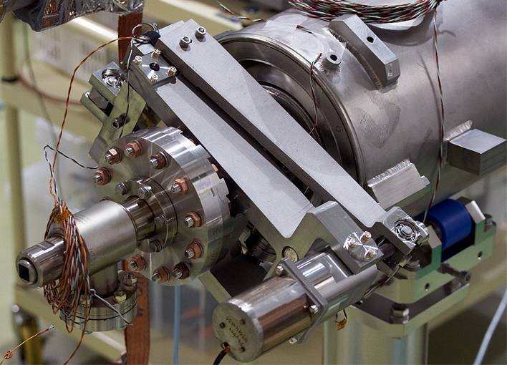
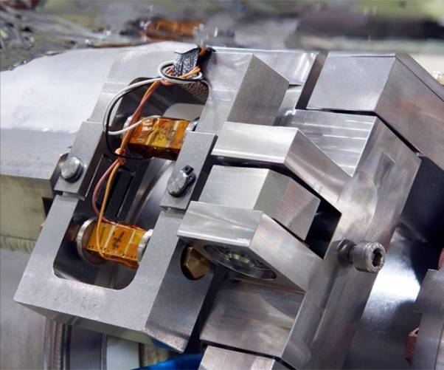
Saclay tuner for TESLA cavity

Slide 9
No interference to other boundary
release
stretch
Modified Saclay tuner design for ILC cavity

Slide 10
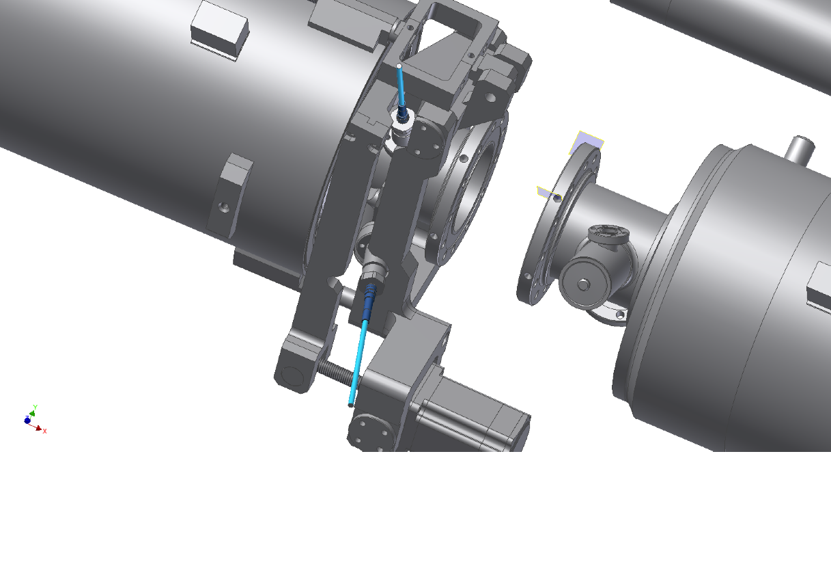
No interference of pickup cables to the tuner arm.
No interference of motor to the next cavity input coupler.
Stiffness is not yet examined, it is worry.

Slide 11
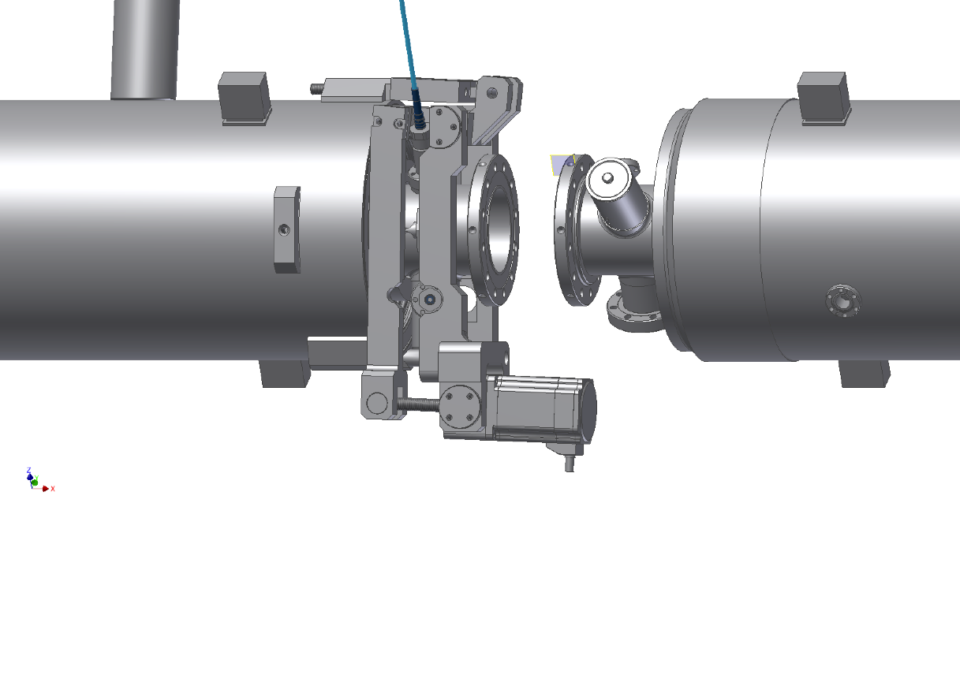
release

Slide 12
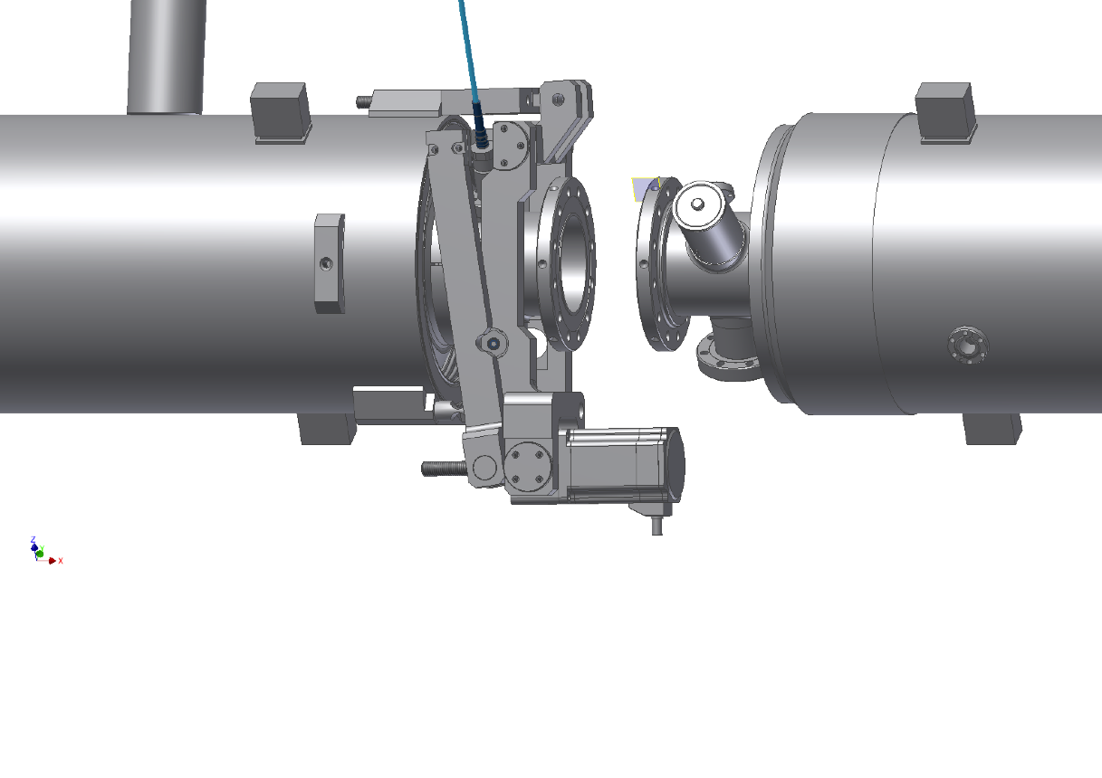
stretch

Slide 13
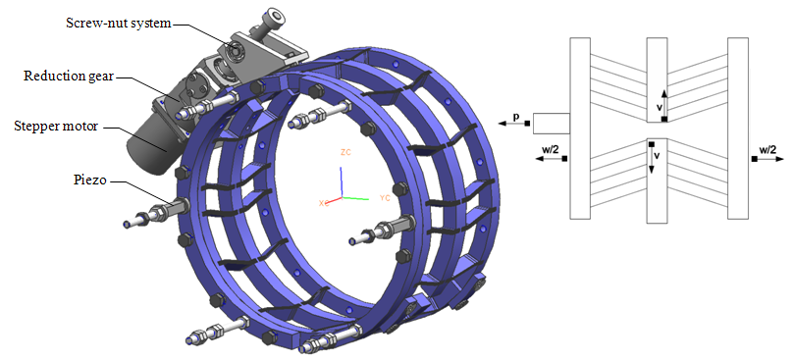
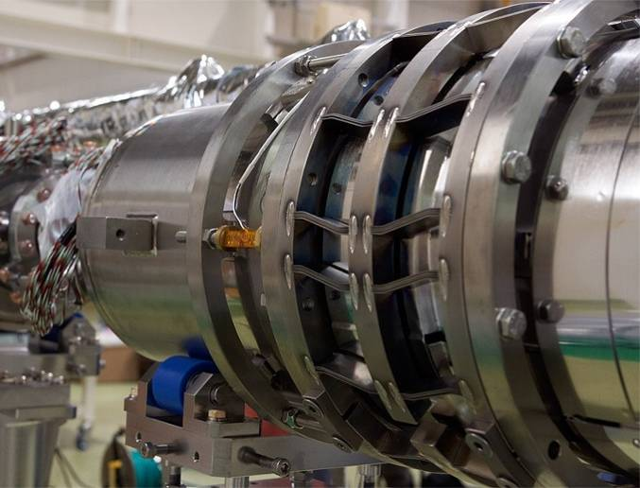
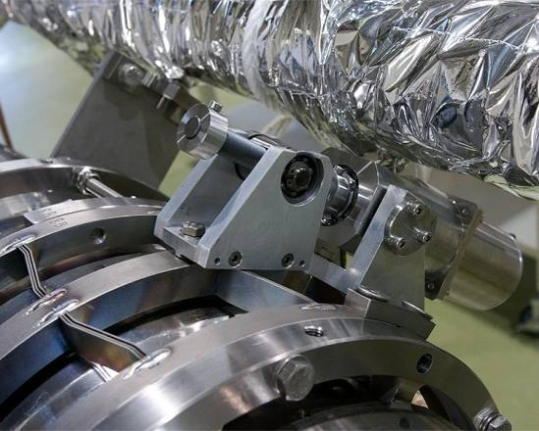
TDR Blade tuner for ILC cavity

Slide 14
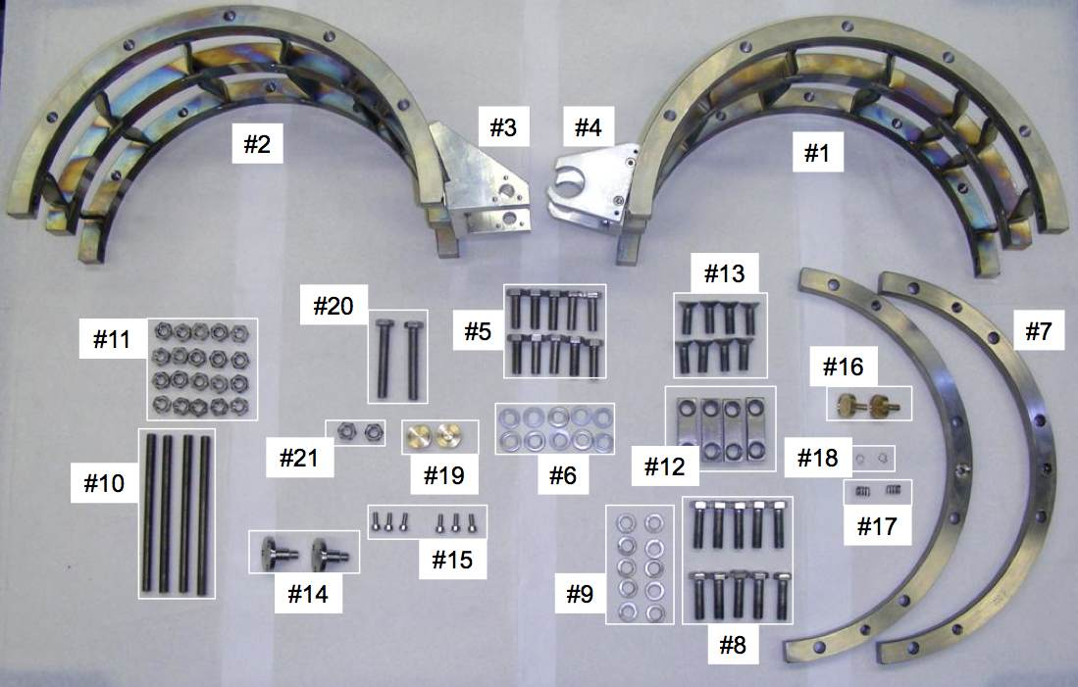
Parts Picture from FNAL installation manual

Slide 15
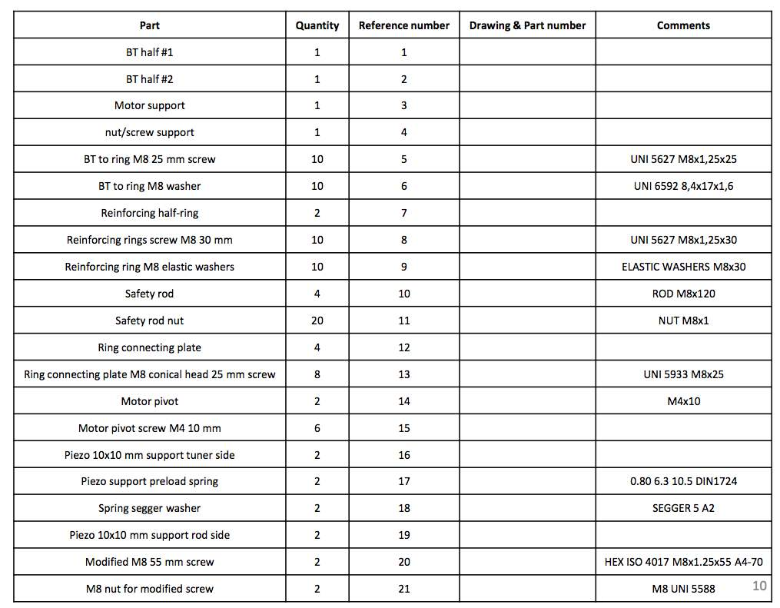
Parts List from FNAL installation manual

Slide 16
In order to make fare cost comparison,
I asked cost estimation to the same company for both of
(1) TDR blade tuner design
(2) Modified Saclay tuner design

Slide 17
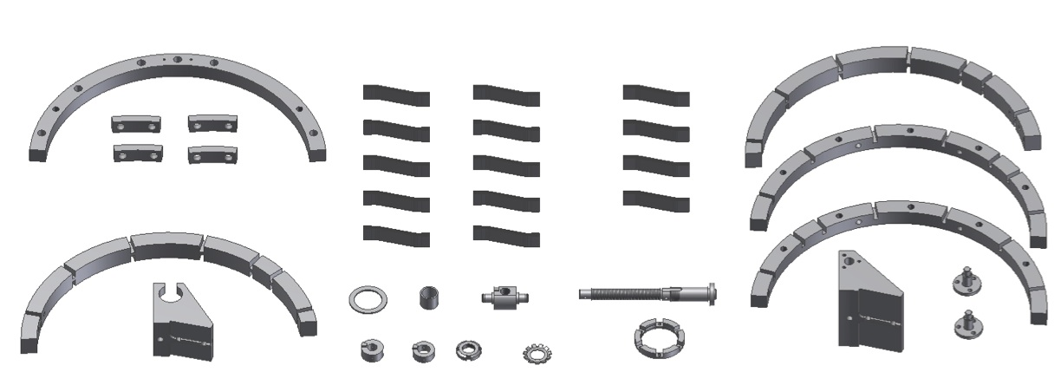
TDR Blade tuner
Components for fabrication
Motor, gear, Bolts and nuts are excluded
36 parts
( sorry, this picture is not correct. The number of parts will be much more.)

Slide 18
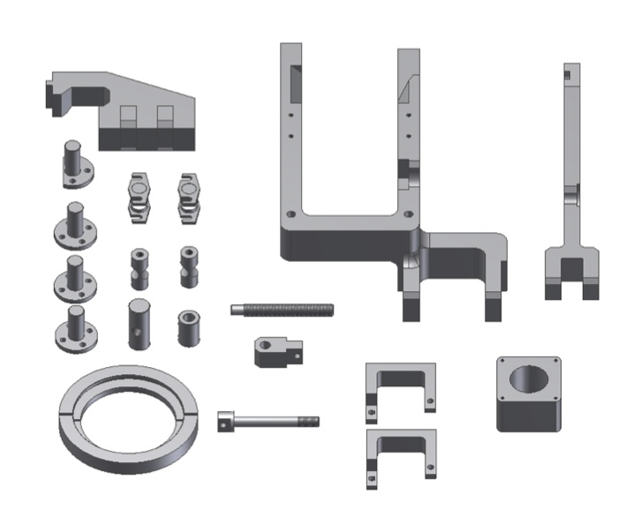
Modified Saclay tuner
Components for fabrication
Motor, gear, Bolts and nuts are excluded
21 parts

Slide 19
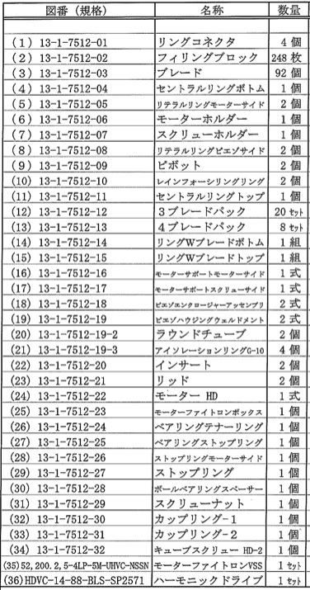
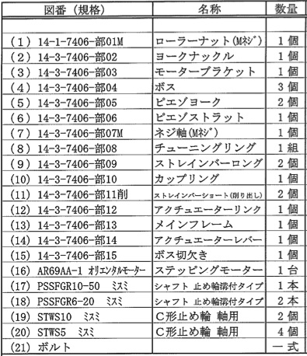
Cost estimation comparison
( Cost = materials + machining + inspection + assembly + company benefit )
TDR Blade tuner design
Modified Saclay tuner design
Component list
Component list
* Motor and harmonic drive are in the both list,
But not included into cost.
Cost (Blade tuner) : (Modified Saclay tuner) = 1 : 0.52

Slide 20
Conclusion
The modified Saclay tuner for ILC cavity was designed.
Their cost was compared to TDR Blade tuner by the one company.
The result was 52% of TDR Blade tuner,
for the mechanical parts fabrication and assembly.
However, the modified Saclay tuner for ILC cavity design
need to be done further study of tuning range, stiffness, toughness, etc.
The R&D is required.

