Slide 1
ILC Start-End Simulations
Glen White, SLAC
May 13, 2014
AWLC14, Fermilab

Slide 2
ILC Start-End Simulations
Form list of all expected “error” sources and generate N (typically ~100) random machine “seeds”
  e.g. magnetic errors, misalignments
  e.g. dynamic errors: ground motion + feedbacks
  e.g. realistic diagnostics performance (BPM scale errors, resolutions…)
Apply all commissioning, tuning and operational measures in as realistic manner as possible using expected input devices with expected performances.
Examine ensemble of results, get a probabilistic picture of what the running state of the entire machine is.
  Especially luminosity.

Slide 3
Why?
Accurate picture of expected luminosity performance of the machine.
  Tuning is a part of the lattice description.
Solid basis for forming tolerance specifications.
Accurately evaluate impact of design changes and choices.
Stored results and infrastructure can form the input of other studies
Limitations:
  Doesn’t cover cases where machine is “broken”, still need to consider capability to diagnose faults.

Slide 4
What to include?
DR?
  Historically not included, usually treat as “source”
  Maybe some benefit in looking at realistic extracted conditions?
RTML
  Bunch-bunch feedback in turn-around?
Linac
  Bunch compression, wakefields, pulse-pulse feedback
BDS/IR
  Including beam-beam simulation for luminosity + beamstrahlung
Extraction line?

Slide 5
Simulation Tools
Many simulation tools exist and have been used in the past
  placet, merlin, lucretia, bmad, ptc/madx…
  Either stand-alone or joined with scripts
Having multiple codes useful (and annoying)
  Have to track down difference in results, can lead to deeper understanding, helps avoid obvious mistakes…
To profit from multiple analysis efforts, useful to define some standards
  Error parameter lists
  Algorithms, including application specifics (e.g. method of adjusting E in DFS).

Slide 6
Work performed in the past
RTML, Linac, BDS studied separately
  Independently defined luminosity growth “budgets”
  Most effort on Linac emittance preservation techniques
Linac+BDS global simulation for RDR performance studies

Slide 7
ILC (RDR-era) S2E Simulations
Lucretia
Linac
  Independently “static” tune 100 seeds
  Pick those that fulfill “emttance growth budget” expectations.
  Apply dynamic errors, tracking through to get wakefields and realistic beam response functions
  Include GM & 5Hz feedbacks
BDS
  Full tuning (BBA, orbit steering etc & FFS tuning with sextupoles).
  Use GUINEA-PIG for beam-beam simulations, track pairs through solenoid to detector.
  BDS 5Hz feedbacks
Intra-pulse effects considered separately.

Slide 8
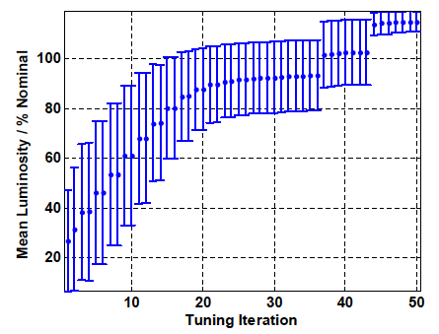
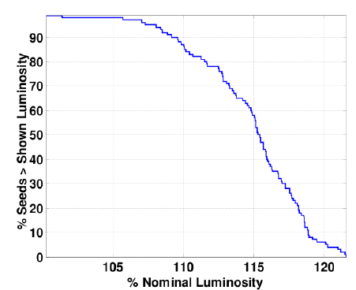
ILC S2E Simulation Results
ILC RDR parameters
Start-end tuning procedure
90% seeds tune with 8% overhead
  Includes pulse-pulse dynamics + FB’s
  Excludes “fast effects” @ IP
Expect ~90% seeds to provide nominal luminosity
  Including IP high-bandwidth feedback for worst possible conditions
Need to update for TDR parameter sets
2-sided simulations
  ILC RDR 2-sided sim: 90% seeds @ 85% lumi
    Needed to expand sim time
Tuning time <1,000 pulses
Tunable with worst-case GM, pessimistic linac behaviour & simplistic correction techniques

Slide 9
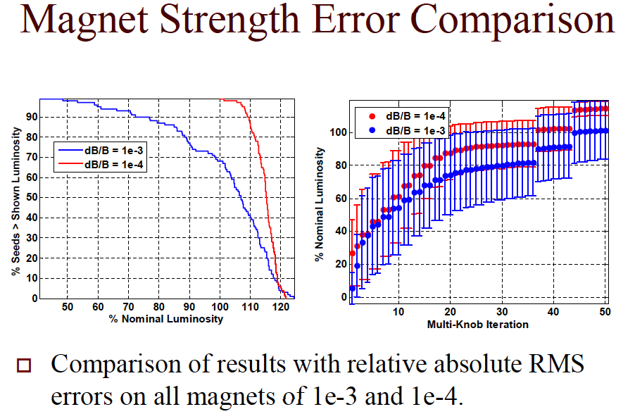

Slide 10
TDR Work
Parameter sets have changed, need to refresh work.
Fully document.
Maintain as an ILC resource
Need to evaluate scope and importance taking into account available resources in immediate future.
  Can image 0.5 – 2+ FTE / year in this effort.

Slide 11
TDR Work
Minimum: (< 6 months)
  BDS-only “static” simulation with full error source list
    All baseline parameter sets, both IR’s
    3 months
  Calculate detailed jitter tolerance of final doublet magnet sets including action of intra-pulse FB
    +1 month
  Detailed list of well-motivated tolerances/ requirements for magnets and diagnostics
    +1 month
Better: +6-12 months
  Include GM + dynamics
  Include Linac
  Intra-pulse dynamics considerations
    Include parameterised effects in S2E simulations
Best: + (?) months
  Include RTML
  Include DR
  Multiple codes

