Slide 1
Issues in ILC Main Linac and Bunch Compressor from Beam dynamics
N. Solyak, A. Latina, K.Kubo

Slide 2
Introduction
From results of large amount of past studies in ML beam dynamics, our conclusion was (and is): No serious problem is expected.
However
  More simulations for emittance preservation in BC is necessary.
  BC + ML combined simulation is necessary for completeness.
  Experimental test of steering correction is desirable.
  How to proceed commissioning has not been studied.
  Our requirements may not be really understood or agreed by groups/people who should be responsible for the hardware e.g., alignment, magnet control, cavity control, , , ,.
    Need to modify some of the requirements, for making them more realistic.
    Coupler kicks in BC

Slide 3
BC emittance growth
Emittance budget is barely satisfied in TDR.
Need more careful studies
E.g. coupler kicks (see later)

Slide 4
BC + ML combined simulations
Most simulations assume beam energy is controllable at the entrance of ML for DFS (DMS).
  Energy control is actually done in BC and should be included in simulations.
  Effects to bunch length?
Difficulty is (was?)
  Most (?) simulation codes do not include relative longitudinal position change.
This can be part of S2E simulations, reported by BDS.

Slide 5
  Experimental test of steering correction
DFS and WFS (Dispersion free steering and wake free steering) experiment at FACET
  Results have not been very satisfactory.
  Need more analysis and simulations. Then, probably further experiments. Possibly by a wider collaboration.
  Though condition is significantly different from ILC BC+ML, this experiment can tell how out simulations are reliable.

Slide 6
Commissioning studies
Strategy?
  What is the incoming beam condition when we want to start commissioning of BC and ML? From upstream to down stream step by step, making good condition in each region (DR, RTML, BC, ML, BDS)? Or go through the whole beam line first and gradually improve all?
Tactics?
  Use single bunch, small number of bunches or long trains?
    Intra-pulse feedback?
No systematic studies so far?

Slide 7
Specifications
Revisit + alpha

Slide 8
Local Alignment Error in ML
Error | RTML and ML Cold | with respect to
Quad Offset | 300 μm | cryo-module
Quad roll | 300 μrad | design
RF Cavity Offset | 300 μm | cryo-module
RF Cavity tilt | 300 μrad | cryo-module
BPM Offset (initial) | 300 μm | cryo-module
Cryomoduloe Offset | 200 μm | design
Cryomodule Pitch | 20 μrad | design
Independent Gaussian Random assumed in evaluation of all errors.
Not based on realistic survey/alignment models.
Distance range up to betatron period, ~ 400 m, is important.
What is the long range alignment method?
Is the “independent random error” assumption good enough?

Slide 9
BPM performance
TDR
Resolution | 5 μm*
Scale Error | <10%*
Attention:
Resolution: Simulations assumed 1 um resolution
→ Need averaging 25
Scale Error: < 3% is desirable.
  For adjusting nonzero vertical dispersion.
  Possibility of calibration using beam should be considered.
  Or, consider optics less sensitive to the error.

Slide 10
Cavity Acc. Voltage Flatness
Cavity tilt (alignemnt) + voltage change cause transverse orbit change
Cavity by cavity Acc. Voltage “Flatness” required
  RF control for individual cavity, not only “Vector Sum”
Tolerance:
  (RMS cavity tilt) x (RMS Flatness) < (300 um) x (1%)
Demonstrated at FLASH (TDR Part I 3.2)
All RF stations can be controlled with this accuracy?
RF control in low energy part of the linac is important.

Slide 11
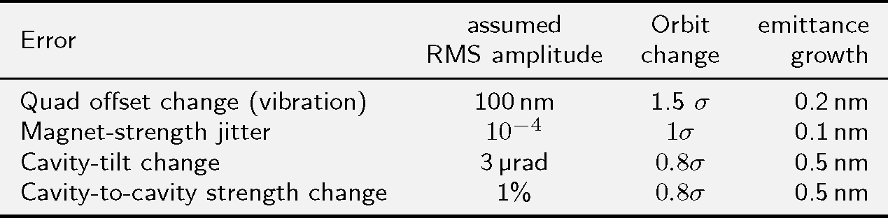
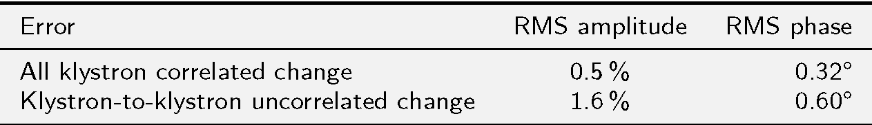
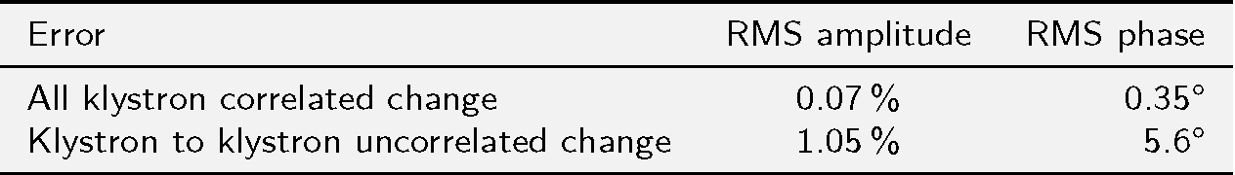
Dynamic Errors (from TDR)
Bunch compressor
Main Linac

Slide 12
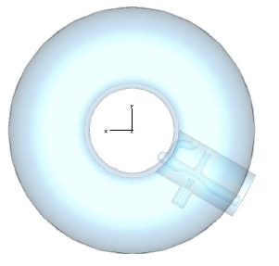
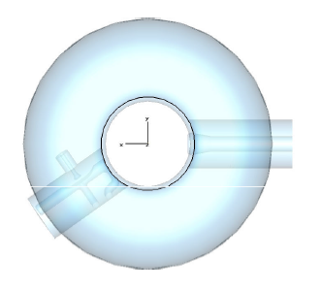
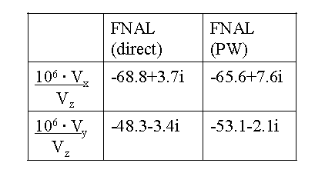
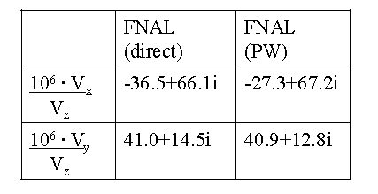
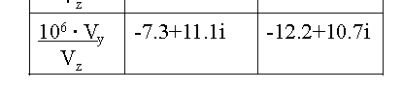
Transverse Coupler Kicks
upstream
downstream
Kicks at Upstream and Downstream mostly cancelled.
Careful design needed???
Vertical total
From slides by V.Yakovlev, in ILC-CLIC Beam Dynamics Workshop, CERN 2009

Slide 13
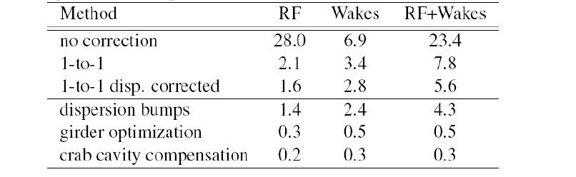
Cryomodule pitch remote control is desirable.
TDR mentions as follows (bol. 3 part II, p130.)
“In addition to the other BBA algorithms, the simulations applied a “girder optimisaton” (or tilting of cryomodules) algorithm to minimize emittance growth to 1.09 nm rms (1.48 for 90% of seeds)”
But this is not explicitly required in TDR.
Simulated Emittance growth in Bunch Compressor
nm
From slides by V.Yakovlev, in ILC-CLIC Beam Dynamics Workshop, CERN 2009

Slide 14
Proposed (used in a simulation)
Cryo-module pitch adjustment
(remote movers)
For better emittance control
Range ~ 0.3 mm
Step ~ 10 micron
All 3 modules in BC1, 4 modules in BC2 (out of 48)
Need response from engineering point of view.
Then, detail should be re-studied

Slide 15
Manpower
Tasks (guesstimated FET x Year)
Beam Dynamics
  Lattice design, including flexible BC (0.5)
  BC emittance simulations including coupler kicks (1)
  BC + ML combined simulations, part of S2E whole machine simulations (1-2)
Beam dynamics + Engineering
  BC cryo-module pitch control engineering (0.5)
  Alignment studies and modeling, probably for whole machine (?)
Experiment
  Beam Based Steering Correction at FACET. (?)
Present manpower is not enough. (for Beam Dynamics)
May be ~1 FTE in 2014 from America ? ~0.1 FTE from Europe ? ~0.2 from Asia ?

