Slide 1
ILC Construction Schedules
For Discussion of the General Assumptions to be used to develop new
Baseline Schedules which are site specific for the Kitakami Site.
Prior to Ground Breaking, T- 0, there is an approximately 4 to 5 year Stage 0 schedule for pre-construction prepared in Japan. Final Design, Environmental Studies, Land Acquisition, International Negotiations, Contract Preparations, etc.
( Insert URL …xxxx.)
The construction and commissioning of a 250 GeV, stage 1 machine, and 2 detectors will be ≈ 9 to 10 years from T- 0. This schedule will be site specific for the Kitakami site and based on earlier work as seen in https://agenda.linearcollider.org/materialDisplay.py?contribId=343&sessionId=15&materialId=slides&confId=5840 This work by Gastal et al, published in May 2013, will be the starting point for the development of the new baseline and identifies many issues that require attention.
The Stage 2 step of completion of 500 GeV capability will occur 2 to 3 years after the start of physics running.

Slide 2
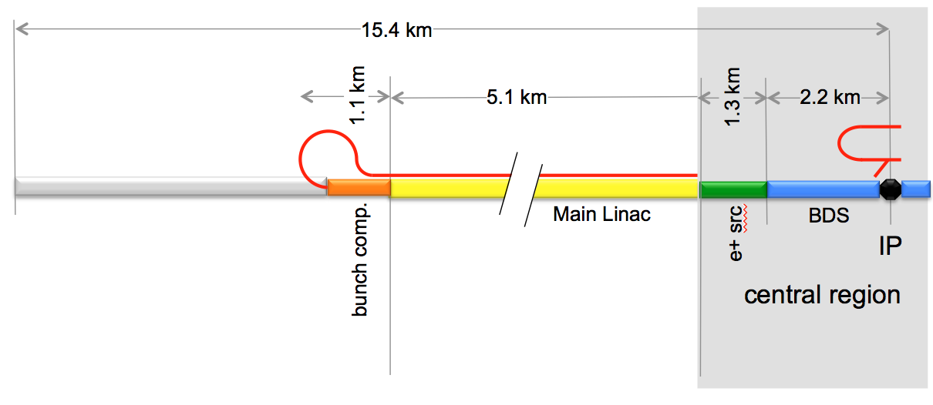
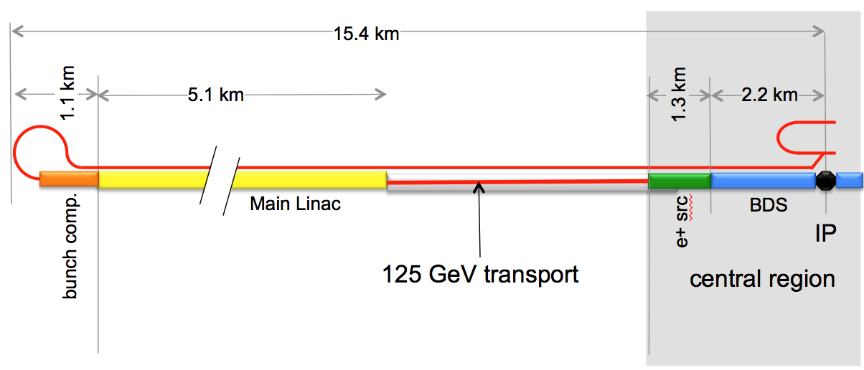
STAGING SCENARIOS
Staging might allow operation for physics at 250 GeV in 9 years from T-0
Staging gives more time for delivery and installation of critical linac components
Scenario 1. Stages both civil and technical system construction and operation.
Scenario 2 has much more flexibility in staging schedule options.
Assumes the Detectors, and Central Region are not on critical path to physics.
Scenario 1, Staged CF’s and Technical Components
Scenario 2, Complete Civil and Staged Technical Options

Slide 3
Proposed Assumptions to be used in developing a Baseline Schedule for an ILC at the Kitakami site
Schedule will cover Pre-construction, Construction, Commissioning, through to operation at 250 GeV and completion of 500 GeV capability.
Schedule will be based on two stages,(≈ 250 and ≈ 500 GeV operation.)
All underground civil construction will be completed in Stage 1.
This allows some variant of Scenario 2 to be implemented with 125 GeV beams being taken from mid linac to the E- BDS and E+ source in temporary transport lines.
All central region systems (Injectors, DR’s, E+ Source, BDS, RTML) are complete and at 500 GeV specification in Stage 1.
Schedules (compatible with 5) for the construction of SiD/ILD detectors in Stage 1 can be developed.
Work on installation of systems in the RF Source side of the Linac tunnel will continue during 250 GeV operation.
After ≈ 2 years? there will be a single shutdown, (≤ 12 but ≥ 3 months,) to complete the linac systems to 500 GeV operational capability.
Installation and commissioning of cryoplants and other infrastructure in Access Halls does not interfere with other installation schedules.

Slide 4
QUESTIONS
There are many more open questions on logistics, availability of components, storage of components, scheduling conflicts in access tunnels, commissioning, that need to be incorporated in any new baseline schedule, but we need a starting point.
Can we produce ( from existing schedules) a possible integrated schedule for the Central Region, including Detector and DR Construction, that we can use to study the Access Tunnel traffic issue? We need to convince ourselves, and others, that there are solutions. We have experience with installation rates in other accelerator tunnels but not with this complexity. Perhaps some modification of access tunnels in this region could alleviate this concern.
Can we produce some answers and a draft baseline schedule for review and discussion at LCWS 14 in May at FNAL?

Slide 5
Comments from CFS
From meeting on 1/21/14

Slide 6
Additional Slides for Reference
Latest Schedule
Standard access hall
IR Hall and Tunnels
Pre-construction Activities, LHC

Slide 7
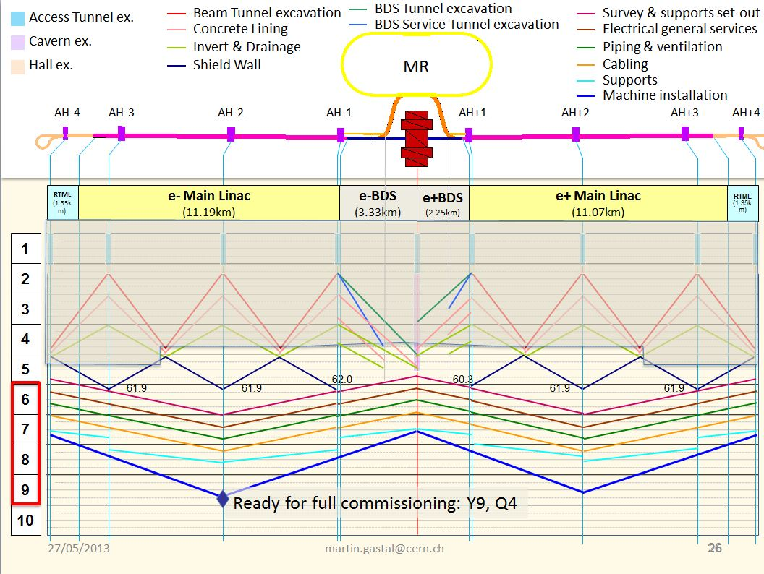
Schedule as of May 2013 @ DESY

Slide 8
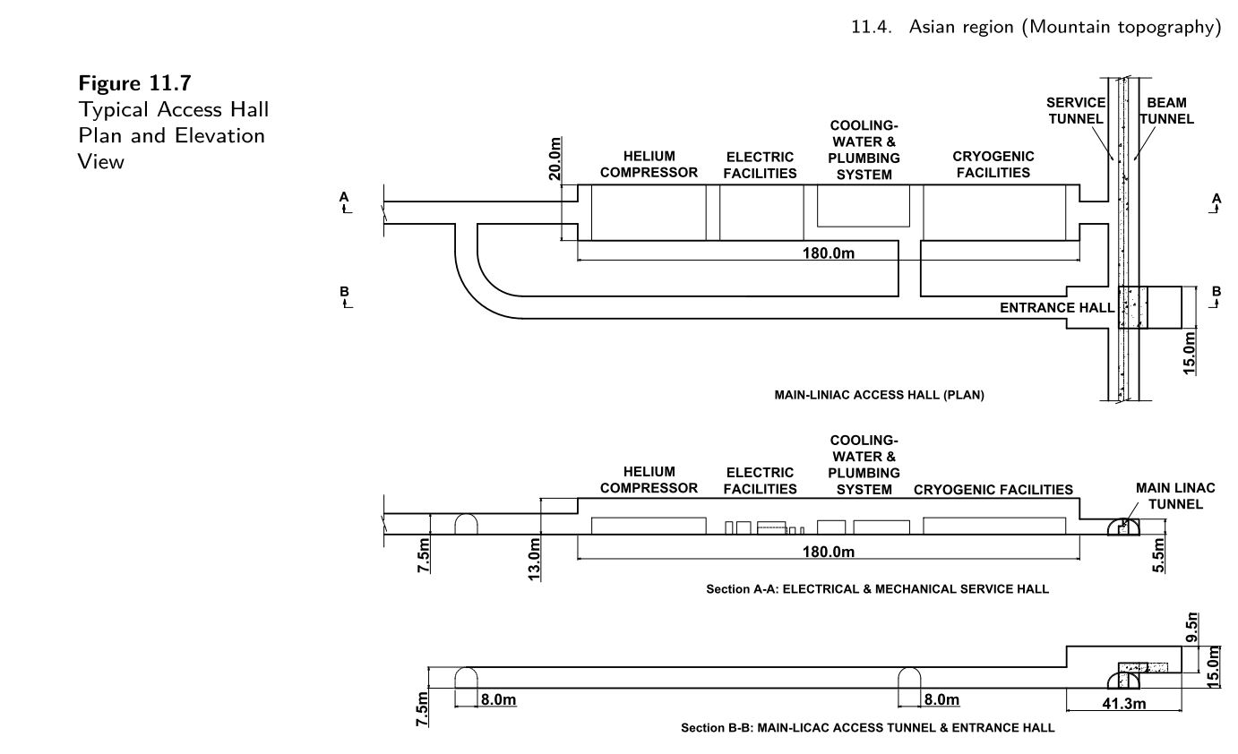
Access Hall

Slide 9
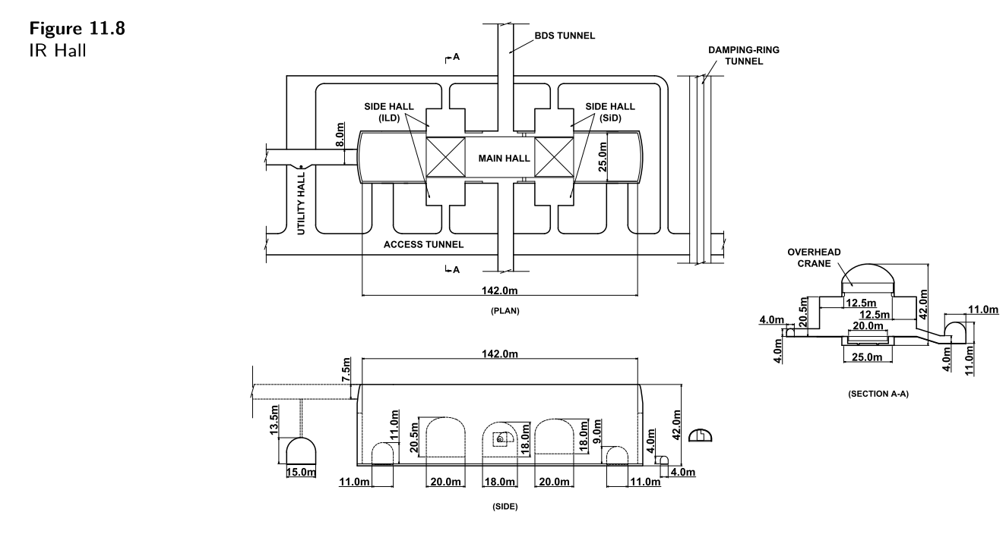

Slide 10
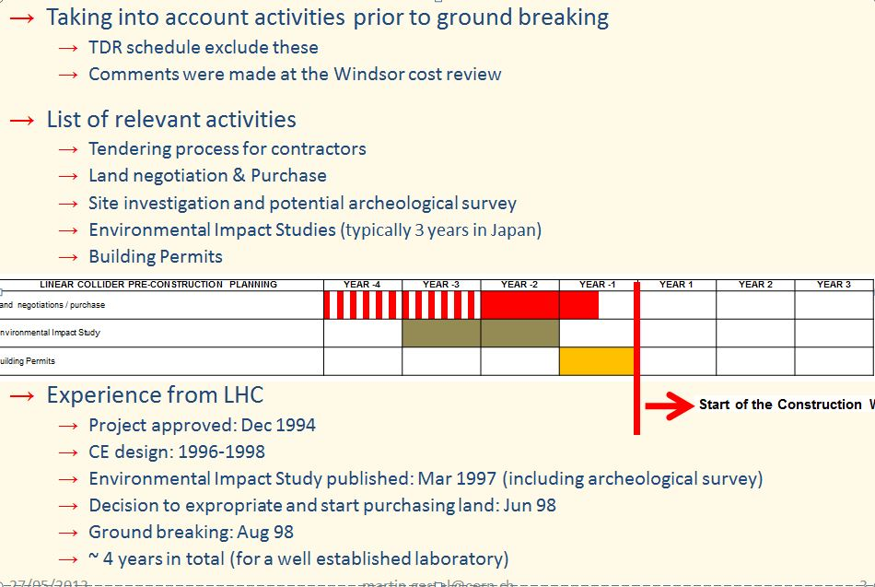
From TDR

