Slide 1
Preliminary feedback results
N. Blaskovic

Slide 2
Contents
Feedback run 1 characteristics:
  K1, K2 coupled loop feedback
  Monitored at P2, P3, MFB1FF
Plots presented here:
  Feedback on/off histograms
  BPM-to-BPM correlations
  Bunch-to-bunch correlations
  Phase advance
  Feedback on/off propagation to MFB1FF
N. Blaskovic

Slide 3
Notes
LO phase correction
  Stripline phase shifters used for online LO phase correction at P2, P3
  Offline LO phase correction used at MFB1FF using phase sensitivity from LO scan
Calibration constant of -0.0025/um assumed for all 3 stripline BPMs
N. Blaskovic

Slide 4
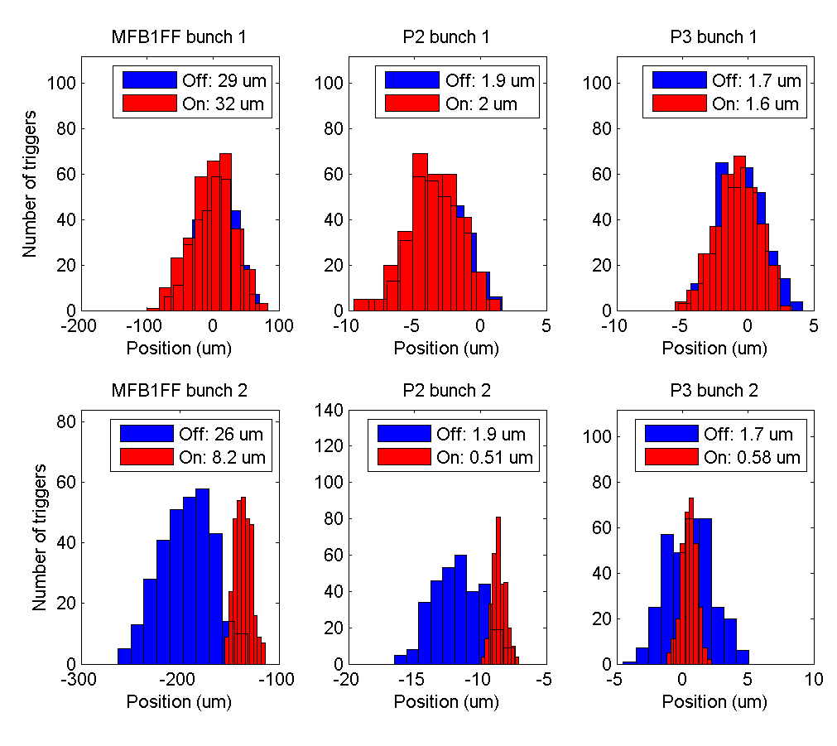
fbRun1
N. Blaskovic

Slide 5
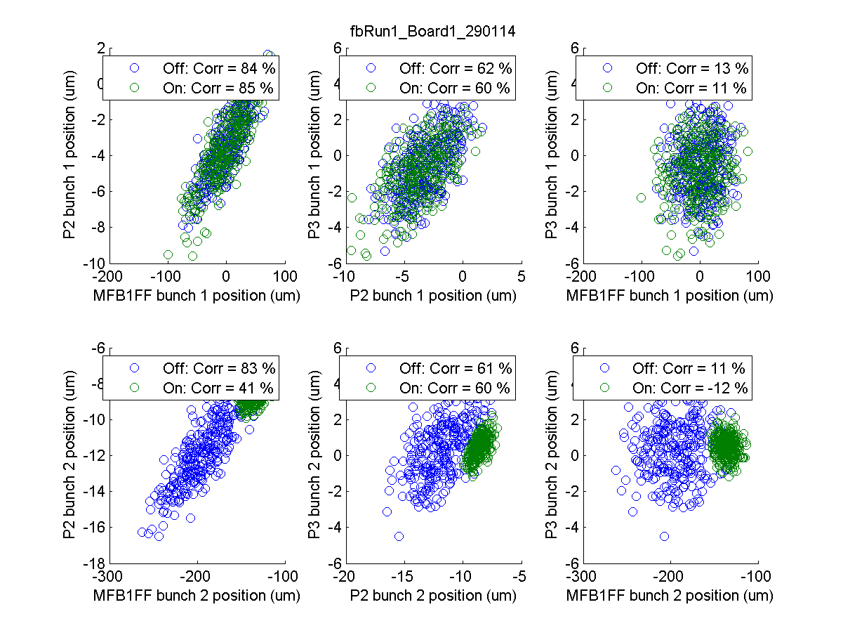
fbRun1
N. Blaskovic

Slide 6
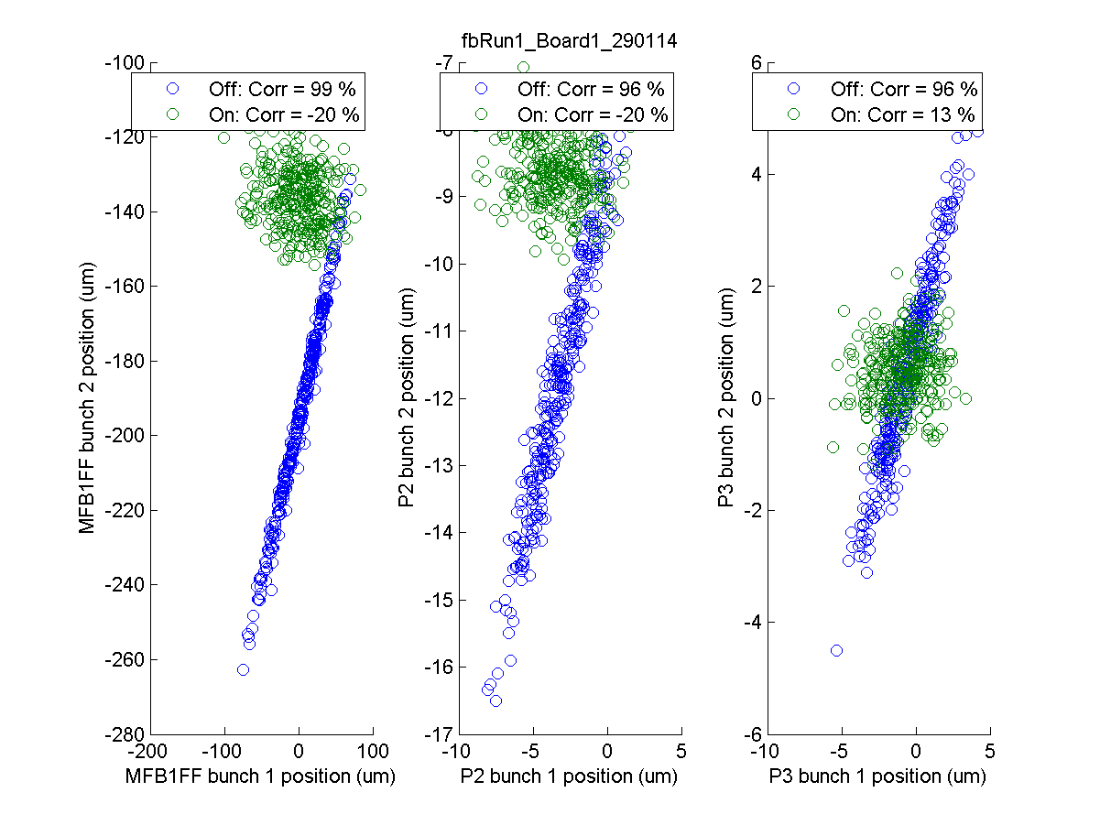
fbRun1
N. Blaskovic

Slide 7
Phase advance
Phase almost unchanged since November
BPM | Phase advance relative to P2 (°)
 | setfile set13nov29_1013 | setfile set14jan29_0131
P2 | 0 | 0
P3 | 18 | 18
MFB1FF | 349 | 348
N. Blaskovic

Slide 8
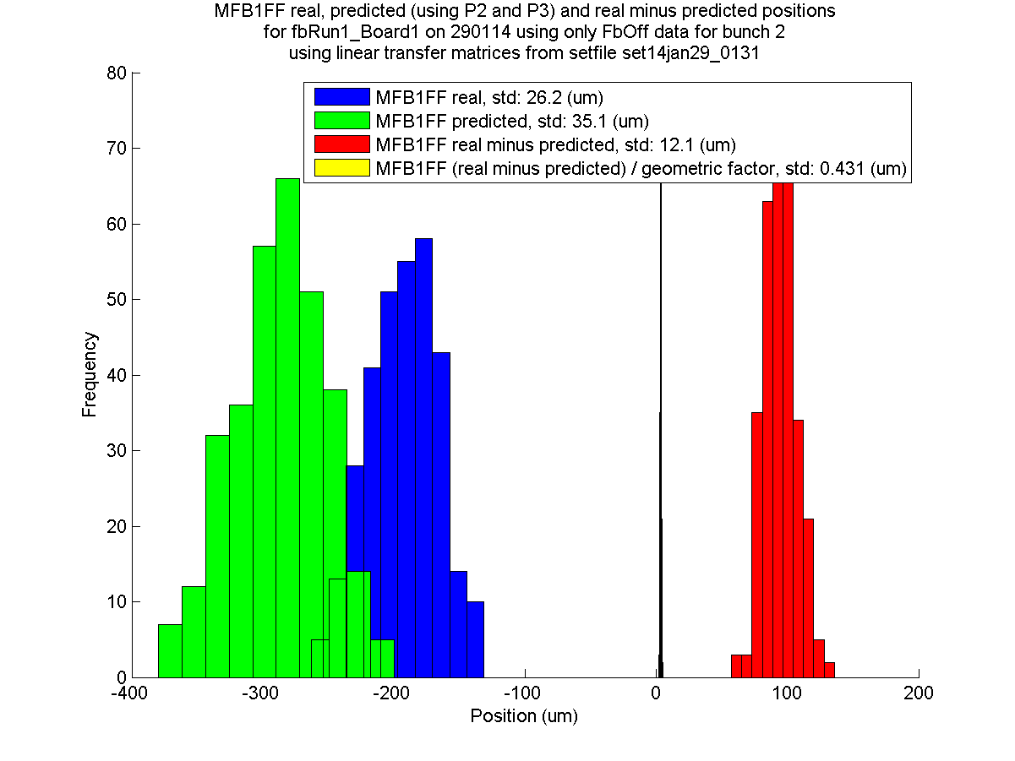
fbRun1
FbOff
N. Blaskovic

Slide 9
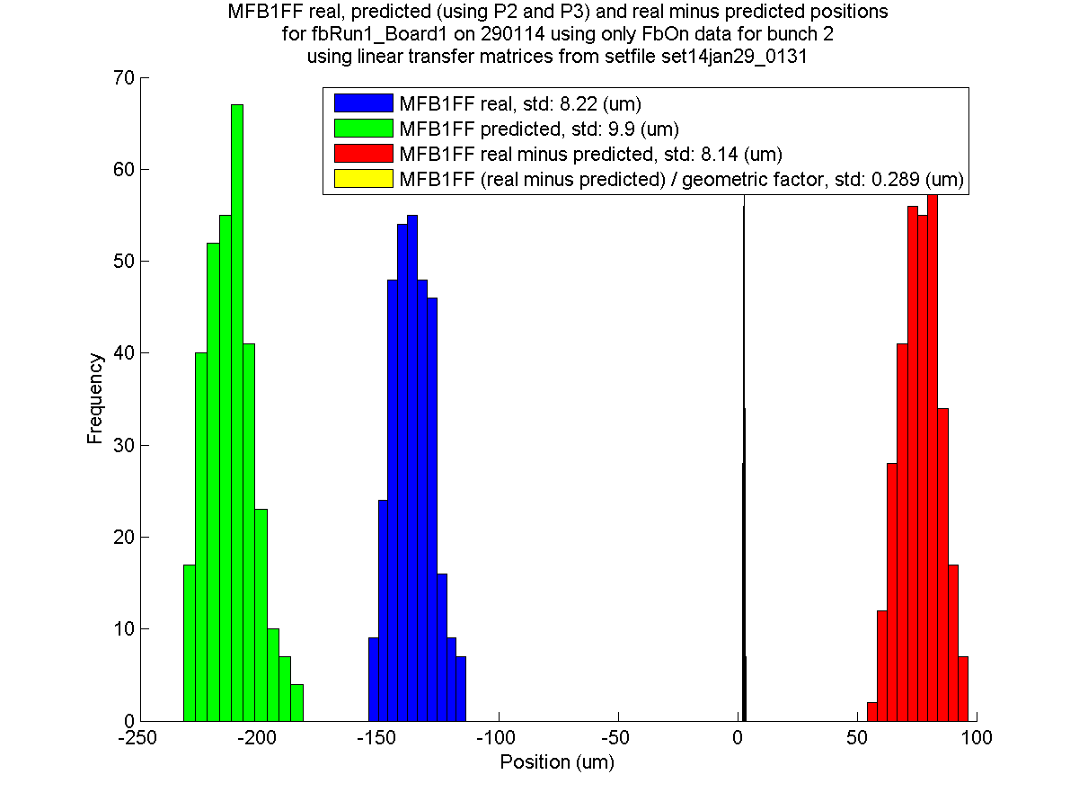
fbRun1
FbOn
N. Blaskovic

Slide 10
Appendix
Phase sensitivity plots
(loPhase3)

Slide 11
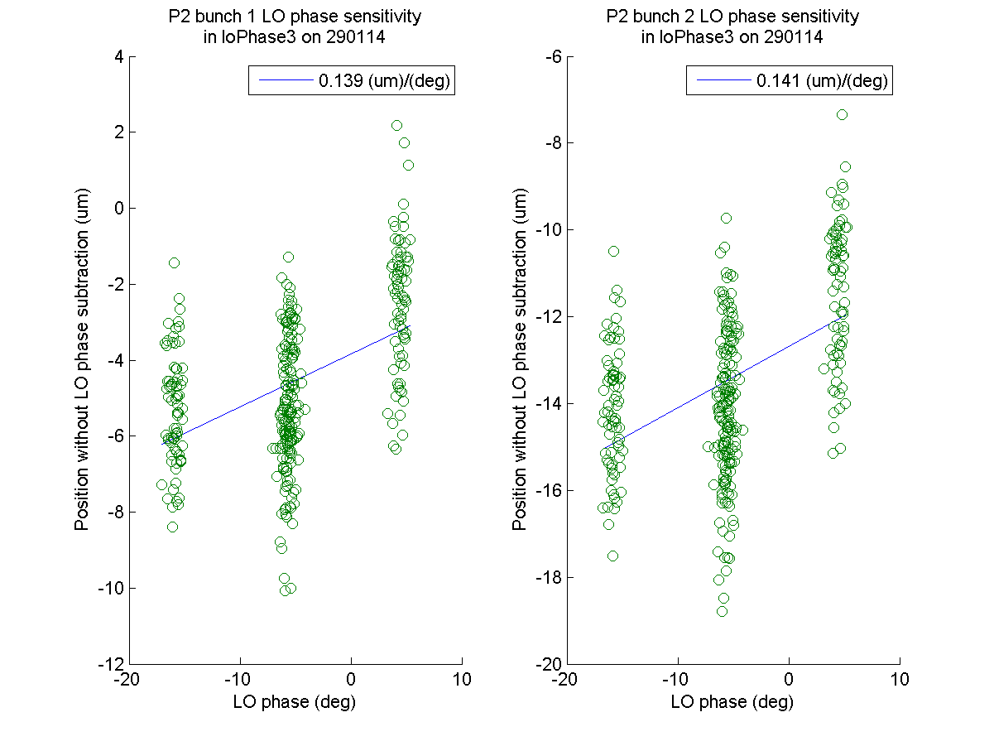
N. Blaskovic

Slide 12
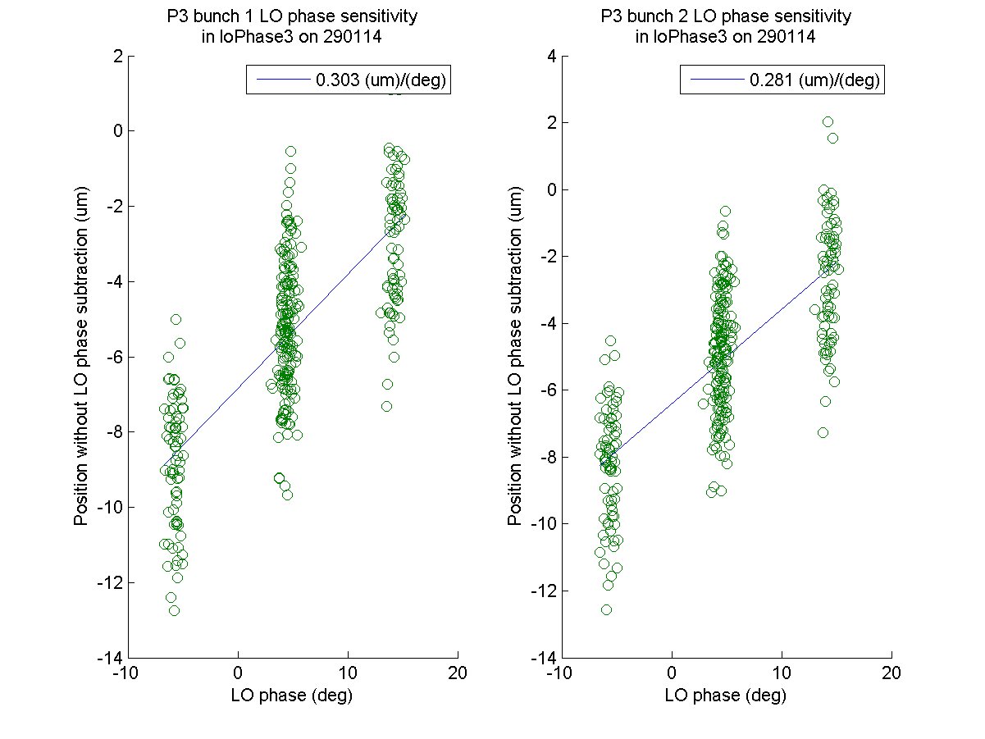
N. Blaskovic

Slide 13
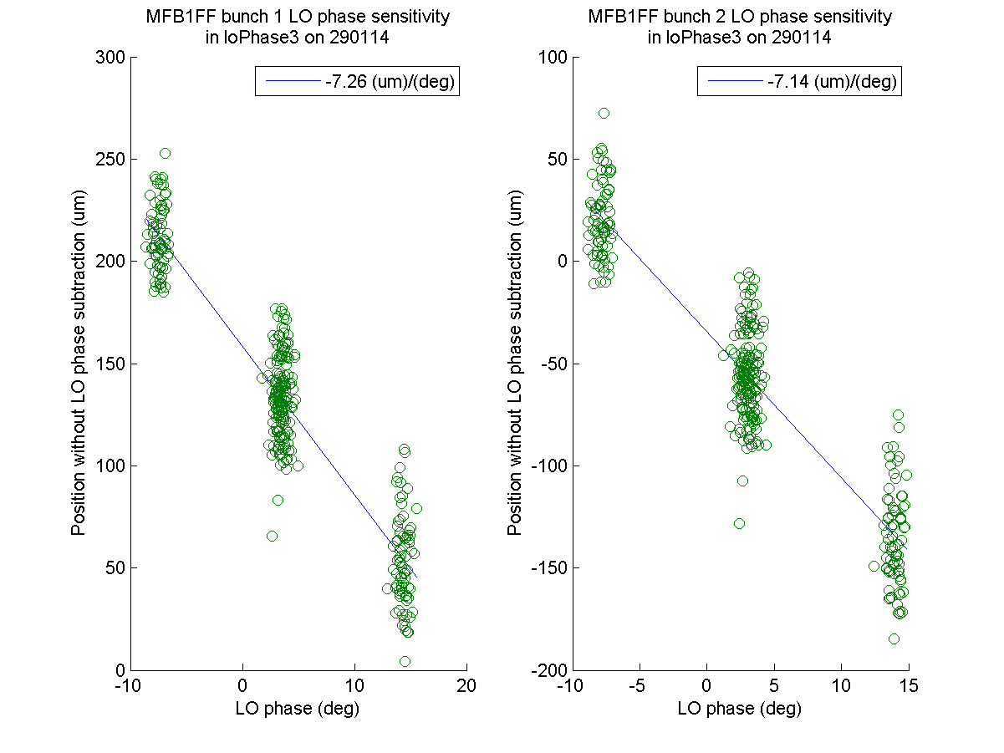
N. Blaskovic

