Slide 1
Summary of FONT Studies
Jan 2014
D. R. Bett

Slide 2
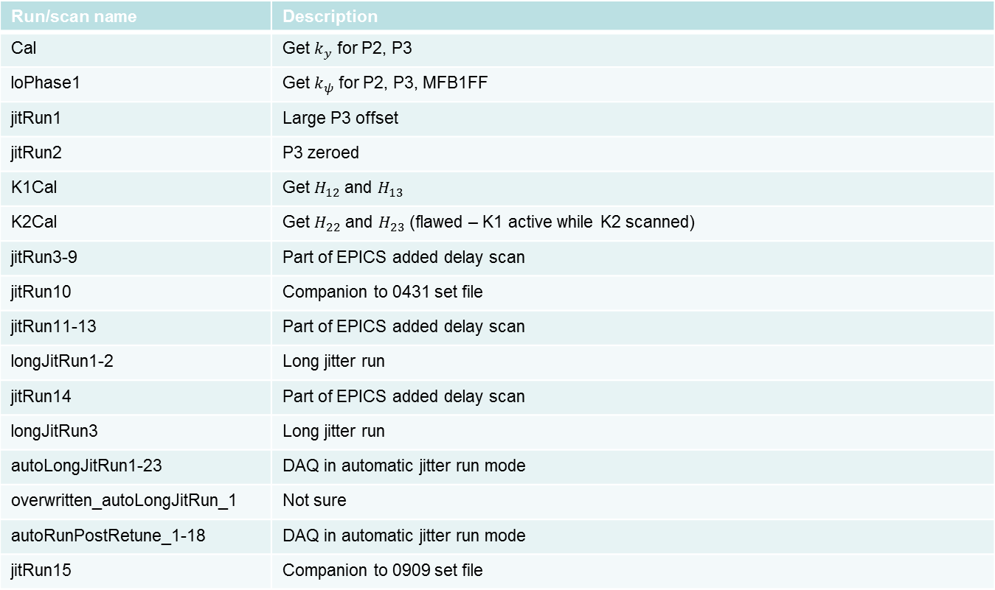
Shift 1 – 23/01/14
Run/scan name | Description
Cal | Get $k_{y}$ for P2, P3
loPhase1 | Get $k_{ψ}$ for P2, P3, MFB1FF
jitRun1 | Large P3 offset
jitRun2 | P3 zeroed
K1Cal | Get $H_{12}$ and $H_{13}$
K2Cal | Get $H_{22}$ and $H_{23}$ (flawed – K1 active while K2 scanned)
jitRun3-9 | Part of EPICS added delay scan
jitRun10 | Companion to 0431 set file
jitRun11-13 | Part of EPICS added delay scan
longJitRun1-2 | Long jitter run
jitRun14 | Part of EPICS added delay scan
longJitRun3 | Long jitter run
autoLongJitRun1-23 | DAQ in automatic jitter run mode
overwritten_autoLongJitRun_1 | Not sure
autoRunPostRetune_1-18 | DAQ in automatic jitter run mode
jitRun15 | Companion to 0909 set file

Slide 3
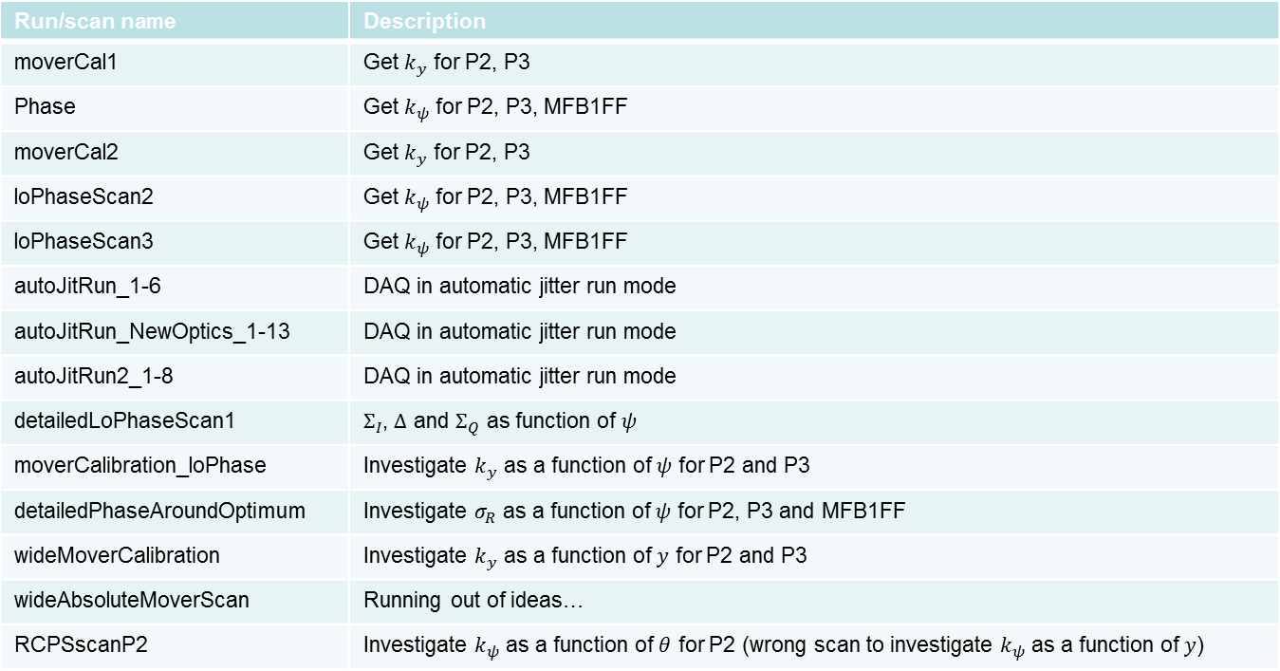
Shift 2 – 24/01/14
Run/scan name | Description
moverCal1 | Get $k_{y}$ for P2, P3
Phase | Get $k_{ψ}$ for P2, P3, MFB1FF
moverCal2 | Get $k_{y}$ for P2, P3
loPhaseScan2 | Get $k_{ψ}$ for P2, P3, MFB1FF
loPhaseScan3 | Get $k_{ψ}$ for P2, P3, MFB1FF
autoJitRun_1-6 | DAQ in automatic jitter run mode
autoJitRun_NewOptics_1-13 | DAQ in automatic jitter run mode
autoJitRun2_1-8 | DAQ in automatic jitter run mode
detailedLoPhaseScan1 | $Σ_{I}$, $Δ$ and $Σ_{Q}$ as function of $ψ$
moverCalibration_loPhase | Investigate $k_{y}$ as a function of $ψ$ for P2 and P3
detailedPhaseAroundOptimum | Investigate $σ_{R}$ as a function of $ψ$ for P2, P3 and MFB1FF
wideMoverCalibration | Investigate $k_{y}$ as a function of $y$ for P2 and P3
wideAbsoluteMoverScan | Running out of ideas…
RCPSscanP2 | Investigate $k_{ψ}$ as a function of $θ$ for P2 (wrong scan to investigate $k_{ψ}$ as a function of $y$)

Slide 4
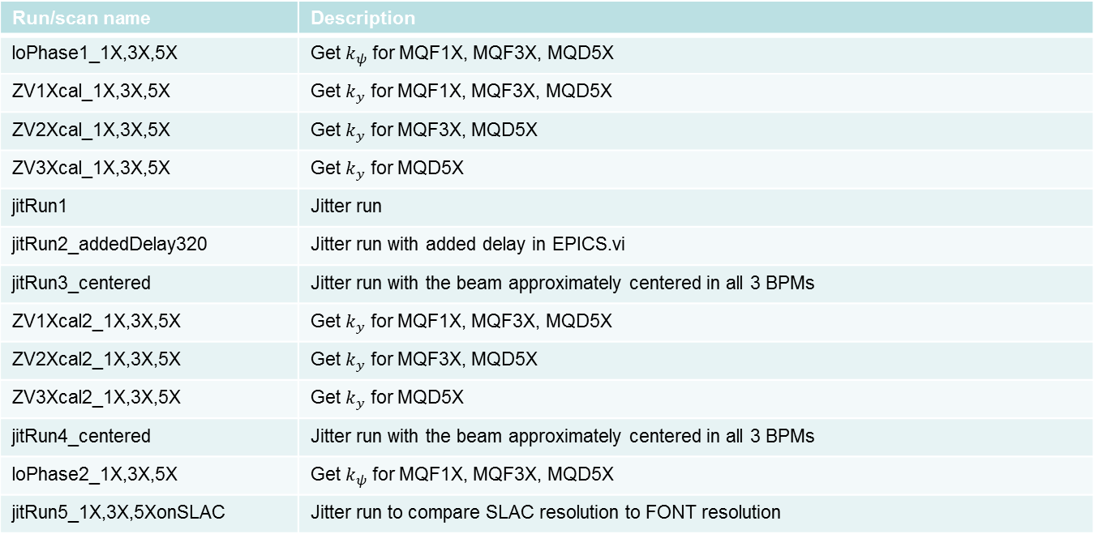
Shift 3(i) – 29/01/14
Run/scan name | Description
loPhase1_1X,3X,5X | Get $k_{ψ}$ for MQF1X, MQF3X, MQD5X
ZV1Xcal_1X,3X,5X | Get $k_{y}$ for MQF1X, MQF3X, MQD5X
ZV2Xcal_1X,3X,5X | Get $k_{y}$ for MQF3X, MQD5X
ZV3Xcal_1X,3X,5X | Get $k_{y}$ for MQD5X
jitRun1 | Jitter run
jitRun2_addedDelay320 | Jitter run with added delay in EPICS.vi
jitRun3_centered | Jitter run with the beam approximately centered in all 3 BPMs
ZV1Xcal2_1X,3X,5X | Get $k_{y}$ for MQF1X, MQF3X, MQD5X
ZV2Xcal2_1X,3X,5X | Get $k_{y}$ for MQF3X, MQD5X
ZV3Xcal2_1X,3X,5X | Get $k_{y}$ for MQD5X
jitRun4_centered | Jitter run with the beam approximately centered in all 3 BPMs
loPhase2_1X,3X,5X | Get $k_{ψ}$ for MQF1X, MQF3X, MQD5X
jitRun5_1X,3X,5XonSLAC | Jitter run to compare SLAC resolution to FONT resolution

Slide 5
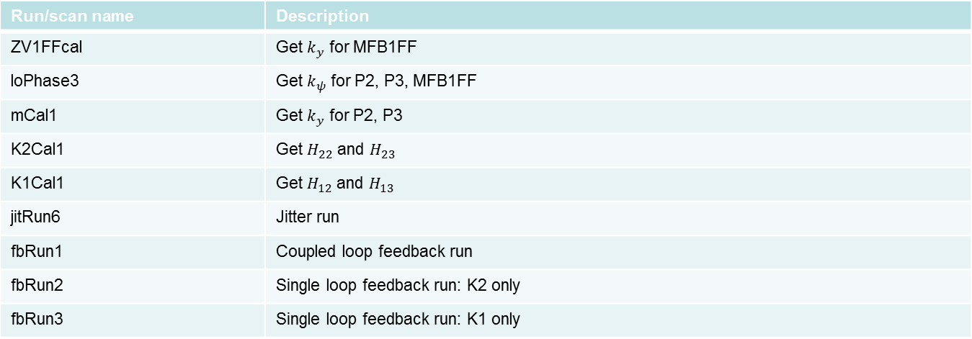
Shift 3(ii) – 29/01/14
Run/scan name | Description
ZV1FFcal | Get $k_{y}$ for MFB1FF
loPhase3 | Get $k_{ψ}$ for P2, P3, MFB1FF
mCal1 | Get $k_{y}$ for P2, P3
K2Cal1 | Get $H_{22}$ and $H_{23}$
K1Cal1 | Get $H_{12}$ and $H_{13}$
jitRun6 | Jitter run
fbRun1 | Coupled loop feedback run
fbRun2 | Single loop feedback run: K2 only
fbRun3 | Single loop feedback run: K1 only

