Slide 1
LCC/ILC Cavity & Cryomodule R&D prospects
H. Hayano 01282014 @ILC-fuze meeting

Slide 2
Cavity R&D Item list
(1) Production
TESLA cavity : XFEL Gradient Yield, cost-effective fabrication
large-grain material
LL cavity shape
Hydro-forming fabrication
Laser Beam Welding fabrication
(2) Surface treatment
EP : Vertical-EP, Bi-polar EP, EP with He-Jacket
CBP with no chemical
N₂ treatment, thermal cycling for High-Q
(3) Cavity Testing
multi-cavities package test facility
(4) New technology
Thin-film coating for more high gradient
(5) Tuner : cost-effective design
(6) Coupler : copper plating technology, cost-effective design
(7) Magnetic shield : cost-effective design
(8) HOM pickup feed-through : for non-heating in vertical test(CW)
(9) High-pressure-vessel code : import/export

Slide 3
Cryomodule R&D Item list
(1) Production
Gradient Degradation : assembly procedure in clean-room,
contaminations from couplers (coupler rinse process?)
from vacuum seal, bolts & nuts, beam-pipe bellows
cost-effective design: 5K shield removal
thermal (heat load) design check
Earth-quake resistant design
(2) Alignment
Procedure of cavity chain connection in clean room
Procedure after GRP hanging
Procedure after cold-mass insertion into vacuum vessel
WPM, Laser base alignment detection, vibration detection
beam induced HOM-base alignment detection
(3) Magnets
conduction cooled magnet R&D
(4) BPM
re-entrant BPM R&D
(5) Waveguide
cost-effective WG design, cryomodule attaching design

Slide 4
Current R&D highlights

Slide 5
ILC (>28MV/m)
~65%

Slide 6
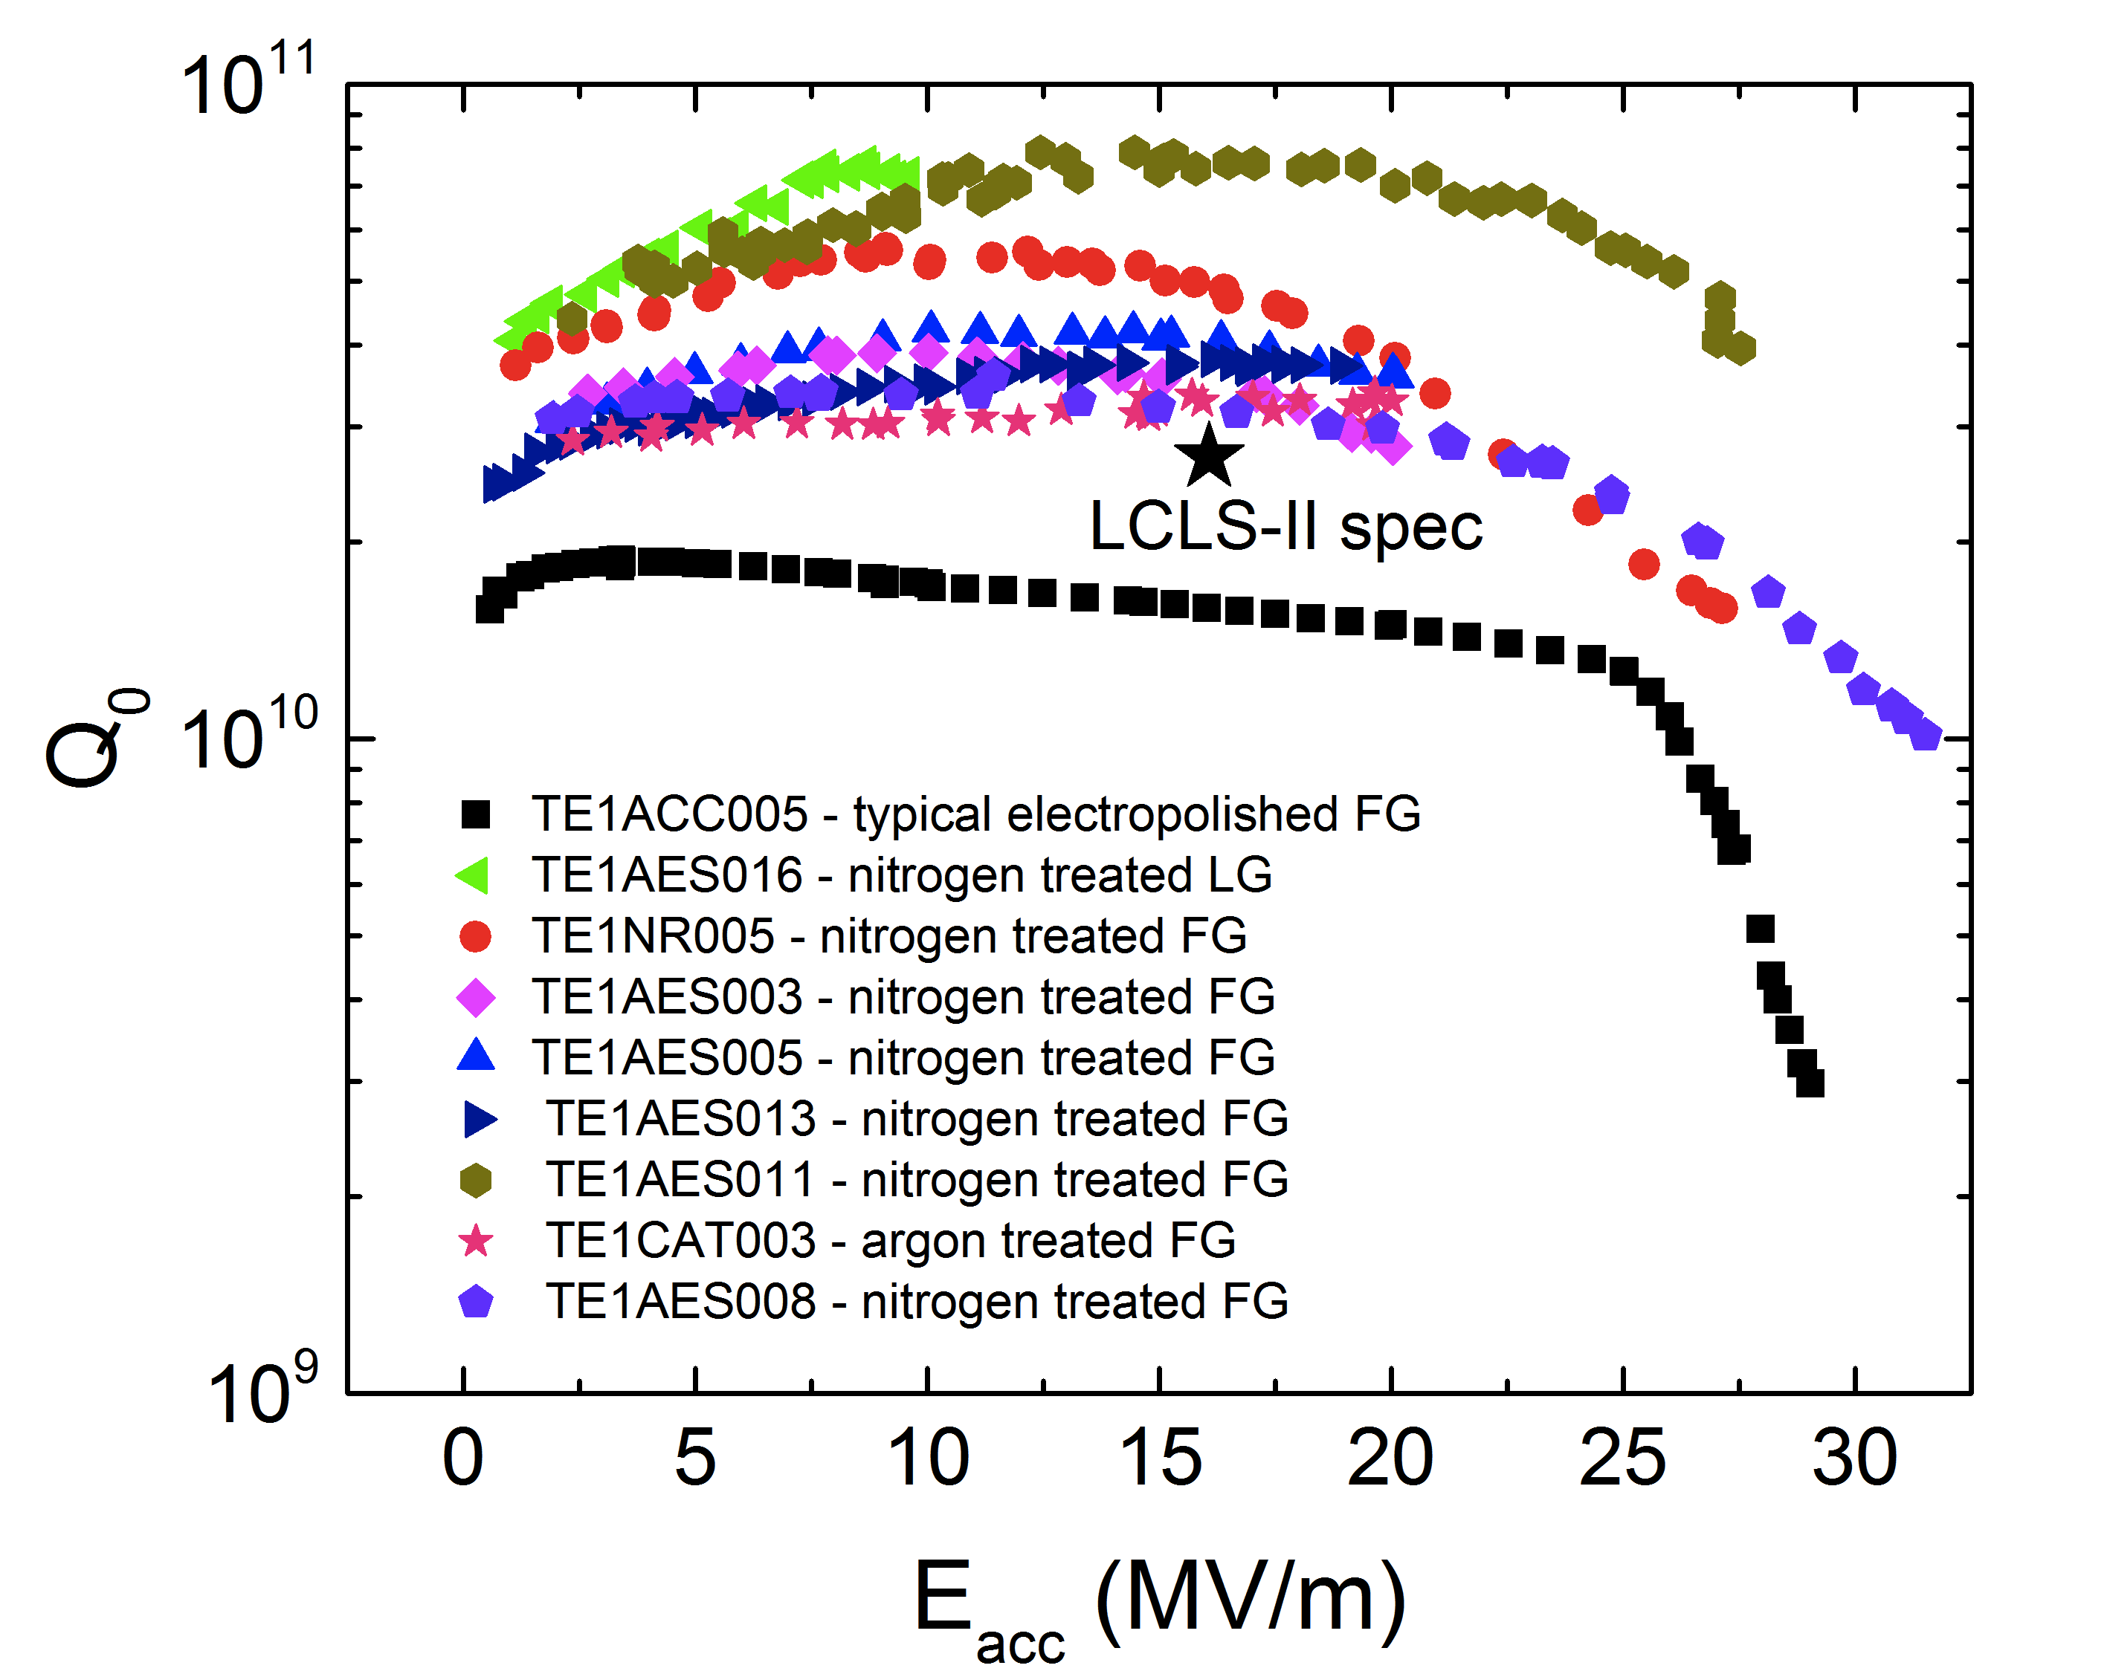
High Q₀ by Nitrogen treatment
Anna Grassellino (FNAL)

Slide 7
VEP effort world-wide
*KEK started VEP R&D in 2012 with Marui-co.
VEP test stand is under fabrication.

Slide 8
HF-free EP effort

Slide 9
CBP+EP effort world-wide
JLAB
FNAL
DESY

Slide 10
Large-grain, Low-Loss shape effort world-wide (esp. Jlab effort here)

Slide 11
Remarks of Rongli Geng at IWLC2010

Slide 12
T. Tajima

Slide 13
R&D during ILC preparation

Slide 14
Hayano’s Prospect before year Zero
(1) Continuous Cost-reduction effort
Cavity fabrication: fine-blanking, press-forming, hydro-forming, etc
multi-work EBW, LBW replace, etc
low-RRR Nb material, large-grain ingot-slice, etc
Power coupler fabrication: cost-effective design
Tuner fabrication: cost-effective design
(2) Time & Cost-effective Cavity-Cryomodule Assembly/Process/Test
Feedback from XFEL cavity & Cryomodule work
to LCLS2 test facilities, and to KEK COI-facility
Application of high-Q surface process, less danger acid EP, acid-free process,
vertical EP, etc
Develop RF process-free coupler, no-contamination coupler
(3) Toward 1TeV upgrade
Surface analysis instruments for field-emission-free surface
Develop LL-shape (high R/Q) high gradient cavity
Develop Thin-film coating technology
End of slide

