Slide 1
Summary of FONT Studies
Jan 2014
D. R. Bett

Slide 2
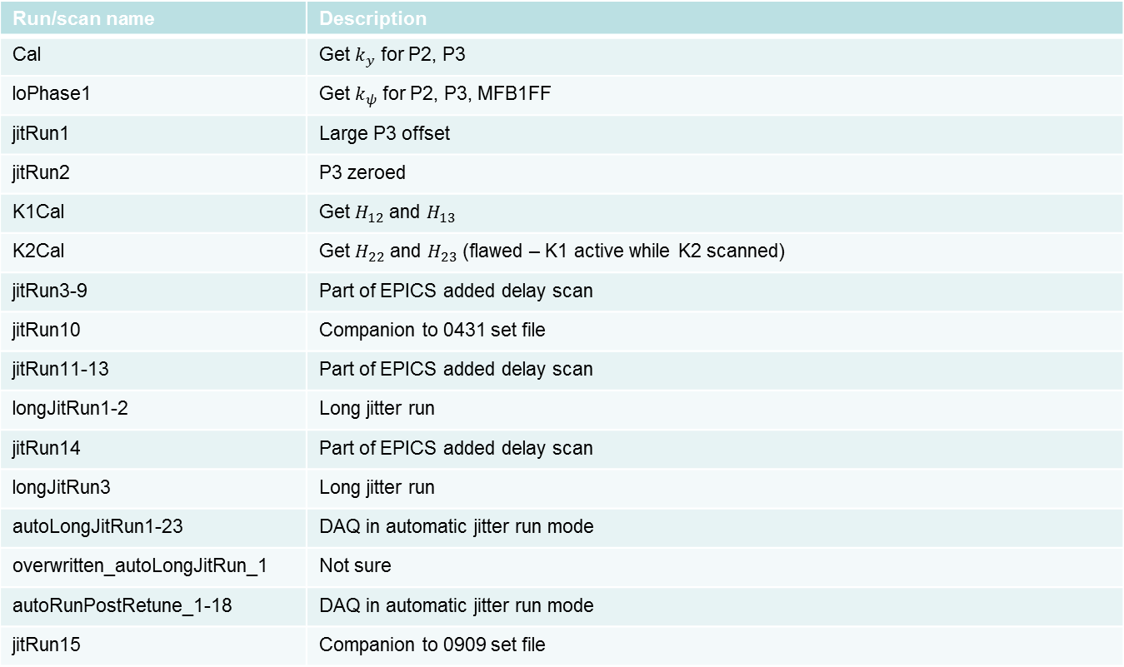
Shift 1 – 23/01/14
Run/scan name | Description
Cal | Get $k_{y}$ for P2, P3
loPhase1 | Get $k_{ψ}$ for P2, P3, MFB1FF
jitRun1 | Large P3 offset
jitRun2 | P3 zeroed
K1Cal | Get $H_{12}$ and $H_{13}$
K2Cal | Get $H_{22}$ and $H_{23}$ (flawed – K1 active while K2 scanned)
jitRun3-9 | Part of EPICS added delay scan
jitRun10 | Companion to 0431 set file
jitRun11-13 | Part of EPICS added delay scan
longJitRun1-2 | Long jitter run
jitRun14 | Part of EPICS added delay scan
longJitRun3 | Long jitter run
autoLongJitRun1-23 | DAQ in automatic jitter run mode
overwritten_autoLongJitRun_1 | Not sure
autoRunPostRetune_1-18 | DAQ in automatic jitter run mode
jitRun15 | Companion to 0909 set file

Slide 3
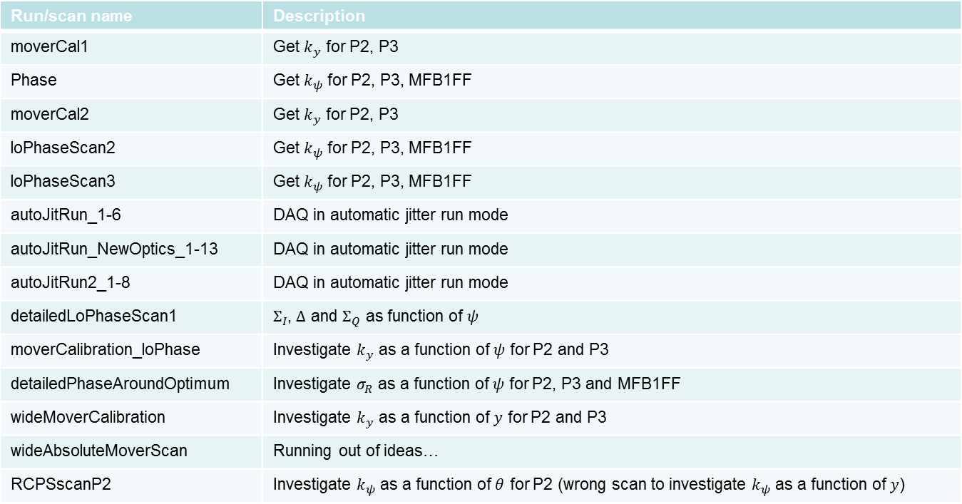
Shift 2 – 24/01/14
Run/scan name | Description
moverCal1 | Get $k_{y}$ for P2, P3
Phase | Get $k_{ψ}$ for P2, P3, MFB1FF
moverCal2 | Get $k_{y}$ for P2, P3
loPhaseScan2 | Get $k_{ψ}$ for P2, P3, MFB1FF
loPhaseScan3 | Get $k_{ψ}$ for P2, P3, MFB1FF
autoJitRun_1-6 | DAQ in automatic jitter run mode
autoJitRun_NewOptics_1-13 | DAQ in automatic jitter run mode
autoJitRun2_1-8 | DAQ in automatic jitter run mode
detailedLoPhaseScan1 | $Σ_{I}$, $Δ$ and $Σ_{Q}$ as function of $ψ$
moverCalibration_loPhase | Investigate $k_{y}$ as a function of $ψ$ for P2 and P3
detailedPhaseAroundOptimum | Investigate $σ_{R}$ as a function of $ψ$ for P2, P3 and MFB1FF
wideMoverCalibration | Investigate $k_{y}$ as a function of $y$ for P2 and P3
wideAbsoluteMoverScan | Running out of ideas…
RCPSscanP2 | Investigate $k_{ψ}$ as a function of $θ$ for P2 (wrong scan to investigate $k_{ψ}$ as a function of $y$)

Slide 4
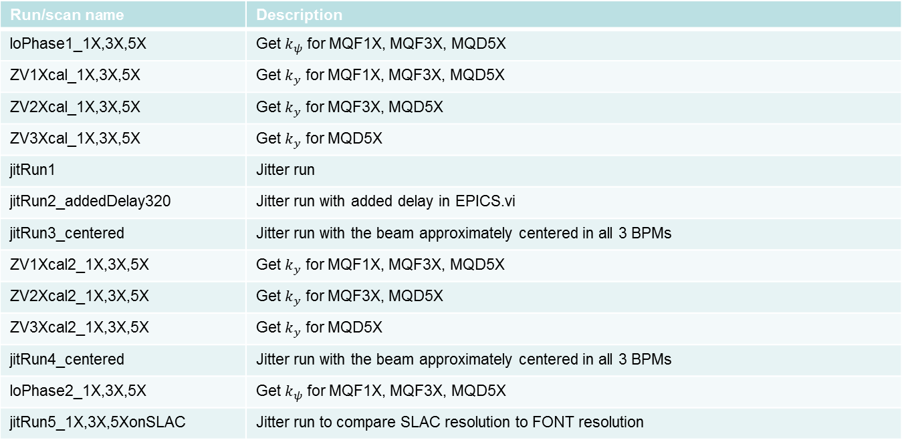
Shift 3(i) – 29/01/14
Run/scan name | Description
loPhase1_1X,3X,5X | Get $k_{ψ}$ for MQF1X, MQF3X, MQD5X
ZV1Xcal_1X,3X,5X | Get $k_{y}$ for MQF1X, MQF3X, MQD5X
ZV2Xcal_1X,3X,5X | Get $k_{y}$ for MQF3X, MQD5X
ZV3Xcal_1X,3X,5X | Get $k_{y}$ for MQD5X
jitRun1 | Jitter run
jitRun2_addedDelay320 | Jitter run with added delay in EPICS.vi
jitRun3_centered | Jitter run with the beam approximately centered in all 3 BPMs
ZV1Xcal2_1X,3X,5X | Get $k_{y}$ for MQF1X, MQF3X, MQD5X
ZV2Xcal2_1X,3X,5X | Get $k_{y}$ for MQF3X, MQD5X
ZV3Xcal2_1X,3X,5X | Get $k_{y}$ for MQD5X
jitRun4_centered | Jitter run with the beam approximately centered in all 3 BPMs
loPhase2_1X,3X,5X | Get $k_{ψ}$ for MQF1X, MQF3X, MQD5X
jitRun5_1X,3X,5XonSLAC | Jitter run to compare SLAC resolution to FONT resolution

Slide 5
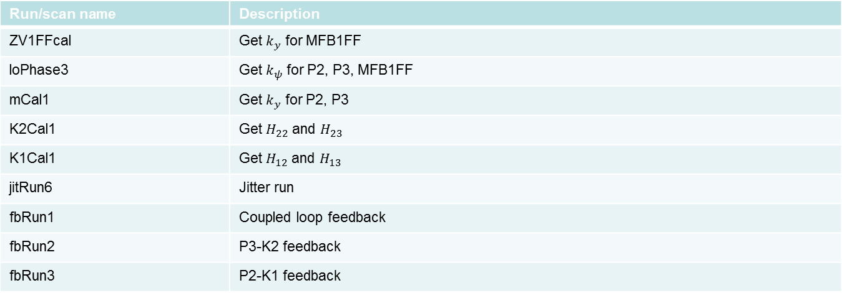
Shift 3(ii) – 29/01/14
Run/scan name | Description
ZV1FFcal | Get $k_{y}$ for MFB1FF
loPhase3 | Get $k_{ψ}$ for P2, P3, MFB1FF
mCal1 | Get $k_{y}$ for P2, P3
K2Cal1 | Get $H_{22}$ and $H_{23}$
K1Cal1 | Get $H_{12}$ and $H_{13}$
jitRun6 | Jitter run
fbRun1 | Coupled loop feedback
fbRun2 | P3-K2 feedback
fbRun3 | P2-K1 feedback

Slide 6
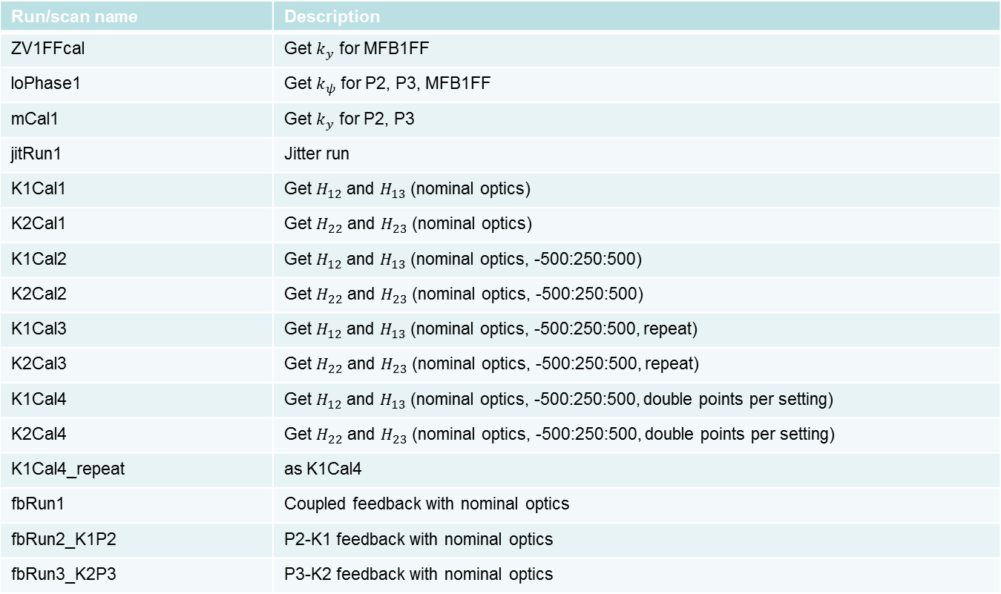
Shift 4(i) – 31/01/14
Run/scan name | Description
ZV1FFcal | Get $k_{y}$ for MFB1FF
loPhase1 | Get $k_{ψ}$ for P2, P3, MFB1FF
mCal1 | Get $k_{y}$ for P2, P3
jitRun1 | Jitter run
K1Cal1 | Get $H_{12}$ and $H_{13}$ (nominal optics)
K2Cal1 | Get $H_{22}$ and $H_{23}$ (nominal optics)
K1Cal2 | Get $H_{12}$ and $H_{13}$ (nominal optics, -500:250:500)
K2Cal2 | Get $H_{22}$ and $H_{23}$ (nominal optics, -500:250:500)
K1Cal3 | Get $H_{12}$ and $H_{13}$ (nominal optics, -500:250:500, repeat)
K2Cal3 | Get $H_{22}$ and $H_{23}$ (nominal optics, -500:250:500, repeat)
K1Cal4 | Get $H_{12}$ and $H_{13}$ (nominal optics, -500:250:500, double points per setting)
K2Cal4 | Get $H_{22}$ and $H_{23}$ (nominal optics, -500:250:500, double points per setting)
K1Cal4_repeat | as K1Cal4
fbRun1 | Coupled feedback with nominal optics
fbRun2_K1P2 | P2-K1 feedback with nominal optics
fbRun3_K2P3 | P3-K2 feedback with nominal optics

Slide 7
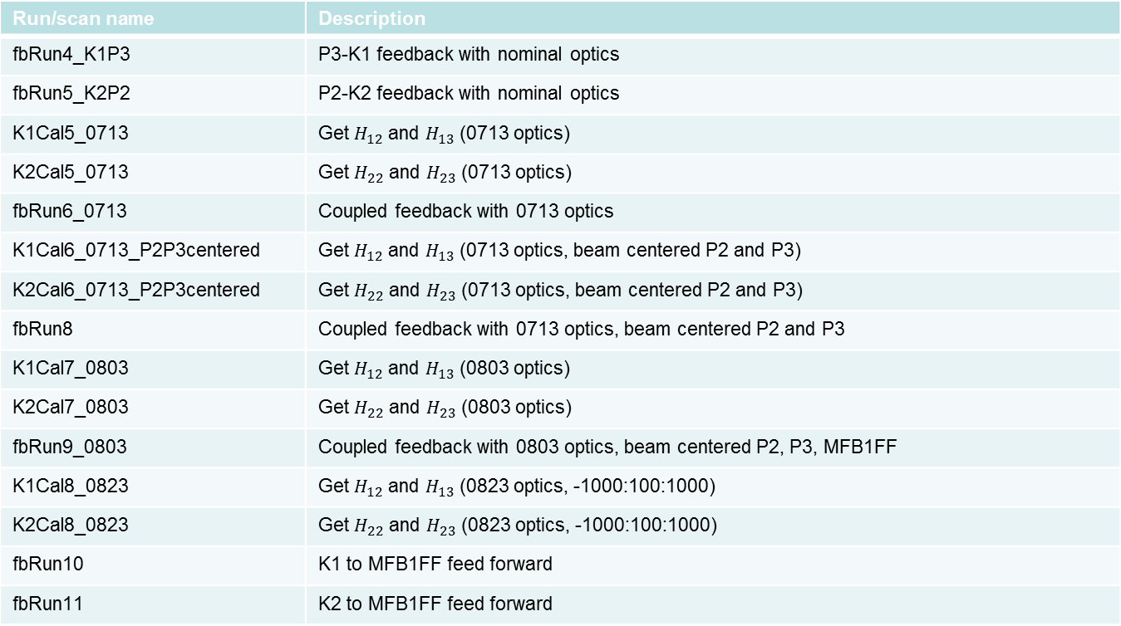
Shift 4(ii) – 31/01/14
Run/scan name | Description
fbRun4_K1P3 | P3-K1 feedback with nominal optics
fbRun5_K2P2 | P2-K2 feedback with nominal optics
K1Cal5_0713 | Get $H_{12}$ and $H_{13}$ (0713 optics)
K2Cal5_0713 | Get $H_{22}$ and $H_{23}$ (0713 optics)
fbRun6_0713 | Coupled feedback with 0713 optics
K1Cal6_0713_P2P3centered | Get $H_{12}$ and $H_{13}$ (0713 optics, beam centered P2 and P3)
K2Cal6_0713_P2P3centered | Get $H_{22}$ and $H_{23}$ (0713 optics, beam centered P2 and P3)
fbRun8 | Coupled feedback with 0713 optics, beam centered P2 and P3
K1Cal7_0803 | Get $H_{12}$ and $H_{13}$ (0803 optics)
K2Cal7_0803 | Get $H_{22}$ and $H_{23}$ (0803 optics)
fbRun9_0803 | Coupled feedback with 0803 optics, beam centered P2, P3, MFB1FF
K1Cal8_0823 | Get $H_{12}$ and $H_{13}$ (0823 optics, -1000:100:1000)
K2Cal8_0823 | Get $H_{22}$ and $H_{23}$ (0823 optics, -1000:100:1000)
fbRun10 | K1 to MFB1FF feed forward
fbRun11 | K2 to MFB1FF feed forward

