Slide 1
Feedback results
N. Blaskovic

Slide 2
Contents
Data from 31 Jan with P2, P3 & MFB1FF
Resolution of jitter run
Resolution over kicker scan
‘Real’ vs. ‘predicted’ MFB1FF positions
Coupled feedback, nominal lattice
Single loop feedback, nominal lattice
Feedback, ‘stretched’ phase advance lattice
N. Blaskovic

Slide 3
Notes
LO phase correction
Stripline phase shifters used for online LO phase correction at P2, P3
Offline LO phase correction used at MFB1FF using phase sensitivity from LO scan
BPM calibration constants used:
P2: -0.00236/um from BPM mover scan
P3: -0.00254/um from BPM mover scan
MFB1FF: -0.00175/um from ZV1FF scans
N. Blaskovic

Slide 4
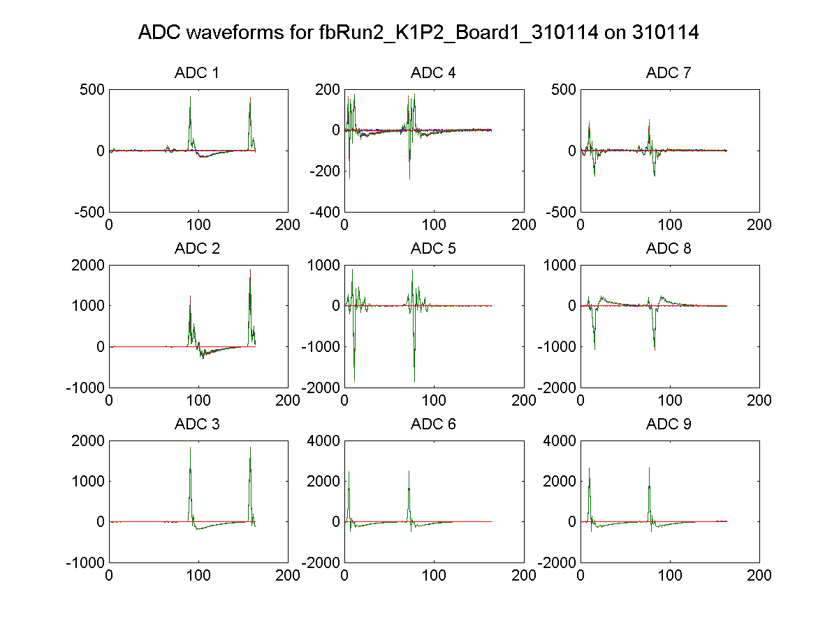
Preliminary
All stripline attenuation removed
Charge: ~0.6 x 10¹⁰ / bunch
Sum peaks: 2400 ADC counts
P2 Σ_{Q}
P2 Δ
P2 Σ_{I}
N. Blaskovic

Slide 5
Resolution
Resolution for jitRun1:
Resolution over K1 kicker scan (next slide)
 |  | Resolution (um)
Fitting | P2 | 0.248
 | P3 | 0.252
 | MFB1FF | 0.254
Model |  | 0.354
N. Blaskovic

Slide 6
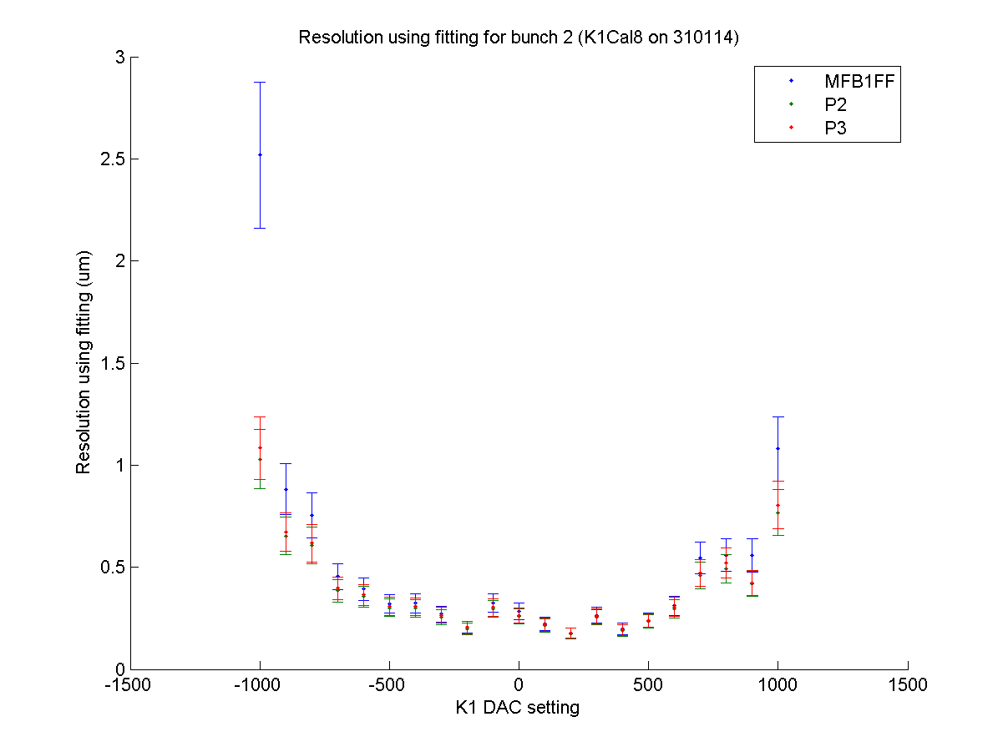
Beam at +1050 um in MFB1FF
Beam at -950 um in MFB1FF
beam centred through MFB1FF
N. Blaskovic

Slide 7
Kicker scan check
Over K1 scan, compare MFB1FF positions
‘Real’: assuming calibration constant
‘Predicted’: propagating P2 & P3 positions
Kicker effect on P2 and P3 reproducible; kicker sensitivity at MFB1FF varies ~5 %
Slow drift oscillations of incoming beam (period ~60 seconds)
No offline phase correction on next slide
N. Blaskovic

Slide 8
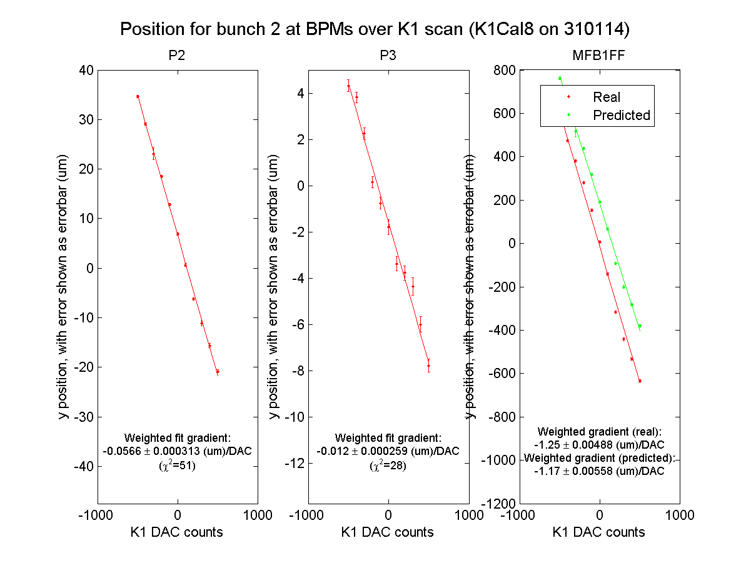
N. Blaskovic

Slide 9
Feedback
Feedback run 1
Coupled loop feedback with nominal gains
Nominal lattice
Observations
Jitter correction down to ~0.5 um, which is the best possible result if resolution is ~0.35 um
Correction propagates well, with bunch 2 feedback-on model-method resolution of 0.33 um
N. Blaskovic

Slide 10
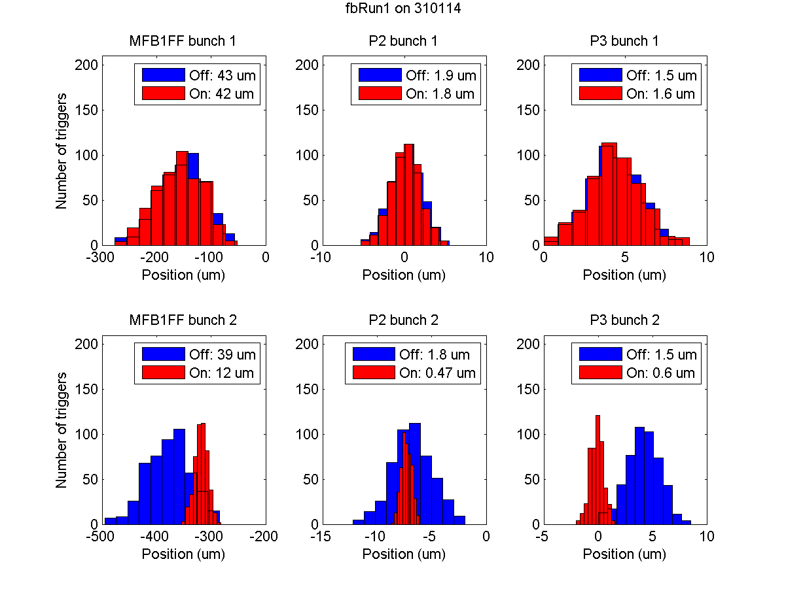
fbRun1
N. Blaskovic

Slide 11
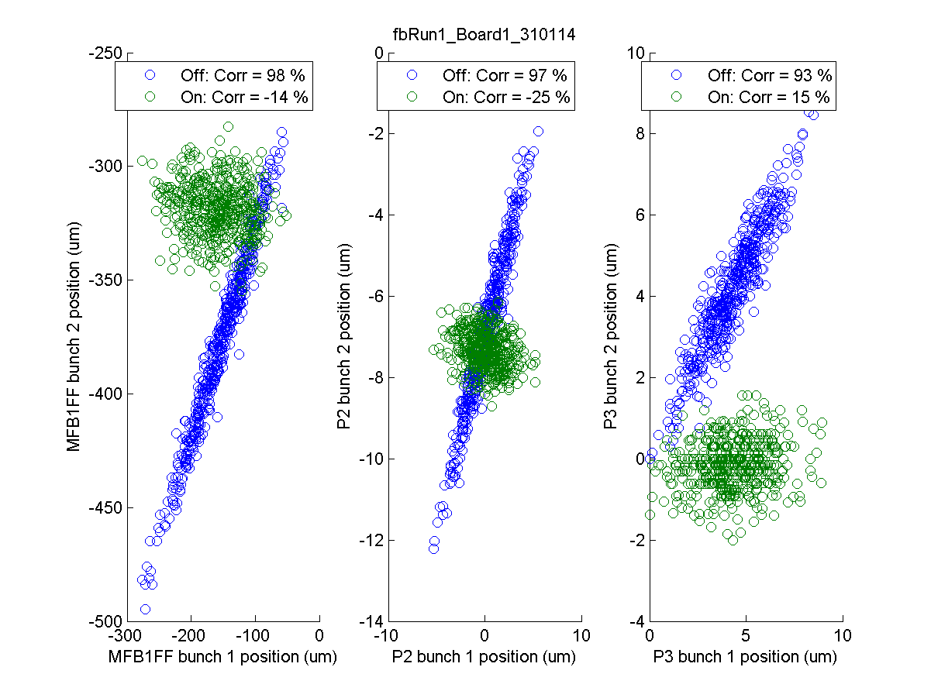
fbRun1
N. Blaskovic

Slide 12
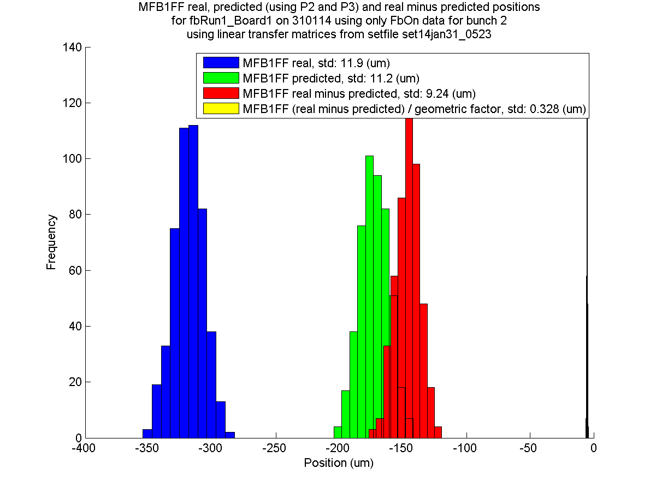
fbRun1
N. Blaskovic

Slide 13
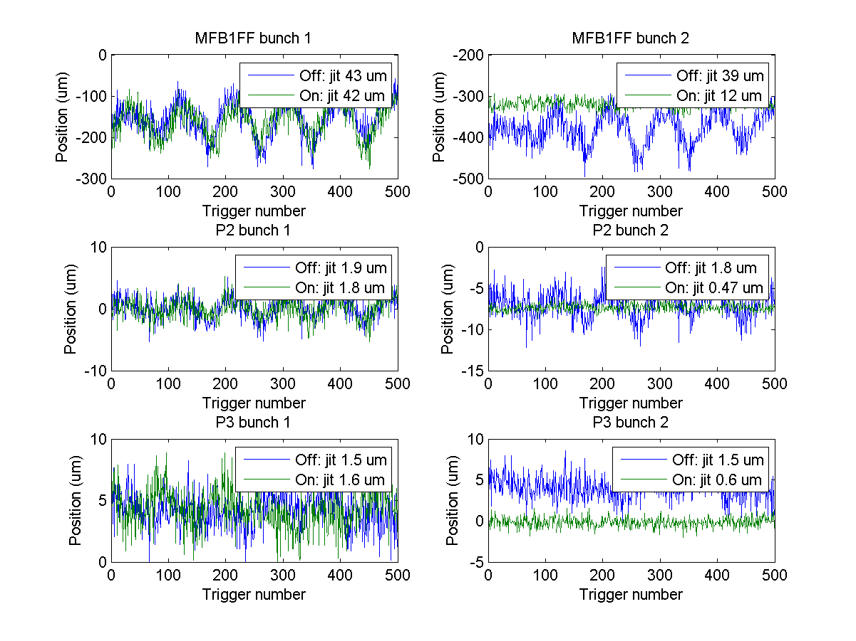
fbRun1
N. Blaskovic

Slide 14
Drift removal
Drift removed data may illustrate better what is achievable if slow orbit feedback were on
Results:
Smaller feedback off jitter with drift removal
Feedback on jitter unchanged
In general, no drift removal was used unless otherwise stated
N. Blaskovic

Slide 15
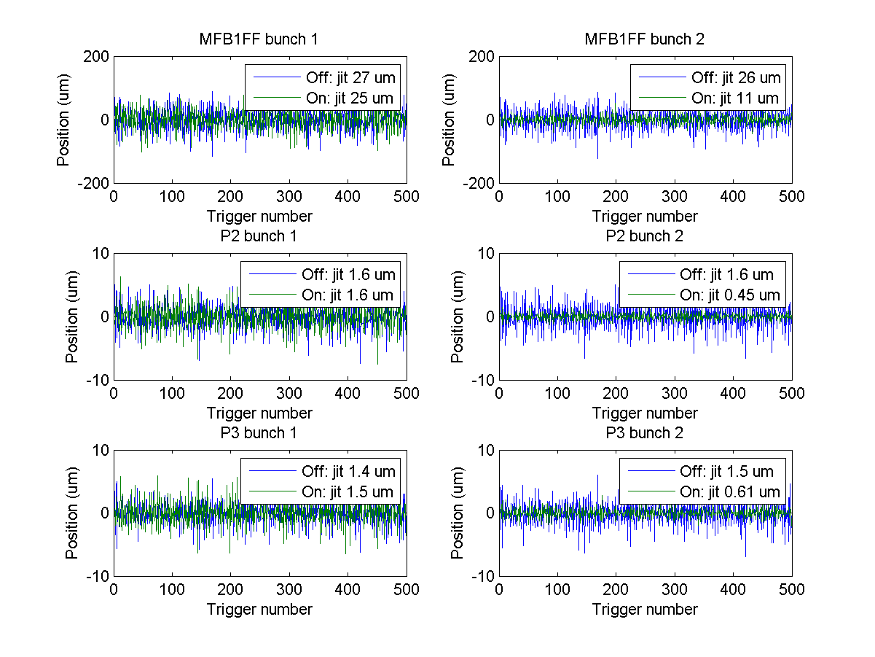
fbRun1
Drift removed
N. Blaskovic

Slide 16
Single loop feedback
Conventional single loop feedback
K1P2
K2P3
Unconventional single loop feedback
K1P3
K2P2
N. Blaskovic

Slide 17
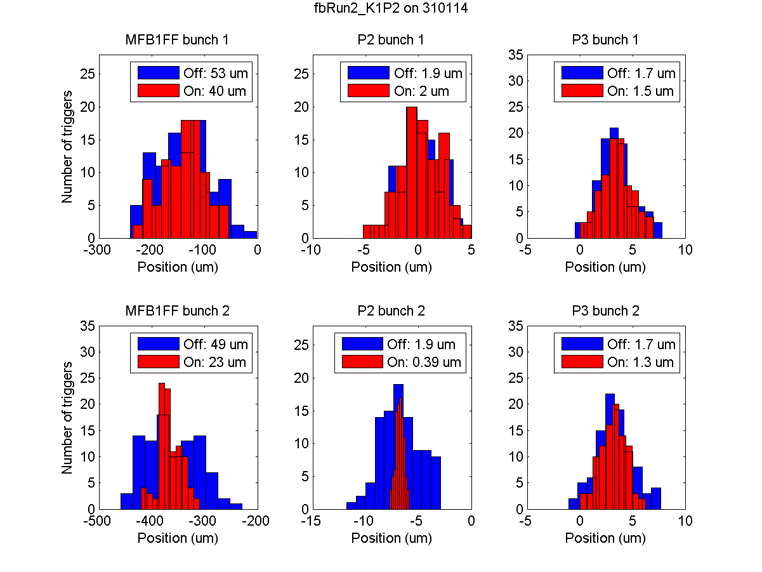
fbRun2
N. Blaskovic

Slide 18
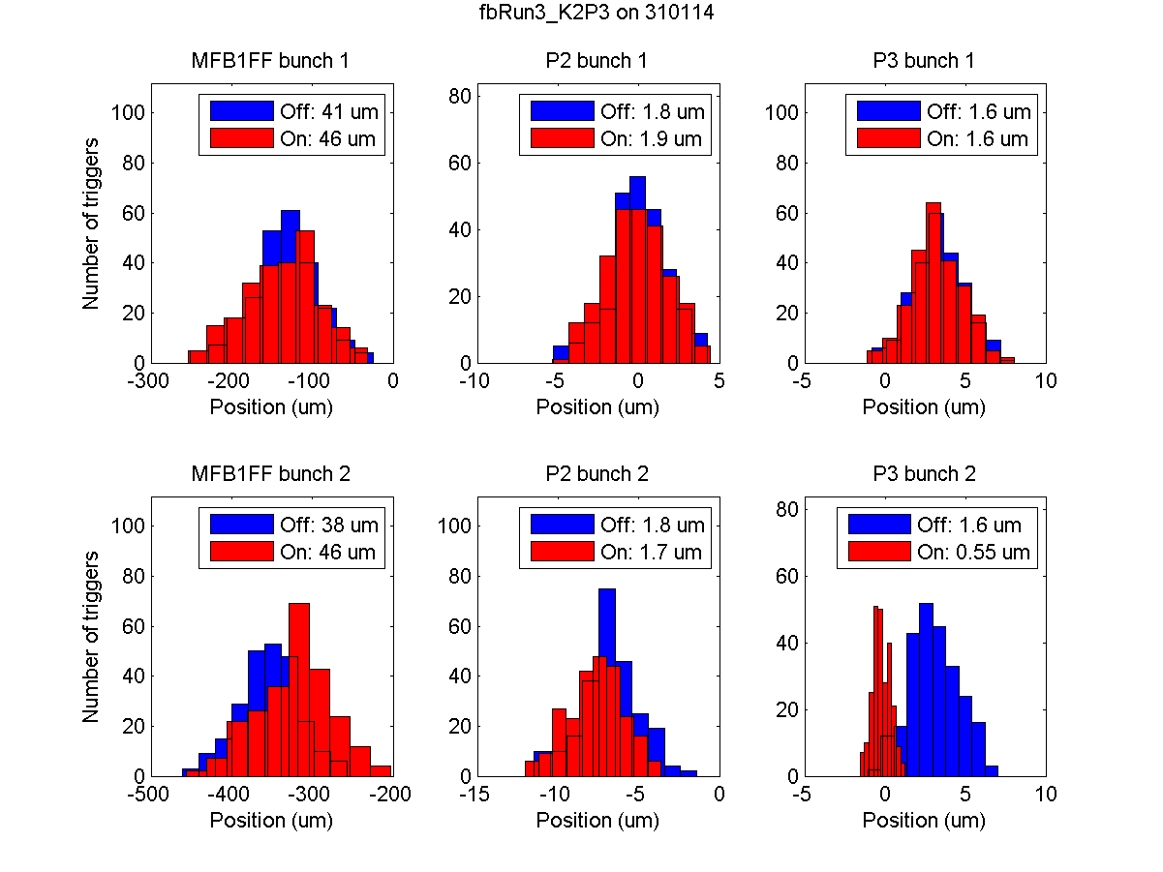
fbRun3
N. Blaskovic

Slide 19
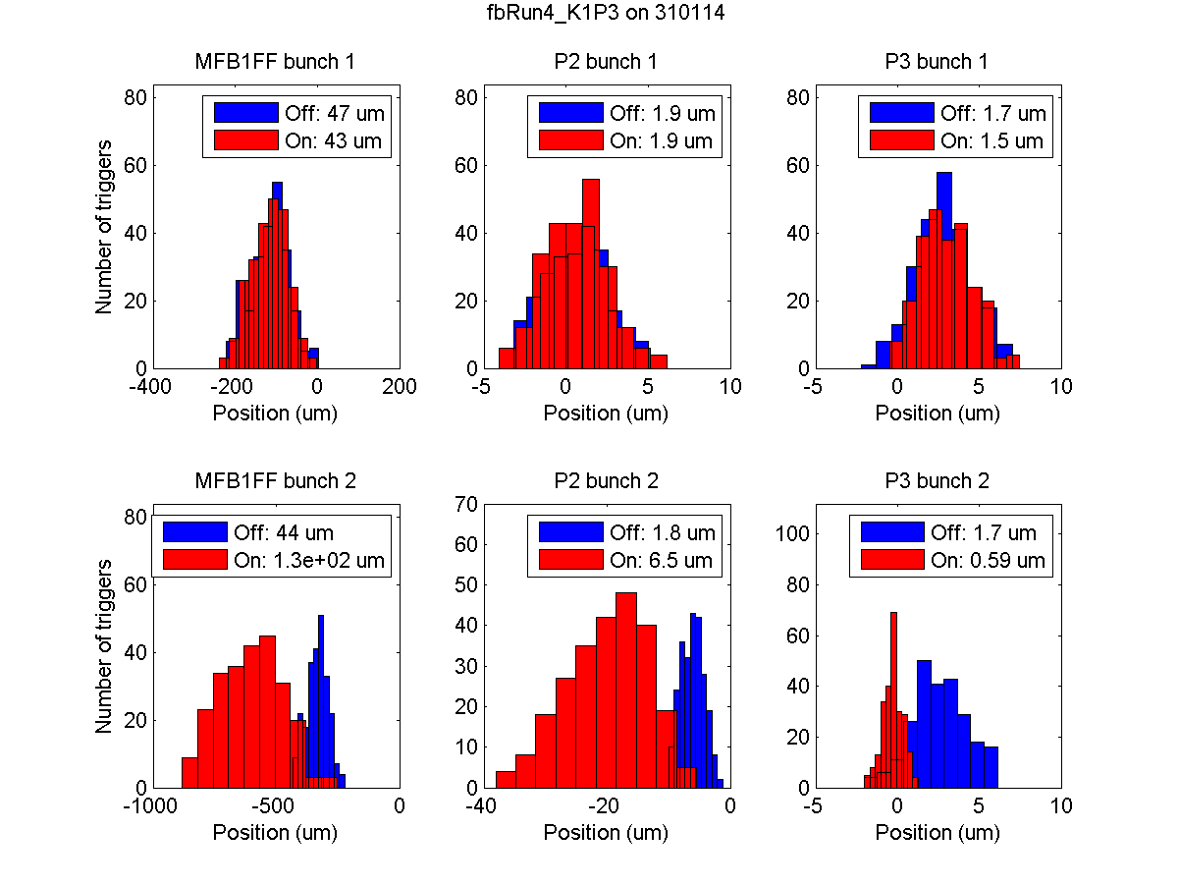
fbRun4
N. Blaskovic

Slide 20
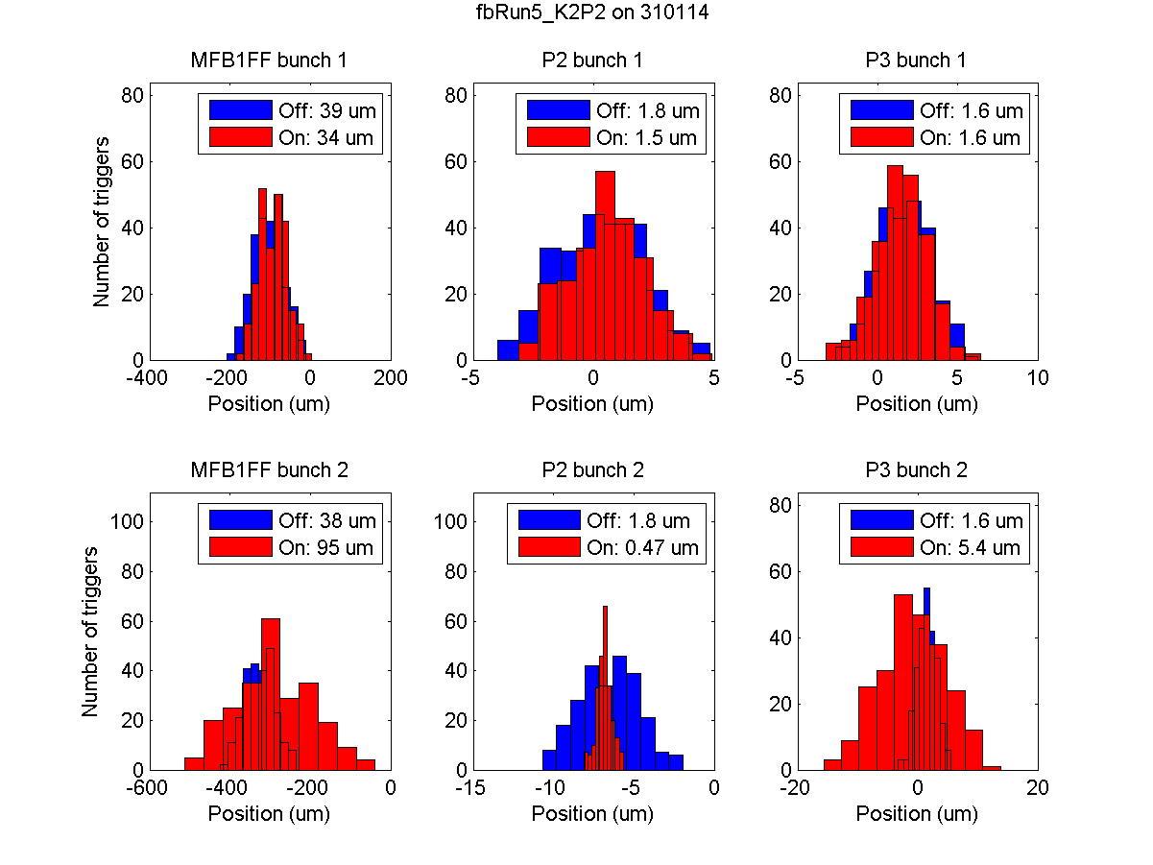
fbRun5
N. Blaskovic

Slide 21
Changes to the lattice
Feedback runs taken on 31 January:
Setfile | QD12X-QF15X extra current | fbRun | Description
0523 | 0 A | 1 | Coupled
 |  | 2-5 | Single loop
0713 | 5 A | 6 | Off-centre
 |  | 8 | Centred in P2 & P3
0803 | 1 A | 9 | Centred in all 3 BPMs
N. Blaskovic

Slide 22
Phase advance
BPM | Phase advance relative to K1 (°)
 | setfile set14jan31_0523 | setfile set14jan31_0713
K1 | 0 | 0
K2 | 152 | 152
P2 | 156 | 155
P3 | 174 | 194
MFB1FF | 503 | 509
N. Blaskovic

Slide 23
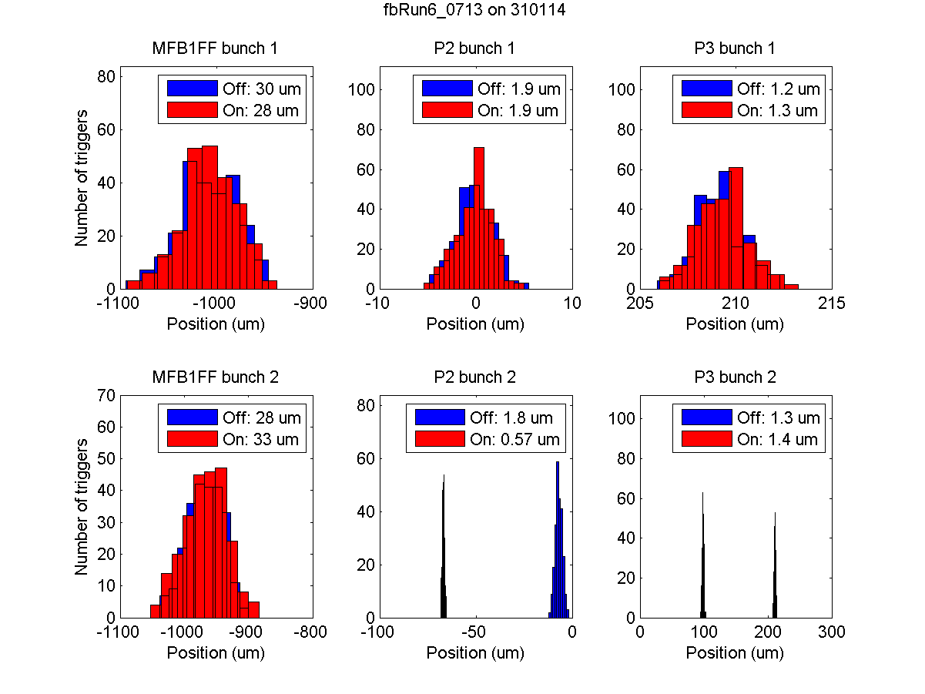
fbRun6
N. Blaskovic

Slide 24
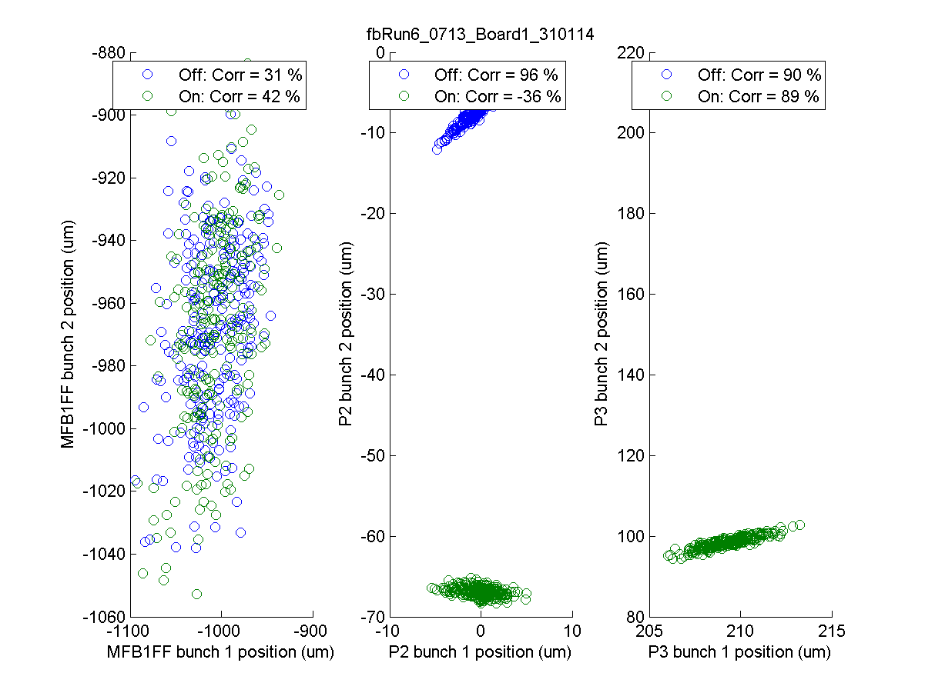
fbRun6
Resolution by fitting
MFB1FF
P2
P3
8.13 um
1.82 um
1.23 um
Model resolution
2.1 um
N. Blaskovic

Slide 25
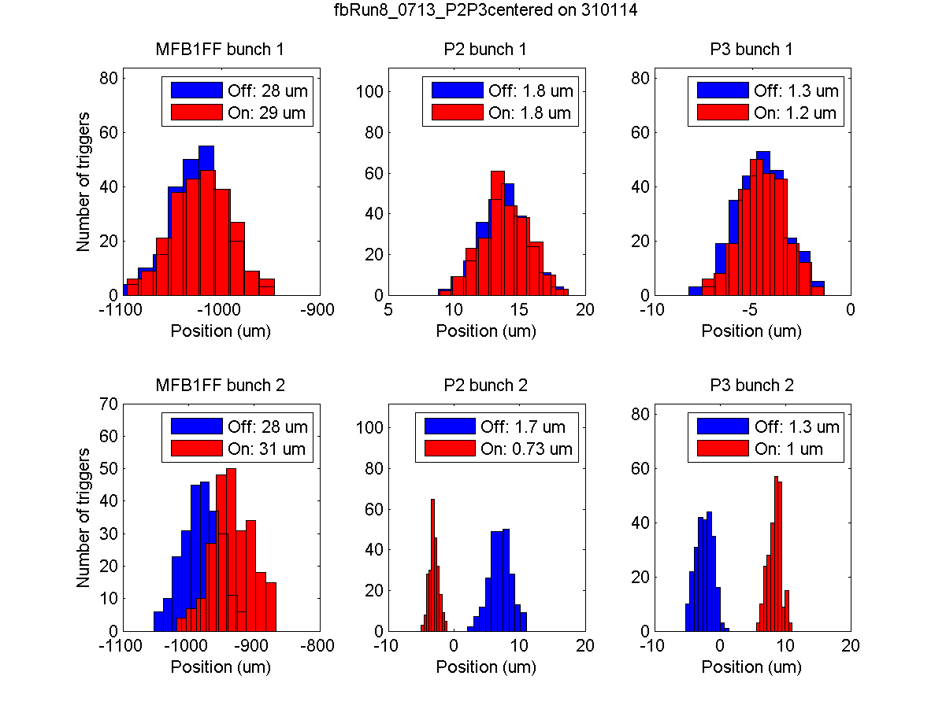
fbRun8
N. Blaskovic

Slide 26
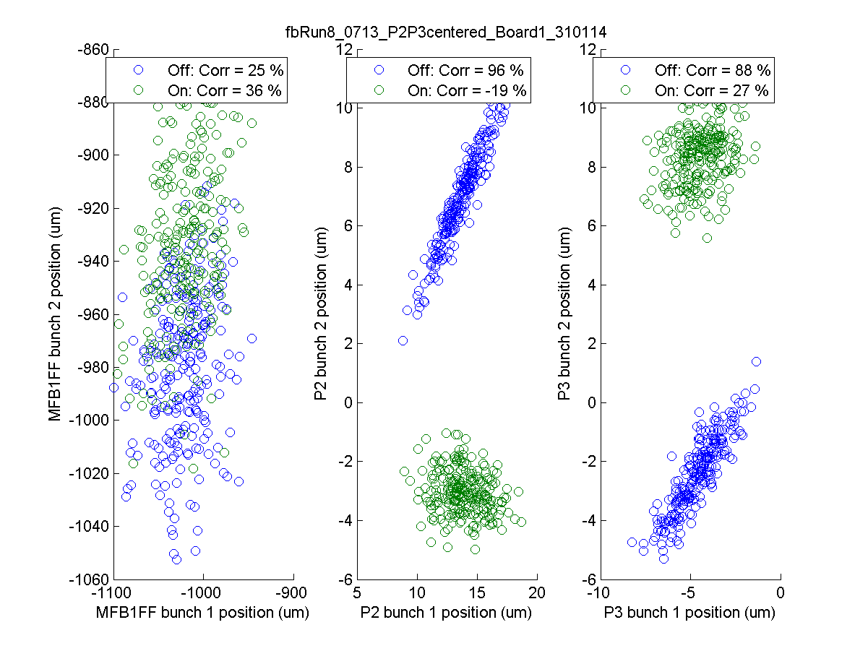
fbRun8
Resolution by fitting
MFB1FF
P2
P3
17.24 um
1.36 um
1.05 um
Model resolution
1.78 um
N. Blaskovic

Slide 27
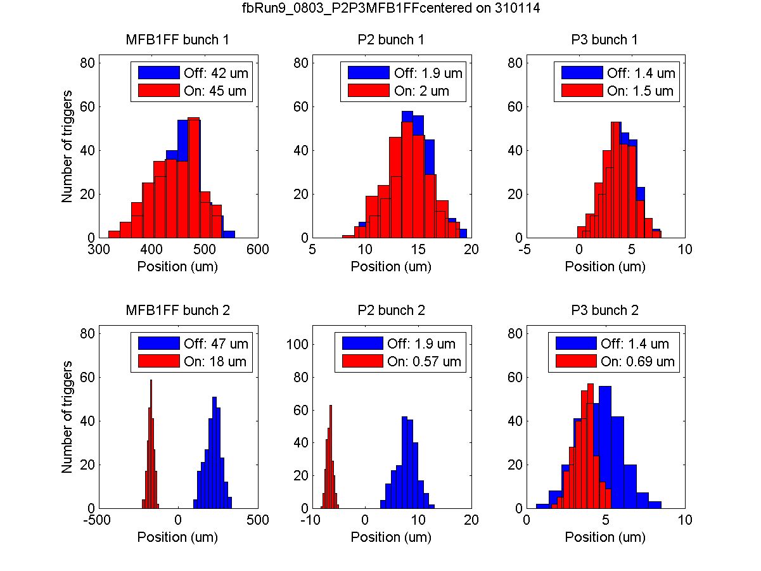
fbRun9
N. Blaskovic

Slide 28
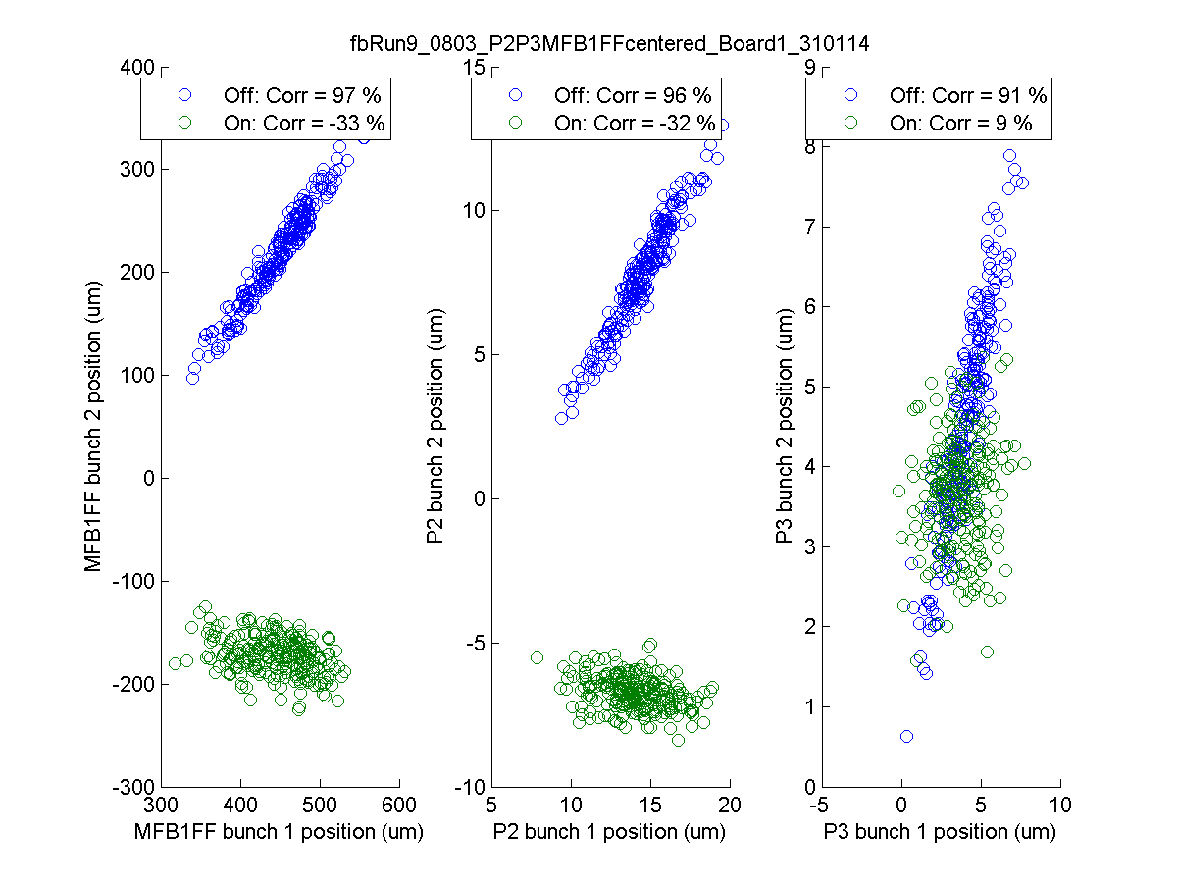
fbRun9
Resolution by fitting
MFB1FF
P2
P3
0.288 um
0.282 um
0.290 um
Model resolution
N. Blaskovic

Slide 29
Conclusions (1)
P2, P3, MFB1FF resolution
Fitting: ~0.25 um
Model: ~0.35 um
Coupled loop feedback
Correction to ~0.5 um at feedback BPMs
Factor 3 jitter drop propagates to MFB1FF
Effectively resolution limited; higher jitter reduction factor may be achieved if β were larger at feedback BPMs
N. Blaskovic

Slide 30
Conclusions (2)
Drift removal
1/3 of jitter due to slow orbit oscillation
Single loop feedback studies
Excellent jitter reduction at target BPM
Poor performance at MFB1FF (except K1P2)
Feedback with ‘stretched’ phase advance
Lower bunch-to-bunch correlation (chance?) so worse feedback
Degraded resolution (MFB1FF saturation?)
N. Blaskovic

Slide 31
Appendix
Bunch-to-bunch correlation for single loop feedback runs

Slide 32
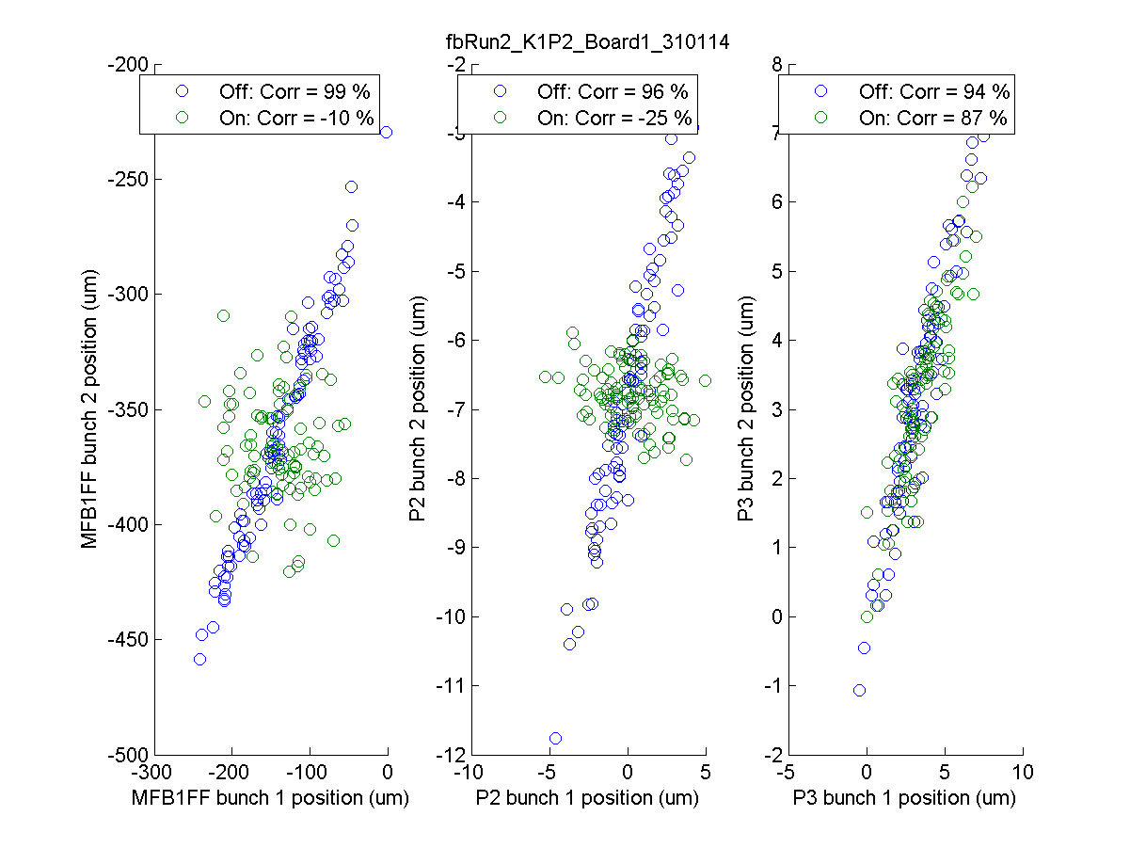
fbRun2
Resolution by fitting
MFB1FF
P2
P3
0.274 um
0.270 um
0.274 um
Model resolution
0.347 um
N. Blaskovic

Slide 33
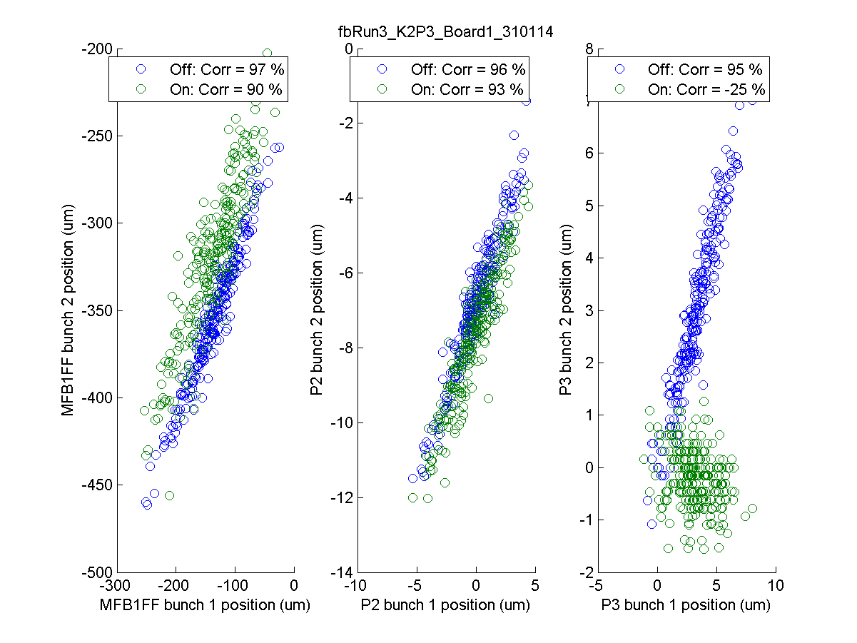
fbRun3
Resolution by fitting
MFB1FF
P2
P3
0.348 um
0.336 um
0.344 um
Model resolution
0.445 um
N. Blaskovic

Slide 34
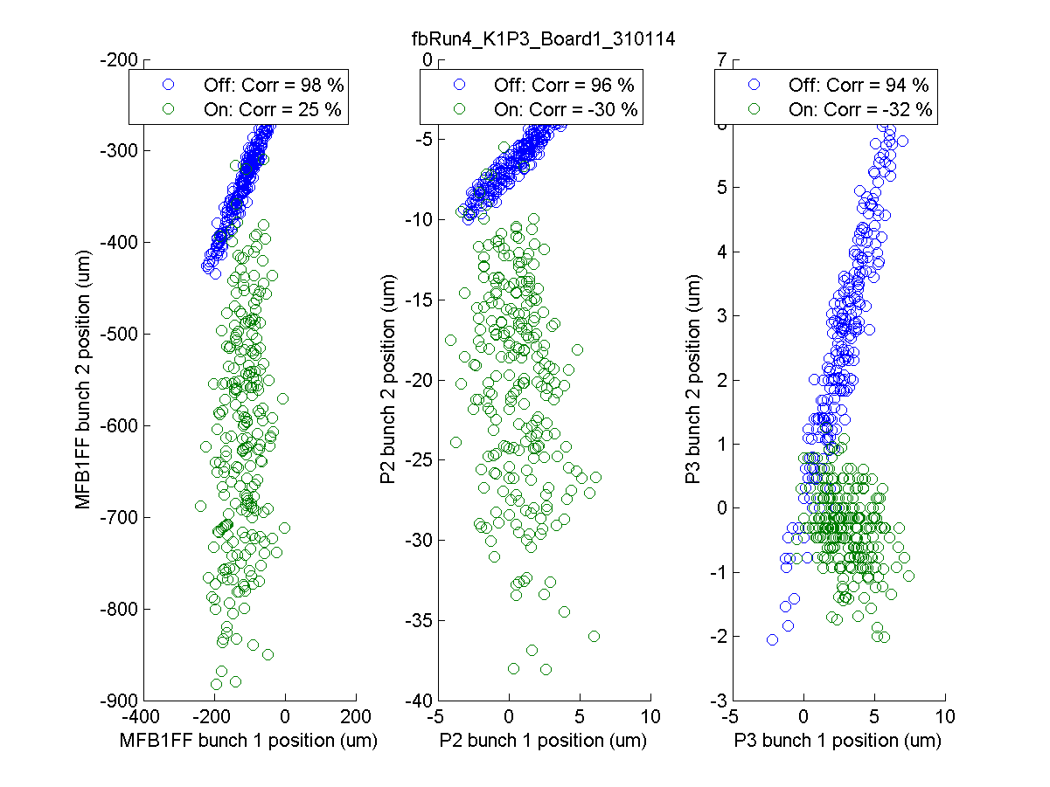
fbRun4
Resolution by fitting
MFB1FF
P2
P3
0.293 um
0.287 um
0.293 um
Model resolution
0.367 um
N. Blaskovic

Slide 35
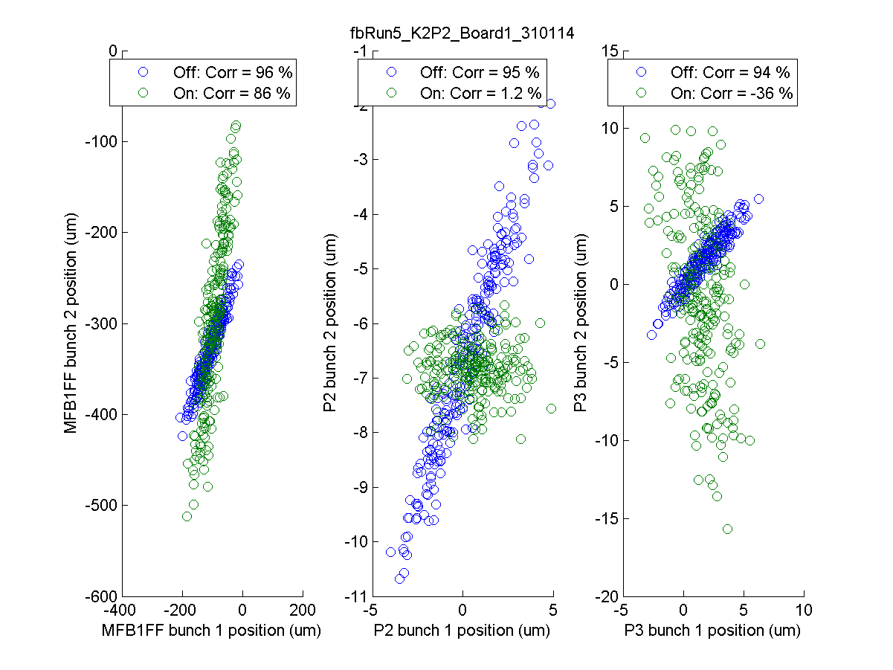
fbRun5
Resolution by fitting
MFB1FF
P2
P3
0.290 um
0.281 um
0.286 um
Model resolution
0.339 um
N. Blaskovic

Slide 36
Appendix
Position vs. trigger for feedback runs

Slide 37
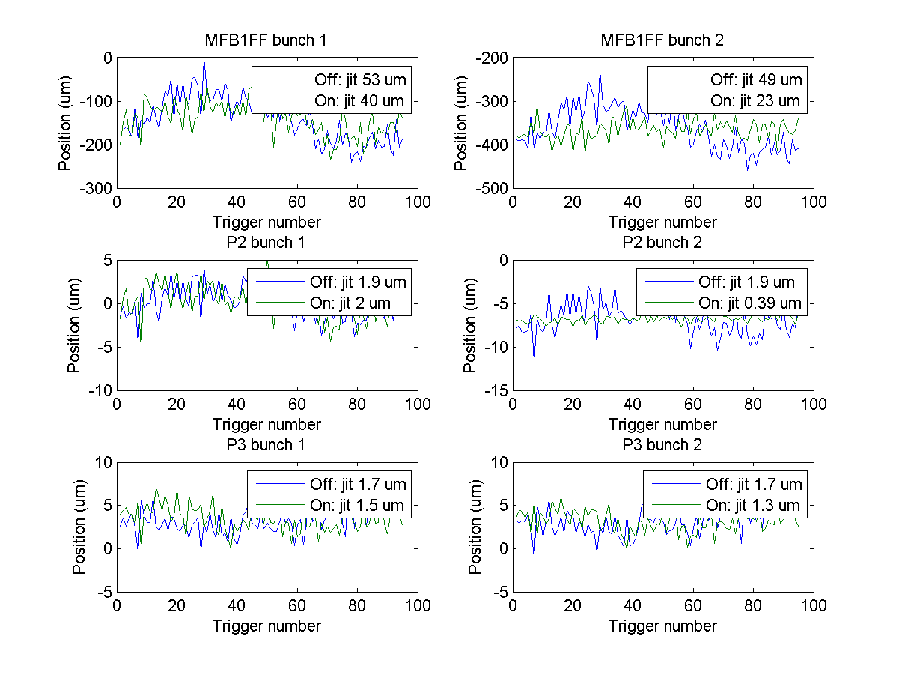
fbRun2
N. Blaskovic

Slide 38
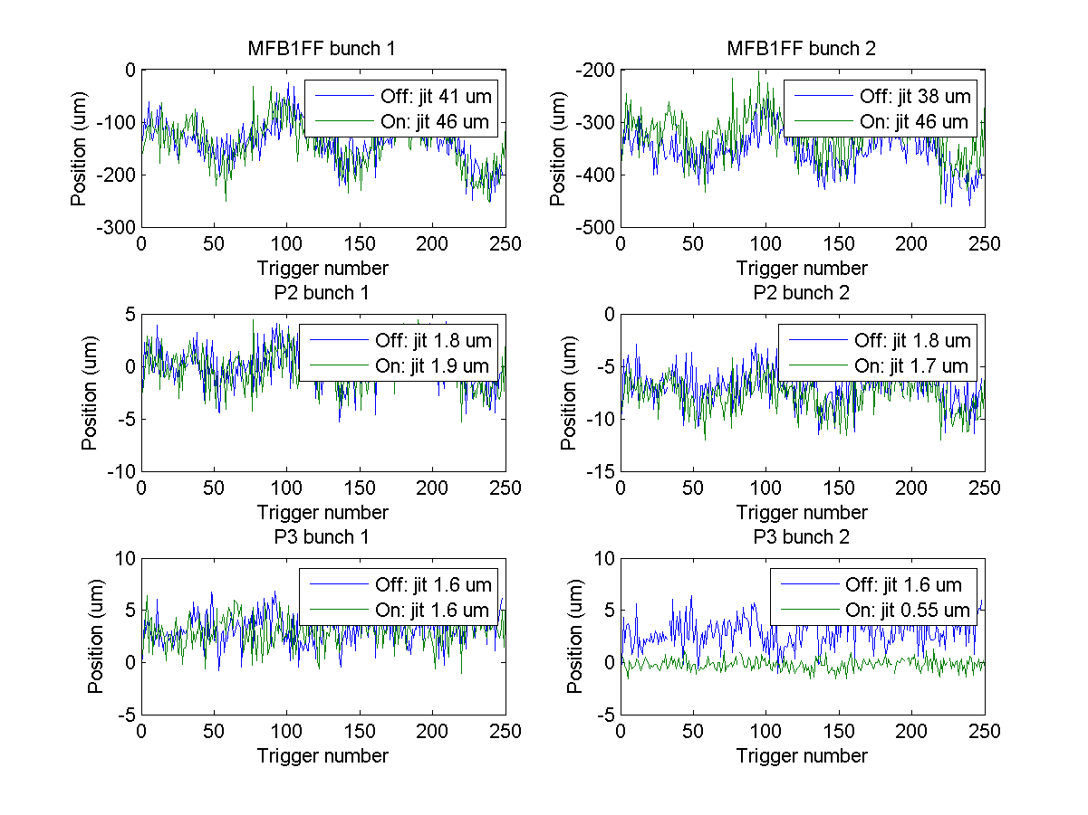
fbRun3
N. Blaskovic

Slide 39
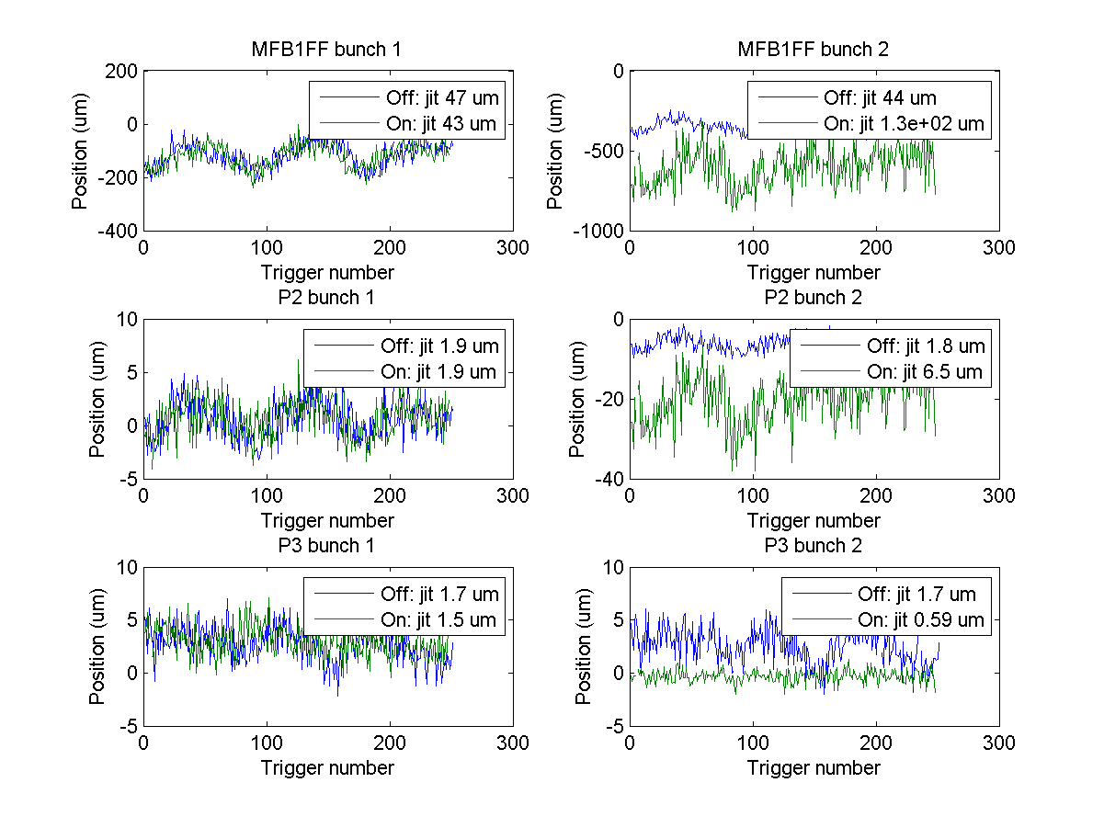
fbRun4
N. Blaskovic

Slide 40
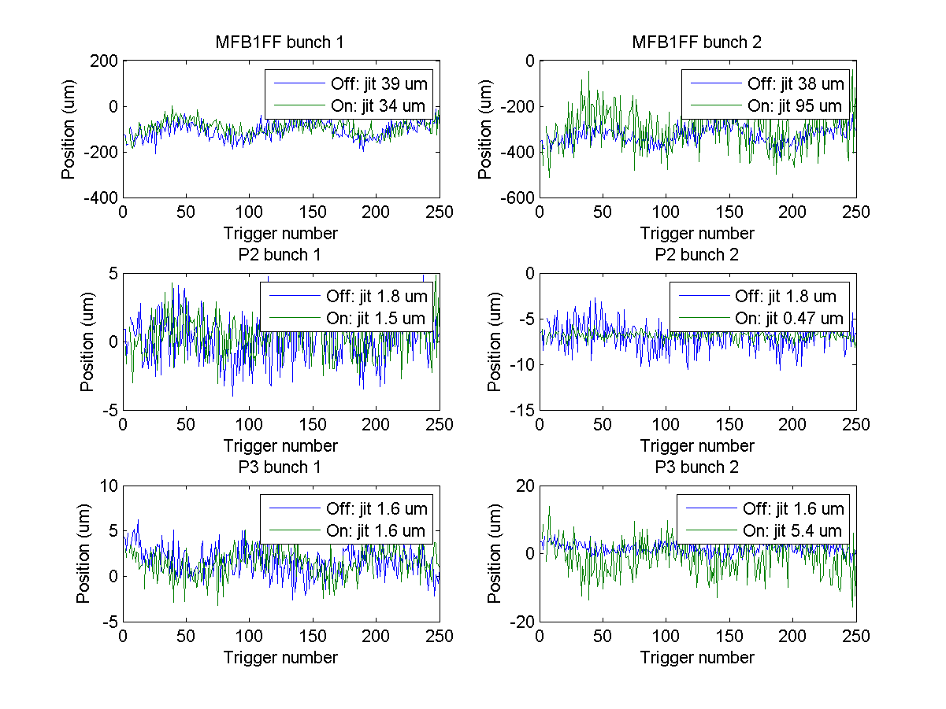
fbRun5
N. Blaskovic

Slide 41
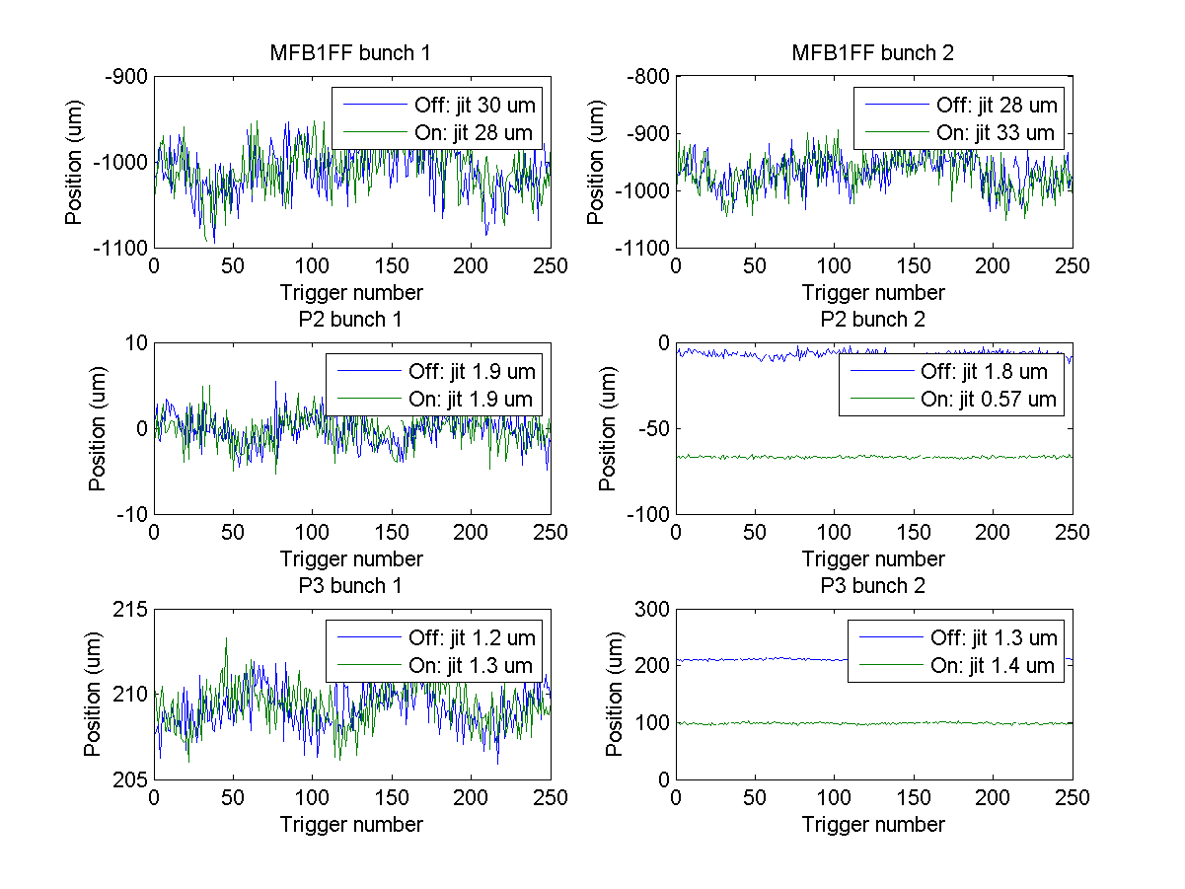
fbRun6
N. Blaskovic

Slide 42
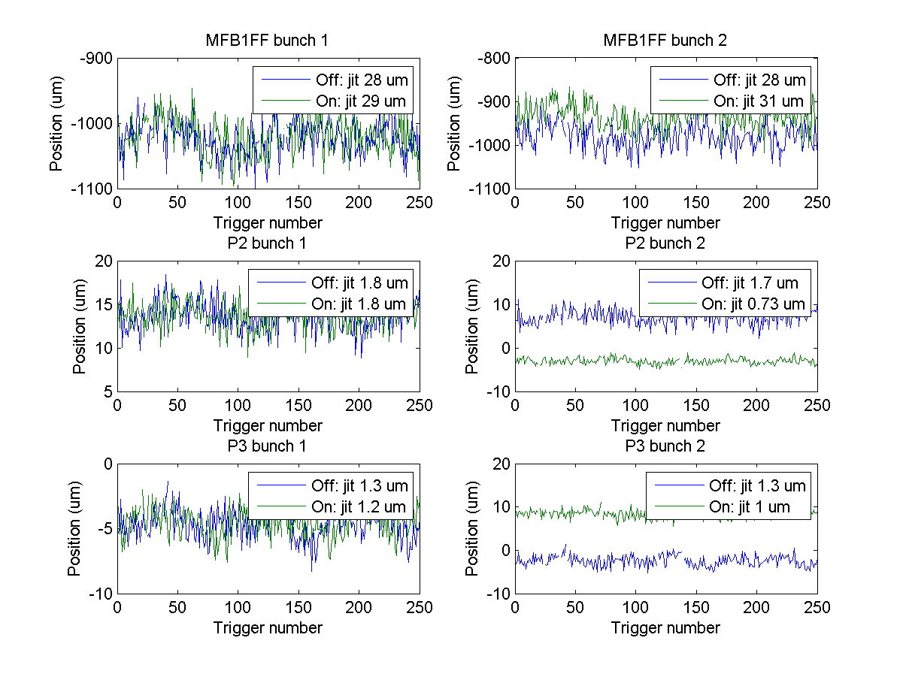
fbRun8
N. Blaskovic

Slide 43
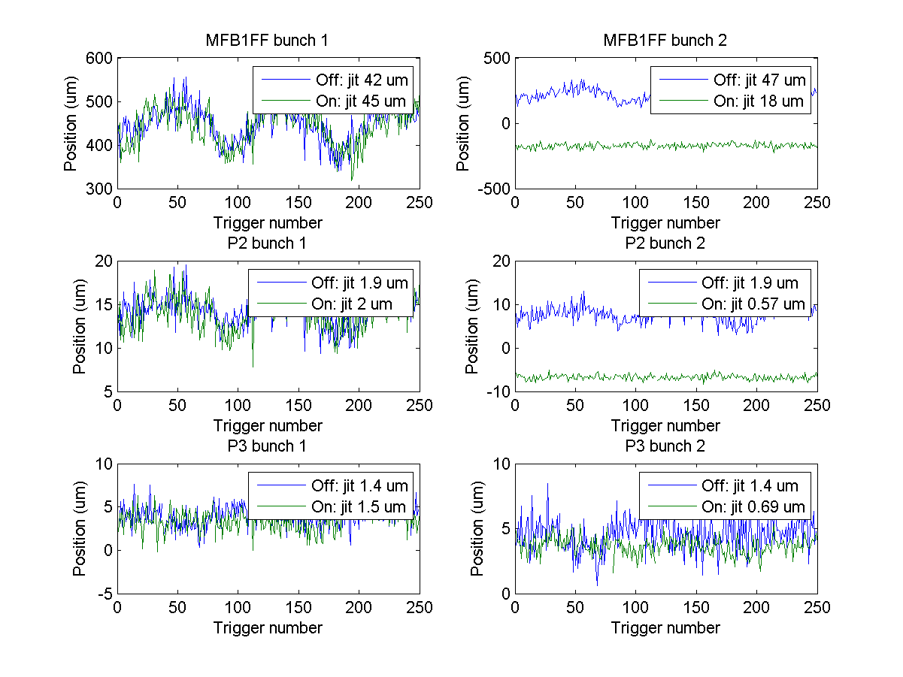
fbRun9
N. Blaskovic

