Slide 1
Parasitic Studies
D. R. Bett

Slide 2
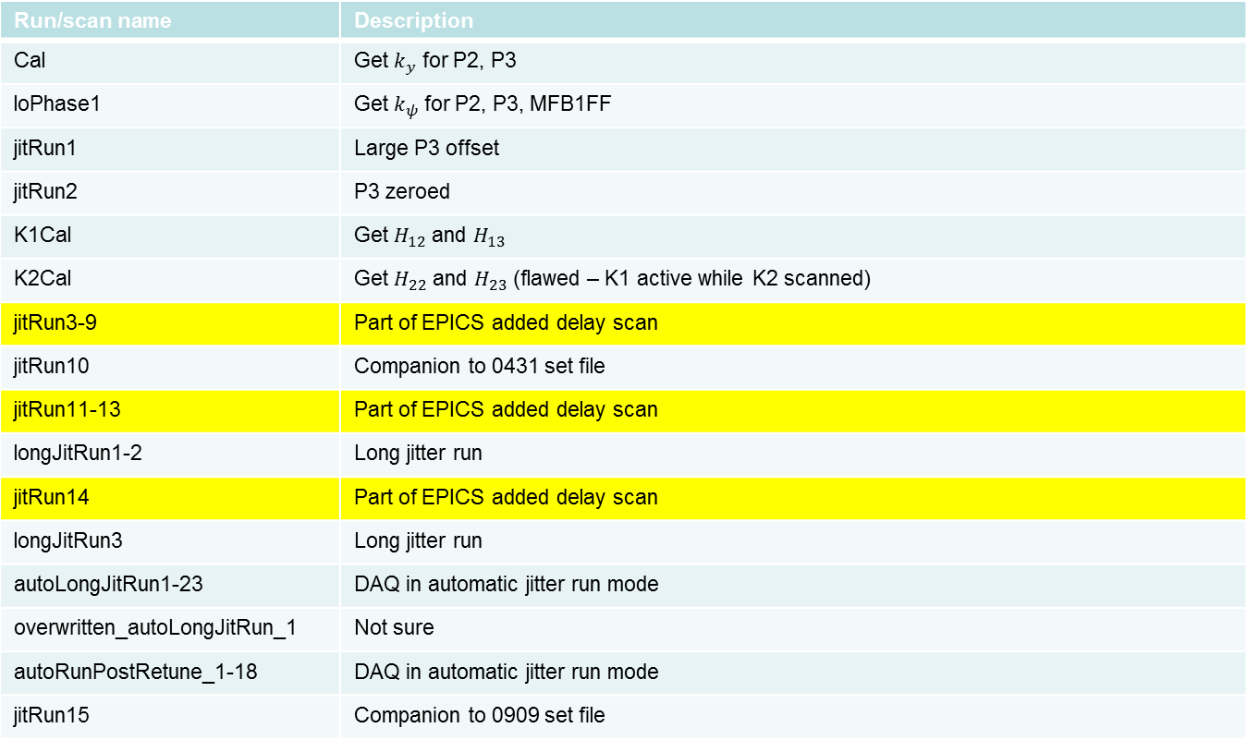
Shift 1 – 23/01/14
Run/scan name | Description
Cal | Get $k_{y}$ for P2, P3
loPhase1 | Get $k_{ψ}$ for P2, P3, MFB1FF
jitRun1 | Large P3 offset
jitRun2 | P3 zeroed
K1Cal | Get $H_{12}$ and $H_{13}$
K2Cal | Get $H_{22}$ and $H_{23}$ (flawed – K1 active while K2 scanned)
jitRun3-9 | Part of EPICS added delay scan
jitRun10 | Companion to 0431 set file
jitRun11-13 | Part of EPICS added delay scan
longJitRun1-2 | Long jitter run
jitRun14 | Part of EPICS added delay scan
longJitRun3 | Long jitter run
autoLongJitRun1-23 | DAQ in automatic jitter run mode
overwritten_autoLongJitRun_1 | Not sure
autoRunPostRetune_1-18 | DAQ in automatic jitter run mode
jitRun15 | Companion to 0909 set file

Slide 3
EPICS added delay (I)
Instead of harvesting data from EPICS immediately after data is received from the FONT5 board, the DAQ first waits for the time specified by the added delay parameter

Slide 4
EPICS added delay (II)
Scan the added delay from 0 ms to 300 ms in steps of 50 ms
Count the number of times any BPM reports the same position for two consecutive triggers

Slide 5
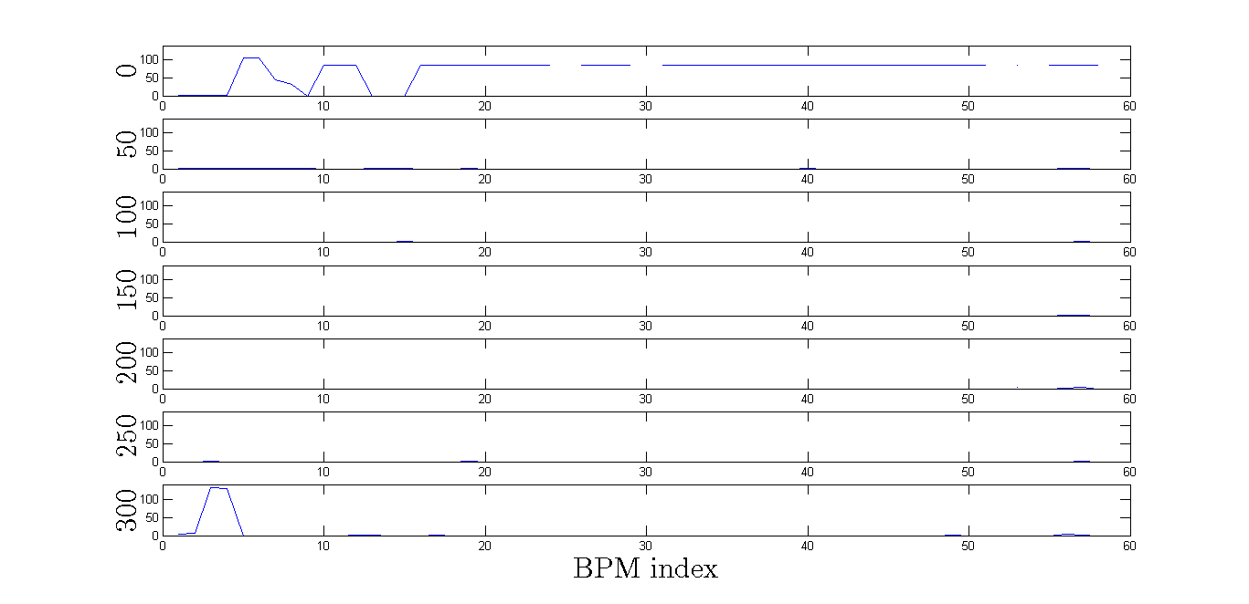
EPICS added delay (III)
Added
delay

Slide 6
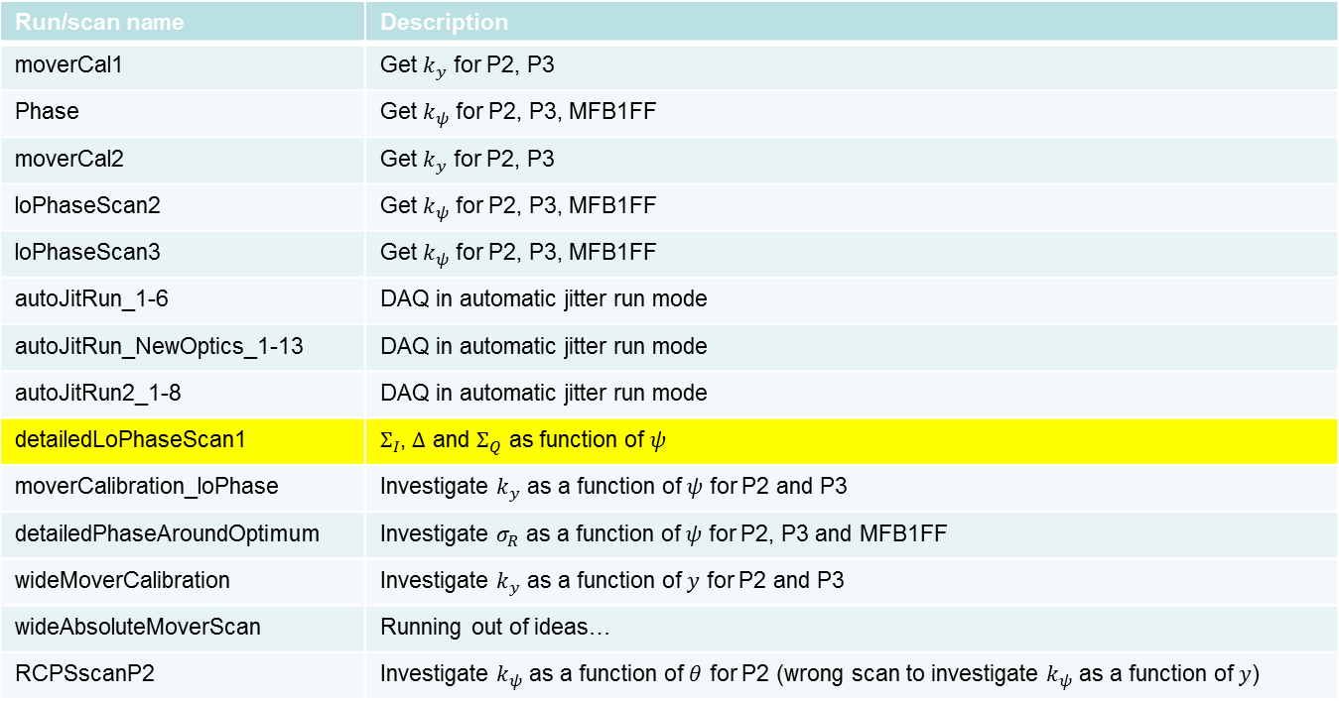
Shift 2 – 24/01/14
Run/scan name | Description
moverCal1 | Get $k_{y}$ for P2, P3
Phase | Get $k_{ψ}$ for P2, P3, MFB1FF
moverCal2 | Get $k_{y}$ for P2, P3
loPhaseScan2 | Get $k_{ψ}$ for P2, P3, MFB1FF
loPhaseScan3 | Get $k_{ψ}$ for P2, P3, MFB1FF
autoJitRun_1-6 | DAQ in automatic jitter run mode
autoJitRun_NewOptics_1-13 | DAQ in automatic jitter run mode
autoJitRun2_1-8 | DAQ in automatic jitter run mode
detailedLoPhaseScan1 | $Σ_{I}$, $Δ$ and $Σ_{Q}$ as function of $ψ$
moverCalibration_loPhase | Investigate $k_{y}$ as a function of $ψ$ for P2 and P3
detailedPhaseAroundOptimum | Investigate $σ_{R}$ as a function of $ψ$ for P2, P3 and MFB1FF
wideMoverCalibration | Investigate $k_{y}$ as a function of $y$ for P2 and P3
wideAbsoluteMoverScan | Running out of ideas…
RCPSscanP2 | Investigate $k_{ψ}$ as a function of $θ$ for P2 (wrong scan to investigate $k_{ψ}$ as a function of $y$)

Slide 7
detailedLoPhaseScan1 (I)
Scan the individual channel phase shifters from 0° to 180° in steps of 5°

Slide 8
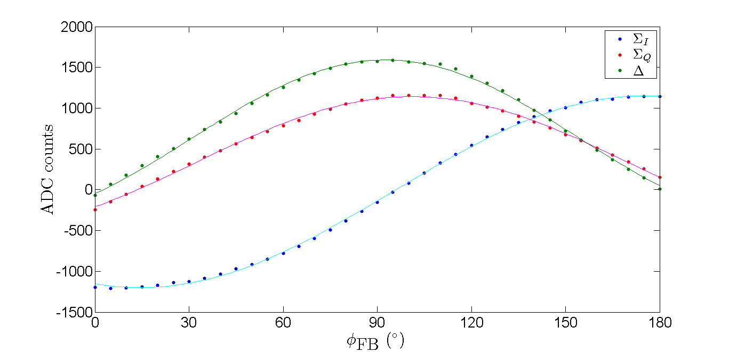
detailedLoPhaseScan1 (II)

Slide 9
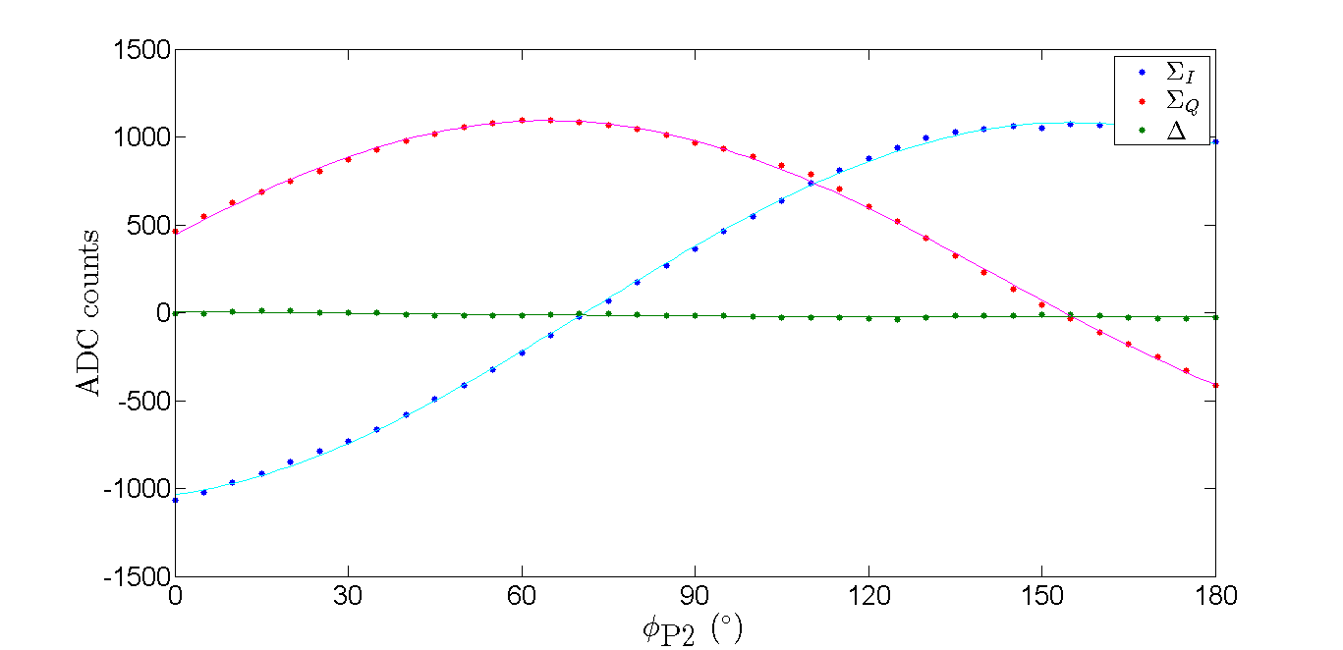
detailedLoPhaseScan1 (III)

Slide 10
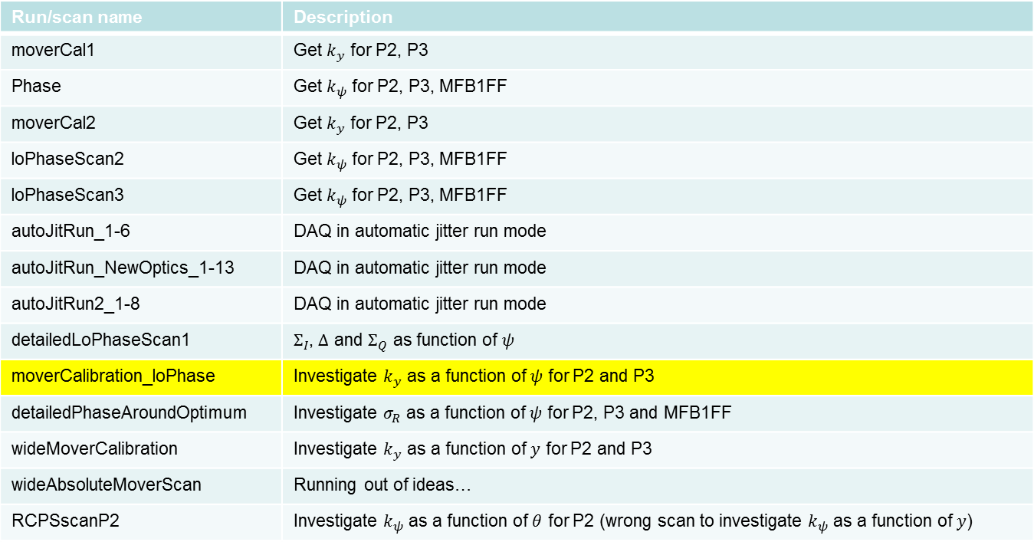
Shift 2 – 24/01/14
Run/scan name | Description
moverCal1 | Get $k_{y}$ for P2, P3
Phase | Get $k_{ψ}$ for P2, P3, MFB1FF
moverCal2 | Get $k_{y}$ for P2, P3
loPhaseScan2 | Get $k_{ψ}$ for P2, P3, MFB1FF
loPhaseScan3 | Get $k_{ψ}$ for P2, P3, MFB1FF
autoJitRun_1-6 | DAQ in automatic jitter run mode
autoJitRun_NewOptics_1-13 | DAQ in automatic jitter run mode
autoJitRun2_1-8 | DAQ in automatic jitter run mode
detailedLoPhaseScan1 | $Σ_{I}$, $Δ$ and $Σ_{Q}$ as function of $ψ$
moverCalibration_loPhase | Investigate $k_{y}$ as a function of $ψ$ for P2 and P3
detailedPhaseAroundOptimum | Investigate $σ_{R}$ as a function of $ψ$ for P2, P3 and MFB1FF
wideMoverCalibration | Investigate $k_{y}$ as a function of $y$ for P2 and P3
wideAbsoluteMoverScan | Running out of ideas…
RCPSscanP2 | Investigate $k_{ψ}$ as a function of $θ$ for P2 (wrong scan to investigate $k_{ψ}$ as a function of $y$)

Slide 11
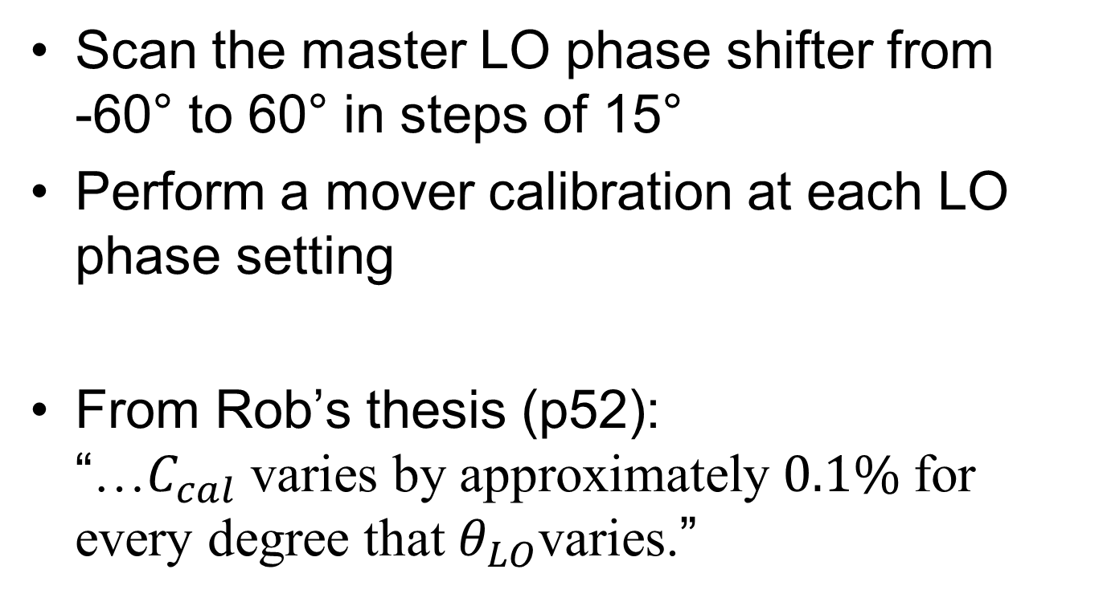
moverCalibration_loPhase (1)
Scan the master LO phase shifter from
-60° to 60° in steps of 15°
Perform a mover calibration at each LO phase setting
From Rob’s thesis (p52):
“…$C_{cal}$ varies by approximately $0.1\%$ for every degree that $θ_{LO}$varies.”

Slide 12
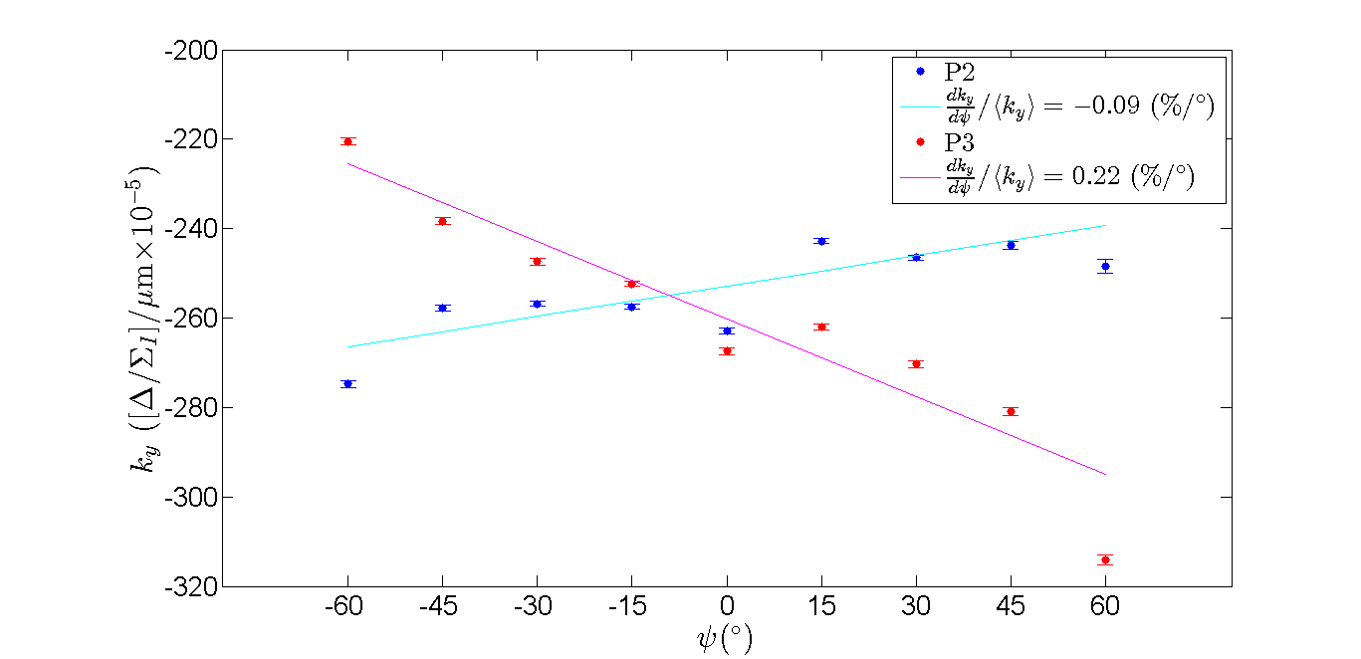
moverCalibration_loPhase (II)

Slide 13
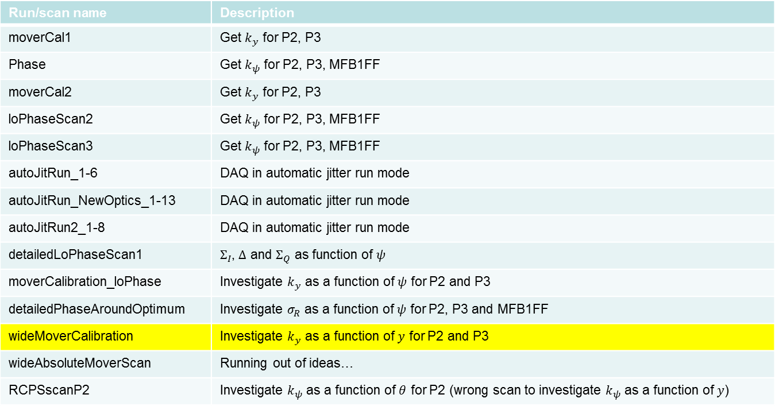
Shift 2 – 24/01/14
Run/scan name | Description
moverCal1 | Get $k_{y}$ for P2, P3
Phase | Get $k_{ψ}$ for P2, P3, MFB1FF
moverCal2 | Get $k_{y}$ for P2, P3
loPhaseScan2 | Get $k_{ψ}$ for P2, P3, MFB1FF
loPhaseScan3 | Get $k_{ψ}$ for P2, P3, MFB1FF
autoJitRun_1-6 | DAQ in automatic jitter run mode
autoJitRun_NewOptics_1-13 | DAQ in automatic jitter run mode
autoJitRun2_1-8 | DAQ in automatic jitter run mode
detailedLoPhaseScan1 | $Σ_{I}$, $Δ$ and $Σ_{Q}$ as function of $ψ$
moverCalibration_loPhase | Investigate $k_{y}$ as a function of $ψ$ for P2 and P3
detailedPhaseAroundOptimum | Investigate $σ_{R}$ as a function of $ψ$ for P2, P3 and MFB1FF
wideMoverCalibration | Investigate $k_{y}$ as a function of $y$ for P2 and P3
wideAbsoluteMoverScan | Running out of ideas…
RCPSscanP2 | Investigate $k_{ψ}$ as a function of $θ$ for P2 (wrong scan to investigate $k_{ψ}$ as a function of $y$)

Slide 14
wideMoverCalibration (I)
Scan the BPM movers from -500 µm to 500 µm in steps of 20 µm
Treat this data set as a sequence of mover calibrations

Slide 15
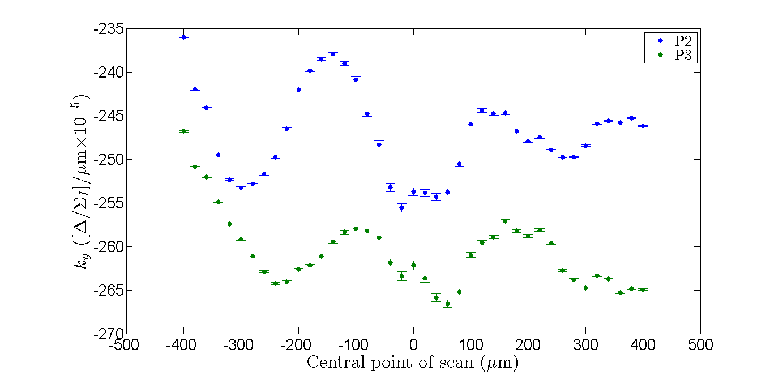
wideMoverCalibration (II)

Slide 16
Conclusions
EPICS added delay
  delaying seems to reduce duplication
  update time seems to differ from BPM to BPM
moverCalibration_loPhase
  results in agreement with Rob’s value
wideMoverCalibration
  variation in calibration constant values could be driven by beam drift

Slide 17
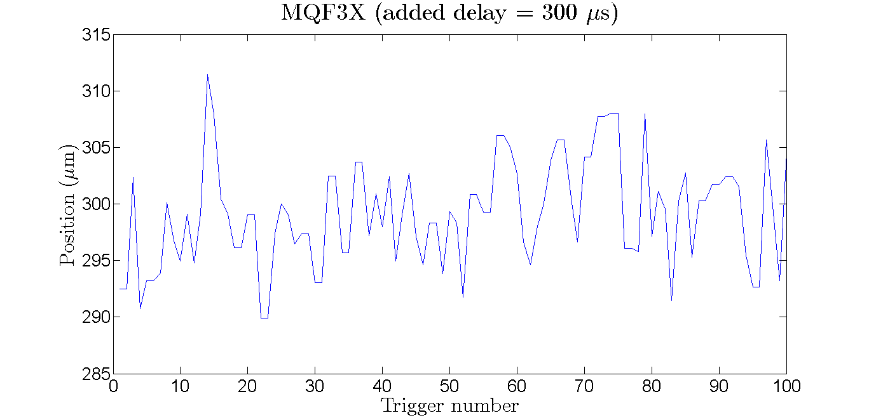
Extras (I)

Slide 18
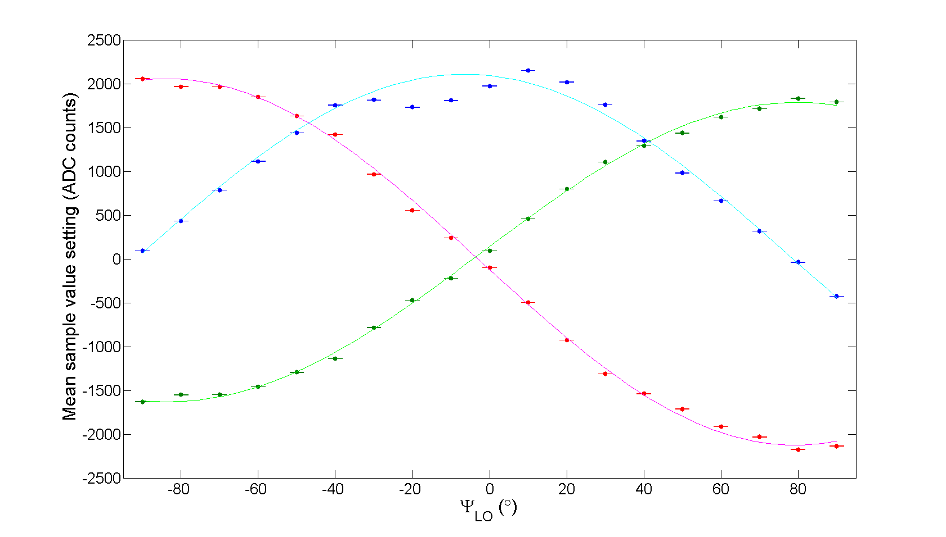
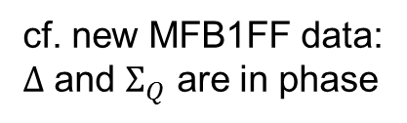
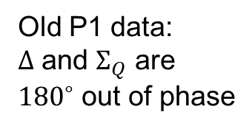
Extras (II)
Old P1 data:
$Δ$ and $Σ_{Q}$ are
${180}^{∘}$ out of phase
cf. new MFB1FF data:
$Δ$ and $Σ_{Q}$ are in phase

Slide 19
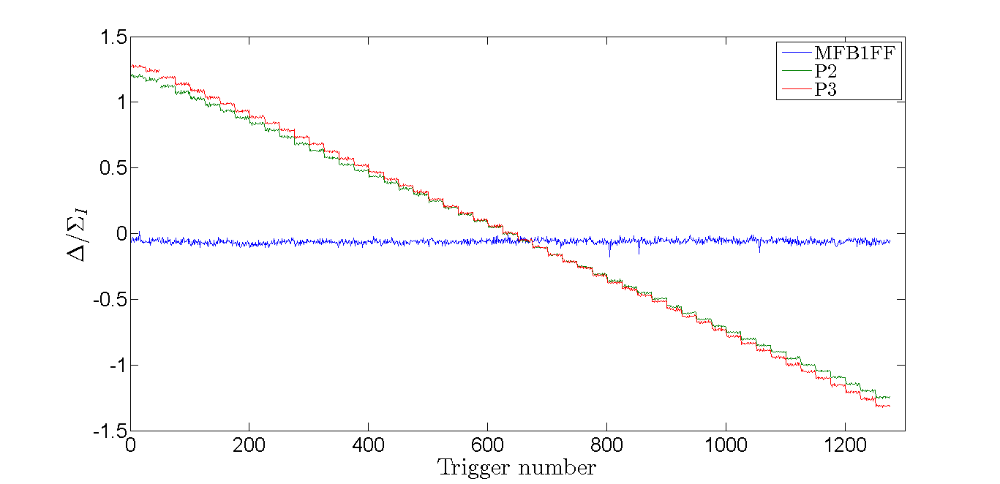
Extras (III)

