Slide 1
Timing
Constraints.
How timing issues constrain the ILC parameters
Benno List
DESY – IPP
ILC@DESY Project Meeting
25.4.2014

Slide 2
Overview
The two timing problems
The Damping Ring harmonic problem
The global timing problem

Slide 3
Two timing problems
The “local” timing problem: How to fit a 300km long bunch train into a 3km damping ring
Constrains the damping ring “harmonic number” (number of RF buckets) -> DR circumference
Constrains also the bunch spacing in the Main Linac -> beam current -> RF power
The “global” timing problem: Find an empty RF bucket in the DR for a new positron bunch
Reason: Positrons are generated from main electron beam
Constrains the ratio of (RTML+Main Linac+BDS)/DR to an integer number
-> Constrains the Main Linac Length -> beam energy

Slide 4
The Damping Ring timing constraint
Basic problem: Fit a 1ms bunch train of 300km length into a 3km damping ring
Imagine a thread with beads, wound around a roll
Each bunch has to have its own bucket
Bunches have to have a >3ns separation (kicker rise time)
Bunches have to form “minitrains” with 40ns gaps in between to allow clearing pulse for ion / electron clouds
Minitrains should not be more than 50 bunches long

Slide 5
The formal constraints
Bunches are ejected from back of DR trains: avoid disturbance of damped bunches by kicker field
Bunch spacing in DR at least n_{b}=2 RF buckets at 650MHz (3ns): limited by kicker speed
Gap size g between trains at least 25 buckets (40ns): needed for fast ion / electron cloud clearing
ML bunch spacing is multiple of 4 or 6ML RF buckets: required by electron source subharmonic buncher
DR trains must be at most 50 bunches long: from fast ion instabilities
ML bunch spacing should be close to SB2009 value (tb=534ns), and RDR value (tb=356ns) should be viable for lumi upgrade: factor ~1.5 -> difficult!
Pulse must be less than 700us / 1000us long for baseline / full power
Current must be close to 6mA / 9mA for baseline / full power

Slide 6
The formal constraints
Bunches are ejected from back of DR trains: avoid disturbance of damped bunches by kicker field
Bunch spacing in DR at least n_{b}=2 RF buckets at 650MHz (3ns): limited by kicker speed
Gap size g between trains at least 25 buckets (40ns): needed for fast ion / electron cloud clearing
ML bunch spacing is multiple of 4 or 6ML RF buckets: required by electron source subharmonic buncher
DR trains must be at most 50 bunches long: from fast ion instabilities
ML bunch spacing should be close to SB2009 value (tb=534ns), and RDR value (tb=356ns) should be viable for lumi upgrade: factor ~1.5 -> difficult!
Pulse must be less than 700us / 1000us long for baseline / full power
Current must be close to 6mA / 9mA for baseline / full power
Minimum for 2625 bunches:
53 trains at 50 bunches x 2 buckets: 5300
+ 53 gaps at 25 buckets: 1325
Minimum size: 6625 buckets

Slide 7
The baseline solution
DR harmonic number: h=7022
DR circumference: 3238.681m
Parameter | Nominal | Lumi upgrade | Short
ML bunch spacing tb [ns] | 554 | 366 | 277
- In DR RF buckets kb* | 360 | 238 | 180
DR bunch spacing (e-/e+)* | 4 | 2 / 4 | 2 / 4
Gap size* | 45 | 31 | 45
Bunches per train | 34 | 45 / 23 | 68 / 34
Total bunches | 1312 | 2625 / 1312 | 2625 / 1312
Bunch charge [1E10] | 2.0 | 2.0 | 1.74
ML Current [mA] | 5.8 | 8.8 | 10.0
*: measured in DR RF buckets (650MHz)

Slide 8
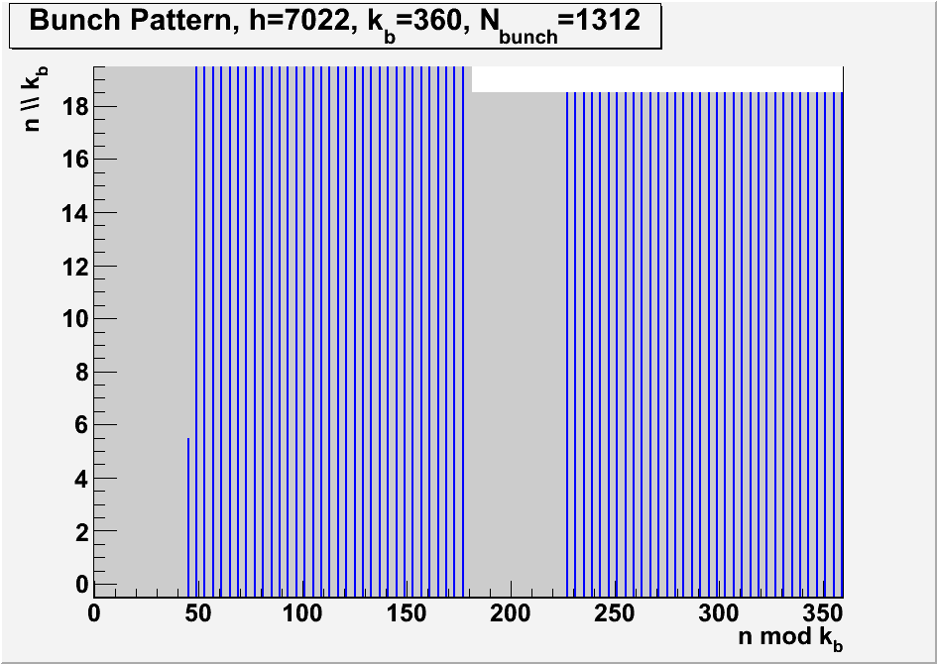
Bunch Pattern, Baseline configuration

Slide 9
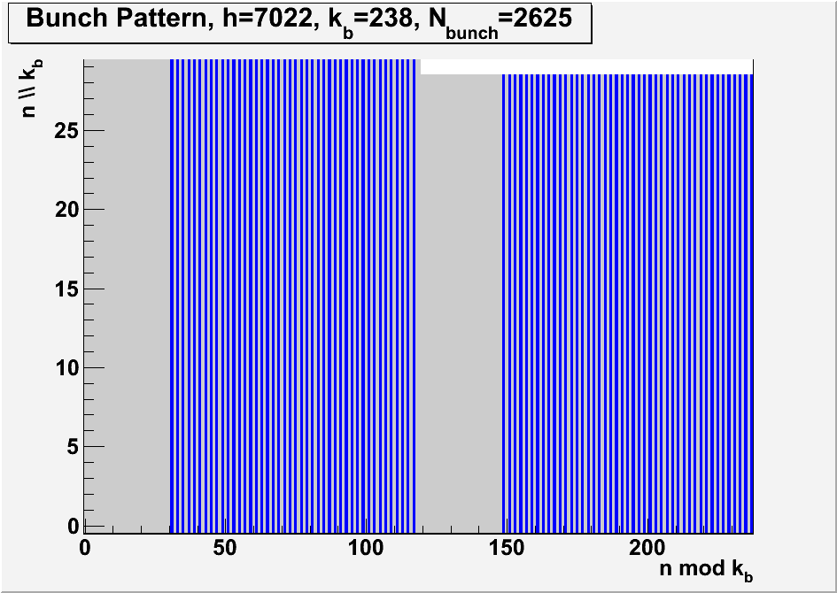
Bunch Pattern, full power

Slide 10
Some other solutions
 |  | Baseline |  |  |  | Full Power
Harmonic number h | Circumf. (m) | DR bucket spacing kb | ML bunch spacing (ns) | ML current (mA) | Max bunches | DR bucket spacing kb | ML bunch spacing (ns) | ML current (mA) | Max bunches
7022 | 3238.7 | 360 | 553.8 | 5.79 | 1263 | 238 | 366.2 | 8.75 | 2731
7126 | 3286.6 | 380 | 584.6 | 5.48 | 1197 | 250 | 384.6 | 8.33 | 2600
7240 | 3339.2 | 356 | 547.7 | 5.85 | 1278 | 254 | 390.8 | 8.20 | 2559
7372 | 3400.1 | 364 | 560.0 | 5.72 | 1250 | 234 | 360.0 | 8.90 | 2777
7382 | 3404.7 | 360 | 553.8 | 5.79 | 1263 | 242 | 372.3 | 8.61 | 2685
7498 | 3458.2 | 346 | 532.3 | 6.02 | 1315 | 238 | 366.2 | 8.75 | 2731
7606 | 3508.0 | 374 | 575.4 | 5.57 | 1216 | 234 | 360.0 | 8.90 | 2777
 |  |  |  |  |  | 248 | 381.5 | 8.40 | 2620
7736 | 3568.0 | 340 | 523.1 | 6.13 | 1338 | 238 | 366.2 | 8.75 | 2731
 |  | 364 | 560.0 | 5.72 | 1250
7906 | 3646.4 | 340 | 523.1 | 6.13 | 1338 | 242 | 372.3 | 8.61 | 2685
 |  | 372 | 572.3 | 5.60 | 1223
8005 | 3692.1 | 368 | 566.2 | 5.66 | 1236 | 232 | 356.9 | 8.98 | 2801
8102 | 3736.8 | 360 | 553.8 | 5.79 | 1263 | 248 | 381.5 | 8.40 | 2620
8108 | 3739.6 | 380 | 584.6 | 5.48 | 1197 | 242 | 372.3 | 8.61 | 2685
8126 | 3747.9 | 366 | 563.1 | 5.69 | 1243 | 250 | 384.6 | 8.33 | 2600
8148 | 3758.0 | 376 | 578.5 | 5.54 | 1210 | 242 | 372.3 | 8.61 | 2685
8172 | 3769.1 | 380 | 584.6 | 5.48 | 1197 | 238 | 366.2 | 8.75 | 2731
8182 | 3773.7 | 362 | 556.9 | 5.75 | 1256 | 236 | 363.1 | 8.83 | 2754
8191 | 3777.8 | 360 | 553.8 | 5.79 | 1263 | 252 | 387.7 | 8.27 | 2579
8237 | 3799.1 | 366 | 563.1 | 5.69 | 1243 | 232 | 356.9 | 8.98 | 2801
8308 | 3831.8 | 352 | 541.5 | 5.92 | 1292 | 234 | 360.0 | 8.90 | 2777
 |  | 356 | 547.7 | 5.85 | 1278
8378 | 3864.1 | 358 | 550.8 | 5.82 | 1270 | 244 | 375.4 | 8.54 | 2663

Slide 11
Consequence of an increased bunch spacing
Nominal bunch spacing: 554ns -> 5.8mA at 3.2nC bunch charge
Increase bunch spacing by 5%:
-> current down by 5%, RF power down by 5%
-> moreRF margin (e.g. for higher gradient)
Bunches in 700us pulse: down by 5% -> lumi down by 5%
Cavity fill time up by 5% -> need to reduce pulse time -> lumi further down
5% lumi loss can be compensated by increase of 2.5% bunch charge increase
Changing the bunch spacing by more than 1-2% reduces luminosity

Slide 12
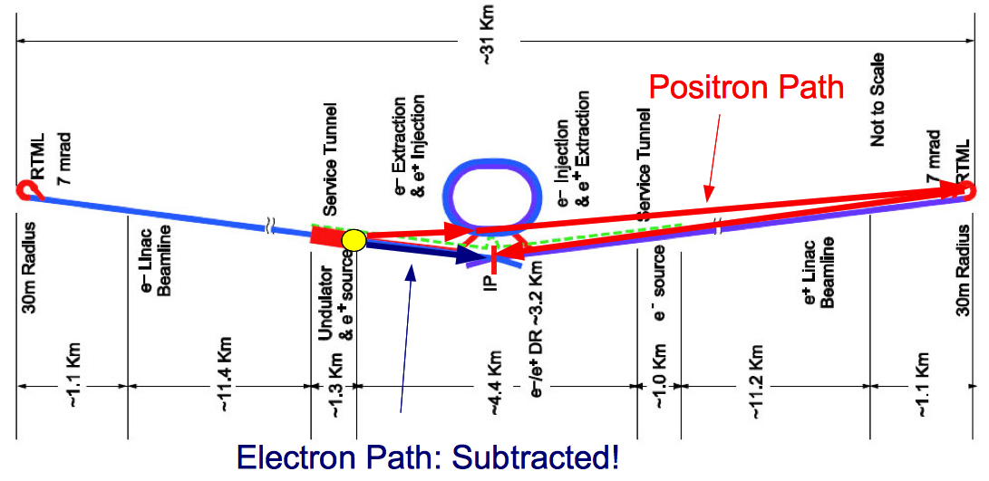
The Global timing constraint
Positron bunches are produced from their “partner” electron bunches
-> new positron bunches are injected into DR while old (damped) positrons are still in
Simplest solution: each e+ bunch goes into exactly the same bucket that was occupied by colliding e+ bunch
  e+ bunch is ejected from DR, travels down RTML and Main Linac, while
  empty bucket left by e+ bunch rotates around DR several times
  Partner e- bunch creates new e+ bunch
  e+ arrives exactly at DR in time to fill rotating void bucket, while
  e- and e+ bunches collide at IP

Slide 13
The numerical condition
Length (DR ejection -> IP) – length (target -> IP) + length (target -> DR injection) =
n * DR circumference
For a given DR circumference:
ML length is quantized by ½ DR circumference (~1.5km: 35GeV)

Slide 14
The calculation for the TDR baseline design (Asian site)
Undulator Photon Transport UPT (BEGEDOGL -> PTARGET) | 372.0
Positron to DR injection PTARGET -> MPDRINJ | 2232.4
INJ straight | 89.3
Photons/positrons to z=0 |  | 2693.7
Electron dogleg EDOGL (BEGDOGL -> TPS2BDS) | -423.6
Electron BDS to IP | -2253.5
Electrons to z=0, i.e. IP |  | -2677.1
Difference Positrons-Electrons to z=0: |  |  | 16.6
Positrons to DR extraction | 107.9
Positron RTML (DKS version) | 15993.0
ML length (DKS) | 11071.7
Positron BDS to IP | 2252.6
Positron Path |  |  | 29425.2
Total Sum |  |  | 29441.8
9 / 10*DR circumference | 3238.7 | 29148.1 | 32386.8
Mismatch |  | -293.6 | 2945.0

Slide 15
What needs to be changed
Reduce ML and/or BDS length by 147m
(can probably be done in BDS)
Or increase ML length by 1473m:
room for 12 more cryostrings a 2.54GeV / 116m: 250 -> 280.5 GeV beam energy
Or change DR circumference -> Try different viable DR circumferences

Slide 16
Possible Solutions
h | Circumference (m) | n | N*circumference (m) | Mismatch (m) | Beam energy (GeV) | CM energy (GeV)
7022 | 3238.7 | 9 | 29148.1 | -293.6 | 244.9 | 489.8
7906 | 3646.4 | 8 | 29171.2 | -270.6 | 244.9 | 489.8
8005 | 3692.1 | 8 | 29536.5 | 94.7 | 250.0 | 500.0
7126 | 3286.6 | 9 | 29579.8 | 138.1 | 250.0 | 500.0
8102 | 3736.8 | 8 | 29894.4 | 452.6 | 252.5 | 505.1
8108 | 3739.6 | 8 | 29916.5 | 474.8 | 255.1 | 510.2
8126 | 3747.9 | 8 | 29982.9 | 541.2 | 255.1 | 510.2
7240 | 3339.2 | 9 | 30053.0 | 611.3 | 255.1 | 510.2
8148 | 3758.0 | 8 | 30064.1 | 622.3 | 255.1 | 510.2
8172 | 3769.1 | 8 | 30152.7 | 710.9 | 257.6 | 515.2
8182 | 3773.7 | 8 | 30189.6 | 747.8 | 257.6 | 515.2
8191 | 3777.8 | 8 | 30222.8 | 781.0 | 257.6 | 515.2
8237 | 3799.1 | 8 | 30392.5 | 950.7 | 260.2 | 520.3
7372 | 3400.1 | 9 | 30601.0 | 1159.2 | 260.2 | 520.3
7382 | 3404.7 | 9 | 30642.5 | 1200.7 | 262.7 | 525.4
8308 | 3831.8 | 8 | 30654.5 | 1212.7 | 262.7 | 525.4
8378 | 3864.1 | 8 | 30912.8 | 1471.0 | 265.2 | 530.5
7498 | 3458.2 | 9 | 31124.0 | 1682.2 | 267.8 | 535.6
7606 | 3508.0 | 9 | 31572.3 | 2130.5 | 272.9 | 545.7
7736 | 3568.0 | 9 | 32111.9 | 2670.2 | 277.9 | 555.9
7022 | 3238.7 | 10 | 32386.8 | 2945.0 | 280.5 | 561.0

Slide 17
Conclusion
A number of possible DR harmonic numbers / circumferences exist,
with different tradeoffs -> needs more checking
Solutions for ML length exist with a few 100m spacing
To fulfill global timing constraint requires change of ML length and/or DR circumference
Many solutions are viable -> choose the required CM energy and energy reserve first, then fix DR and ML lengths

