Slide 1
TB Fuze Meeting – Feb 25th
  LCB Meeting
  CFS-ADI meeting
  Parameter Joint WG
  ALCW 14

Slide 2
ILC Status
1. Linear Collider Overview (Evans)
2. ILC Status (Harrison)
3. CLIC Status (Stapnes)
4. Linear Collider Detector Status (Yamamoto)
5. ILC Laboratory Structure and Management (Komamiya)
6. PAC Status (Komamiya)
7. LCC MOUs (Komamiya)
8. Regional Reports (Bagger, Gao, Le Diberder)
9. Future LCB Meetings
10. Any Other Business

Slide 3
ILC Status
  Management activities
  An Energy Phased Project
  Schedule comments
  SRF

Slide 4
Energy Phasing - Summary
A phased energy implementation results in a minimal change to the construction project costs and shortens the first-phase construction schedule slightly, allowing physics at 250 GeV centre of mass to begin up to 1 year earlier.
The complete tunnel construction and injector systems are necessary in the first stage to achieve this state of affairs.
Beam dynamics considerations argue for an initial accelerating stage and a hybrid scheme involving three linac sections is somewhat more favourable for luminosity upgrade schemes at 250 GeV CoM energies.
We estimate that one-year of commissioning and 4 years of operation at 250 GeV is necessary for 250 fb-1 of integrated luminosity. A subsequent shutdown of one year will be needed to attain 500 GeV.
The most significant change involves the cryomodule/HLRF production rate and the corresponding project funding profile.

Slide 5
ILC (>28MV/m)
~65%

Slide 6
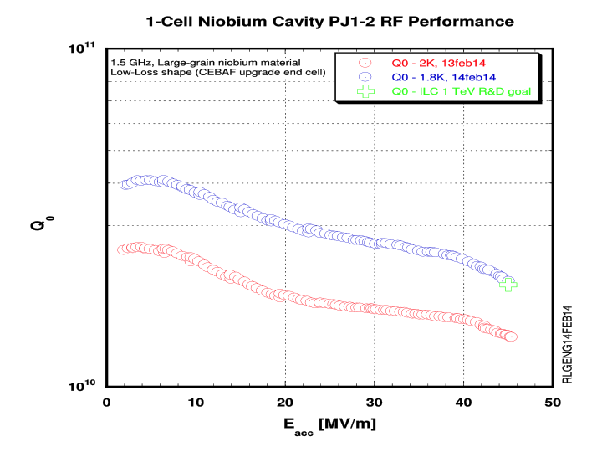
JLAB Single cell
45 MV/m @ 2 10e10

Slide 7
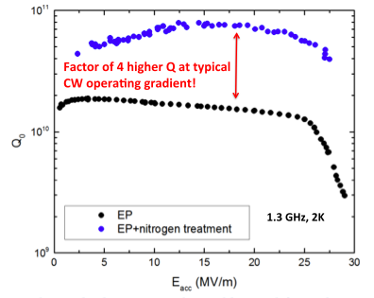
Surface Doping

Slide 8
Summary
  Almost any energy staging scenario is feasible with some cost and schedule implications. Multiple installation stop-starts is inefficient, cryomodule production stop-starts are very disruptive.
  LCB needs to take the lead in officially updating machine parameters.
  CFS pre-project schedule will drive the accelerator design work and the overall project schedule at this point.
  Some level of pre-project funding is needed for CFS work in Japan.

Slide 9
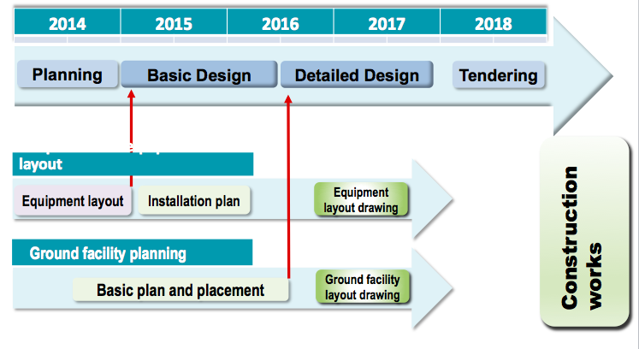
CFS-ADI joint meeting
  U. of Tokyo – April 8-9-10
  Meeting Charge by March 11th
  ^{Need to sort out attendees} (~15)

Slide 10
Parameters Joint WG
  Jim Brau – co-convener
  Jenny List
  Fujii Keisuke
  Tim Barklow
  Nick – co-convener
  Kaoru
  Jie Gao
  Sort out energy phasing

Slide 11
ALCW 14
  Fermilab May 12-16
  Machine conveners MH & Steinar Stapnes
  How shall we determine the ILC program

