Slide 1
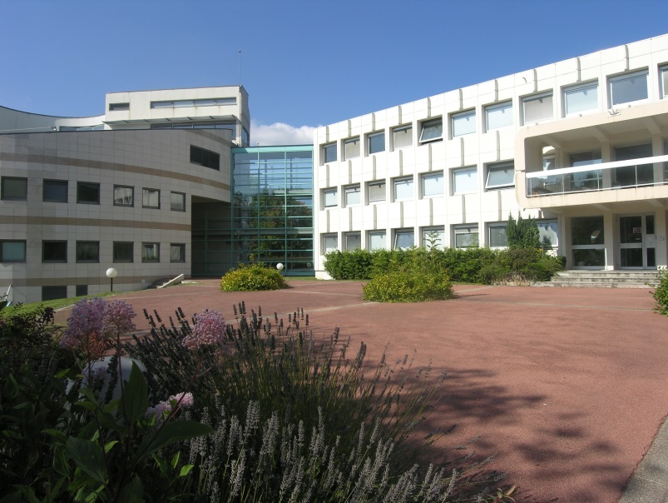
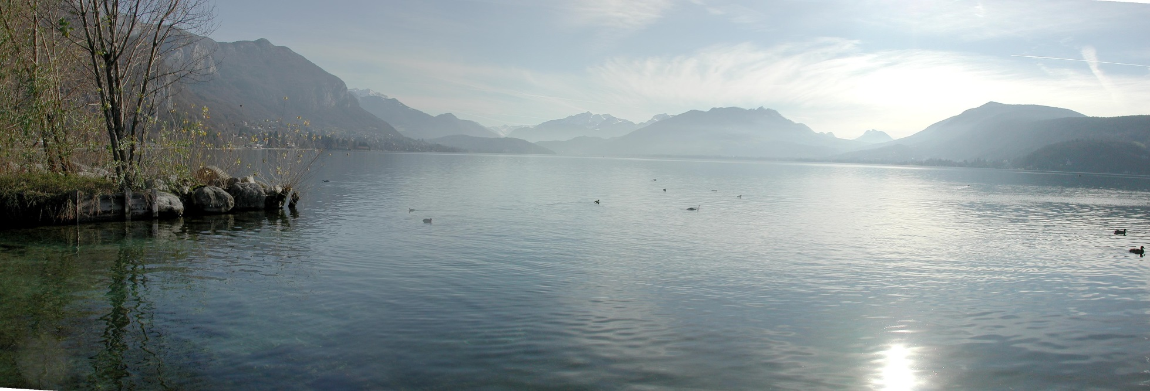
Welcome to Annecy
A.Jeremie

Slide 2
Workshop rooms
The sessions will take place in the « Salle des Sommets » (3rd floor round building).
The coffee breaks will take place on the Ground Floor in the Grande Galerie
There will be a short visit of LAPP facilities on Tuesday afternoon.

Slide 3
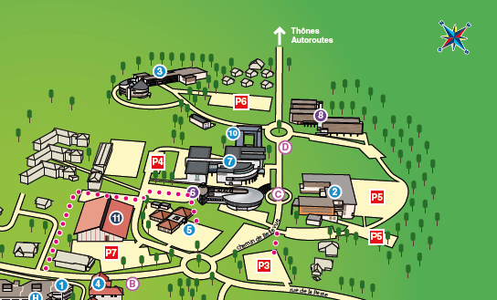
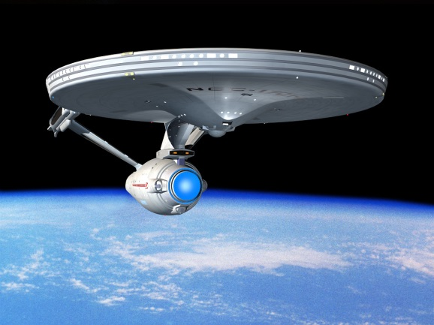
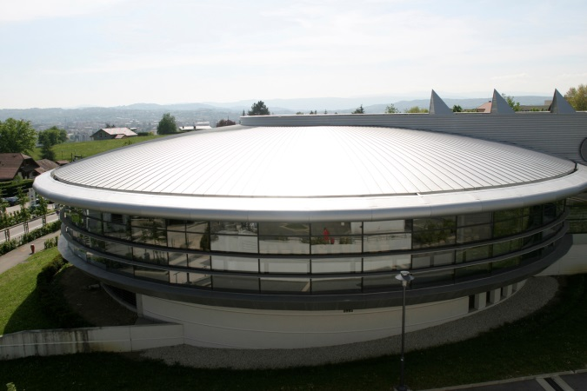
Lunches provided by the FJPPL
3 minute walk, down to the main road
Then go to the building that looks like the Starship Enterprise from Star Treck…

Slide 4
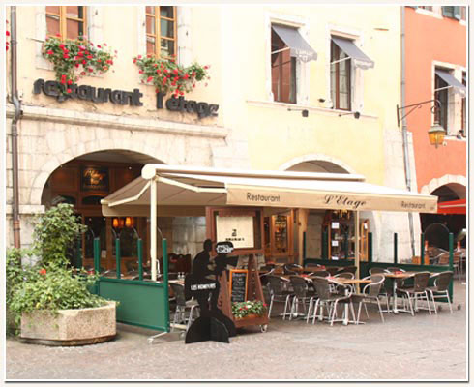
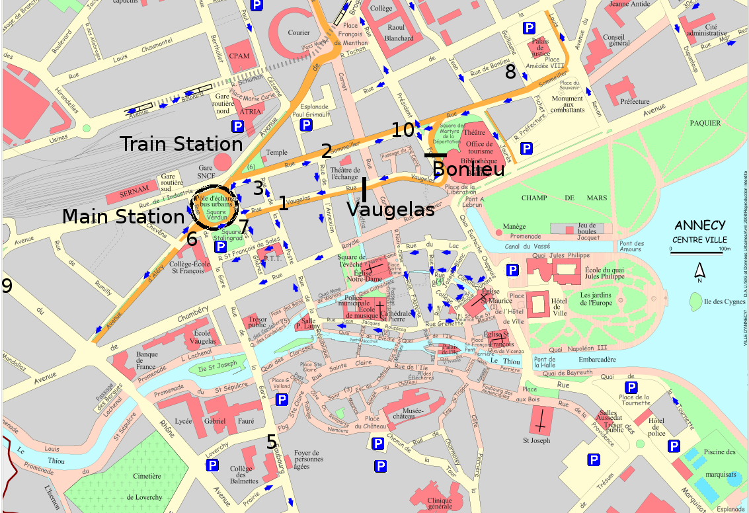
Workshop dinner
L’Etage 13, rue du Paquier 19:30
The dinner will be « à la carte »

Slide 5
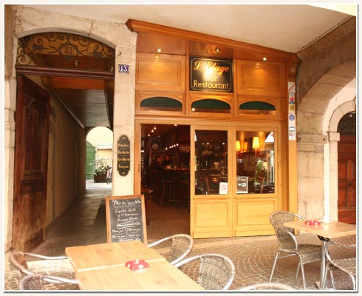
Workshop dinner
L’Etage 13, rue du Paquier
Go through the bar on the Ground floor, or through the arcade, then out the back to go up the stairs to the first floor.
Then the restaurant is on the right at the end of the balcony.

Slide 6
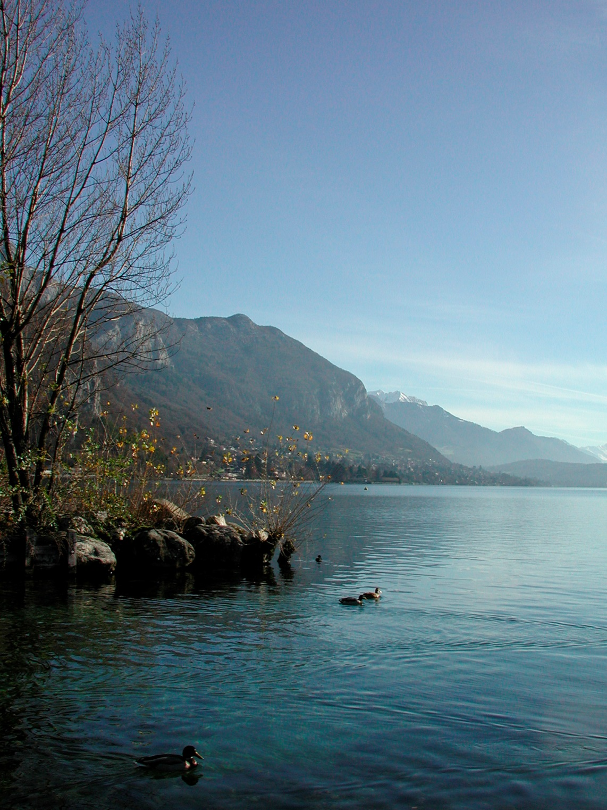
Enjoy your stay!

