Slide 1

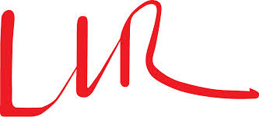




Building blocks 0.18 µm XFAB SOI
Calice Meeting - Argonne 2014
CALIIMAX-HEP

Slide 2
XFAB SOI 0.18 µm
SOI Silicon On Insulator ;
Recent technology (2011) ;
Cheaper than the 0.35 µm AMS technology ;
Better for digital electronics.
Disclaimer: The following is a study for building blocks in this technology, not a chip.

Slide 3
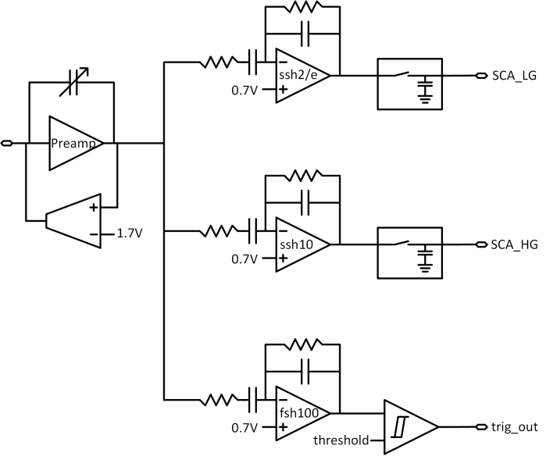
Simplified schematic

Slide 4
Specifications
Adjustable feedback capacitor from 500 fC to 7.5 pC ;
Slow shapers’ shaping time of 180 ns ;
Fast shaper’s shaping time of 30 ns ;
2 slow shapers: slow shaper high gain with a gain of 10, slow shaper low gain with a gain of 2/e (≈0.74) ;
Fast shaper gain 100 ;
No fancy adjustable parameters, the building blocks are as simple as it could be, there will be different versions of these ;
For all the following simulations, the feedback capacitance had been chosen to be 6 pF.

Slide 5
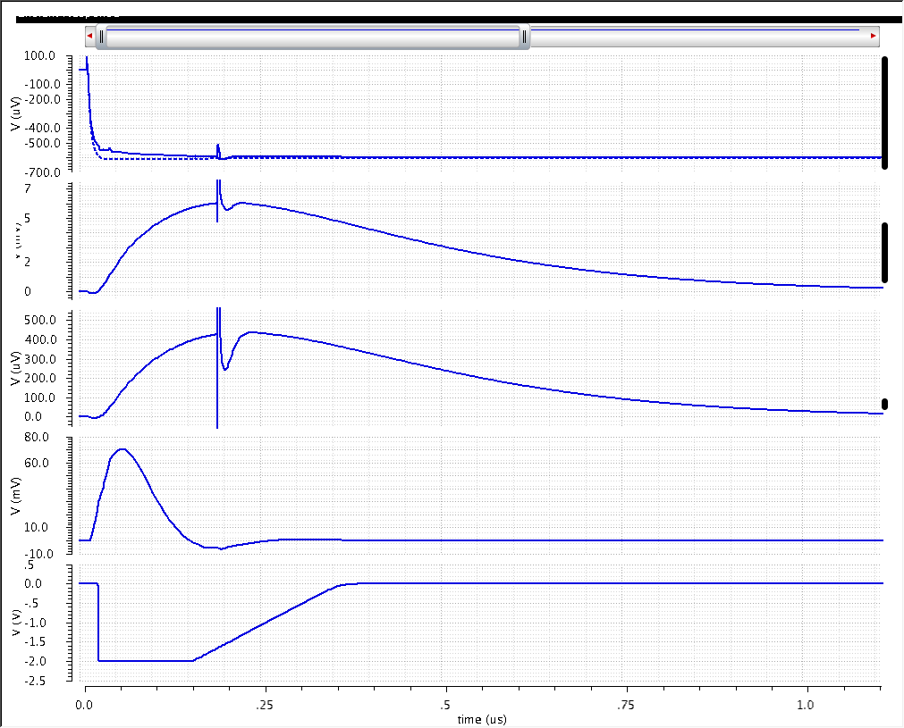
Analog outputs – simulation results
Preamp output = 600 uV
Ssh10 = 6 mV
Ssh2/e = 430 µV
Fsh100 = 70 mV
discriminator

Slide 6
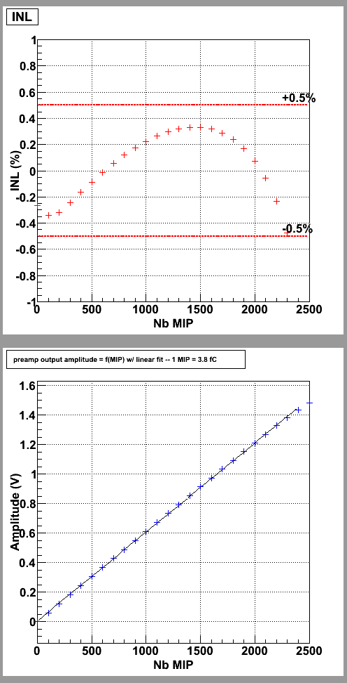
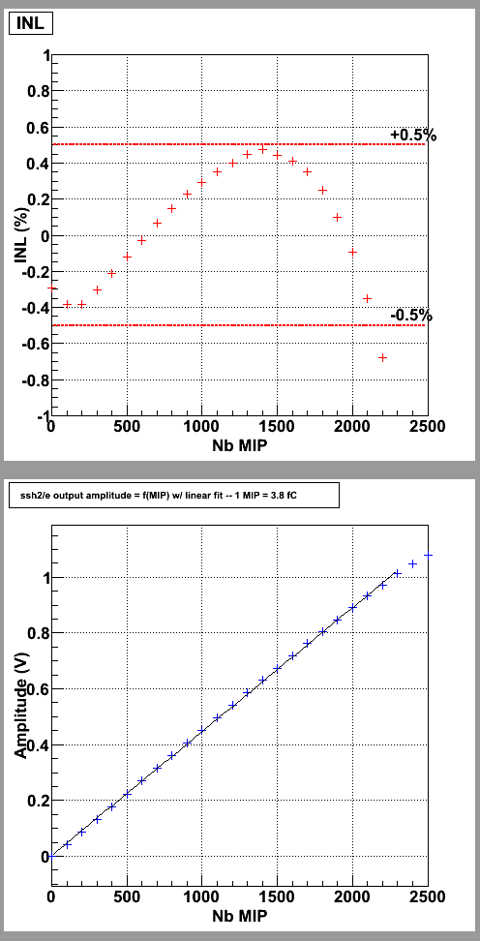
Linearity
1% linearity up to 2300 MIP at preamplifier output and 2200 MIP at low gain slow shaper output.
1 MIP = 3.8 fC => 1% linearity up to 8.36 pC (with a 6 pF preamplifier feedback capacitance)

Slide 7
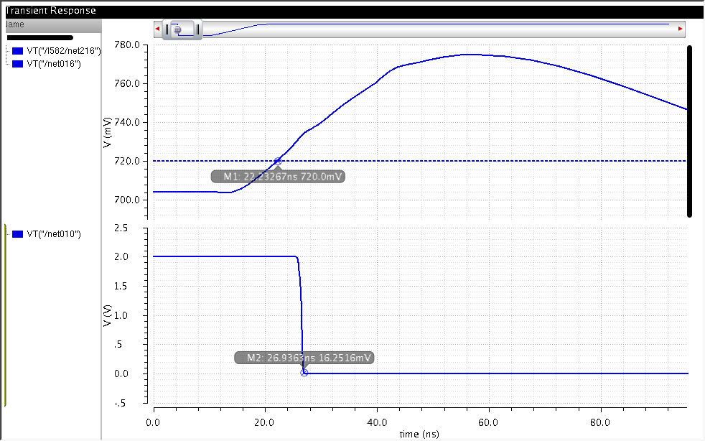
Discriminator efficiency
Less than 5 ns of trigger time

Slide 8
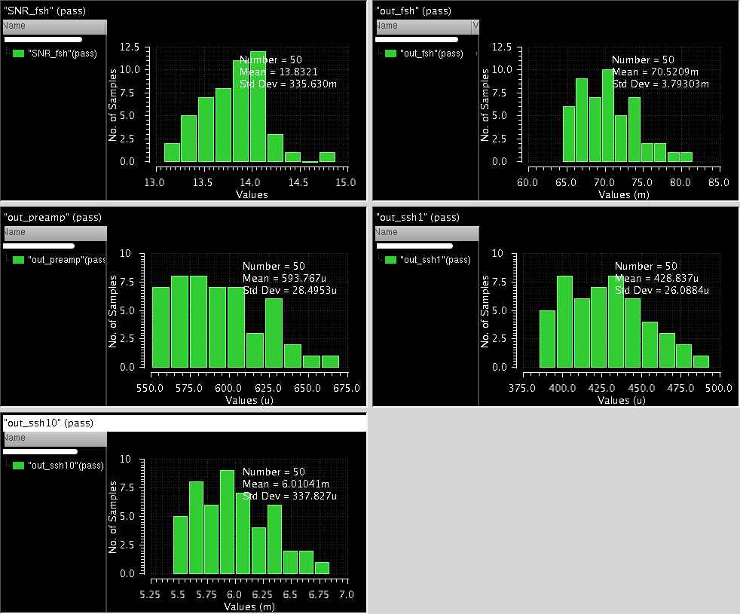
Monte Carlo
The dispersion is mainly due to the feedback capacitance of the preamplifier (+/- 10% accuracy)

Slide 9
Noise issues
Noise contributions not understood. (doesn’t seem to fit the theory)
6 pF doesn’t give enough first stage gain to have a nice noise behaviour. 2 pF is preferable but the handled charge range will be reduced.

Slide 10
Different preamplifier design options
A Nmos common source was used for these simulations.
Differential amplifier and Pmos common source have been studied too.
Differential:
  Differential preamplifier works well and permits high gain in open loop (2-stages) and so 1/1000 linearity.
  More noise and consumption.
  Bigger surface (2 input transistors, adjustable compensation capacitor)
Pmos common source:
  Preamplifier architecture of skiroc2.
  Standard cascode reduces the dynamic range, so folded cascode is used instead, leading in a drop in open loop gain and thus degrading closed loop linearity.
  Potentially the same issues with power supply than in skiroc2.

Slide 11
Different building blocks design options
Bandgap
Shaper amplifiers
Analog memories

Slide 12
Schedule
Tape-out in May
Back in october
First results expected in december
Possibly a new skiroc prototype on 0.18 µm

Slide 13
Thanks for your attention

