Slide 1
Update on mass assembly
3/19/14 - CALICE Collaboration Meeting
Argonne National Laboratory
JGU Mainz – Phi Chau
Bruno Bauss, Volker Büscher, Julien Caudron, Reinhold Degele, Karl Heinz Geib, Sascha Krause, Yong Liu, Lucia Masetti, Uli Schäfer, Rouven Spreckels, Stefan Tapprogge, Rainer Wanke

Slide 2
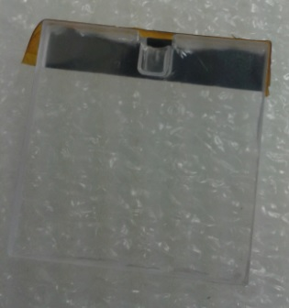
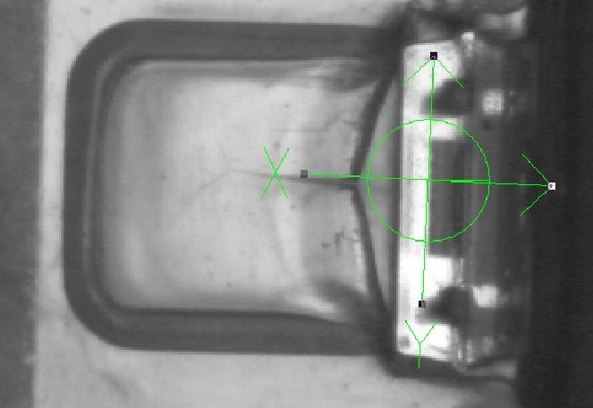
Soldering tests
Short reminder of first soldering test
Test at SEHO, Kreuzwertheim, october 13
Dimple was melted (on board side of the dimple) during soldering
Photo taken at Fuji Machine MFG Europe GmbH in Mainz-Kastel

Slide 3
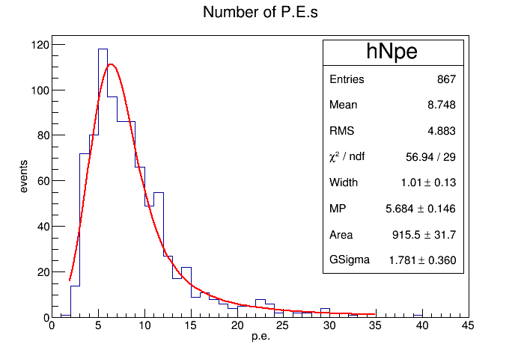
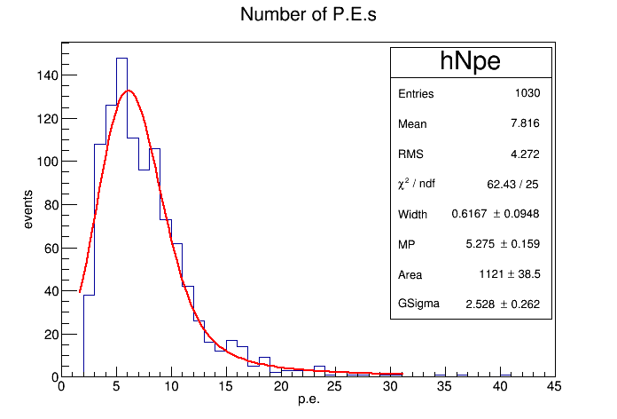
Soldering tests
Short reminder of first soldering test
Test at SEHO, Kreuzwertheim, october 13
Dimple was melted (on board side of the dimple) during soldering
Analysis with Landau-Gaussian-Fit

Slide 4
Soldering tests
Short reminder of first soldering test
Test at SEHO, Kreuzwertheim, october 13
Dimple was melted during soldering
Analysis with Landau-Gaussian-Fit
Configuration | Events | Landau Gaussian fit MPV [PE] | Mean [PE]
Before soldering | 867 | 5,684±0,146 | 8,748
After soldering | 1030 | 5,275±0,159 | 7,816

Slide 5
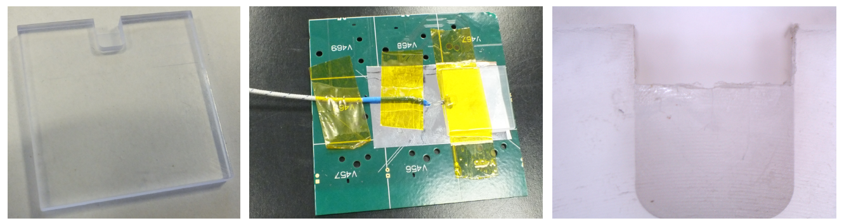
Soldering tests
Second soldering test
Test at Streckfuss Systems in Eggenstein, december 13
Test dummies with one sided dimple with 0,3 mm (instead of 0,5 mm of original dimple) thickness and scintillator material from Portvino (NA62)
Maximum temperature at the dimple ~69-74°C for several runs
Scintillator dummies melted much less at the dimple

Slide 6
Soldering tests
Second soldering test
Several dummies were used until a modification of the soldering parameter was found at which the dimple did not melt
Test with an original tile → melted again

Slide 7
Soldering tests
Conclusion for soldering
Soldering is the most critical part for mass assembly
Selective soldering has much lower temperature stress than wave soldering
Scintillator material is less stable than the dummy material
Dimple was melted every time just on one side → main part of temperature transportation turns up from the soldering pads not from SiPM
Board design with smaller or without soldering pads on the tile assembled side of the board should reduce the temperature transportation
SMD-SiPMs which are assembled together with the SMD components

Slide 8
Assembly tests
Overview of assembling tests
Assembly tests in december 2013 with ASM/SIPLACE and MYDATA in Munich with two different pick-and-place machines
Tests of camera detection of the SiPM pins
Test of automatic glue point setting with screen printer
Tests of placement precision with minimal tolerances between tiles

Slide 9
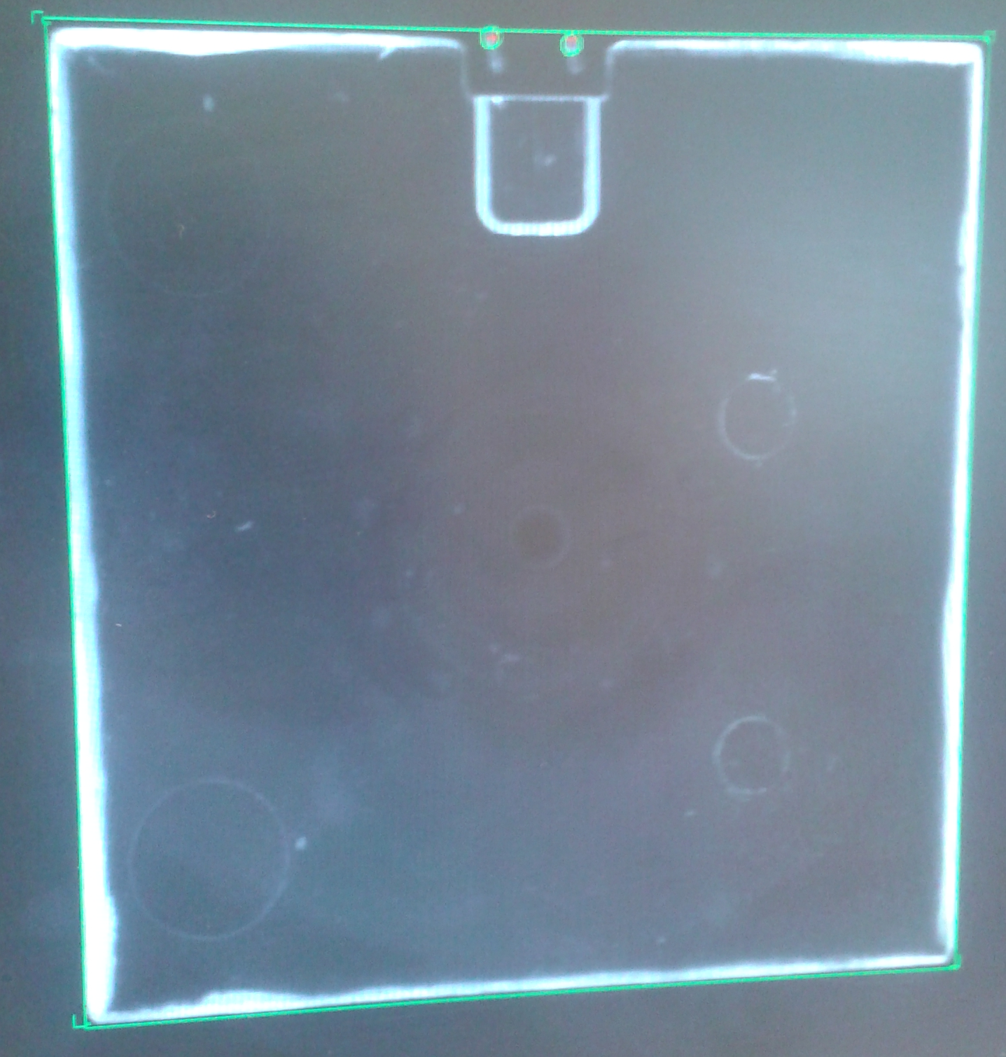
Assembly tests
Camera tests
Recognition of six positions of the tile and SiPM pins are because of manual assembling necessary
Four edges
Two pins
Every six positions should be fit together
The two tested machines fulfill these needs
Example:
Pin and edge detection with MYDATA MY9
Green symbolized accepted positions, red for not accepted positions
In this example tolerances for pins and edges are very big, with lower tolerances pins turn red

Slide 10
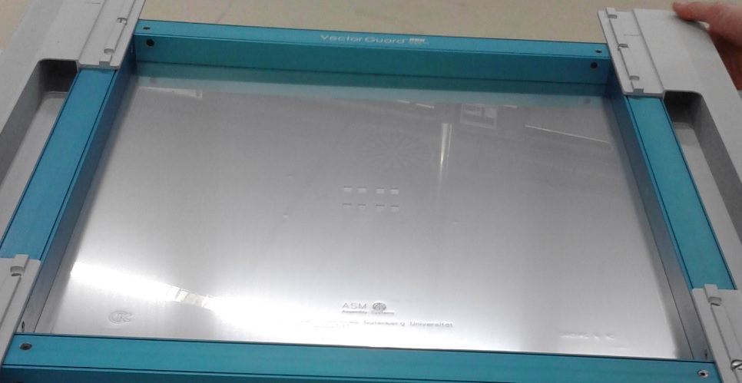
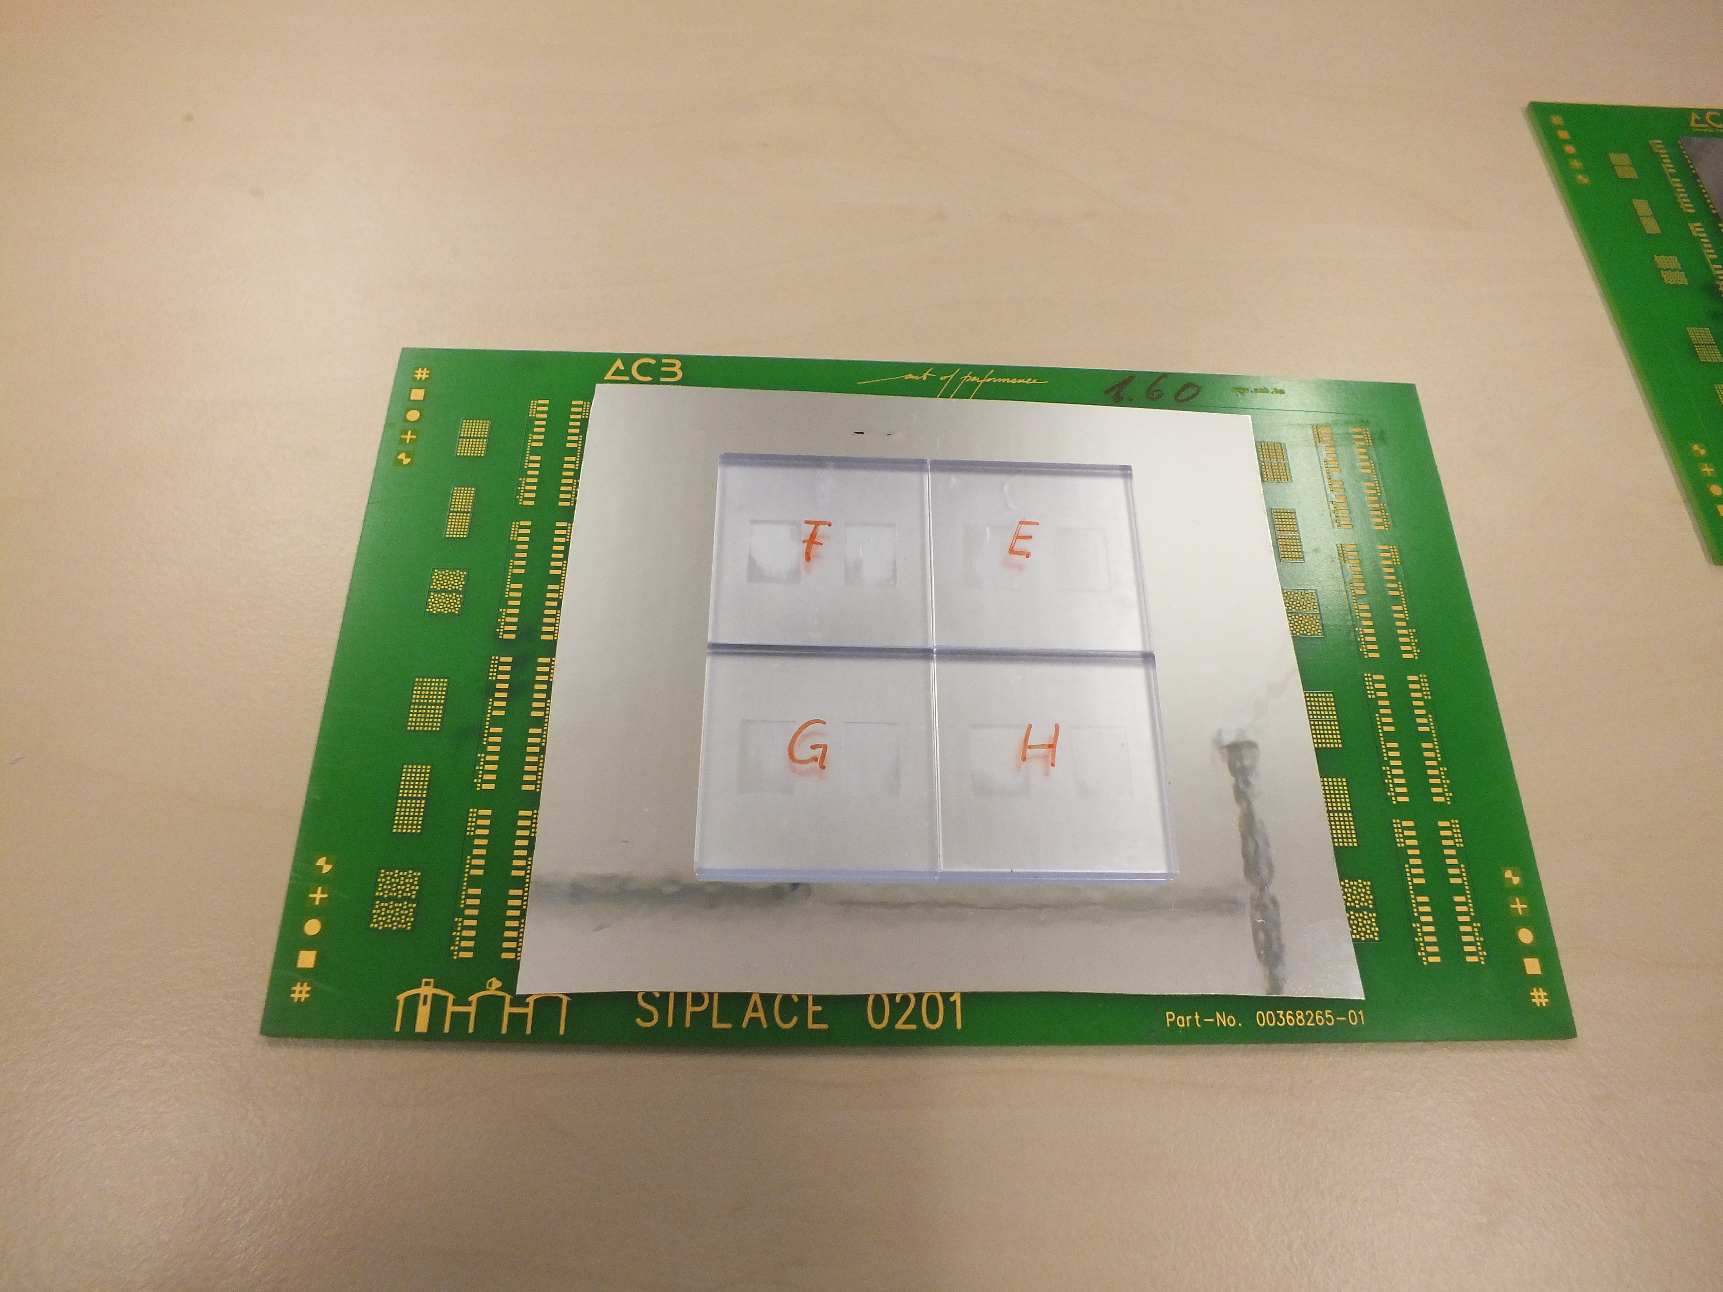
Assembly tests
Setting glue points on different boards
First test screen for screen printer with 80 µm thickness
On plane boards: without any problem
On HBU board: Problematic with the alignment of placed tiles because of the height of the circuit path
Thicker glue points

Slide 11
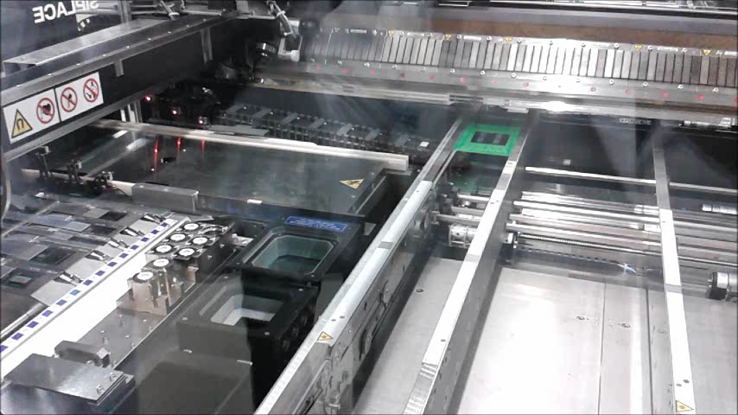
Assembly tests
Placement process

Slide 12
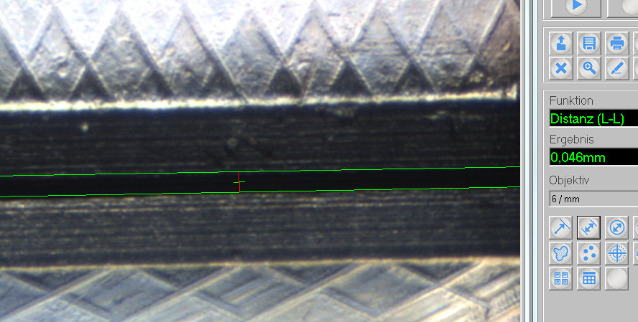
Assembly tests
Precision tests
Placement tests on several plane boards with glue points set by screen printer
Measurement of distances with microscope
Maximum variation of distances to each other was 16 µm
16 distances was measured in this way

Slide 13
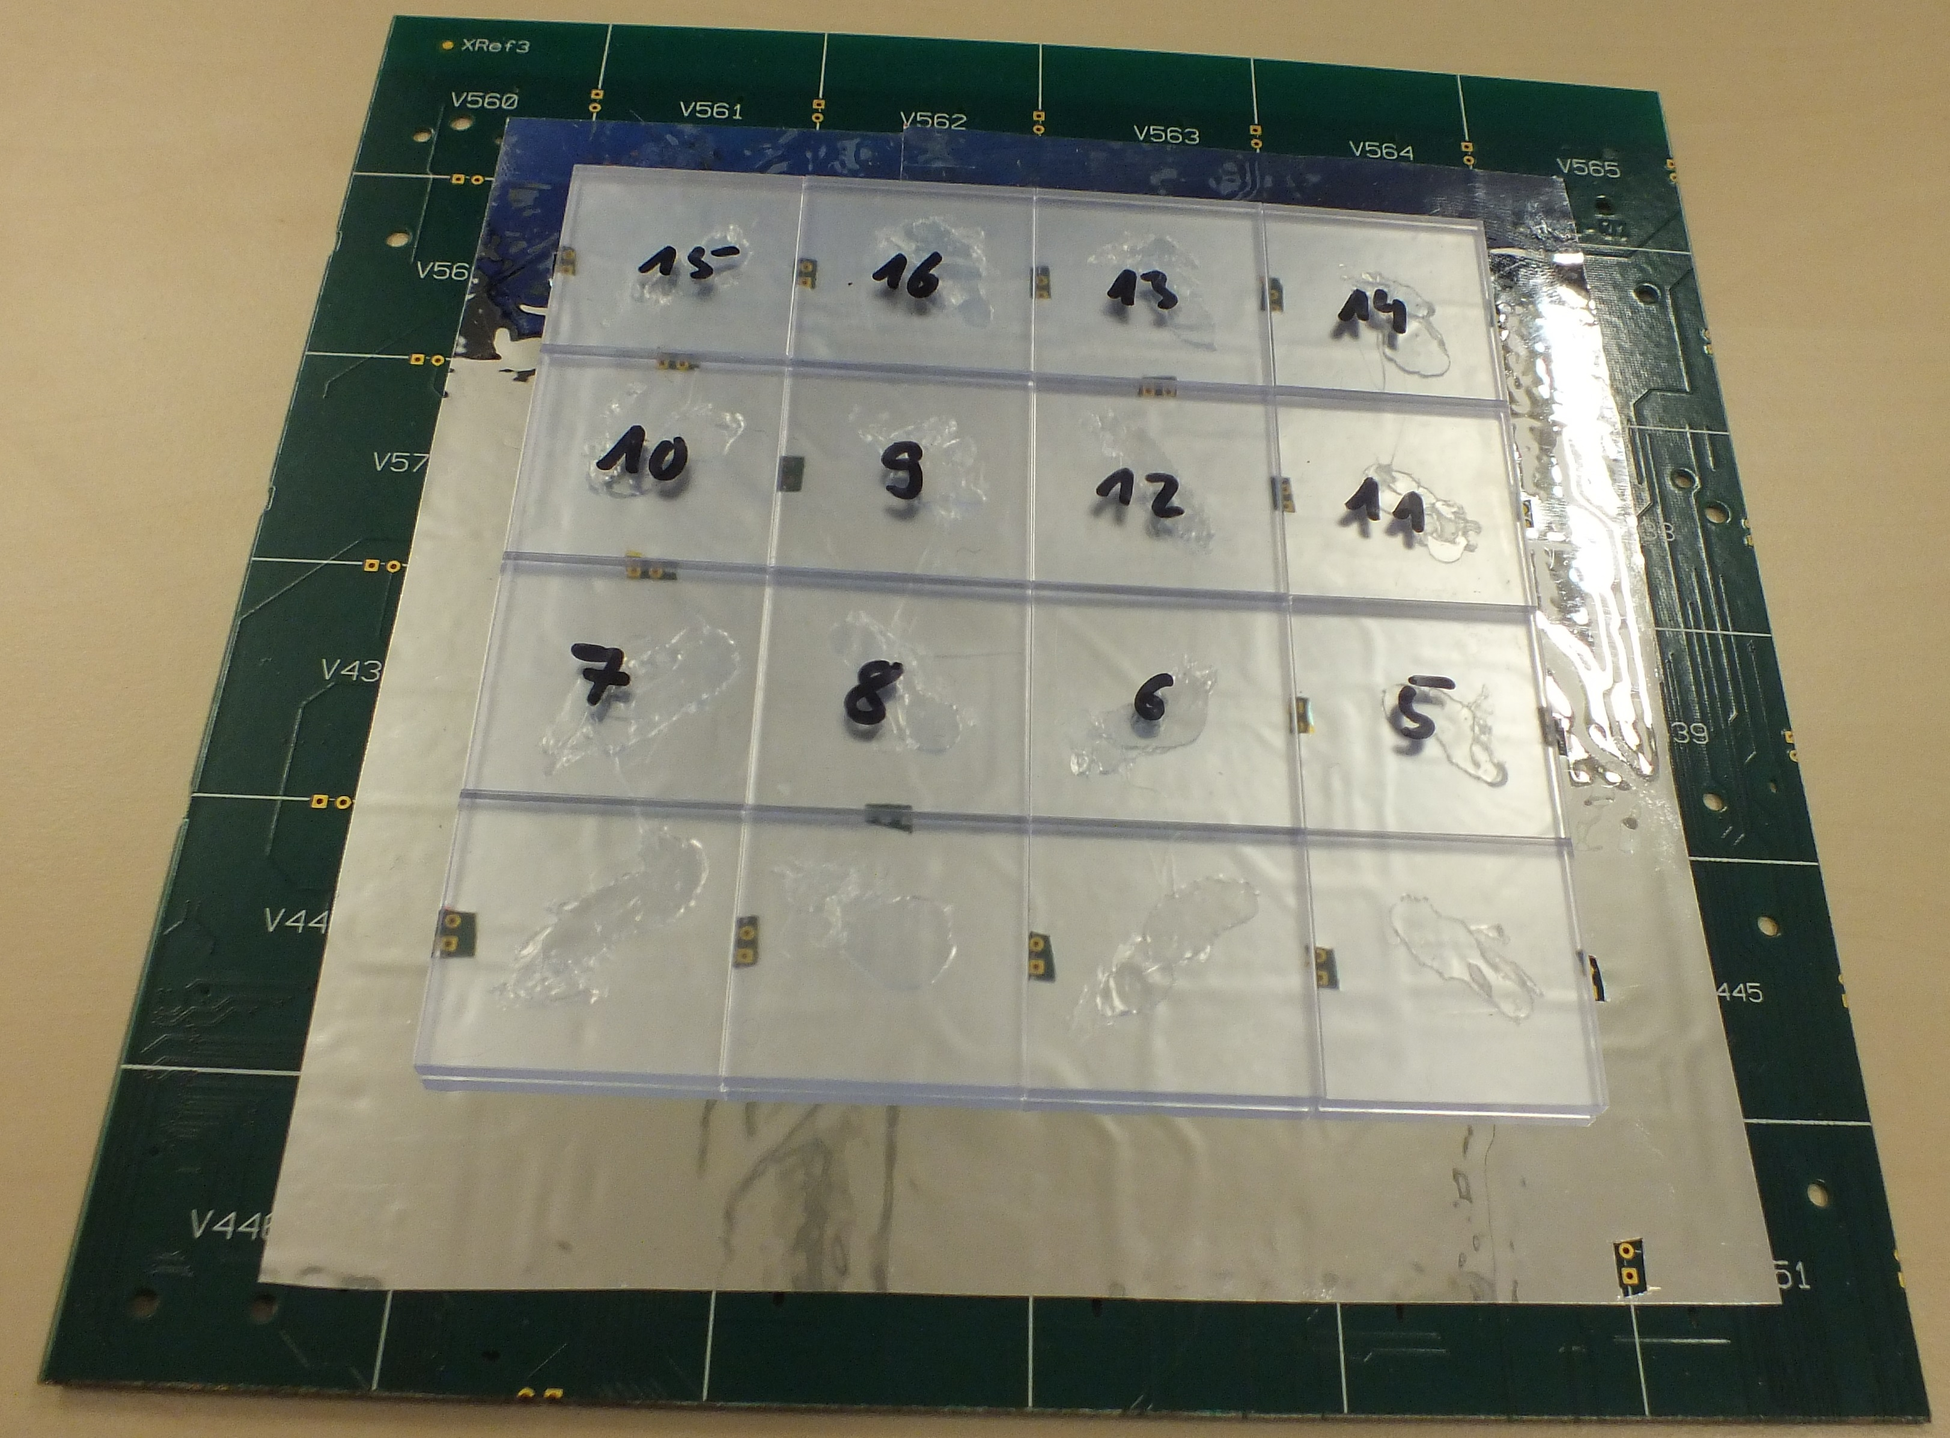
Assembly tests
Precision tests
Test on thick, not defined glue points on part of HBU board
Placement without any problems

Slide 14
Assembly tests
Conclusion for assembling
Setting glue points should be unproblematic
Pin recognition should be unproblematic (with the two tested machines)
Fulfillment of tolerances during placement is possible (with the two tested machines)
64 tiles were placed (with minimum two neighbors) without any problems
16 distances are measured and every distance was in the tolerance range

Slide 15
Forecast
Screen printer
Adaption on HBU board design with thicker glue points
Pick-and-place machine
More tiles have to be placed
Tests with original tiles with original SiPM to check the manual alignment of the components
Soldering machines
HBU design with smaller or without soldering pads on the tile placed side of the board
If this tests isn’t working:
Maybe an alternative scintillator material will work
SMD SiPMs

Slide 16
Thank you for your attention

