Slide 1


Upstream Phase Advance
Mikey Davis
14 March 2014
1/10

Slide 2
Introduction
At Phil’s request I have continued the studied on the upstream phase advance
Have used the Fight Simulator
Compared the ‘current method’ and Glen White method
Mikey Davis
14 March 2014
2/10

Slide 3
Flight Simulator
Beam Input Parameters
Flight Simulator
Phase Advance
Magnet Settings
Mikey Davis
14 March 2014
3/10

Slide 4
Nominal
Nominal Beam
Flight Simulator
Phase Advance
NominalMagnet Settings
Mikey Davis
14 March 2014
4/10

Slide 5
‘Current Method’
Nominal Beam
Flight Simulator
Phase Advance
Real Magnet Settings
Mikey Davis
14 March 2014
5/10

Slide 6
‘Glen White Method’
Simulated Beam
Flight Simulator
Phase Advance
Real Magnet Settings
Mikey Davis
14 March 2014
6/10

Slide 7
Simulated Beam
Start off with nominal input beam and magnet settings
Track the beam to OTR0 -> save the Twiss params
Input real magnet settings
Reverse track the beam from OTR0 to entrance to extraction line
This gives you the ‘simulated beam’
Mikey Davis
14 March 2014
7/10

Slide 8
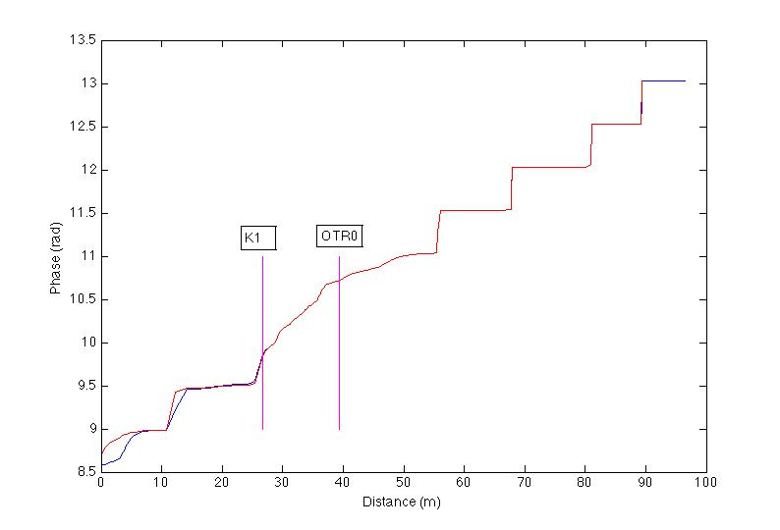
Results – Whole ATF2
Mikey Davis
14 March 2014
8/10

Slide 9
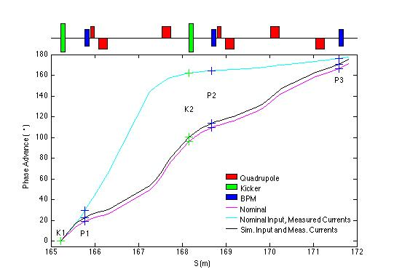
FONT Region
Mikey Davis
14 March 2014
9/10

Slide 10
Further Comments/Conclusions
Seems Glen is write and our method is overly simple
I have fiddled around with various Twiss parameters to see what effects they do
  Not much
  Maybe a more systematic study would be useful
Going through the log it seems like using OTR0 to actually measure these things isn’t too difficult
Might be worth doing this in the future?
Glenn has asked me to put together something on how to do the tracking, would this be helpful?
Mikey Davis
14 March 2014
10/10

