Slide 1
FONT digitisation studies of IP BPMs
D. Bett, N. Blaskovic, P. Burrows, G. Christian, M. Davis, Y. I. Kim, C. Perry
John Adams Institute, Oxford University
N. Blaskovic

Slide 2
Introduction
Introduction to IP BPMs and electronics
Signal digitisation: waveforms and FFT
Calibrations and phase shifter operation
Dynamic range and steering the beam
Setup modifications
Q vs. beam/BPM tilt scans
Charge normalisation considerations
N. Blaskovic

Slide 3
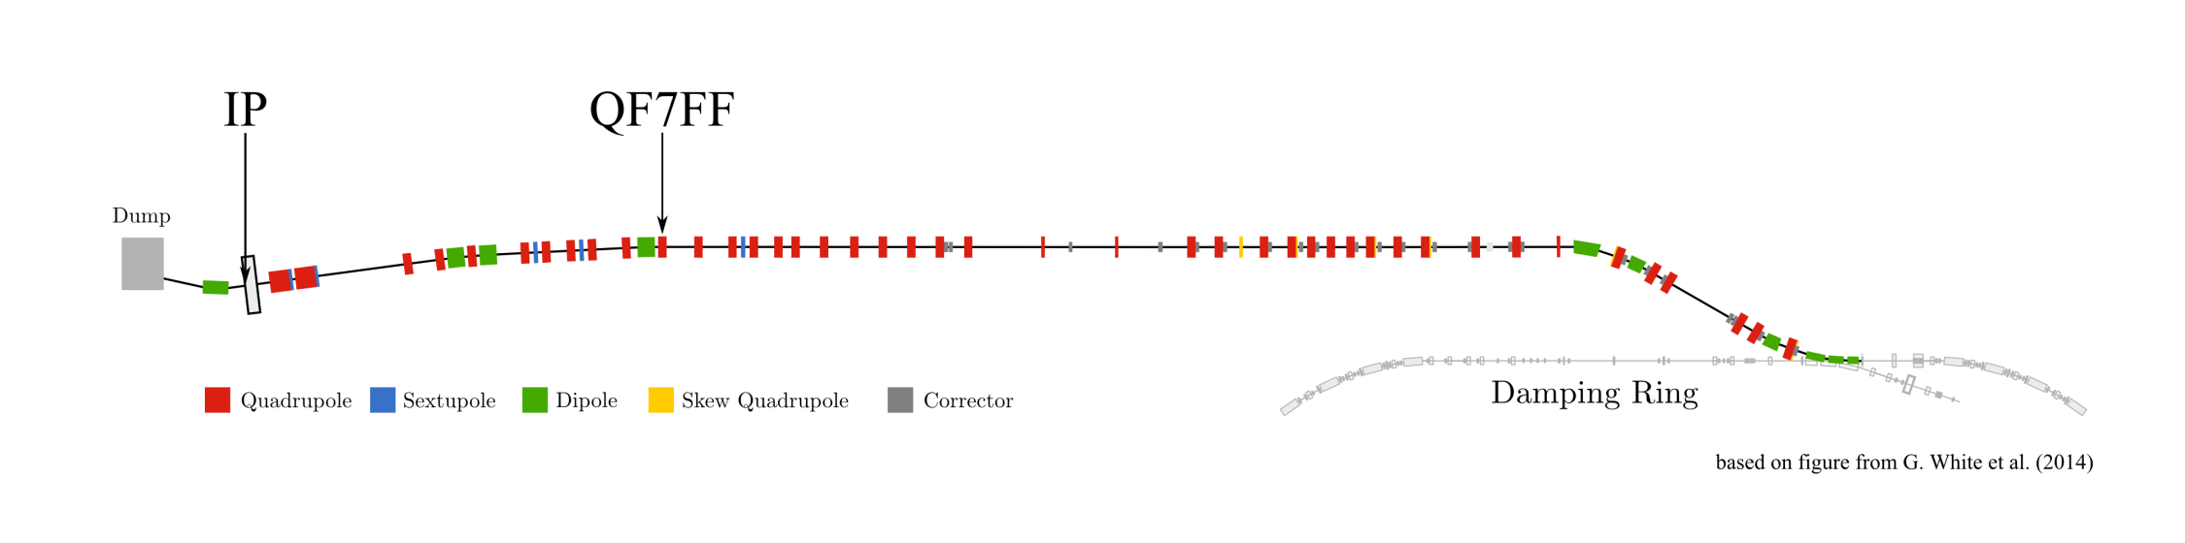
Location of IP BPMs
IPC
IP
IPB
IPA
N. Blaskovic

Slide 4
IP BPMs on movers
IPA & IPB
IPC
IP
movers
based on figure from N. Terunuma
N. Blaskovic

Slide 5
IP BPM signal processing
IPA
port 1
variable attenuator
electronics
I
port 2
Q
IPB
port 1
electronics
I
FONT5 board (digitiser)
port 2
Q
IPC
port 1
electronics
I
port 2
Q
Ref
splitter
attenuator
diode
IP BPM C-band signal
6.4 GHz (y) / 5.7 GHz (x)
Reference C-band signal
Base-band signal
based on S. Jang
N. Blaskovic

Slide 6
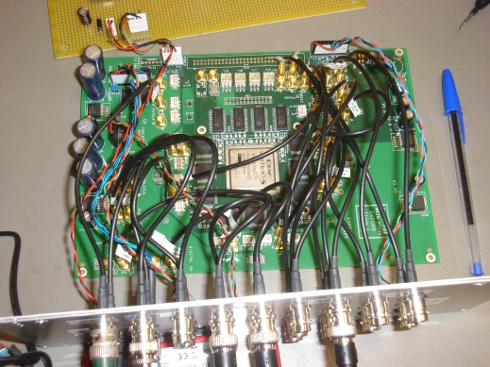
FONT5 board
9 ADCs (analogue-to-digital convertors)
Sampling at 357 MHz (2.8 ns)
13 bit: ± 4095 ADC counts for ± 0.5 V
Based on a Xilinx Vertex 5 FPGA
N. Blaskovic

Slide 7
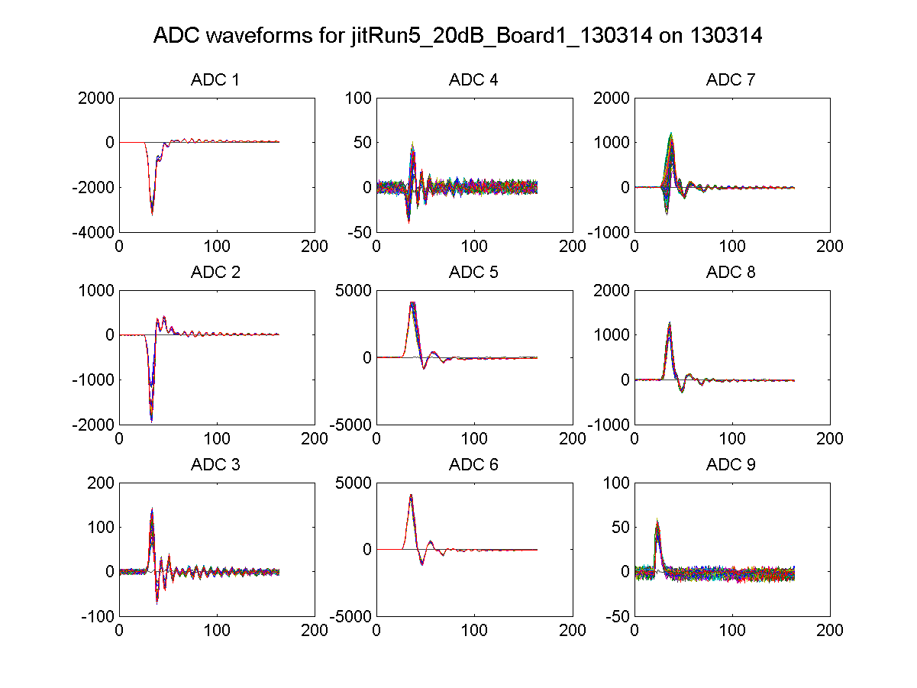
20 dB
IPB(Y) I
IPC(Y) Q
IPC(X) I
IPB(Y) Q
IPB(X) I
IPC(X) Q
IPC(Y) I
IPB(X) Q
Ref(Y)
N. Blaskovic

Slide 8
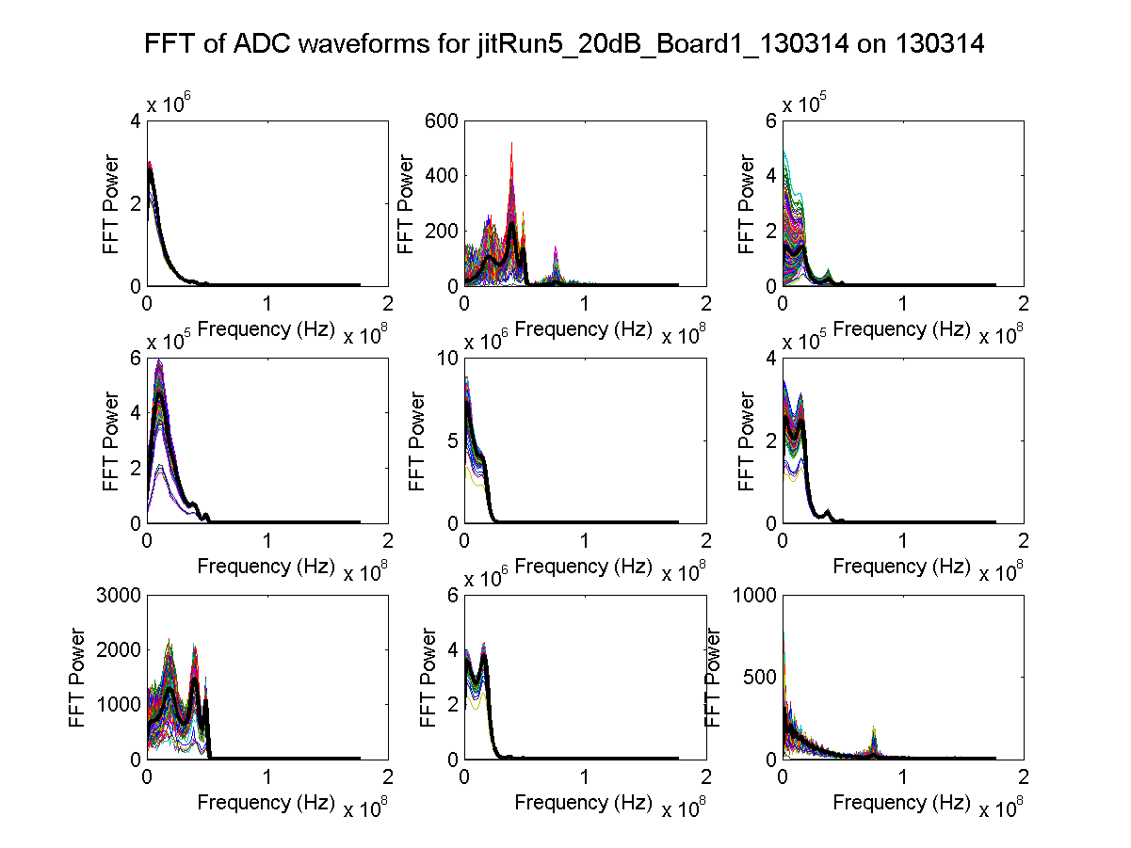
20 dB
IPB(Y) I
IPC(Y) Q
IPC(X) I
IPB(Y) Q
IPB(X) I
IPC(X) Q
IPC(Y) I
IPB(X) Q
Ref(Y)
N. Blaskovic

Slide 9
Calibration
IP BPM mover exercised across dynamic range
Dynamic range given as ± 3.6 um at 0 dB with charge of 5x10⁹ for current electronics gain and single-port BPM (T. Tauchi)
BPM movers: ~30 um/V (O. Blanco)
N. Blaskovic

Slide 10
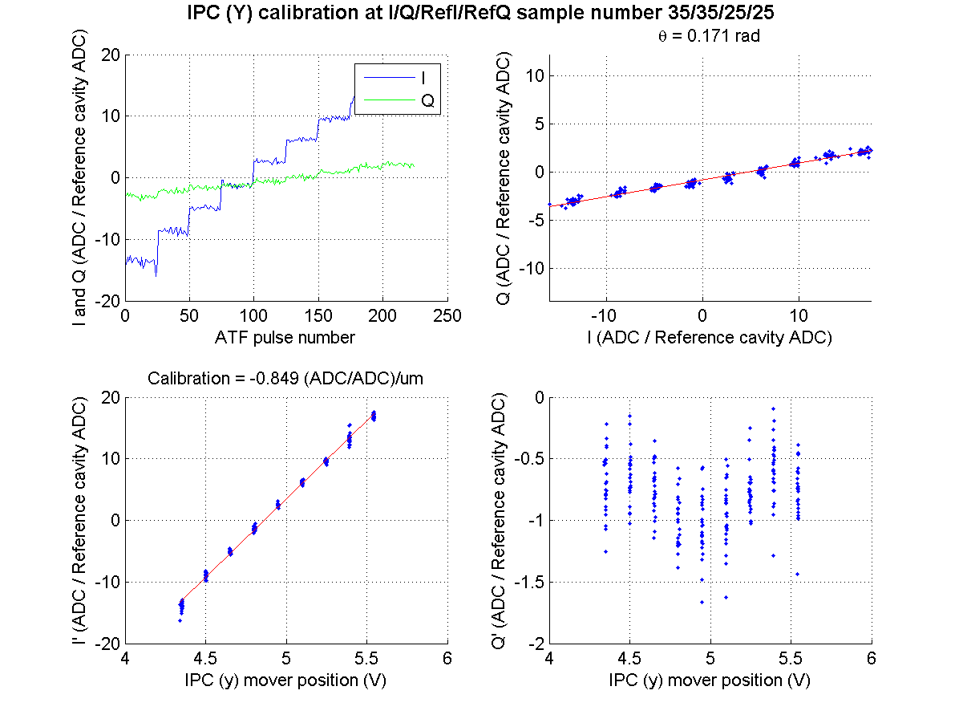
20 dB
9 mover steps with 25 pulses per step
I and Q charge normalised using reference cavity
N. Blaskovic

Slide 11
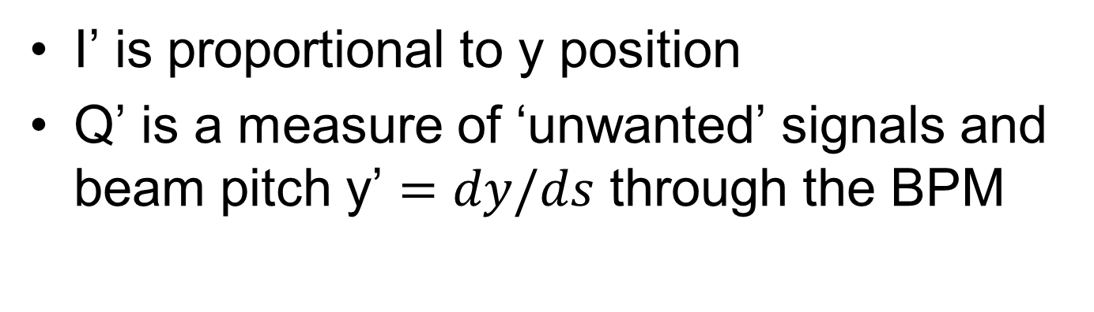
20 dB
Q’
I’
θ_{IQ}
I’ is proportional to y position
Q’ is a measure of ‘unwanted’ signals and beam pitch y’ $=dy/ds$ through the BPM
N. Blaskovic

Slide 12
20 dB
Q’
I’
θ_{IQ}
N. Blaskovic

Slide 13
Phase shifter
The IQ plot can be rotated in hardware by using the phase shifters in the electronics
Procedure:
Phase shifter setting changed
Calibration θ_{IQ} determined at each setting
Plotting θ_{IQ} vs. phase shifter setting allows θ_{IQ} to be set to zero (i.e. I’ = I and Q’ = Q)
N. Blaskovic

Slide 14
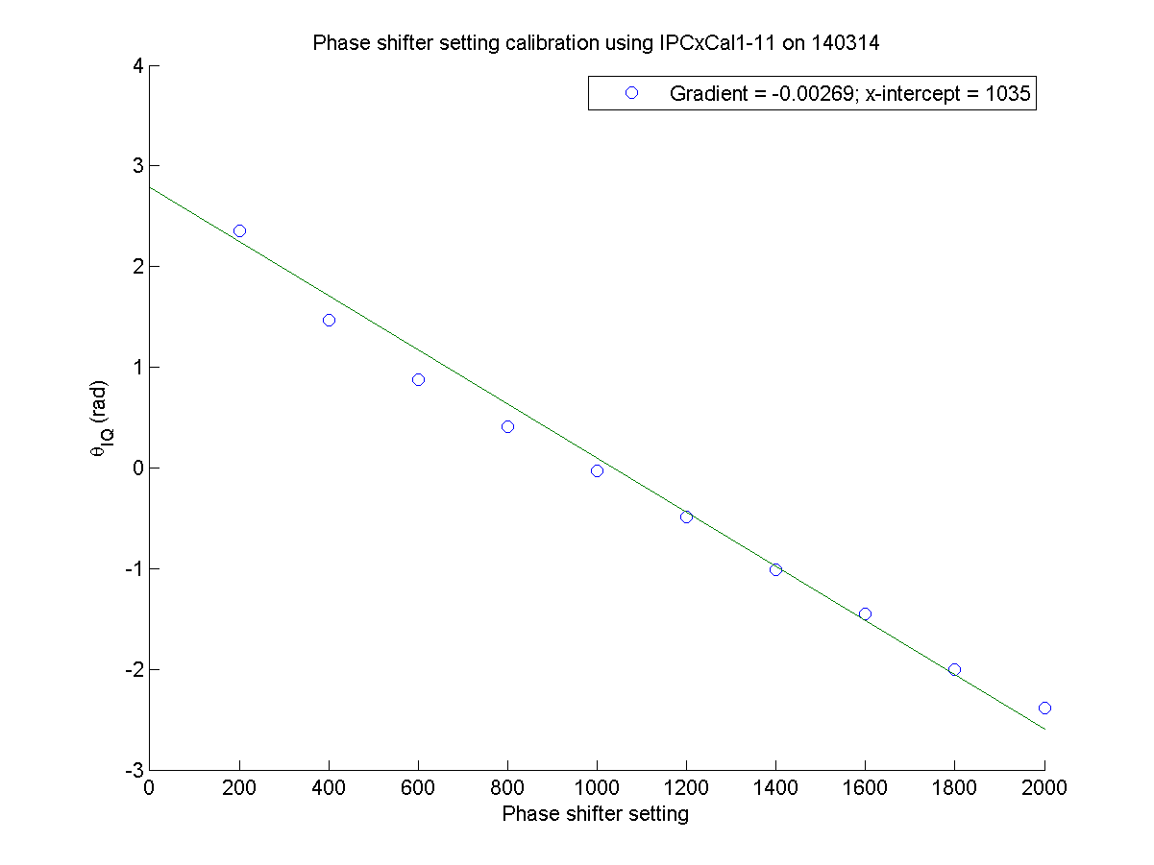
x
N. Blaskovic

Slide 15
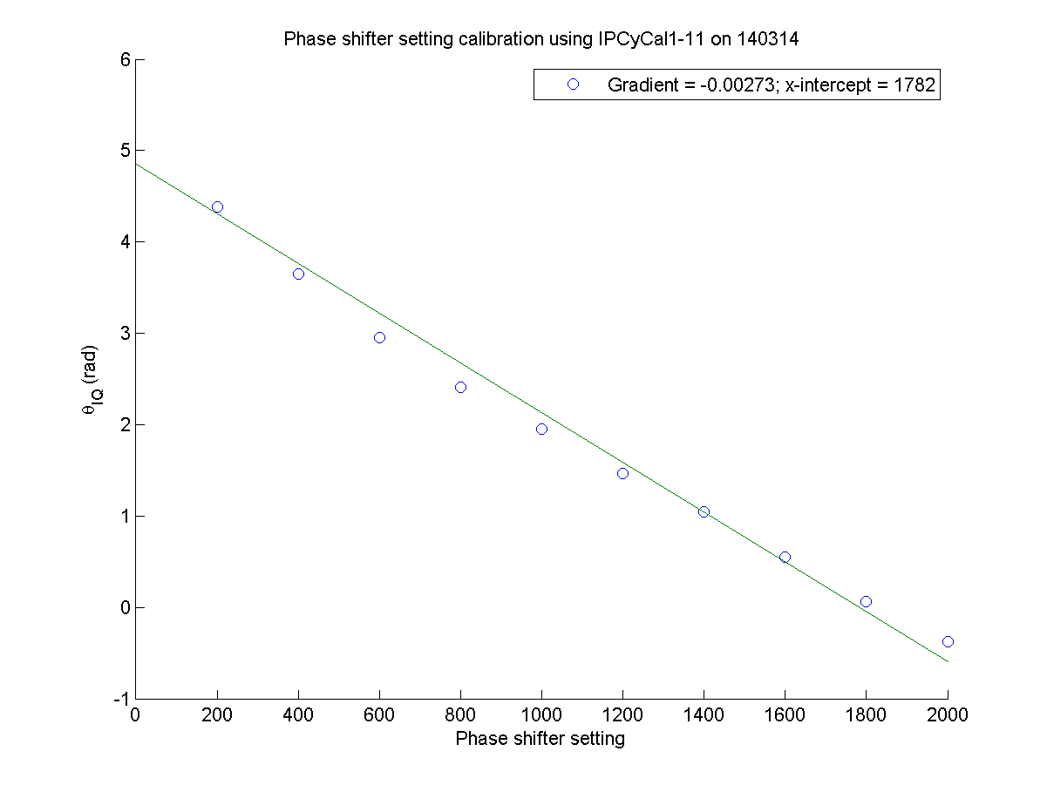
y
N. Blaskovic

Slide 16
Dynamic range
By inspecting the waveforms over a full dynamic range calibration, the I and Q dynamic range is < ± 1000 ADC counts
N. Blaskovic

Slide 17
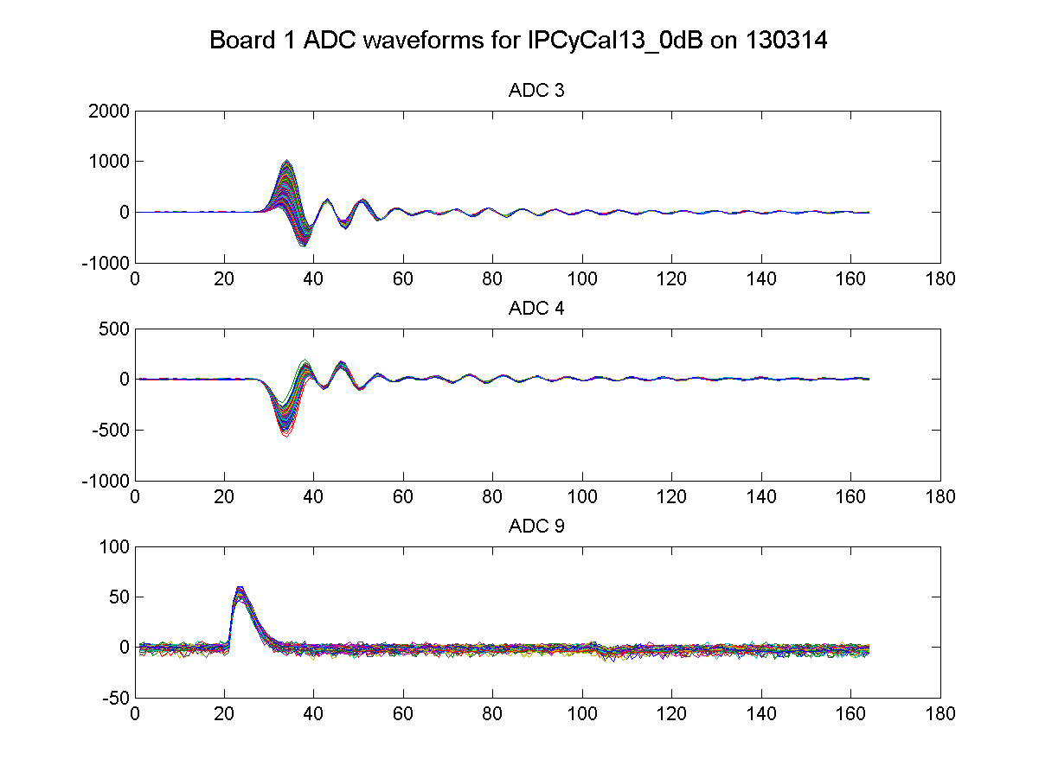
IPC(Y) I
IPC(Y) Q
Ref(Y)
N. Blaskovic

Slide 18
Minimising signals
To avoid electronics saturation, signals were minimised as follows:
Minimise | Method
 | using beam | using BPM mover
x position | Move QD0FF(x) | Use x-mover
y position | Move QD0FF(y) | Use y-mover
y’ pitch | Move QF7FF(y) | Change pitch
N. Blaskovic

Slide 19
Variable attenuator
The variable attenuator on the raw C-band signals from the IP BPMs was varied from 50 dB to 0 dB
IPC calibrated at each setting, with waist in y on IPC
Checked dependence on attenuation:
Calibration constant (I’ per mover offset)
Jitter (standard deviation of position)
N. Blaskovic

Slide 20
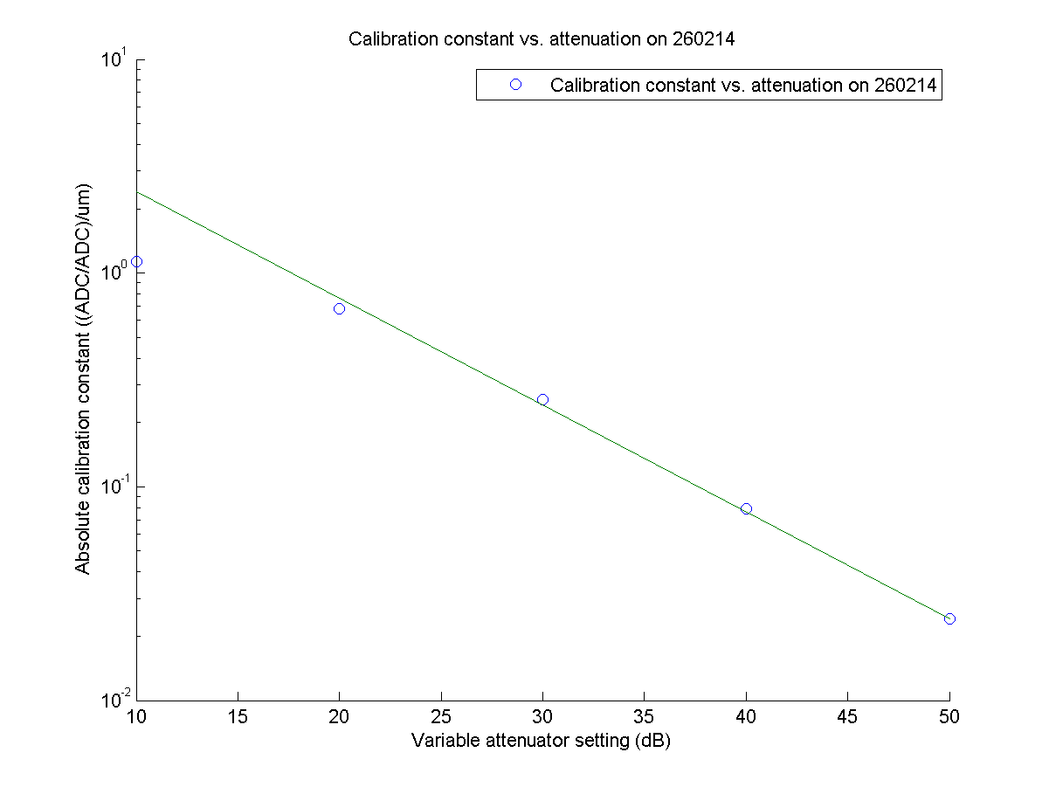
Factor 2 disagreement at 10 dB
N. Blaskovic

Slide 21
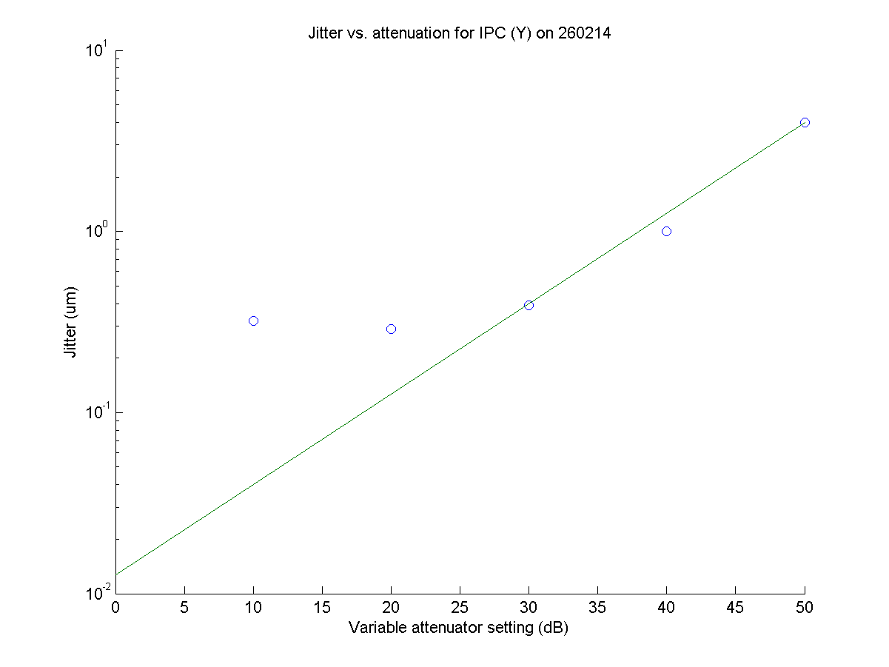
Resolution?
True jitter?
Resolution at 0 dB?
N. Blaskovic

Slide 22
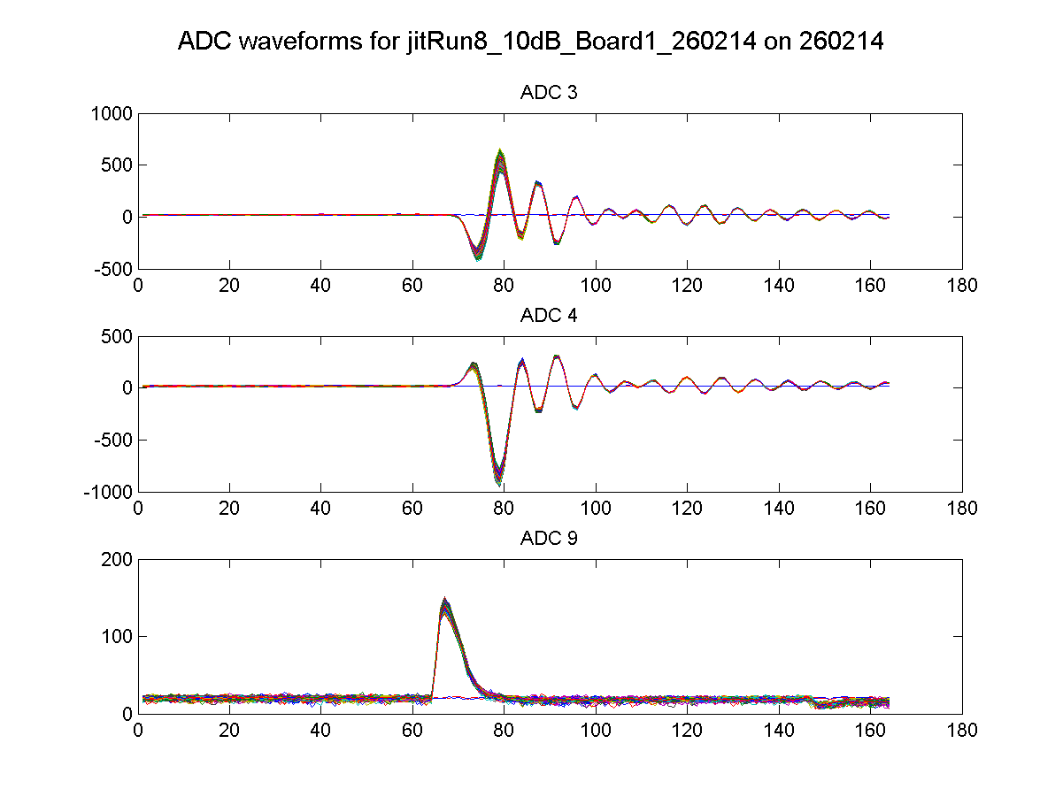
10 dB
large
~1000
IPC(Y) I
large
~1000
IPC(Y) Q
Ref(Y)
N. Blaskovic

Slide 23
Changes to the set-up
Over the course of 5 shifts, performed the following changes cumulatively:
Changed IPB (Y) and IPC (Y) from 1 to 2 port operation by using external 180º hybrids
Placed waist in x on IPC (as well as in y)
Interchanged IPB (Y) and IPC (Y) electronics
All changes undone at end of operation
N. Blaskovic

Slide 24
IP BPM signal processing
IPA
port 1
variable attenuator
electronics
I
port 2
Q
IPB
port 1
hybrid
electronics
I
FONT5 board (digitiser)
port 2
Q
IPC
port 1
hybrid
electronics
I
port 2
Q
Ref
splitter
attenuator
diode
IP BPM C-band signal
6.4 GHz (y) / 5.7 GHz (x)
Reference C-band signal
Base-band signal
N. Blaskovic

Slide 25
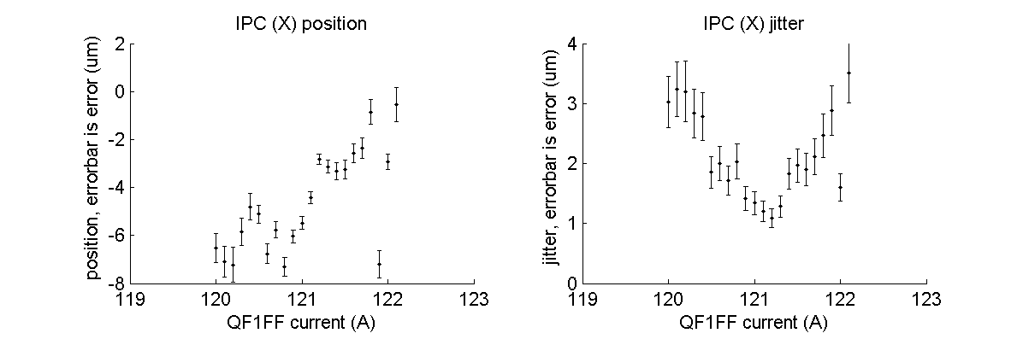
Waist scan
Waist scan in x at IPC
Performed by changing QF1FF current
N. Blaskovic

Slide 26
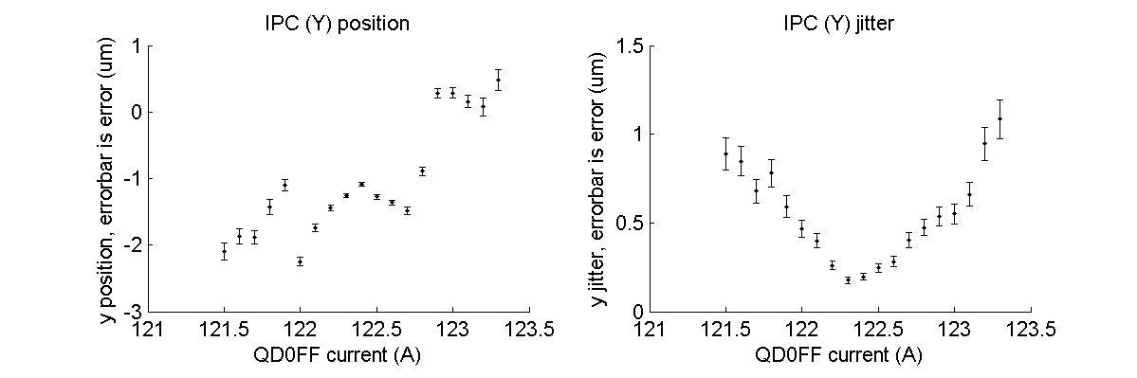
Waist scan
Waist scan in y at IPC
Performed by changing QD0FF current
N. Blaskovic

Slide 27
Variable attenuator
Variable attenuator varied from 50 dB to 0 dB with all changes implemented
N. Blaskovic

Slide 28
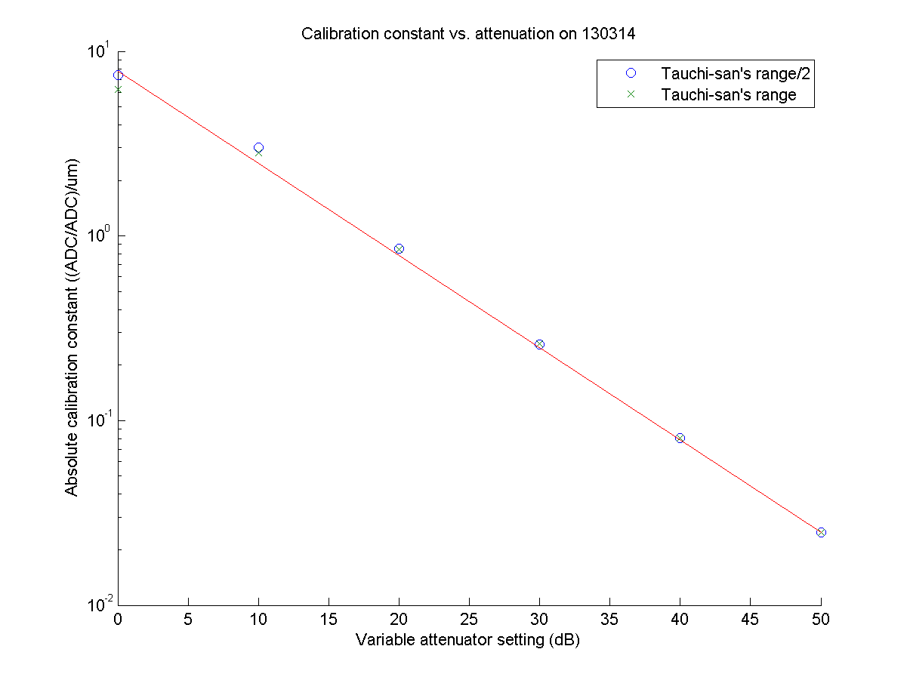
Agreement at 0 dB
Agreement at 10 dB
N. Blaskovic

Slide 29
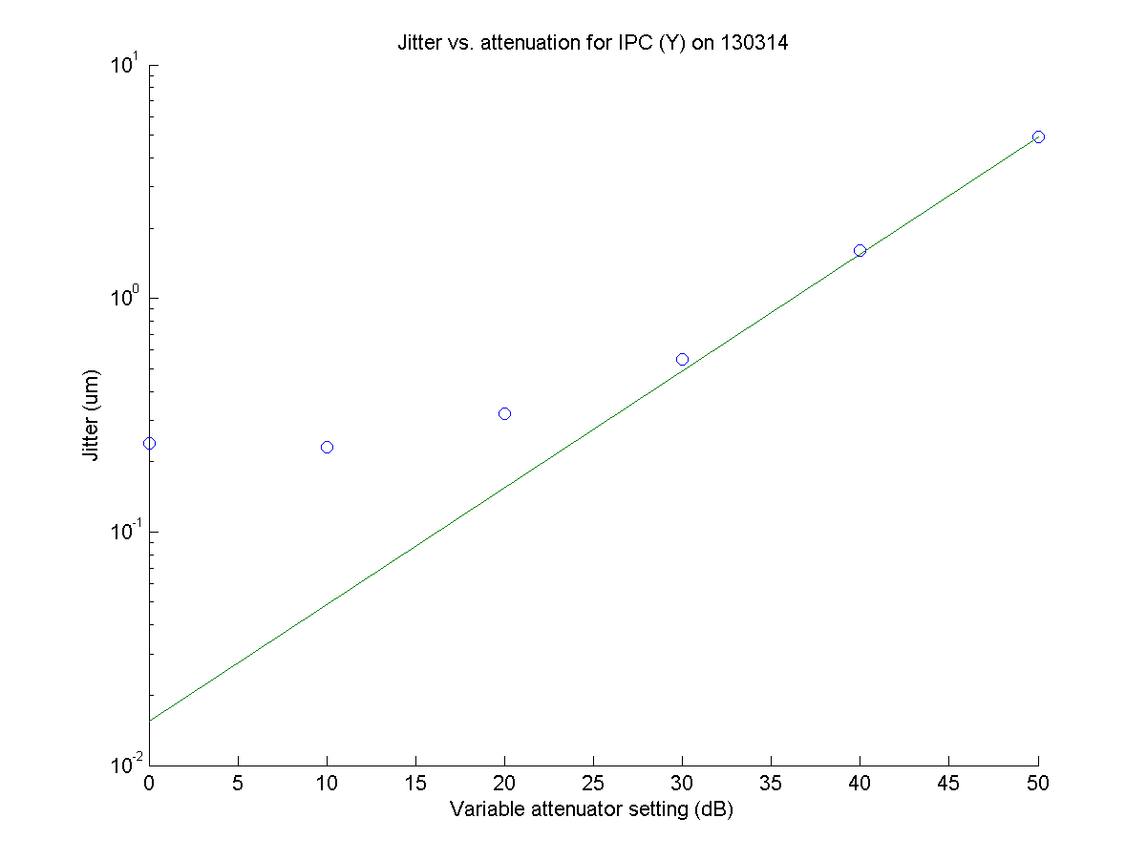
Resolution?
True jitter?
Resolution at 0 dB?
N. Blaskovic

Slide 30
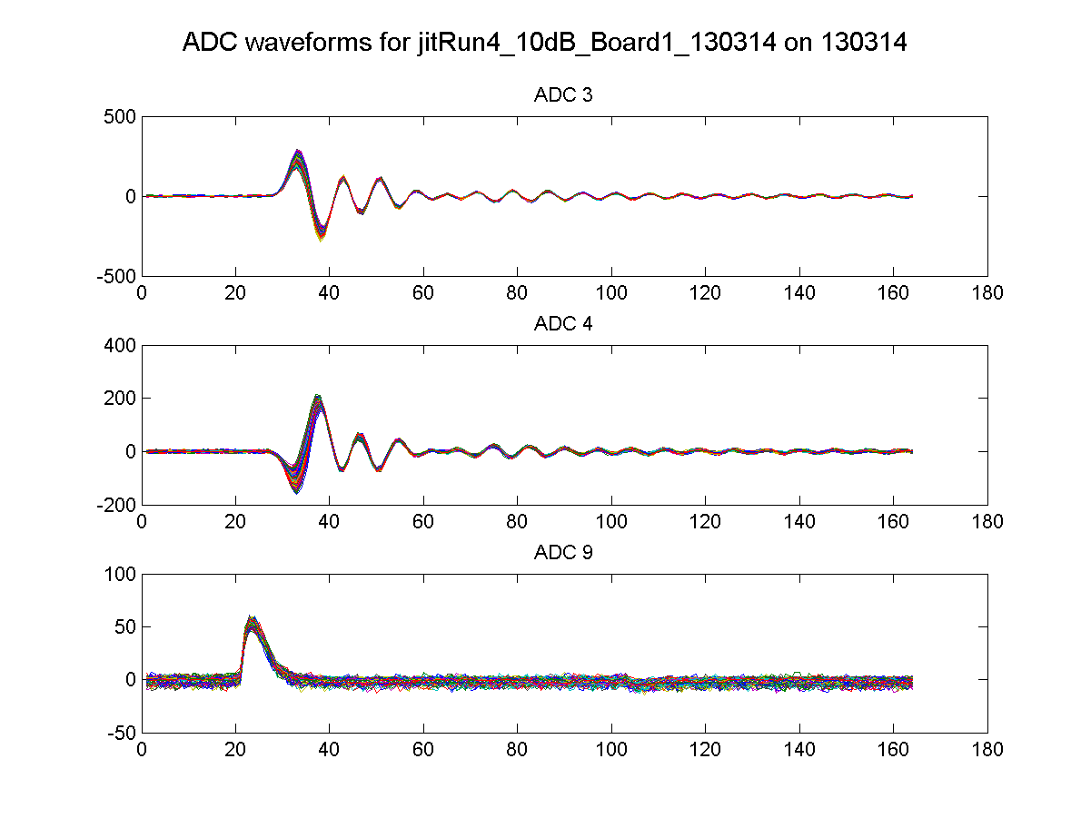
10 dB
smaller
~500
IPC(Y) I
smaller
~300
IPC(Y) Q
Ref(Y)
N. Blaskovic

Slide 31
Calibration ranges
Comparison of 3 calibrations at 0 dB over
T. Tauchi’s dynamic range / 2
T. Tauchi’s dynamic range
T. Tauchi’s dynamic range x 3
N. Blaskovic

Slide 32
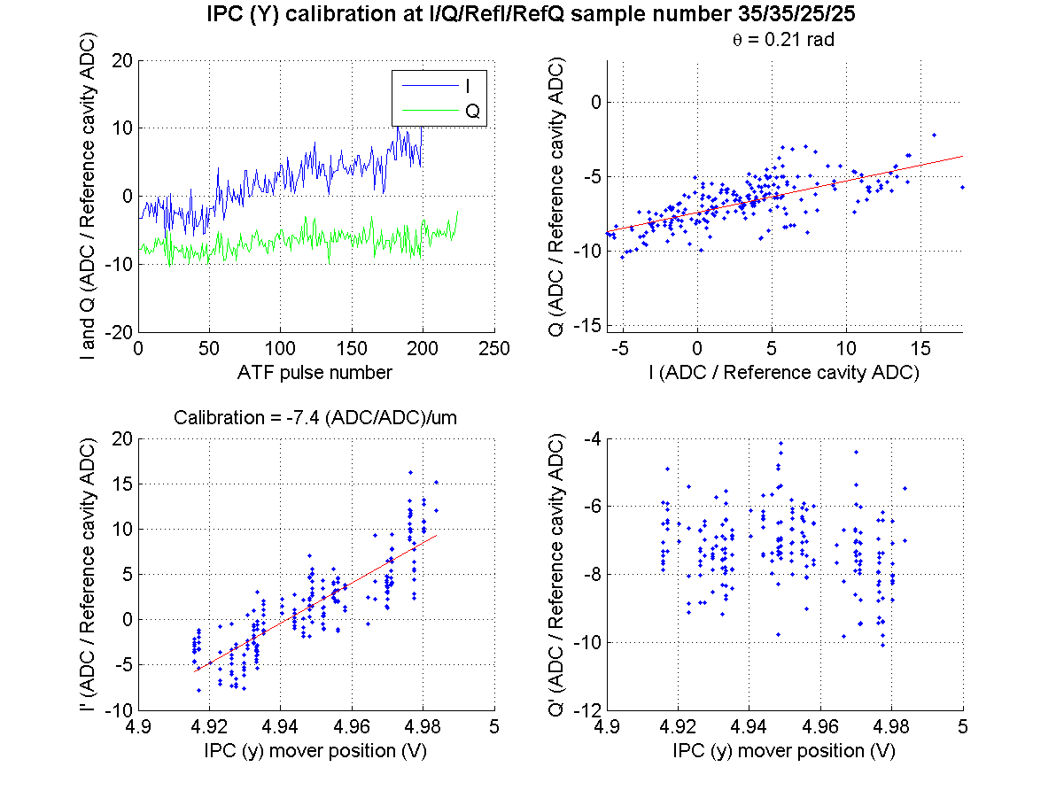
Tauchi/2
N. Blaskovic

Slide 33
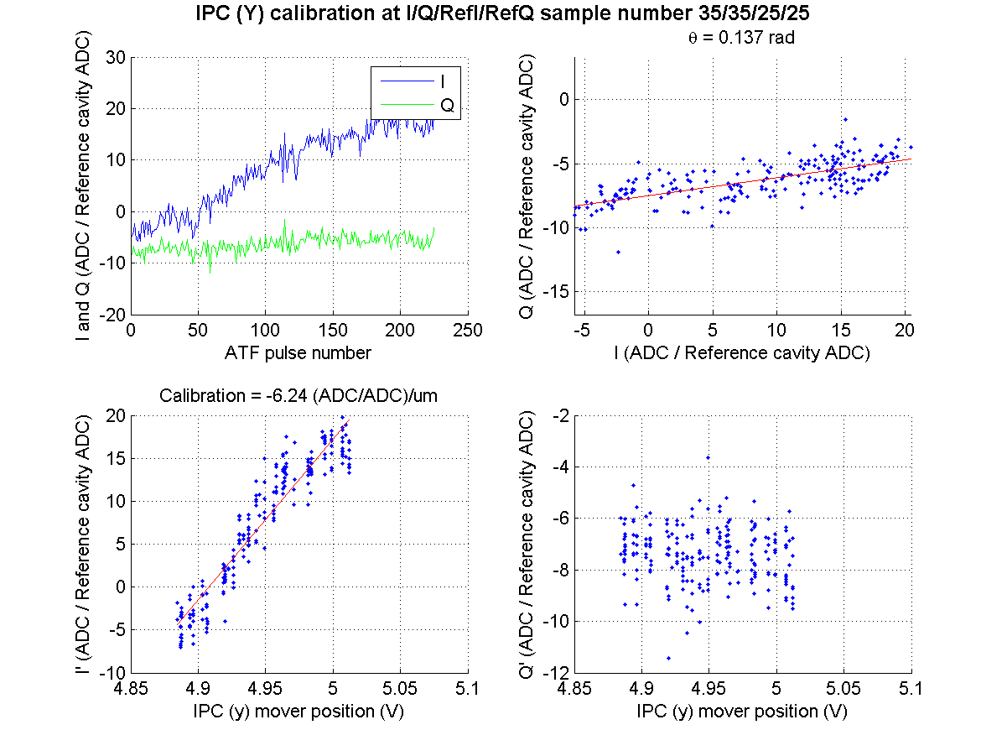
Tauchi
Saturation
or drift?
Saturation
or drift?
N. Blaskovic

Slide 34
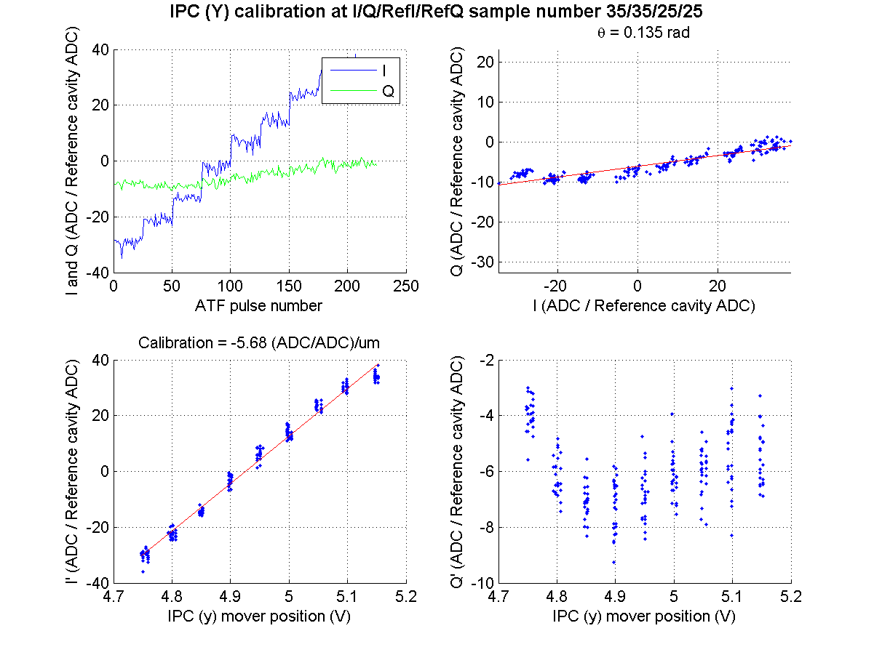
Tauchi*3
N. Blaskovic

Slide 35

Q vs. pitch scan
Dependence of Q on relative beam pitch (y’ $=dy/ds$) to BPM axis tested by
Changing beam pitch y’ using QF7FF mover
Changing BPM pitch using IPC mover E:
BPM block C (from above)
Mover D
Mover E
beam
Mover C
figure from O. Blanco
N. Blaskovic

Slide 36
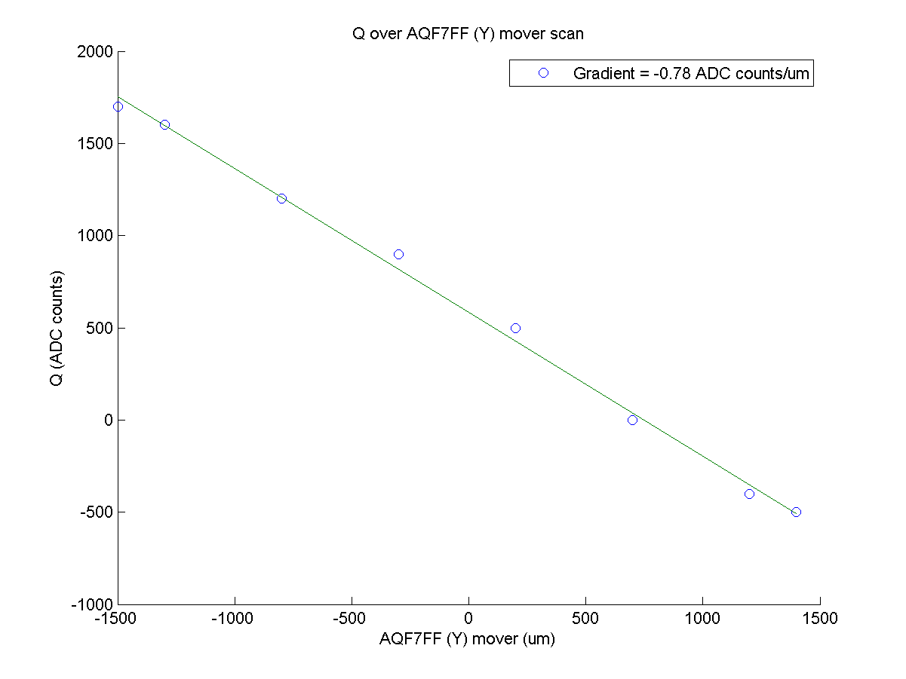
Operation on FONT IP BPM shifts
N. Blaskovic

Slide 37
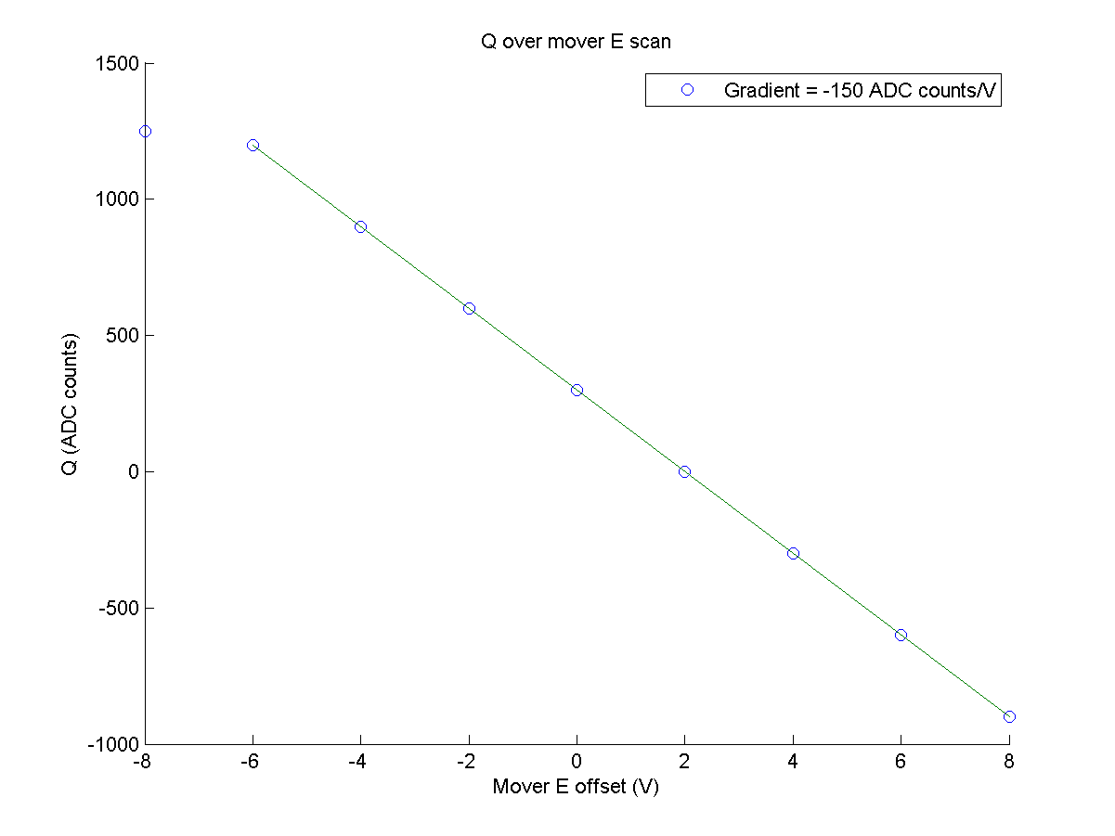
Operation on FONT IP BPM shifts
N. Blaskovic

Slide 38
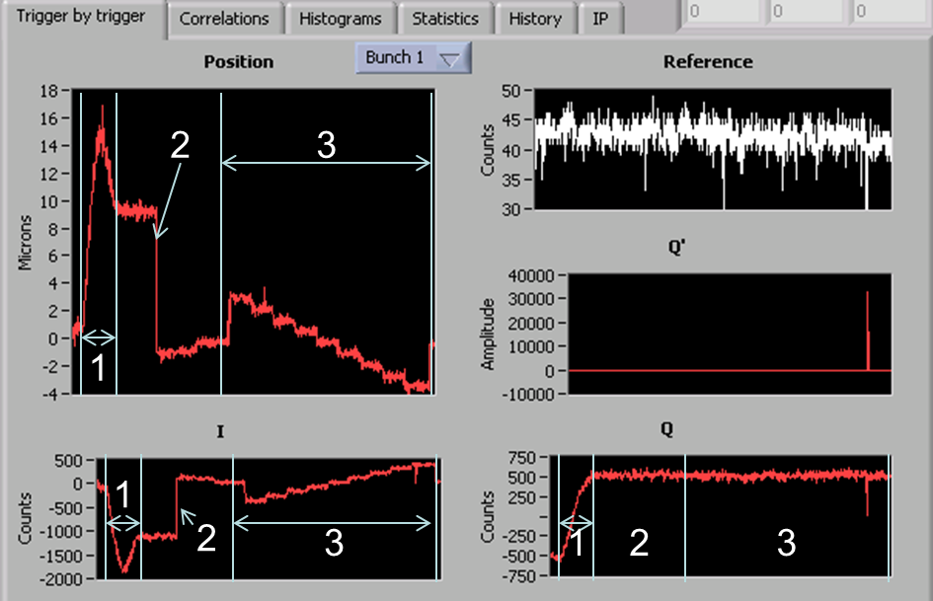
Q vs. pitch scan method
Move QF7FF(Y)
Centre beam using QD0FF(Y) mover
Perform calibration using mover
N. Blaskovic

Slide 39
Reference diode
Comparison of reference diode to sum (charge) signal of MFB1FF stripline BPM
The two charge indicators show a linear dependence, but are not proportional
May lead to incorrect charge normalisation
Also, reference signal is small
N. Blaskovic

Slide 40
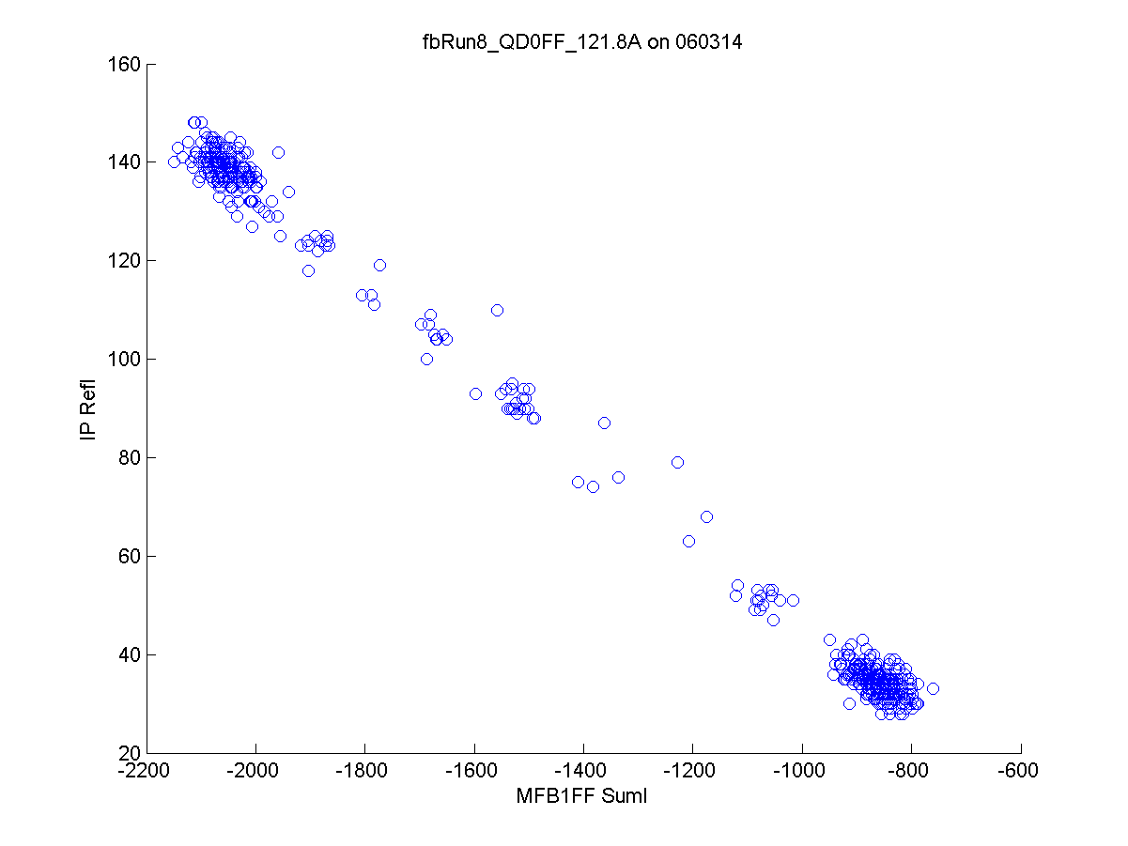
N. Blaskovic

Slide 41
Further work
Investigate use of other signals for charge normalisation, e.g. stripline BPM or ICT
Use band pass filters to remove unwanted frequencies
N. Blaskovic

Slide 42
Issues
Large ~40 MHz ripple at low attenuations
Large jitter measured even on waist
Apparent beam drift
Small reference signal
Reference signal not proportional to stripline charge measurement
N. Blaskovic

Slide 43
Conclusions
IP BPM signals digitised by FONT5 board
Minimised I, Q signals by beam steering
Calibrated from 50 dB to 0 dB
Progressed to achieve calibration constants that scale with attenuation
Ripples, apparent beam drift and limited charge normalisation require attention
N. Blaskovic

