Slide 1
Calibrations on 060314
N. Blaskovic
N. Blaskovic

Slide 2
Contents
Slides 3–8: Calibration waveforms
Slides 9–20: Calibration control plots (reference/upstream charge normalised)
Slides 21–27: Calibration constant vs. attenuator setting for different samples
Slides 28–31: Jitter vs. offset
Slide 32: IP reference diode vs. stripline Σ_{I}
Slides 33–52: Calibration θ_{IQ} vs. sample
N. Blaskovic

Slide 3
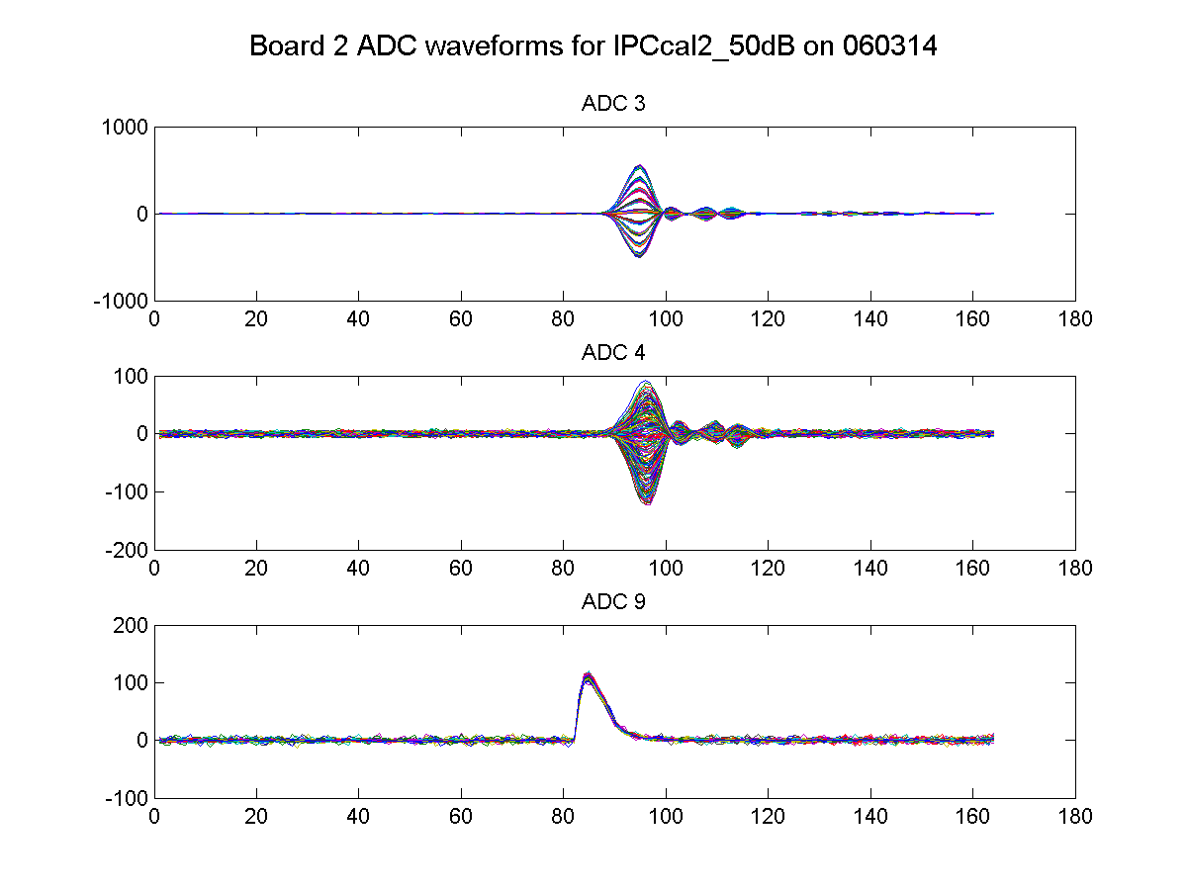
50 dB
IPC(Y) I
IPC(Y) Q
Ref(Y)
N. Blaskovic

Slide 4
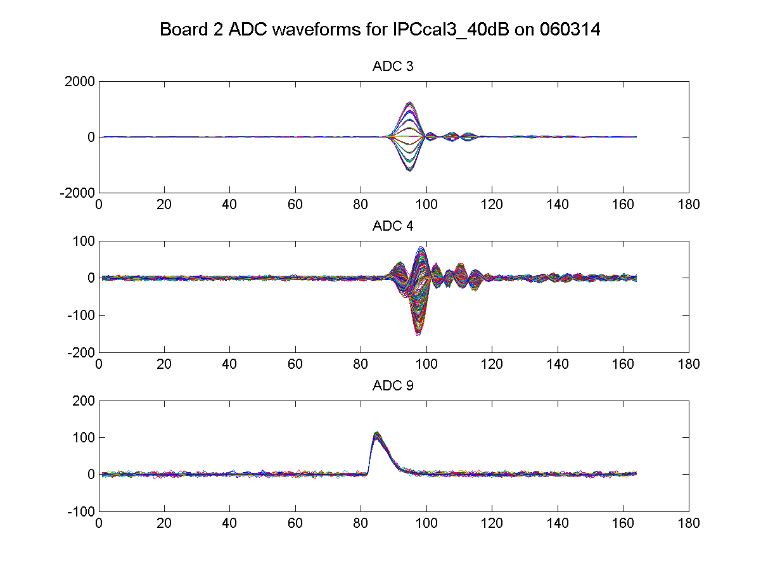
40 dB
IPC(Y) I
IPC(Y) Q
Ref(Y)
N. Blaskovic

Slide 5
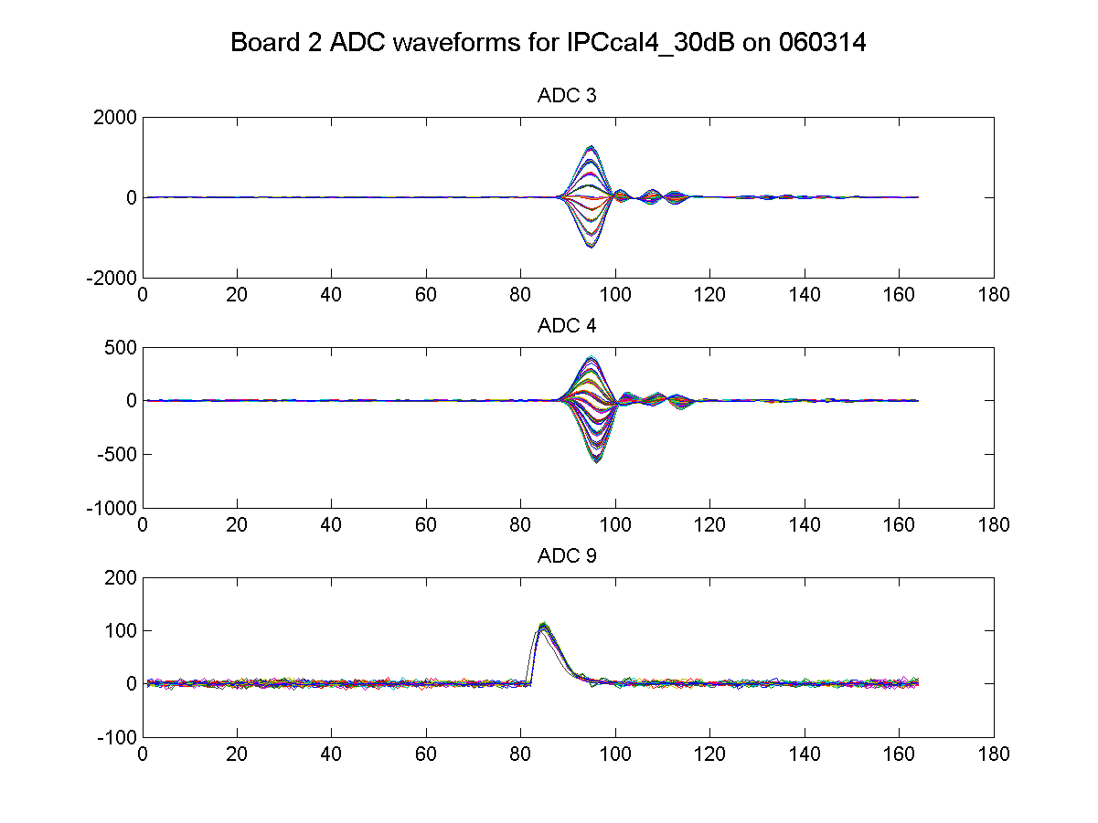
30 dB
IPC(Y) I
IPC(Y) Q
Ref(Y)
N. Blaskovic

Slide 6
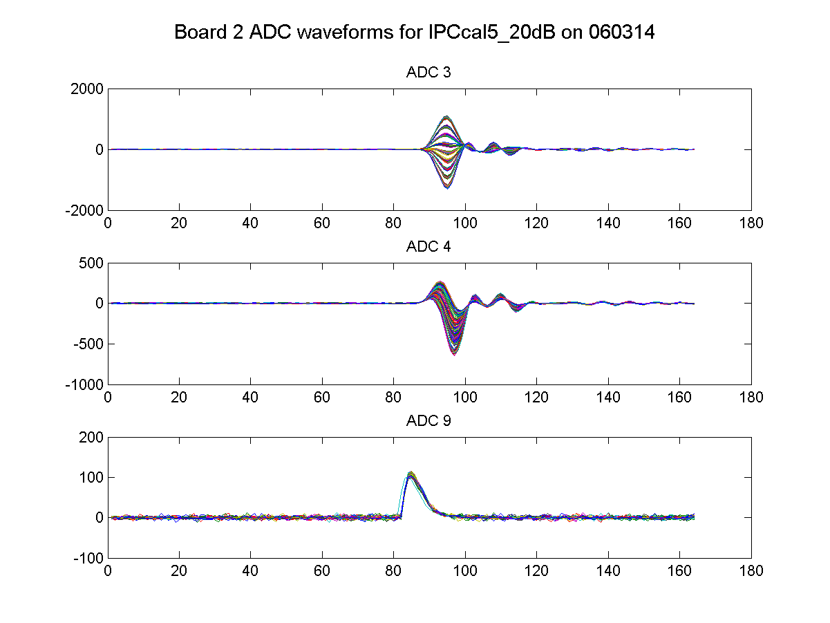
20 dB
IPC(Y) I
IPC(Y) Q
Ref(Y)
N. Blaskovic

Slide 7
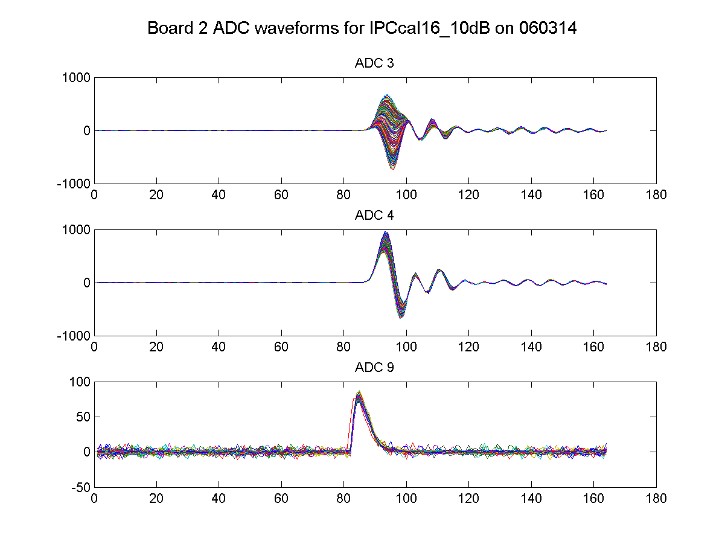
10 dB
IPC(Y) I
IPC(Y) Q
Ref(Y)
N. Blaskovic

Slide 8
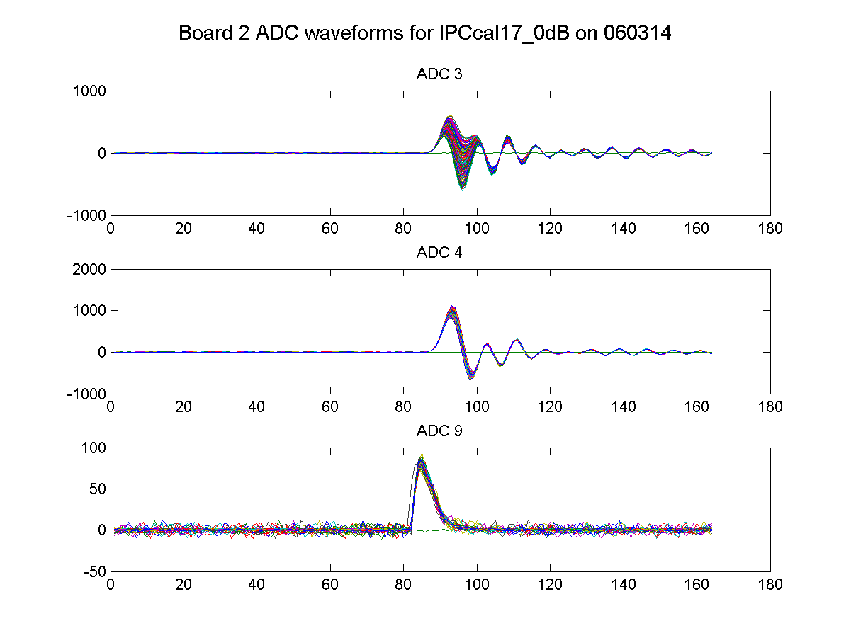
0 dB
IPC(Y) I
IPC(Y) Q
Ref(Y)
N. Blaskovic

Slide 9
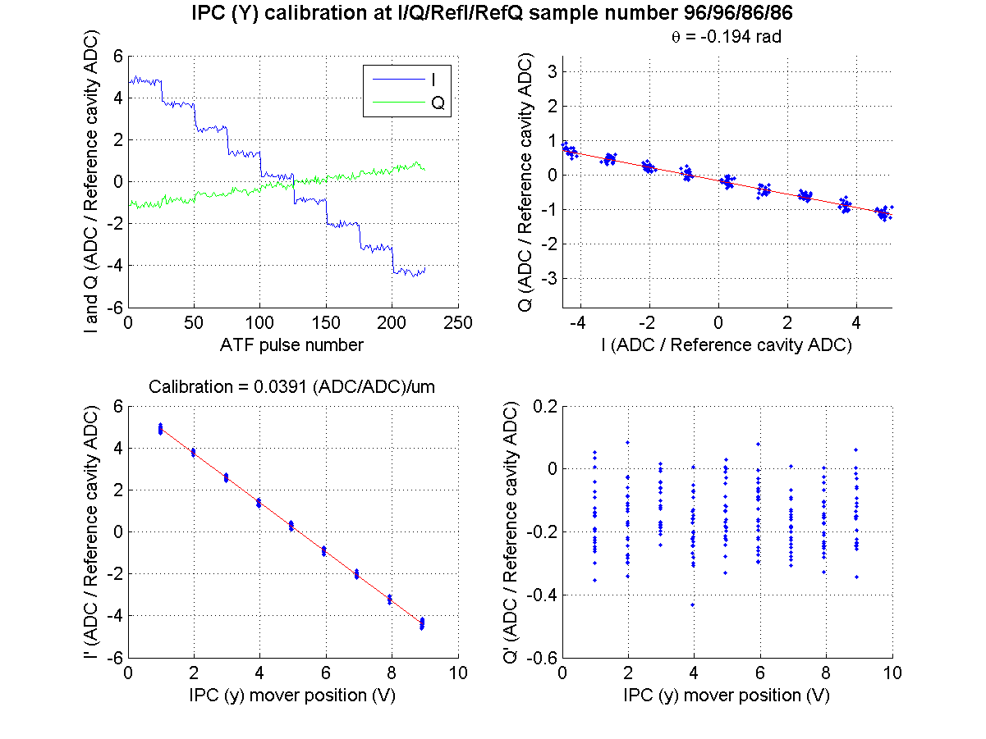
50 dB
N. Blaskovic

Slide 10
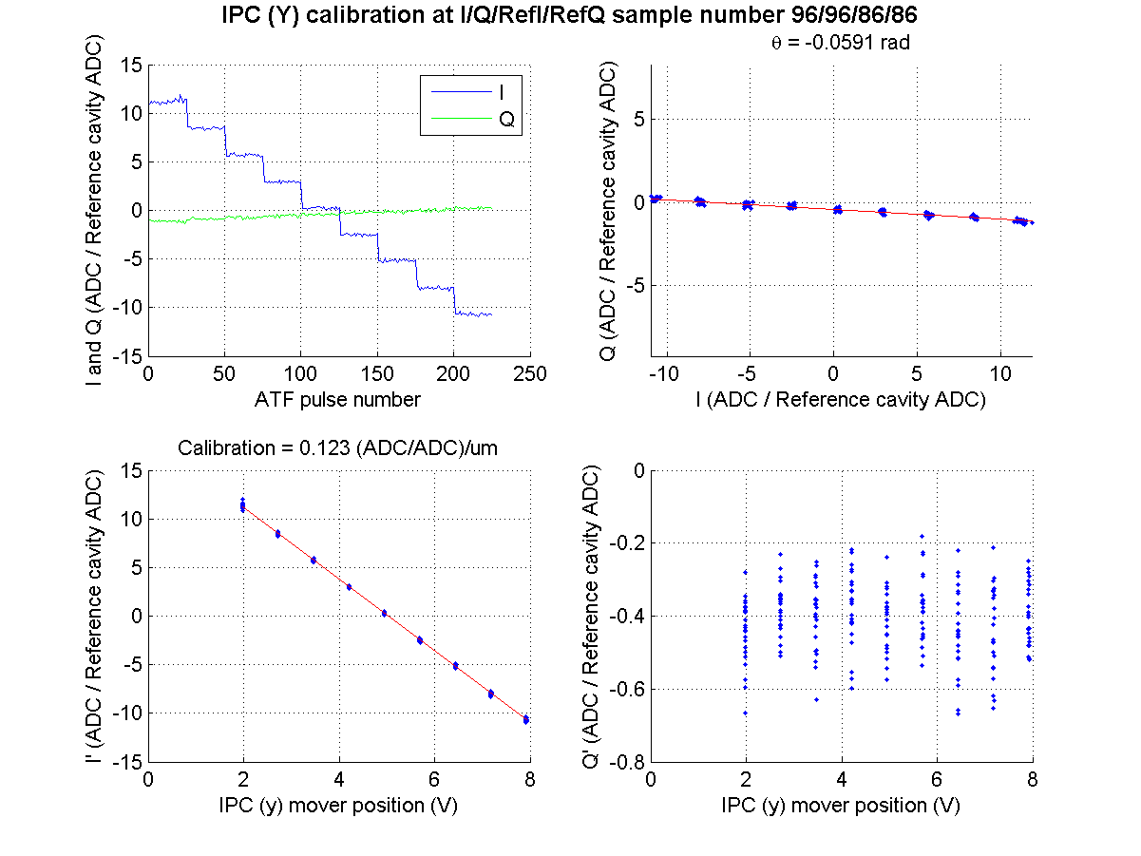
40 dB
N. Blaskovic

Slide 11
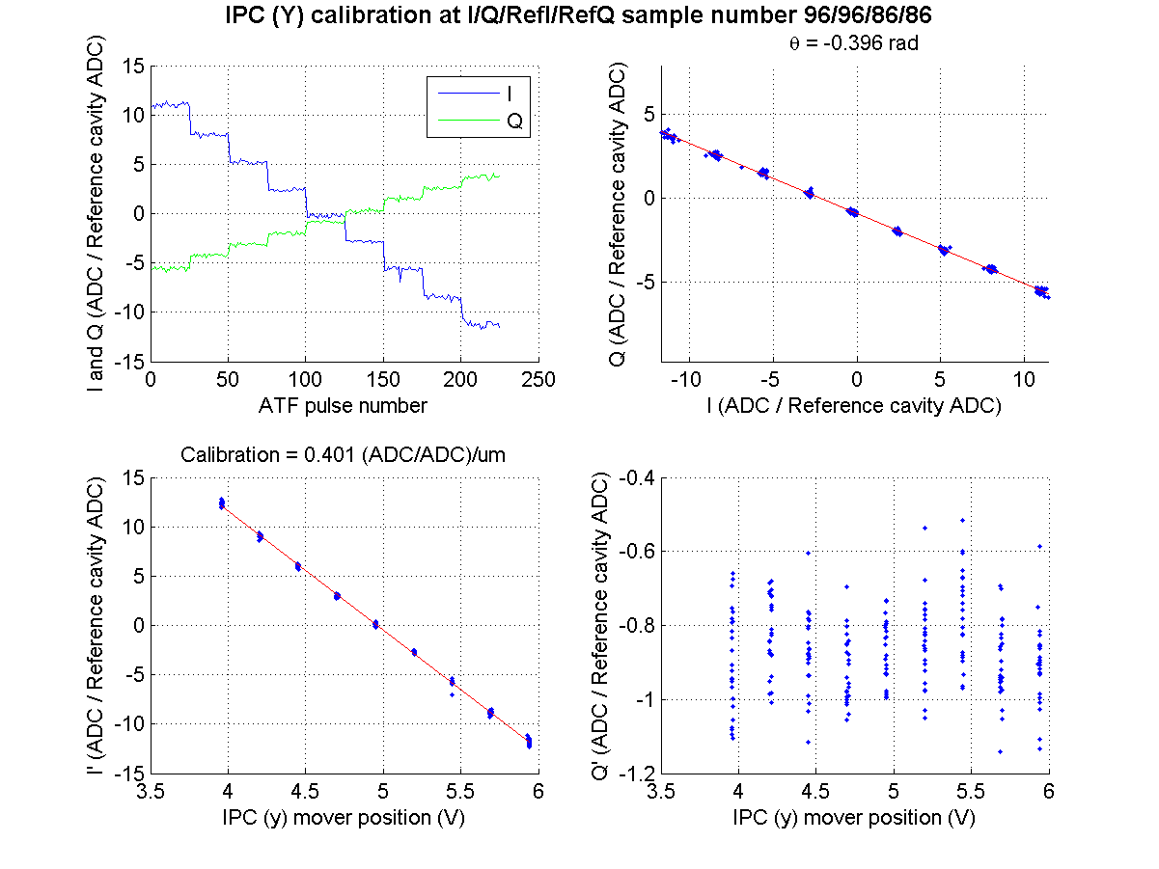
30 dB
N. Blaskovic

Slide 12
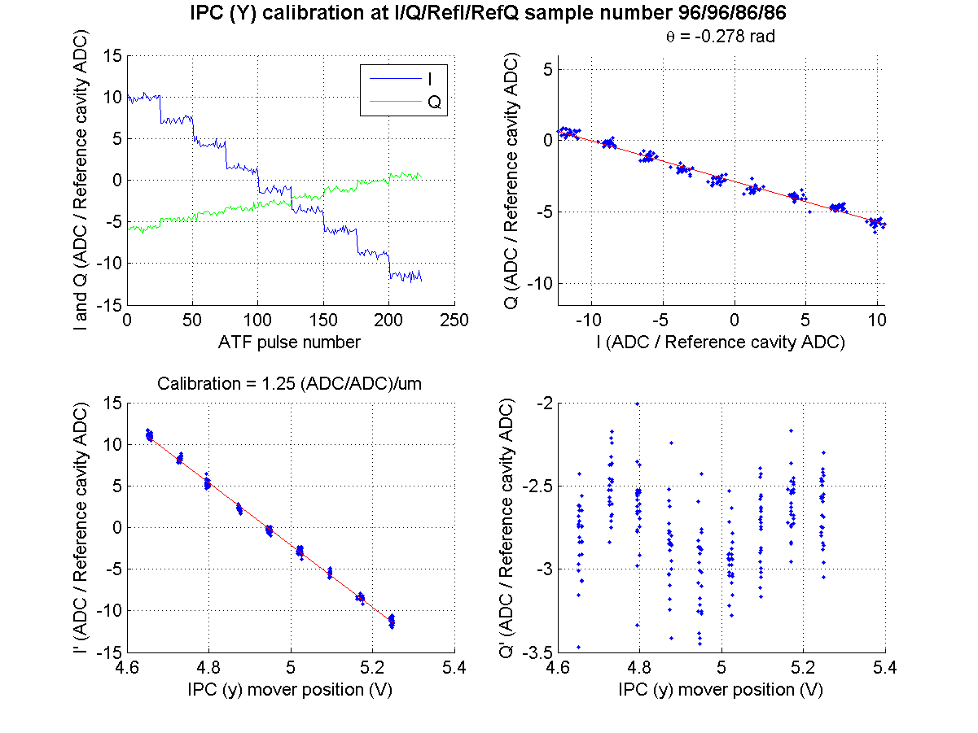
20 dB
N. Blaskovic

Slide 13
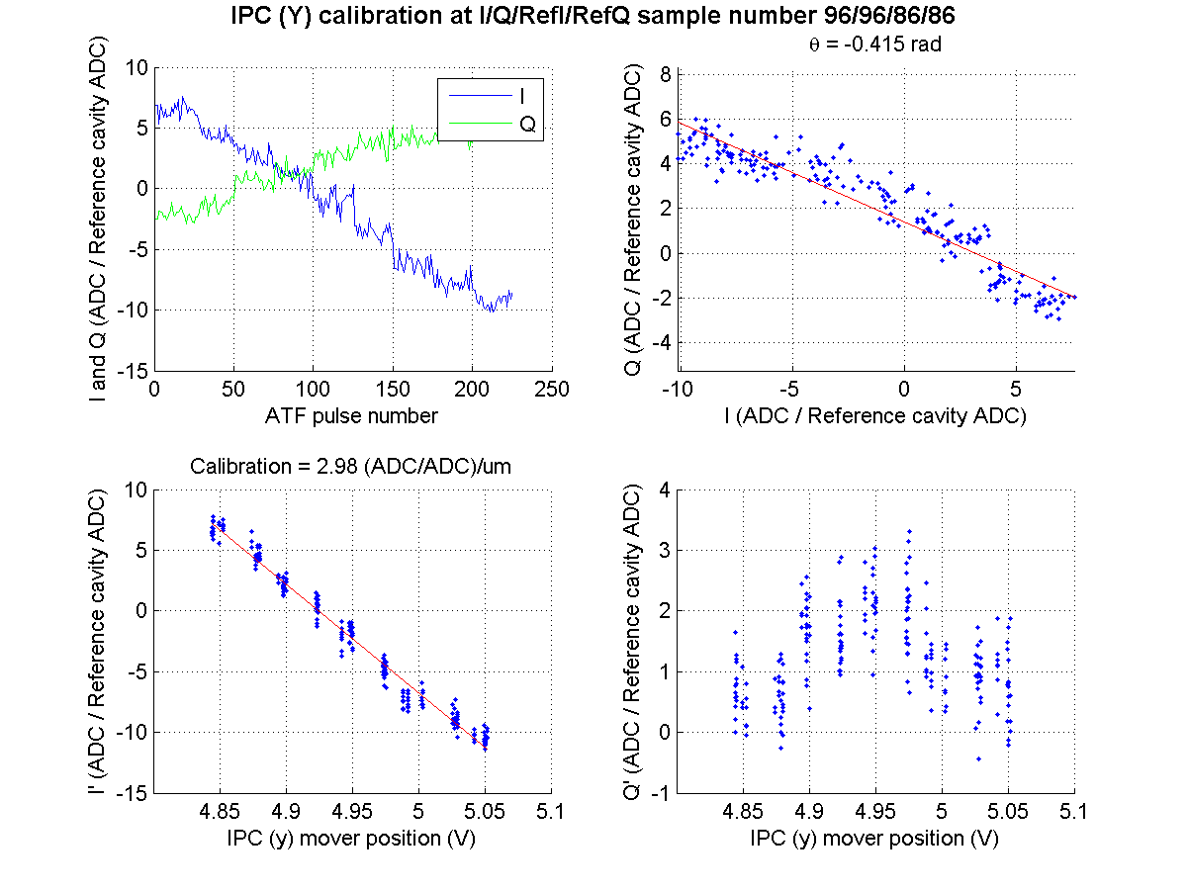
10 dB
N. Blaskovic

Slide 14
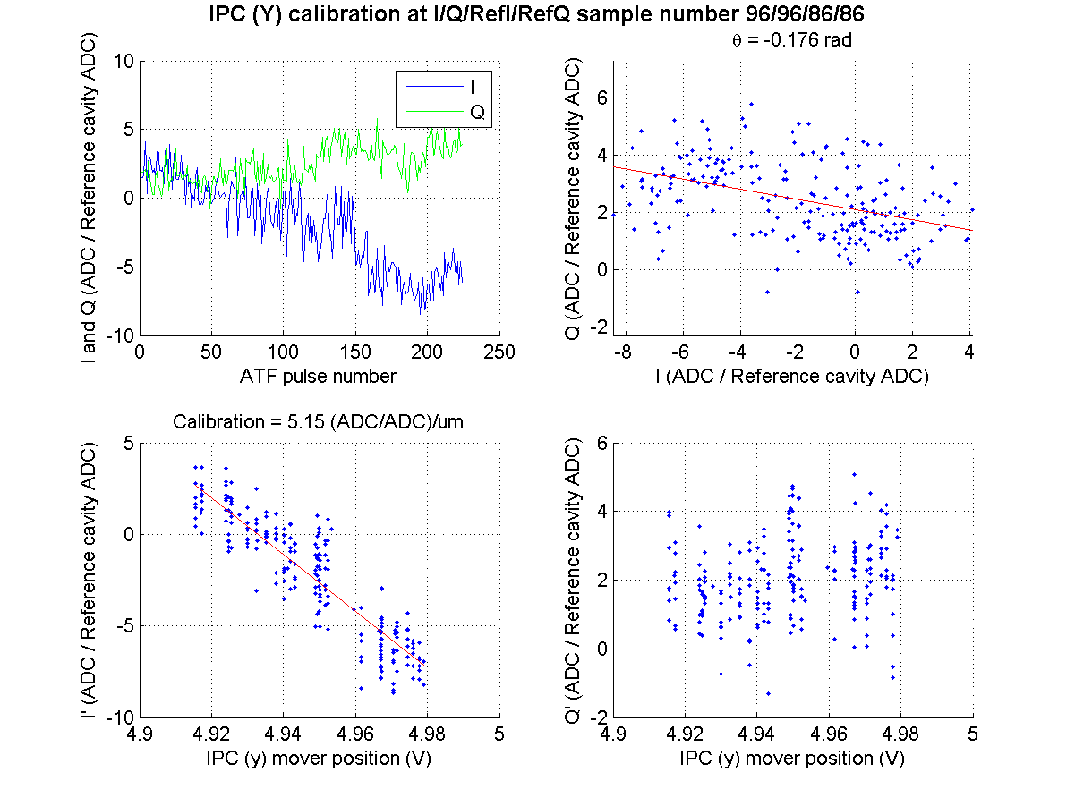
0 dB
N. Blaskovic

Slide 15
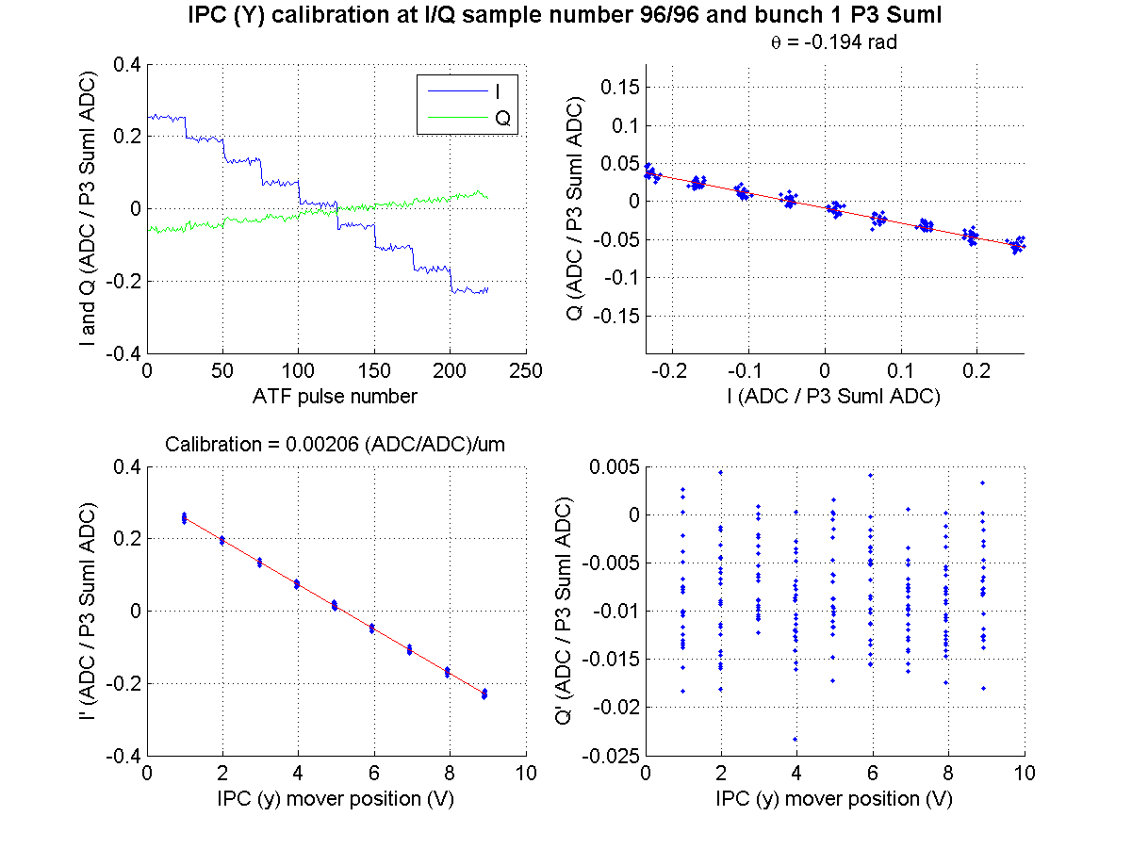
50 dB
N. Blaskovic

Slide 16
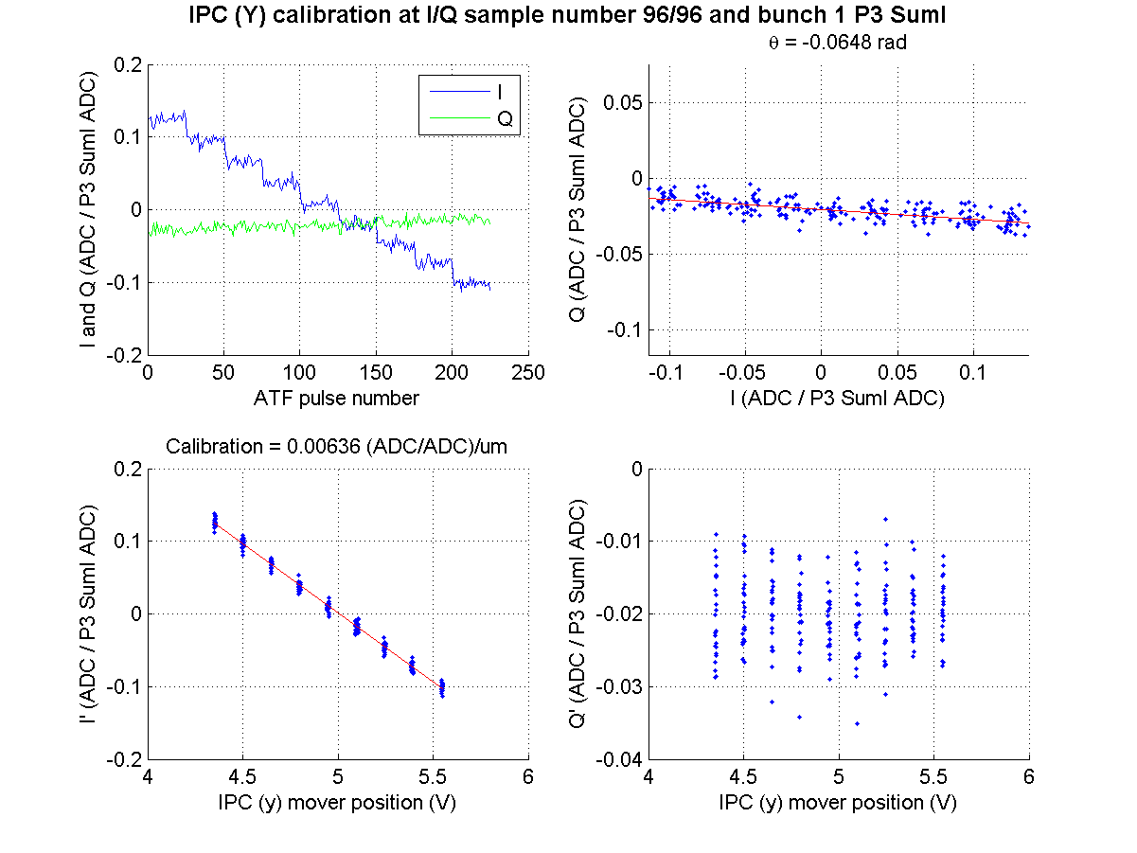
40 dB
N. Blaskovic

Slide 17
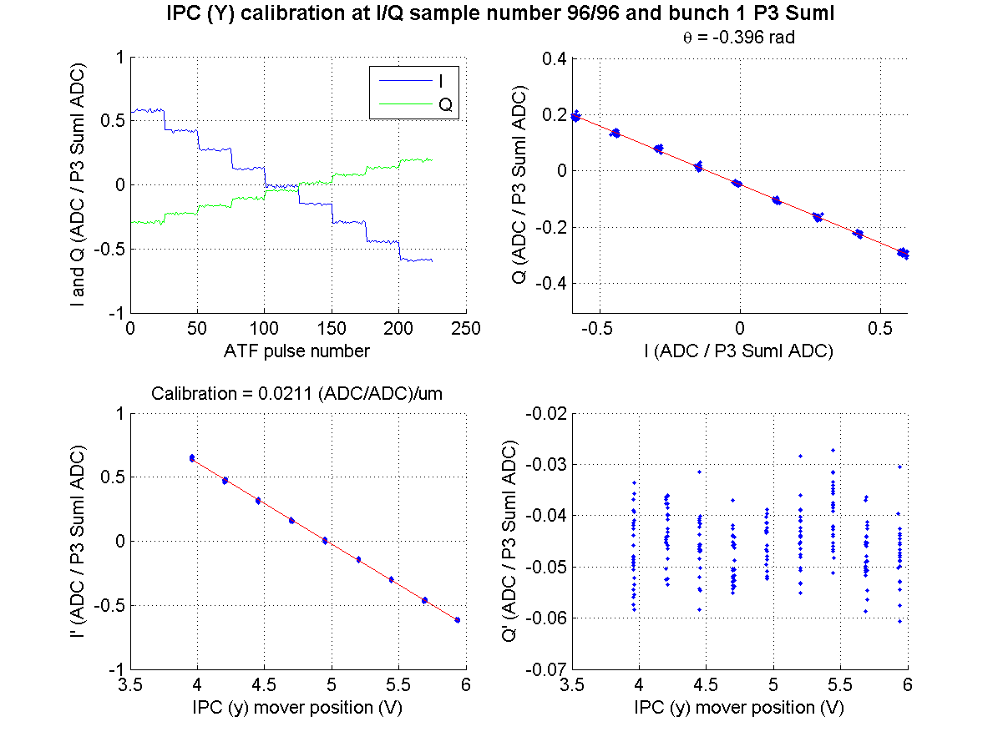
30 dB
N. Blaskovic

Slide 18
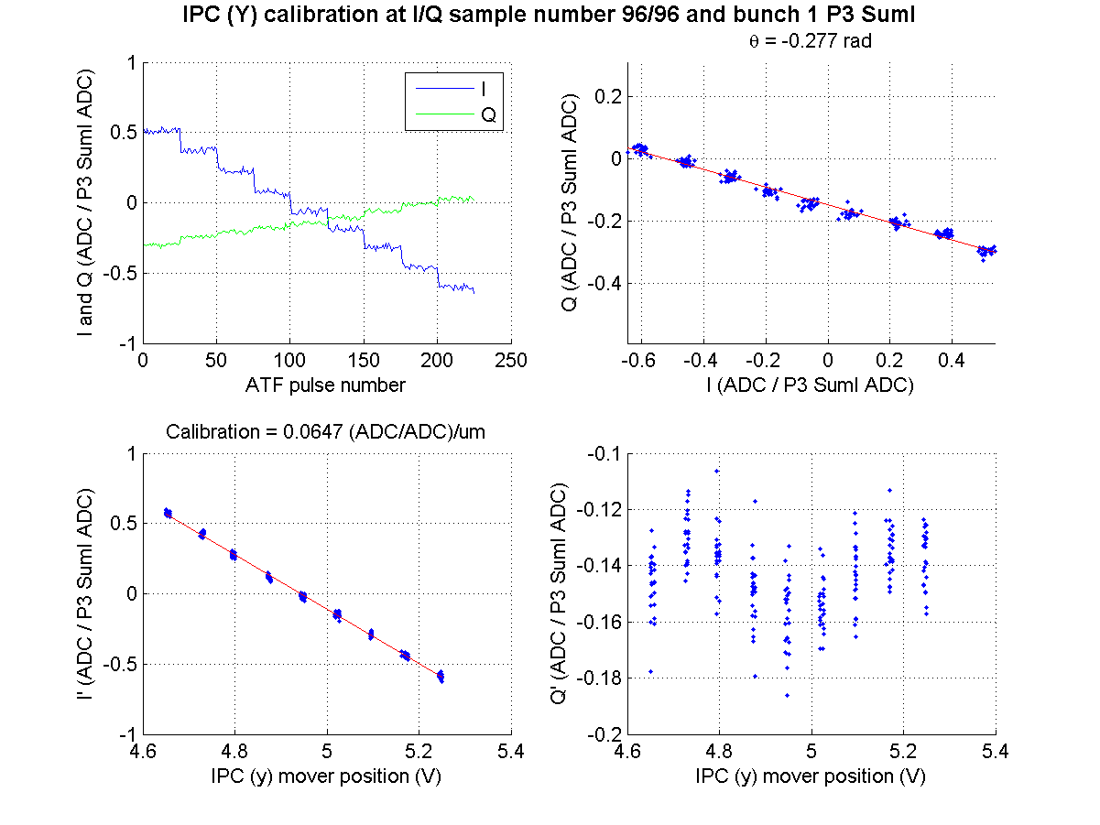
20 dB
N. Blaskovic

Slide 19
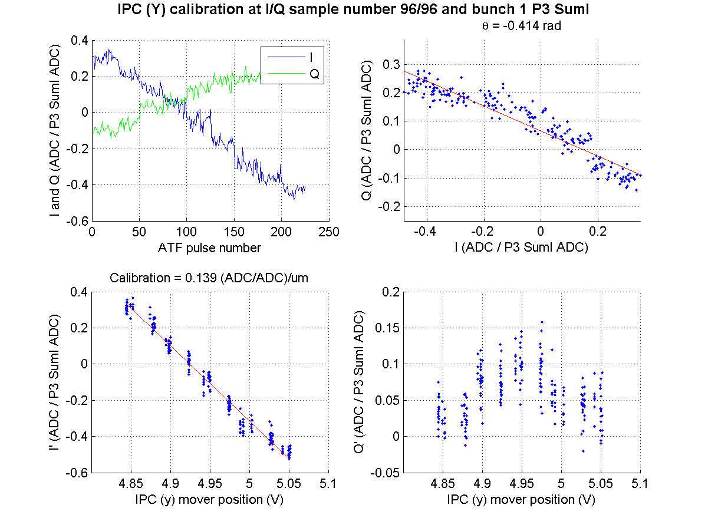
10 dB
N. Blaskovic

Slide 20
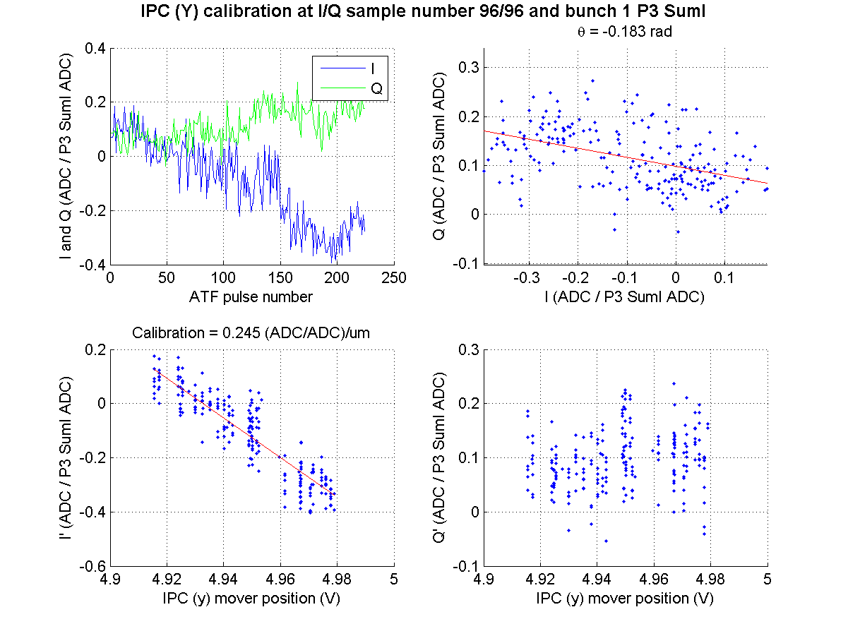
0 dB
N. Blaskovic

Slide 21
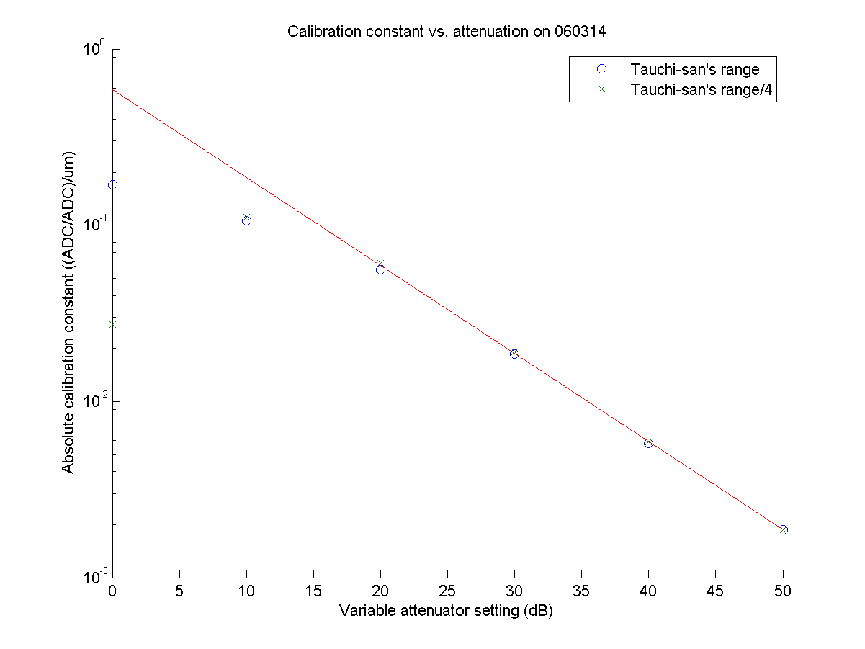
Sample 93
N. Blaskovic

Slide 22
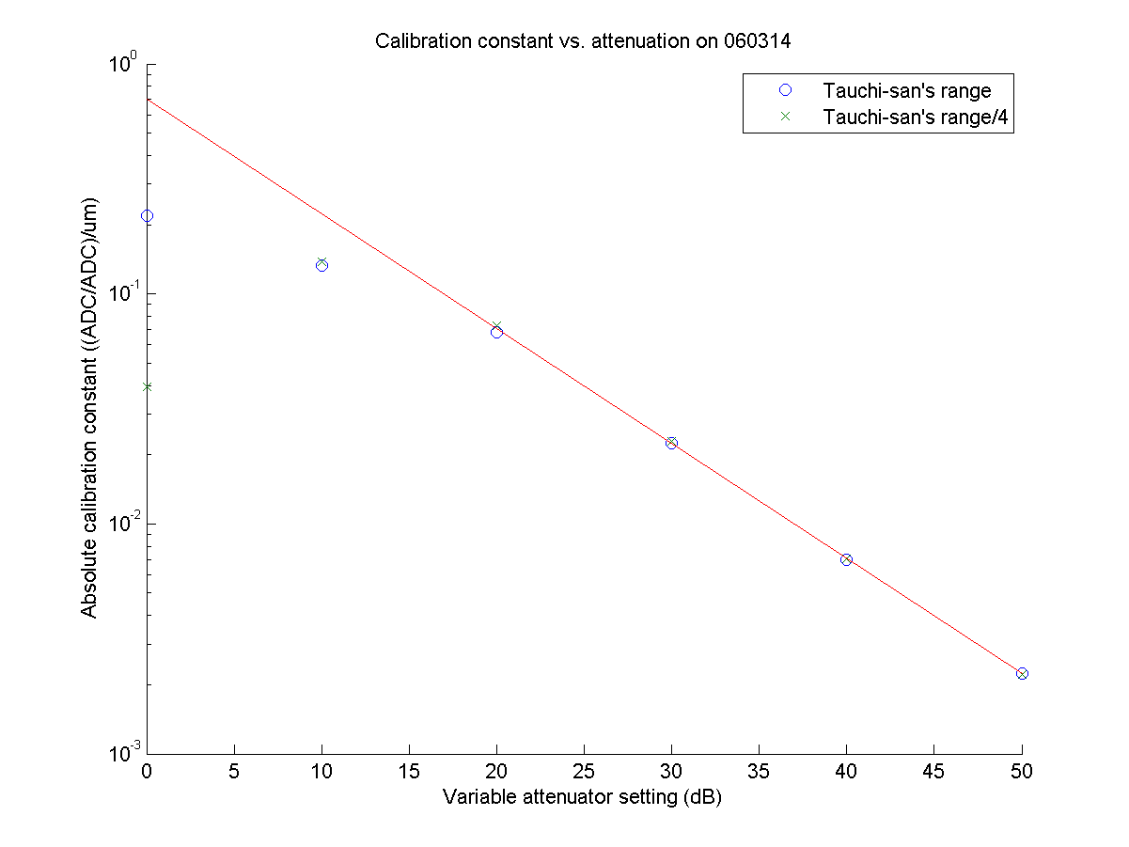
Sample 94
N. Blaskovic

Slide 23
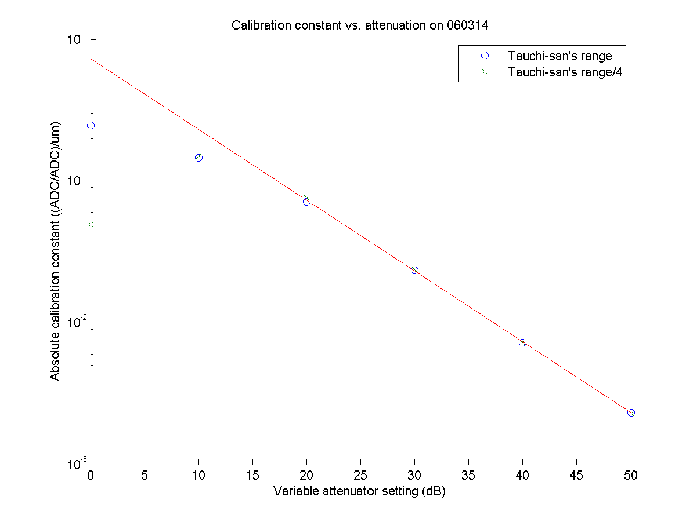
Sample 95
N. Blaskovic

Slide 24
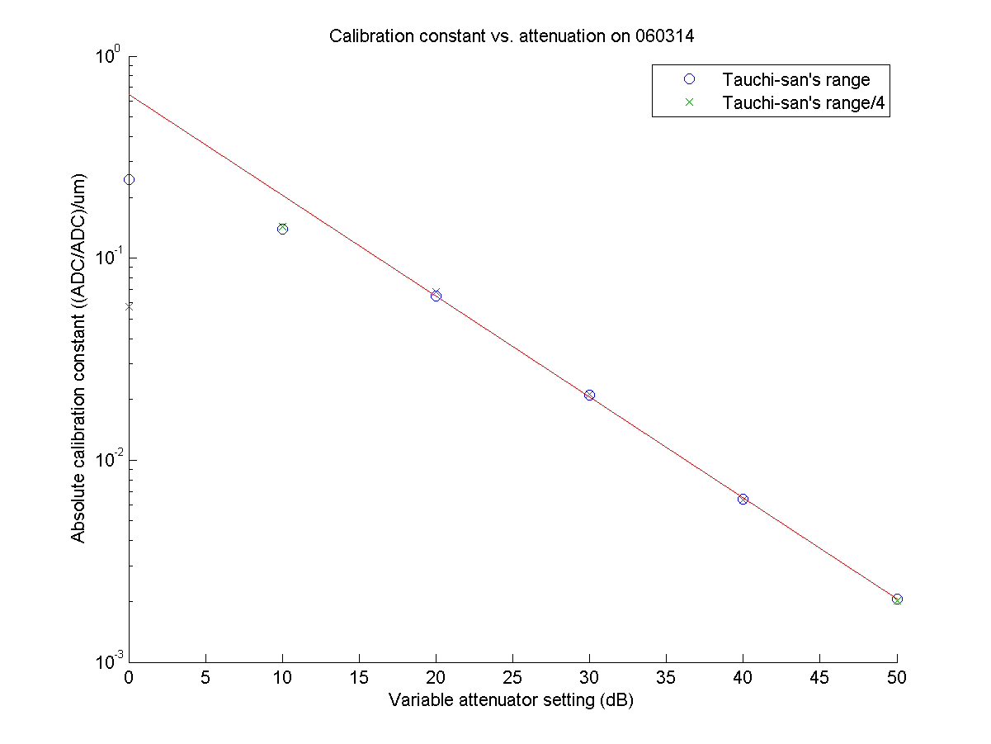
Sample 96
N. Blaskovic

Slide 25
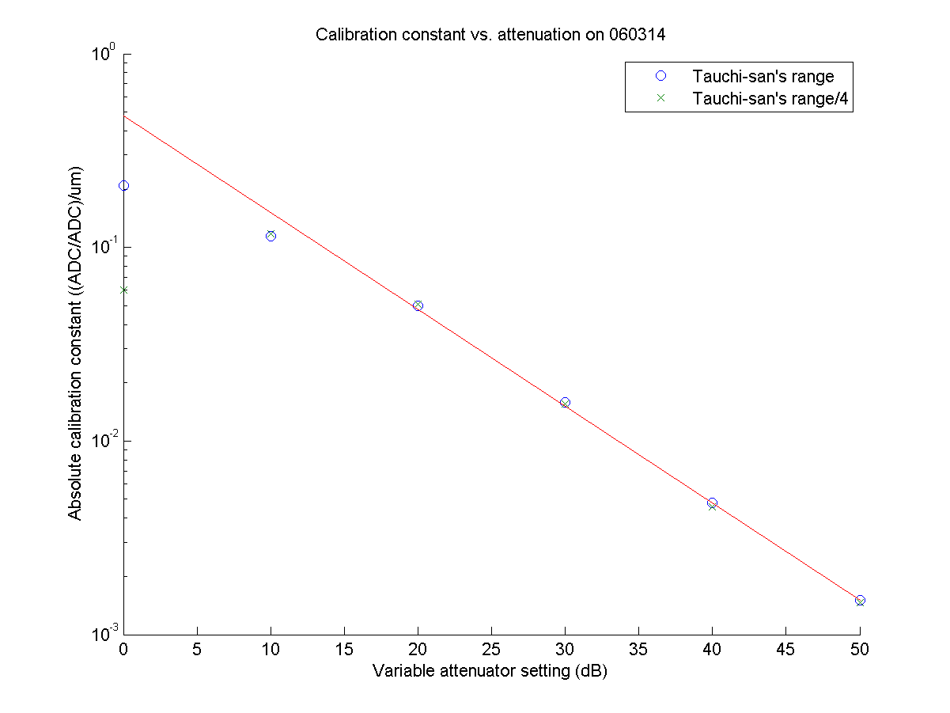
Sample 97
N. Blaskovic

Slide 26
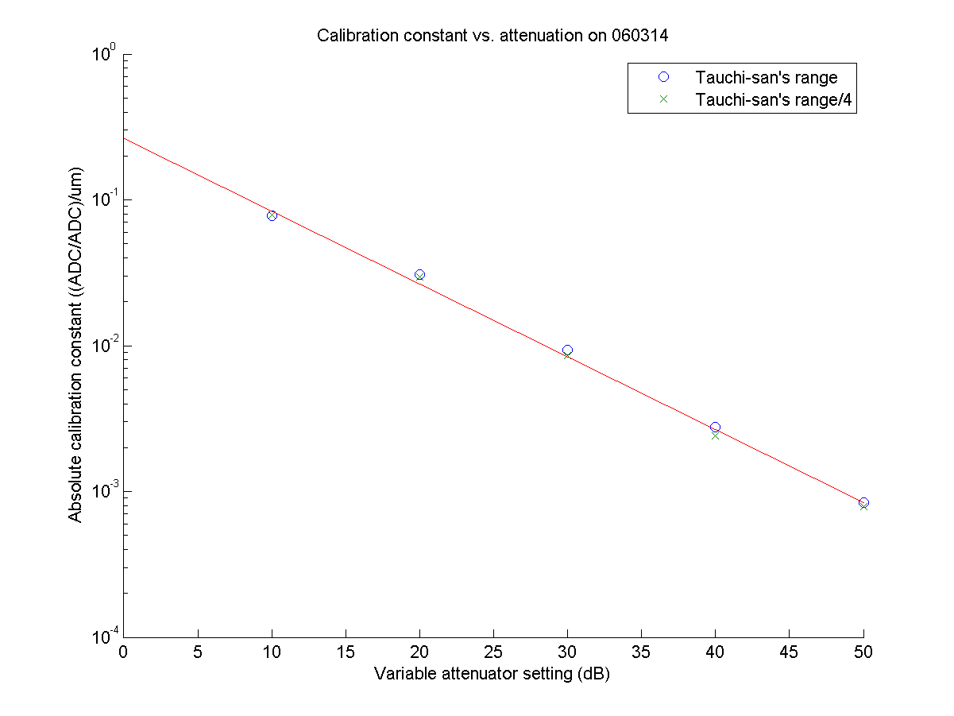
Sample 98
N. Blaskovic

Slide 27
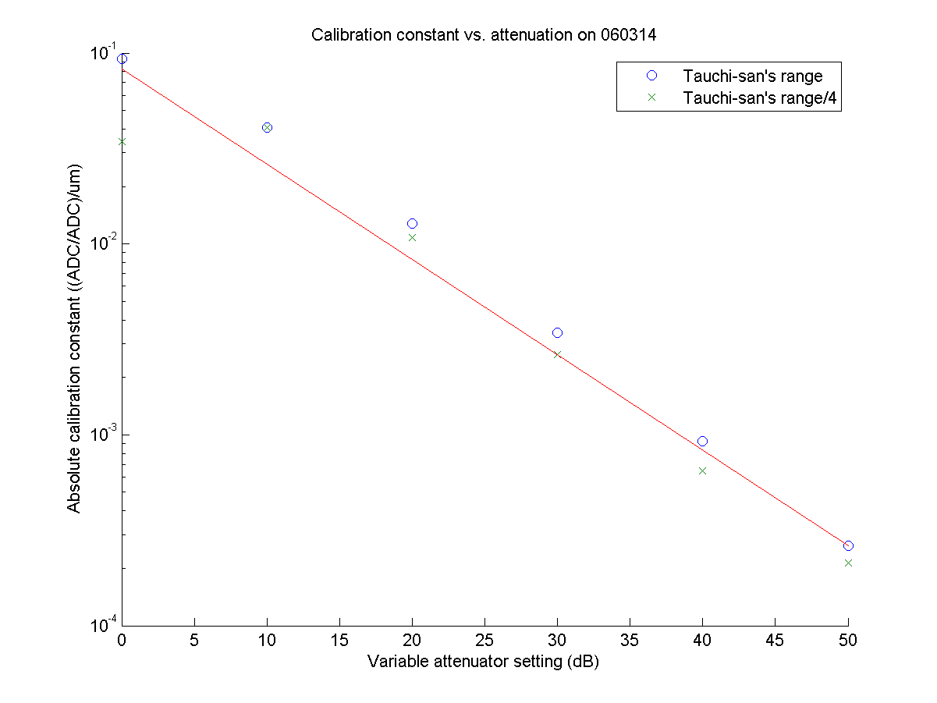
Sample 99
N. Blaskovic

Slide 28
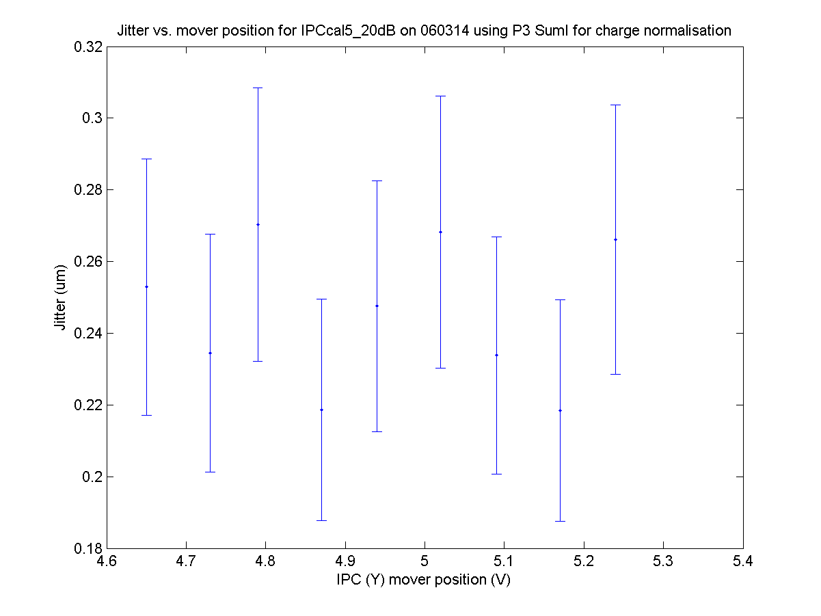
20 dB
N. Blaskovic

Slide 29
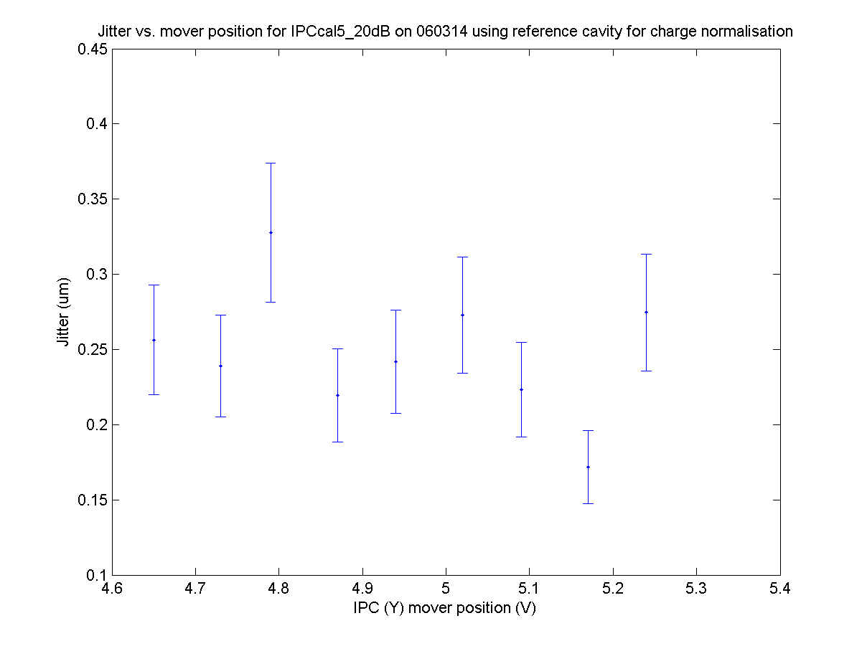
20 dB
N. Blaskovic

Slide 30
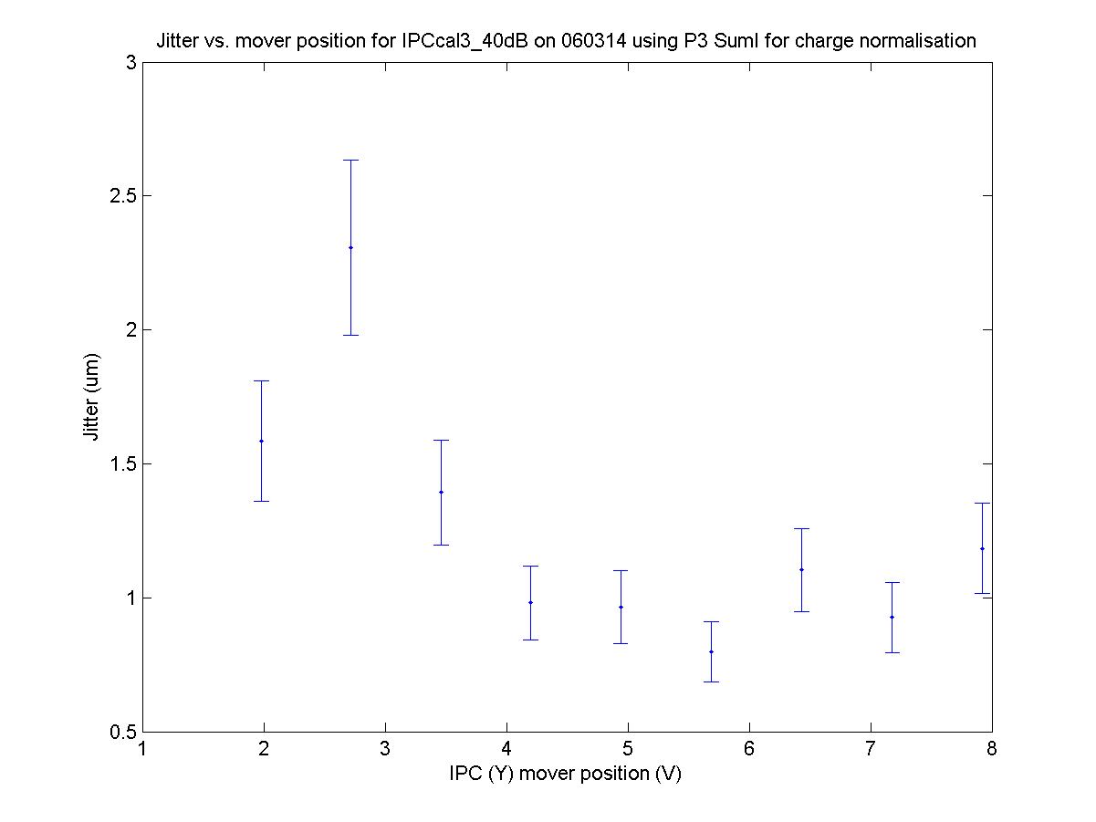
40 dB
N. Blaskovic

Slide 31
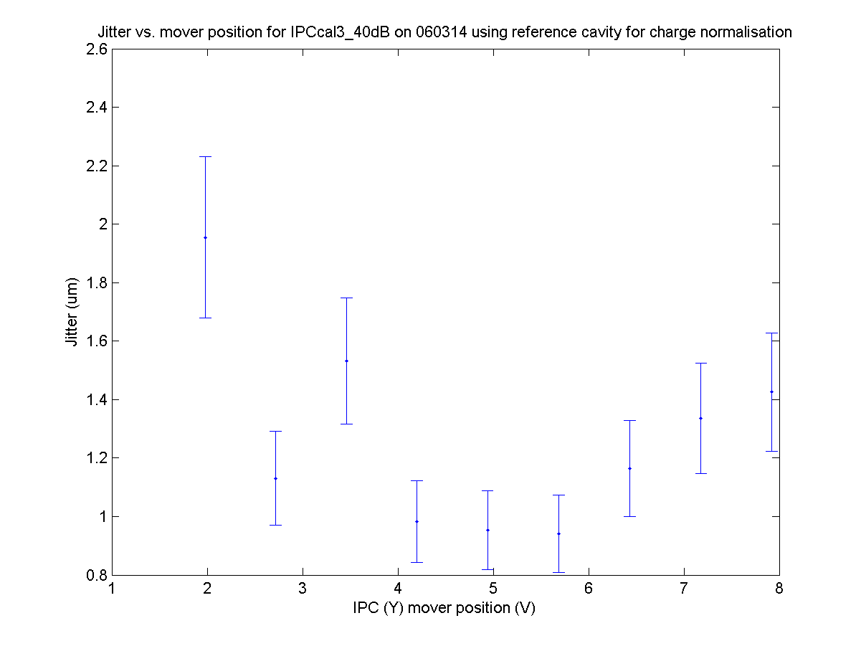
40 dB
N. Blaskovic

Slide 32
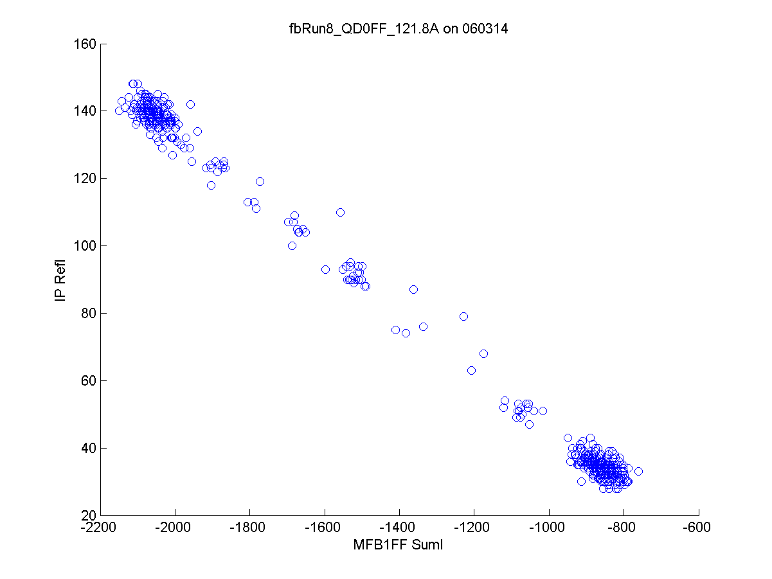
N. Blaskovic

Slide 33
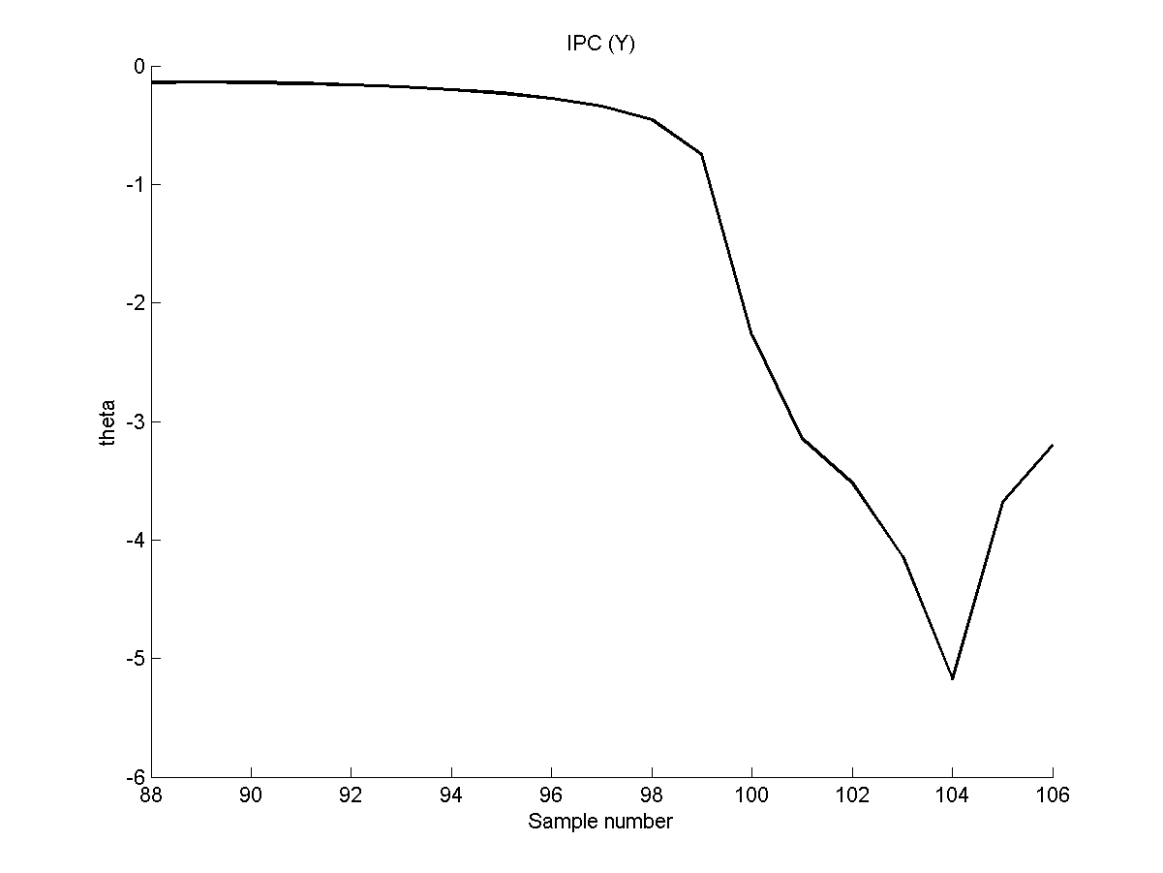
(IPCcal5_20dB on 060314)
N. Blaskovic

Slide 34
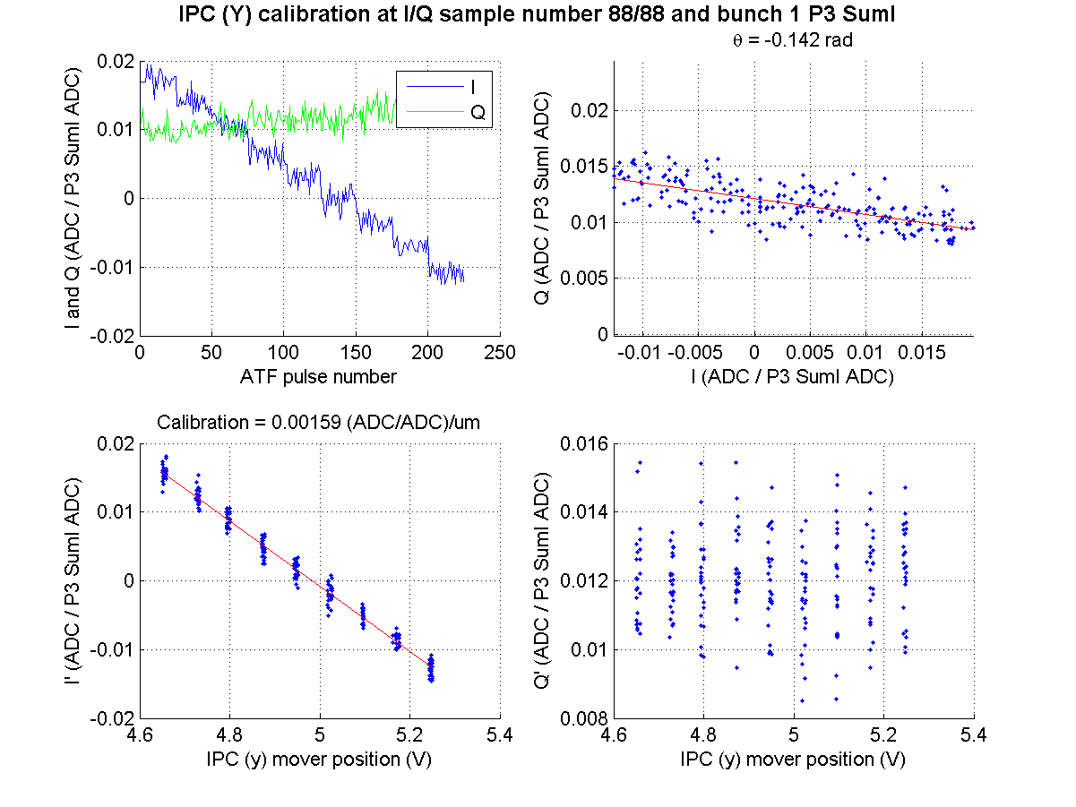
Sample 88
(IPCcal5_20dB on 060314)
N. Blaskovic

Slide 35
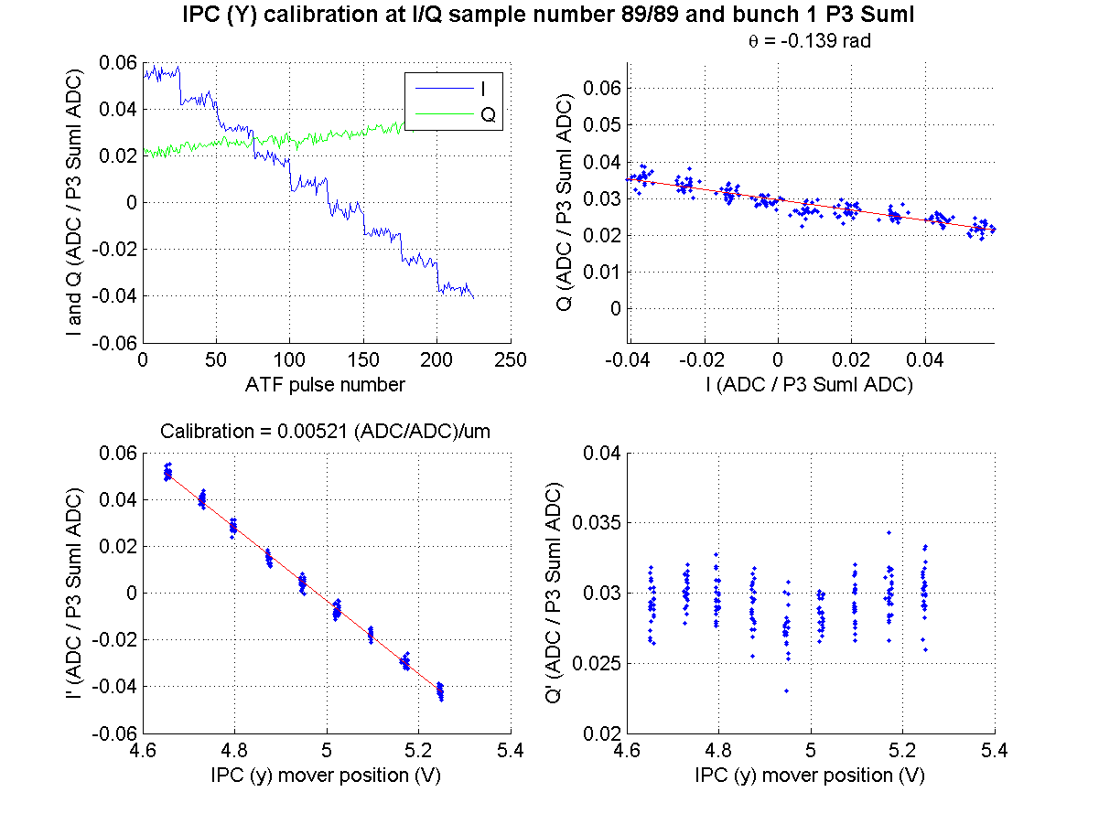
Sample 89
(IPCcal5_20dB on 060314)
N. Blaskovic

Slide 36
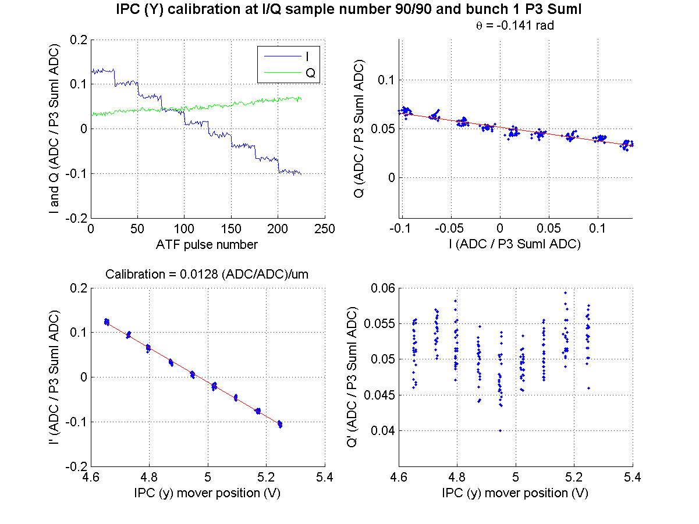
Sample 90
(IPCcal5_20dB on 060314)
N. Blaskovic

Slide 37
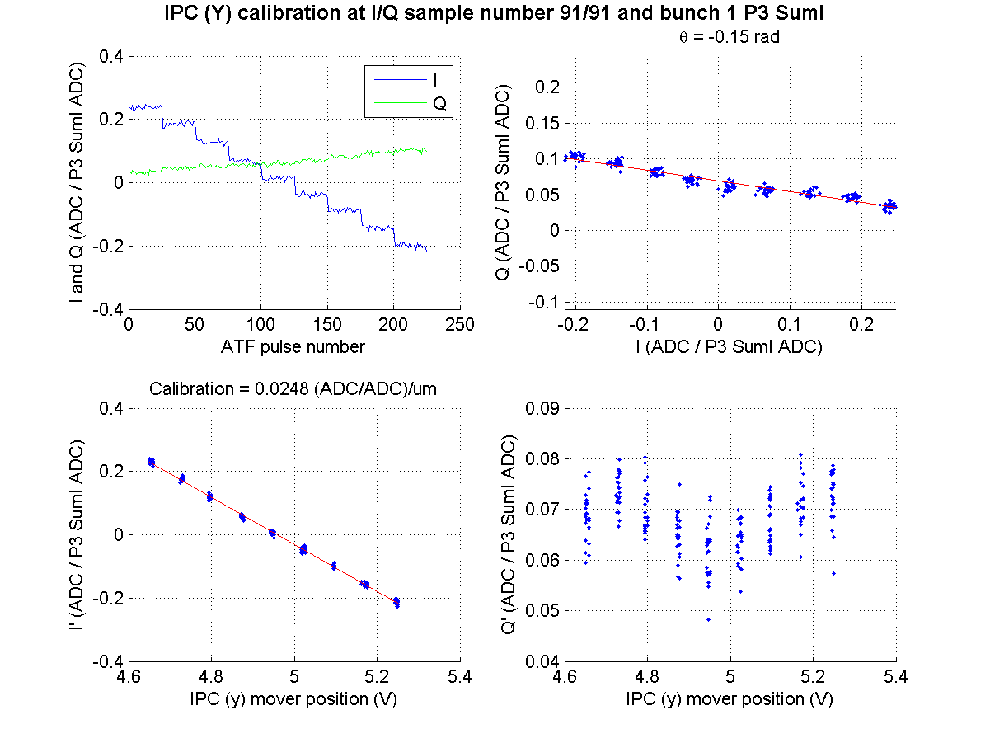
Sample 91
(IPCcal5_20dB on 060314)
N. Blaskovic

Slide 38
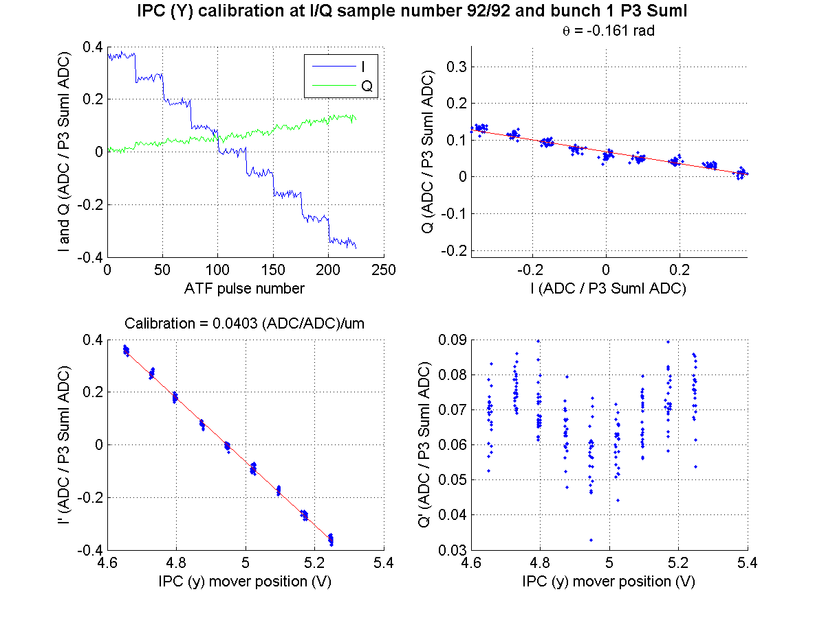
Sample 92
(IPCcal5_20dB on 060314)
N. Blaskovic

Slide 39
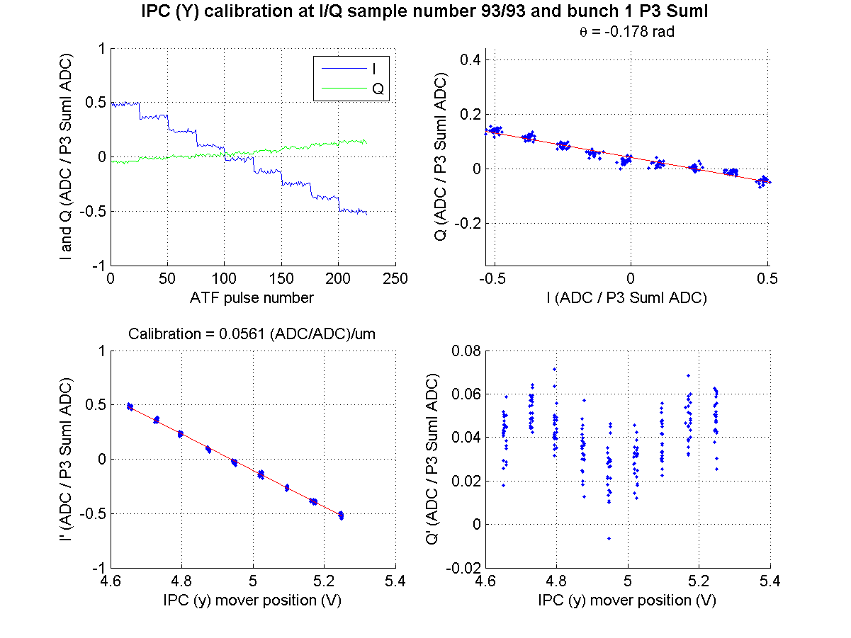
Sample 93
(IPCcal5_20dB on 060314)
N. Blaskovic

Slide 40
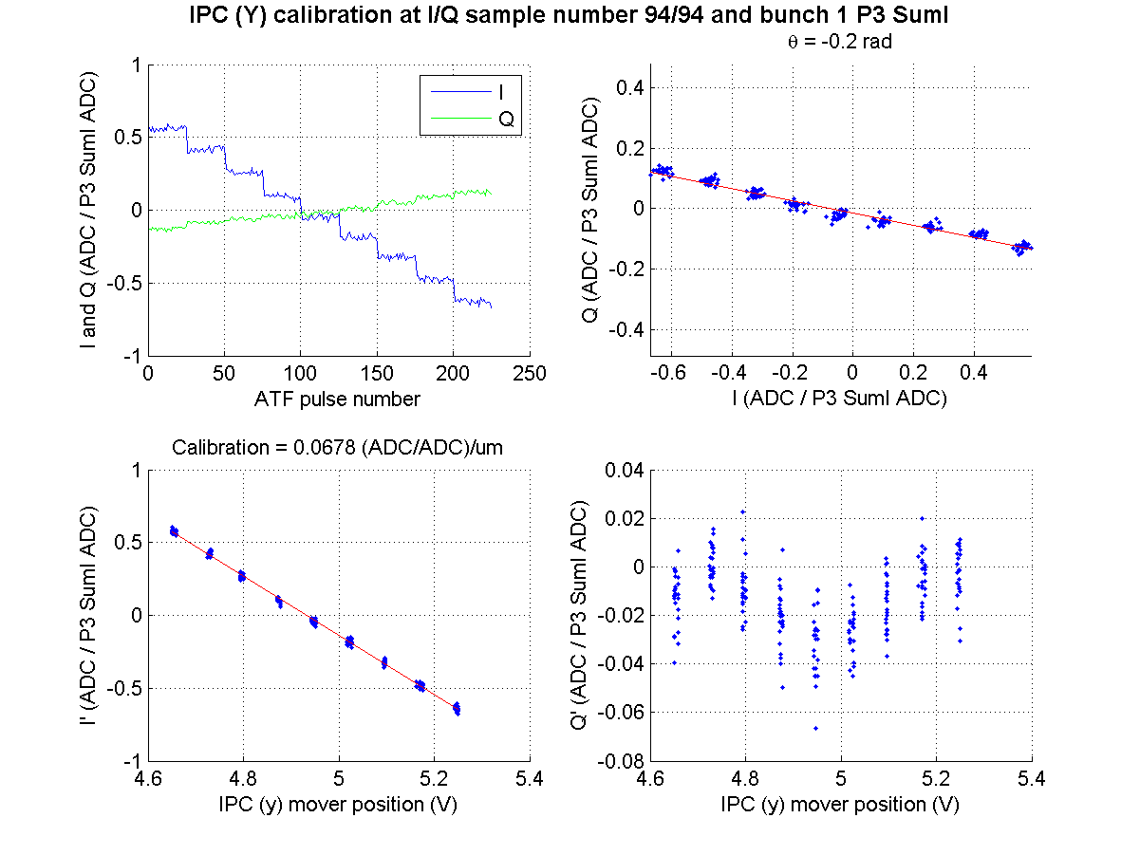
Sample 94
(IPCcal5_20dB on 060314)
N. Blaskovic

Slide 41
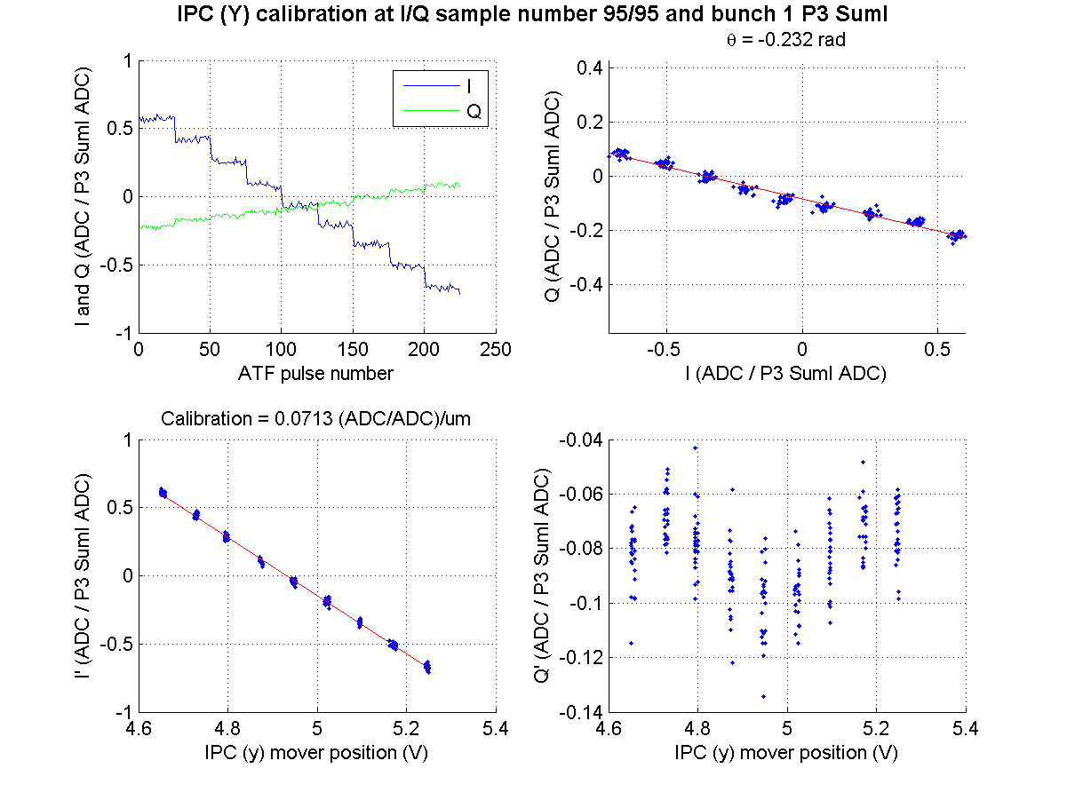
Sample 95
(IPCcal5_20dB on 060314)
N. Blaskovic

Slide 42
Sample 96
(IPCcal5_20dB on 060314)
N. Blaskovic

Slide 43
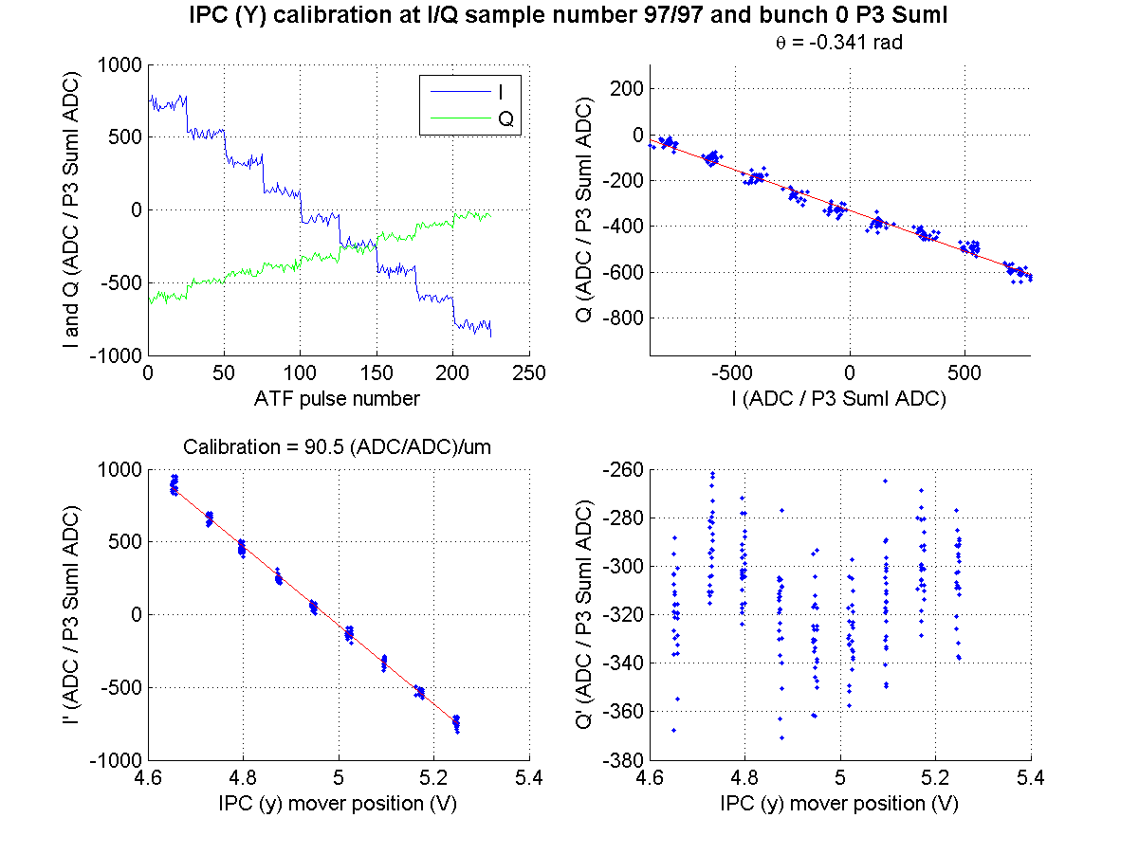
Sample 97
(IPCcal5_20dB on 060314)
N. Blaskovic

Slide 44
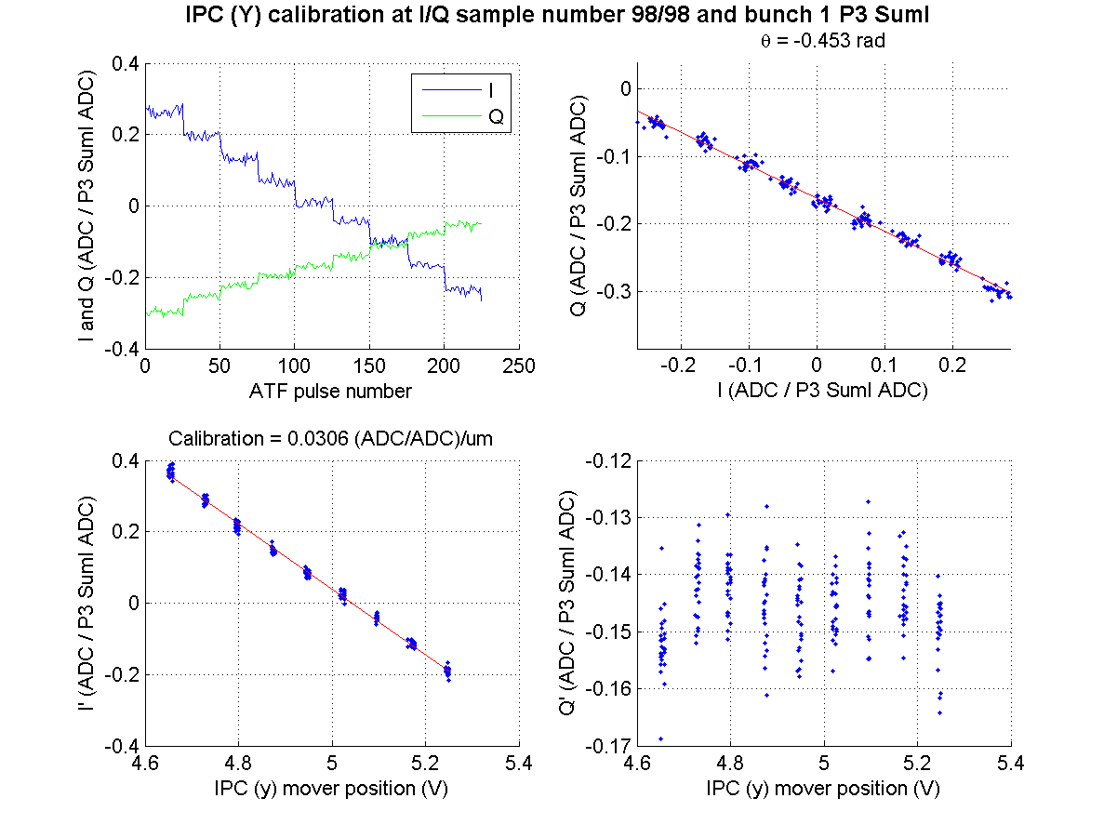
Sample 98
(IPCcal5_20dB on 060314)
N. Blaskovic

Slide 45
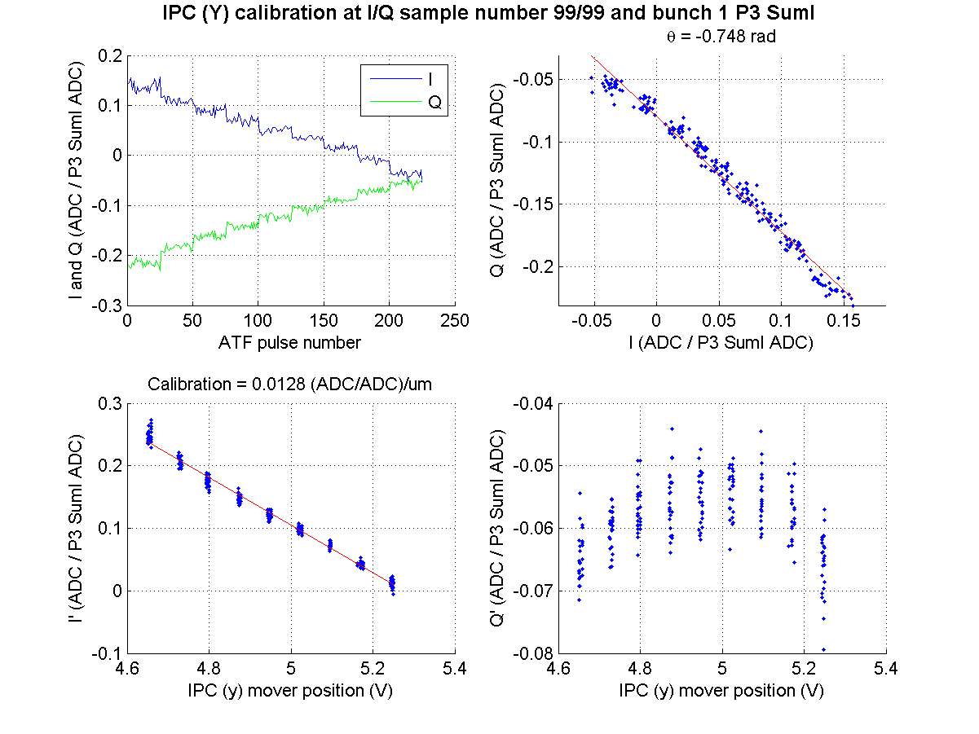
Sample 99
(IPCcal5_20dB on 060314)
N. Blaskovic

Slide 46
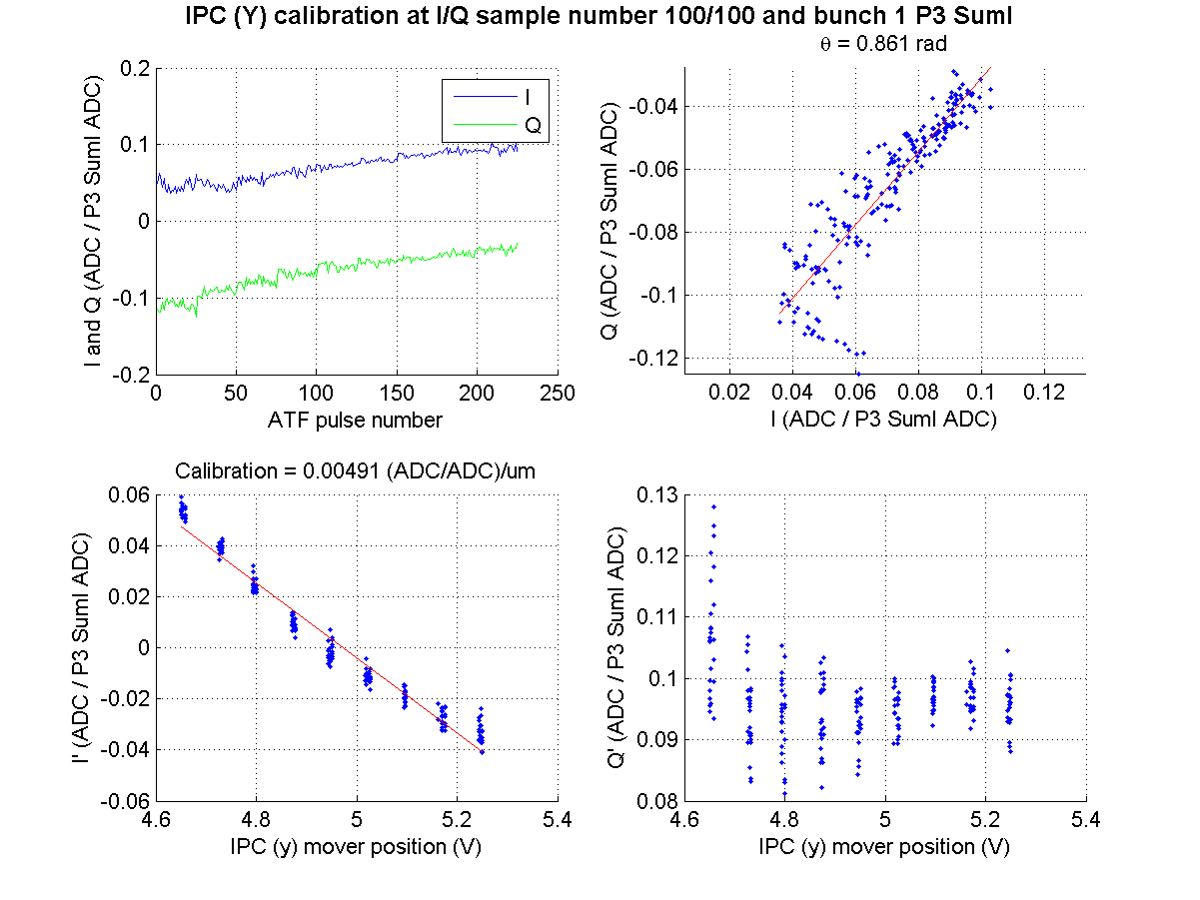
Sample 100
(IPCcal5_20dB on 060314)
N. Blaskovic

Slide 47
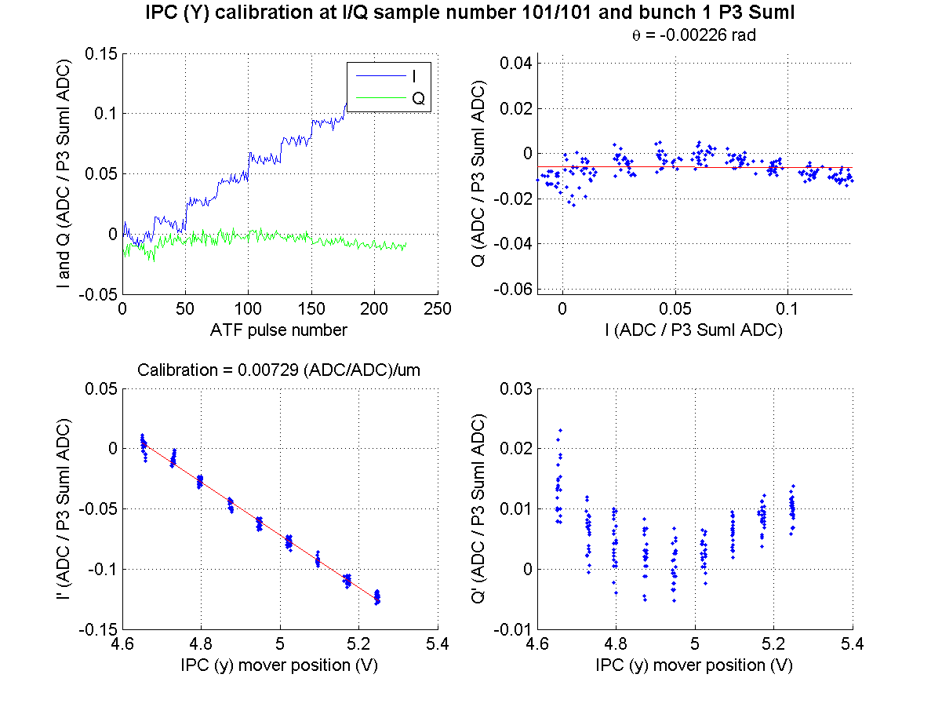
Sample 101
(IPCcal5_20dB on 060314)
N. Blaskovic

Slide 48
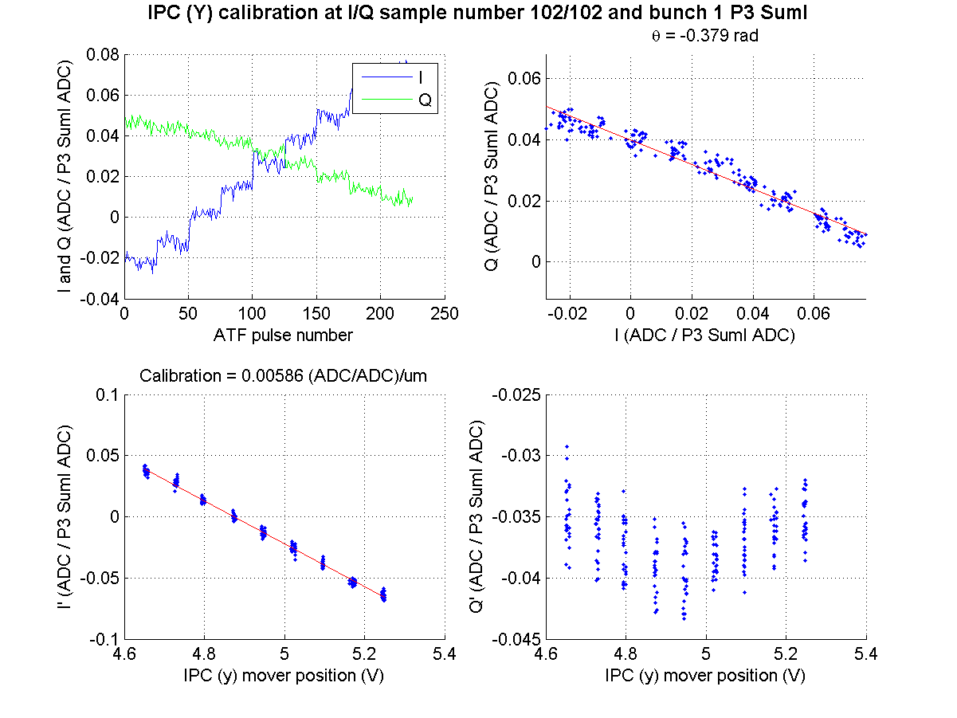
Sample 102
(IPCcal5_20dB on 060314)
N. Blaskovic

Slide 49
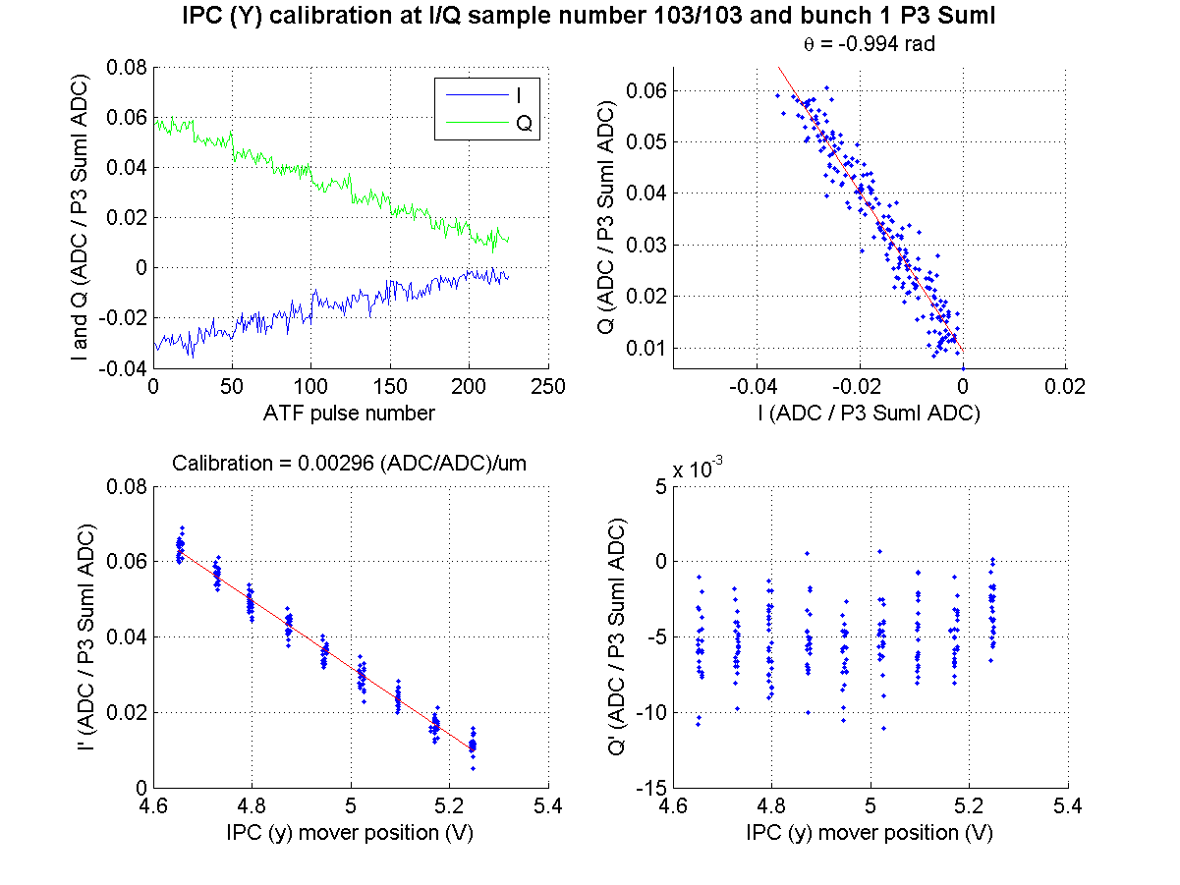
Sample 103
(IPCcal5_20dB on 060314)
N. Blaskovic

Slide 50
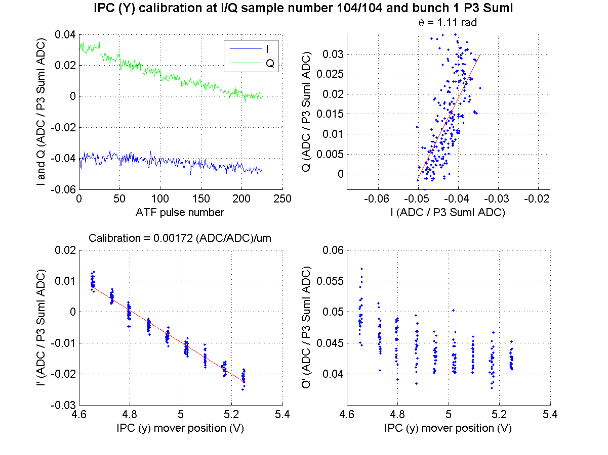
Sample 104
(IPCcal5_20dB on 060314)
N. Blaskovic

Slide 51
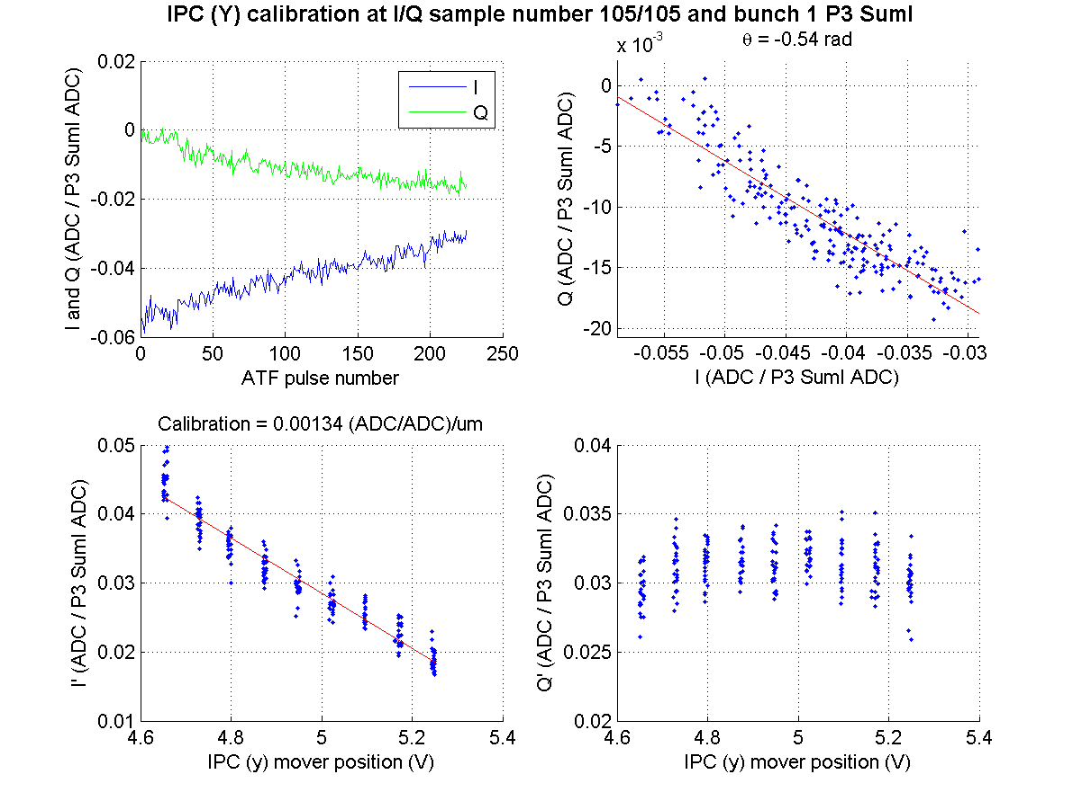
Sample 105
(IPCcal5_20dB on 060314)
N. Blaskovic

Slide 52
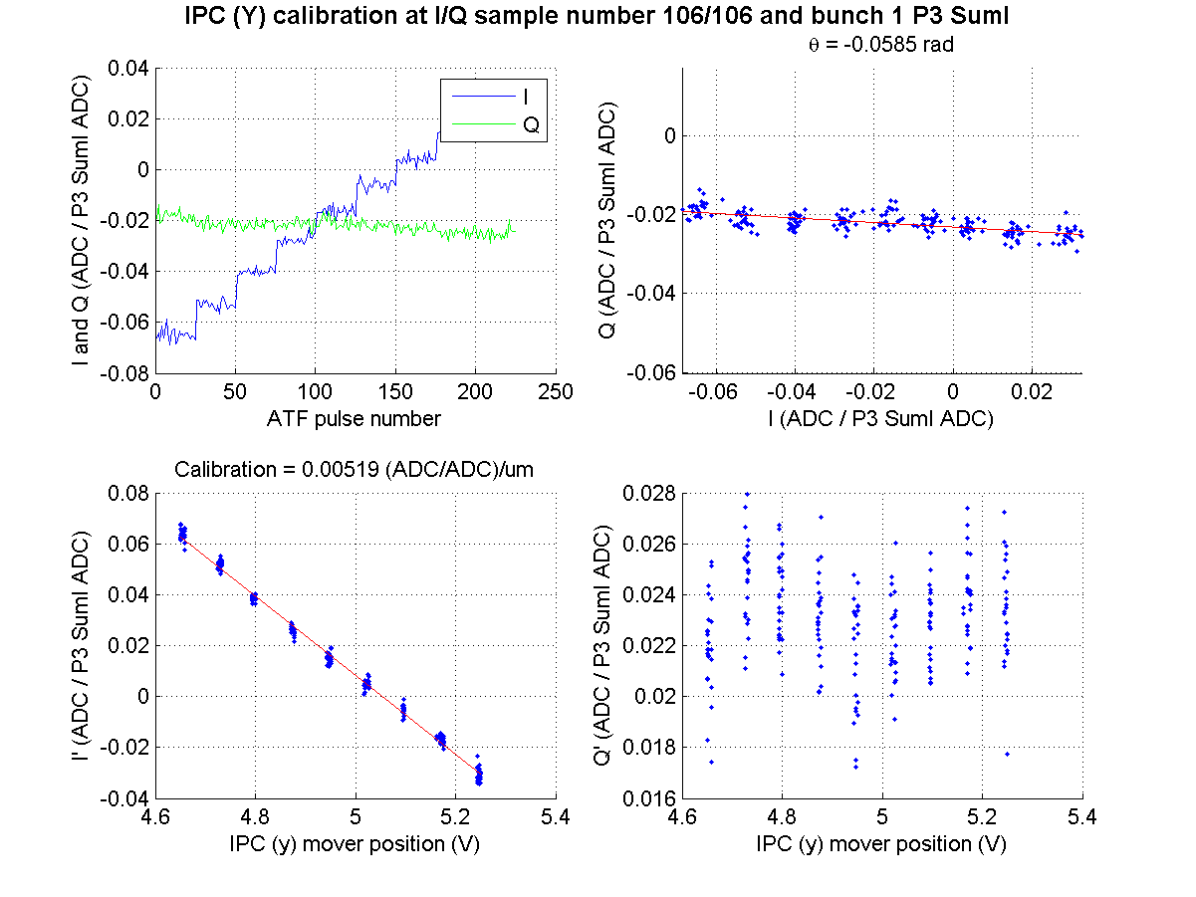
Sample 106
(IPCcal5_20dB on 060314)
N. Blaskovic

