Slide 1
Charge measurements and Q scan
N. Blaskovic
N. Blaskovic

Slide 2
Contents
Waist scan with(out) charge normalisation
Stripline Σ_{I} vs. reference diode
I and Q vs. stripline and reference diode
I’ vs. position calibrations at different Q
N. Blaskovic

Slide 3
Waist scan
QD0FF waist scan on 130314:
  Using reference diode charge normalisation
  Using no charge normalisation
Minimum jitter measured:
  177 nm using reference charge normalisation
  173 nm without charge normalisation
N. Blaskovic

Slide 4
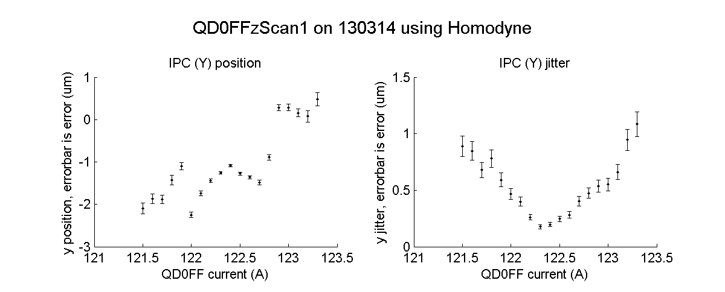
Ref charge normalised
N. Blaskovic

Slide 5

Not charge normalised
N. Blaskovic

Slide 6
Charge measurements
Scatter plots:
  Stripline Σ_{I} vs. reference diode
  I and Q vs. stripline and reference diode
N. Blaskovic

Slide 7
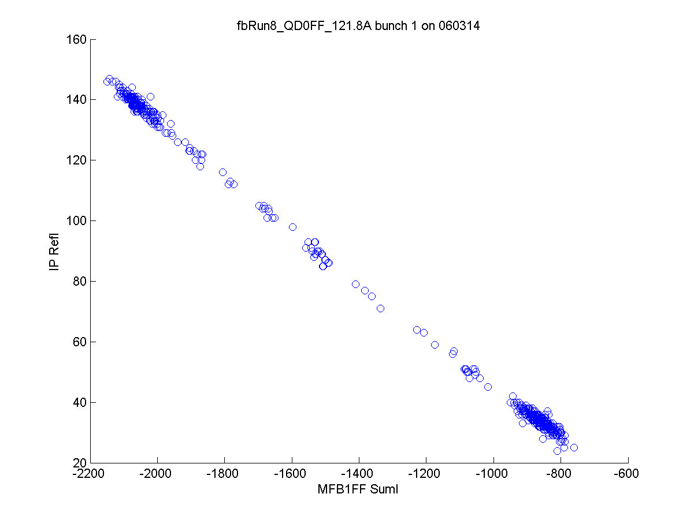
N. Blaskovic

Slide 8
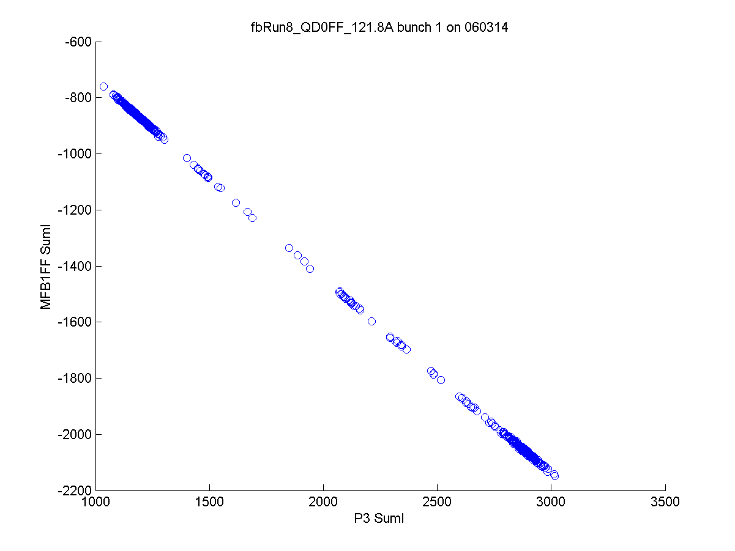
N. Blaskovic

Slide 9
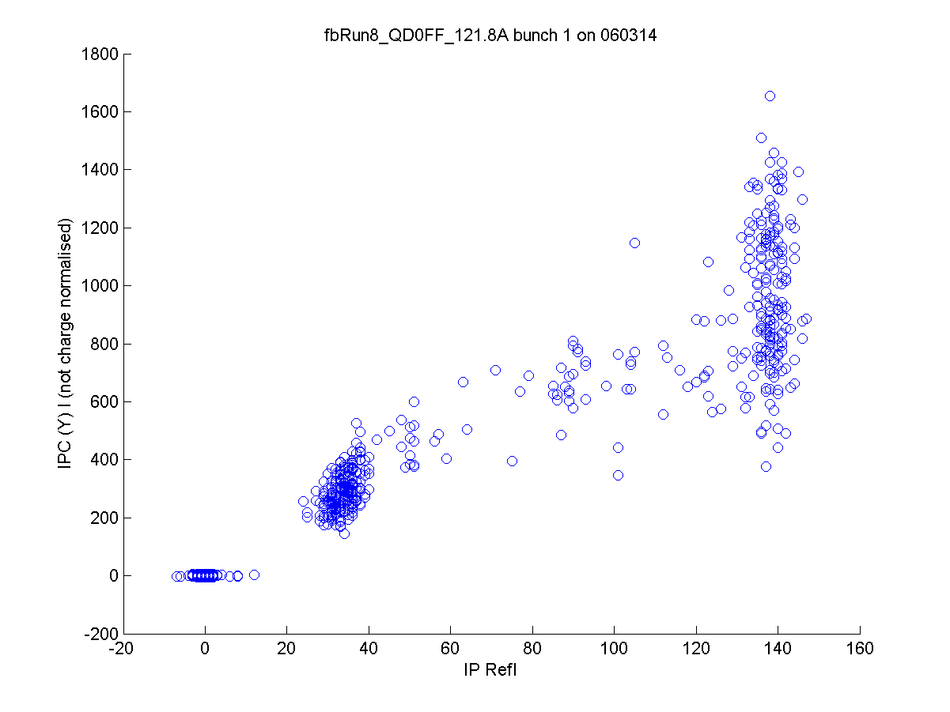
N. Blaskovic

Slide 10
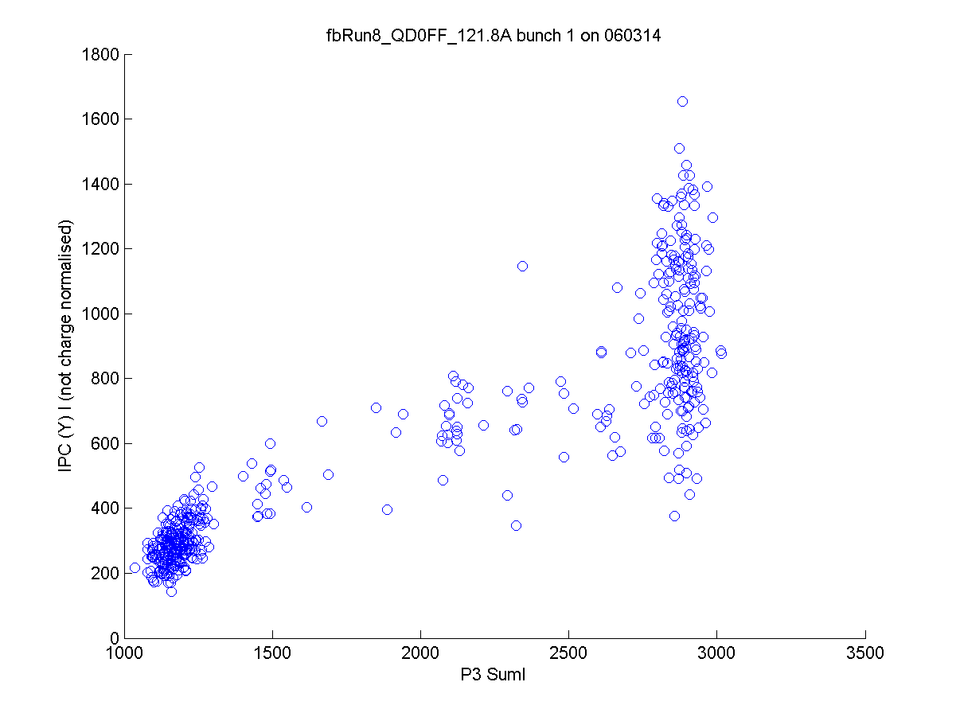
N. Blaskovic

Slide 11
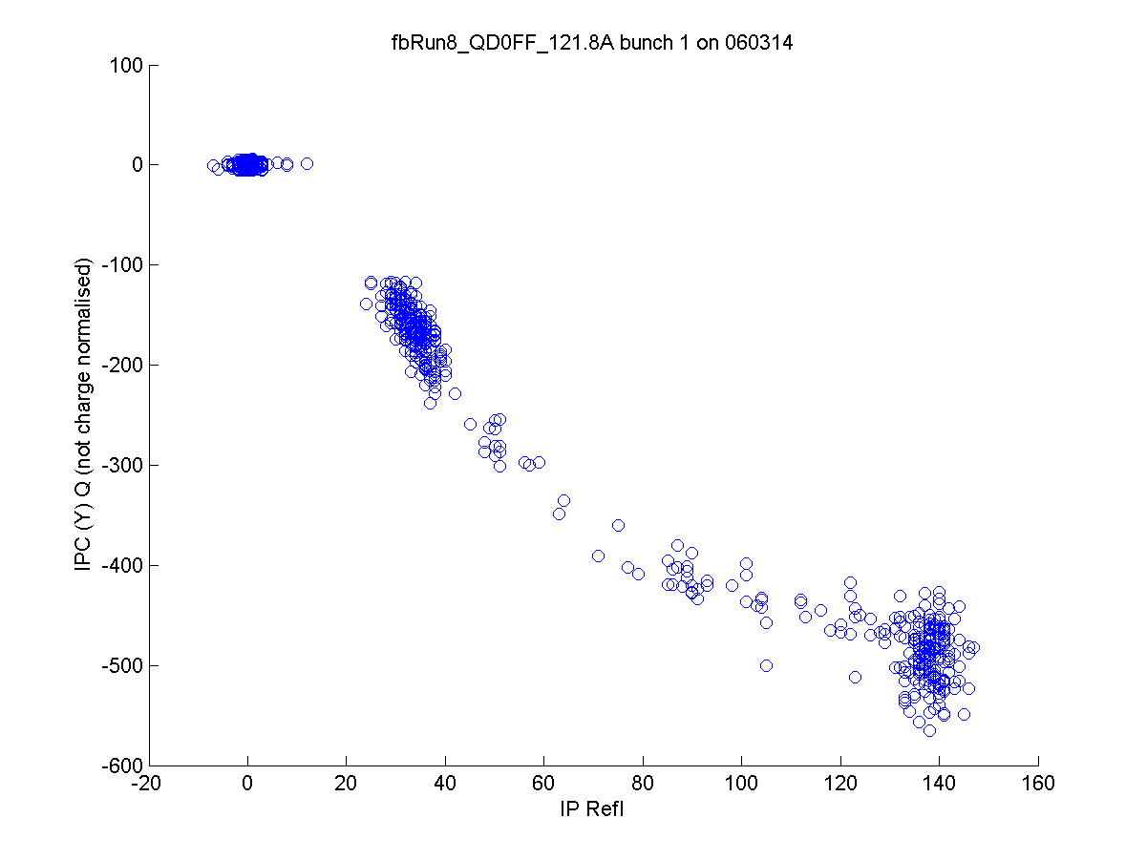
N. Blaskovic

Slide 12
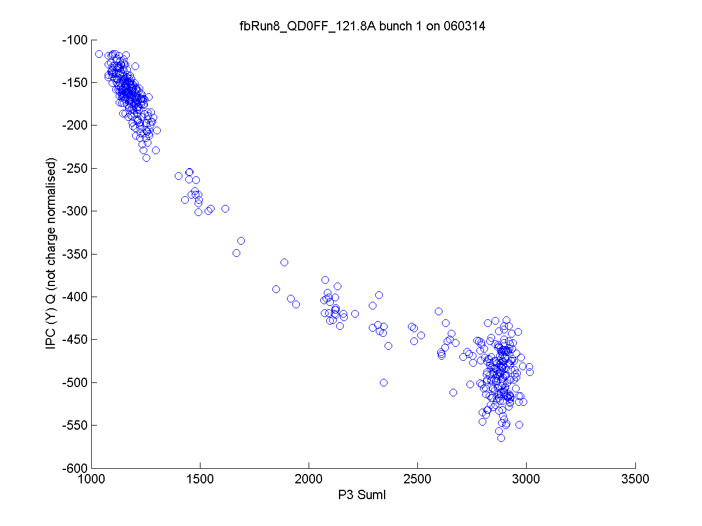
N. Blaskovic

Slide 13
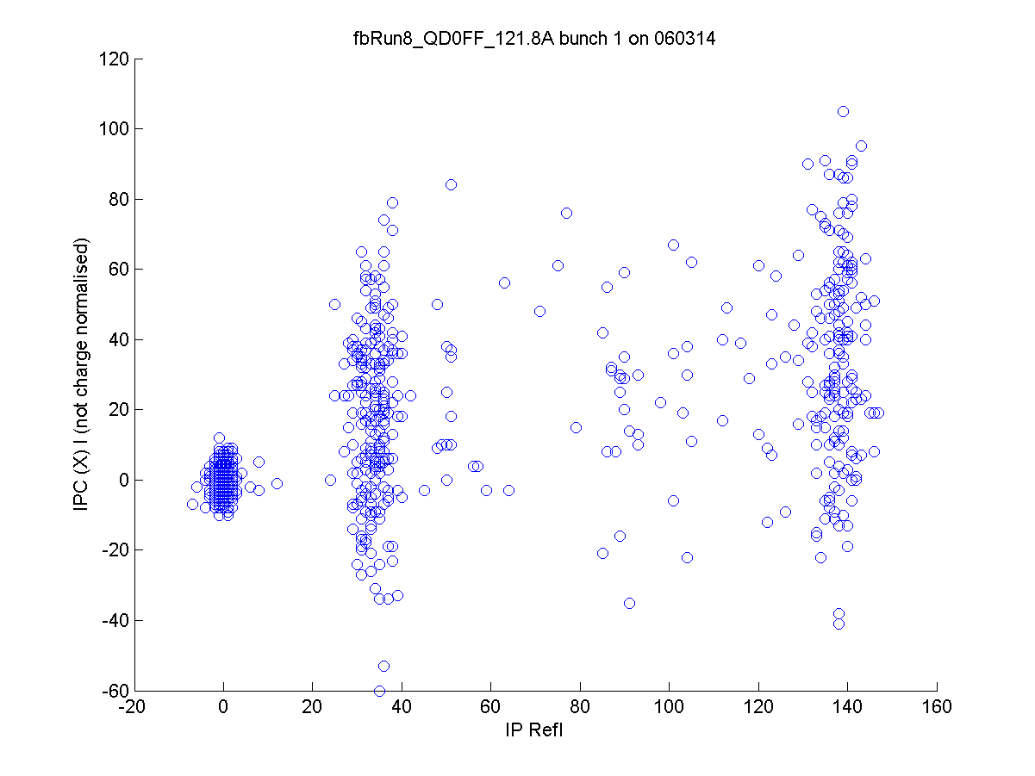
N. Blaskovic

Slide 14
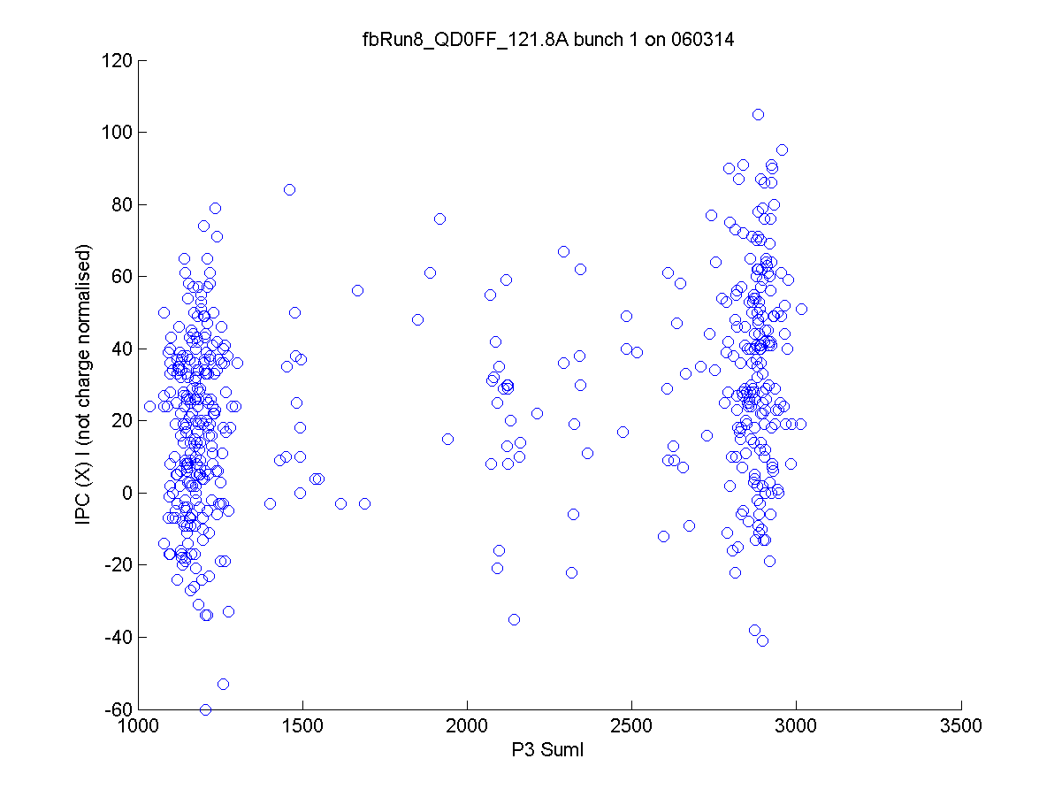
N. Blaskovic

Slide 15
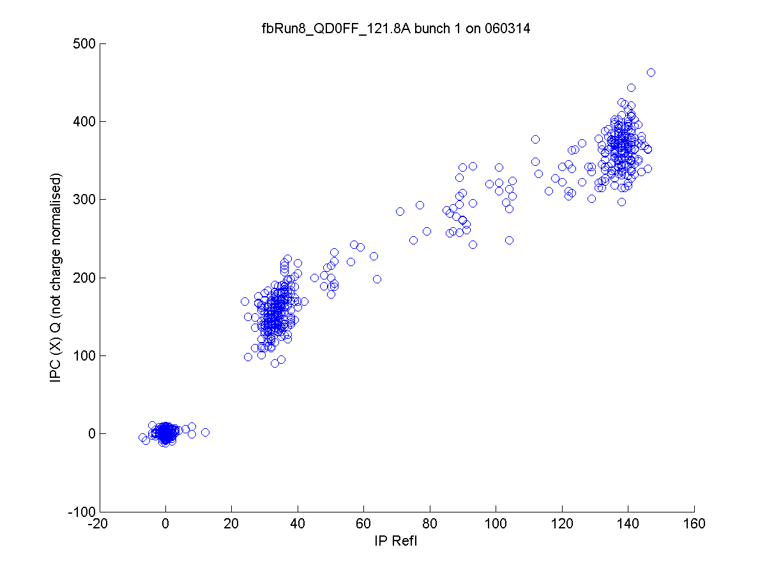
N. Blaskovic

Slide 16
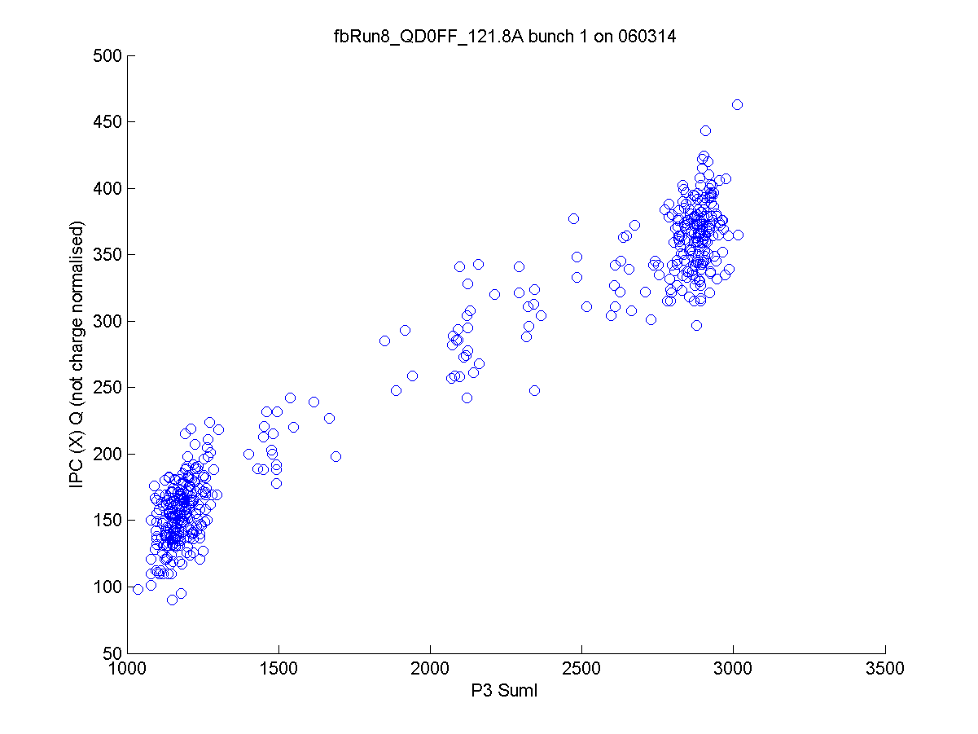
N. Blaskovic

Slide 17
Q scan
I’ vs. position calibrations at different Q
Range of Q obtained by changing beam and/or BPM pitch y’
N. Blaskovic

Slide 18
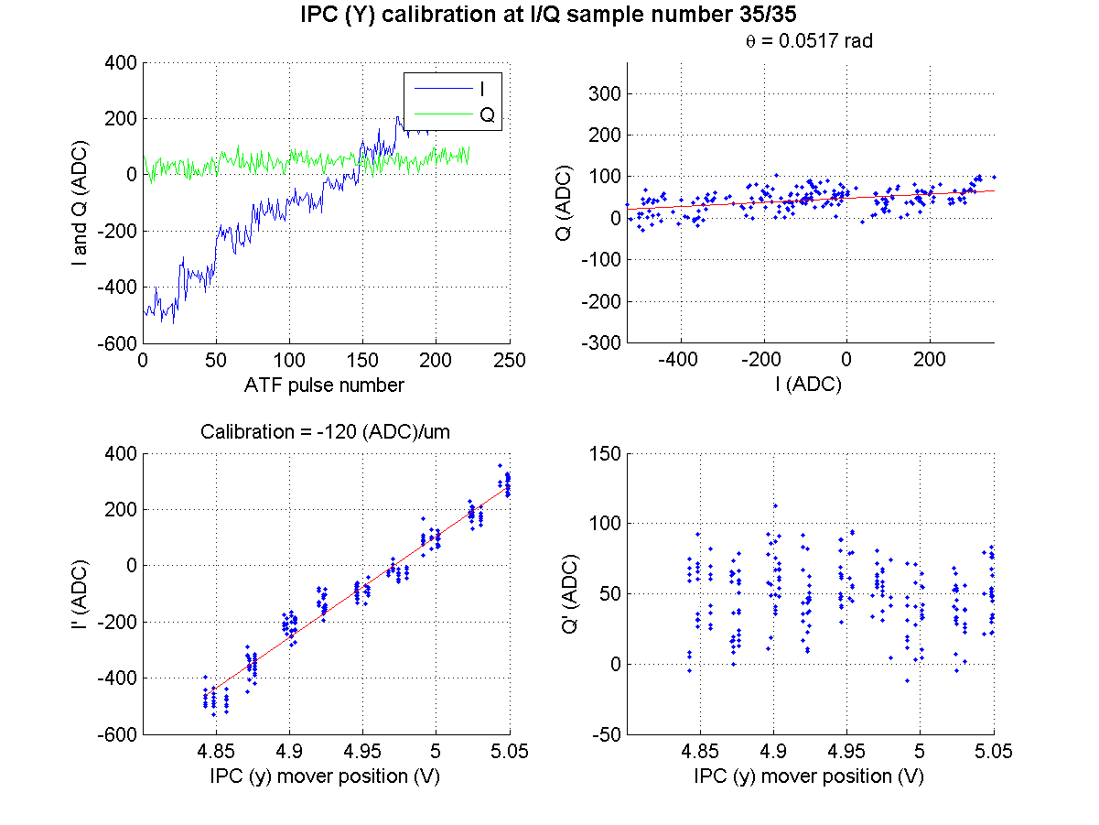
N. Blaskovic

Slide 19
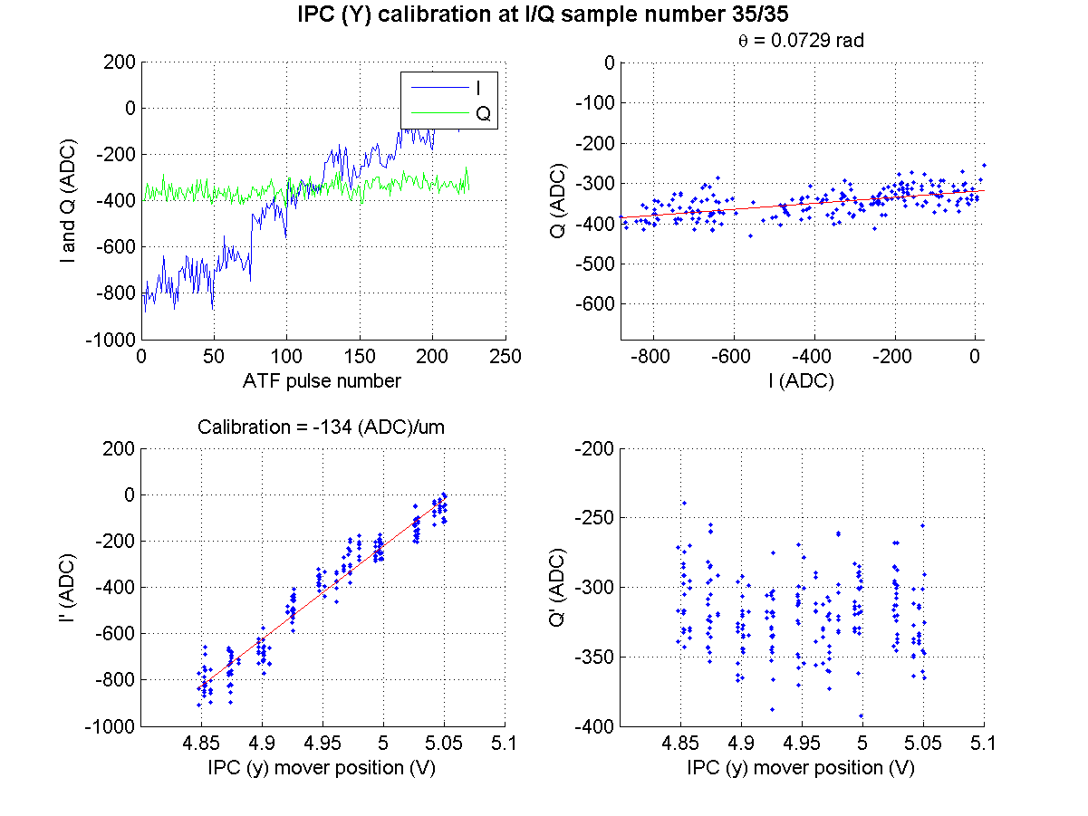
N. Blaskovic

Slide 20
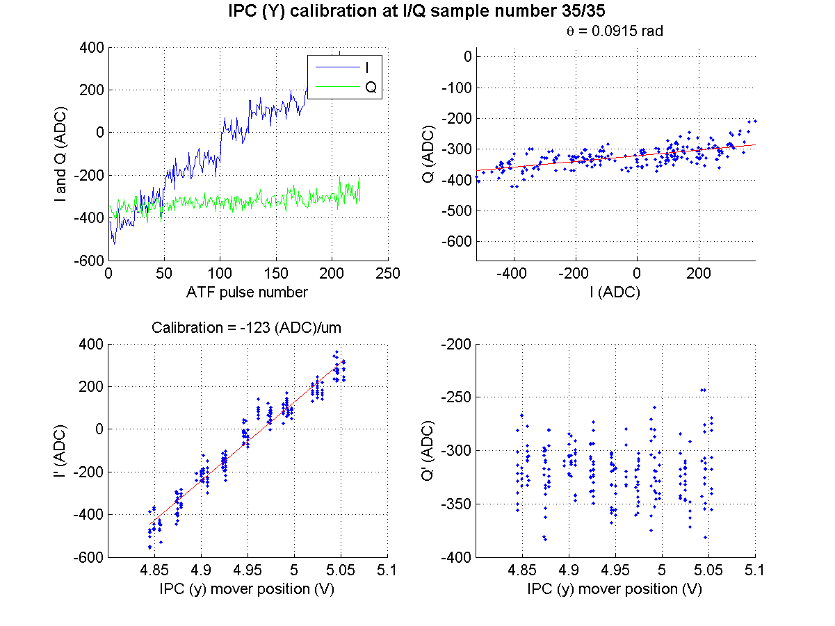
N. Blaskovic

Slide 21
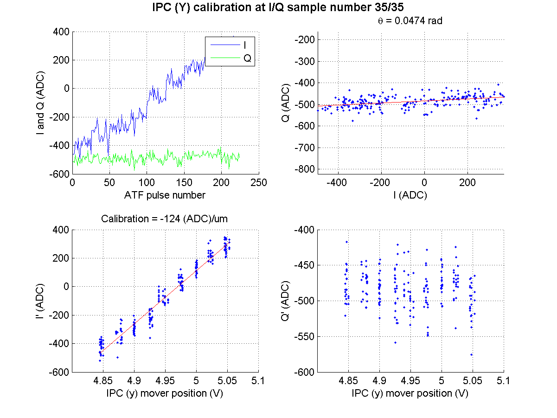
N. Blaskovic

Slide 22
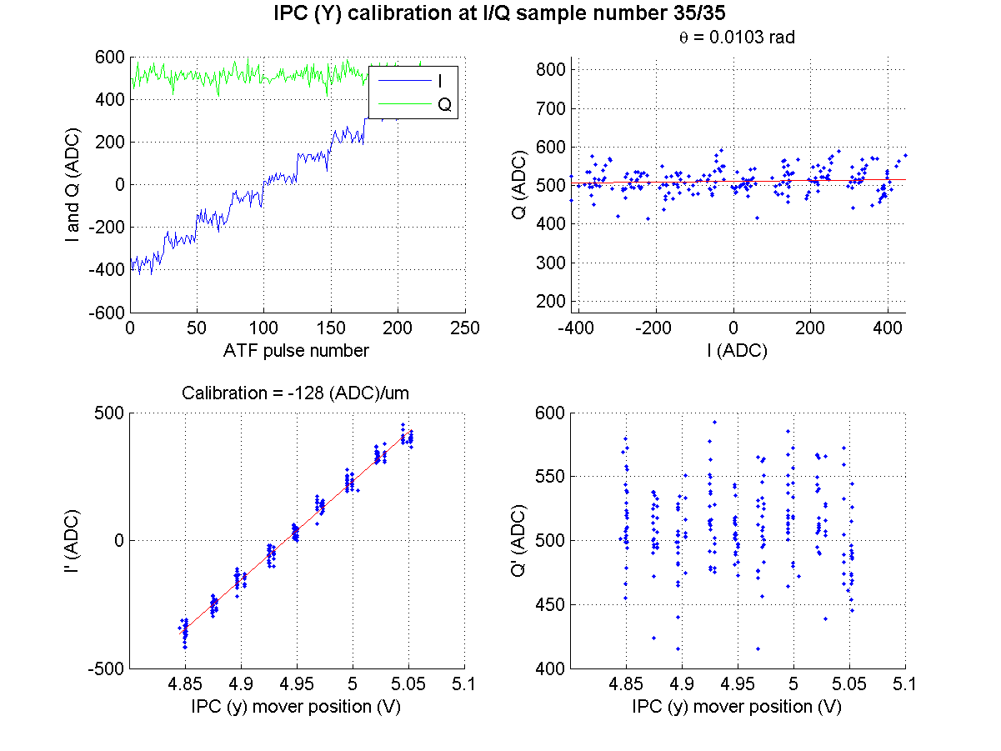
N. Blaskovic

Slide 23
N. Blaskovic

Slide 24
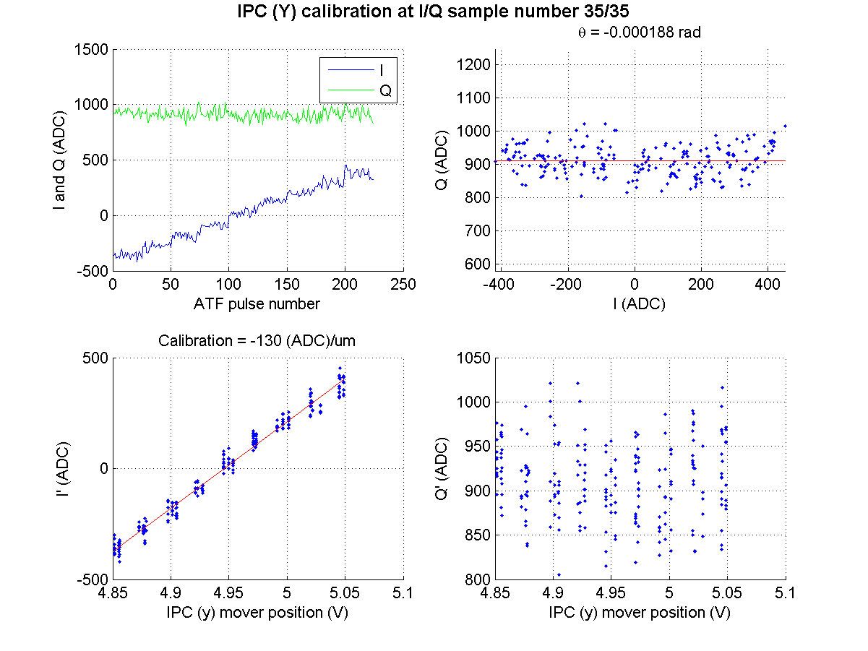
N. Blaskovic

Slide 25
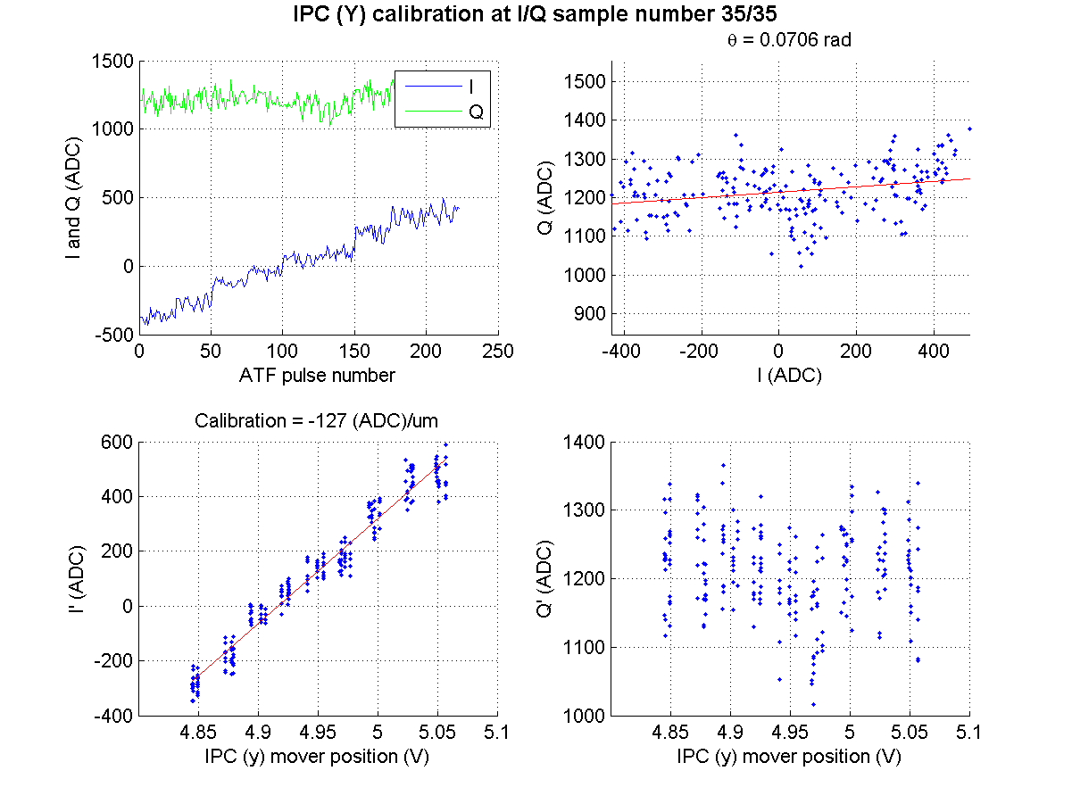
N. Blaskovic

Slide 26
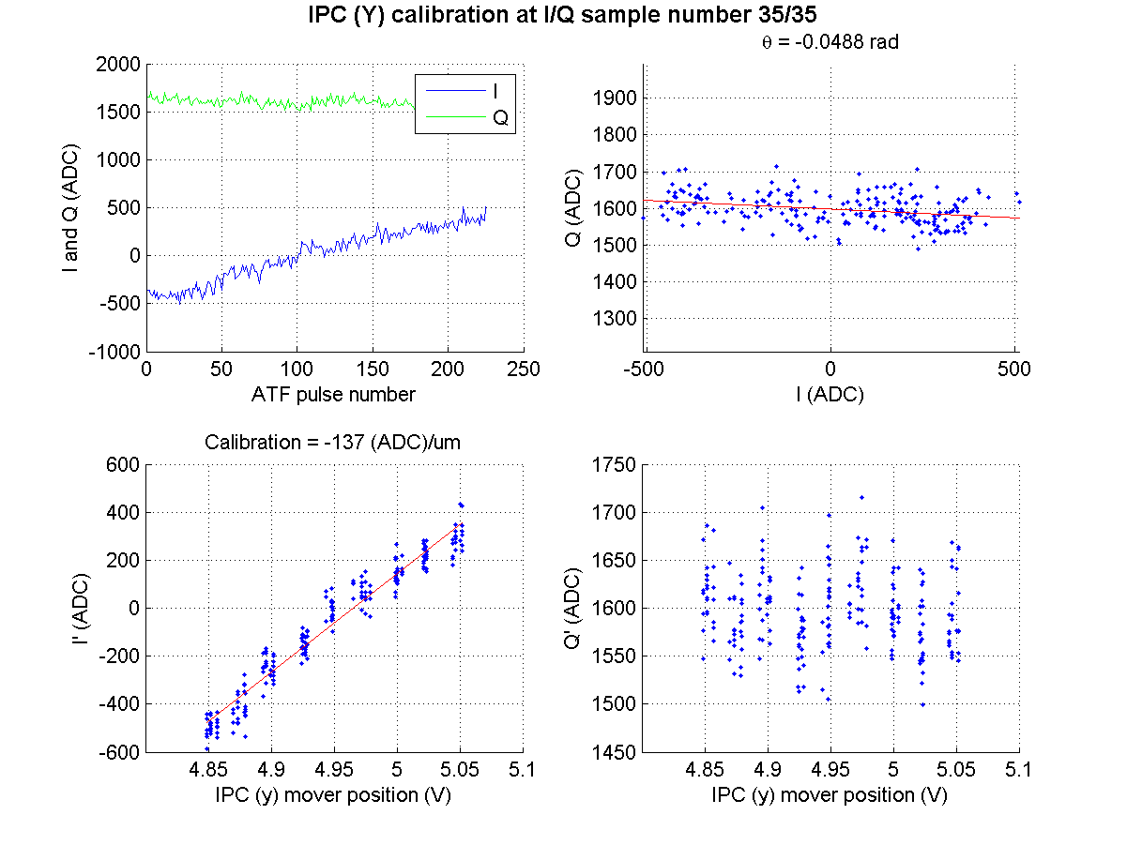
N. Blaskovic

Slide 27
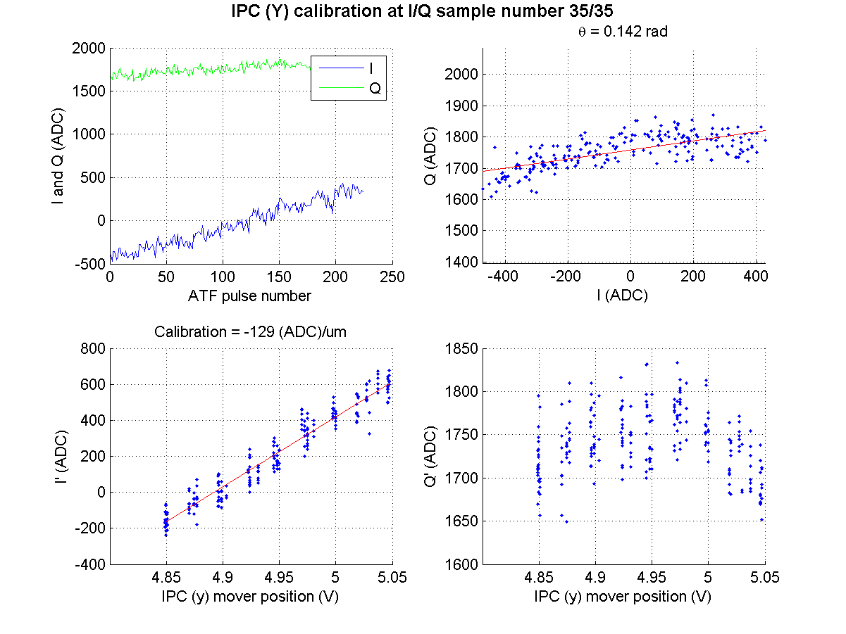
N. Blaskovic

Slide 28
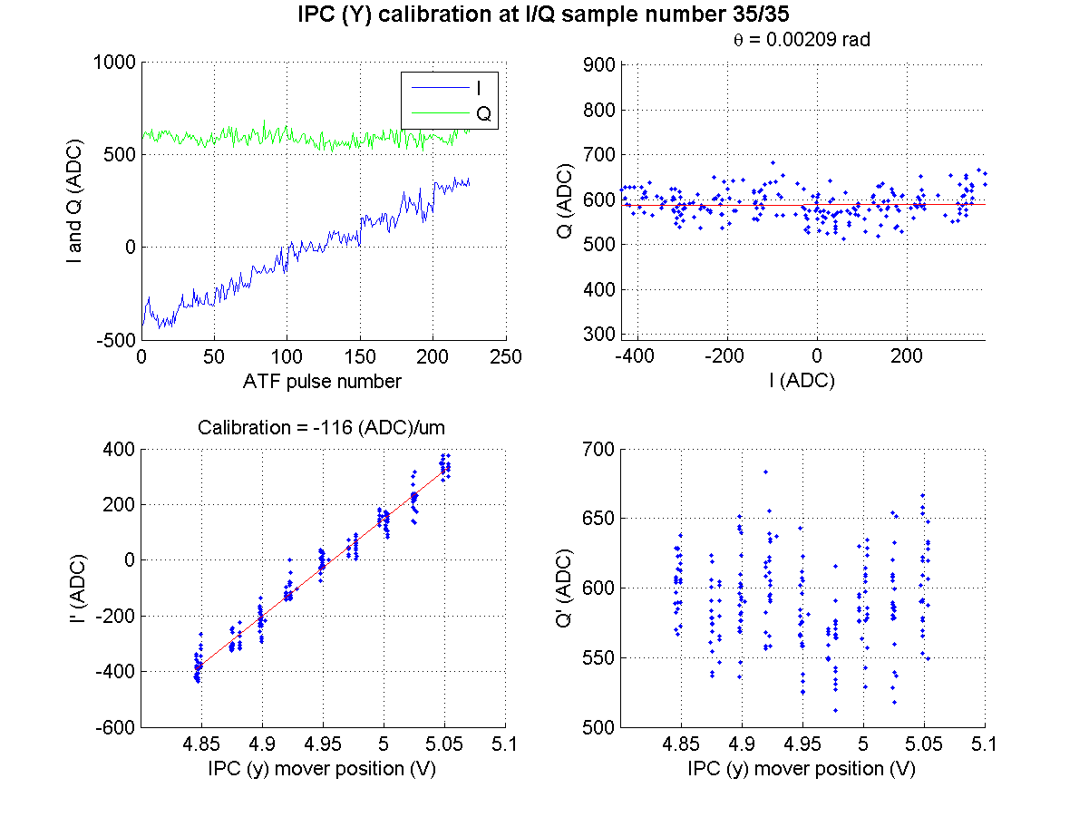
N. Blaskovic

Slide 29
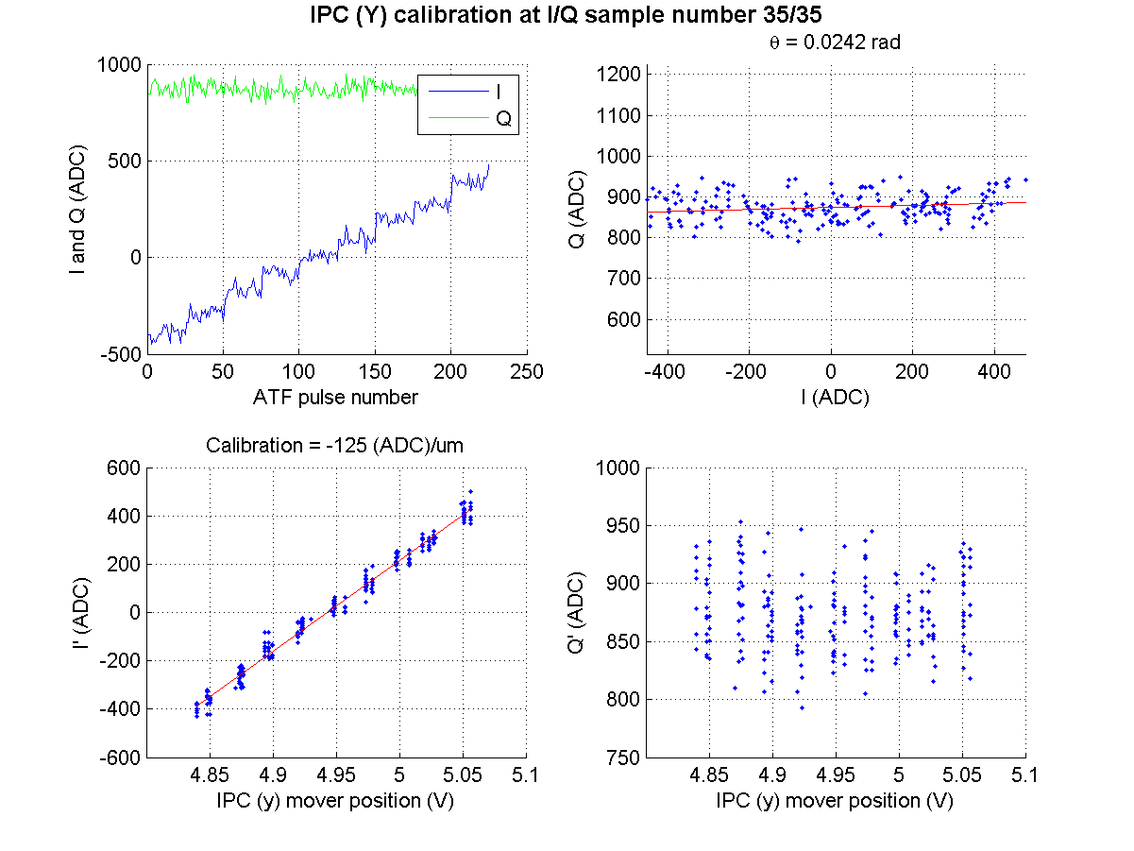
N. Blaskovic

Slide 30
Next steps
Still to do:
  LO power scan (I, Q, jitter vs. LO attenuation)
  0-11 dB variable attenuator path length test
  I vs. Q correlation for x vs. y
  y positions over x beam position scan
  Propagate P2 & P3 position to IP waist (MAD)
  Propagate slow drift to IP waist
  AQF7FF position to IP y’ pitch relation (FS)
  Software filter to remove 40 MHz ripple
N. Blaskovic

