Slide 1
MQF1X-MQF3X-MQD5X Calibrations
D. R. Bett

Slide 2
Recap
Unusual calibration constants obtained for MQF1X, MQF3X and MQD5X when instrumented with the FONT electronics
back in January
 | Date: 29/01 Electronics: FONT Set file: 140129_0131
 | MQF1X | MQF3X | MQD5X
ZV1X | -271 | -146 | 61
ZV2X |  | -147 | -144
ZV3X |  |  | -155

Slide 3
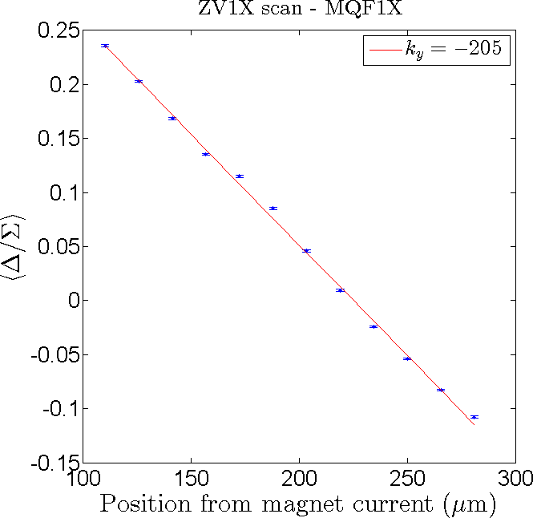
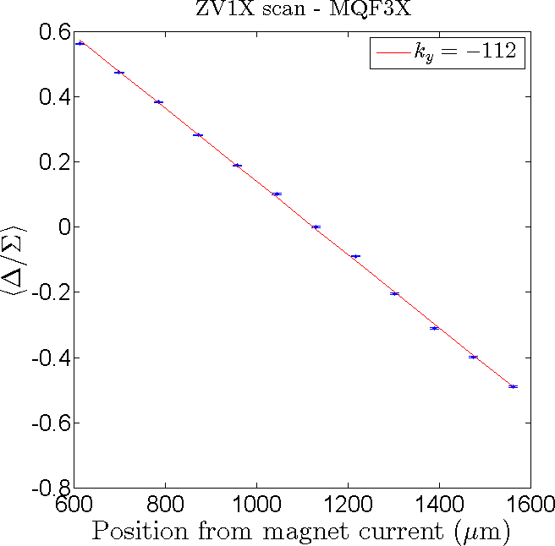
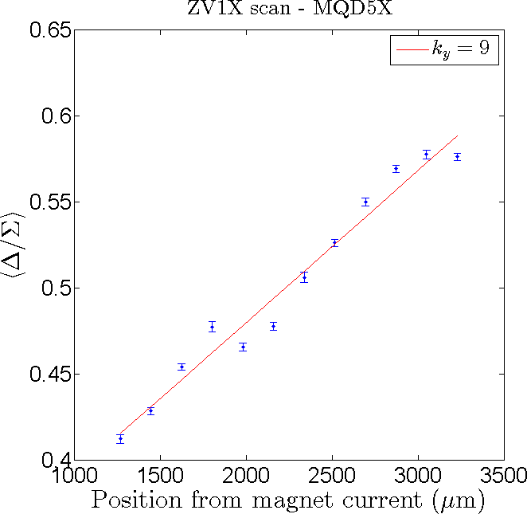
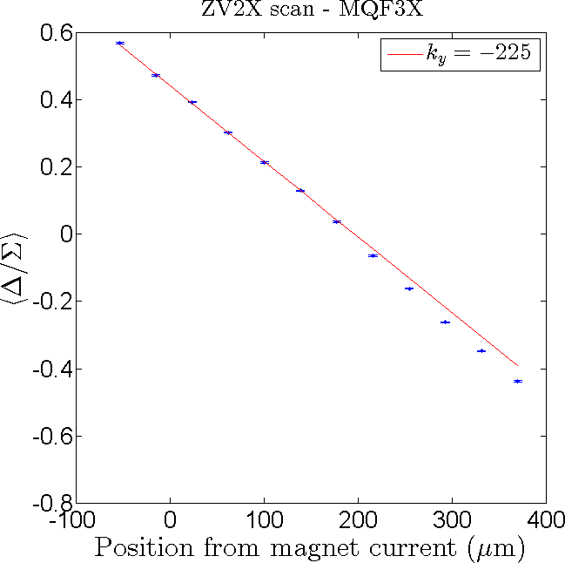
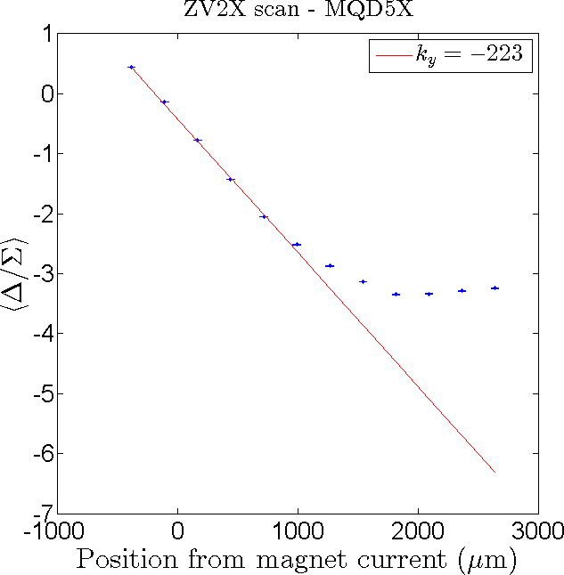
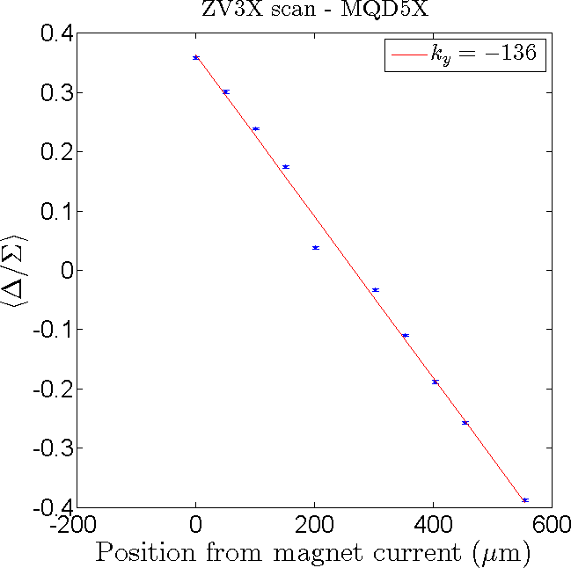
ZV1X
Date: 27/02
Electronics: FONT
Set file: flightSim_140228_0615
ZV2X
ZV3X

Slide 4
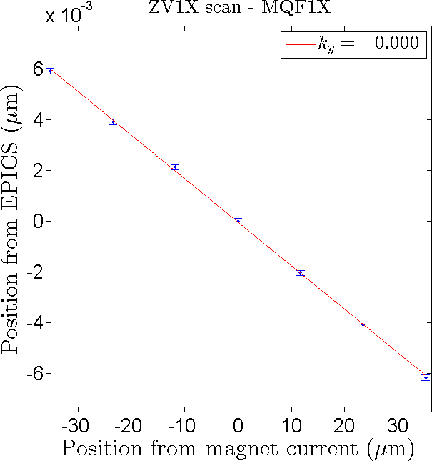
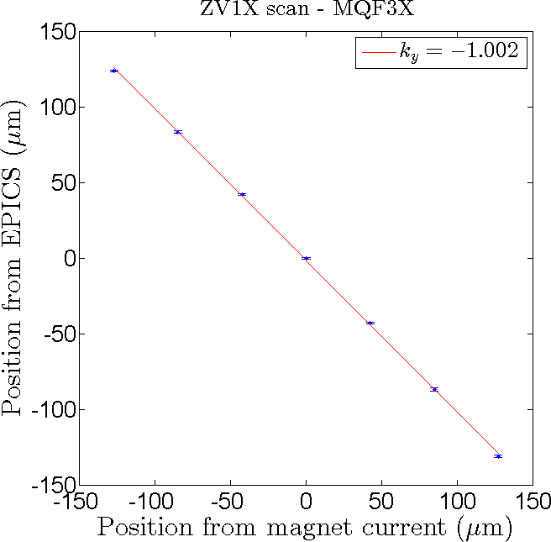
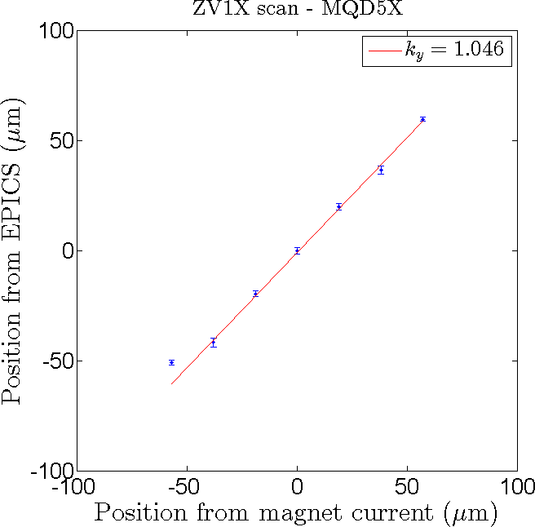
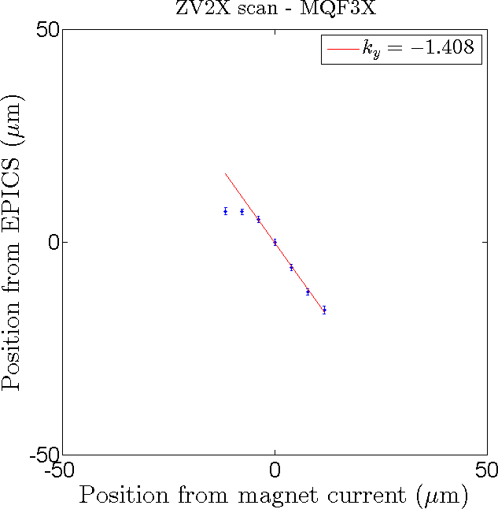
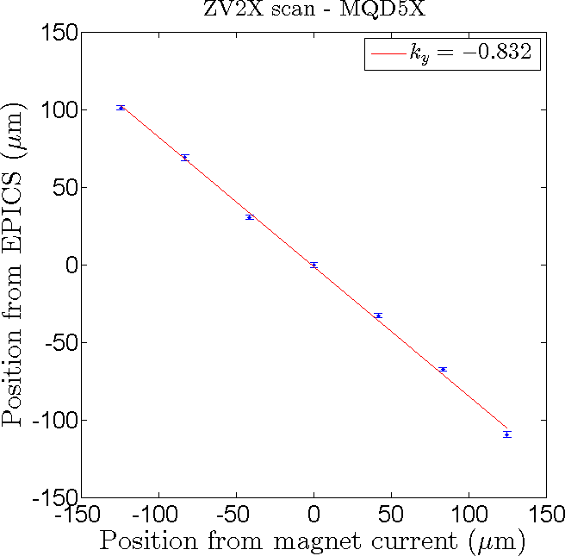
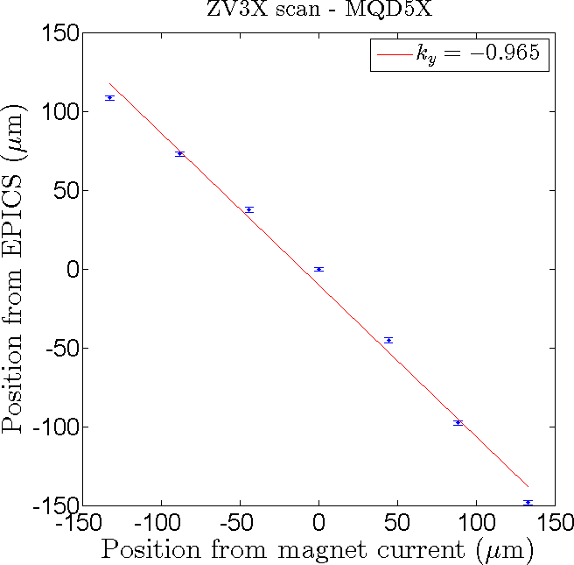
ZV1X
Date: 13/03
Electronics: SLAC
Set file: 140313_0732
ZV2X
ZV3X

Slide 5
Comparison
 | Date: 27/02 Electronics: FONT Set file: flightSim_140228_0615
 | MQF1X | MQF3X | MQD5X
ZV1X | -192 | -66 | 8
ZV2X |  | -122 | -209
ZV3X |  |  | -125
 | Date: 13/03 Electronics: SLAC Set file: 140313_0732
 | MQF1X | MQF3X | MQD5X
ZV1X | N/A | -1.002 | 1.046
ZV2X |  | -1.408 | -0.832
ZV3X |  |  | -0.965

Slide 6
Conclusion
FONT results remain a mystery
SLAC results not entirely consistent
MQF1X no longer works as expected

